Slide 1
Semester 1 Time Capsule
By: Ellie Brown

Slide 2
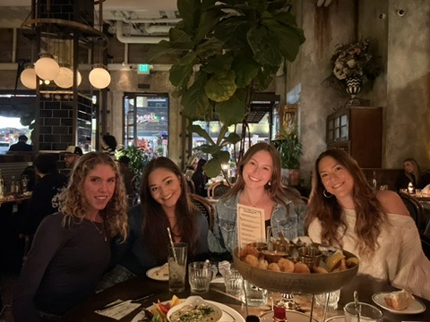
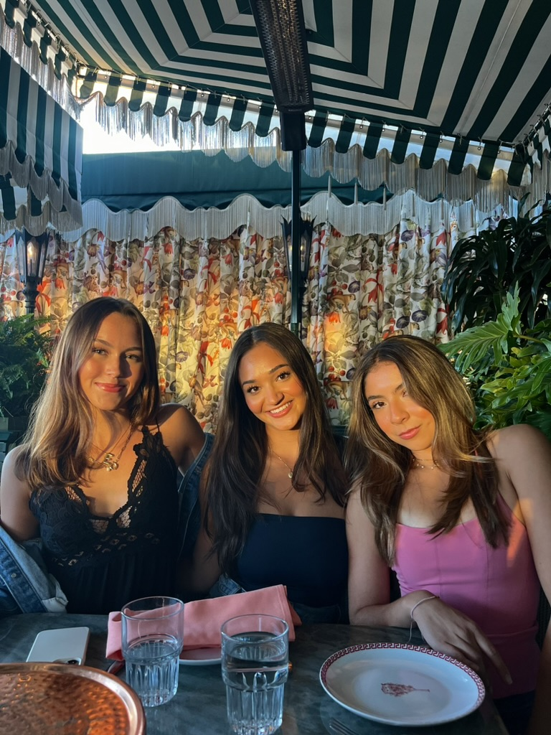
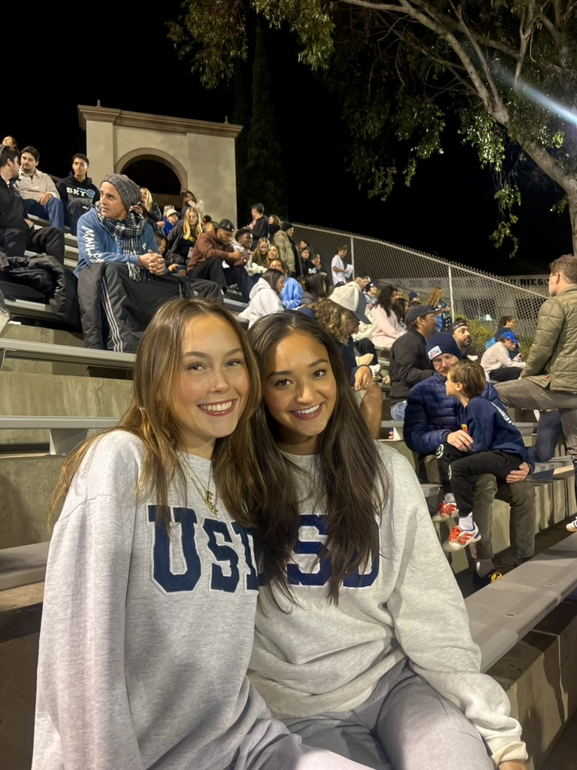
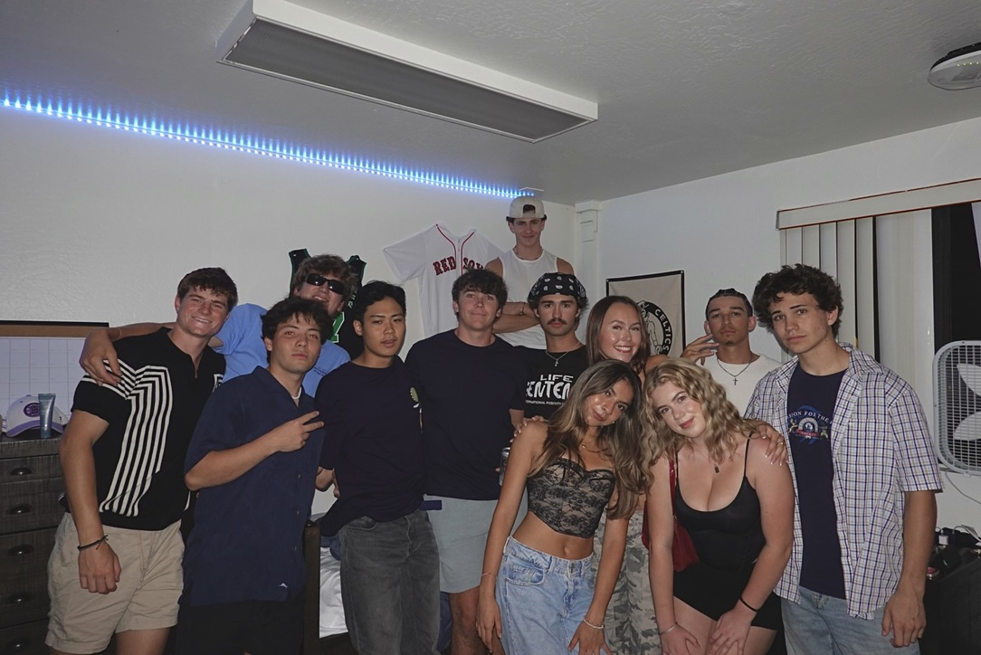
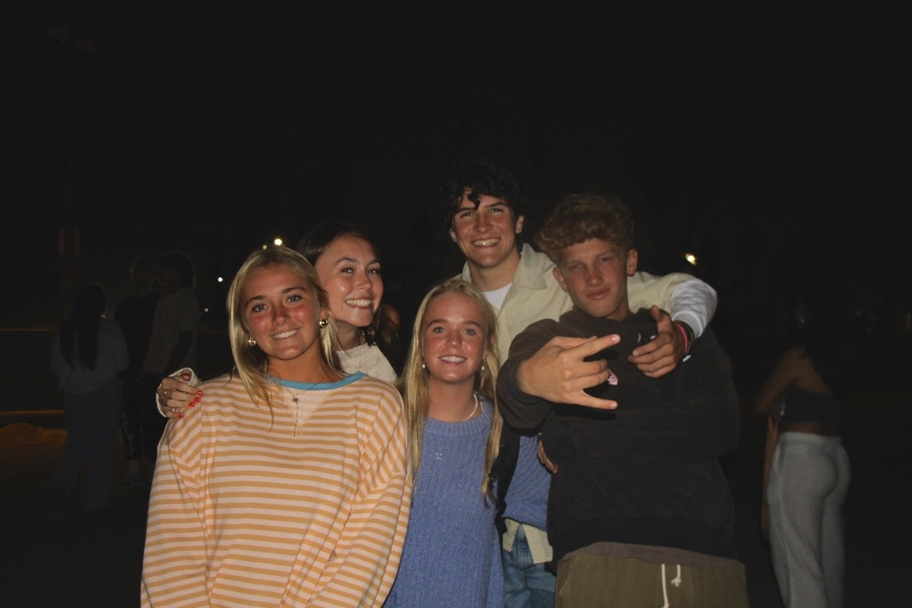
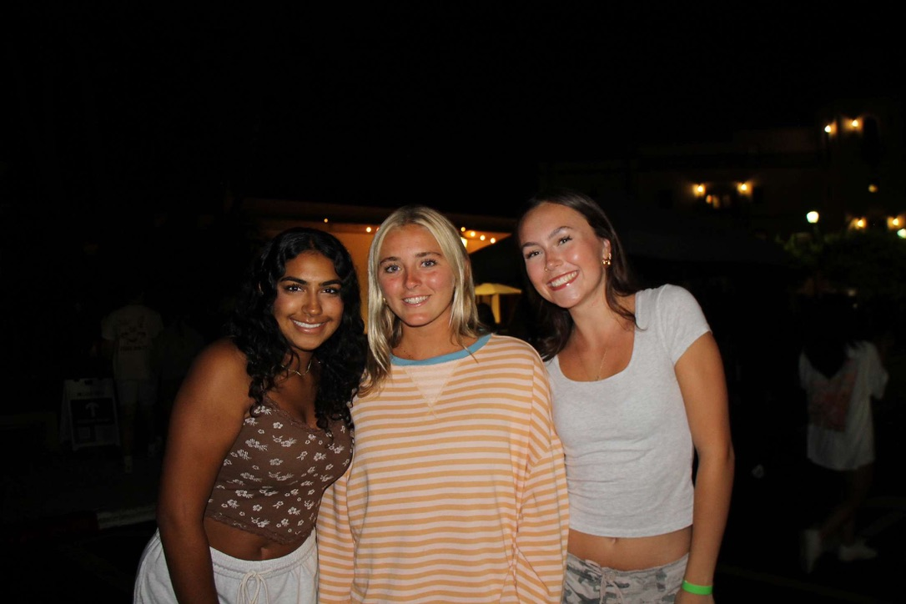
What happened?
I met some amazing people!

Slide 3
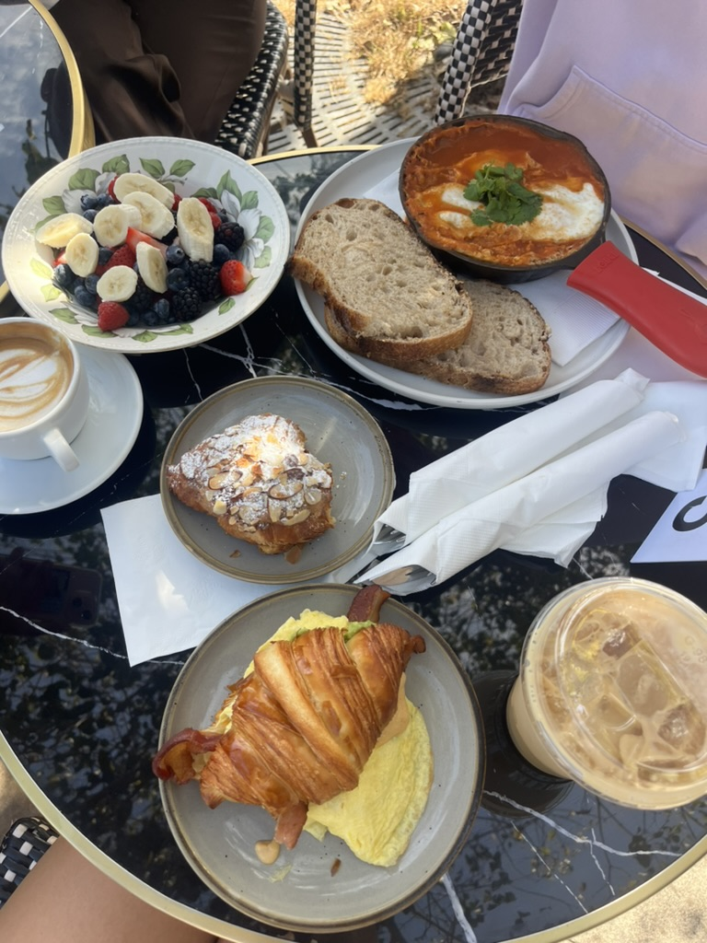
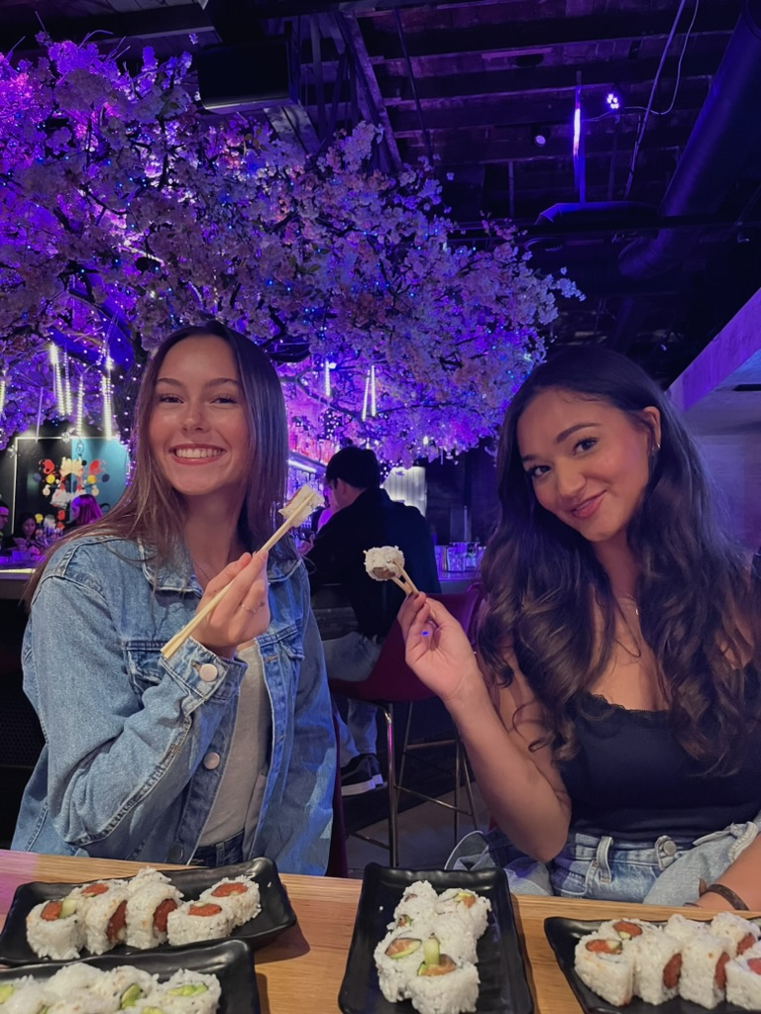
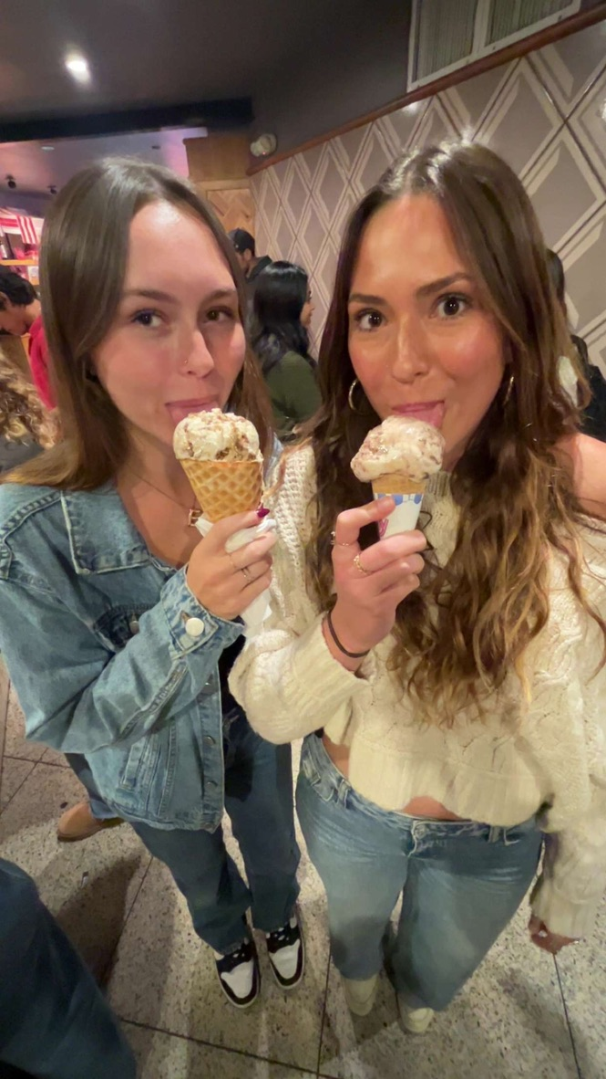
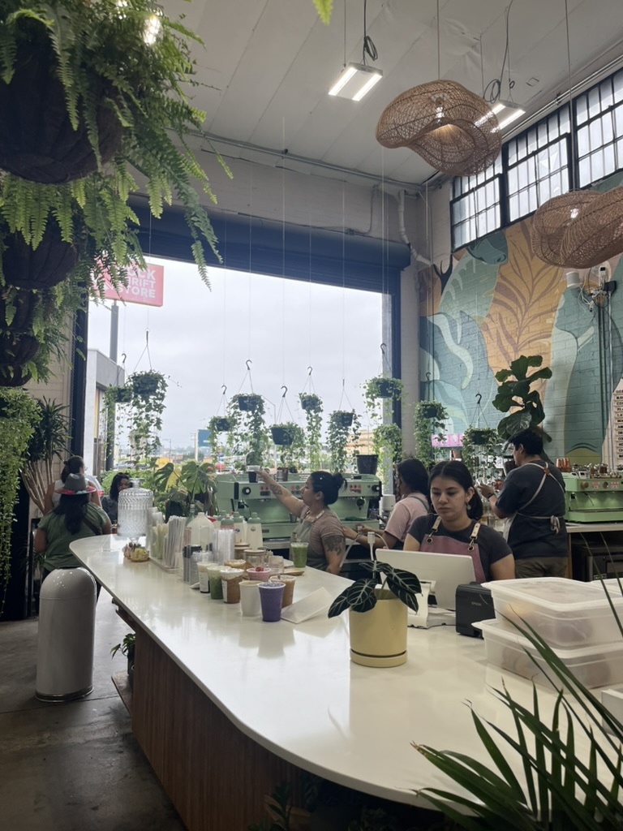
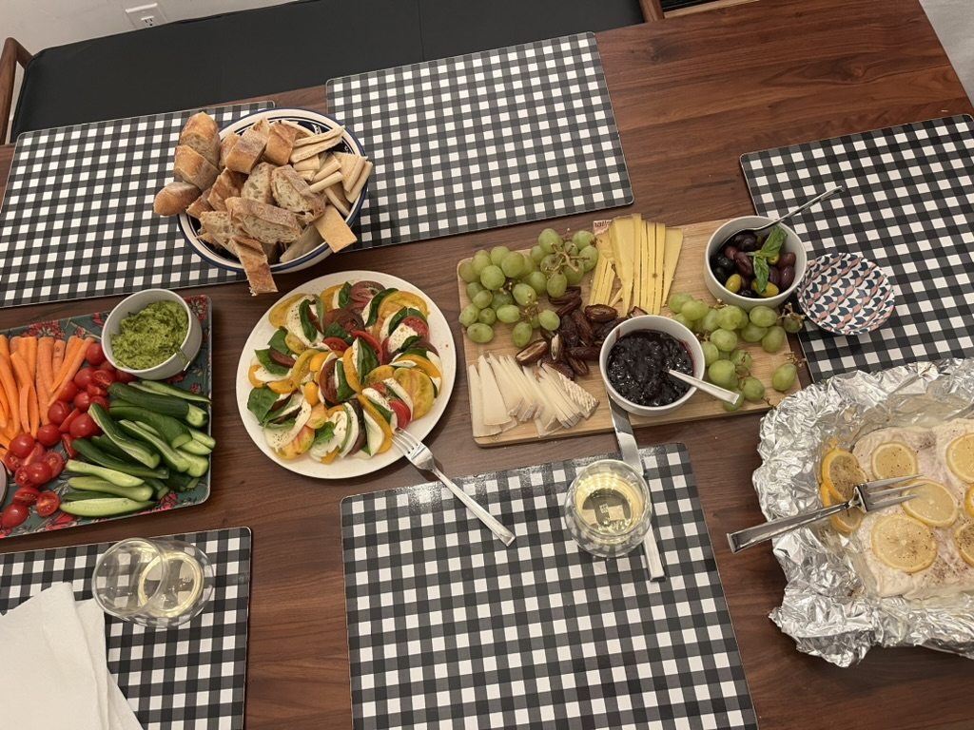
What happened?
I ate some great food
in San Diego

Slide 4
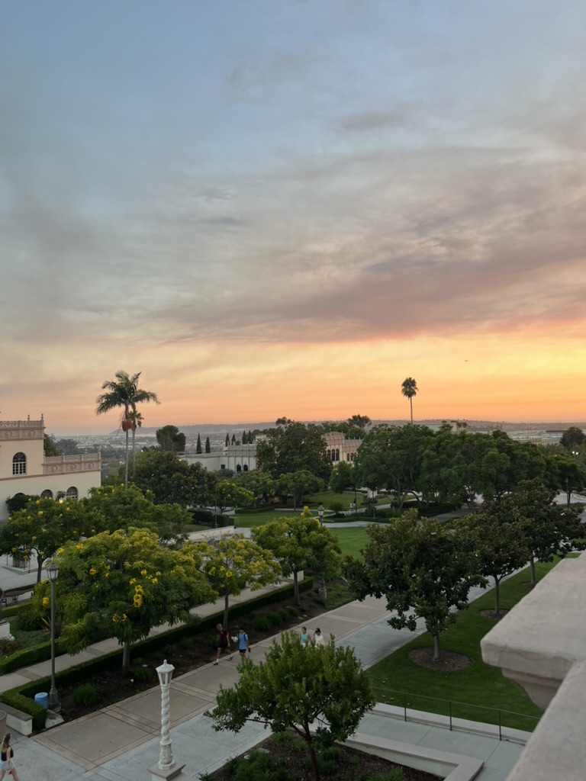
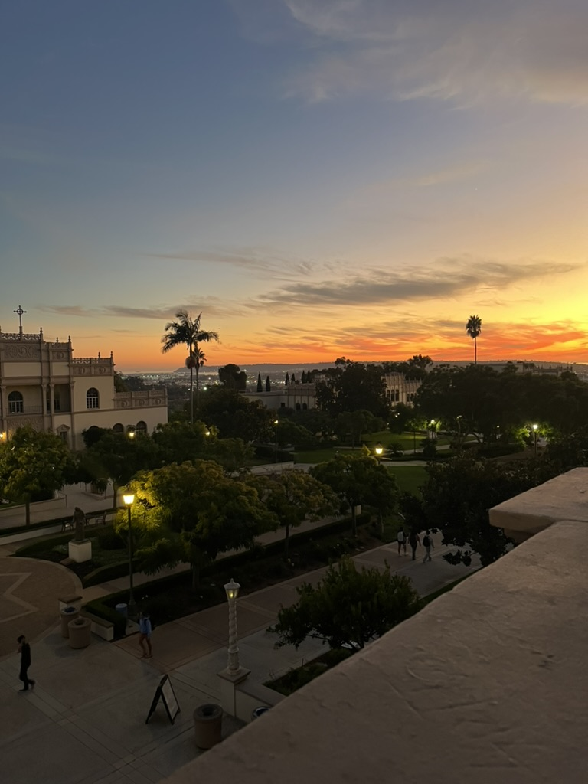
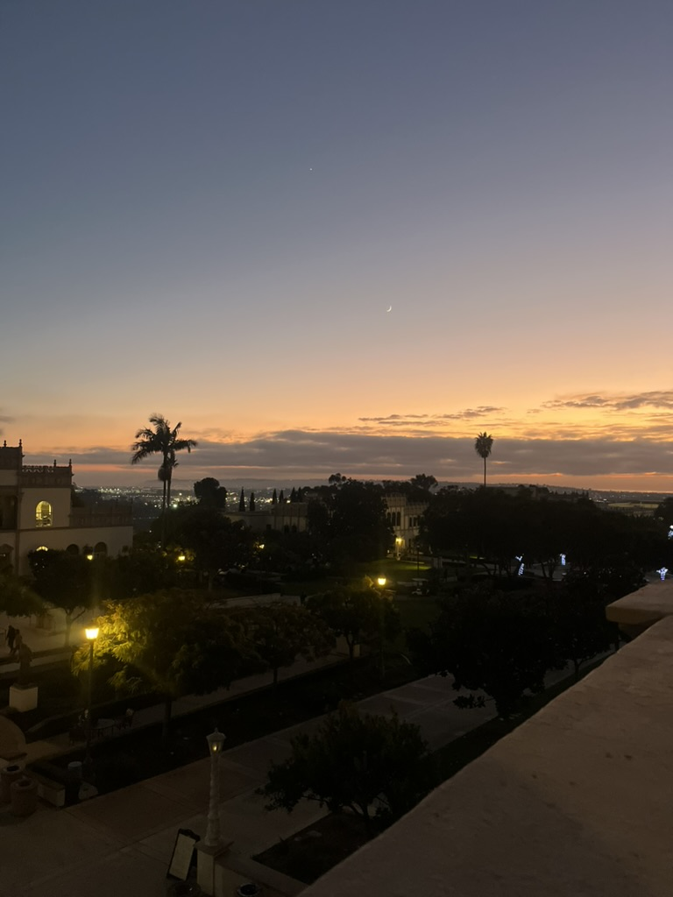
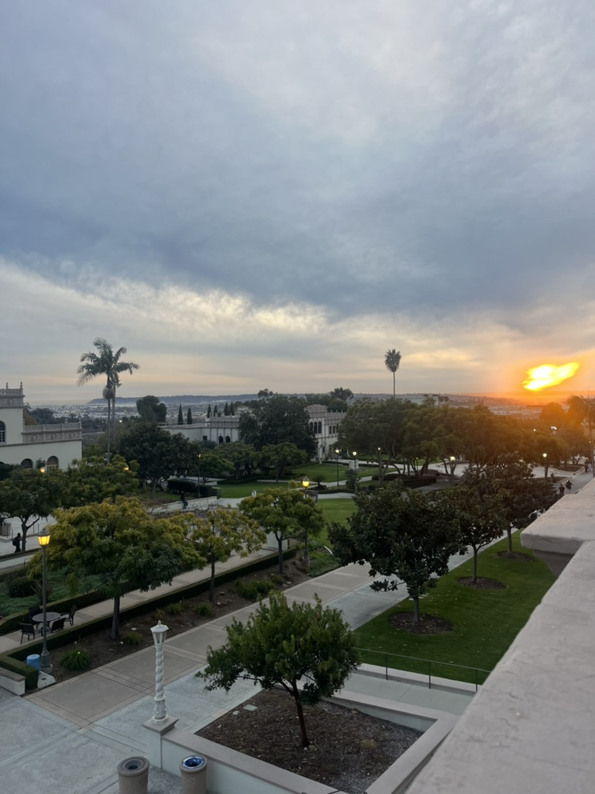
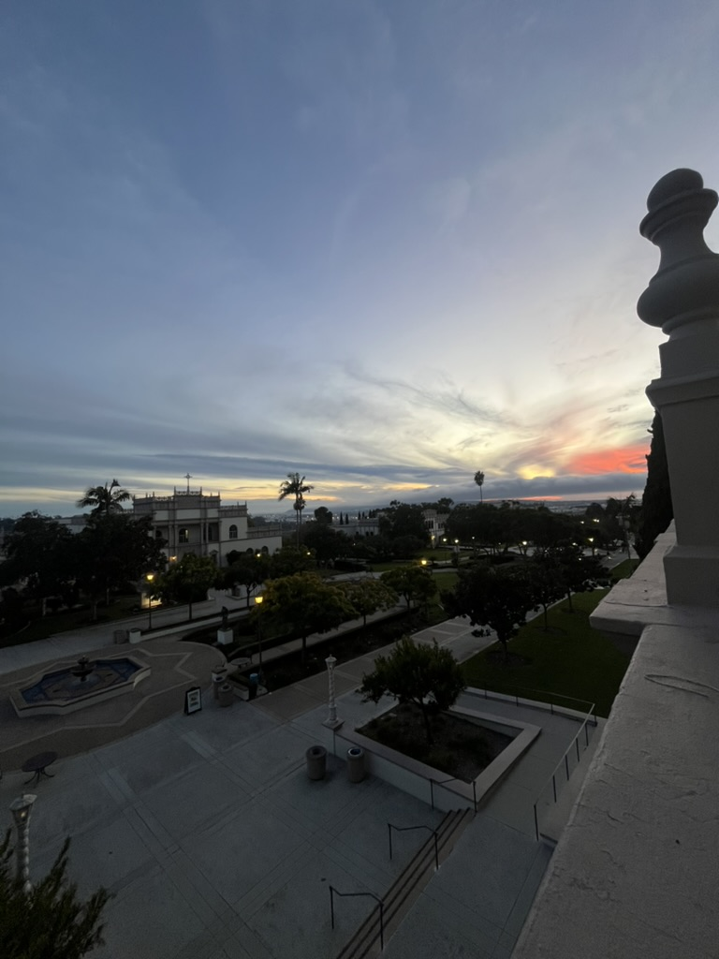
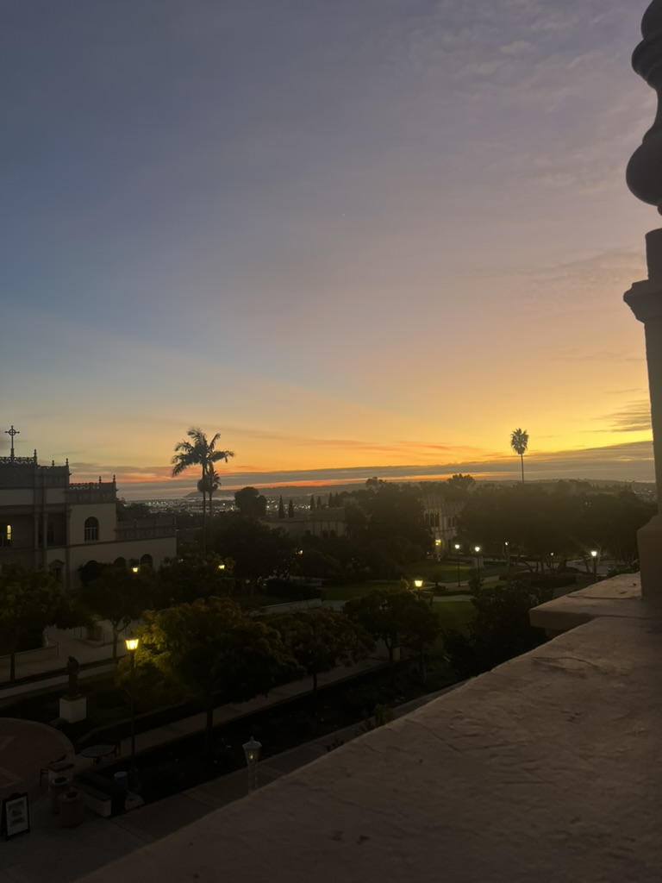
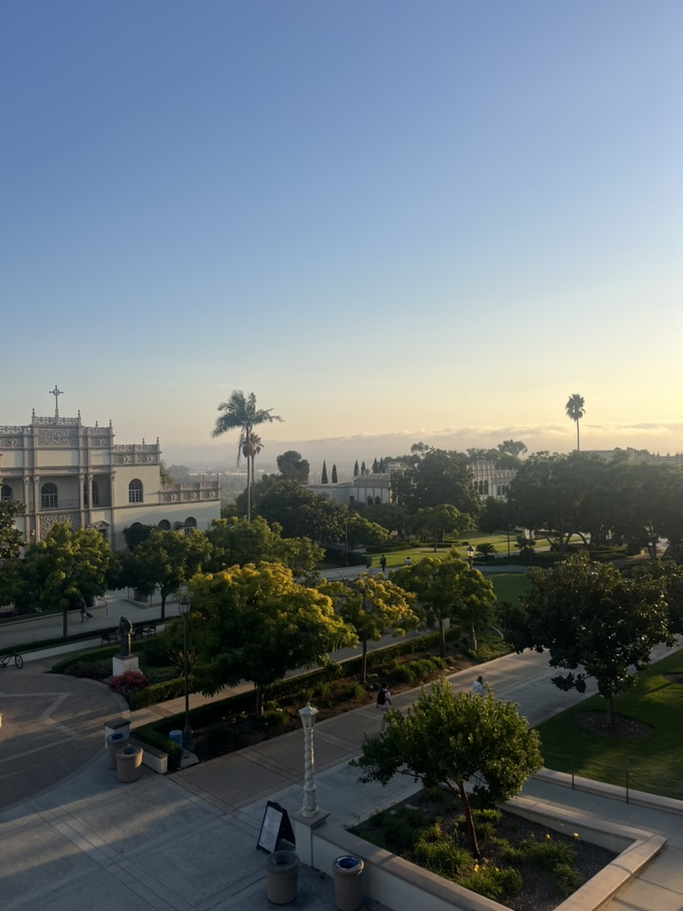
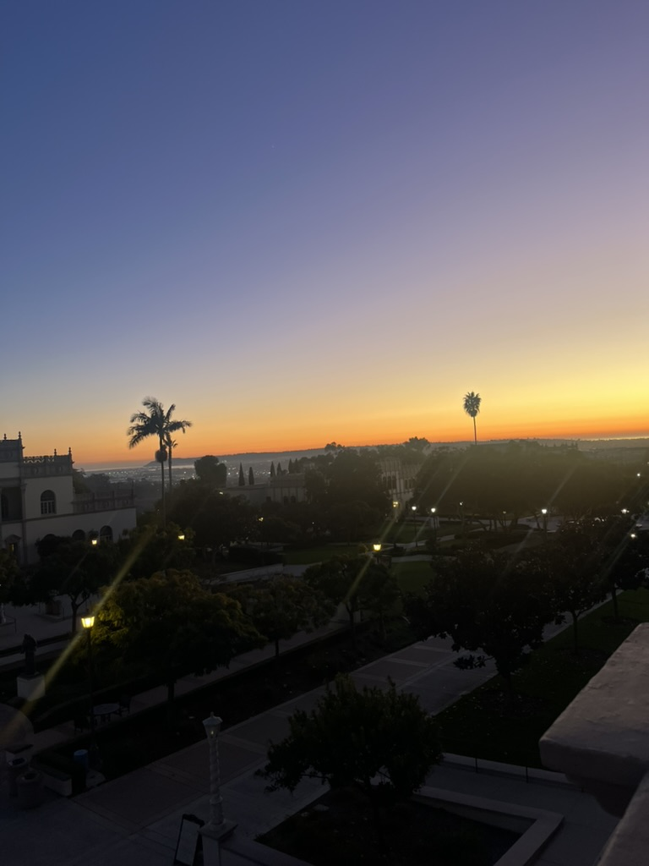
What happened?
I watched the
sunsets from my dorm

Slide 5





What didn’t happen?
I thought I would get off campus a lot
more then I did, but no car
I thought that I would find my best friends
on the very first day of college
I thought I would be studying in the
library, but I found better places
I assumed I would be homesick,
but I never was!
I procrastinated way more then
I assumed I would

Slide 6
Positive Things
Being in a new city and exploring a place I’ve never lived
I took more pictures then ever before
LLC class had me go to a lot of concerts
Although a lot of procrastination went on, I did do work
Hit the beach, a lot ☺

Slide 7




Negative Things
Not many to report! But here's a few that took a while to think of:
Making friends (from scratch)
Missing my pet
Cooking!
That period between Thanksgiving
and Christmas break

Slide 8



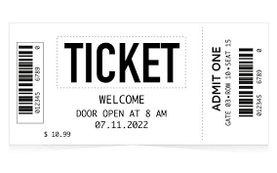

The News!
August 3-10 Hurricane Debby
August 19-22 Tim Walz
and Kamala Harris are
named party’s choice for
president and vice president
September 10th Trump
and Harris debate for
the first time
November 3rd Taylor Swift
concludes her massive tour
November 5th Trump is president

Slide 9
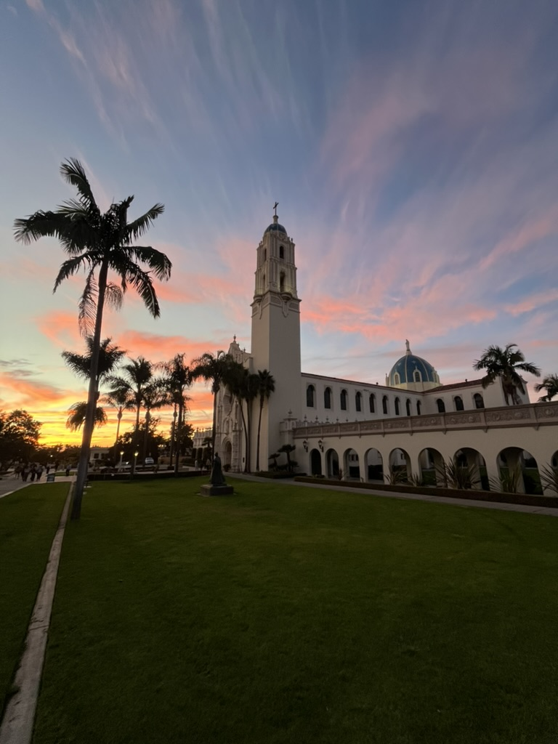
Thank you!
Hope you all had a great semester too!

