Slide 1
Time Capsule project
Anahi Garcia

Slide 2
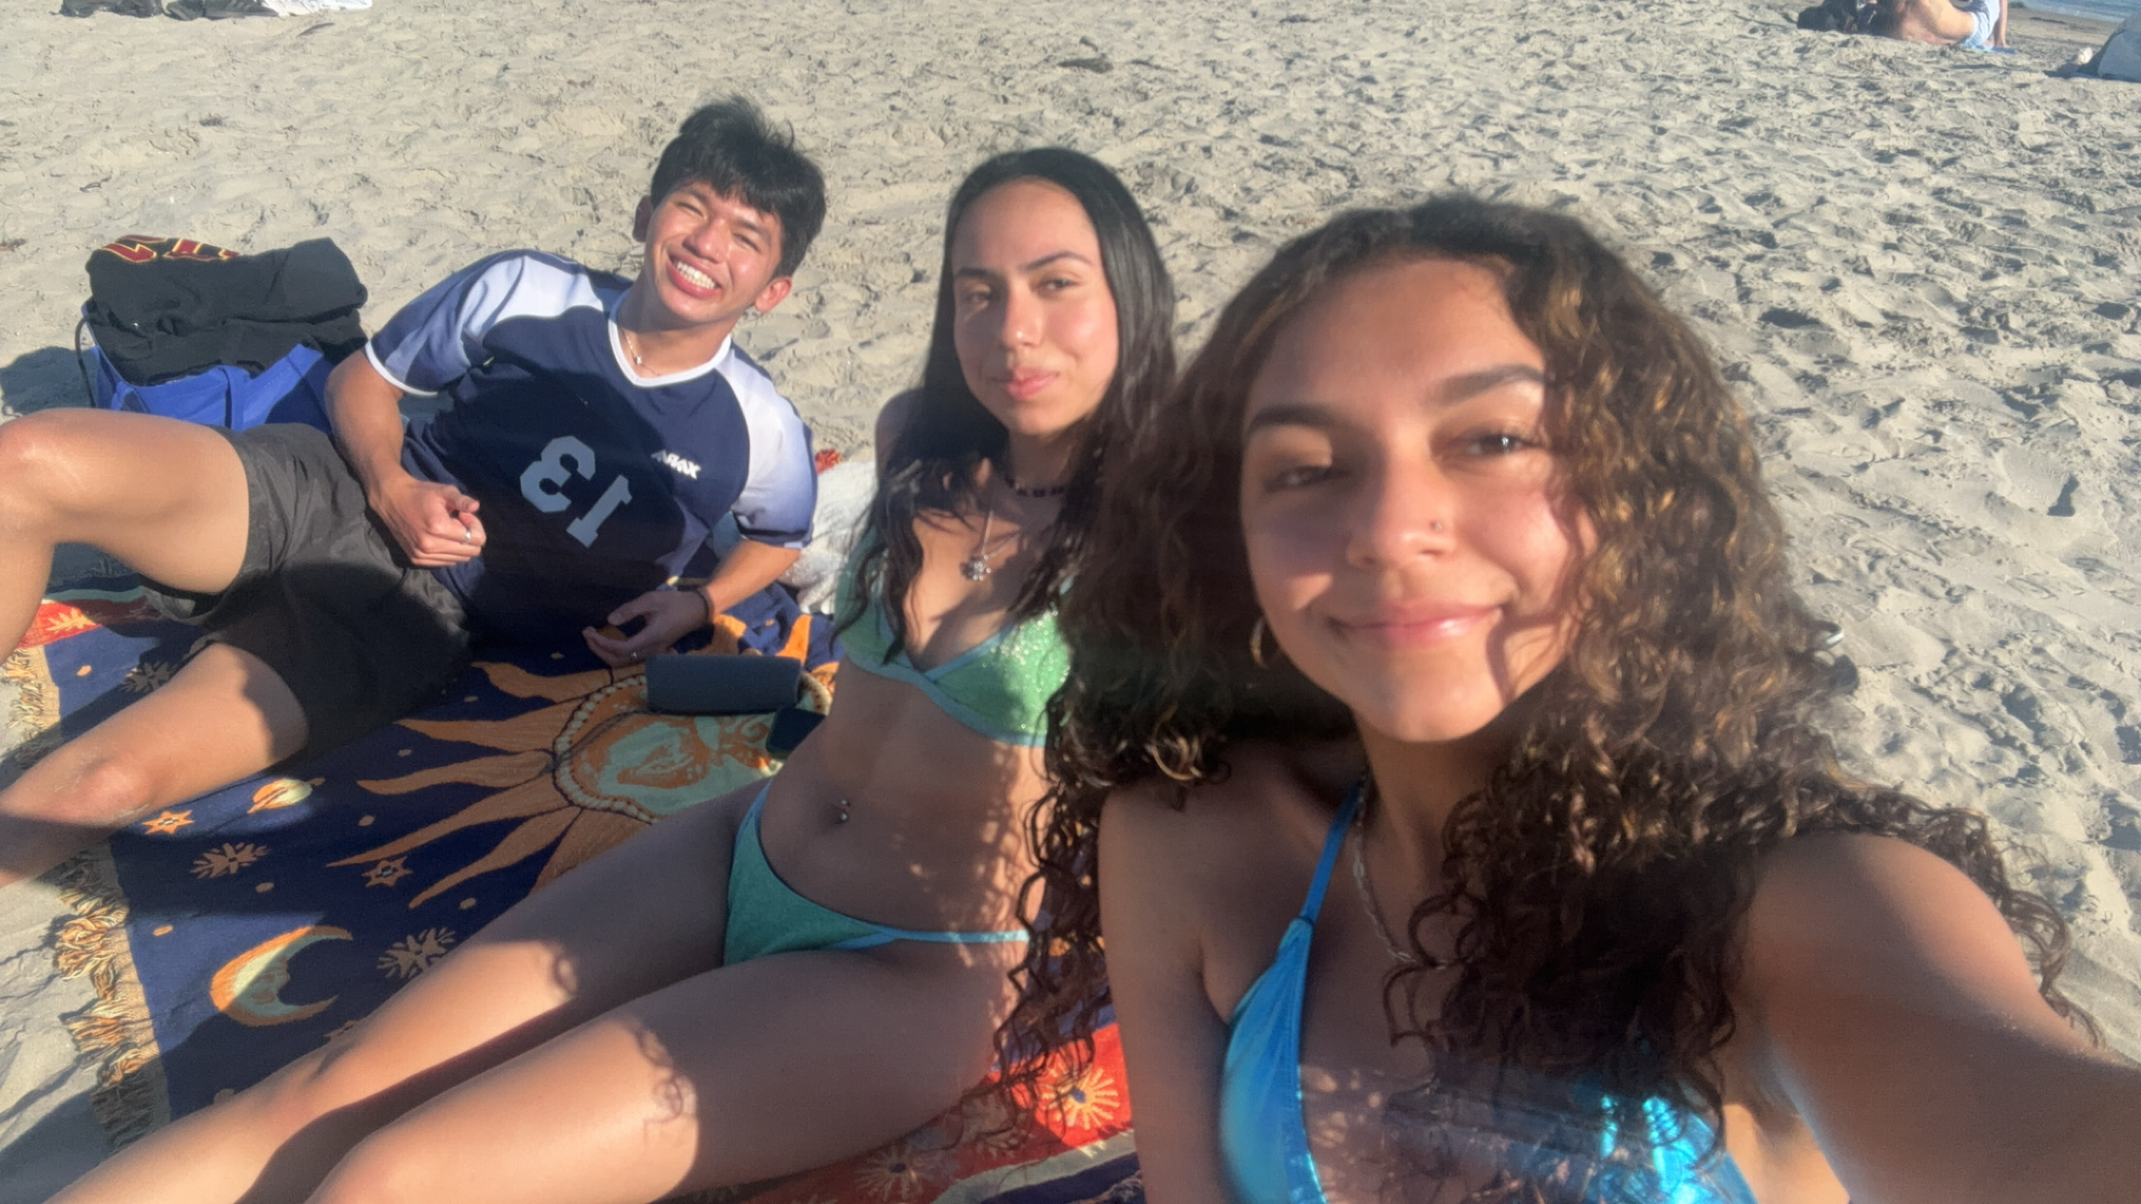
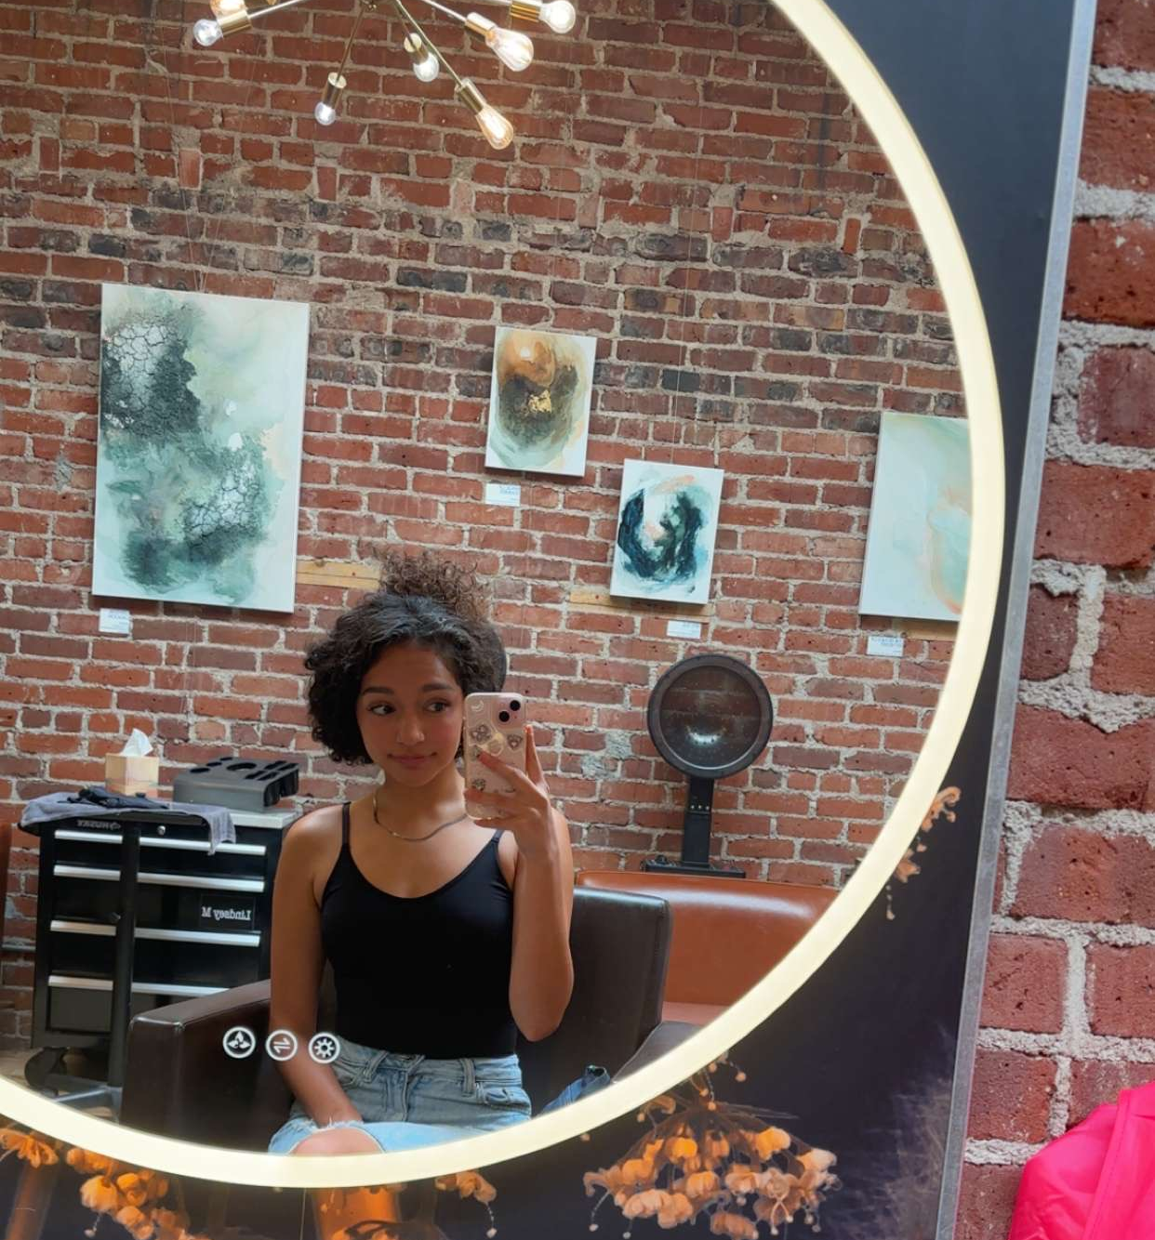
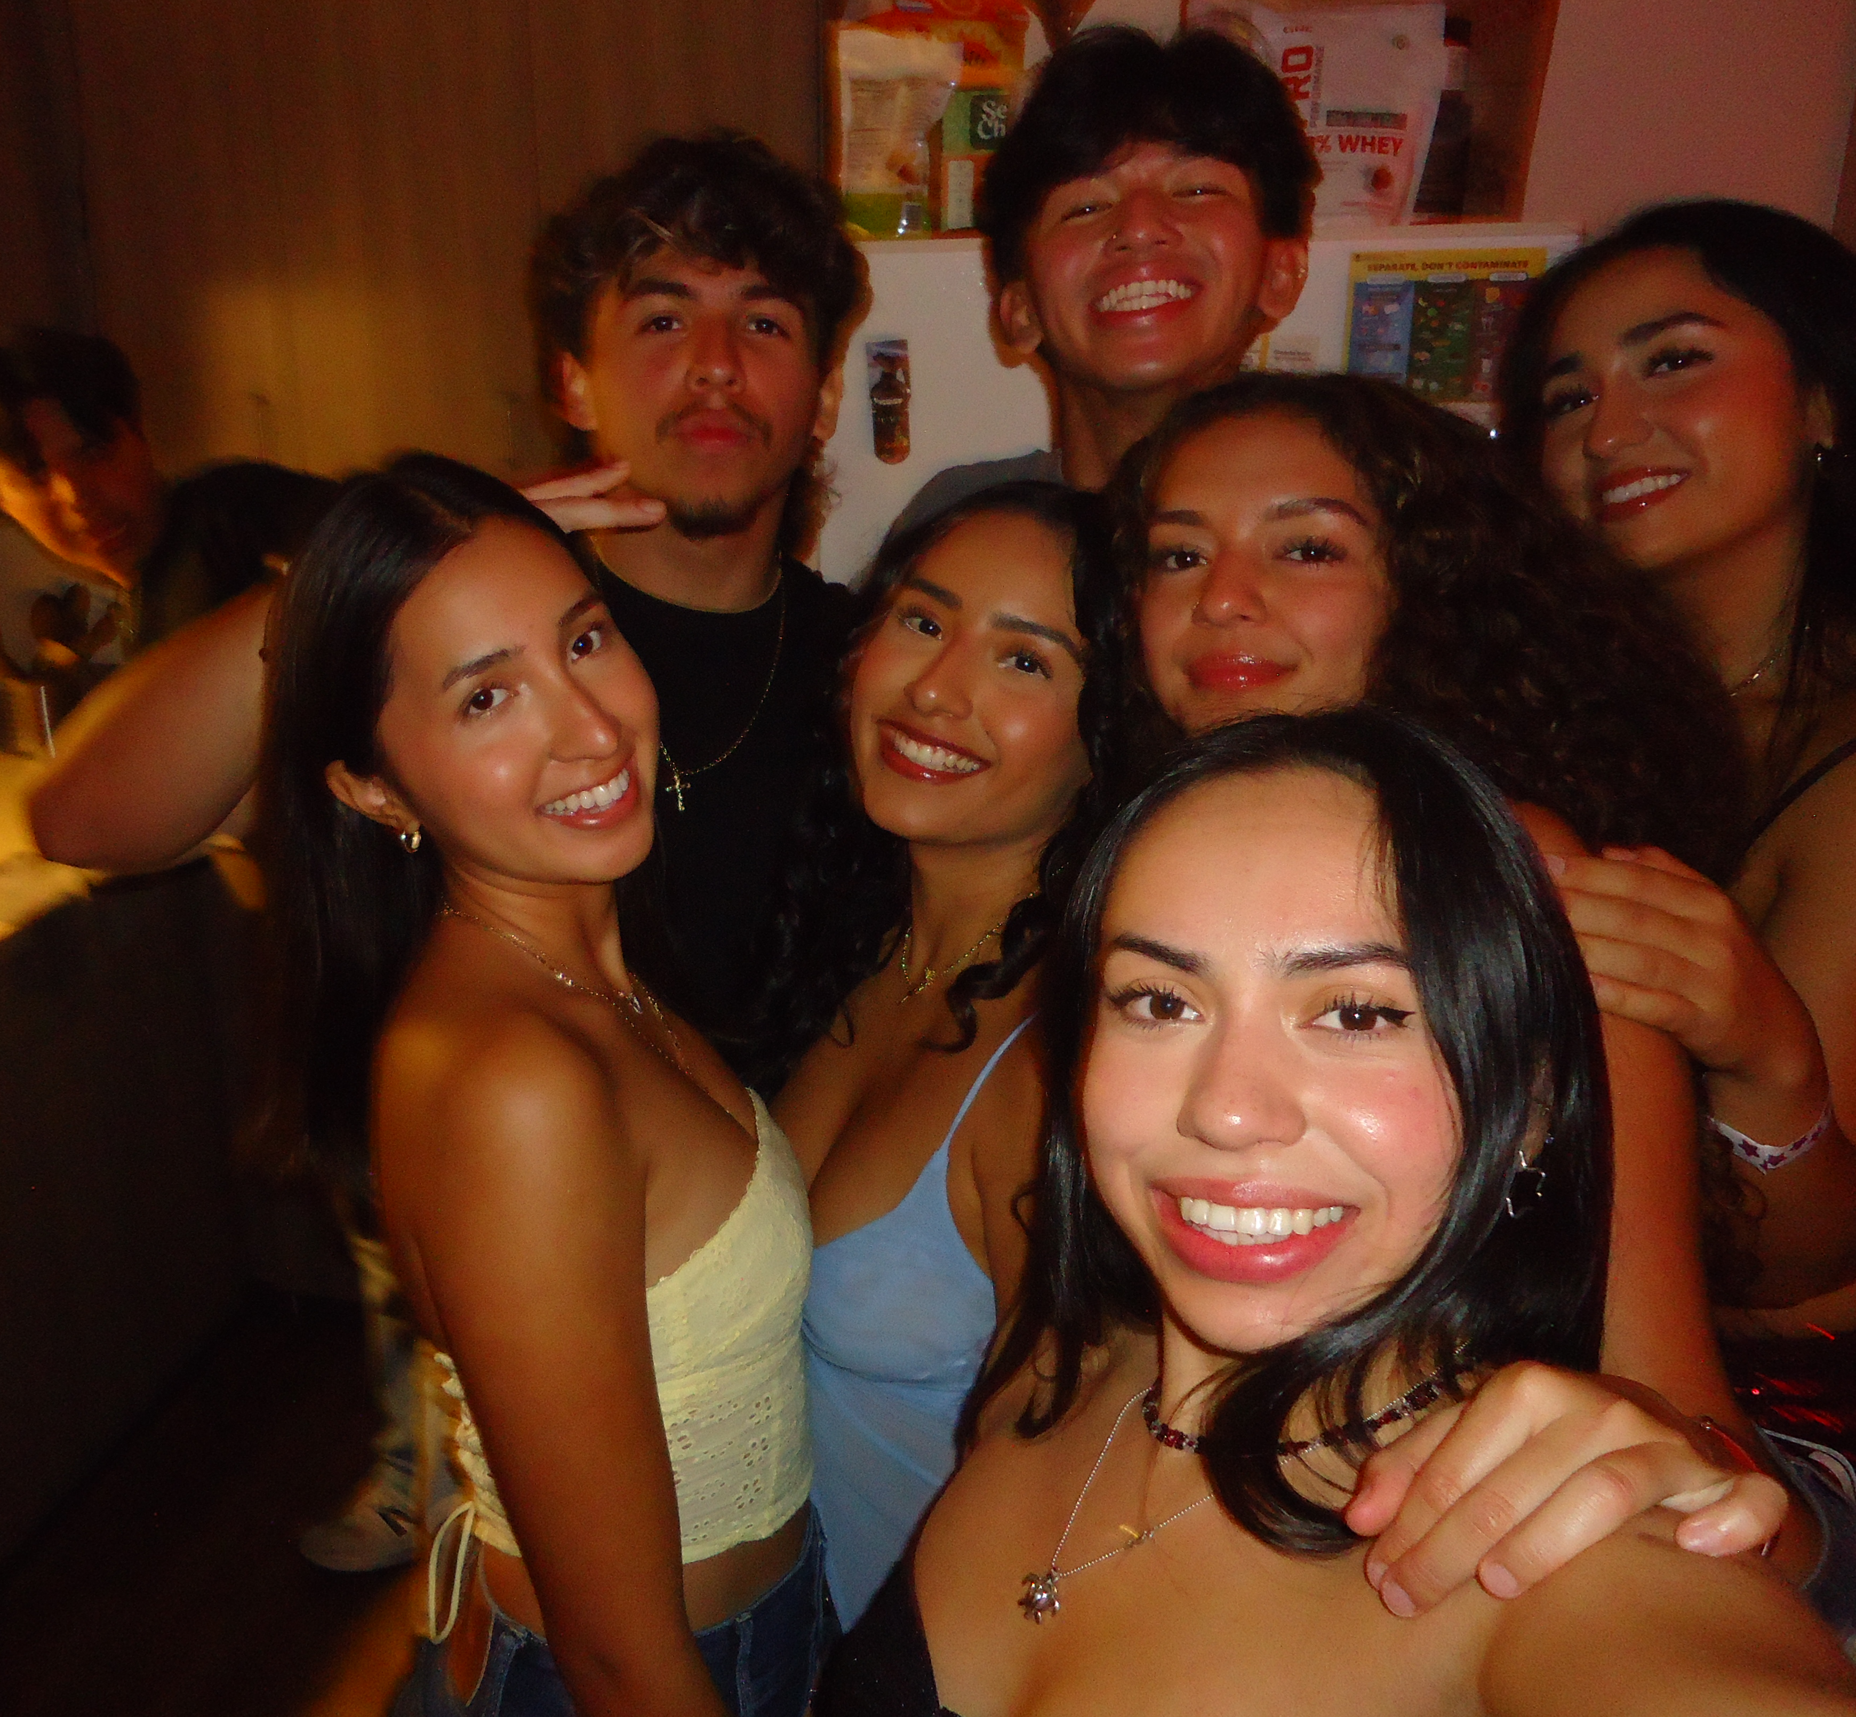
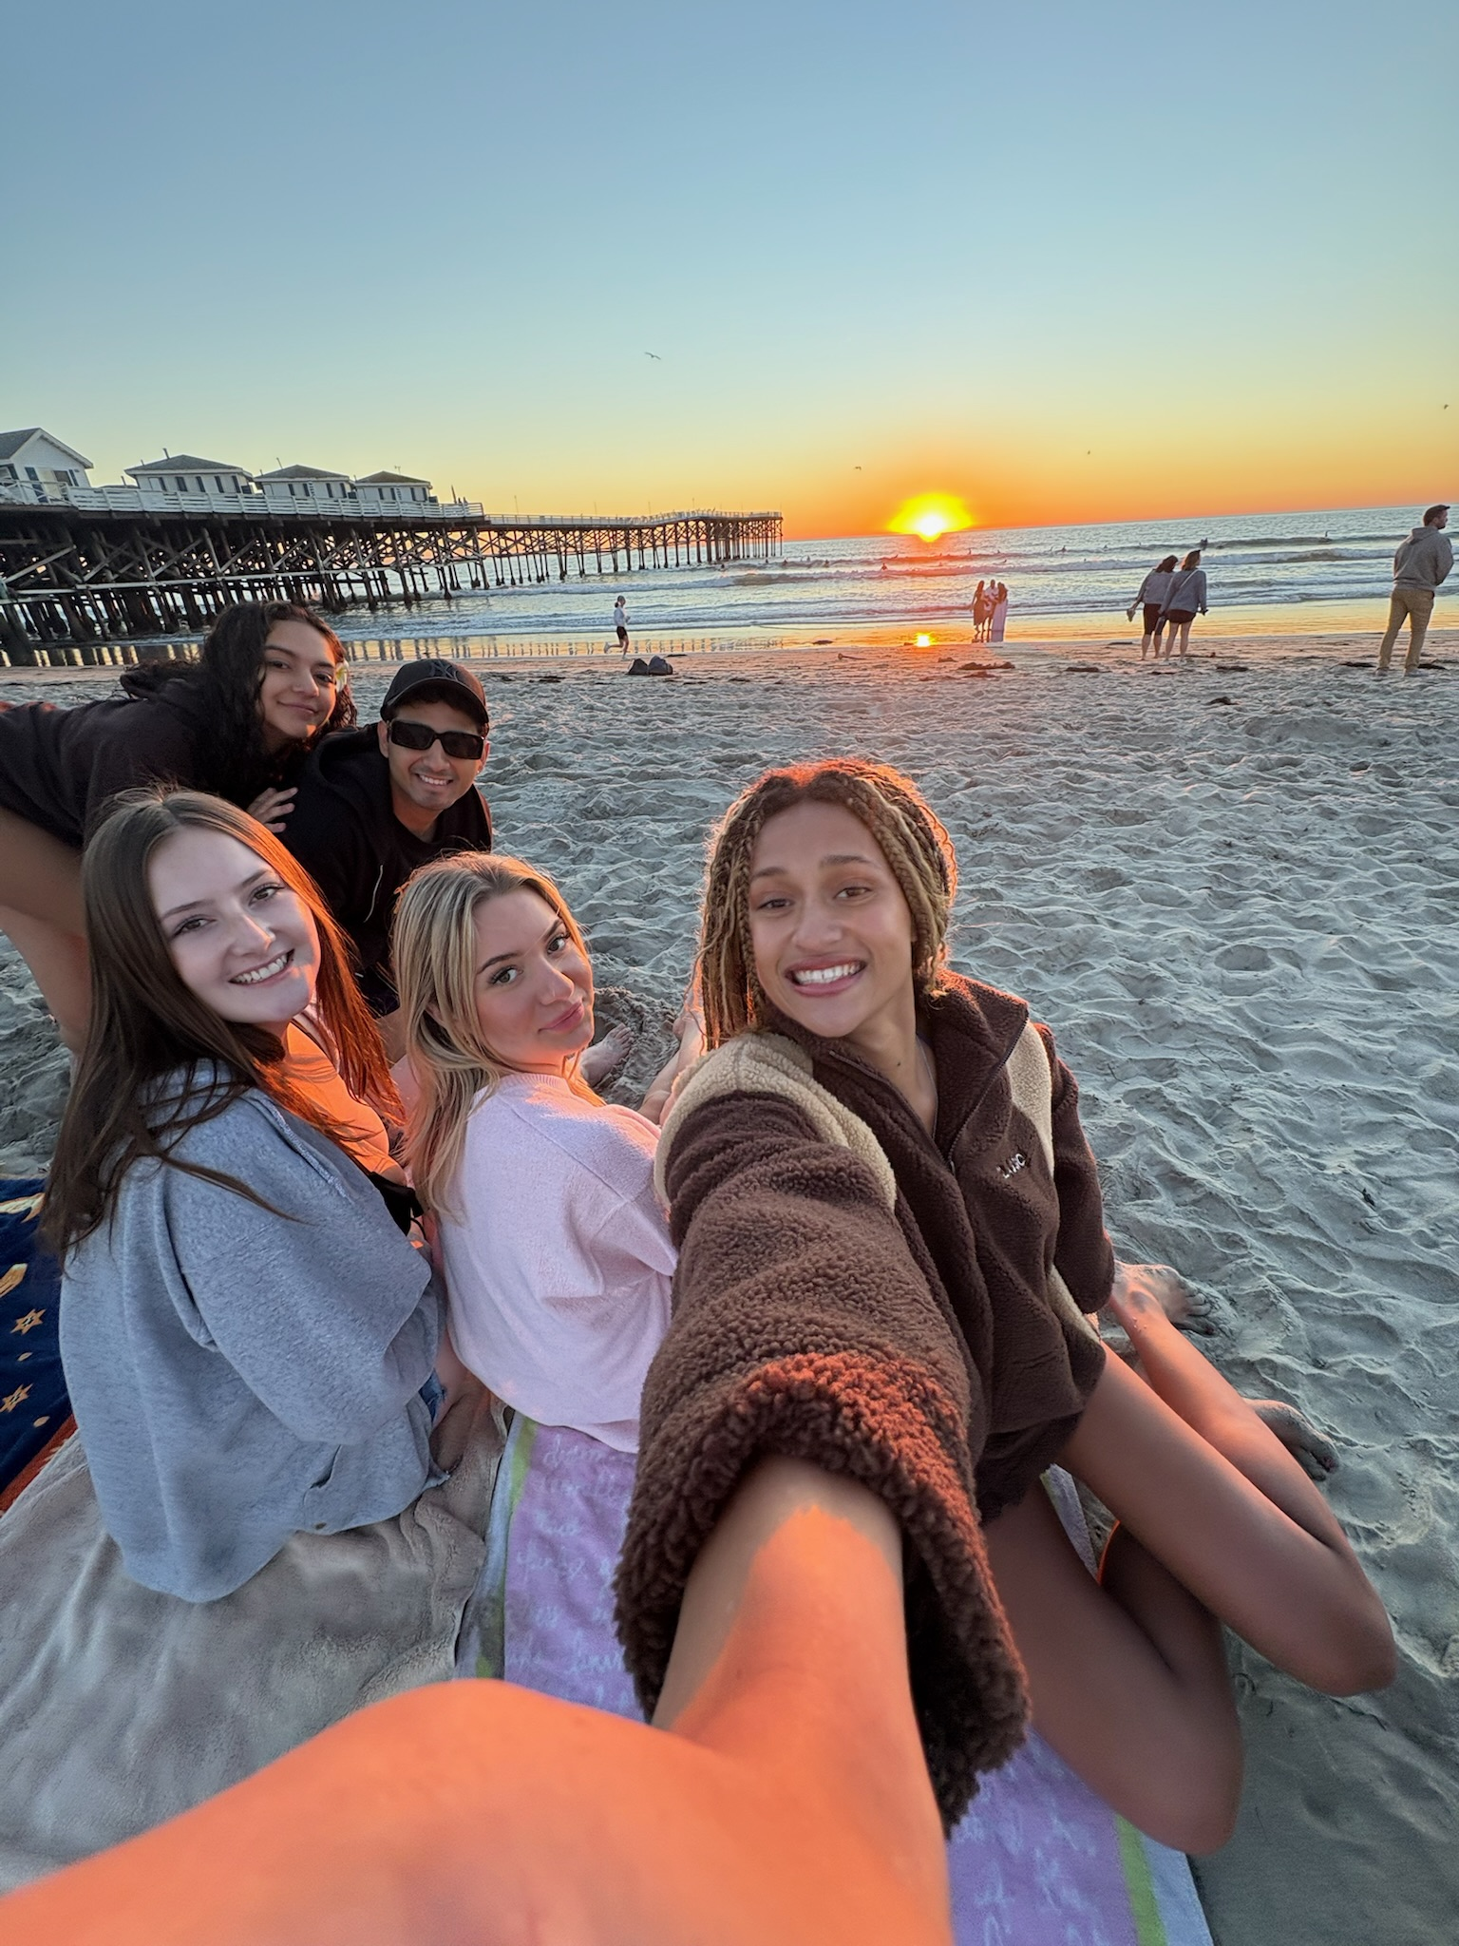
Showed my friends San Diego and had them stay with me
I dyed my hair for the first time
Went up to USC multiple times to hangout with my friends from back home!

Slide 3

I did not keep my word on learning how to surf ☹
Credit: Sony Pictures/Photofest
Copyright: © Sony Pictures

Slide 4
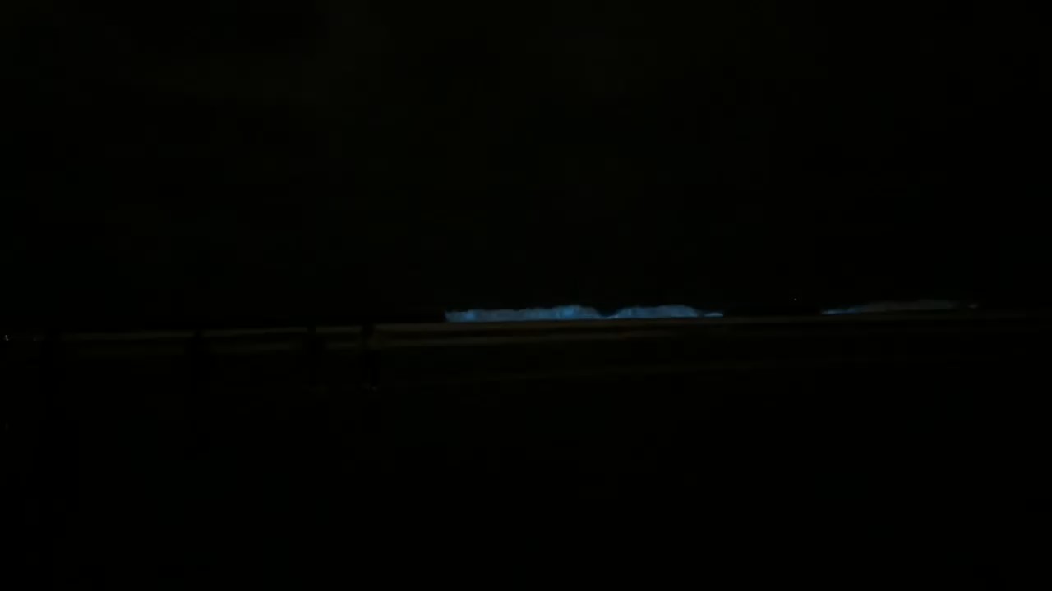
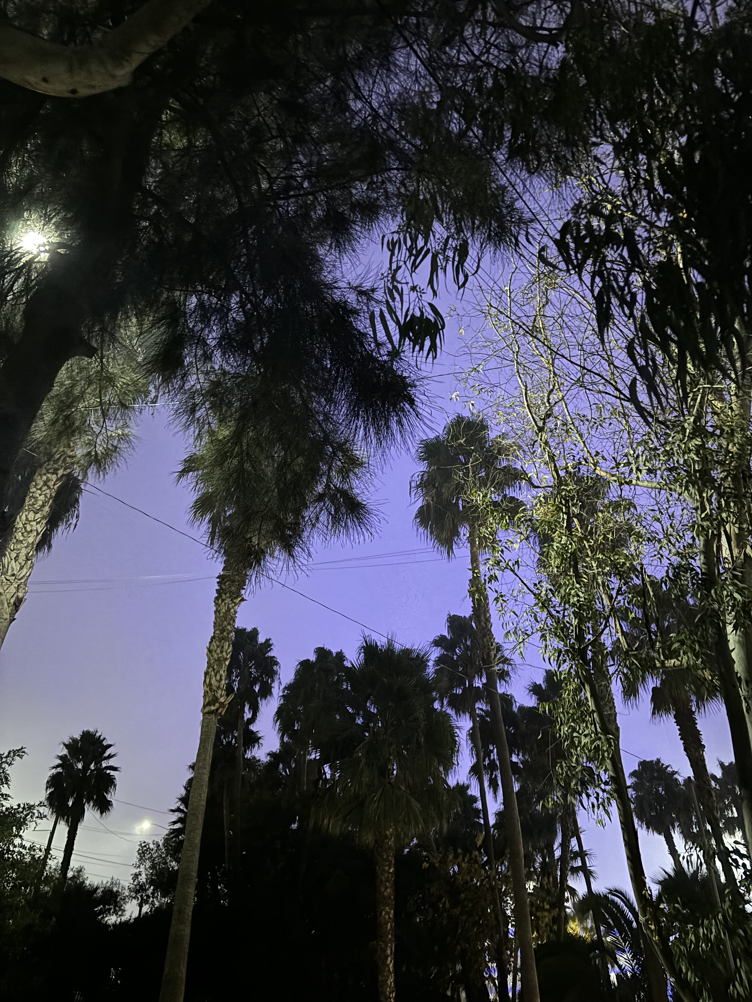
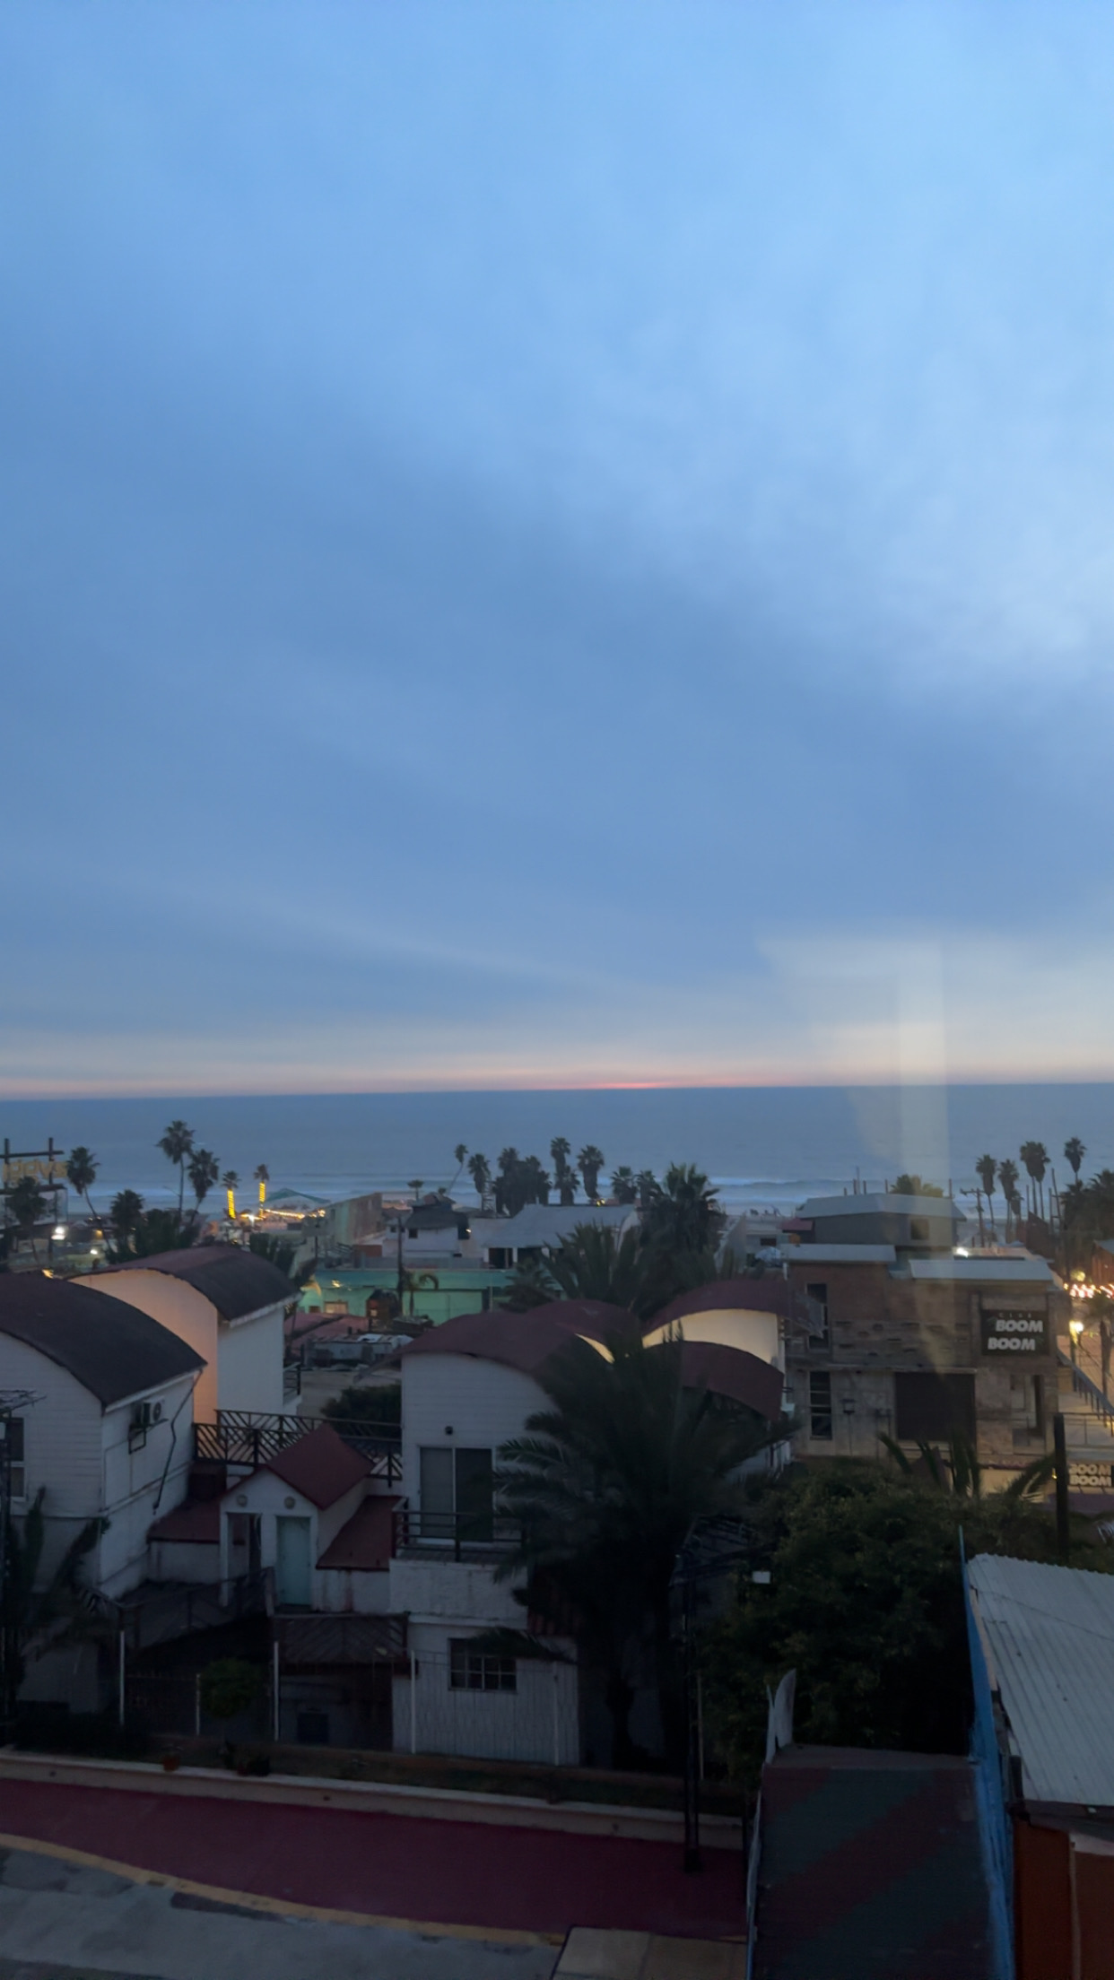
Traveling outside the country for the first time.
Seeing Bioluminescent waves. (best night of my semester)

Slide 5
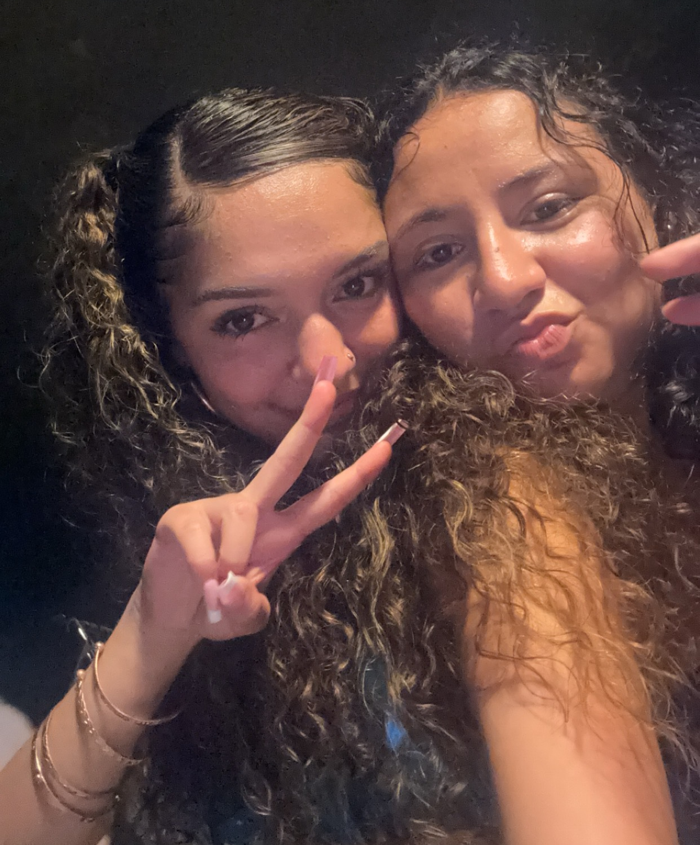
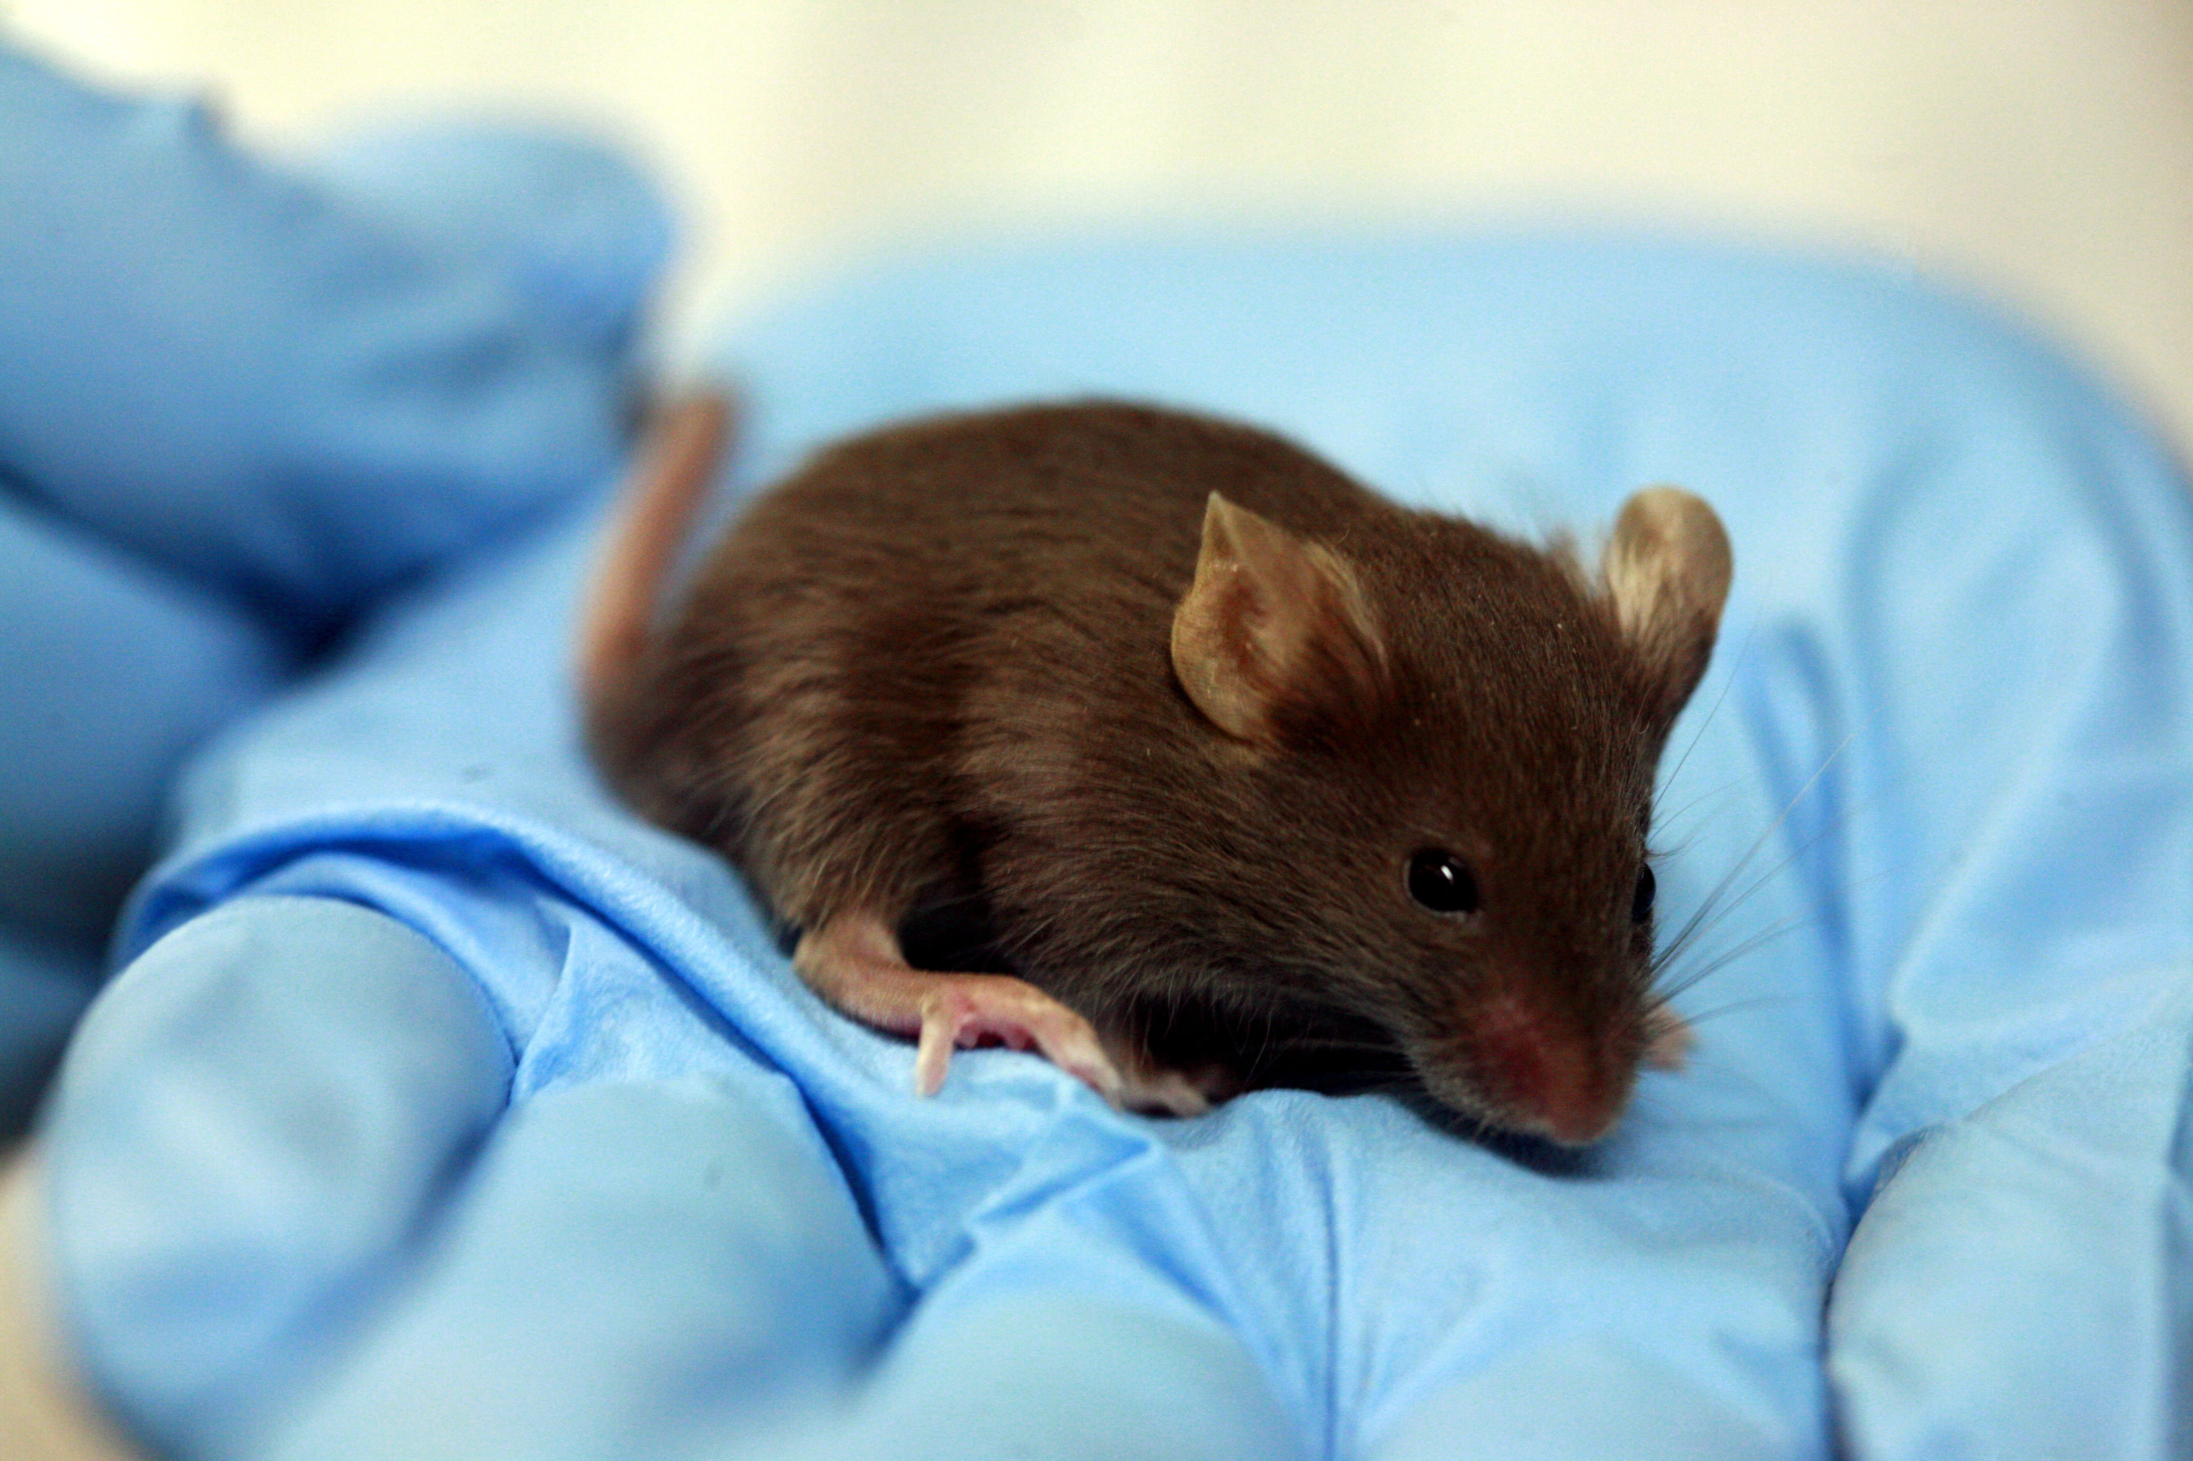
This Photo by Unknown Author is licensed under CC BY-SA
Not having a roommate for most of the semester as my original roommate had to leave USD. (I have one now though ☺)
Had a mouse crash at my dorm for about a week.

Slide 6

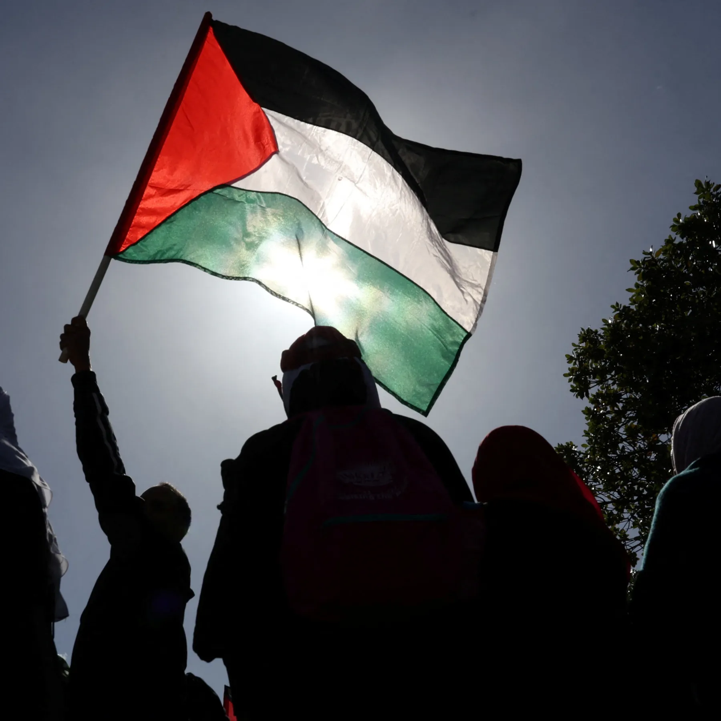
The 2024 Presidential Election
A lot of conversations and debates about Palestine and Israel
Uploaded: Nov 6, 2024·1.36M Views·3.77K Likes
ASL interpreting provided in partnership with DPAN. , https://dpan.tv/,
A person holds a Palestinian flag during the annual Quds Day (Jerusalem Day) in Cape Town, South Africa on April 14, 2023 [File: Reuters/Esa Alexander]

Slide 7
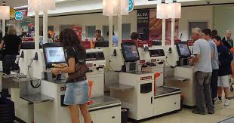

kioskmarketplace.com
OpenAI logo
Almost everywhere I go, there is a self-checkout kiosk instead of a cashier or person to assist me.
AI is being used daily everywhere

Slide 8
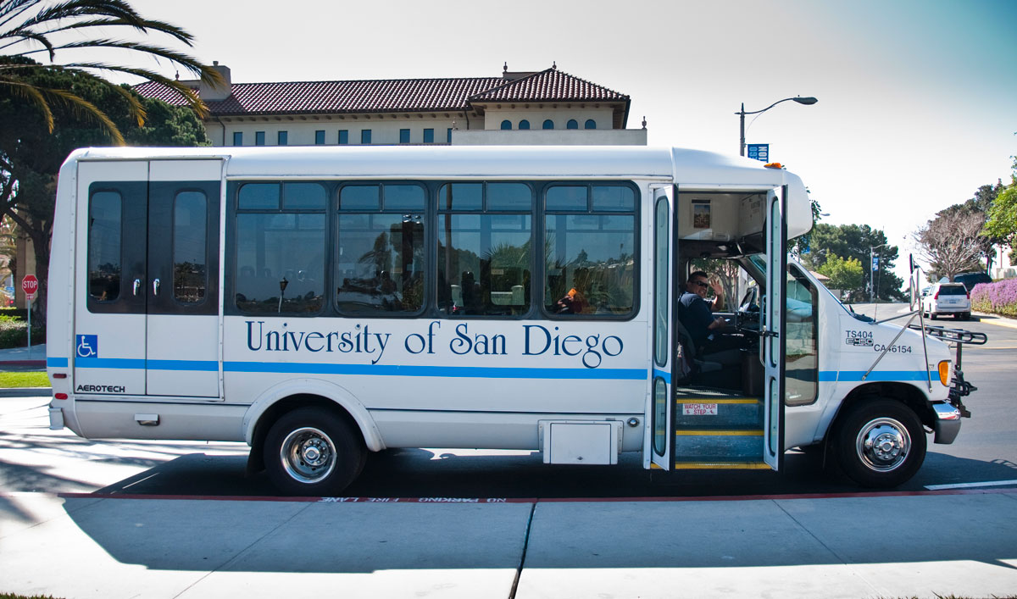
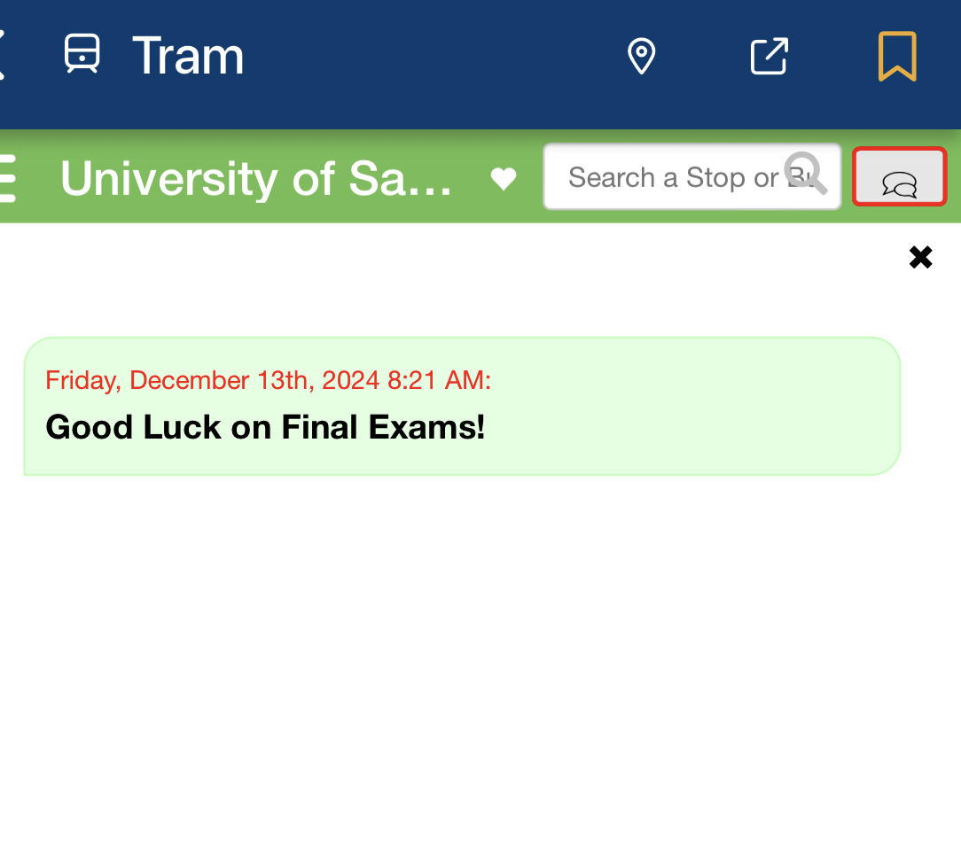
Trams have positive affirmation stickers near the door!

Slide 9
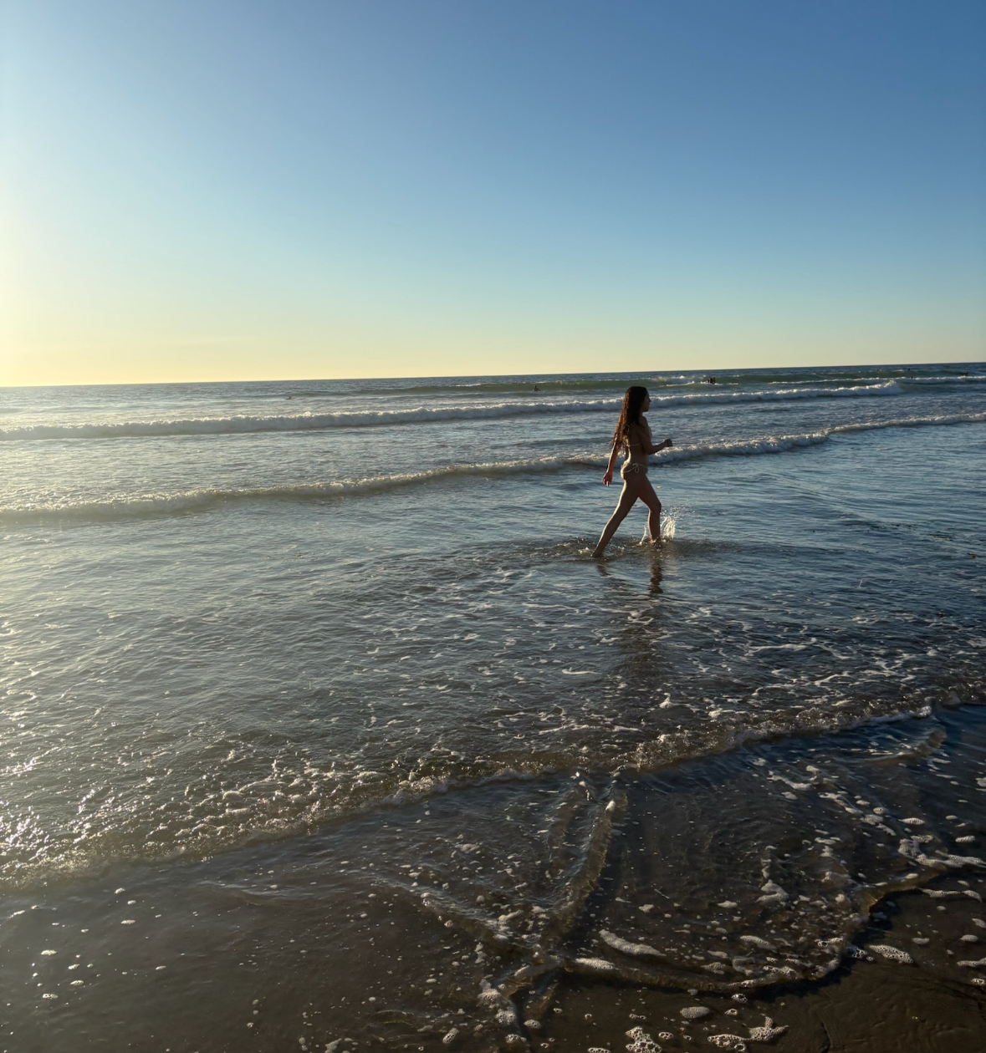
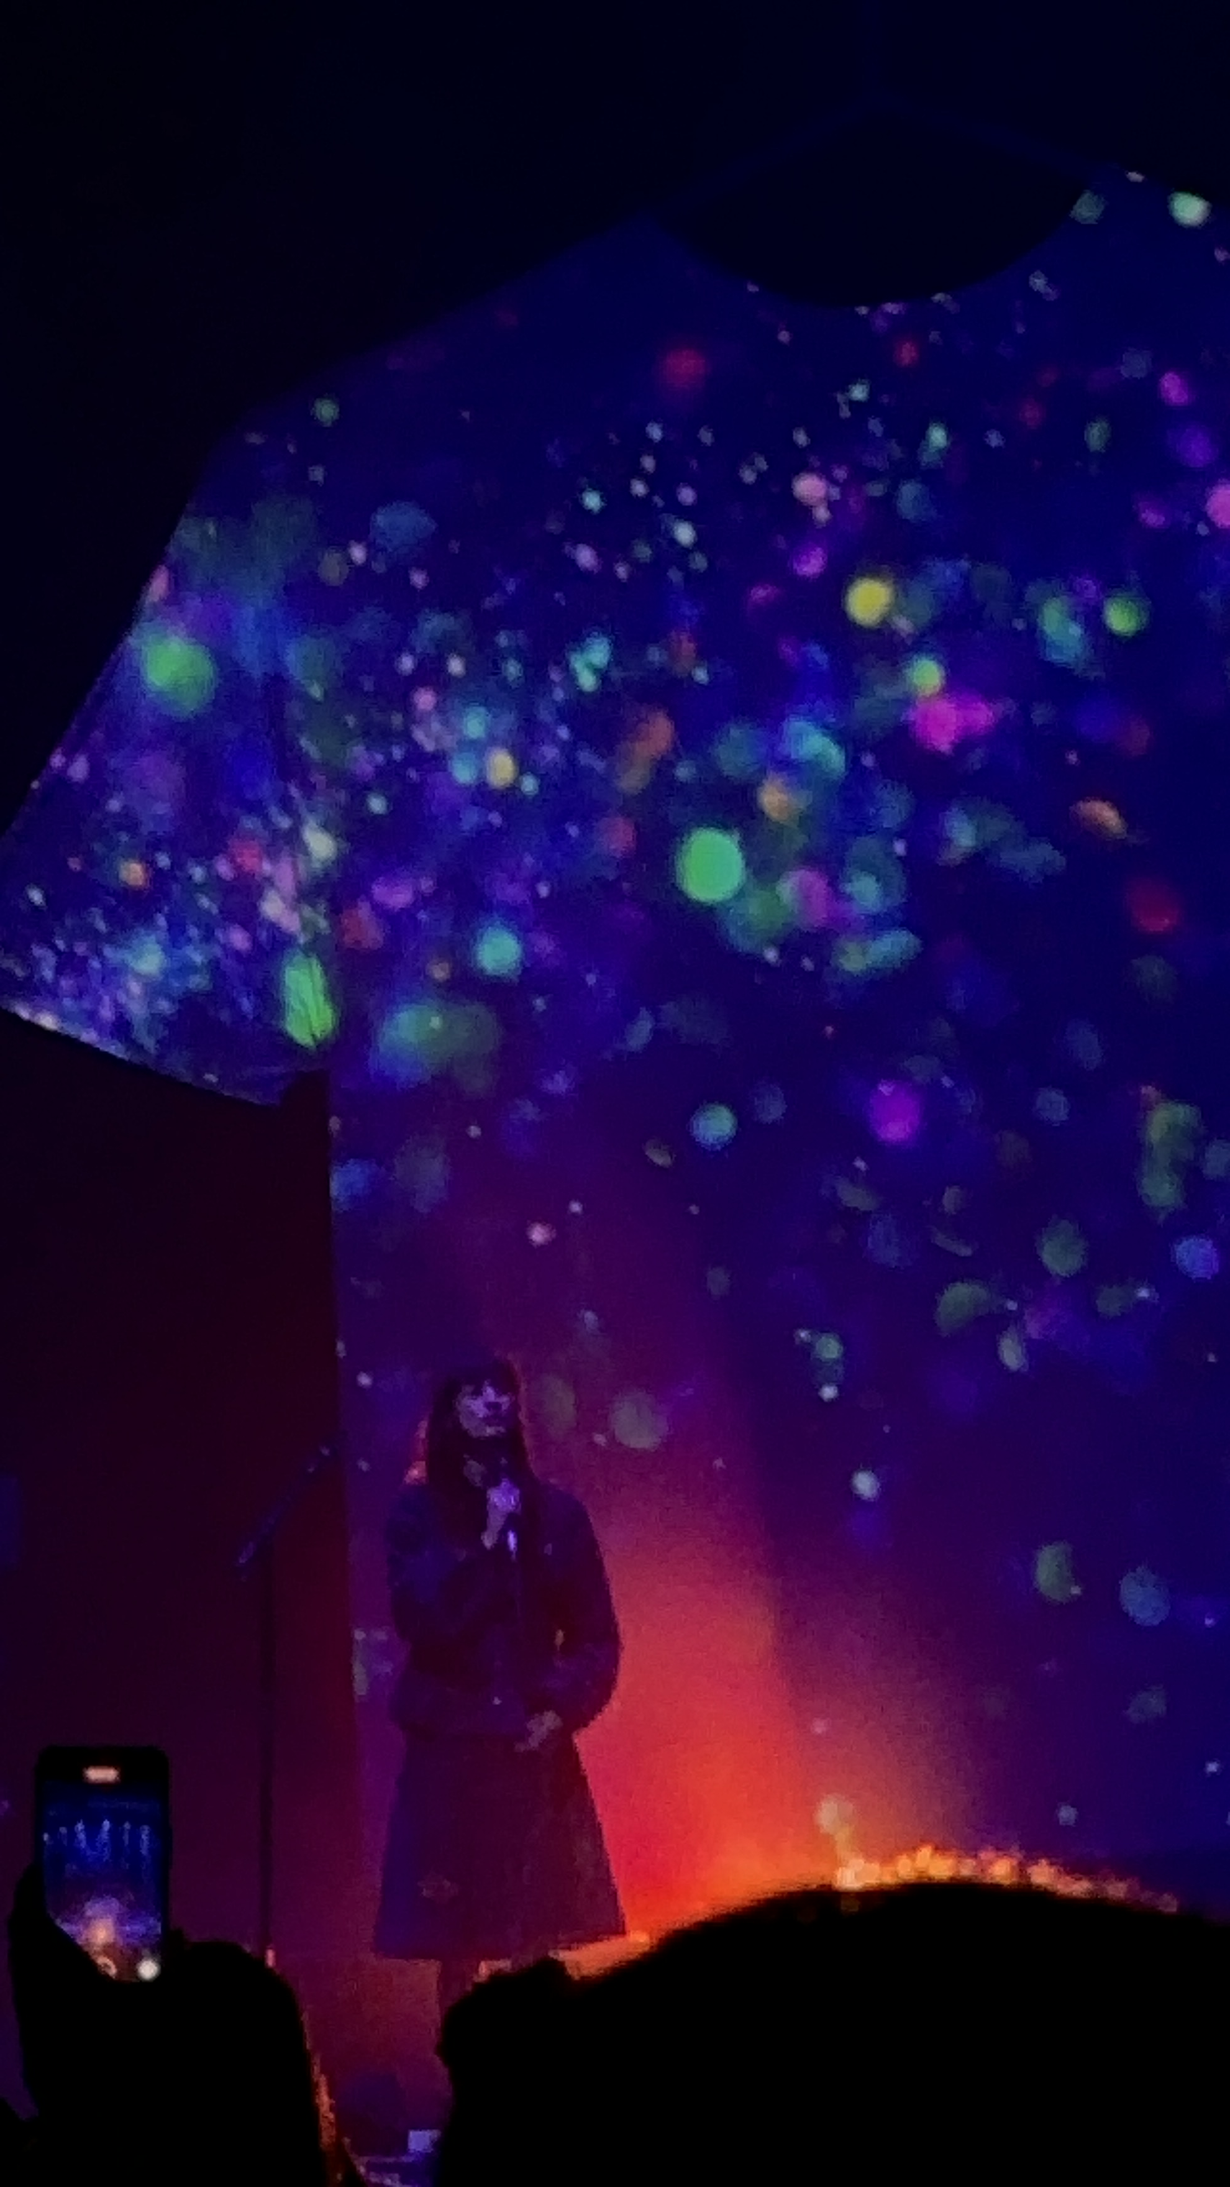
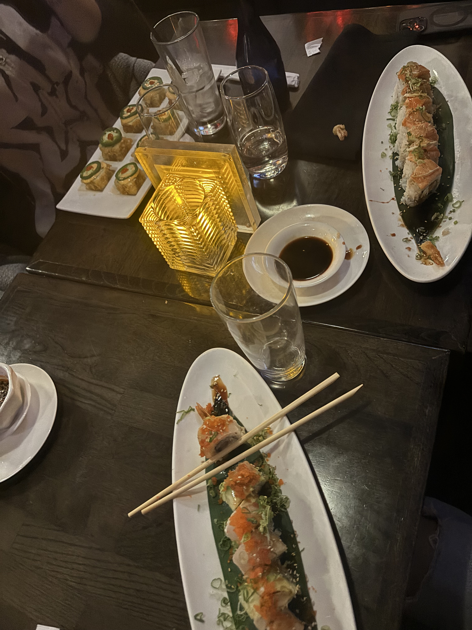
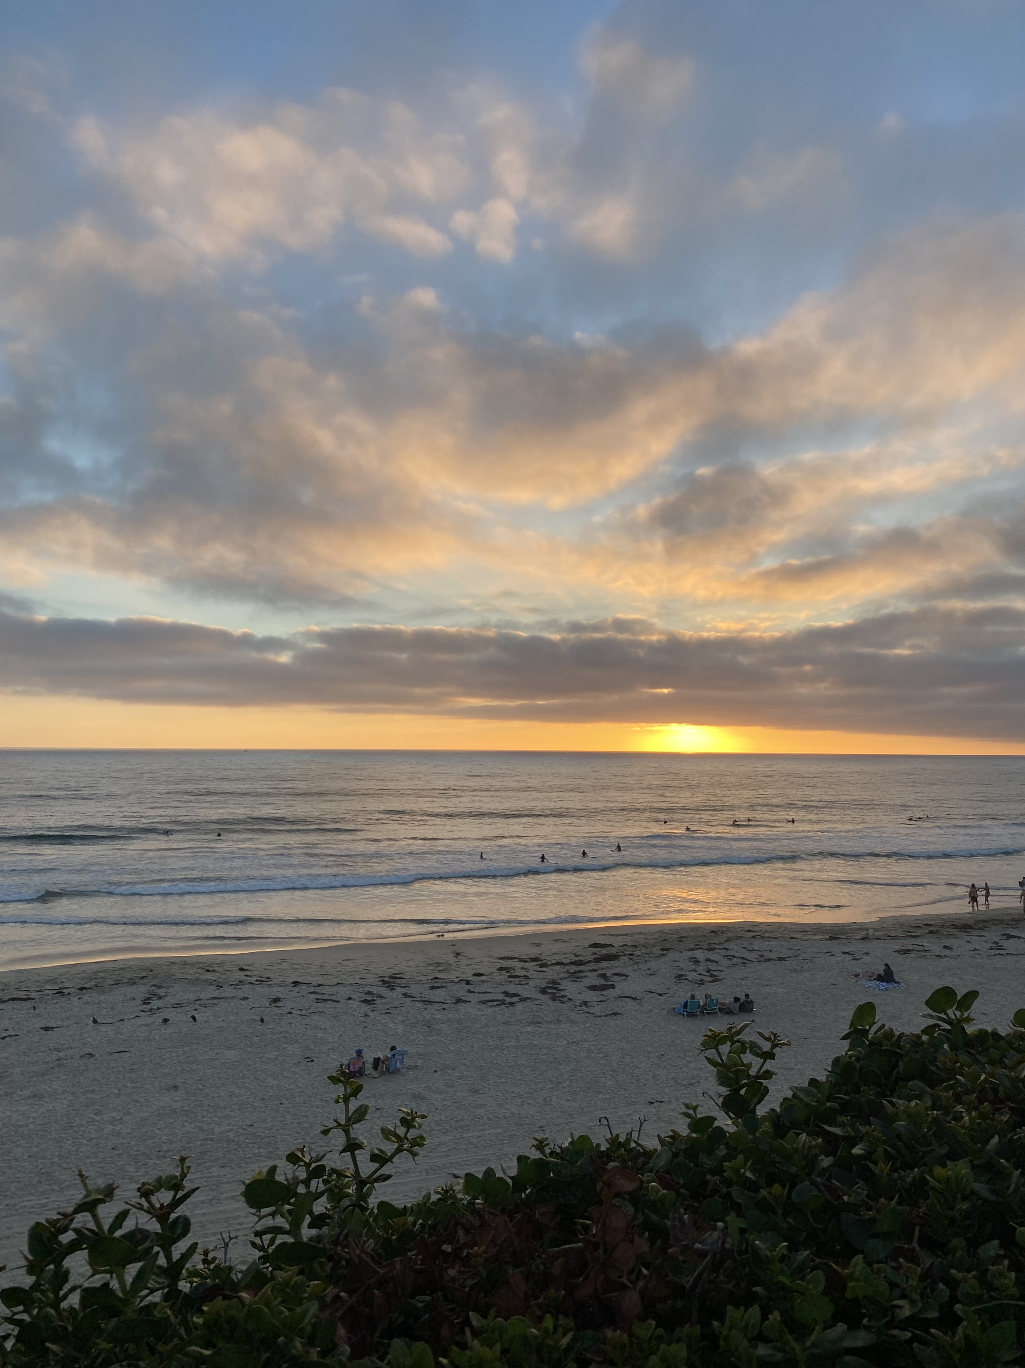
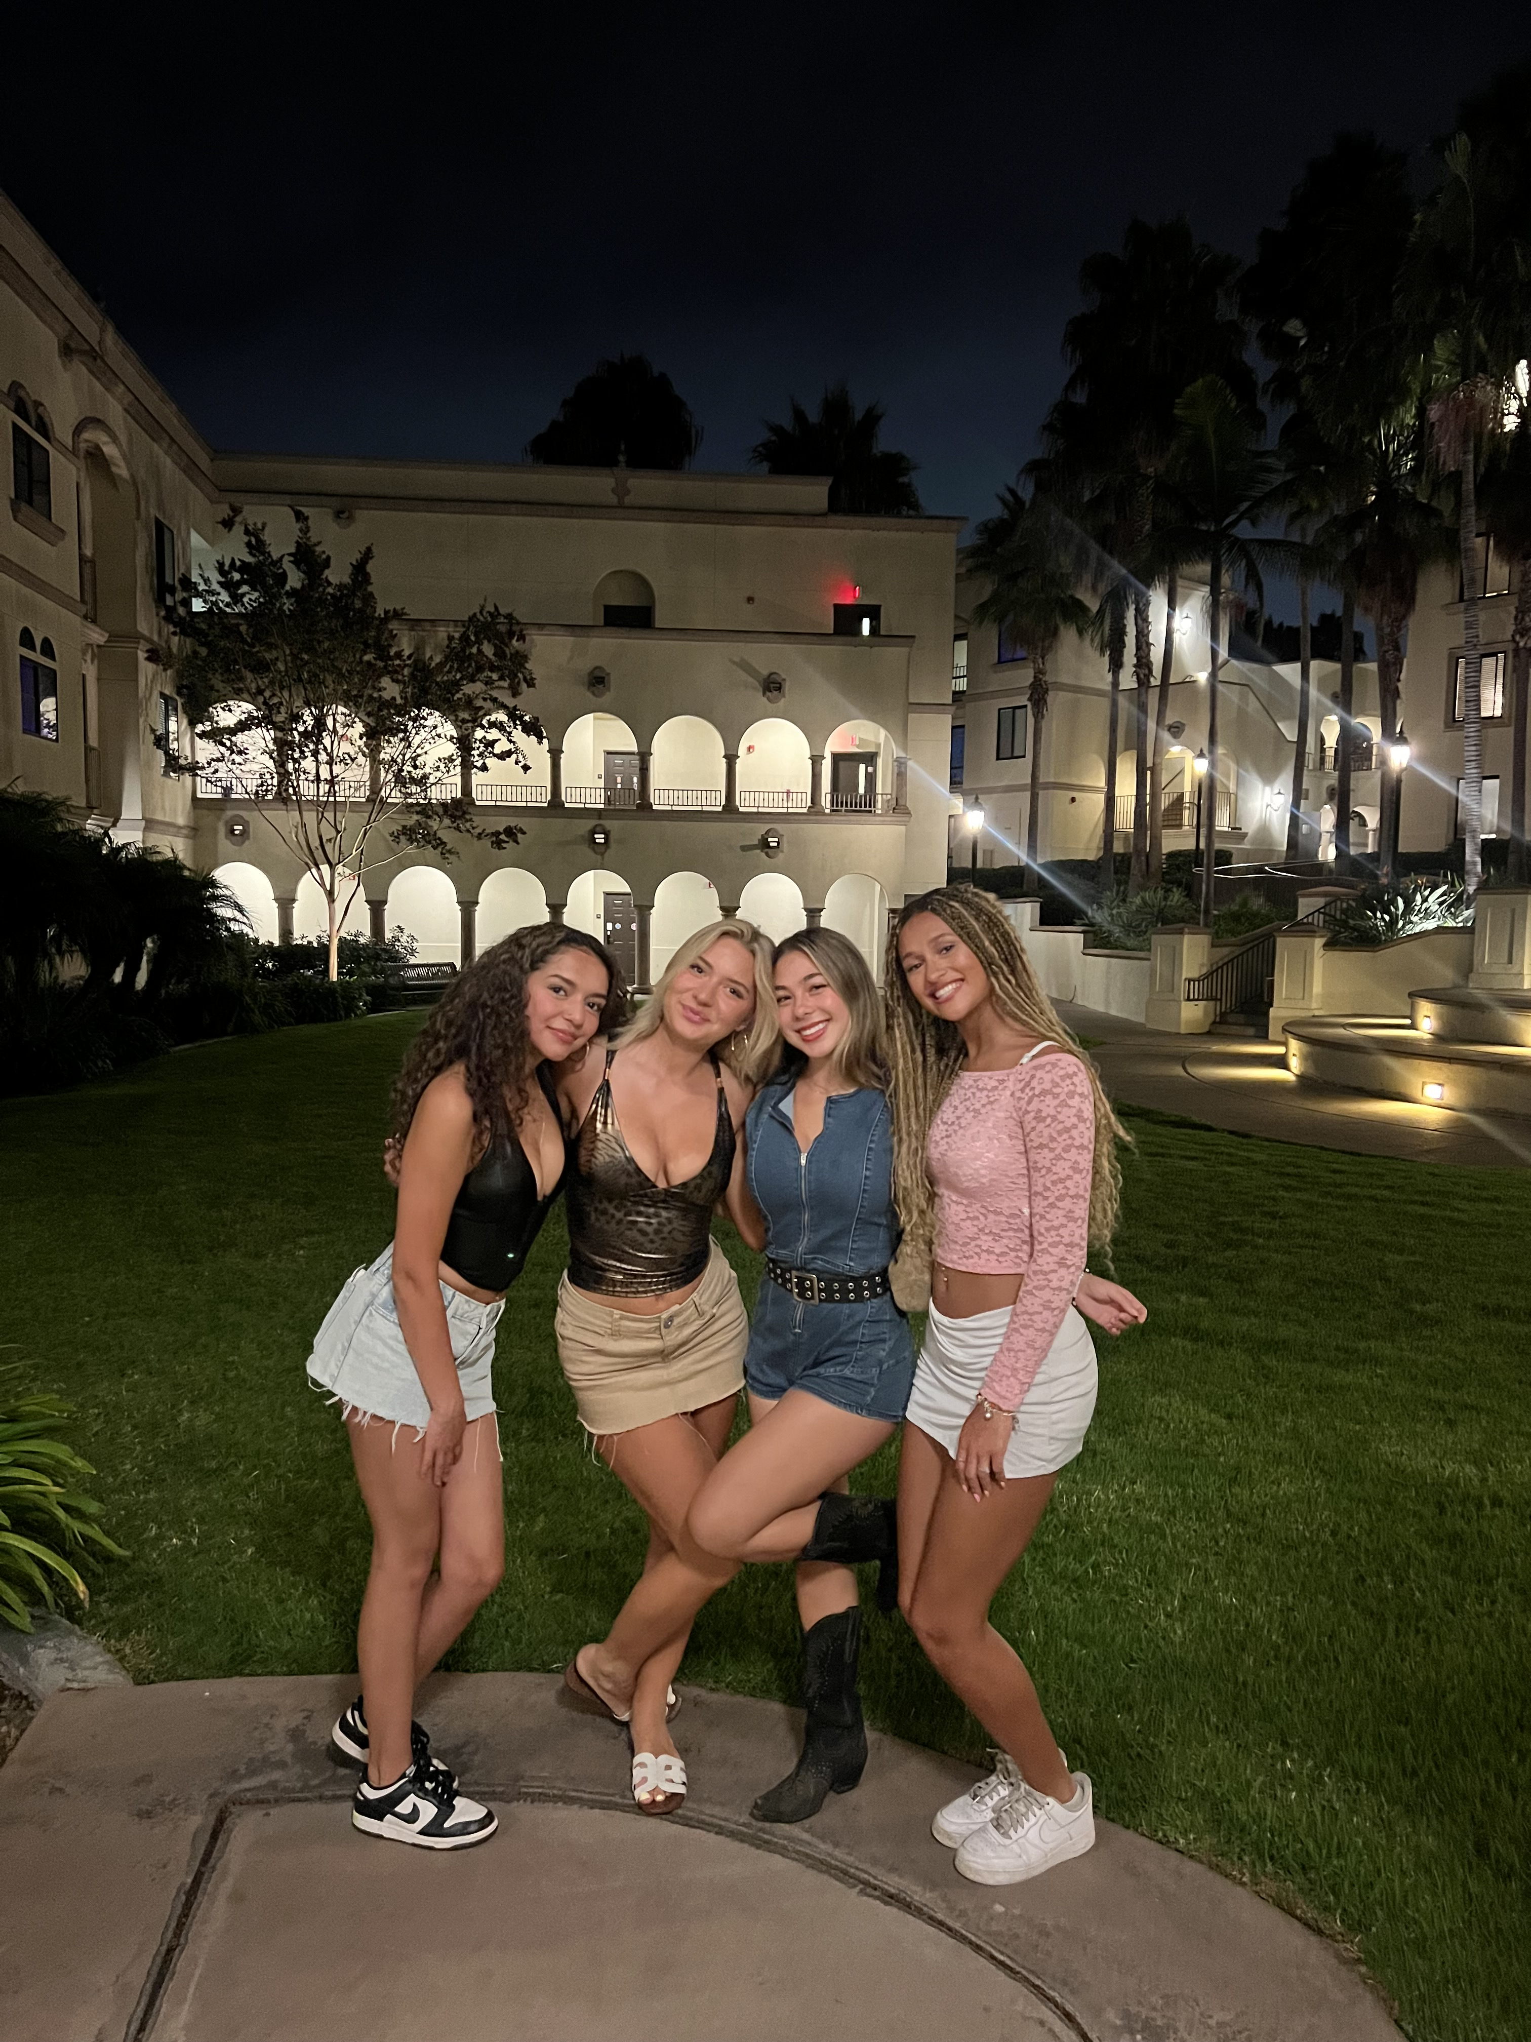
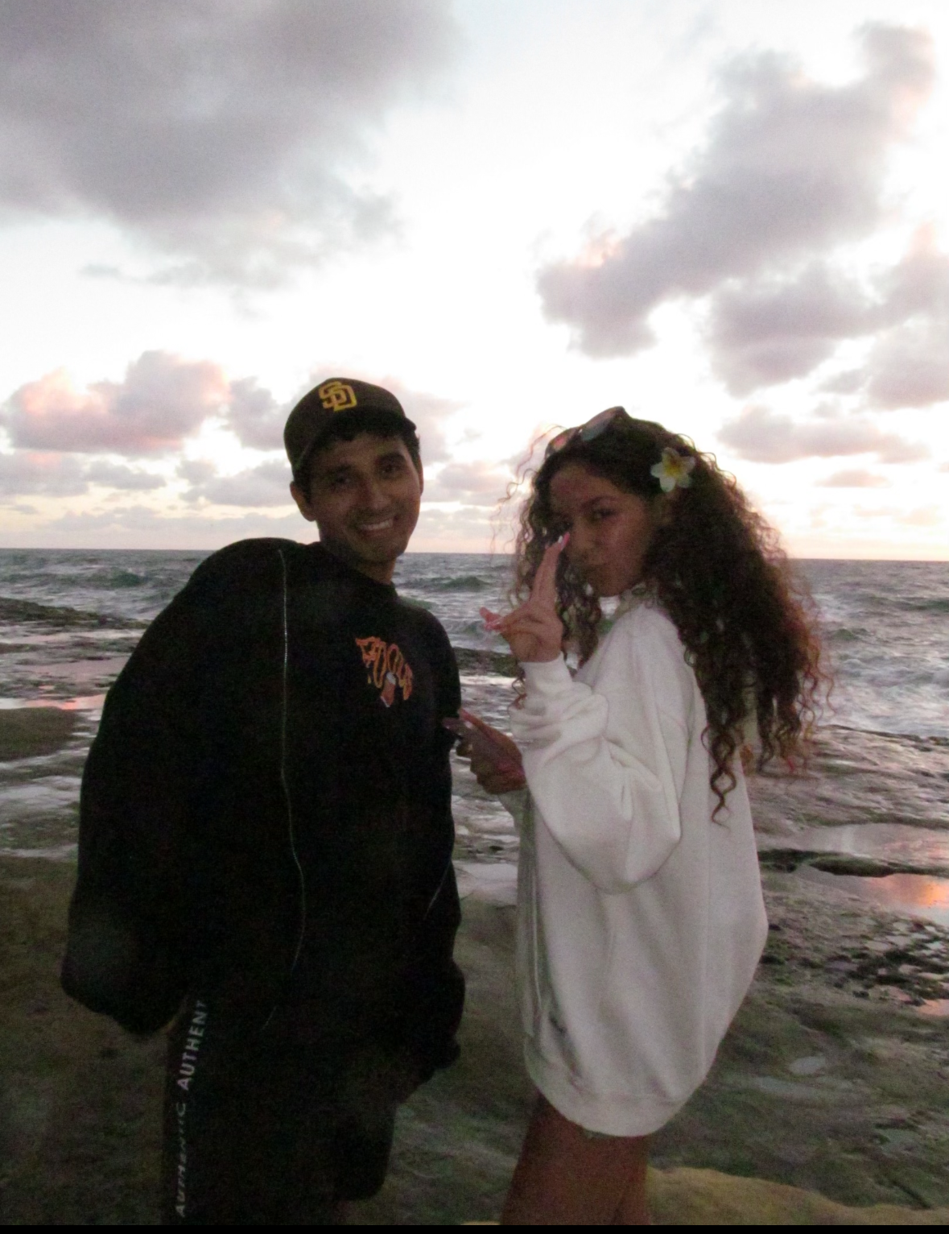
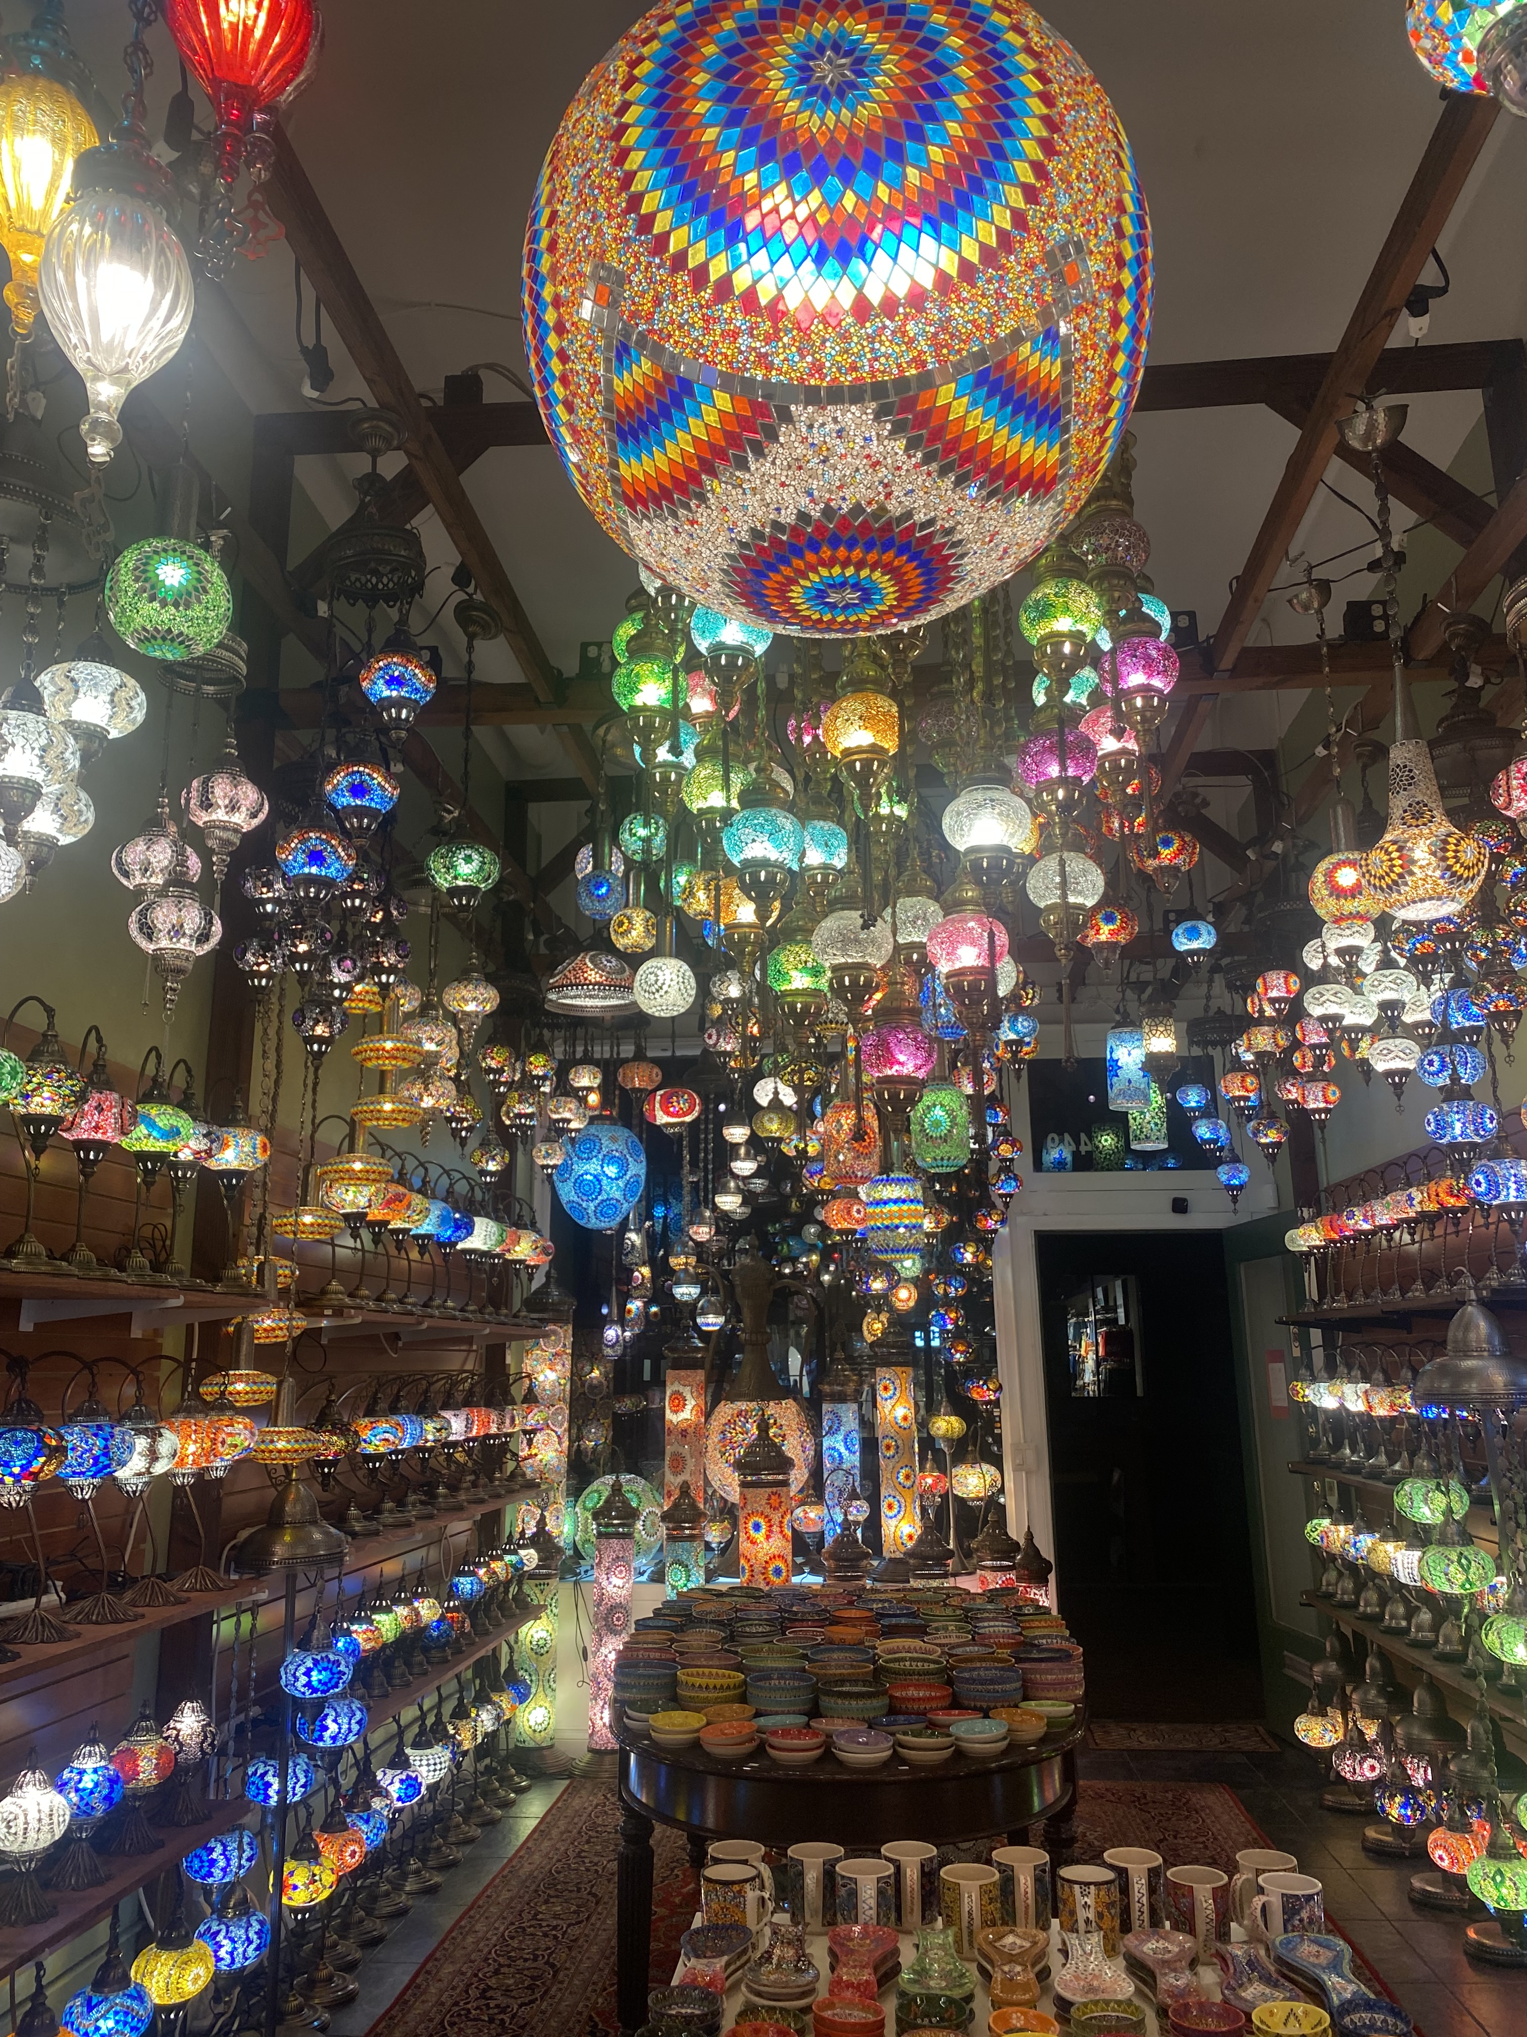
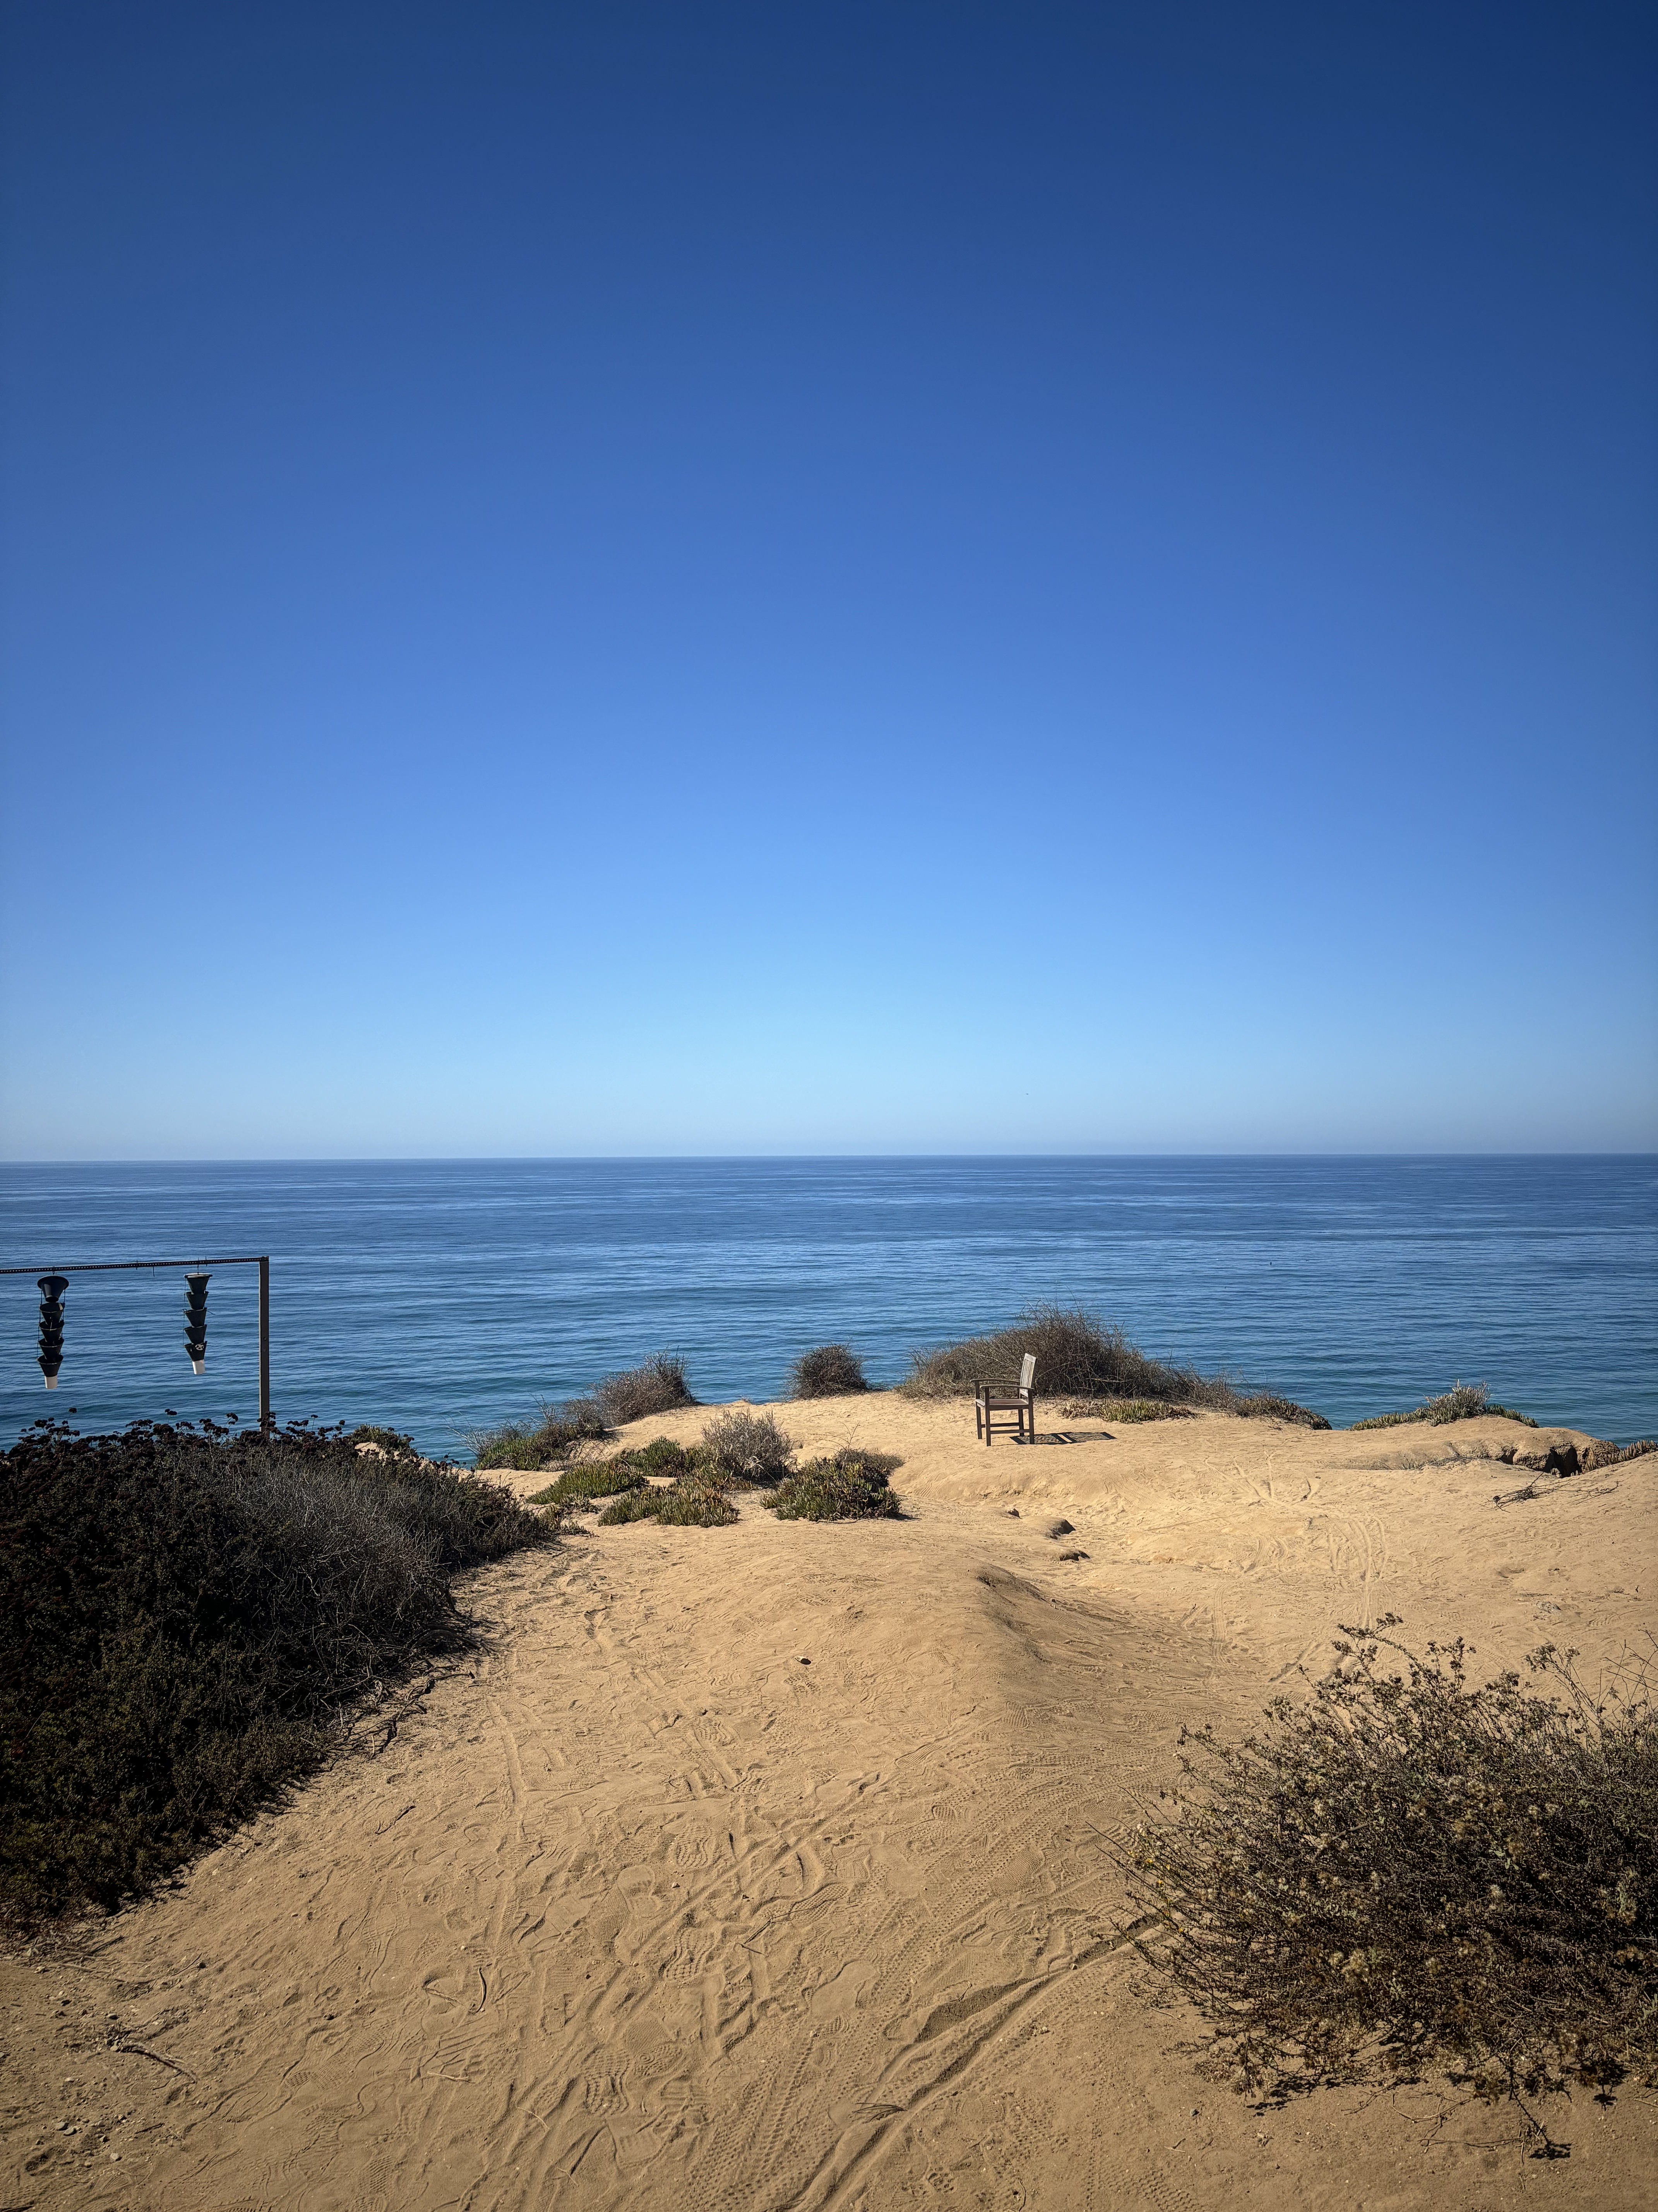
I did a lot of things by myself this semester. I love going out by myself now. Especially the beach.
I wanted a semester filled with new experiences and self-growth. Moving forward, I wish to continue stepping out of my comfort zone, exploring new places, and having new experiences in future semesters.

Slide 10
THANK YOU

