Slide 1

Time Capsule
Documenting the Past and Present
Will Kakos
12/9/2024

Slide 2
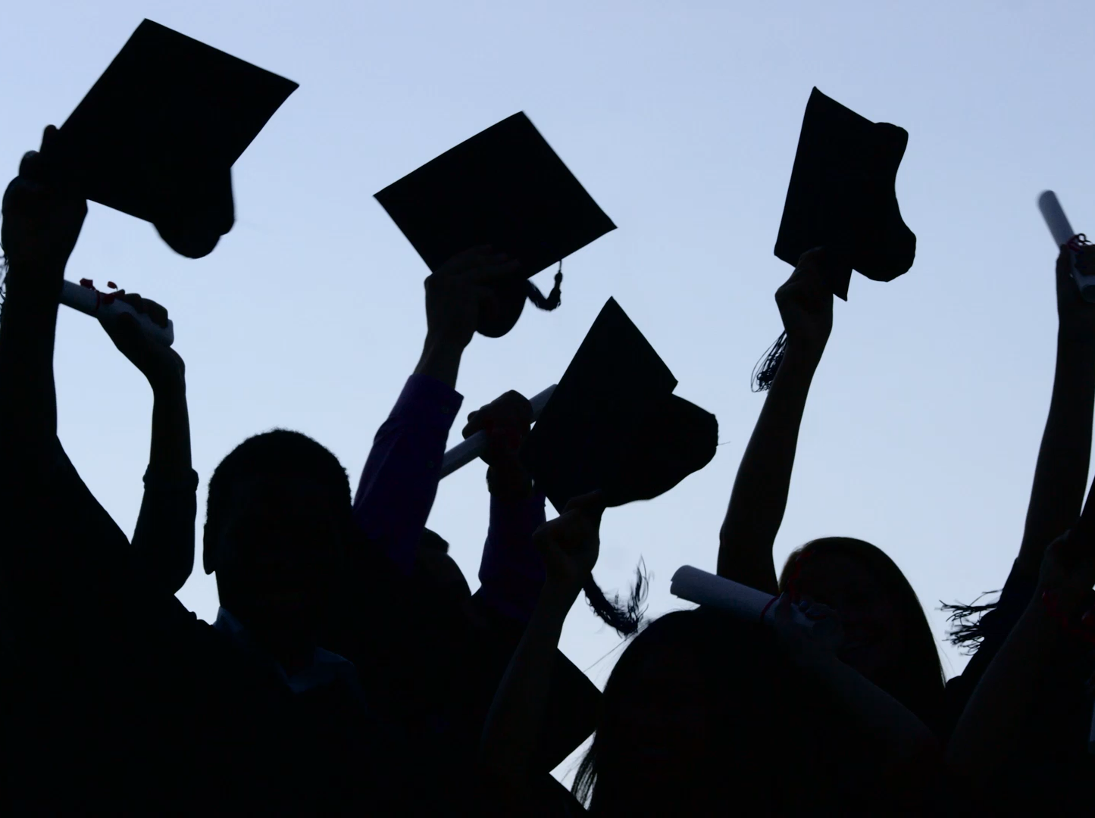
Items that happened this semester (Individual, Friends, Groups, Local, National)

Slide 3
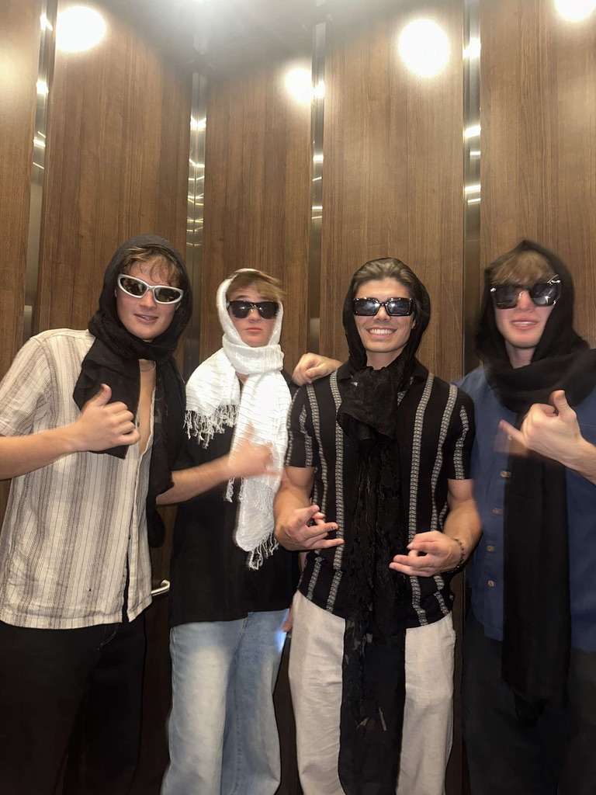
This when when me and my friends went to a concert for Levity earlier this semester

Slide 4
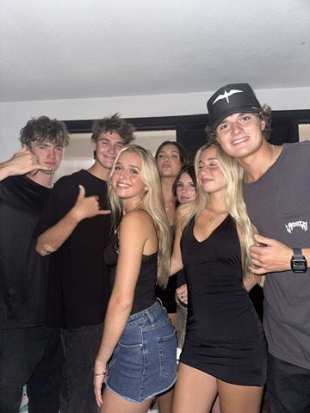
This was in the beginning of the semester when I was able to meetup with some of my friends from Hawaii that go to San Diego State.

Slide 5
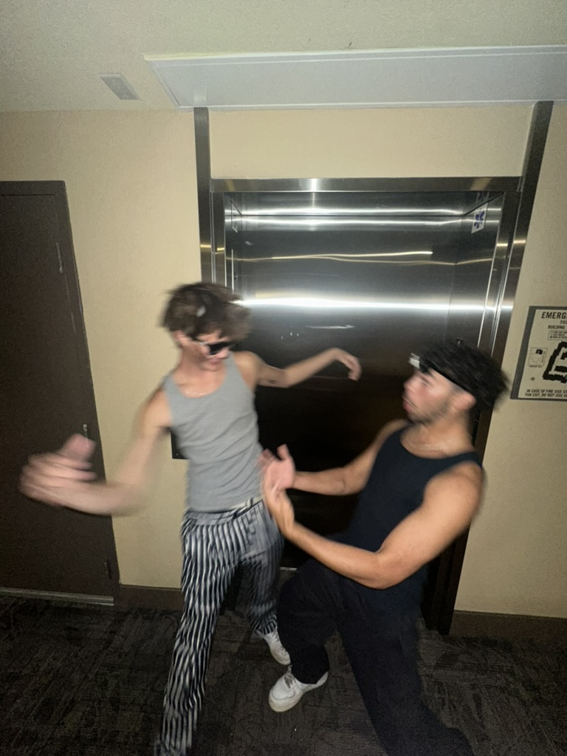
This was around Halloween where I saw my friend Jackson after being away for a while

Slide 6
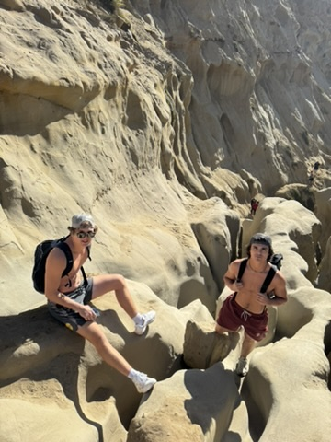
I tried out a hike with some of my friends that I had been wanting to try for a while. It was challenging but super fun!

Slide 7

Items that did not happen as expected

Slide 8
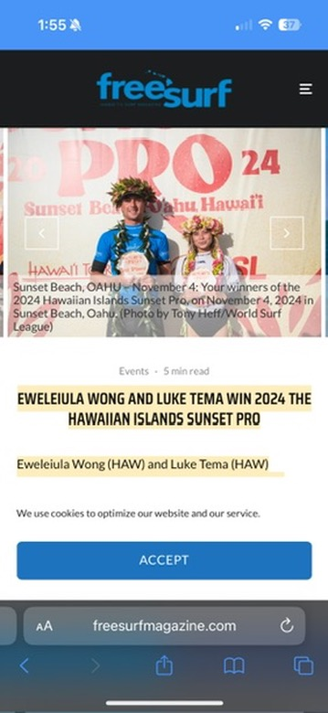

I wanted my friend Luke Swanson to win the sunset pro competition earlier this semester, but instead my friend Luke Tema won it.

Slide 9
Positive experiences this semester

Slide 10
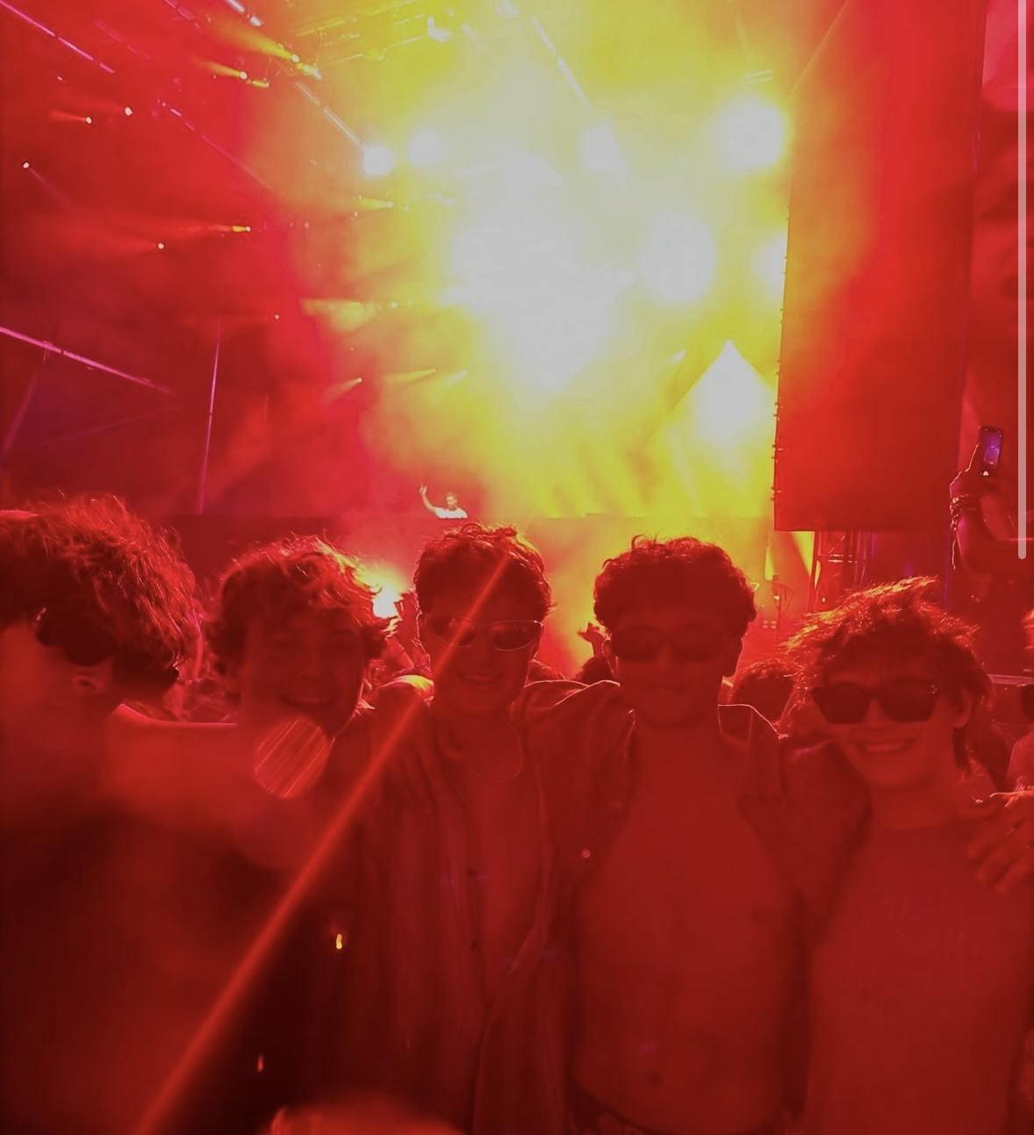
Went up to Dana Point to see Calvin Harris and the Chainsmokers. I was able to go with my brother and some friends as well as stay with my friends from Hawaii so it was super fun.

Slide 11
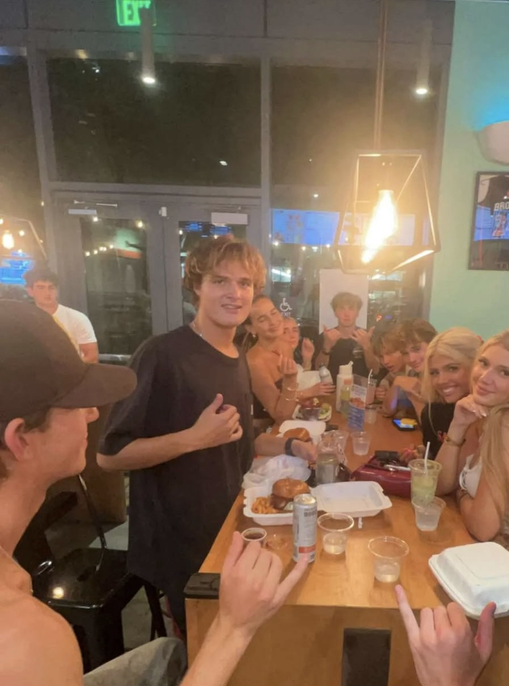
After a tailgate earlier this semester at San Diego State I met up with a bunch of my friends who go there and we had a big dinner afterwards.

Slide 12
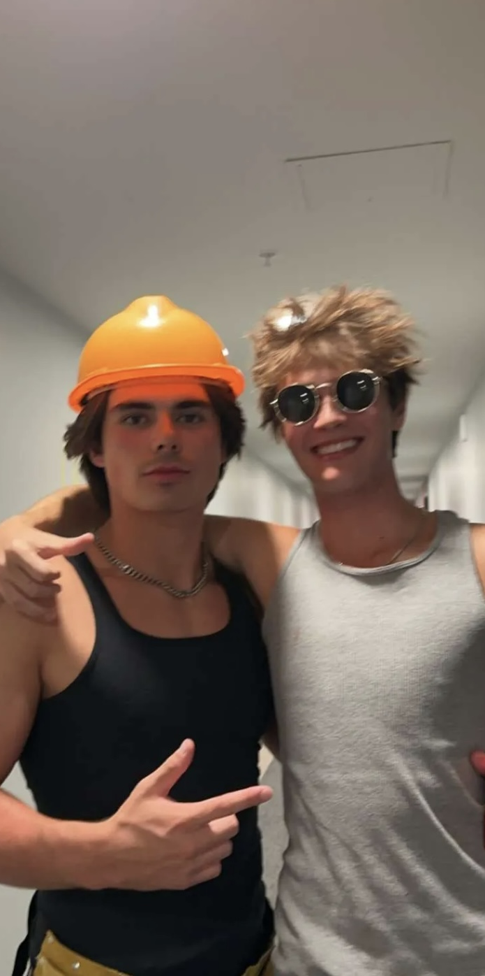
Went up to Arizona State University with my friend for Halloween Weekend

Slide 13
Negative experiences this semester

Slide 14
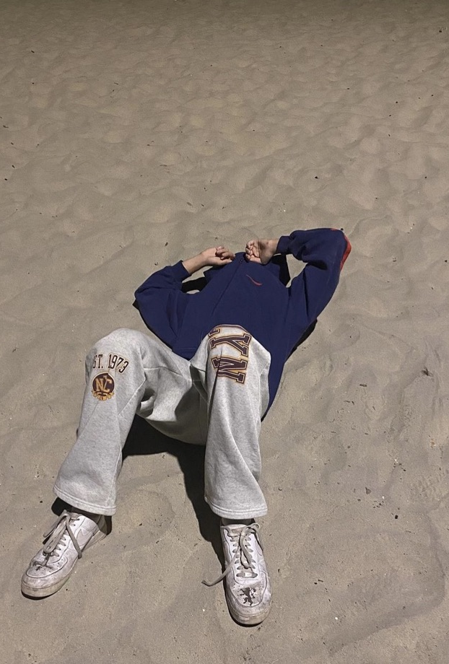
This was after I got a 73% on my paper when I was at my friend’s house on Mission Beach.

Slide 15
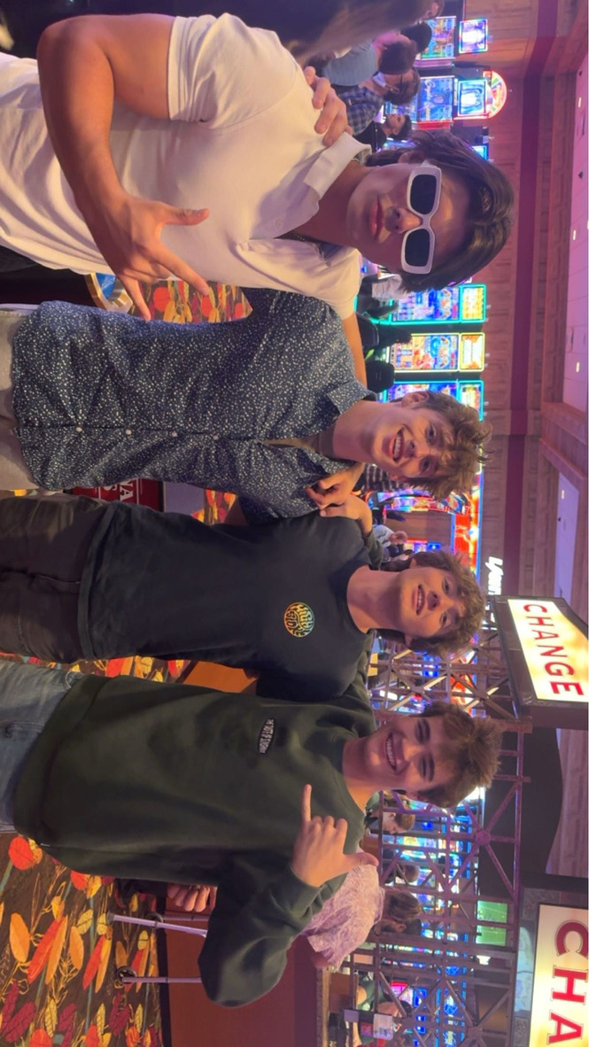
This was before I lost money at the Casino earlier in the semester.

Slide 16
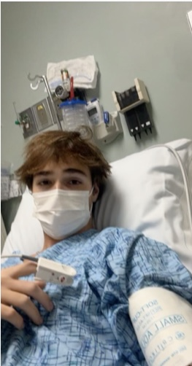
This was over thanksgiving break where I could not go home, and I was stuck in bed all day over break. I got extremely sick and had to go to the Emergency room for the whole day.

Slide 17

News, Media, and Global Highlights

Slide 18
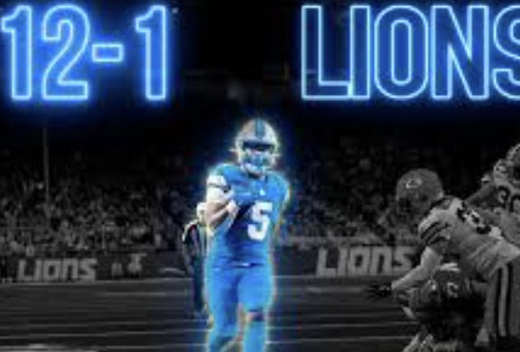
Detroit Lions going 12-1 after being 3-13 less than 4 years ago

Slide 19

Bitcoin hitting 100k earlier this year after being at $100 in 2014.

Slide 20

Changes to Processes, Laws, and Restrictions

Slide 21
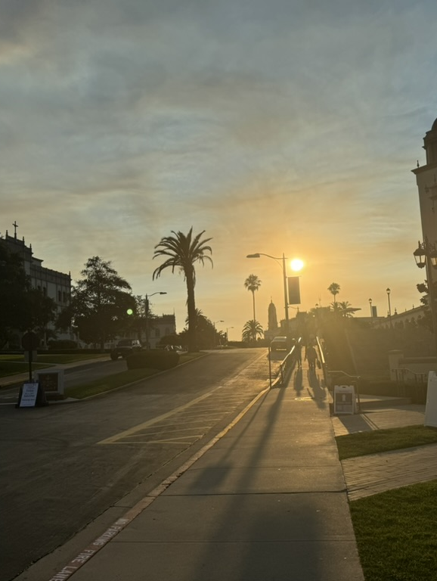
First time in college was a pretty big change for me.

Slide 22
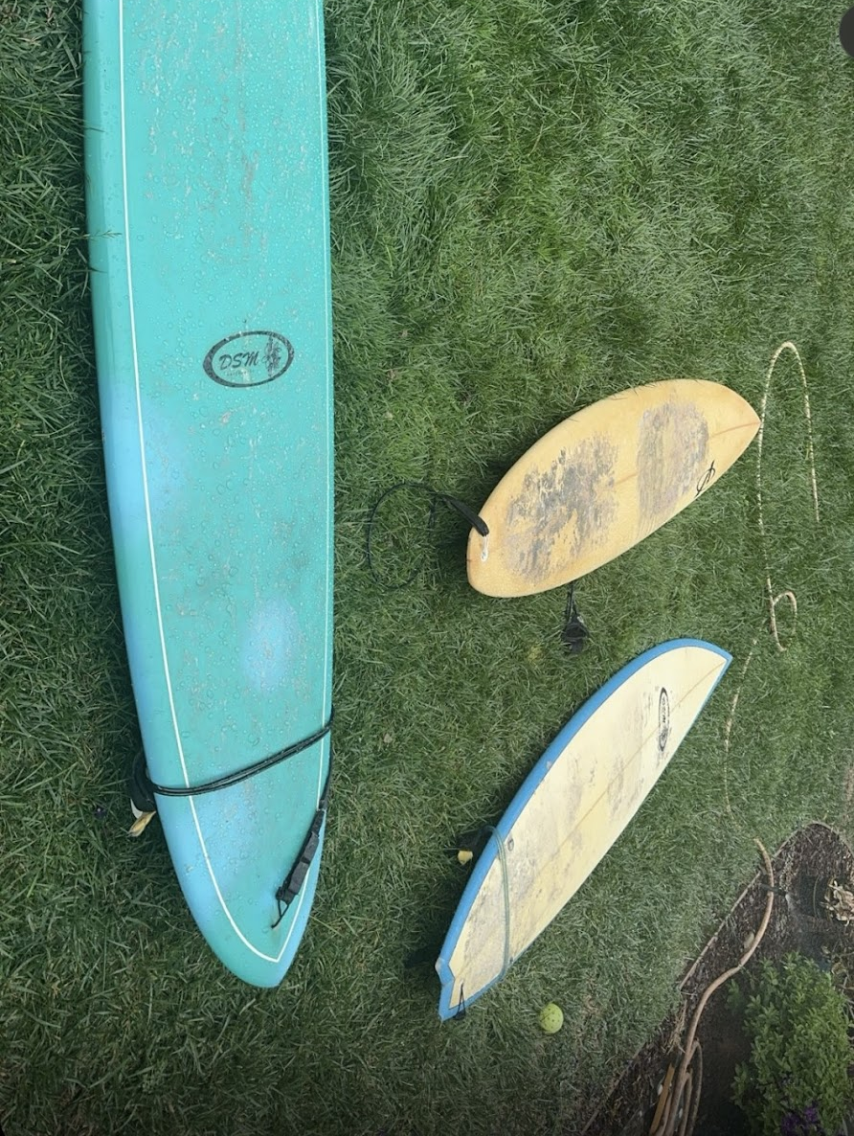
Surfed in San Diego for the first time and had to wear a full wetsuit for the first time

Slide 23
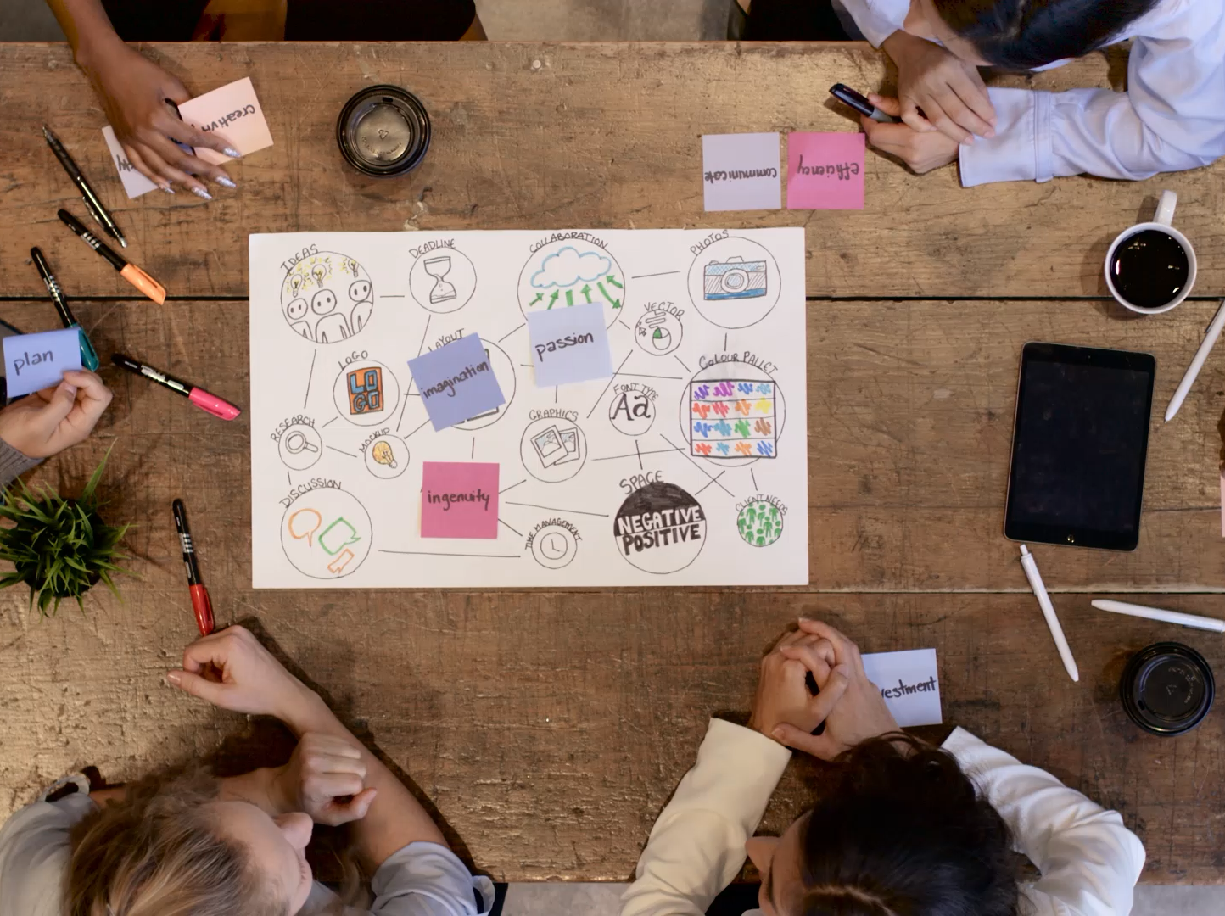
Examples of Peoples Creativity to Assist Others

Slide 24
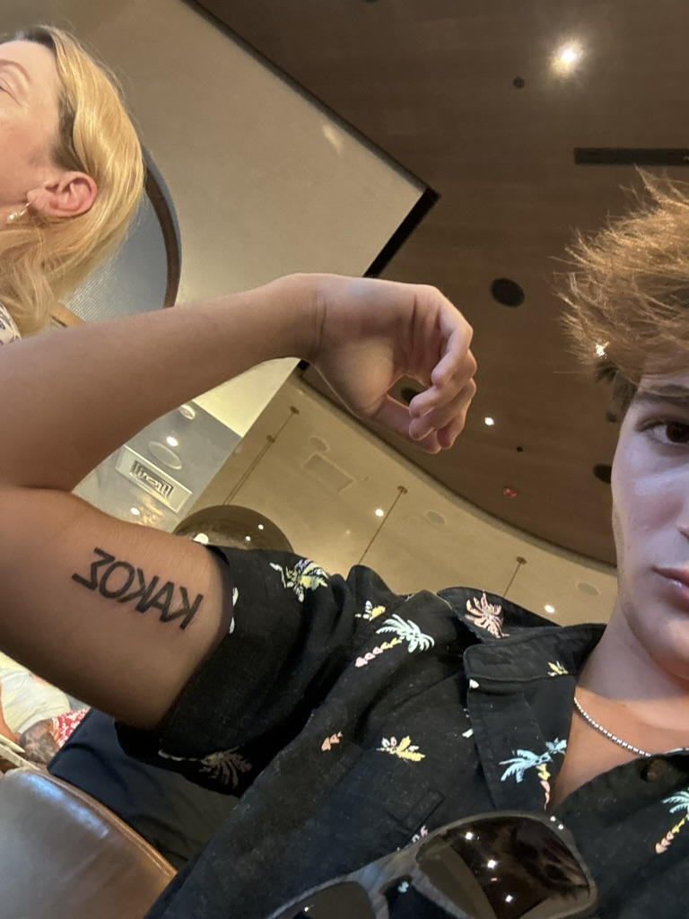
The tattoo artist I went to was very creative and great at line work

Slide 25
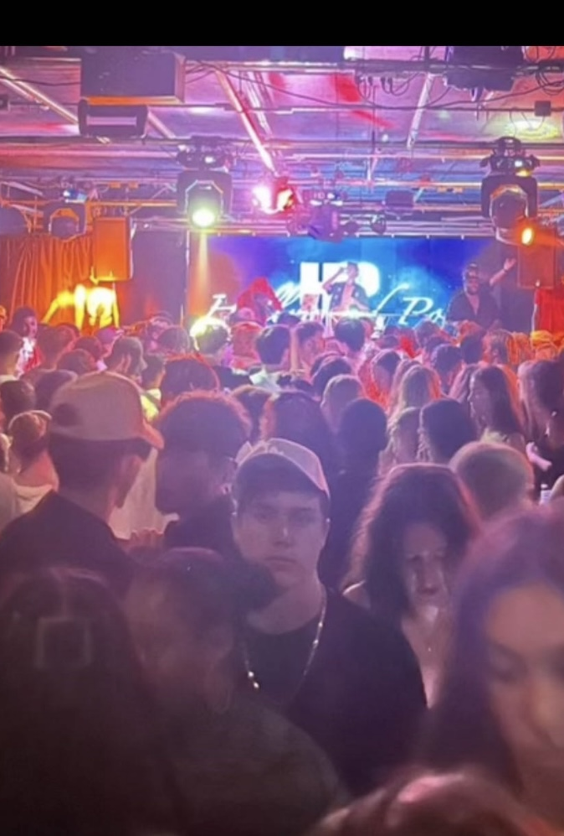
I djed at a club for a lot of people to show my creativity.

Slide 26

Other Semester Moments and Semester Reflection

Slide 27
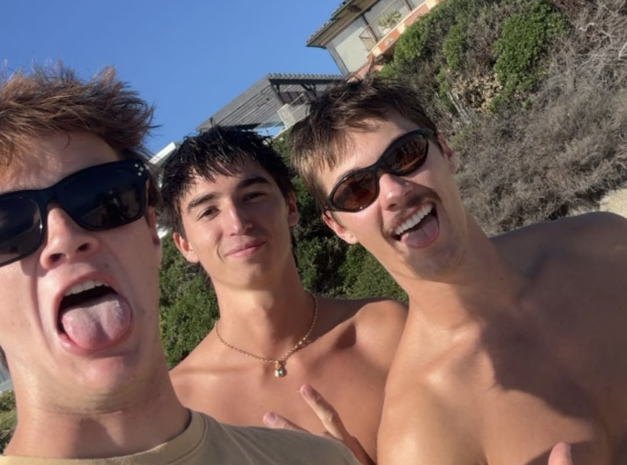
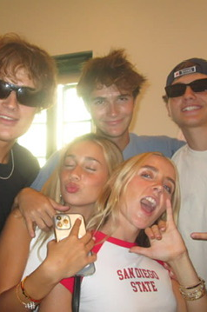
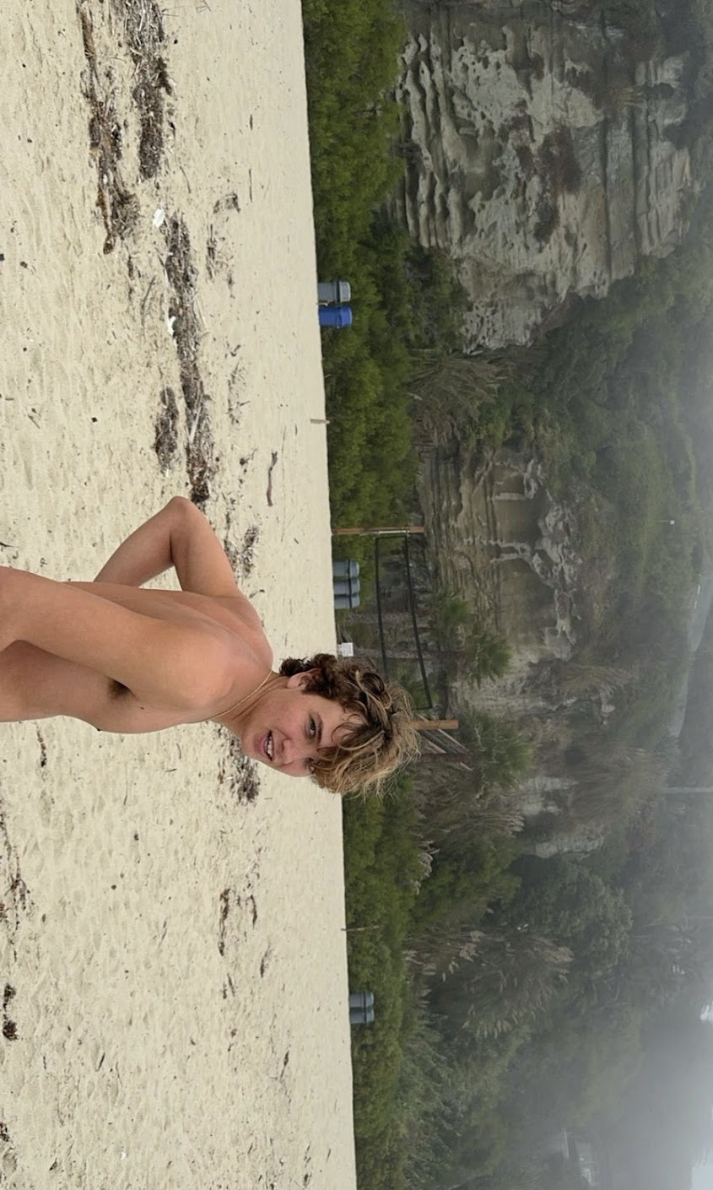
Went to Laguna beach bottom right with some friends. In the other photos I saw lots of my friends from Hawaii who go to different schools in San Diego. I spent lots of great time with friends this semester and it helped me balance school.

Slide 28

THANK YOU

