Slide 1

Time Capsule: Documenting My Semester
Capturing Moments, Reflections, and Milestones from an Extraordinary Journey
By: Luke Morrison
Course: ITMG 100
Date: 12/9/2024

Slide 2
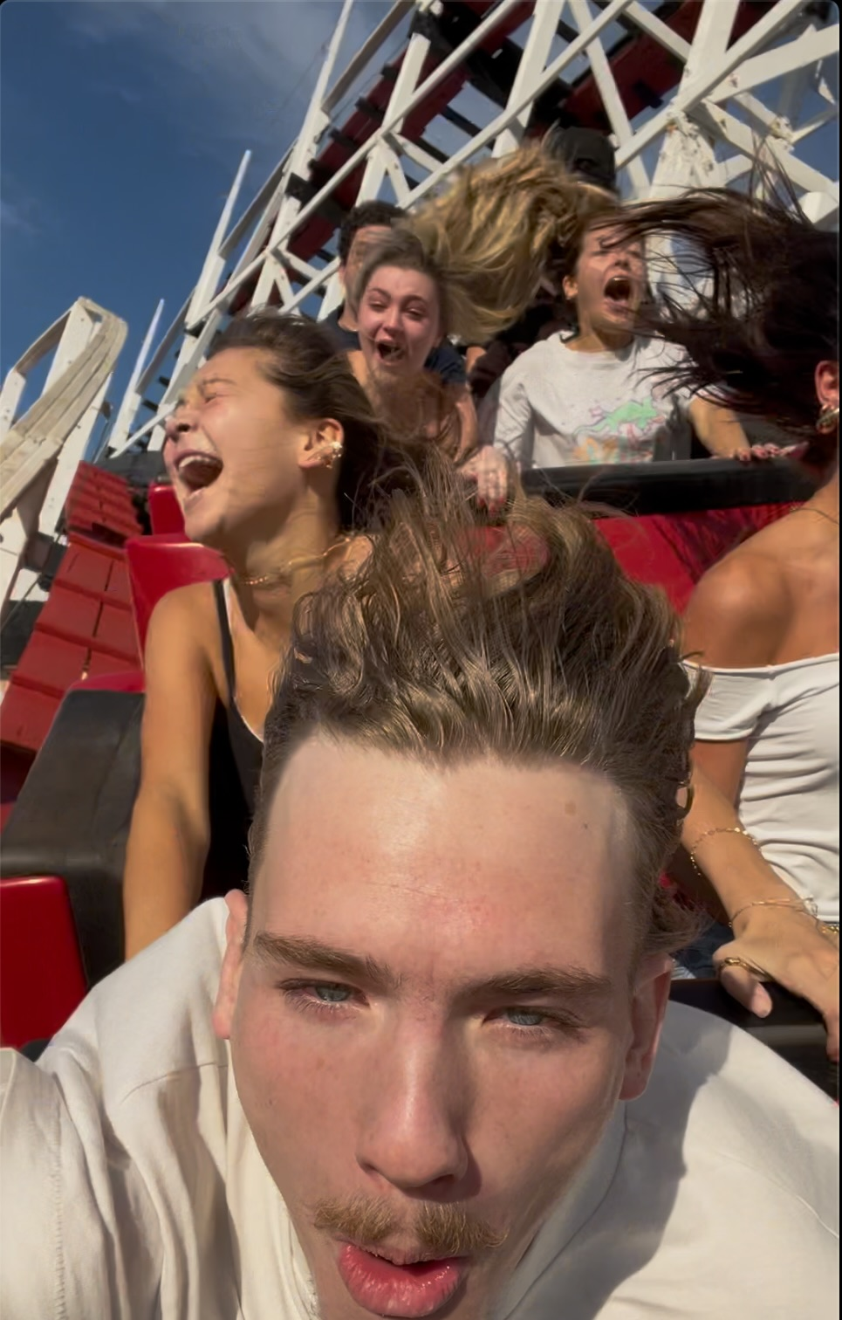
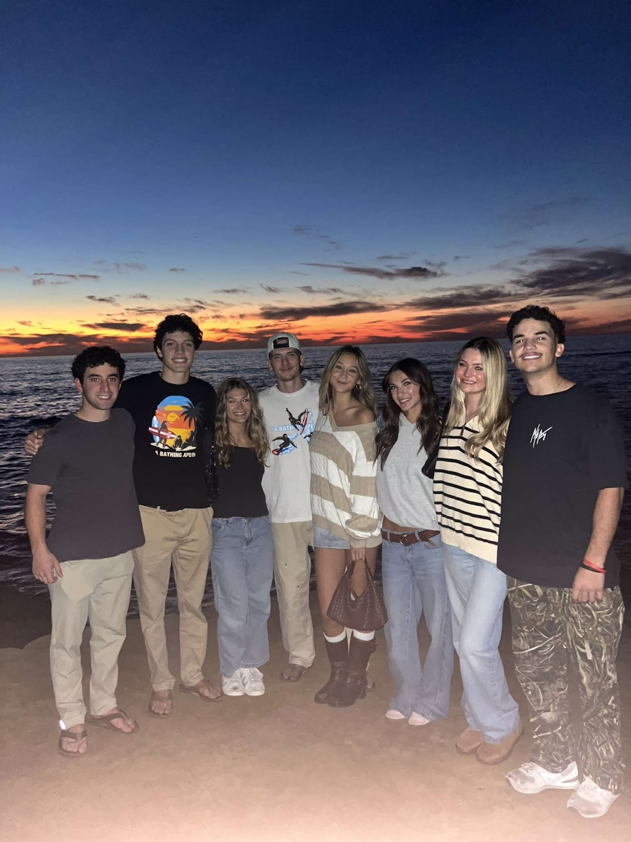
Items that Happened Individually, with Friends, Groups, Locally, Nationally
Went to the Mission roller coaster with friends visiting from Arizona. Also visited Sunset Cliffs, as shown in another picture.

Slide 3
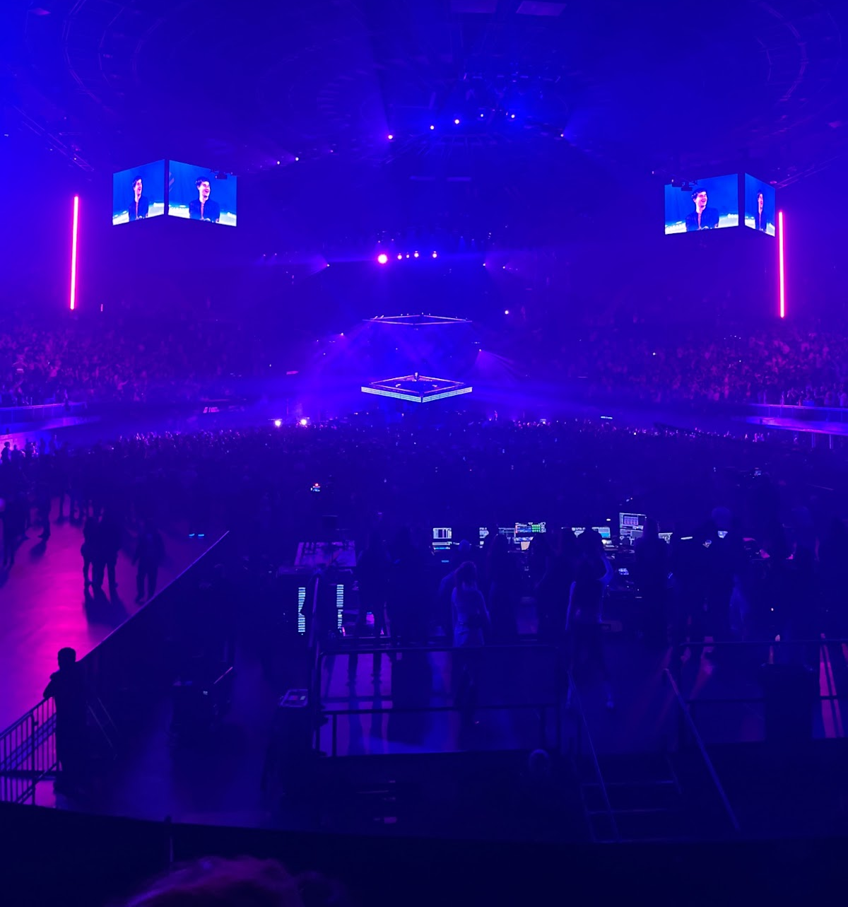
Items that Happened Individually, with Friends, Groups, Locally, Nationally
Last-minute decision during class to drive to the Kia Forum in LA for a John Summit concert.

Slide 4
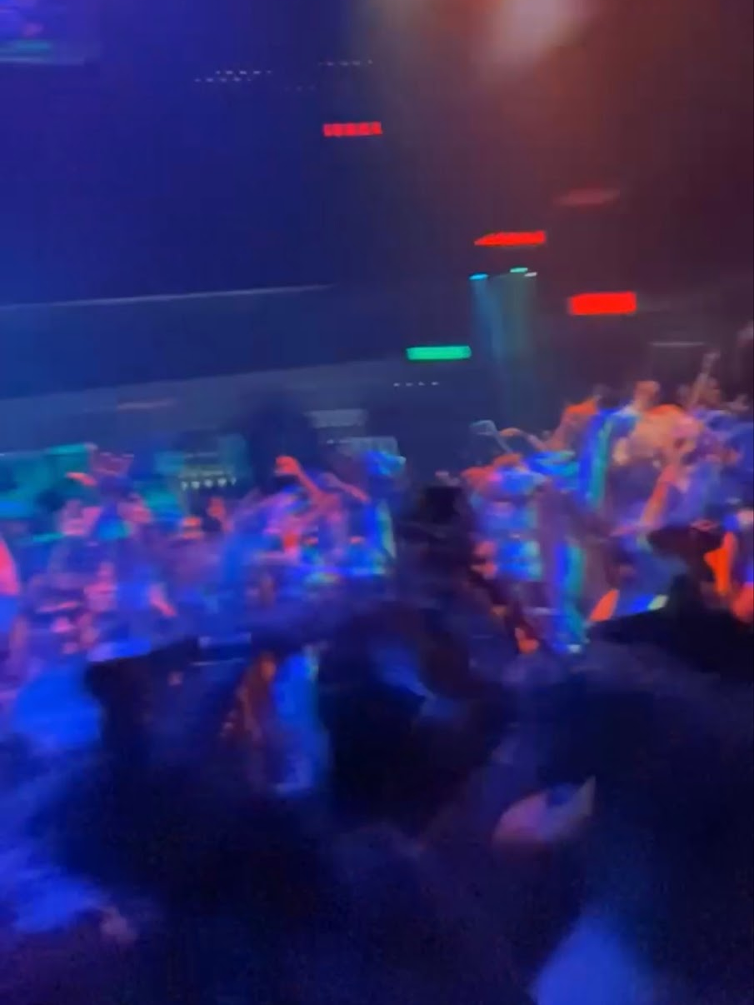
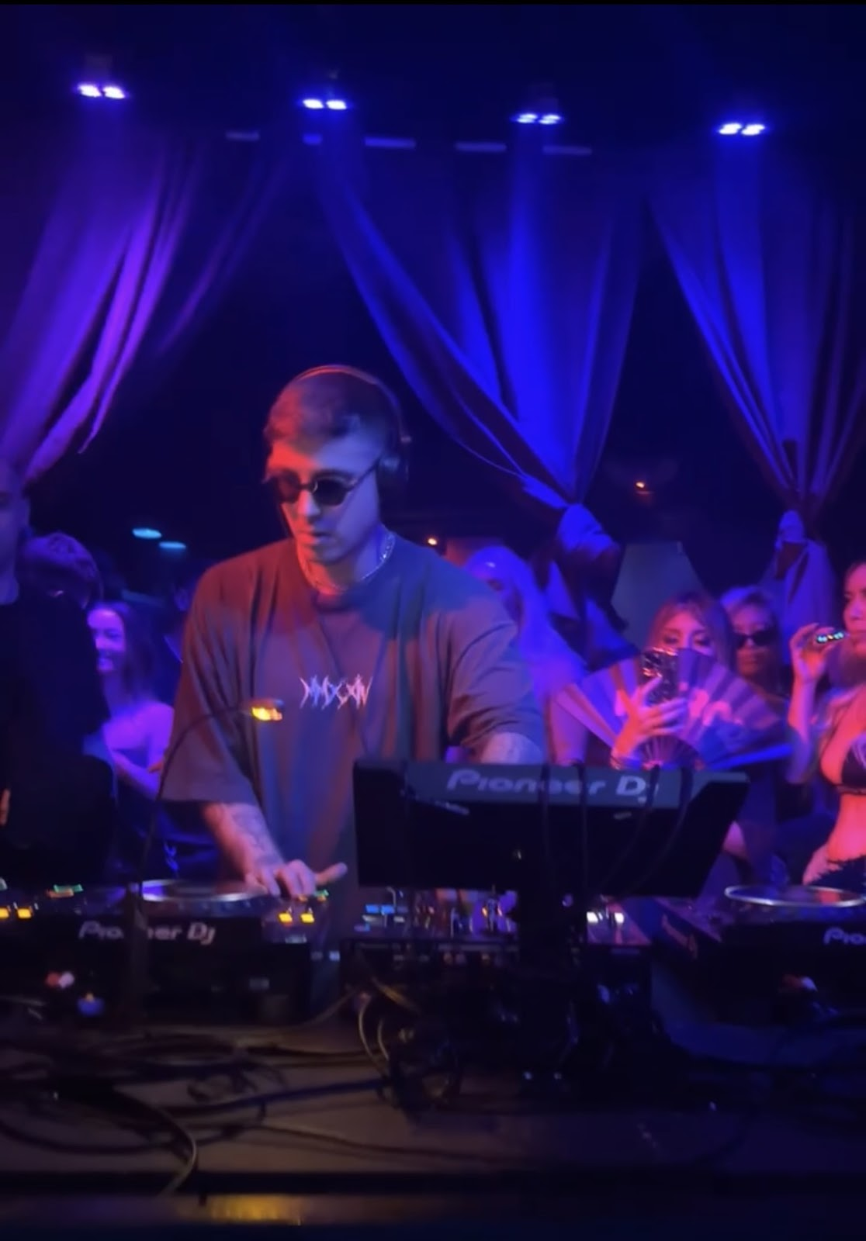
Items that Happened Individually, with Friends, Groups, Locally, Nationally
Saw Matroda, a famous EDM artist, in a San Diego nightclub (the night after the Summit concert).

Slide 5
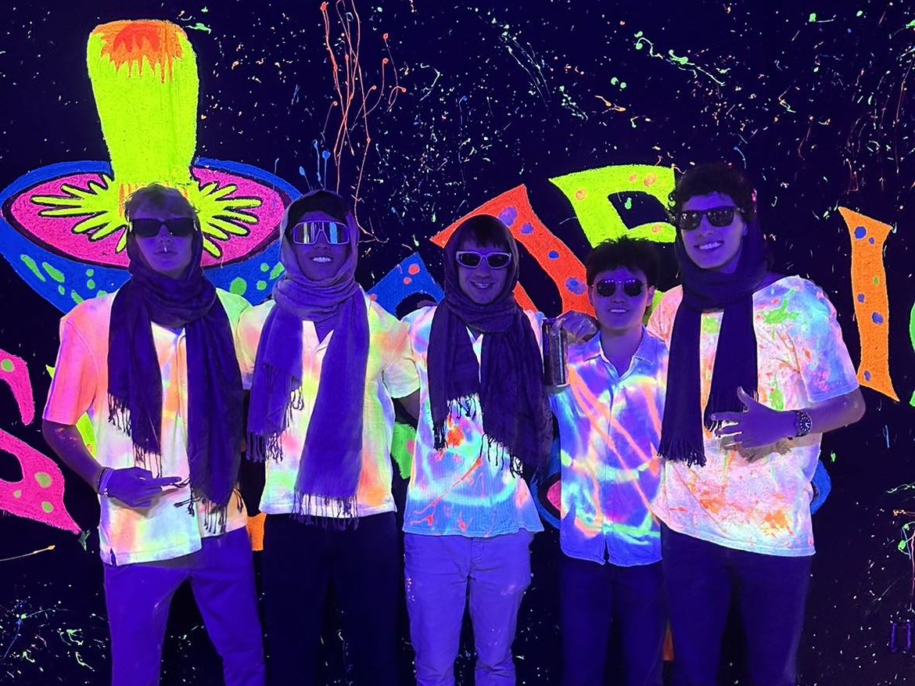
Items that Happened Individually, with Friends, Groups, Locally, Nationally
Friends from home visited, and we attended events at SDSU.

Slide 6
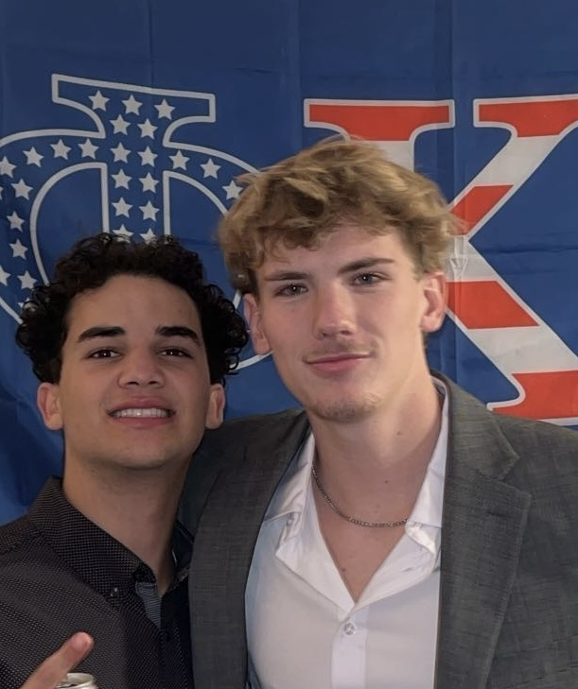
Items that Happened Individually, with Friends, Groups, Locally, Nationally
Formal event!

Slide 7
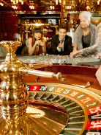
Items that Did Not Happen That You Wanted, Expected
Got absolutely rinsed at the casino with my boys.

Slide 8
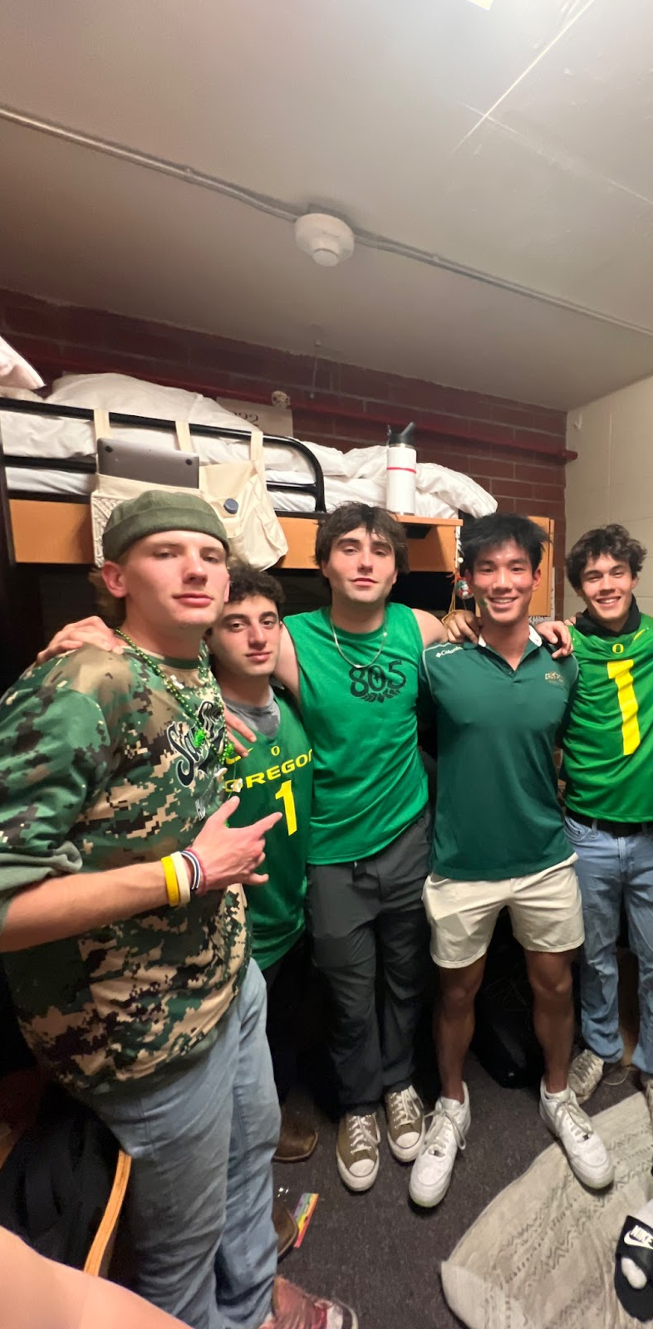
Positive Experiences That Touched Your Life
Visiting friends in SLO. It was great to reconnect and have fun.

Slide 9
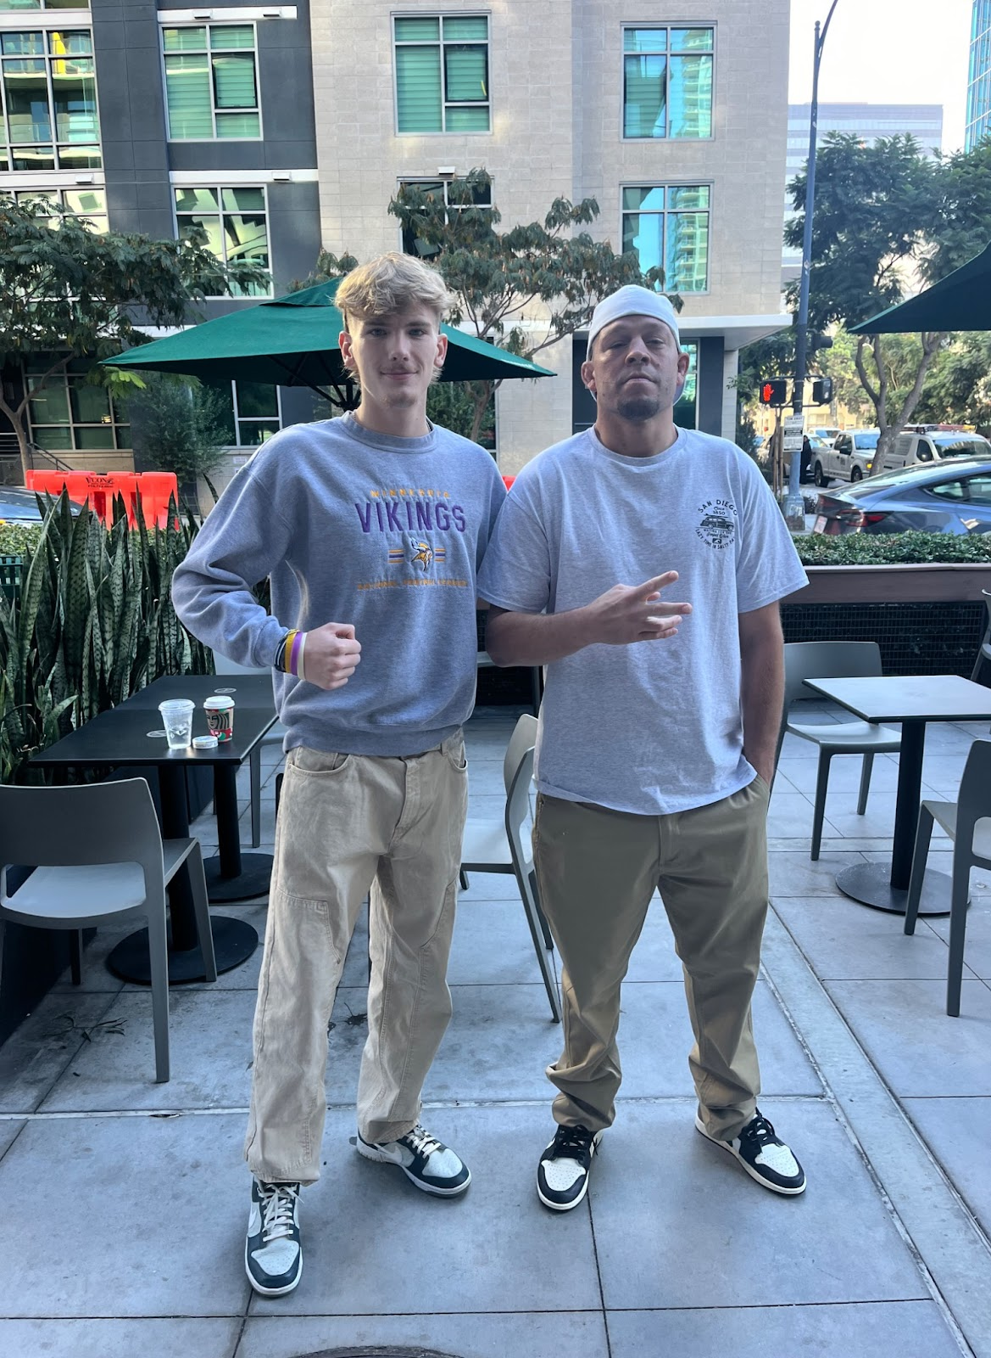
Positive Experiences That Touched Your Life
Meeting Nate Diaz, a famous UFC fighter, the morning after my birthday at a Starbucks downtown.

Slide 10
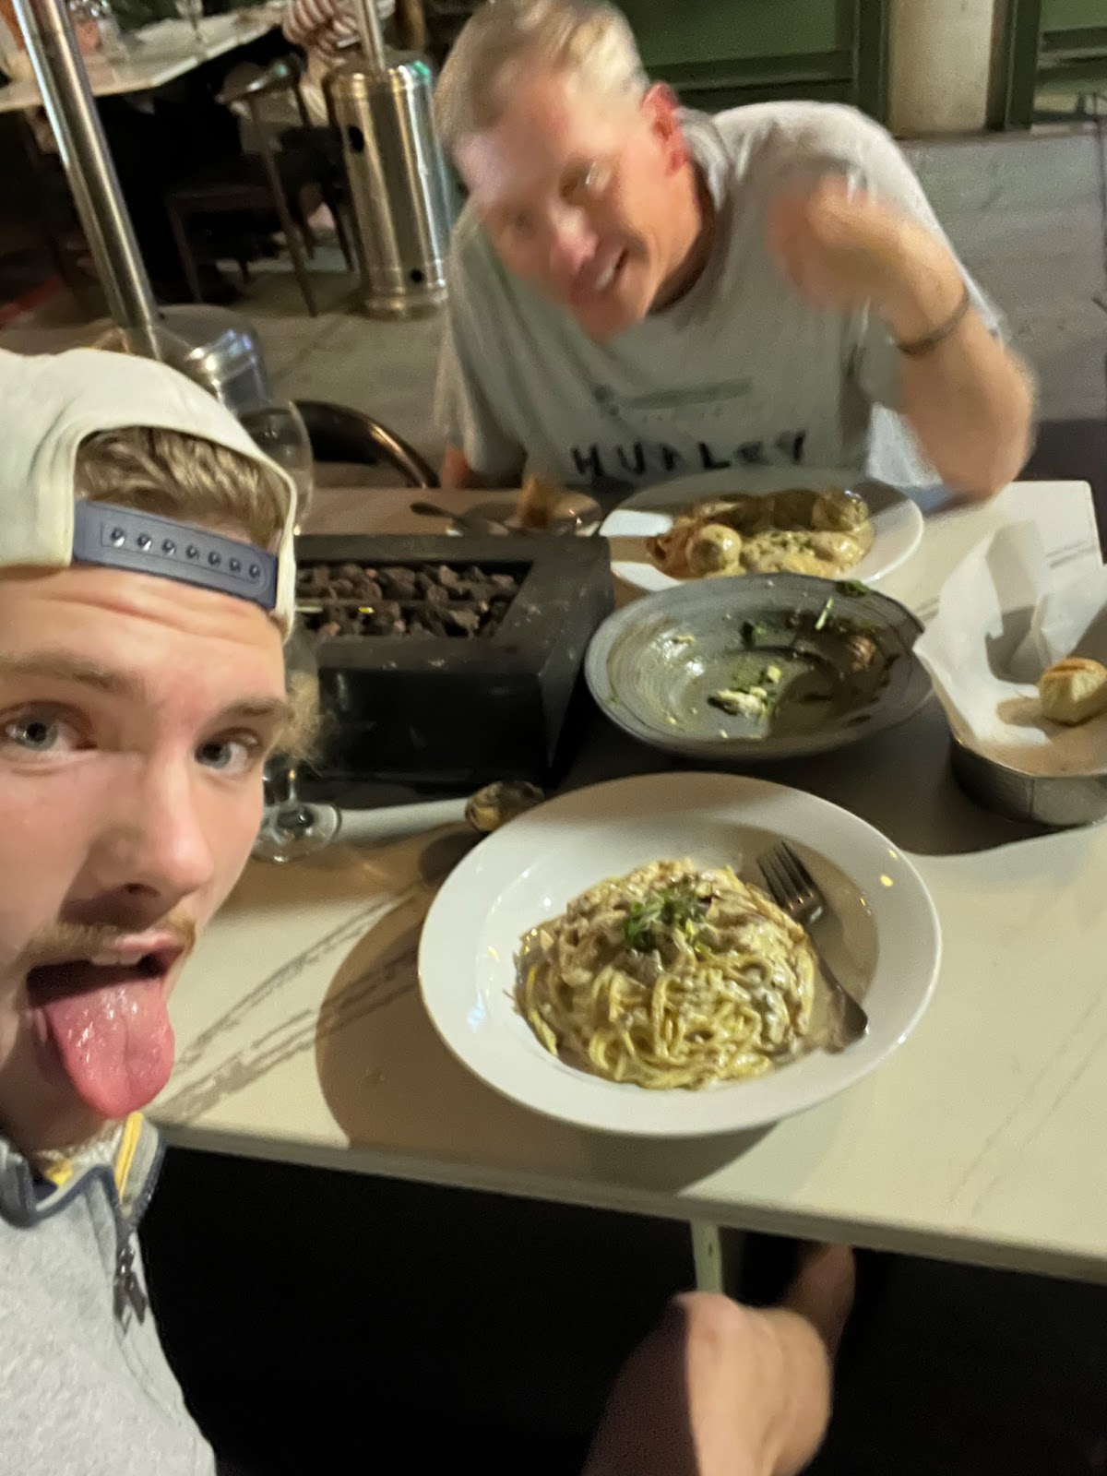
Positive Experiences That Touched Your Life
Dad came to visit, and we had amazing food and drinks in Little Italy, downtown.

Slide 11
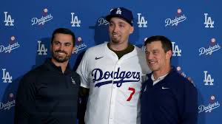
Negative Experiences You Wish Not to Experience Again
The Dodgers won the World Series and stole Tony Snell, the Giants' best pitcher, with their 'unlimited money glitch' management.

Slide 12


Negative Experiences You Wish Not to Experience Again
Rejected from countless internships I applied to.

Slide 13

Highlighted by News, Media, Advertisements, or Government
Trump elected as the 2024 President of the United States. This was my first election, and I felt like I had a say in our country.

Slide 14
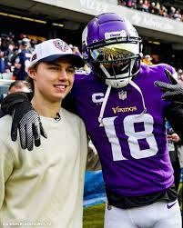
Highlighted by News, Media, Advertisements, or Government
The Vikings are 11-2, like when are the Vikings ever this good?

Slide 15
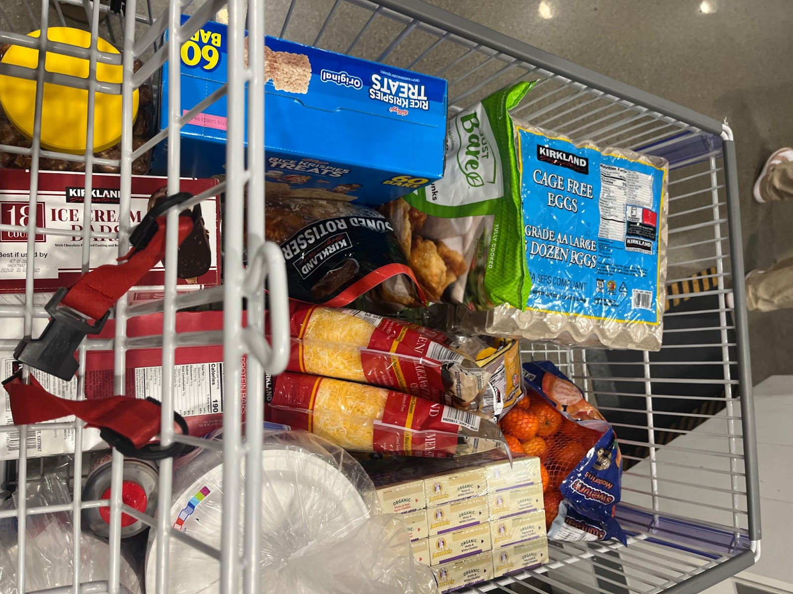
Changes to Processes (Buying Food, Laws/Restrictions)
Living in an apartment for the first time meant shopping with roommates, splitting costs, and planning meals.

Slide 16
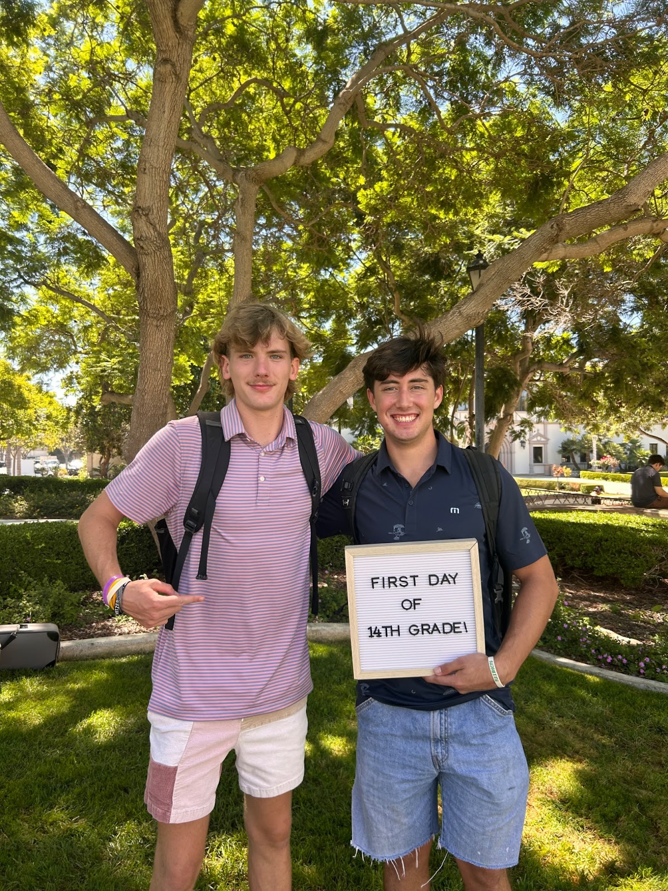
Changes to Processes (Buying Food, Laws/Restrictions)
Starting Sophomore year came with new challenges, freedoms, and opportunities.

Slide 17
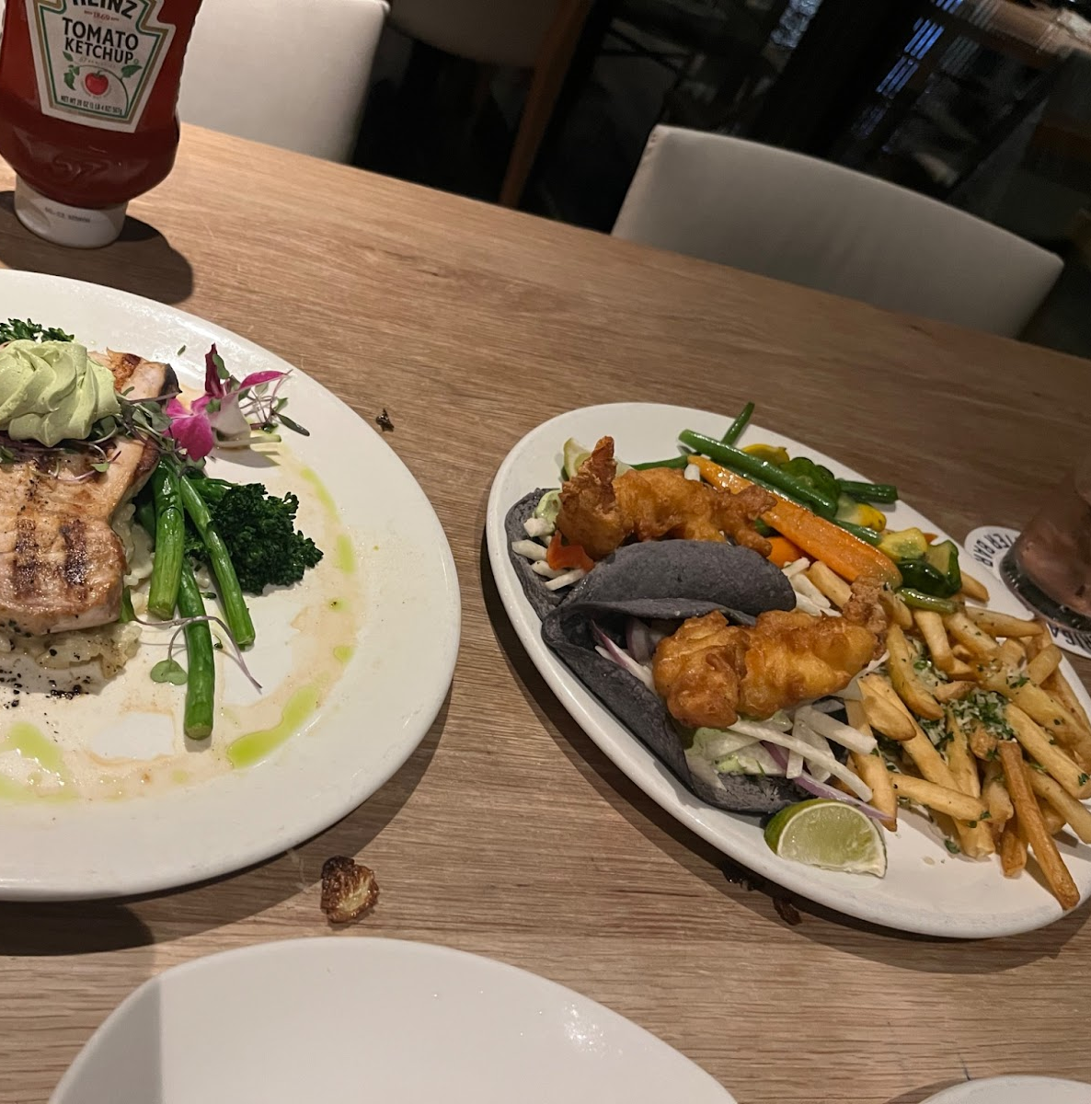
People's Creativity to Assist Others
Dinner that was bought for me on my birthday
my favorite meal—swordfish and lobster.

Slide 18
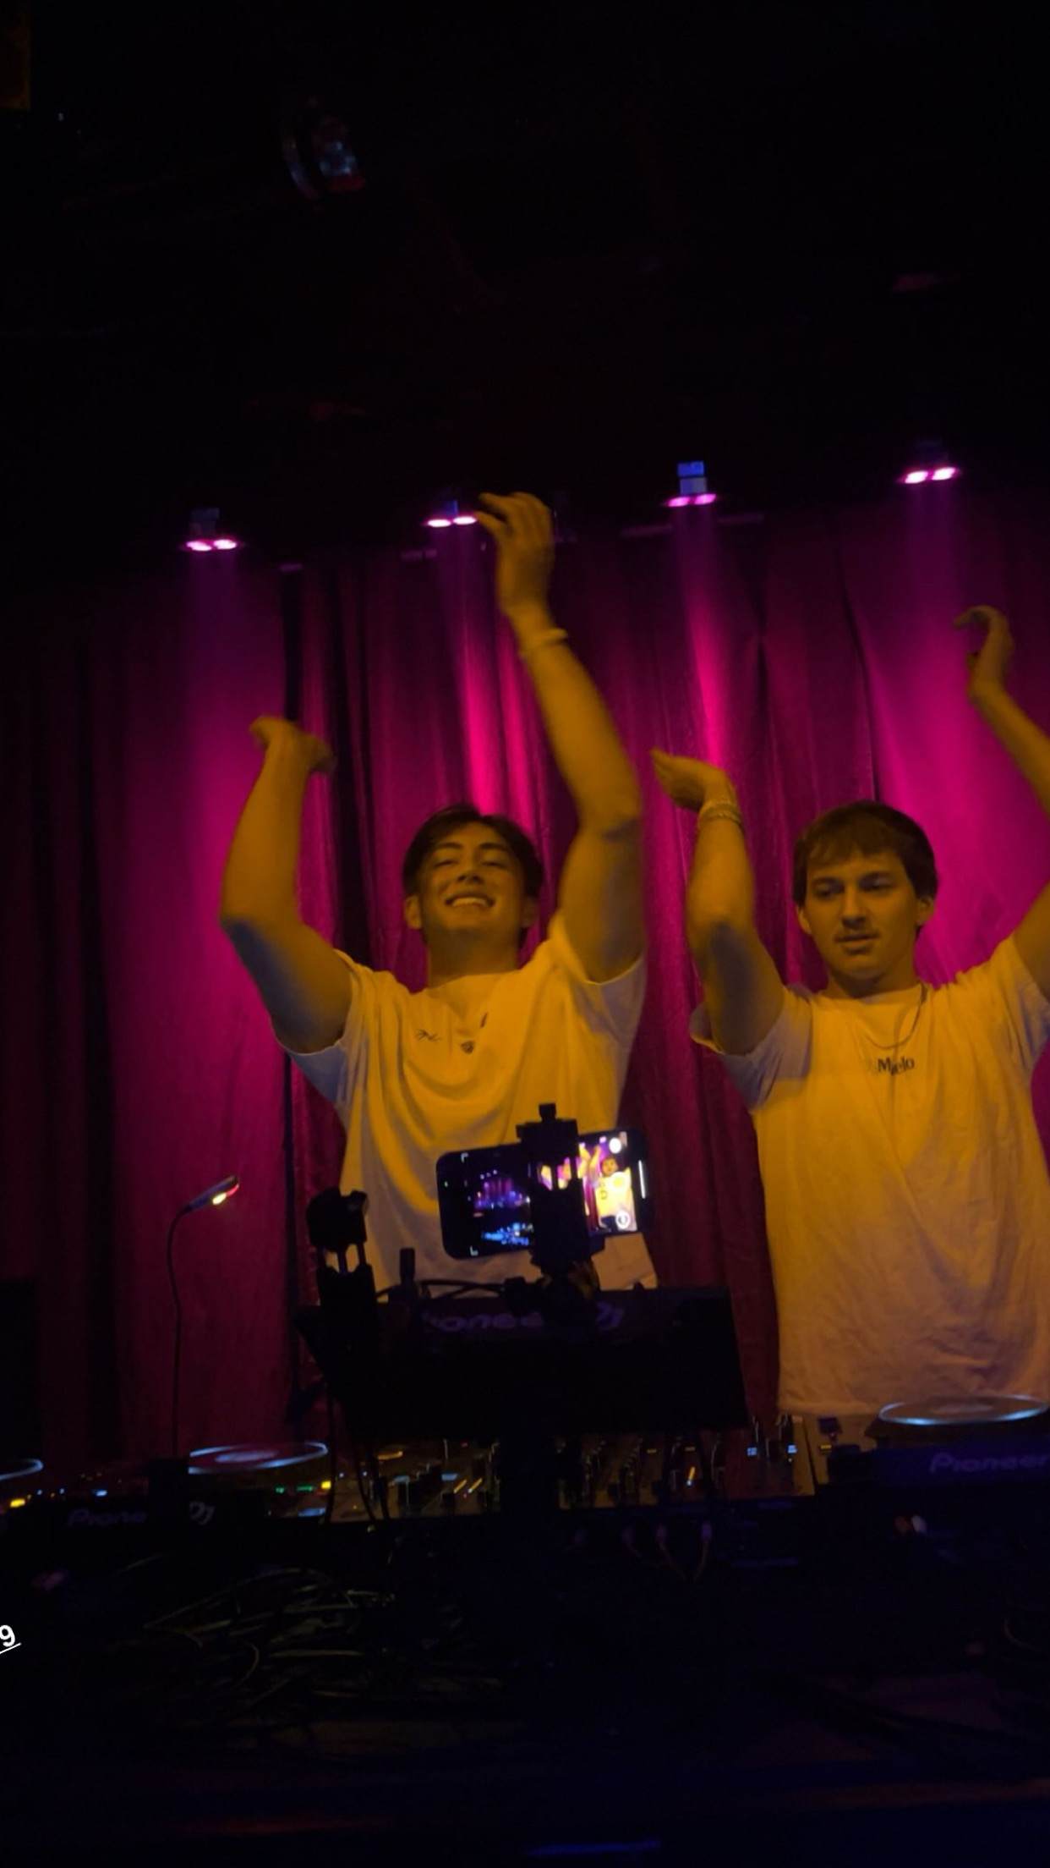
People's Creativity to Assist Others
I went to support my friend his first time playing at a club.

Slide 19
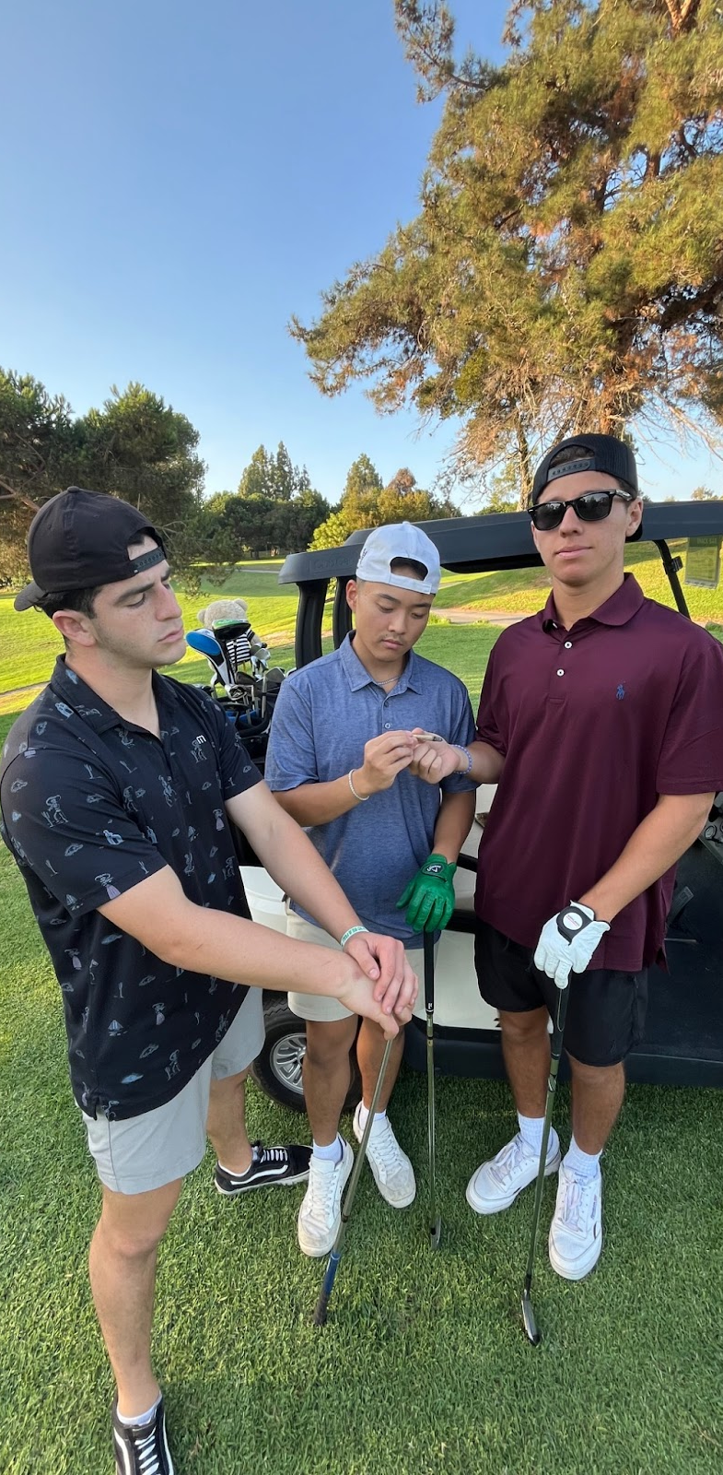

Reflections on the Semester
Spent lots of time with roommates, went on trips, and golfed—a fun activity we did frequently.

