Slide 1
Time Capsule
By Eduardo Pescatore

Slide 2
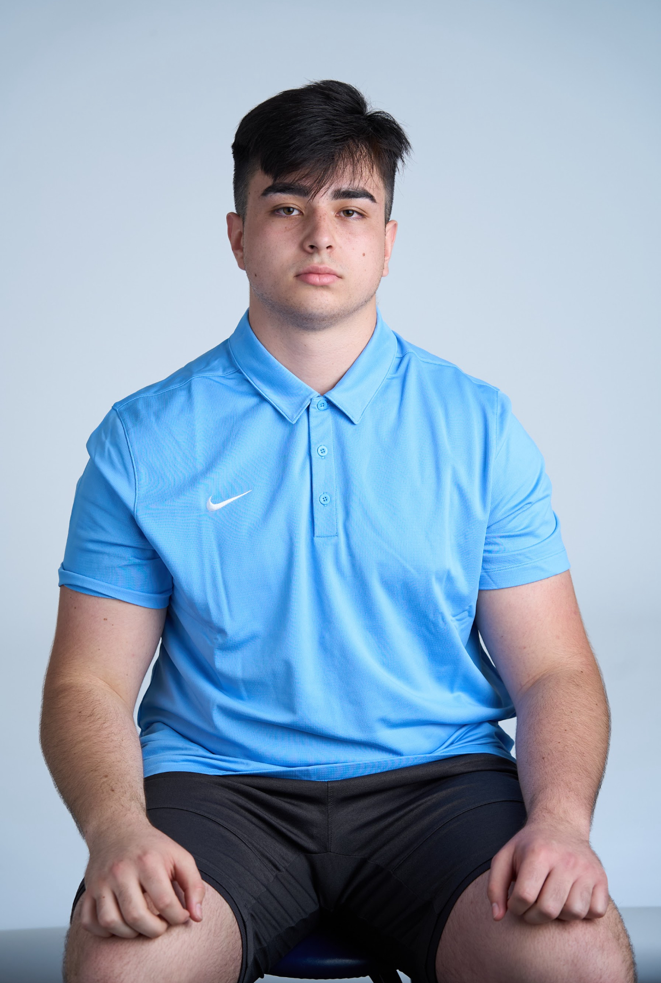
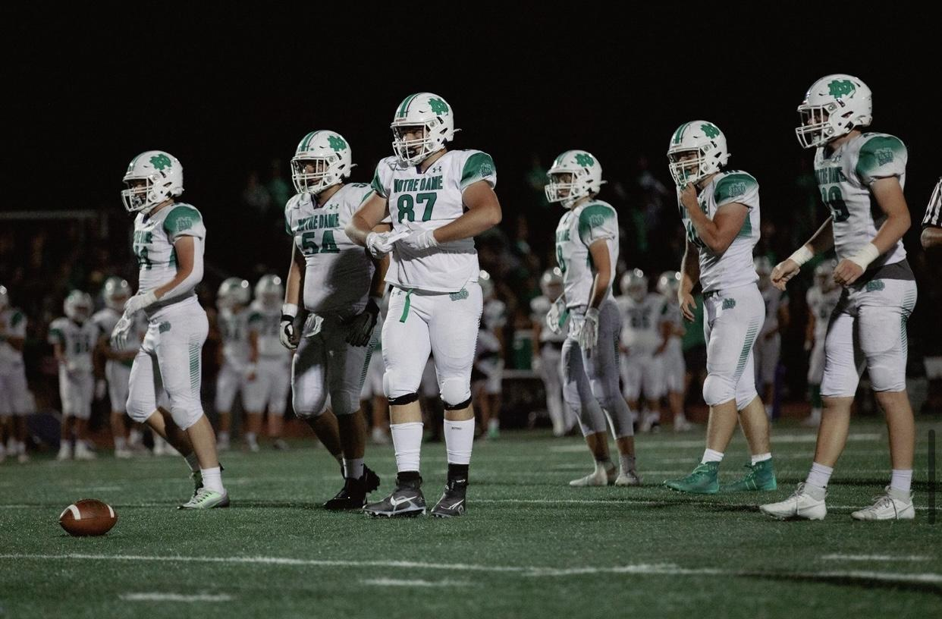
Past Changes
Coming from Chicago, USD was a clear change.

Slide 3
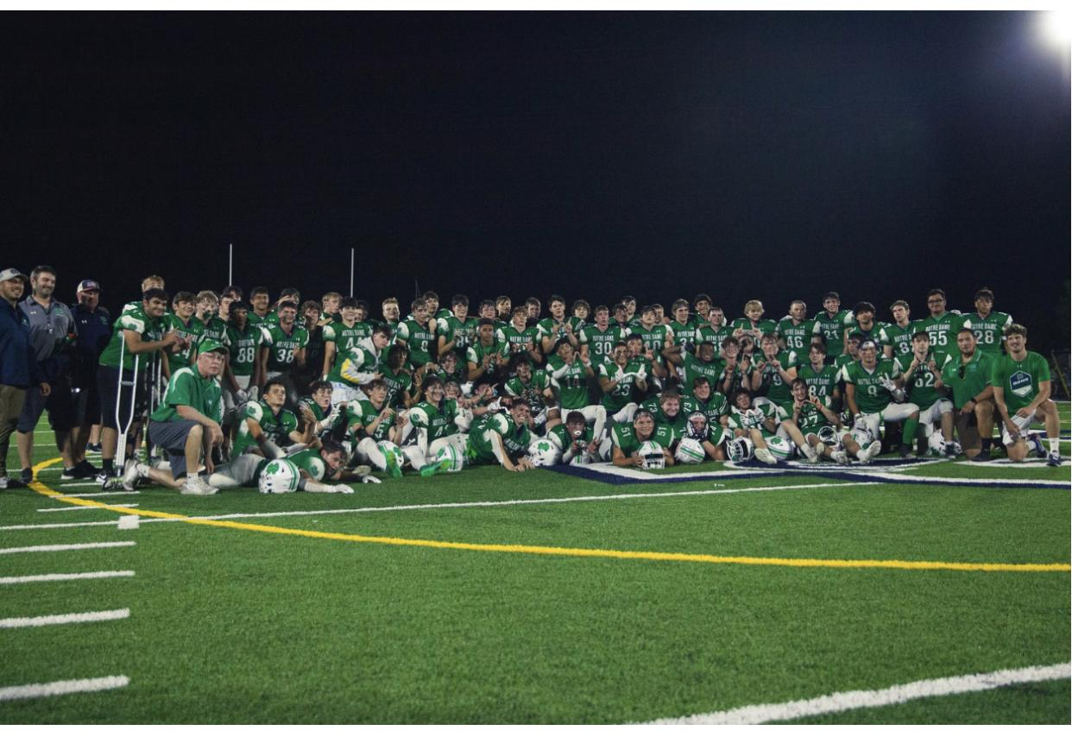
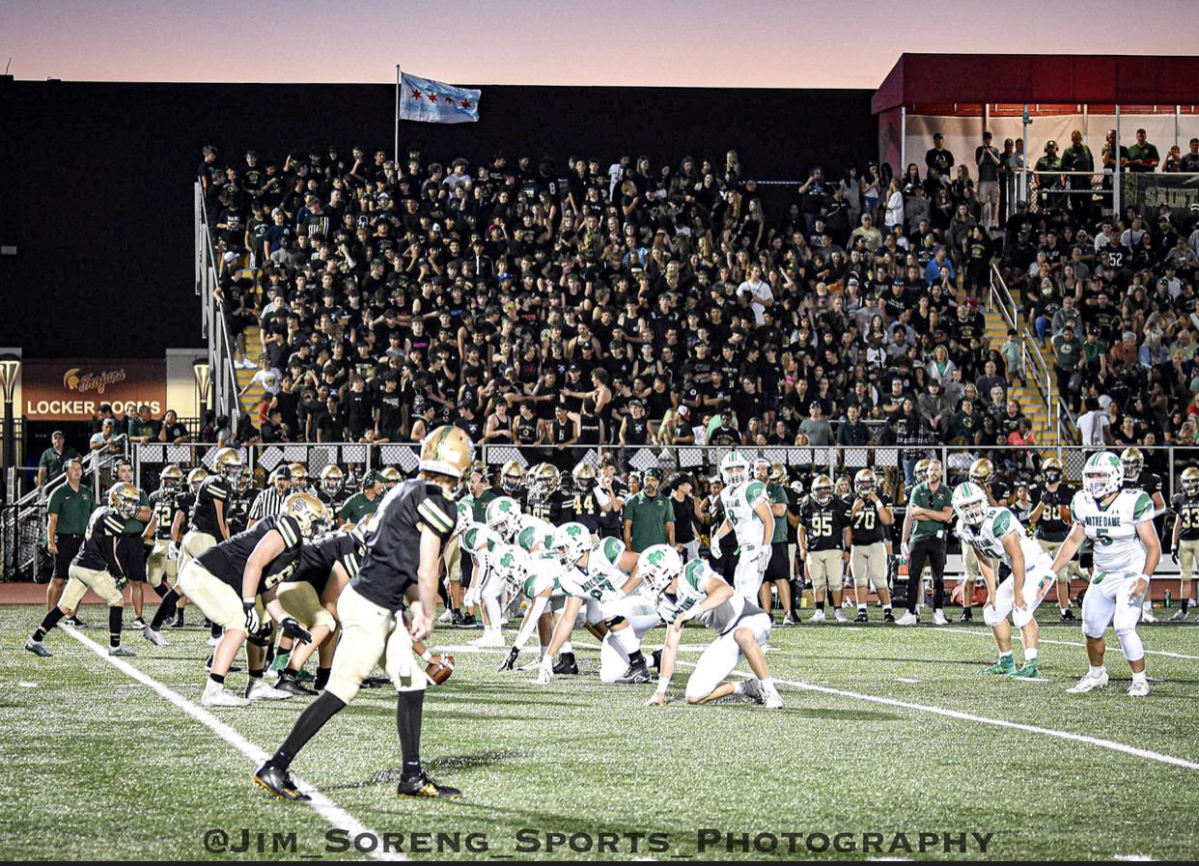
Past Changes:
Had great times back home, but was ready for change.

Slide 4
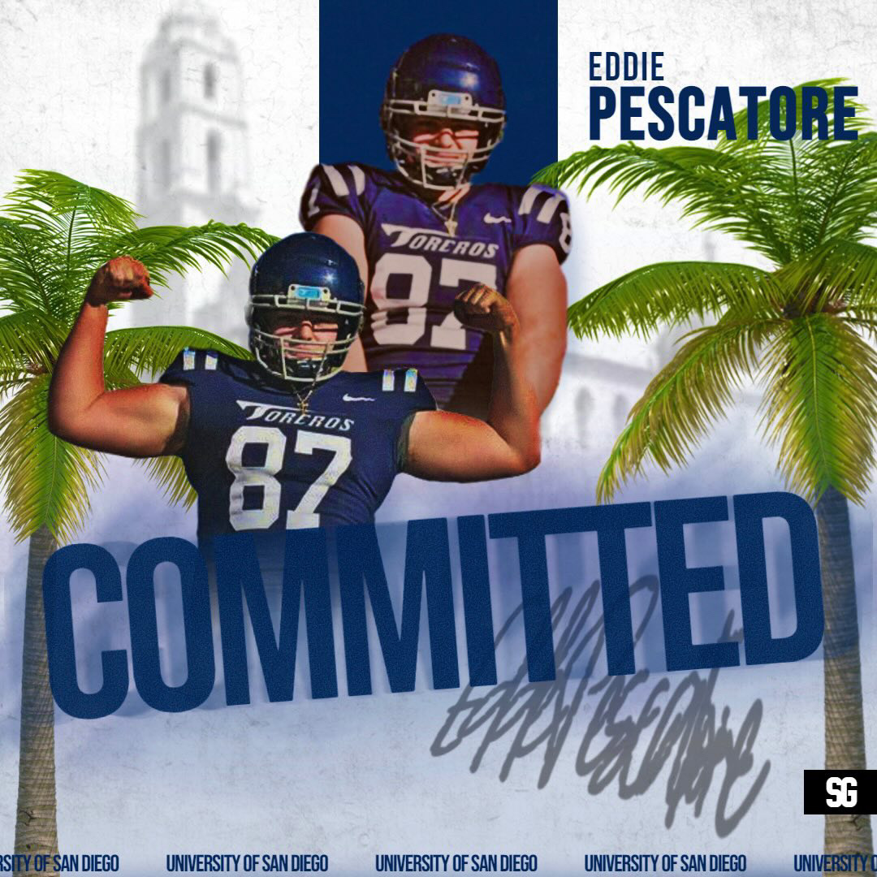
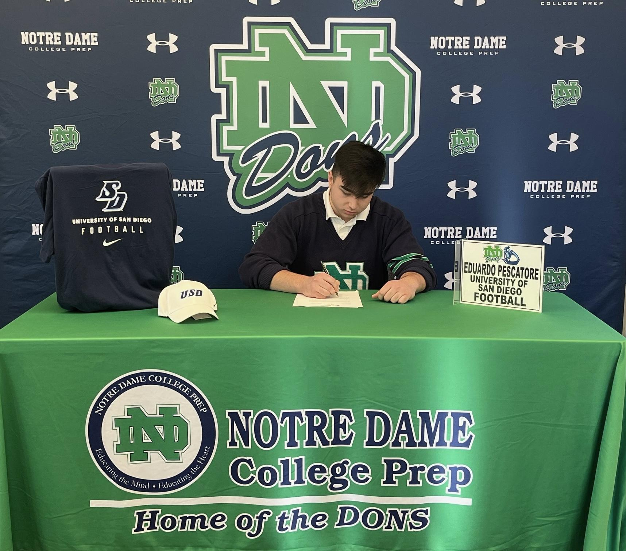
Past Changes:
USD was the right place for me.

Slide 5
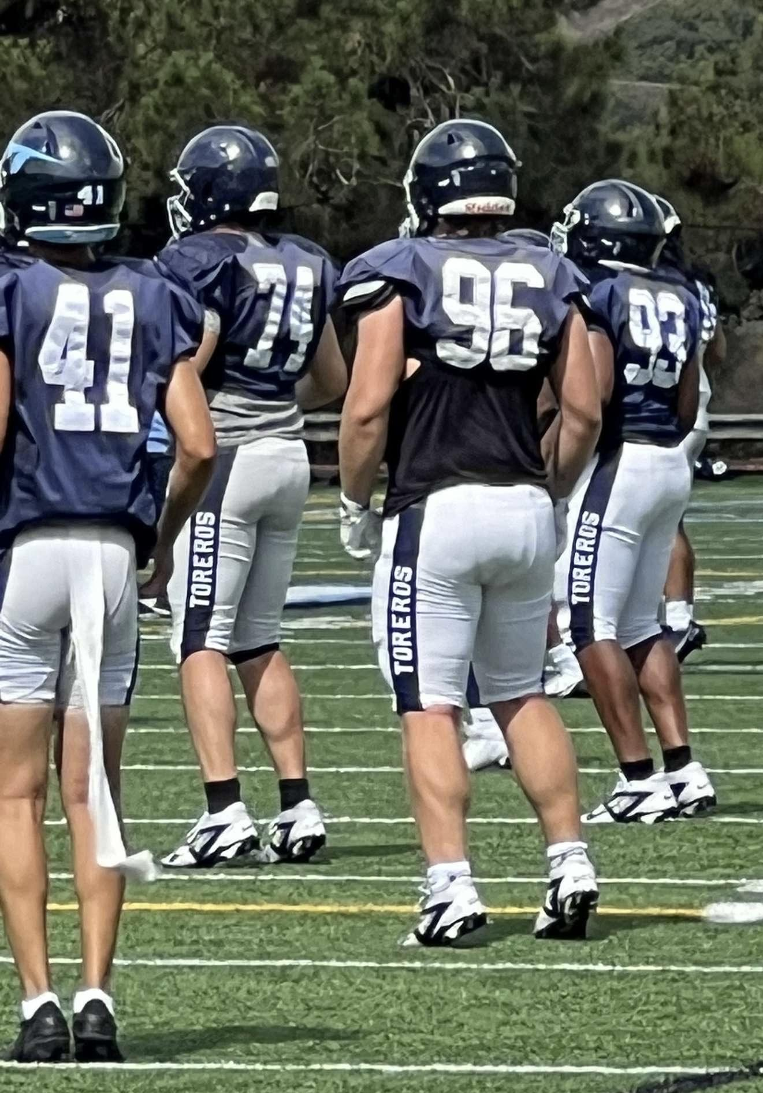
Items that happened in the semester:
Came to USD in July of 2024 for fall camp.
Was pretty tough but had a good time.

Slide 6
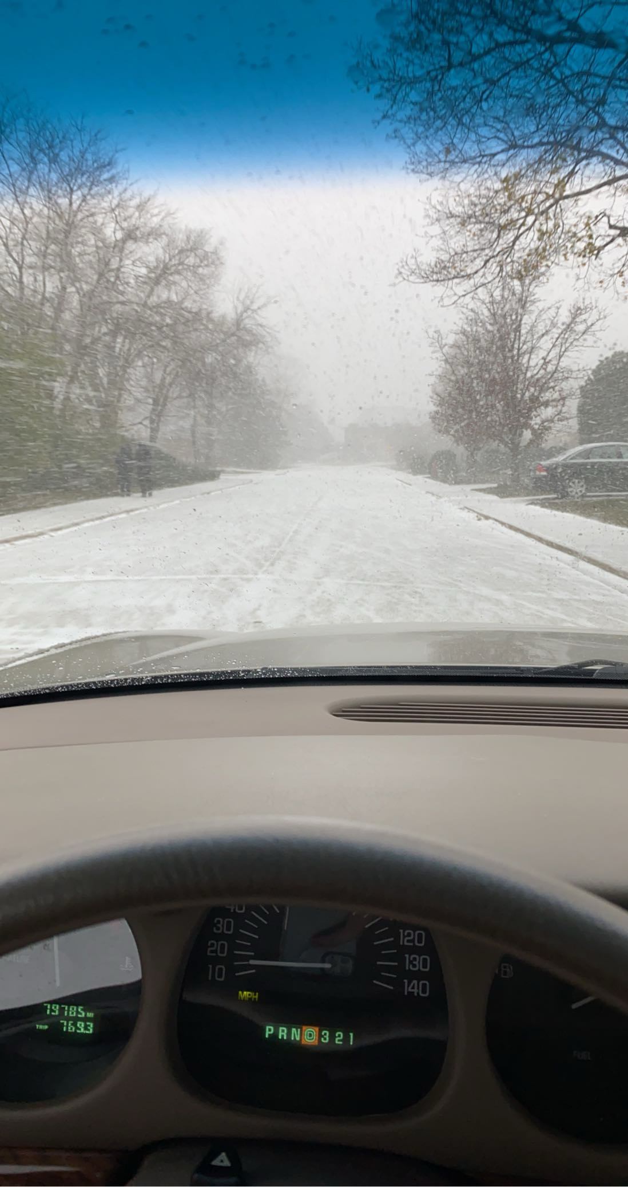
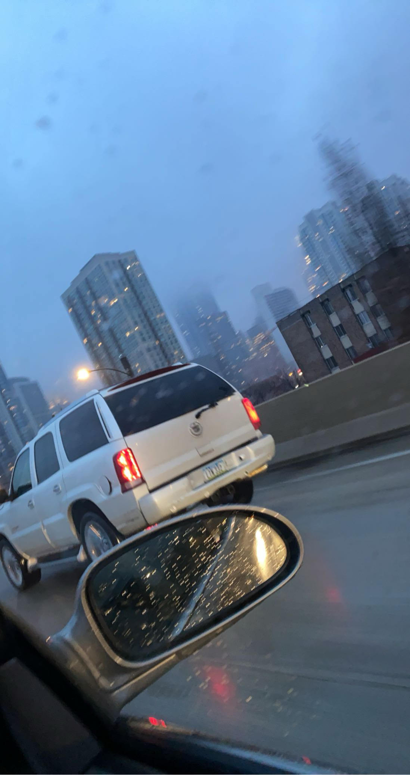
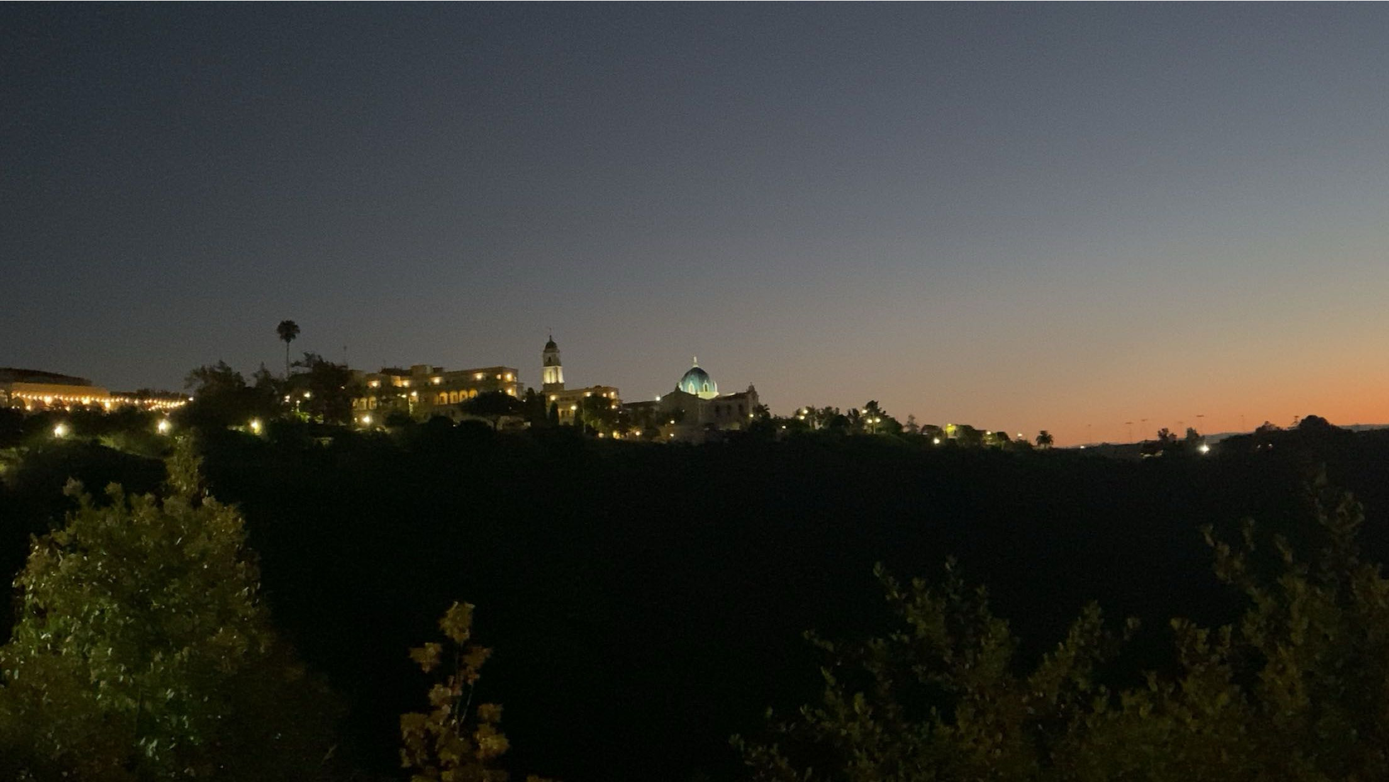
Items that happened in the semester:
San Diego was definitely different from Chicago and it was a nice change.

Slide 7
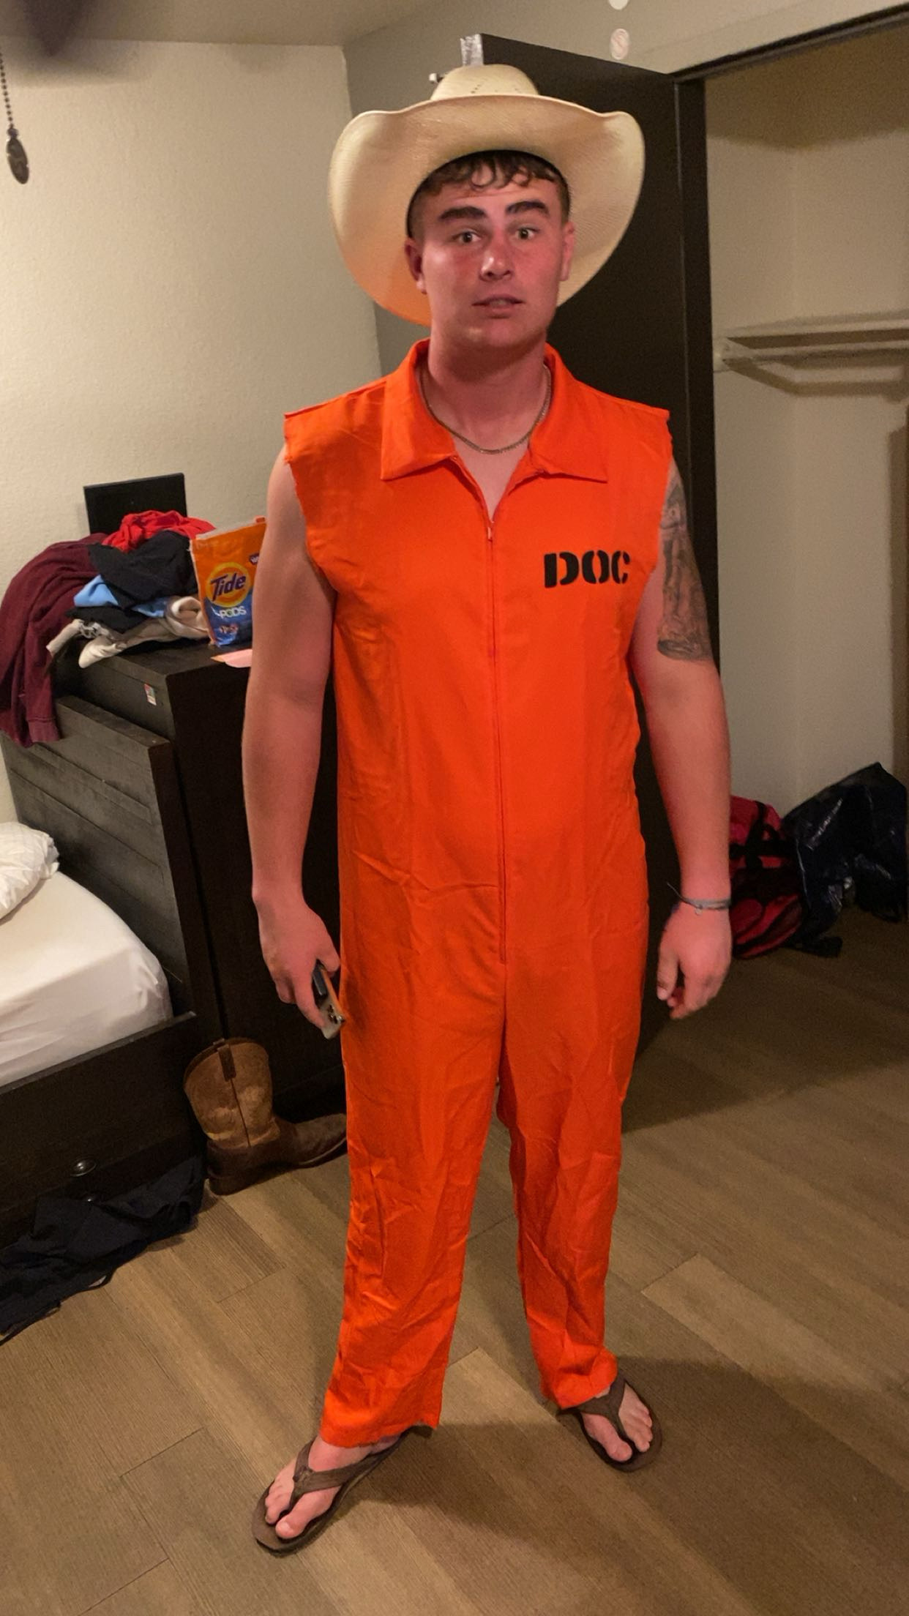
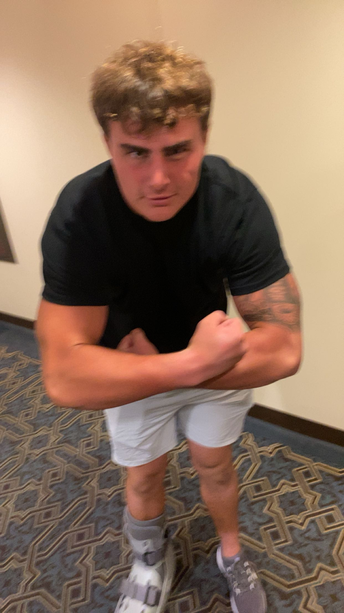
Items that happened in the semester:
Met my roommate for the first time.
Became pretty close and did many things.

Slide 8
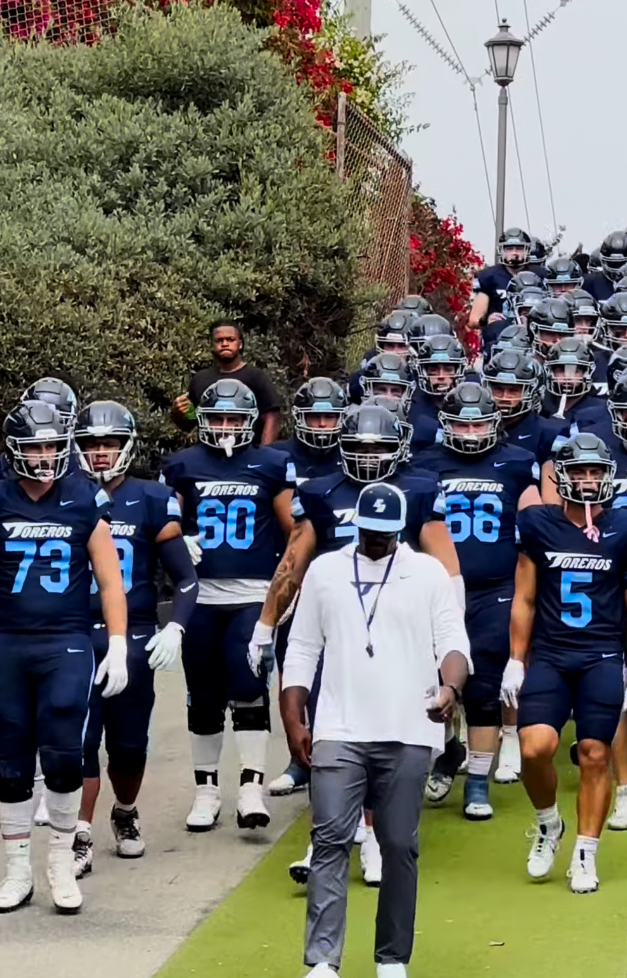
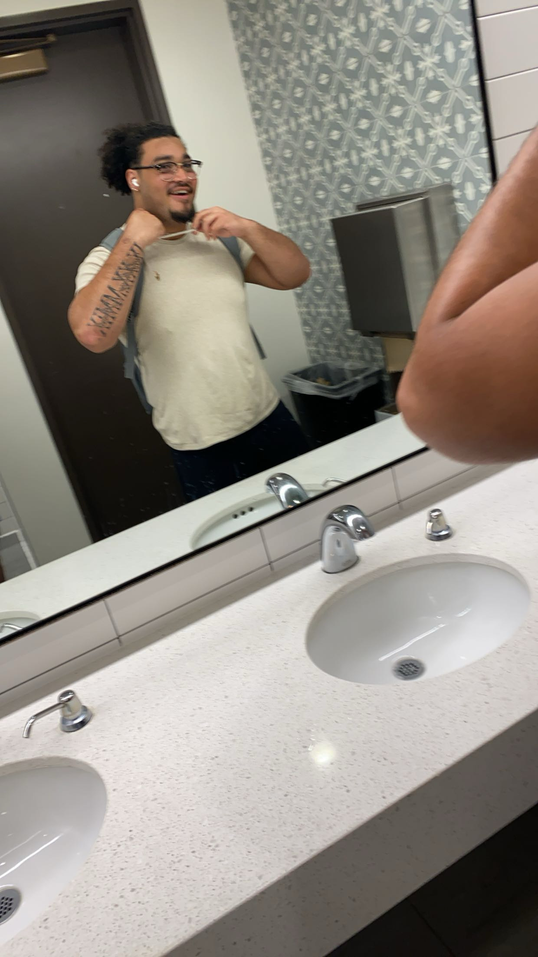
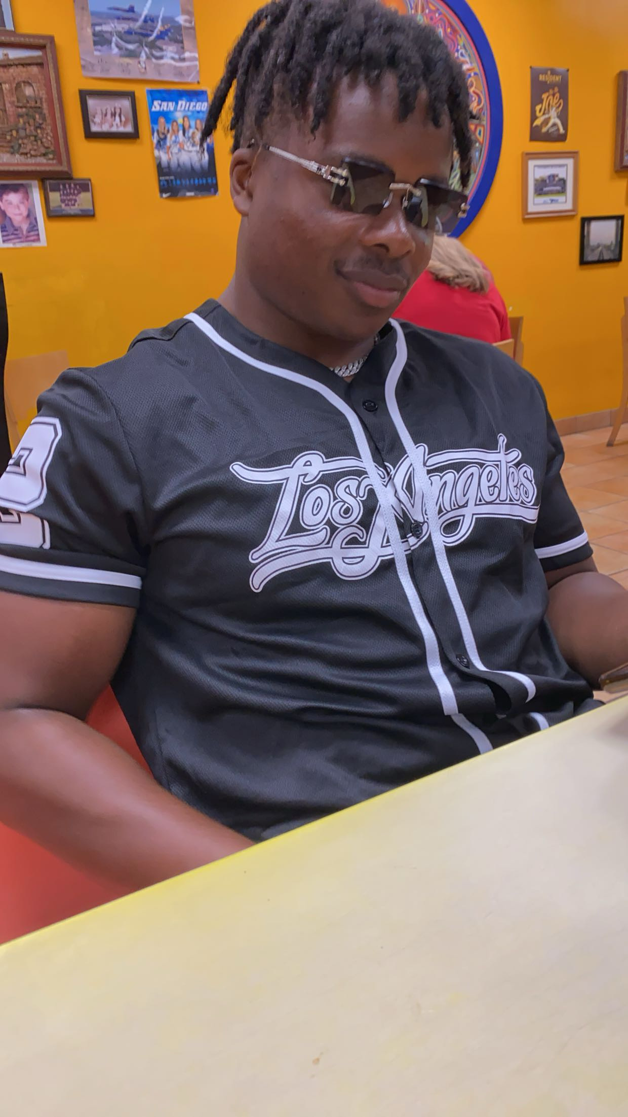
Items that happened in the semester:
Made new friends and connected with the team.
Football was a large part of meeting new people.

Slide 9
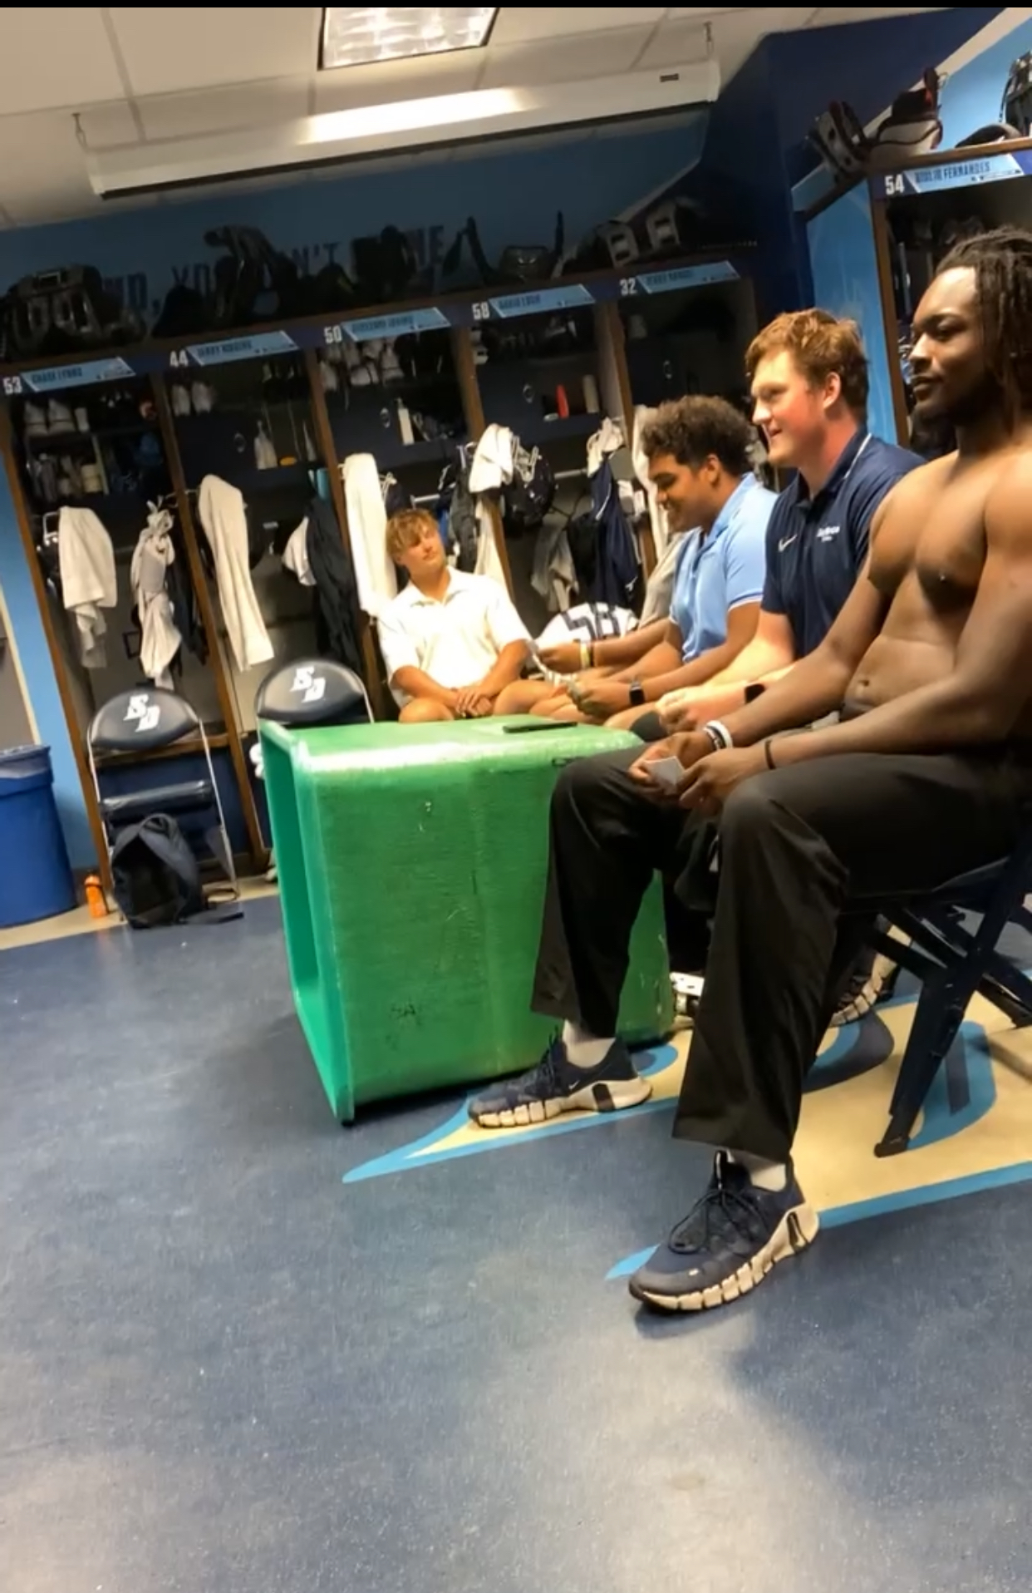
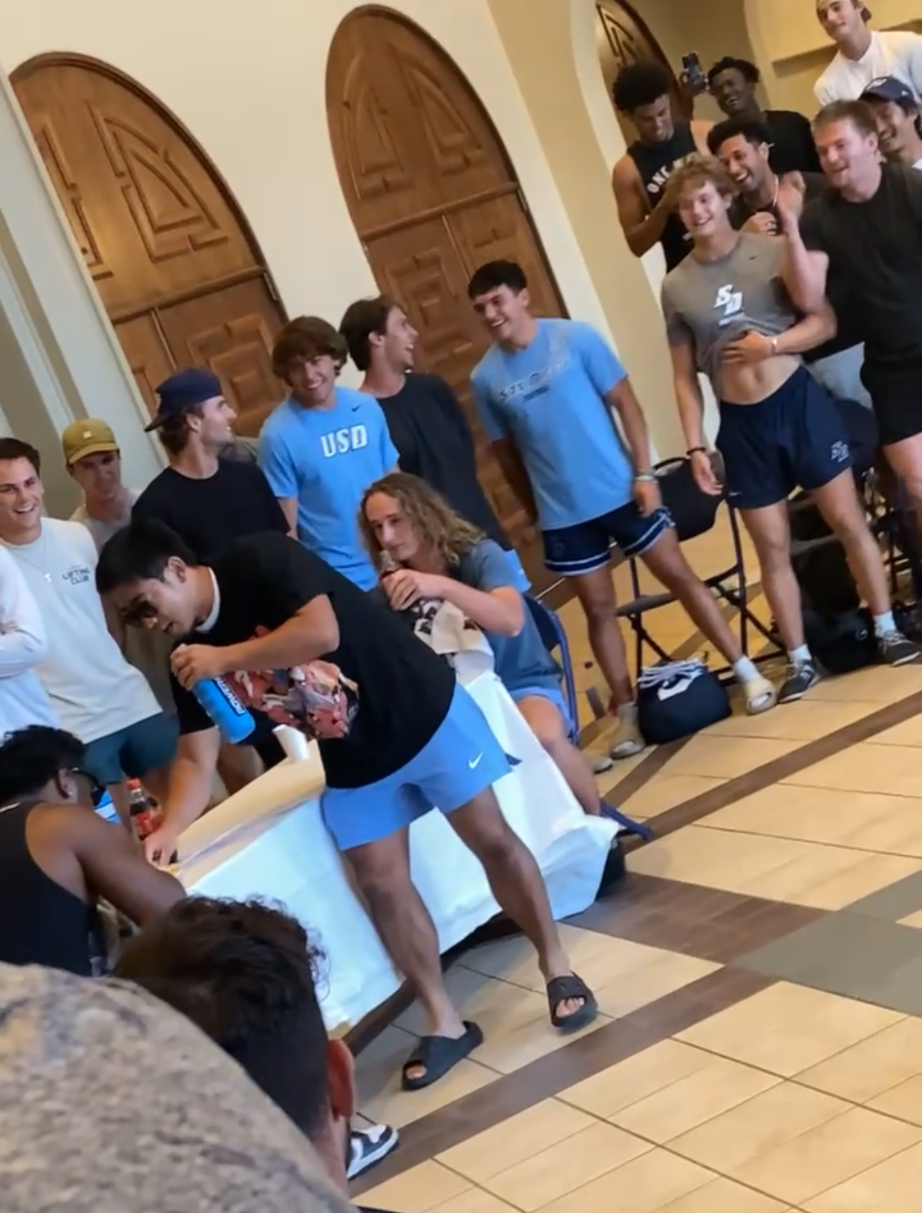
Items that happened in the semester:
Did a lot of team building and we became very close.
All the silly things really made us trust each other.

Slide 10
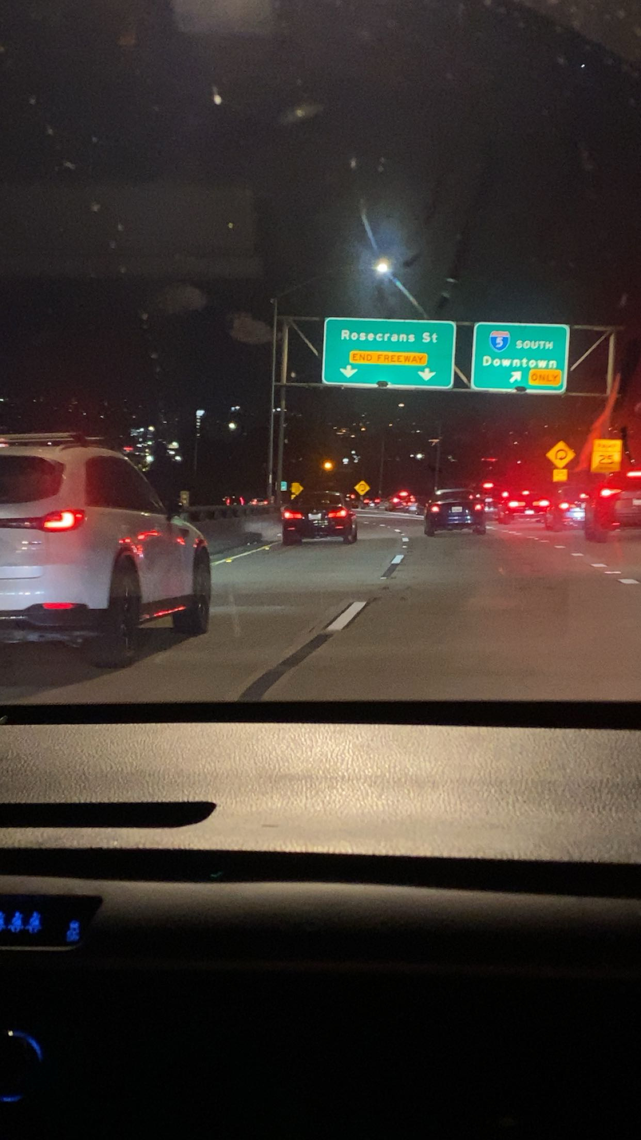
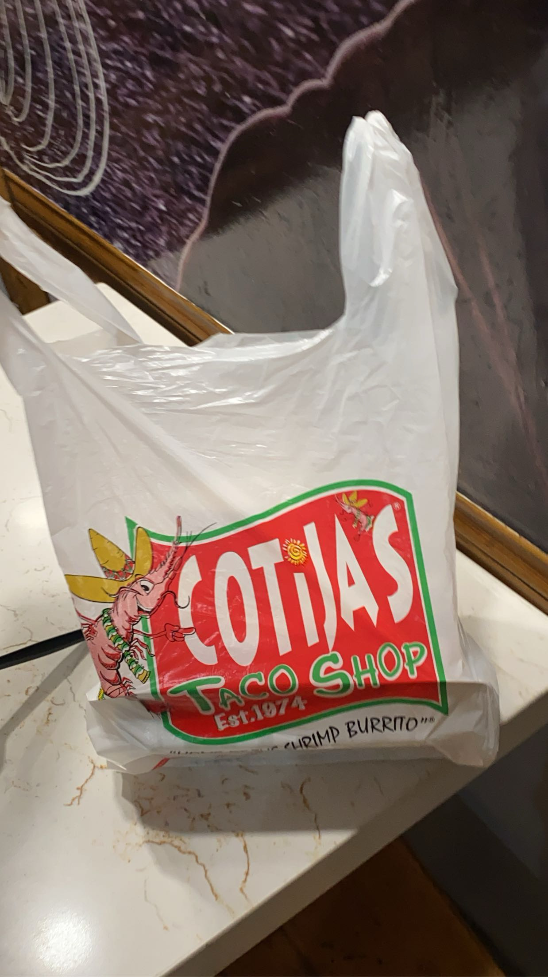
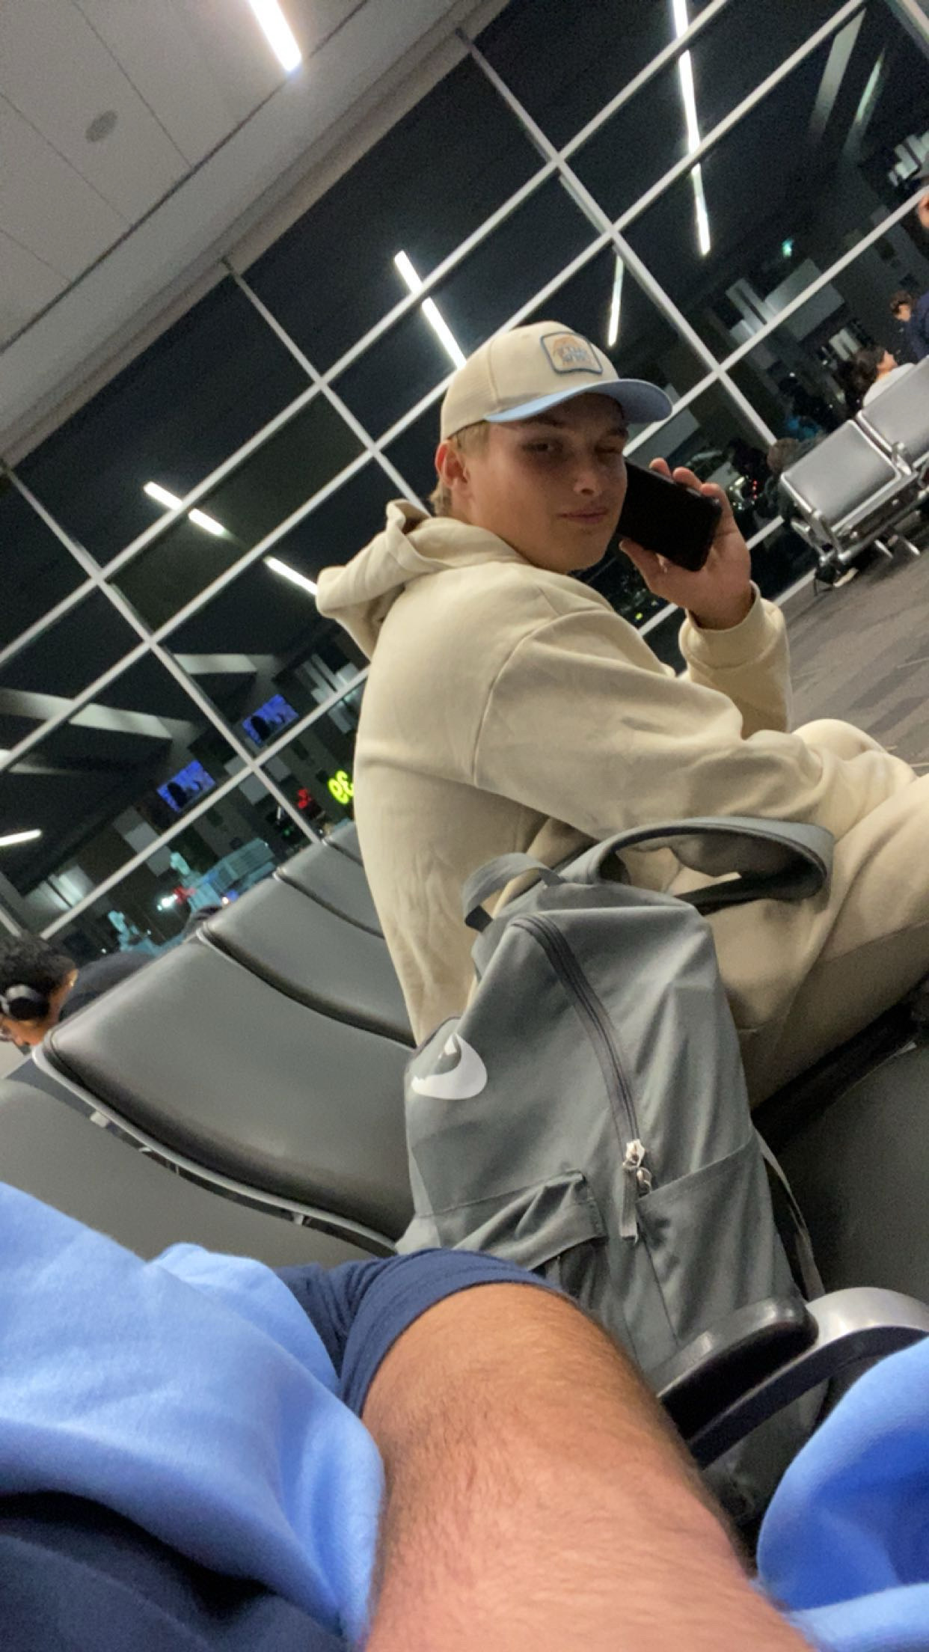
Items that happened in the semester:
Ate a lot of food and went to new places.
Travelled throughout San Diego and out of state.

Slide 11
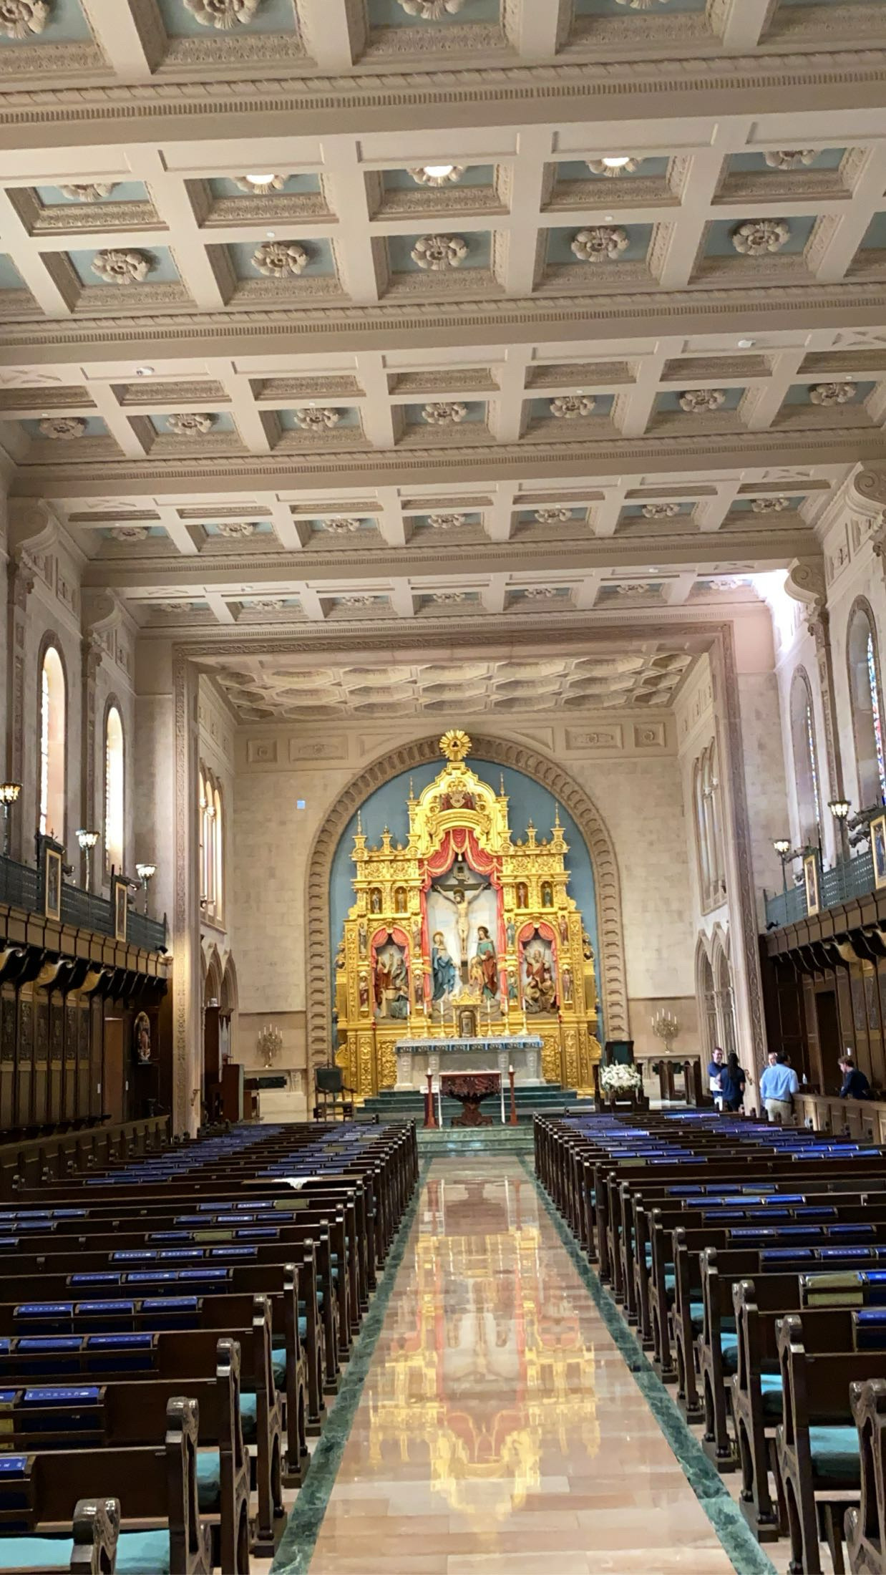
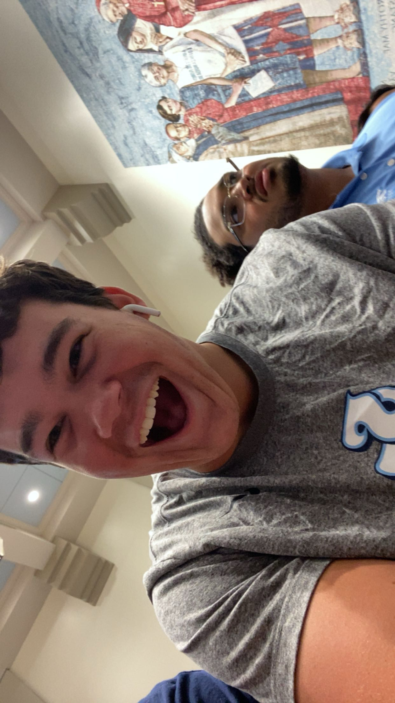
Items that happened in the semester:
Went to Church a lot.

Slide 12
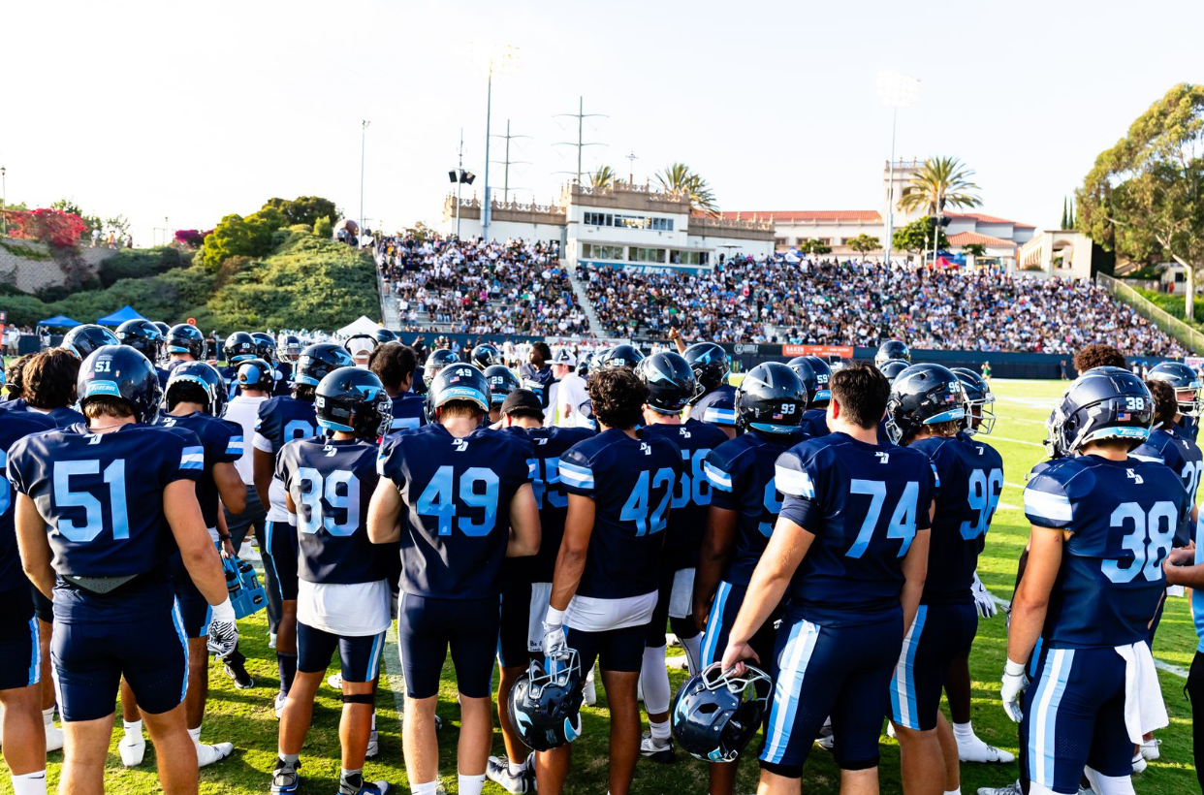
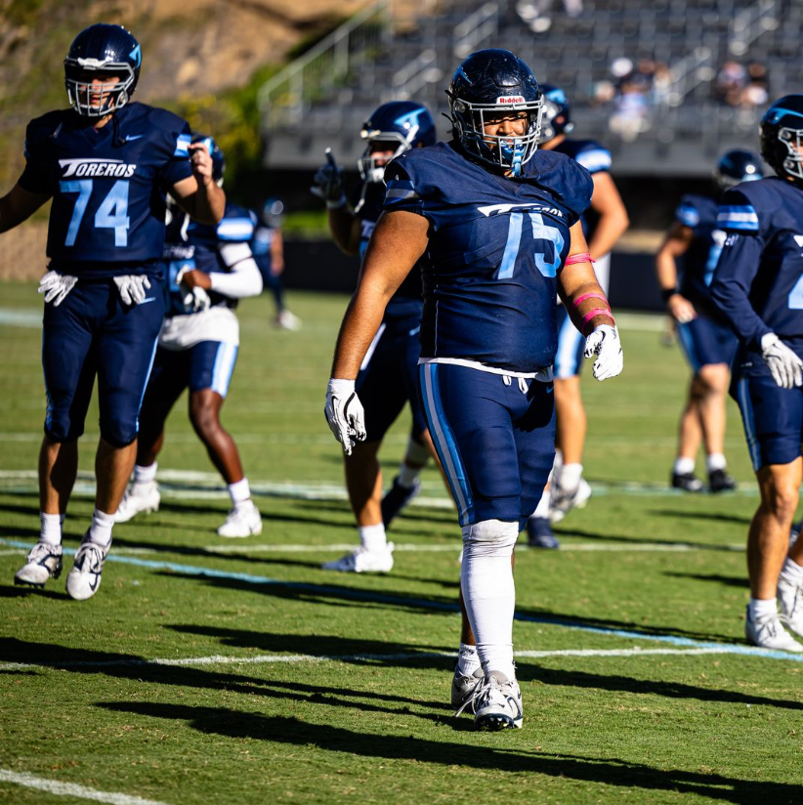
Items that did not happen but wanted:
Was not able to play a lot this season, but hope to do so next season.

Slide 13
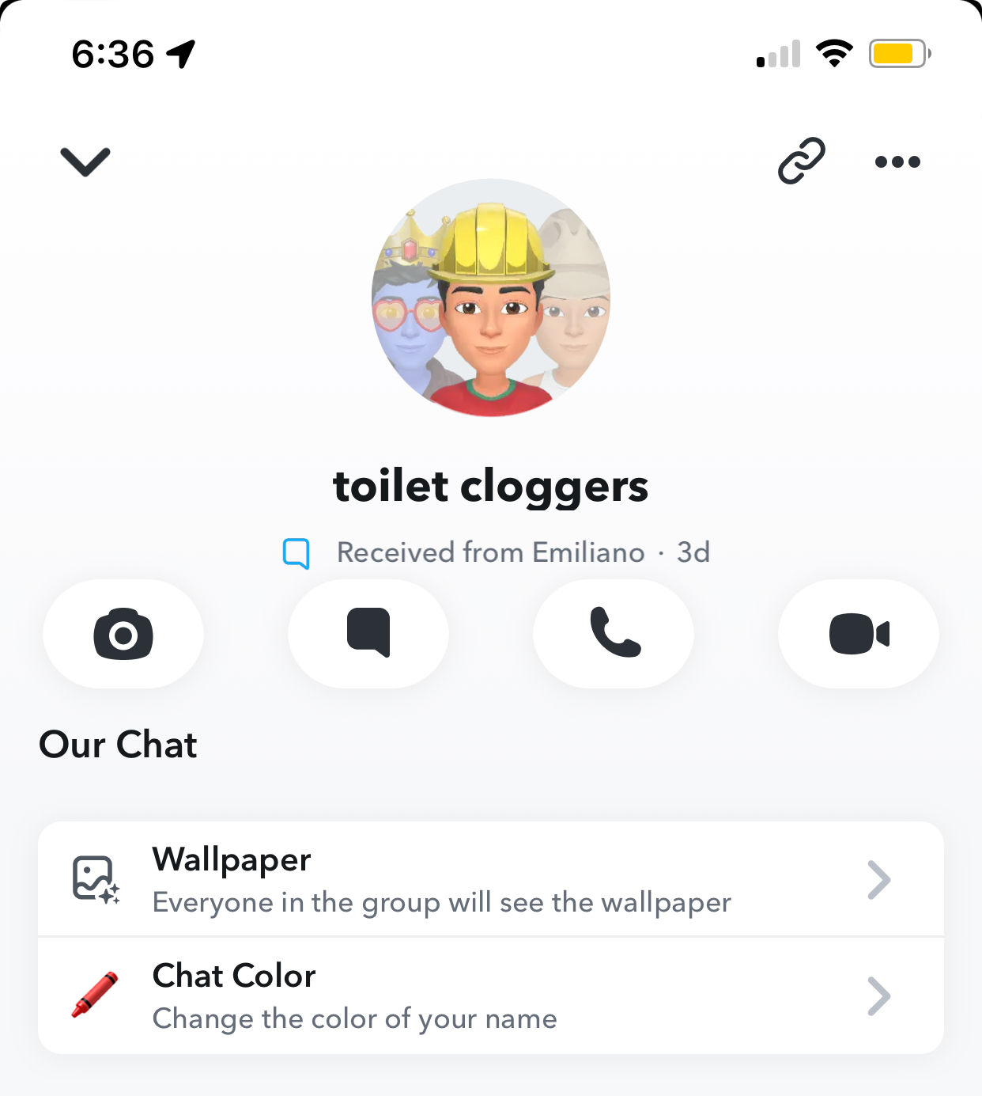
Items that I experienced that I wish to never experience again:
Toilet Cloggers

Slide 14
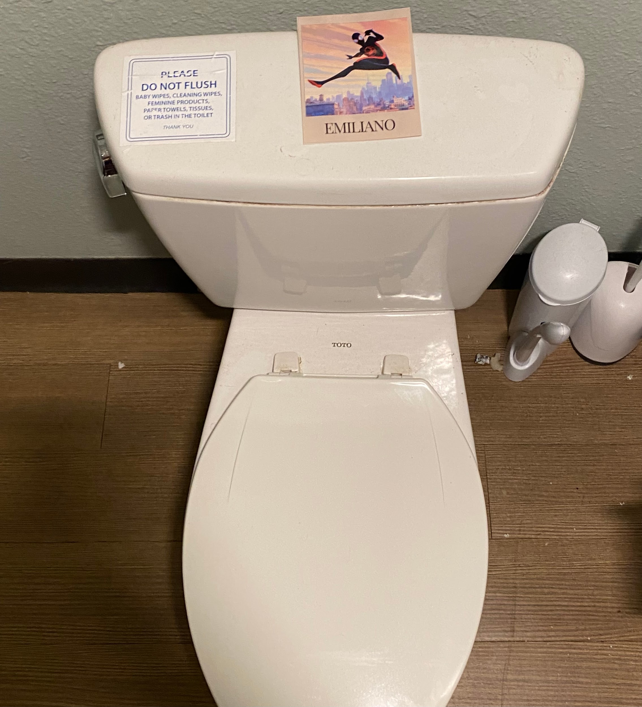
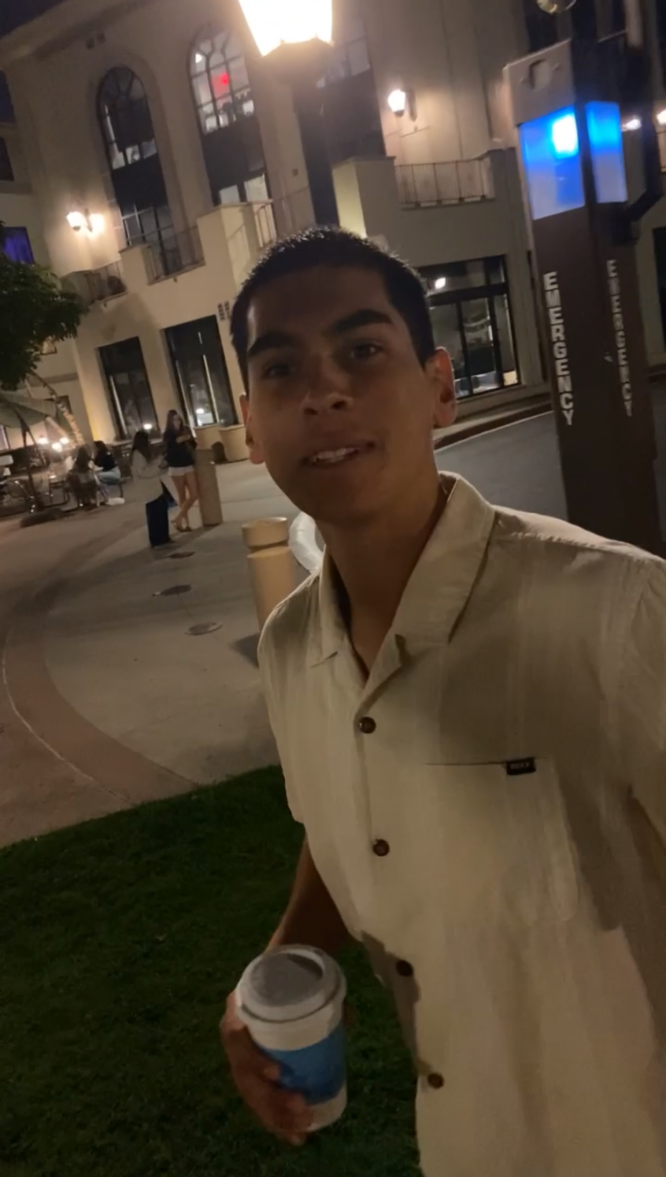
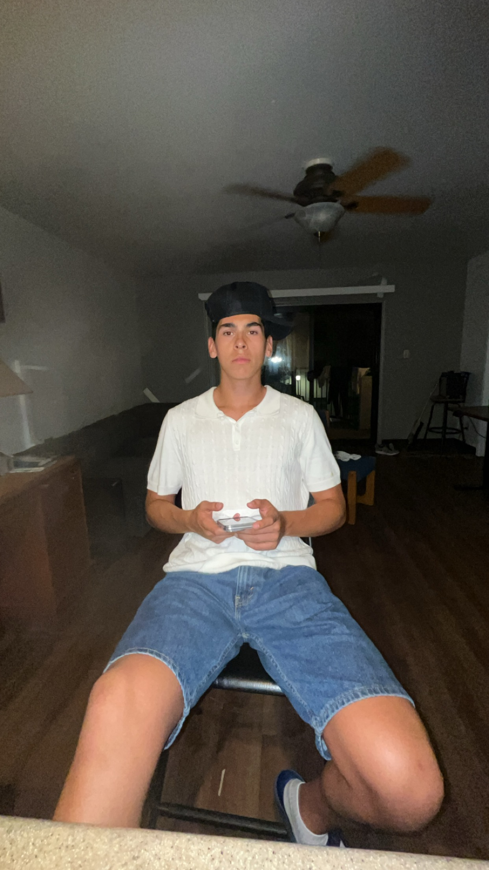
Items that I experienced that I wish to never experience again:
Happened far to often and one person was to blame —>

Slide 15
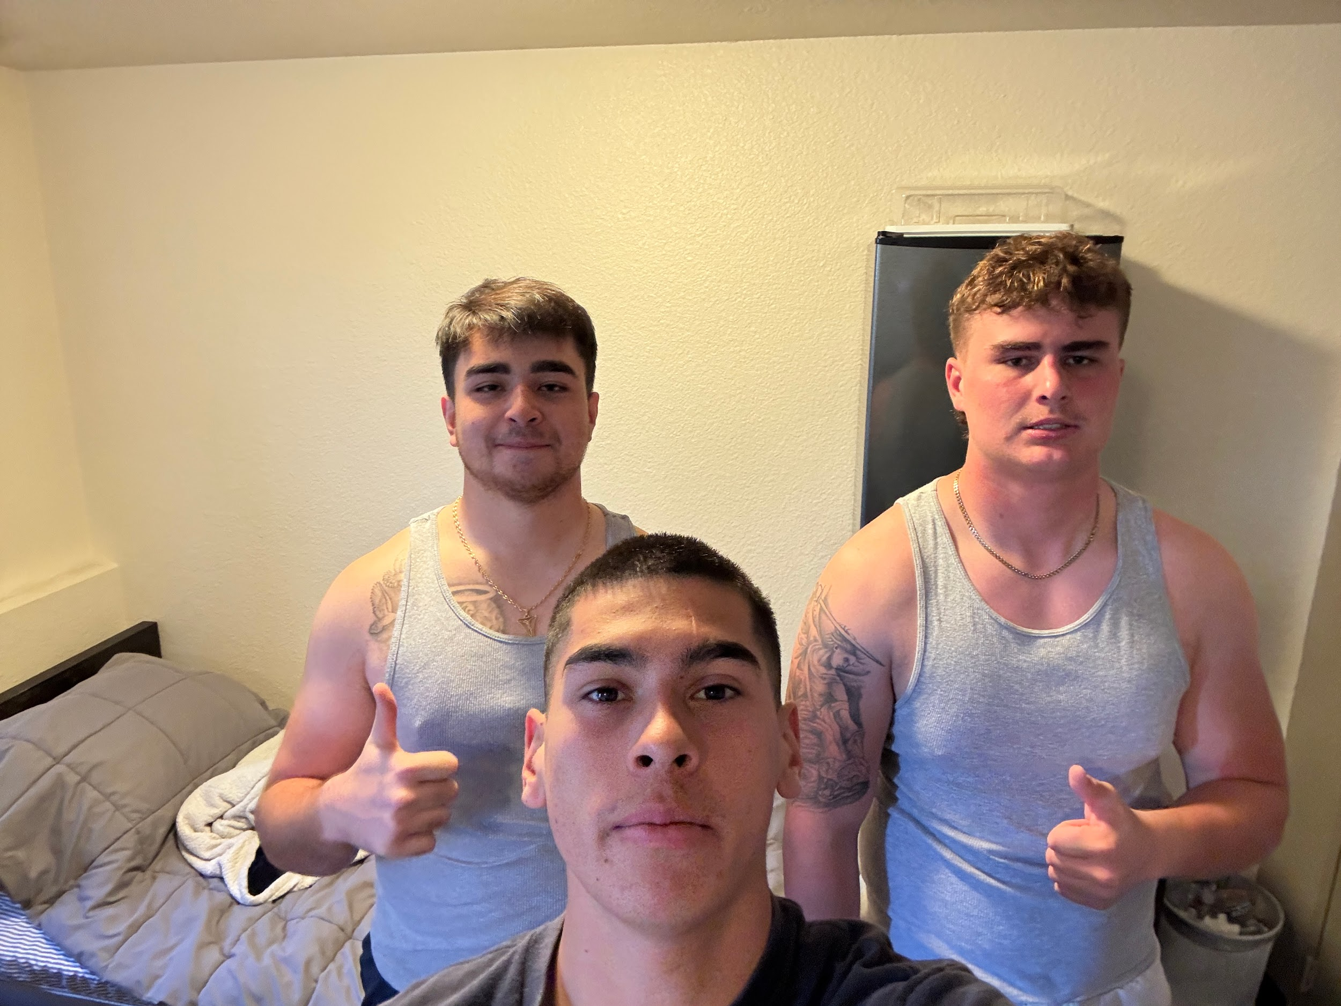
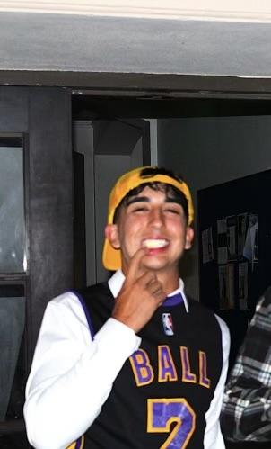
Items that I have experienced that were positive in my life.
Our suite became very close in 5909.
“We run Valley A” - Smooth-e

Slide 16
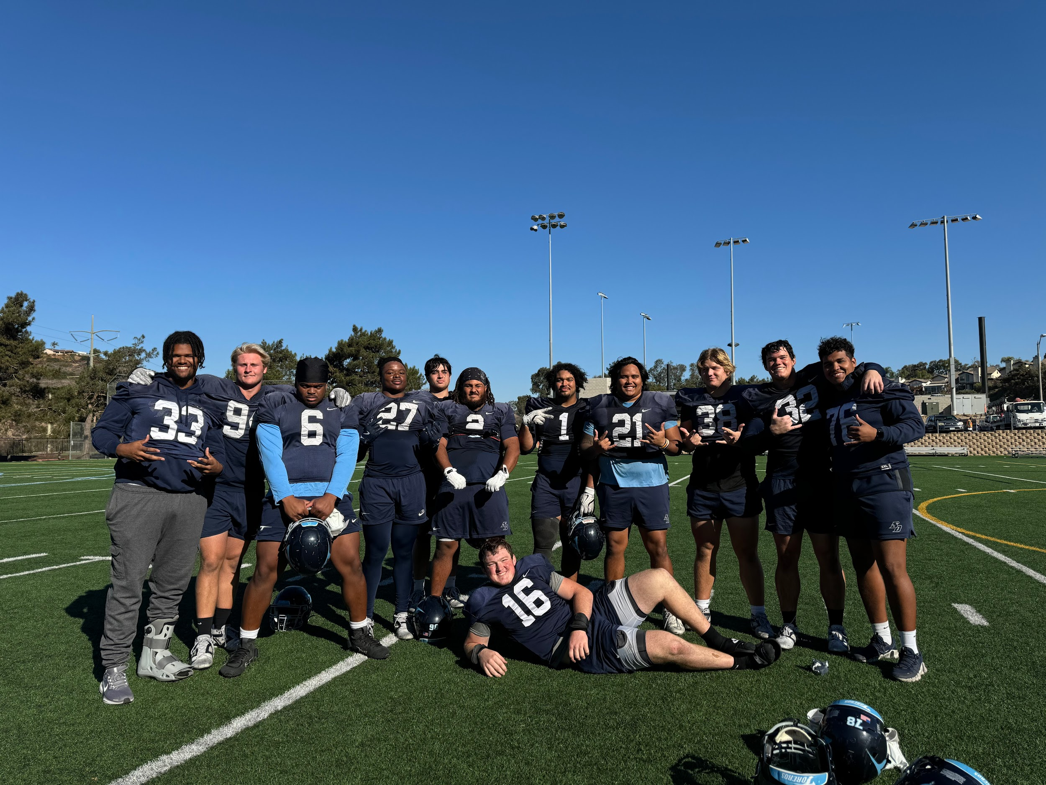
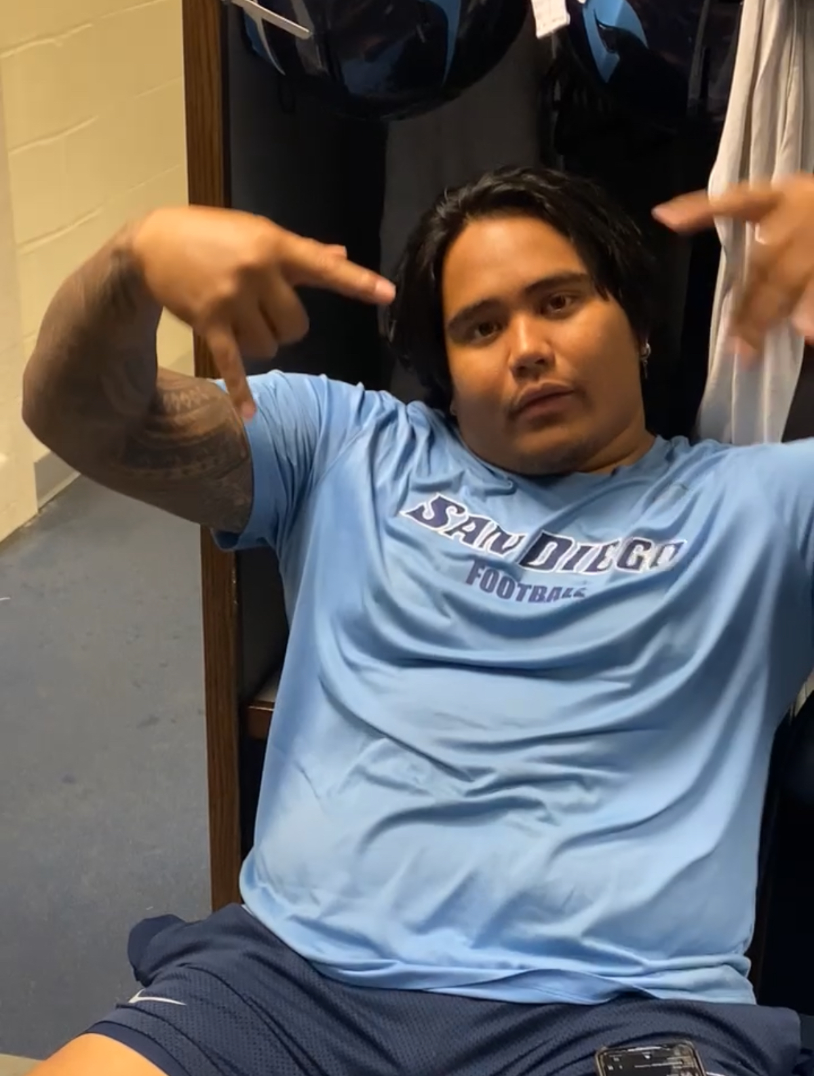
Items that I have experienced that were positive in my life.
All the new friends that were made and new experiences.

Slide 17
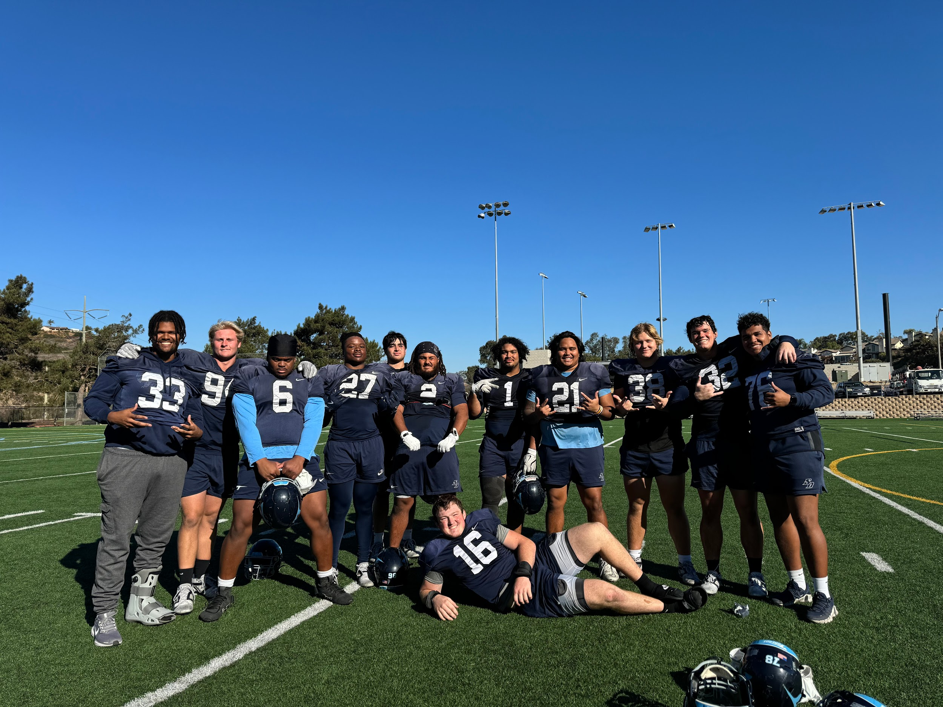
Items that I have experienced that were positive in my life.
The DLine group that will forever be my brothers.

Slide 18
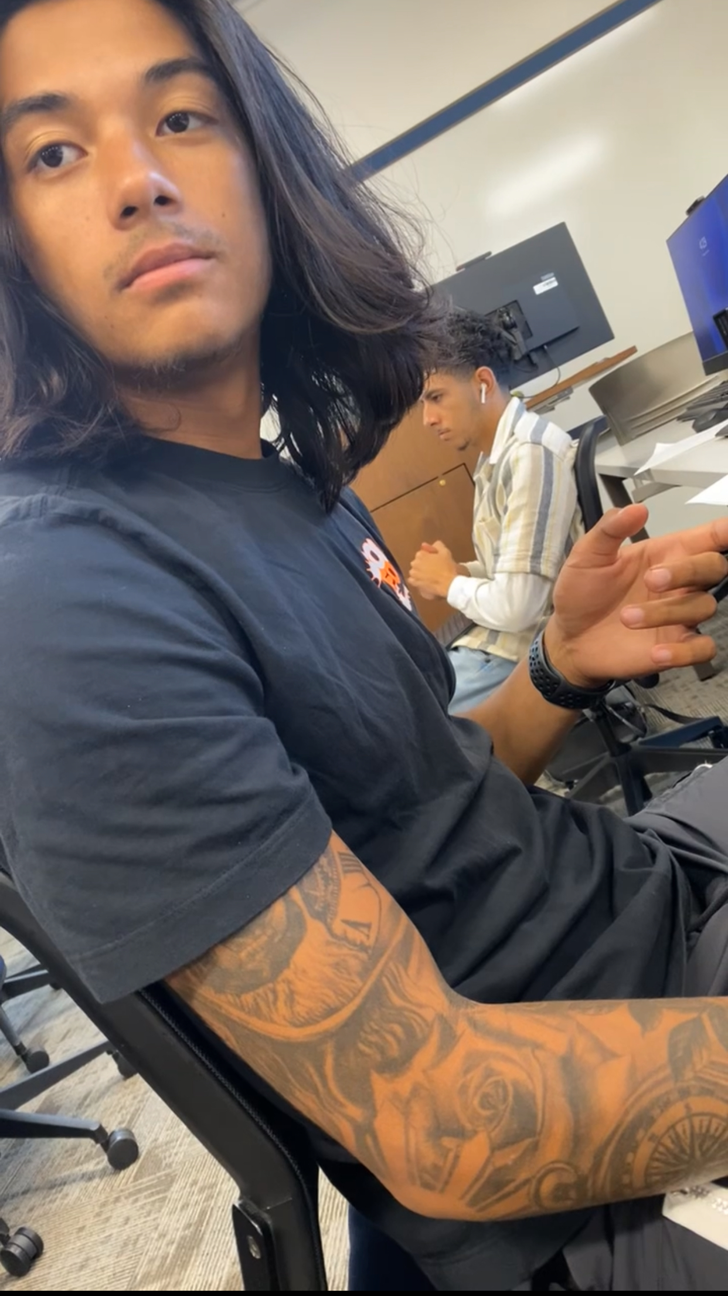
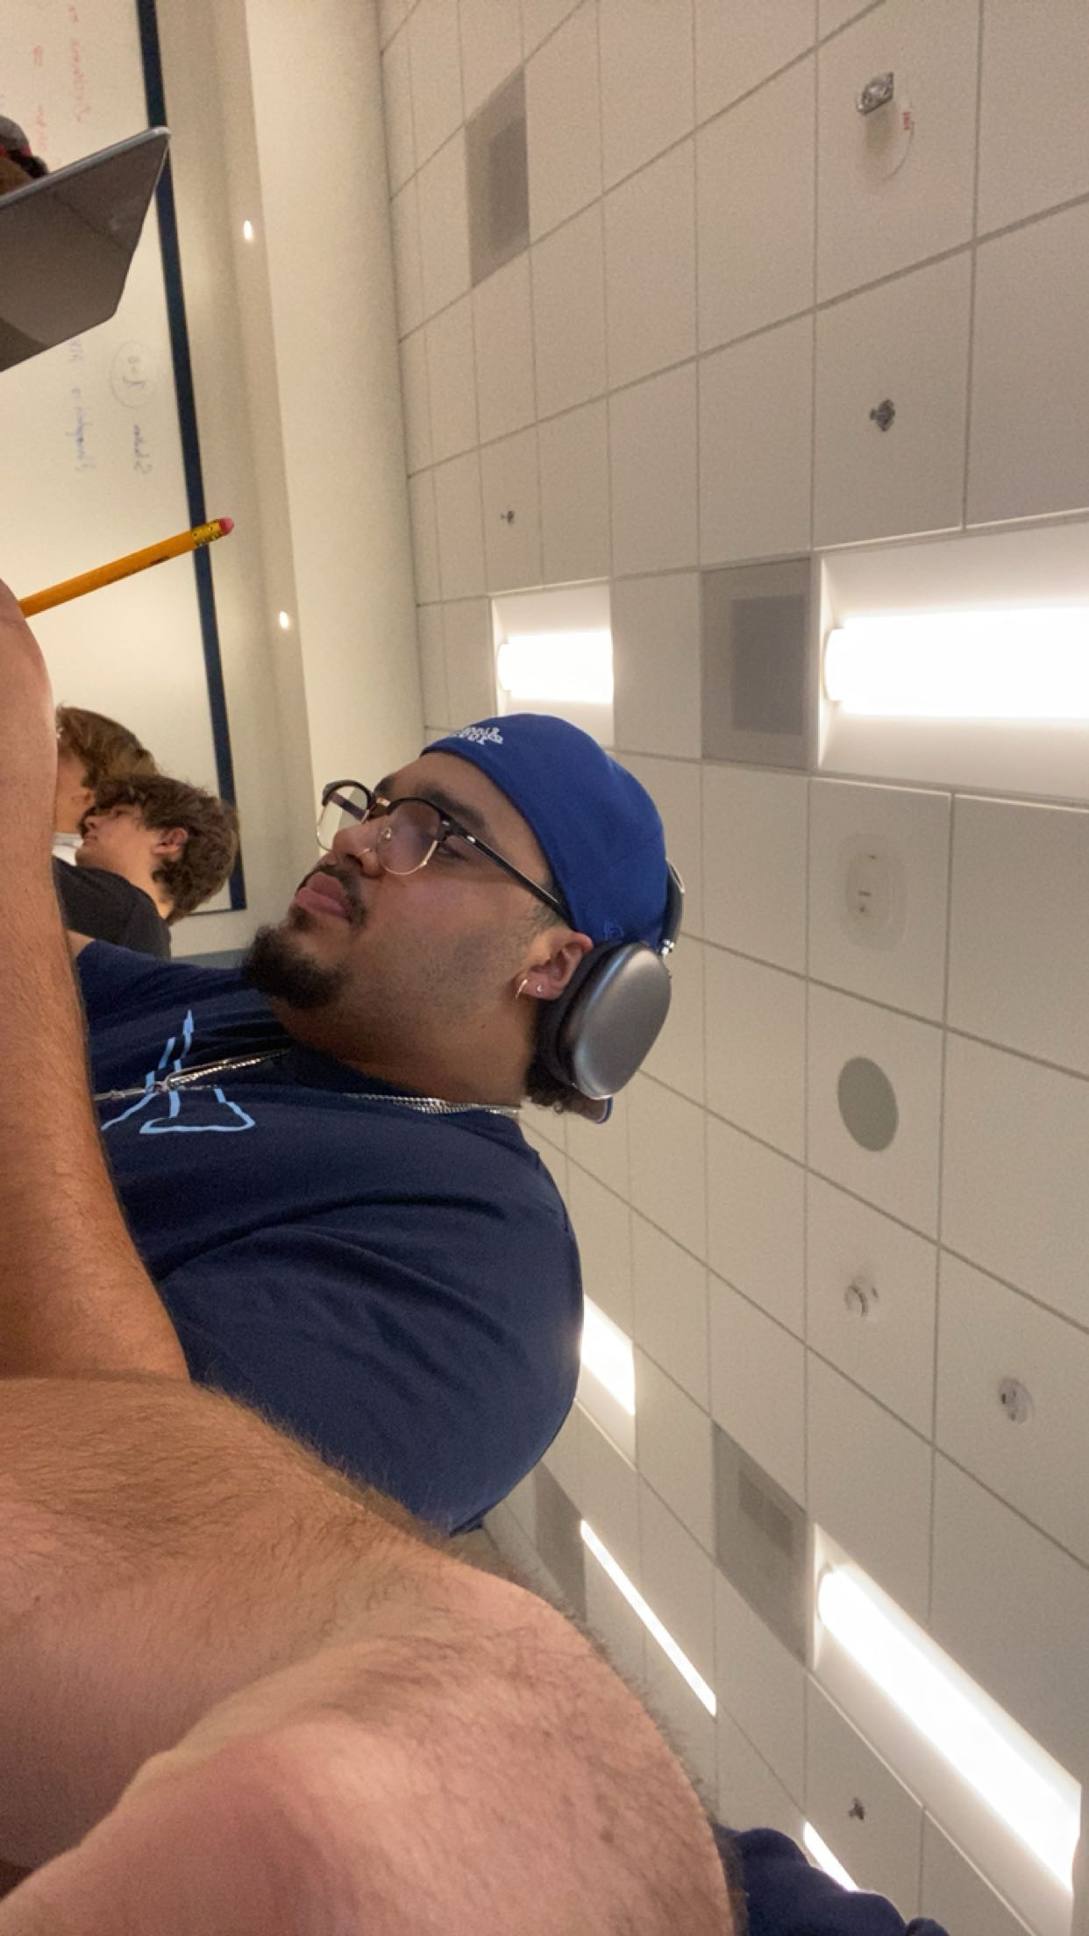
Relevant items about the semester:
Got closer to a lot of people and enjoyed all my classes much more because of it.

Slide 19
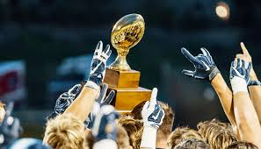
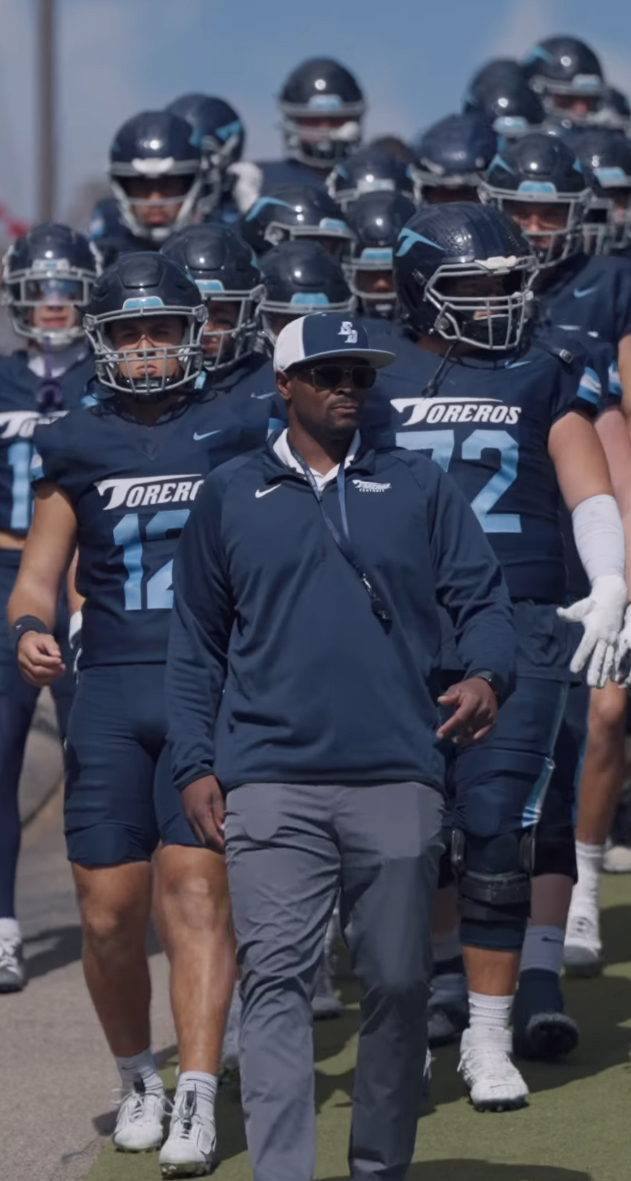
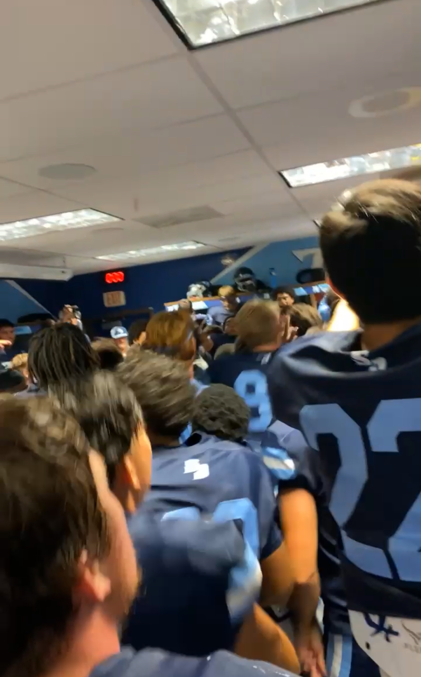
Wish for the future:
Hope to continue to build my family of friends, enjoy my time here at USD, and win the PFL.

Slide 20
ITMG 100 Final Project
By Eduardo Pescatore

