Slide 1

Time Capsule
Will Semler

Slide 2
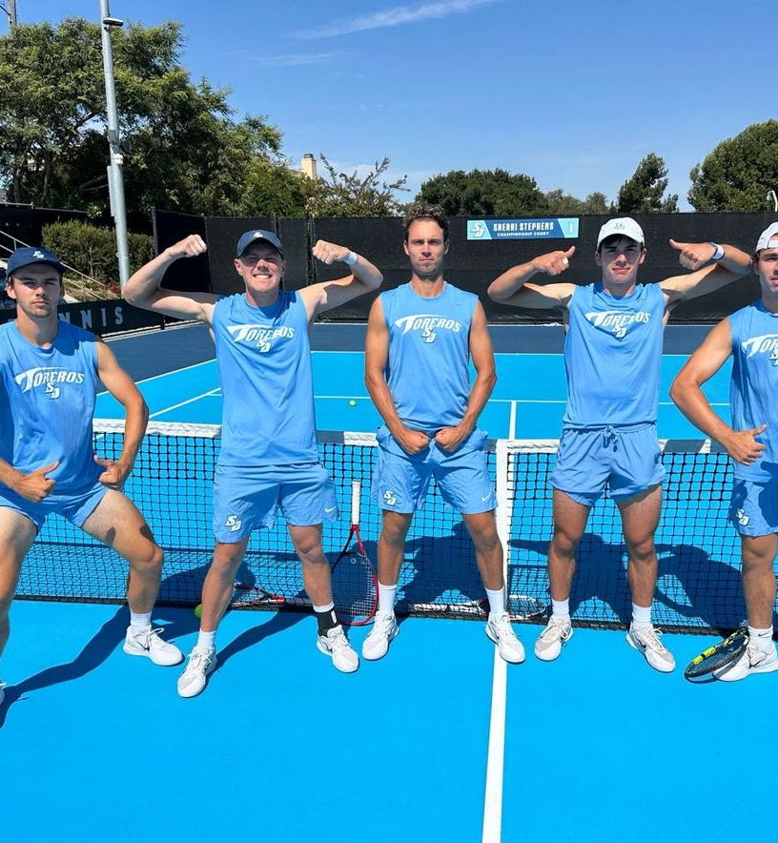
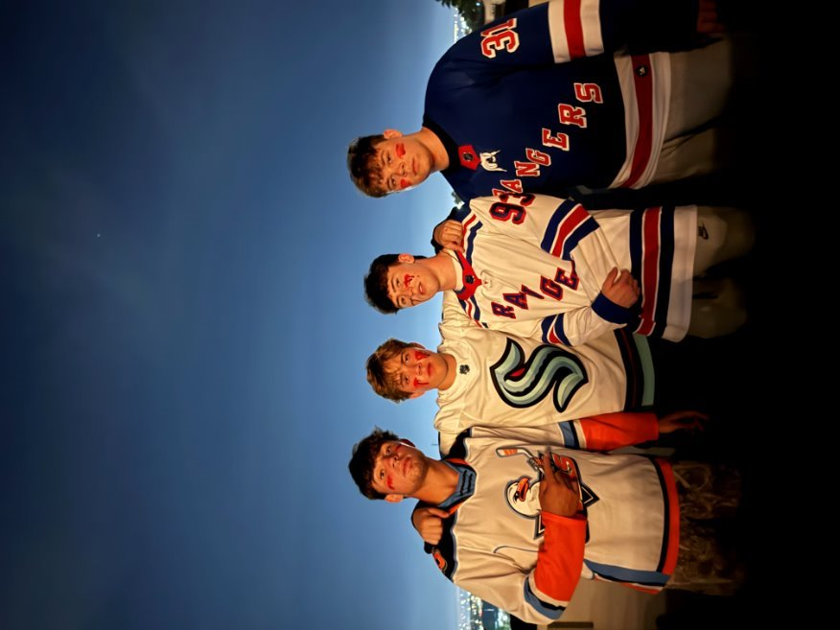
Items that happened in the semester with friends, groups, locally, nationally
This semester has been busy to say the least. I have enjoyed my time throughout the semester most with my friends. On the left is a photo with my team and on the right is with some of my friends on Halloween.

Slide 3
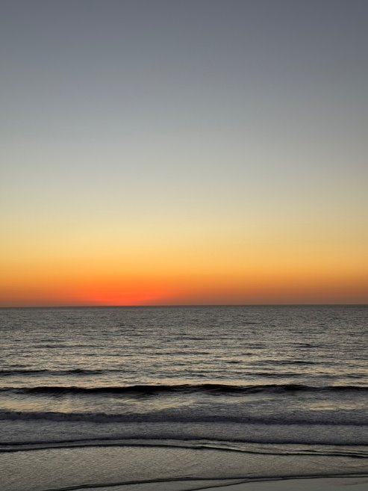
Items that you experienced that have touched your life this semester in an positive way
San Diego's views have touched me a throughout this semester.​ I have been lucky enough to explore the city a bit and have been mesmerized by the sunsets. They have truly impacted me extremely positively

Slide 4
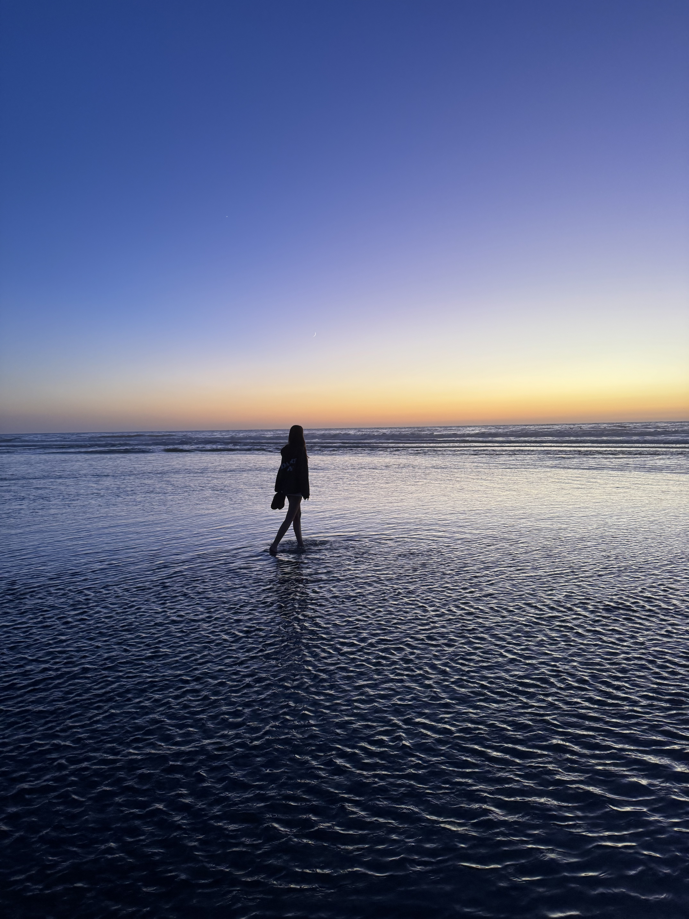
Sunset's have been amazing!

Slide 5
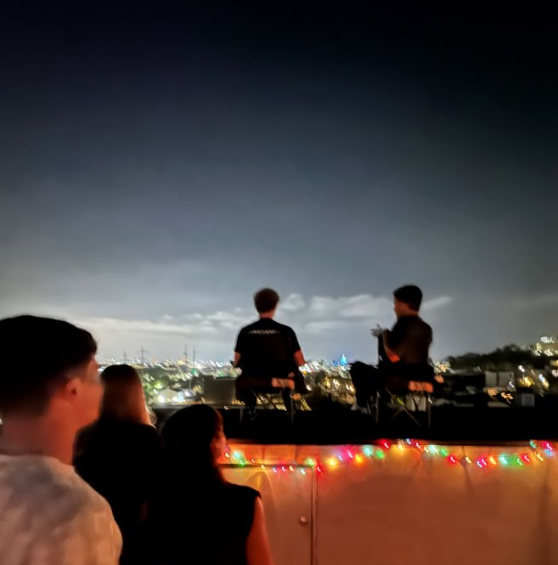
Items that you experienced that were sad or negative that you wish not to be experienced again
I have not experienced too many sad things, but I wish to never experience witnessing my friend nearly fall off the roof of his house.

Slide 6
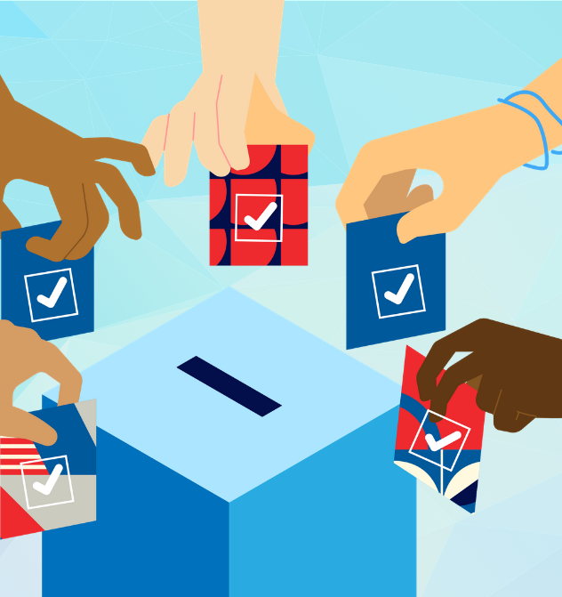
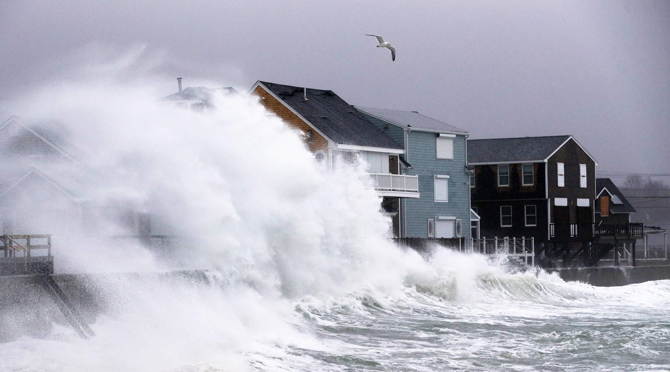
Items that were highlighted by news, media advertisements/messages, government, other countries, other sources
The election was one of the bigger things to take place this semester. There were also a large number of storms that took place. It was pretty chaotic to say the least!

Slide 7
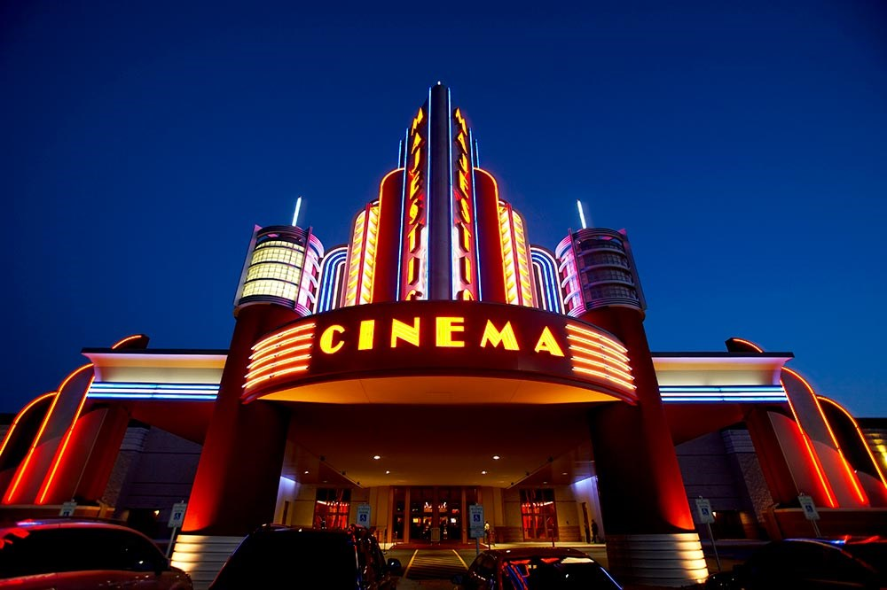
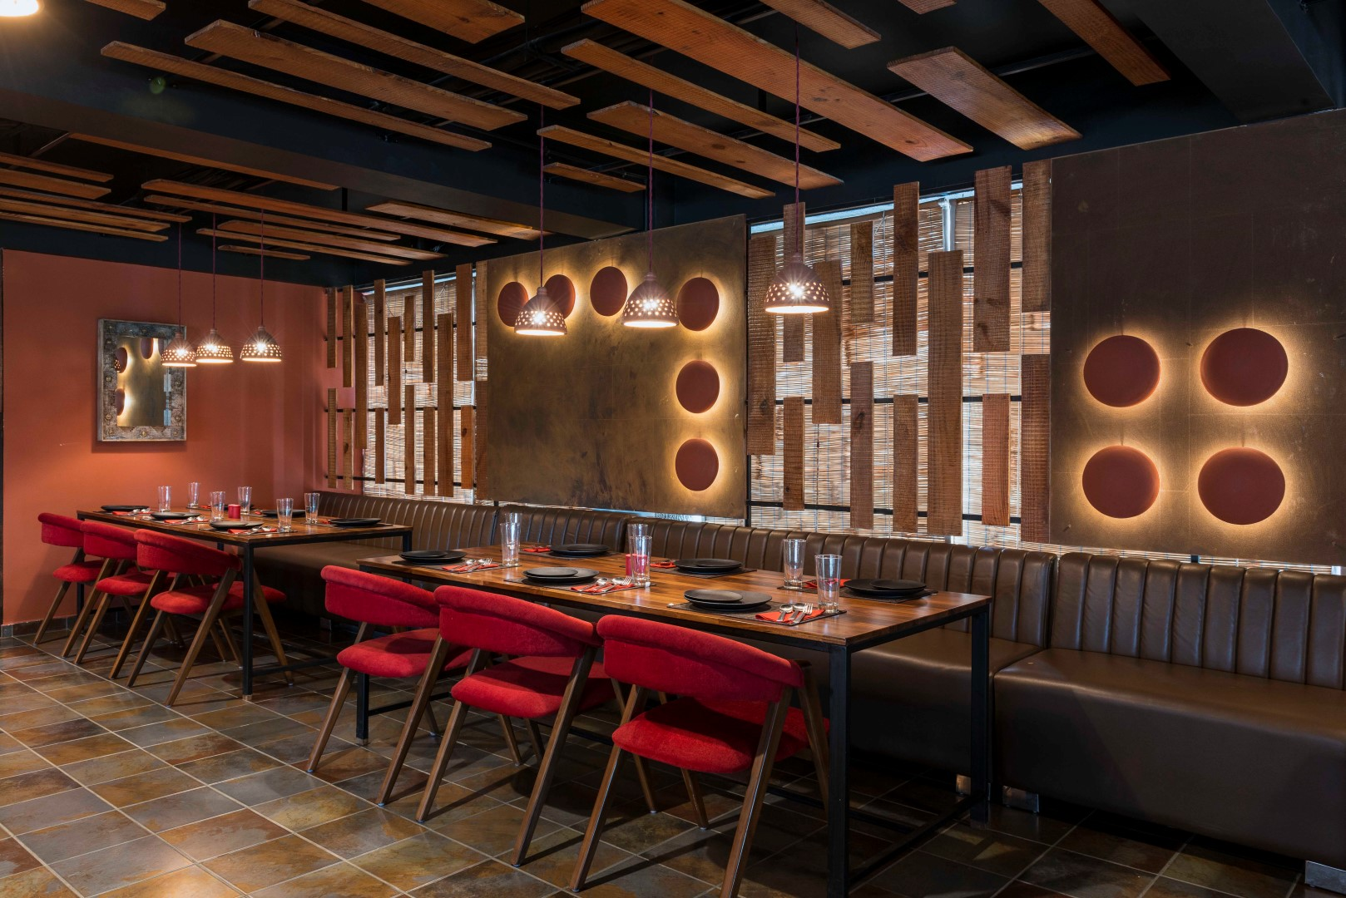
Items that did not happen that you wanted, expected that did not happen that you wanted, expected
I haven't had much free time. I expected to have more free time and with that I wanted to enjoy time going to the movies, trying new restaurants, and exploring San Diego in general. I will try to be better with time management in the future so I can do more of the things I love to do.

Slide 8
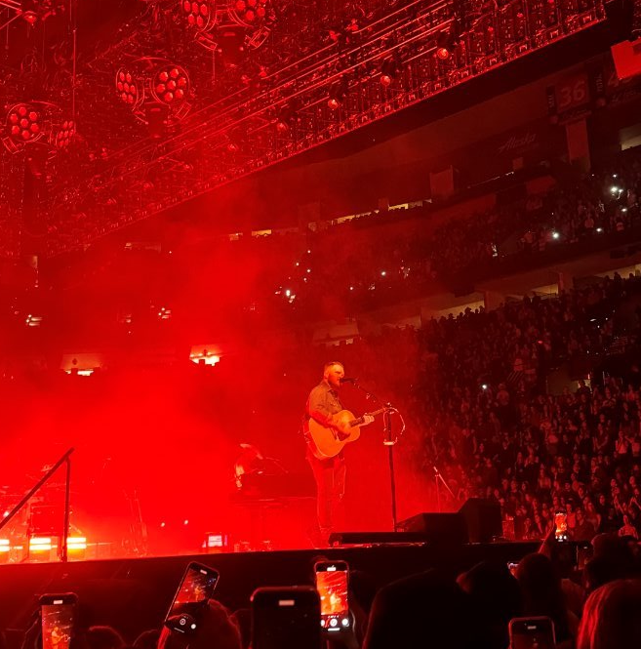
Items that illustrates changes to processes (buying food other items), laws/restrictions
A highlight of this semester is attending a Zach Bryan concert back home over thanksgiving break. I ordered the tickets online which is a process

Slide 9
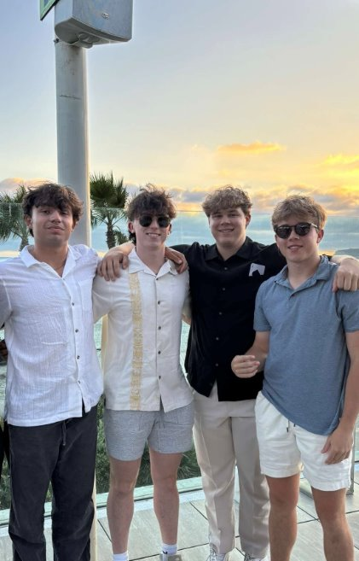
Items that illustrates people’s creativity to assist others (i.e. drive by birthday parties)
A core memory of the semester is my friends and I surprising my friend for his birthday and taking him out to dinner. We found an amazing restaurant in Coronado and he was so thankful.

Slide 10
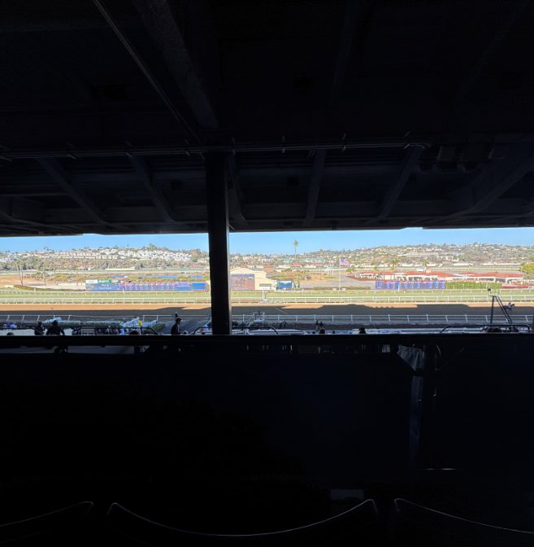
Other relevant items to discuss the semester you had, the semester you wanted, and the semesters that you wish to have in the future.
I had lots of other amazing experiences throughout the semester. While I didn't get to explore San Diego as much as I would like, I did things like going to the horse races and going to the beach which I plan to do more of. The horse races were amazing.

Slide 11
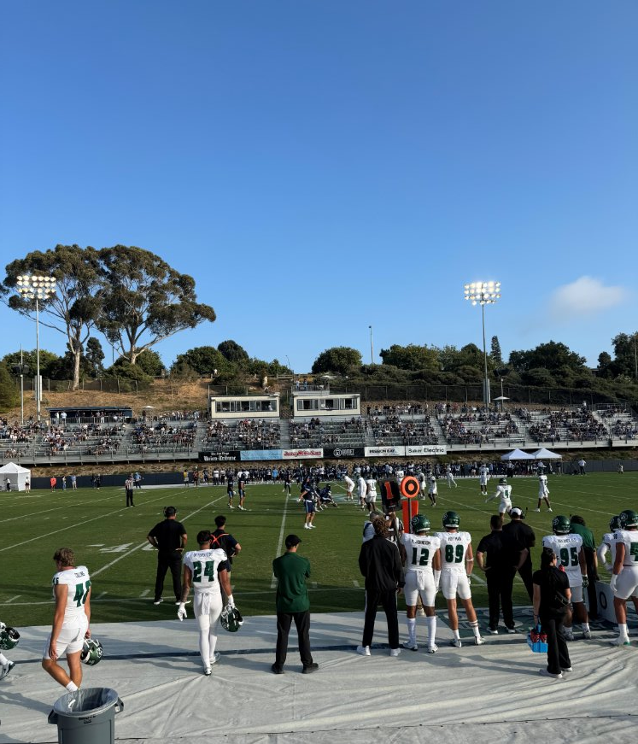
I have also enjoyed attending USD sporting events!

Slide 12
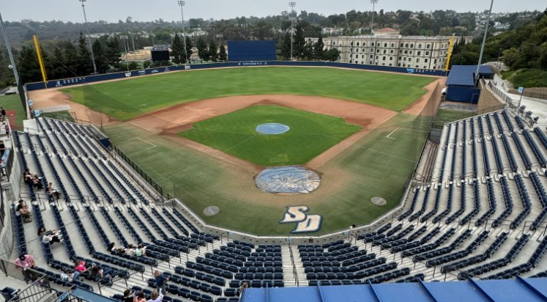

Slide 13
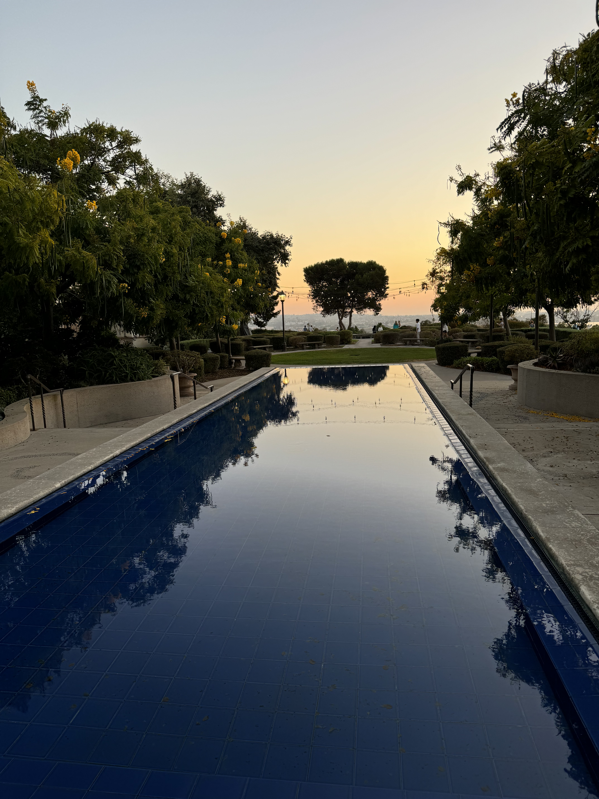
I have really enjoyed USD's Campus too!

Slide 14
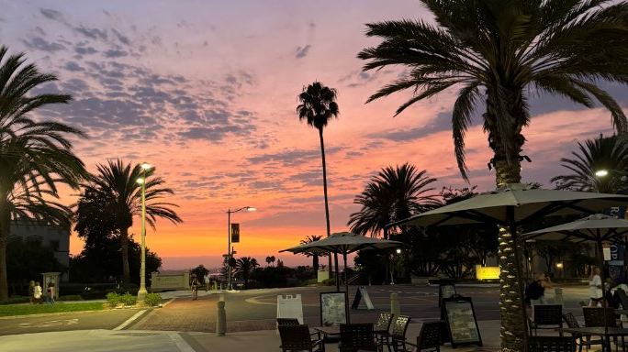

Slide 15
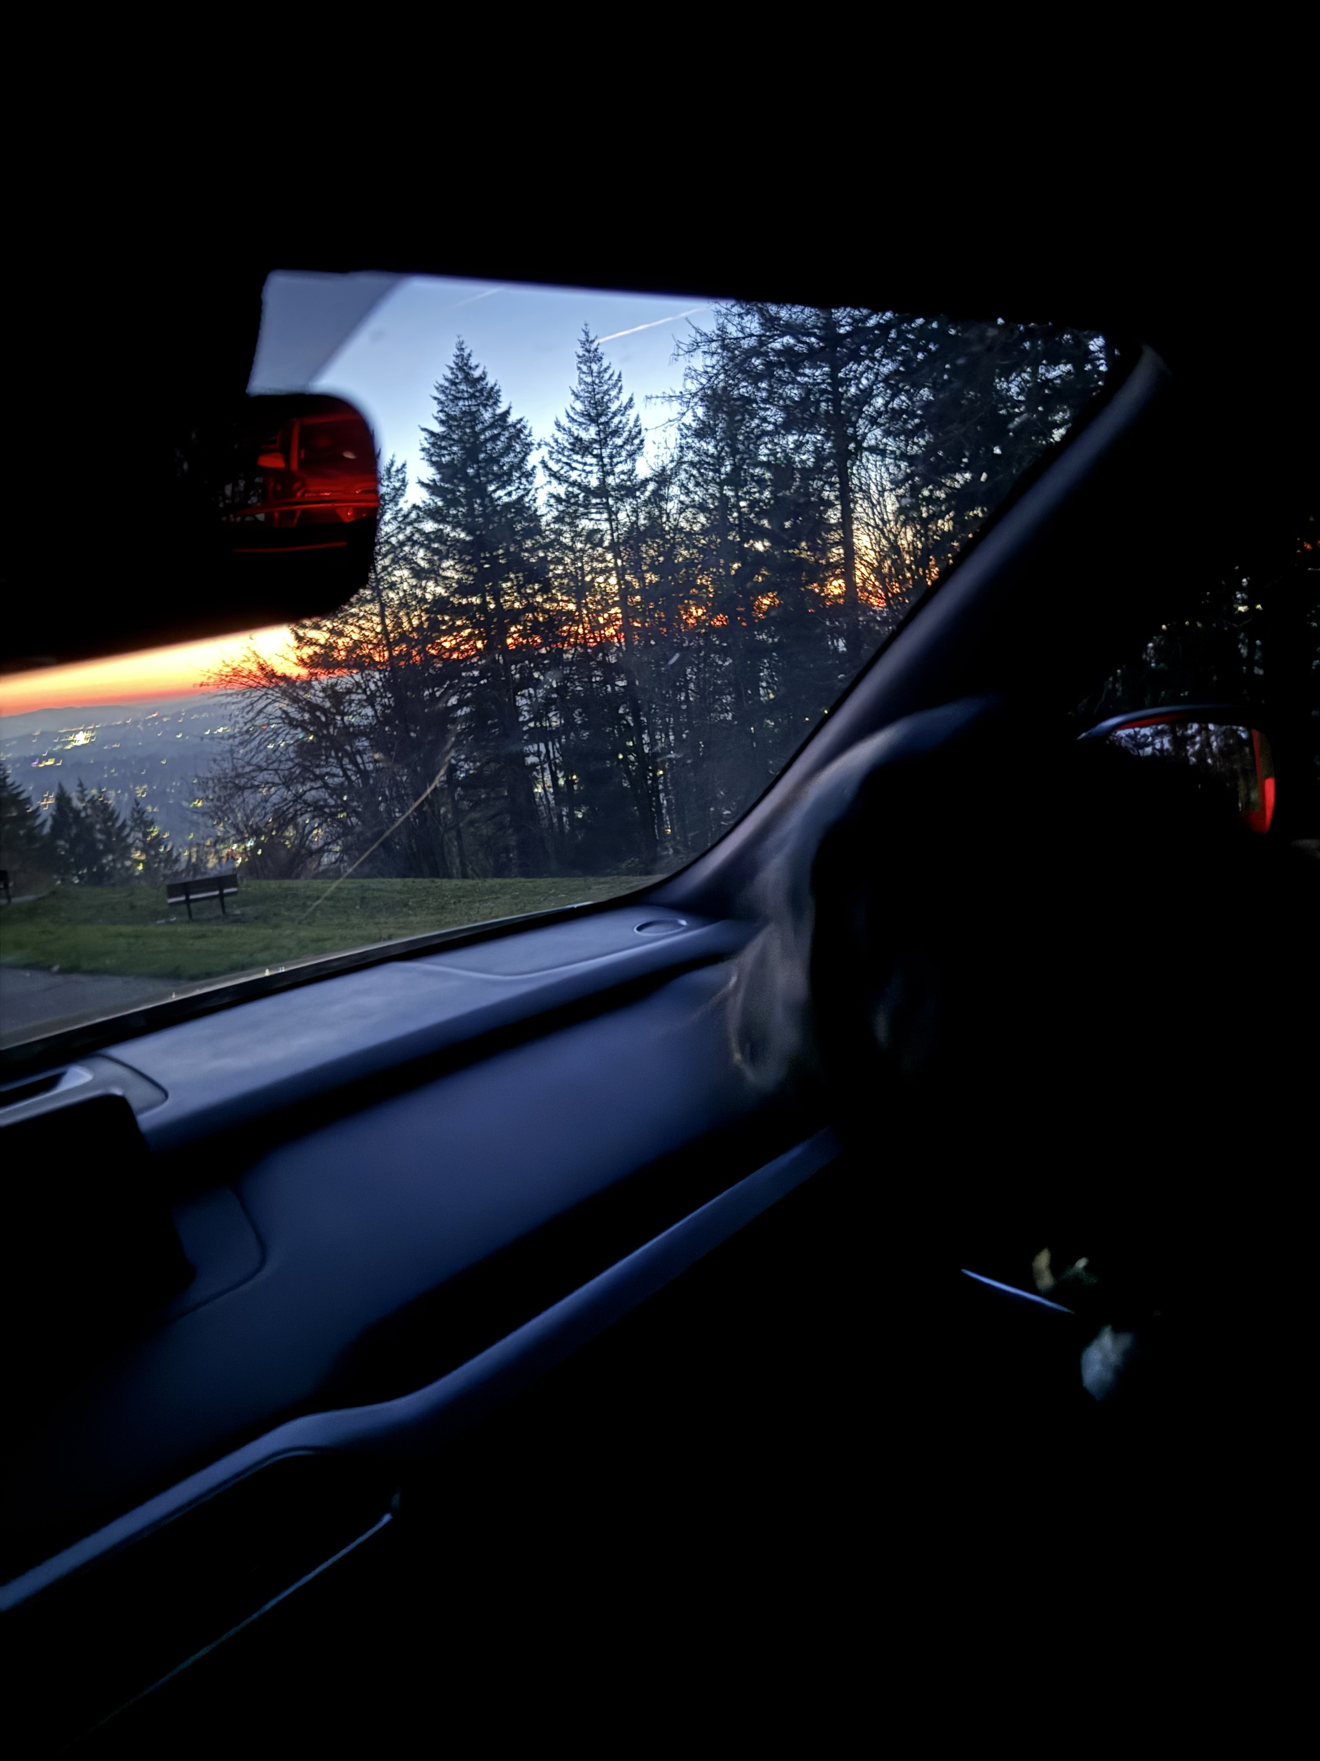
Going home and seeing my dogs over thanksgiving break was amazing.

Slide 16
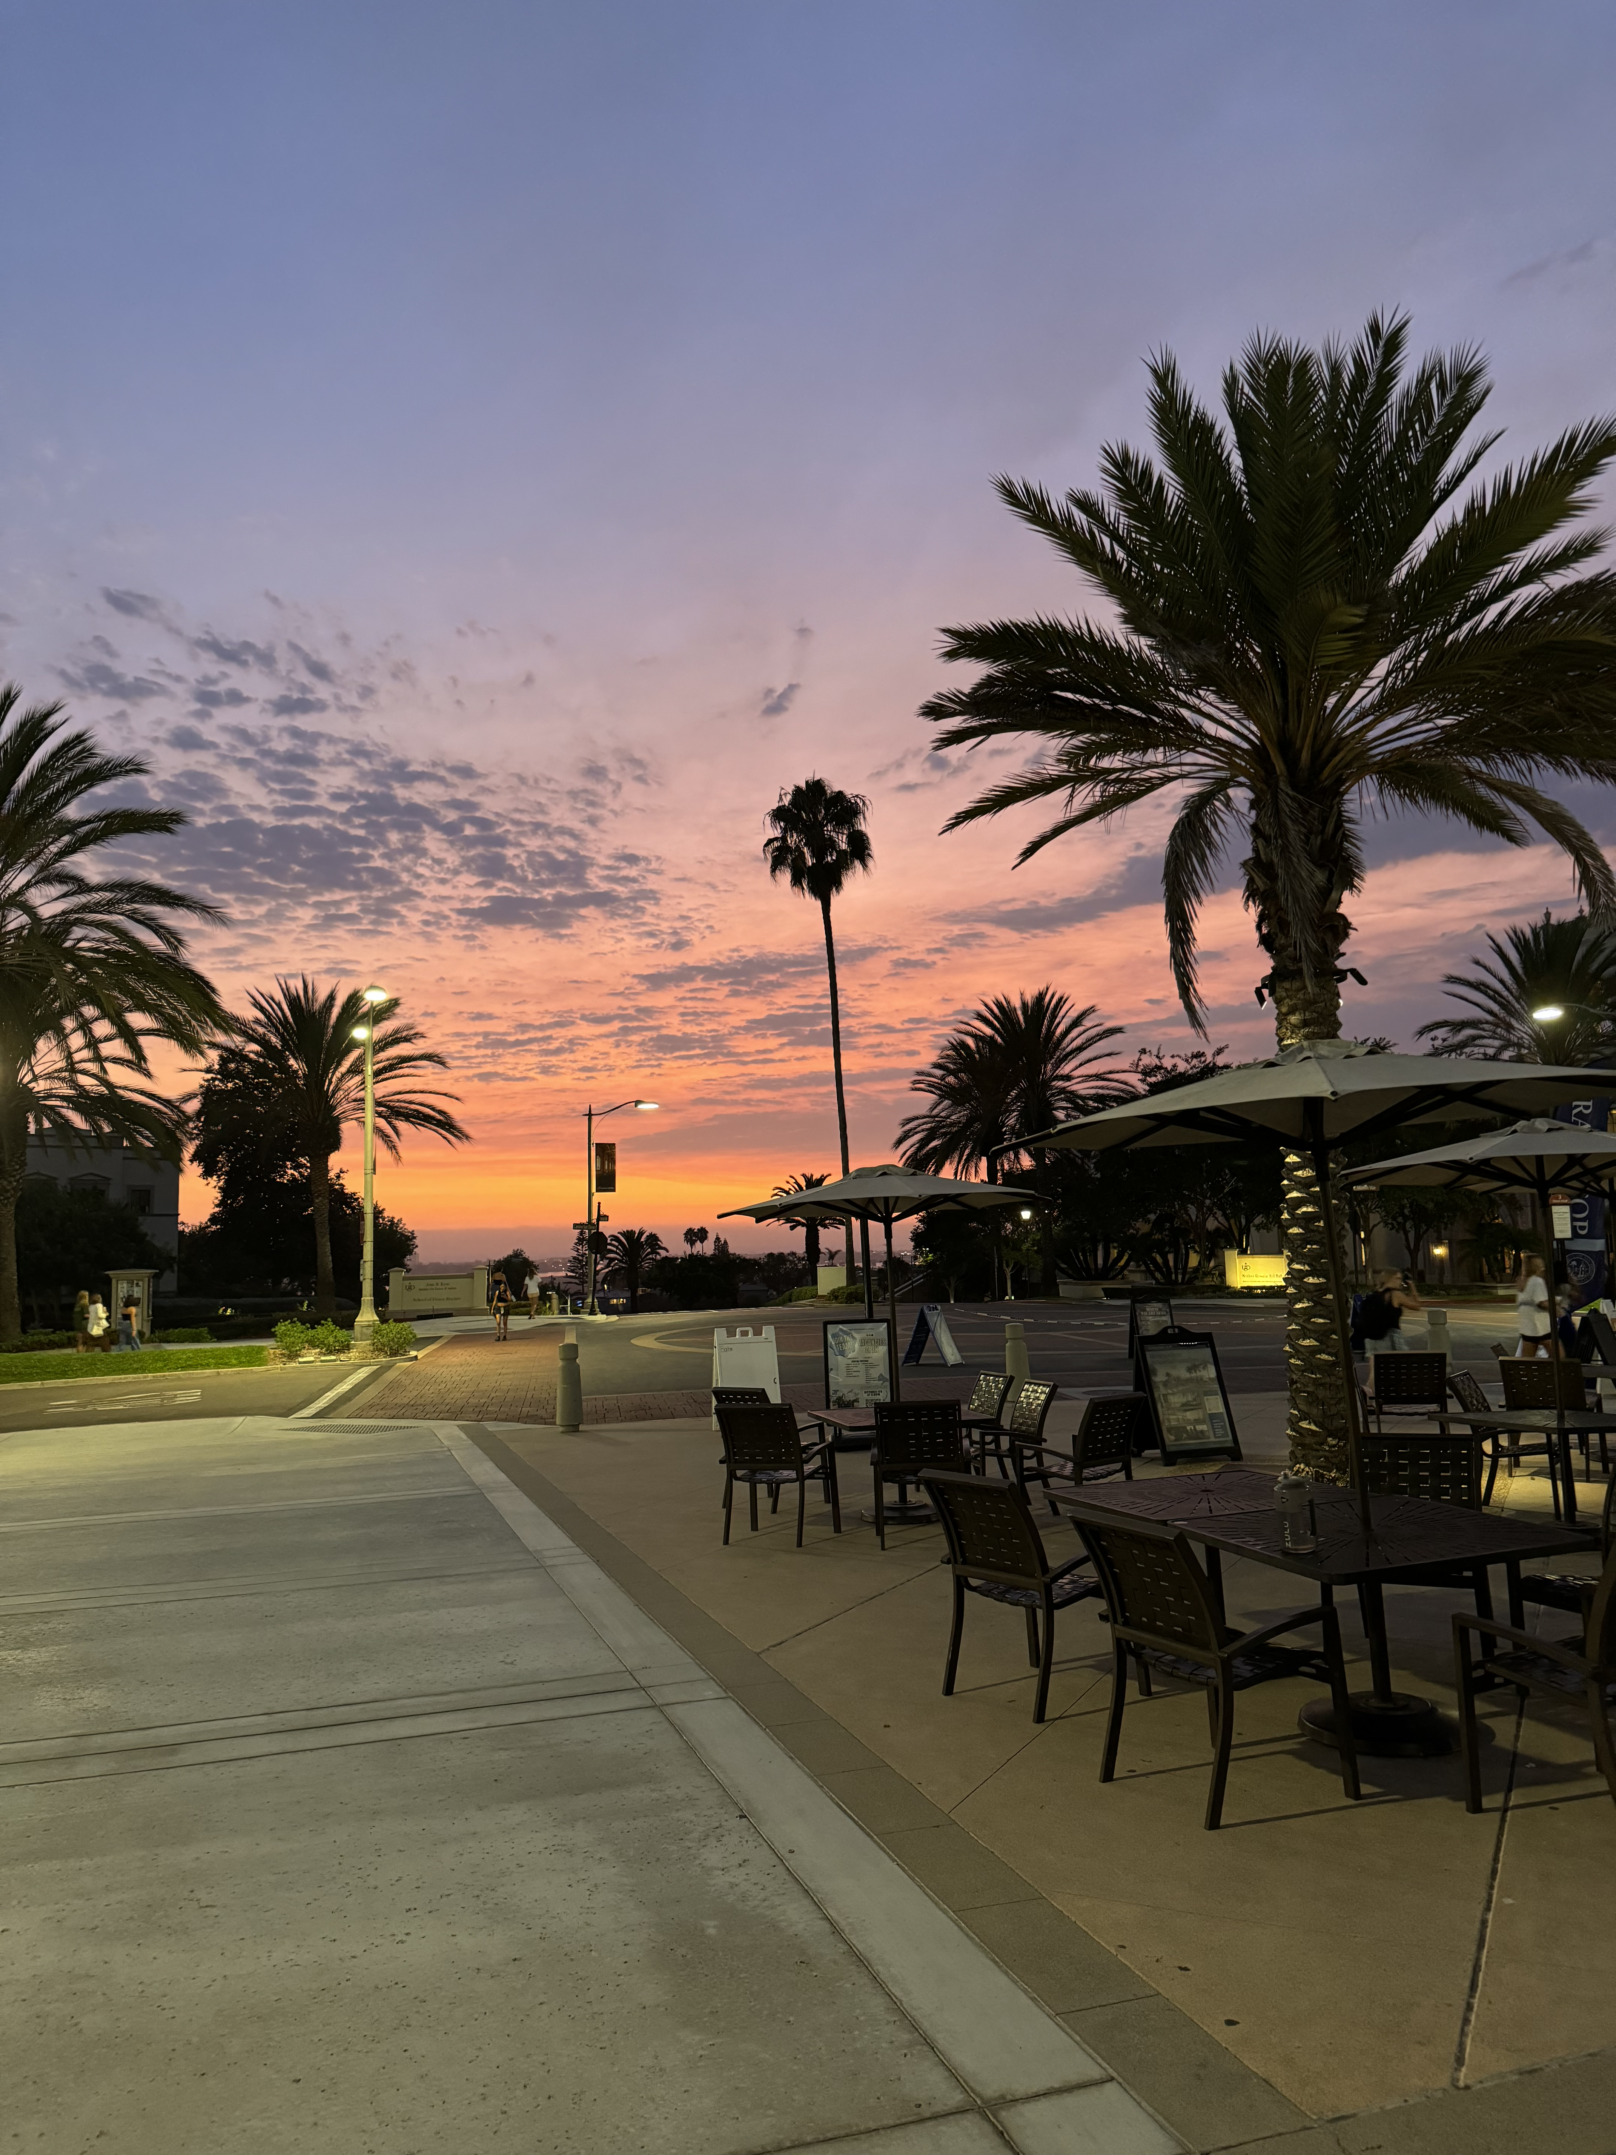
Summary
My first semester at the University of San Diego has been an incredible experience. I am truly grateful for the amazing friends I have made along the way, who have played such a significant role in making my time here so special. From shared moments of laughter to the constant support we’ve provided one another, these friendships have been at the heart of my university journey so far. The campus itself, with its vibrant community and beautiful surroundings, has been the perfect place to grow academically and personally. I feel so fortunate to be part of this community, and I’m thrilled to continue my four years here, building more memories, strengthening bonds, and making the most of everything USD has to offer. This semester has truly been an amazing one.

Slide 17
Thank You

