Slide 1
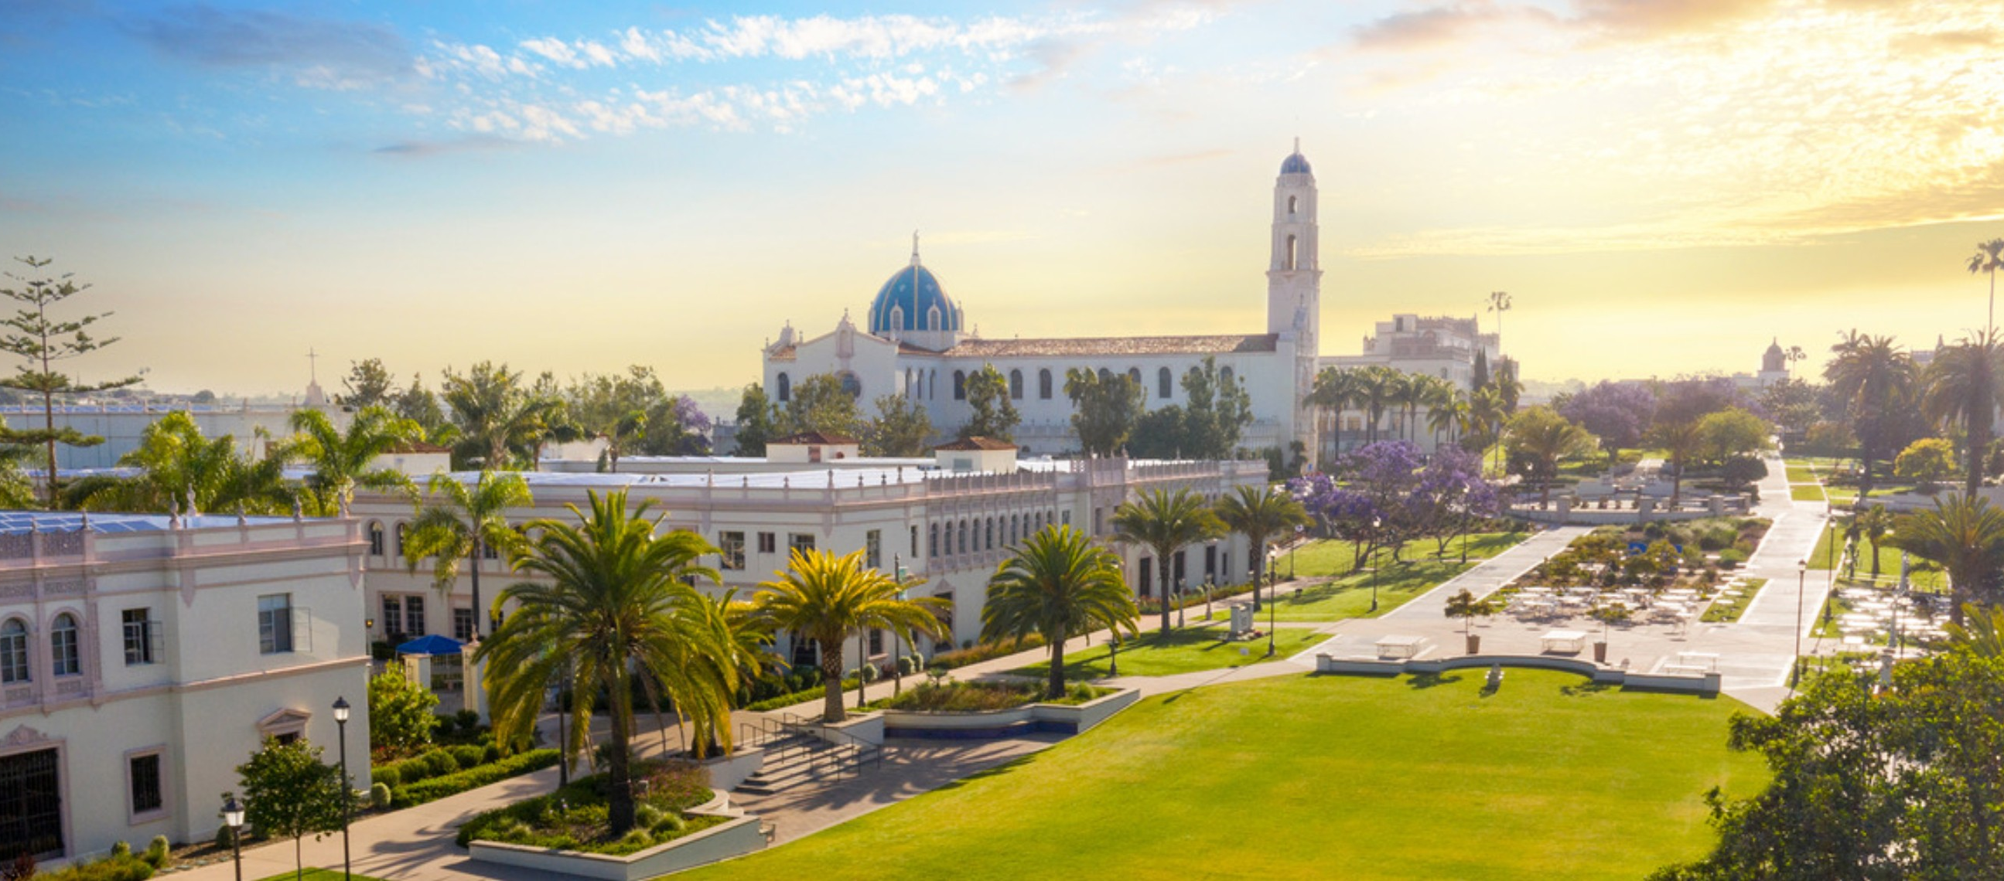
2024 Fall Semester
Delaney Sunderland

Slide 2
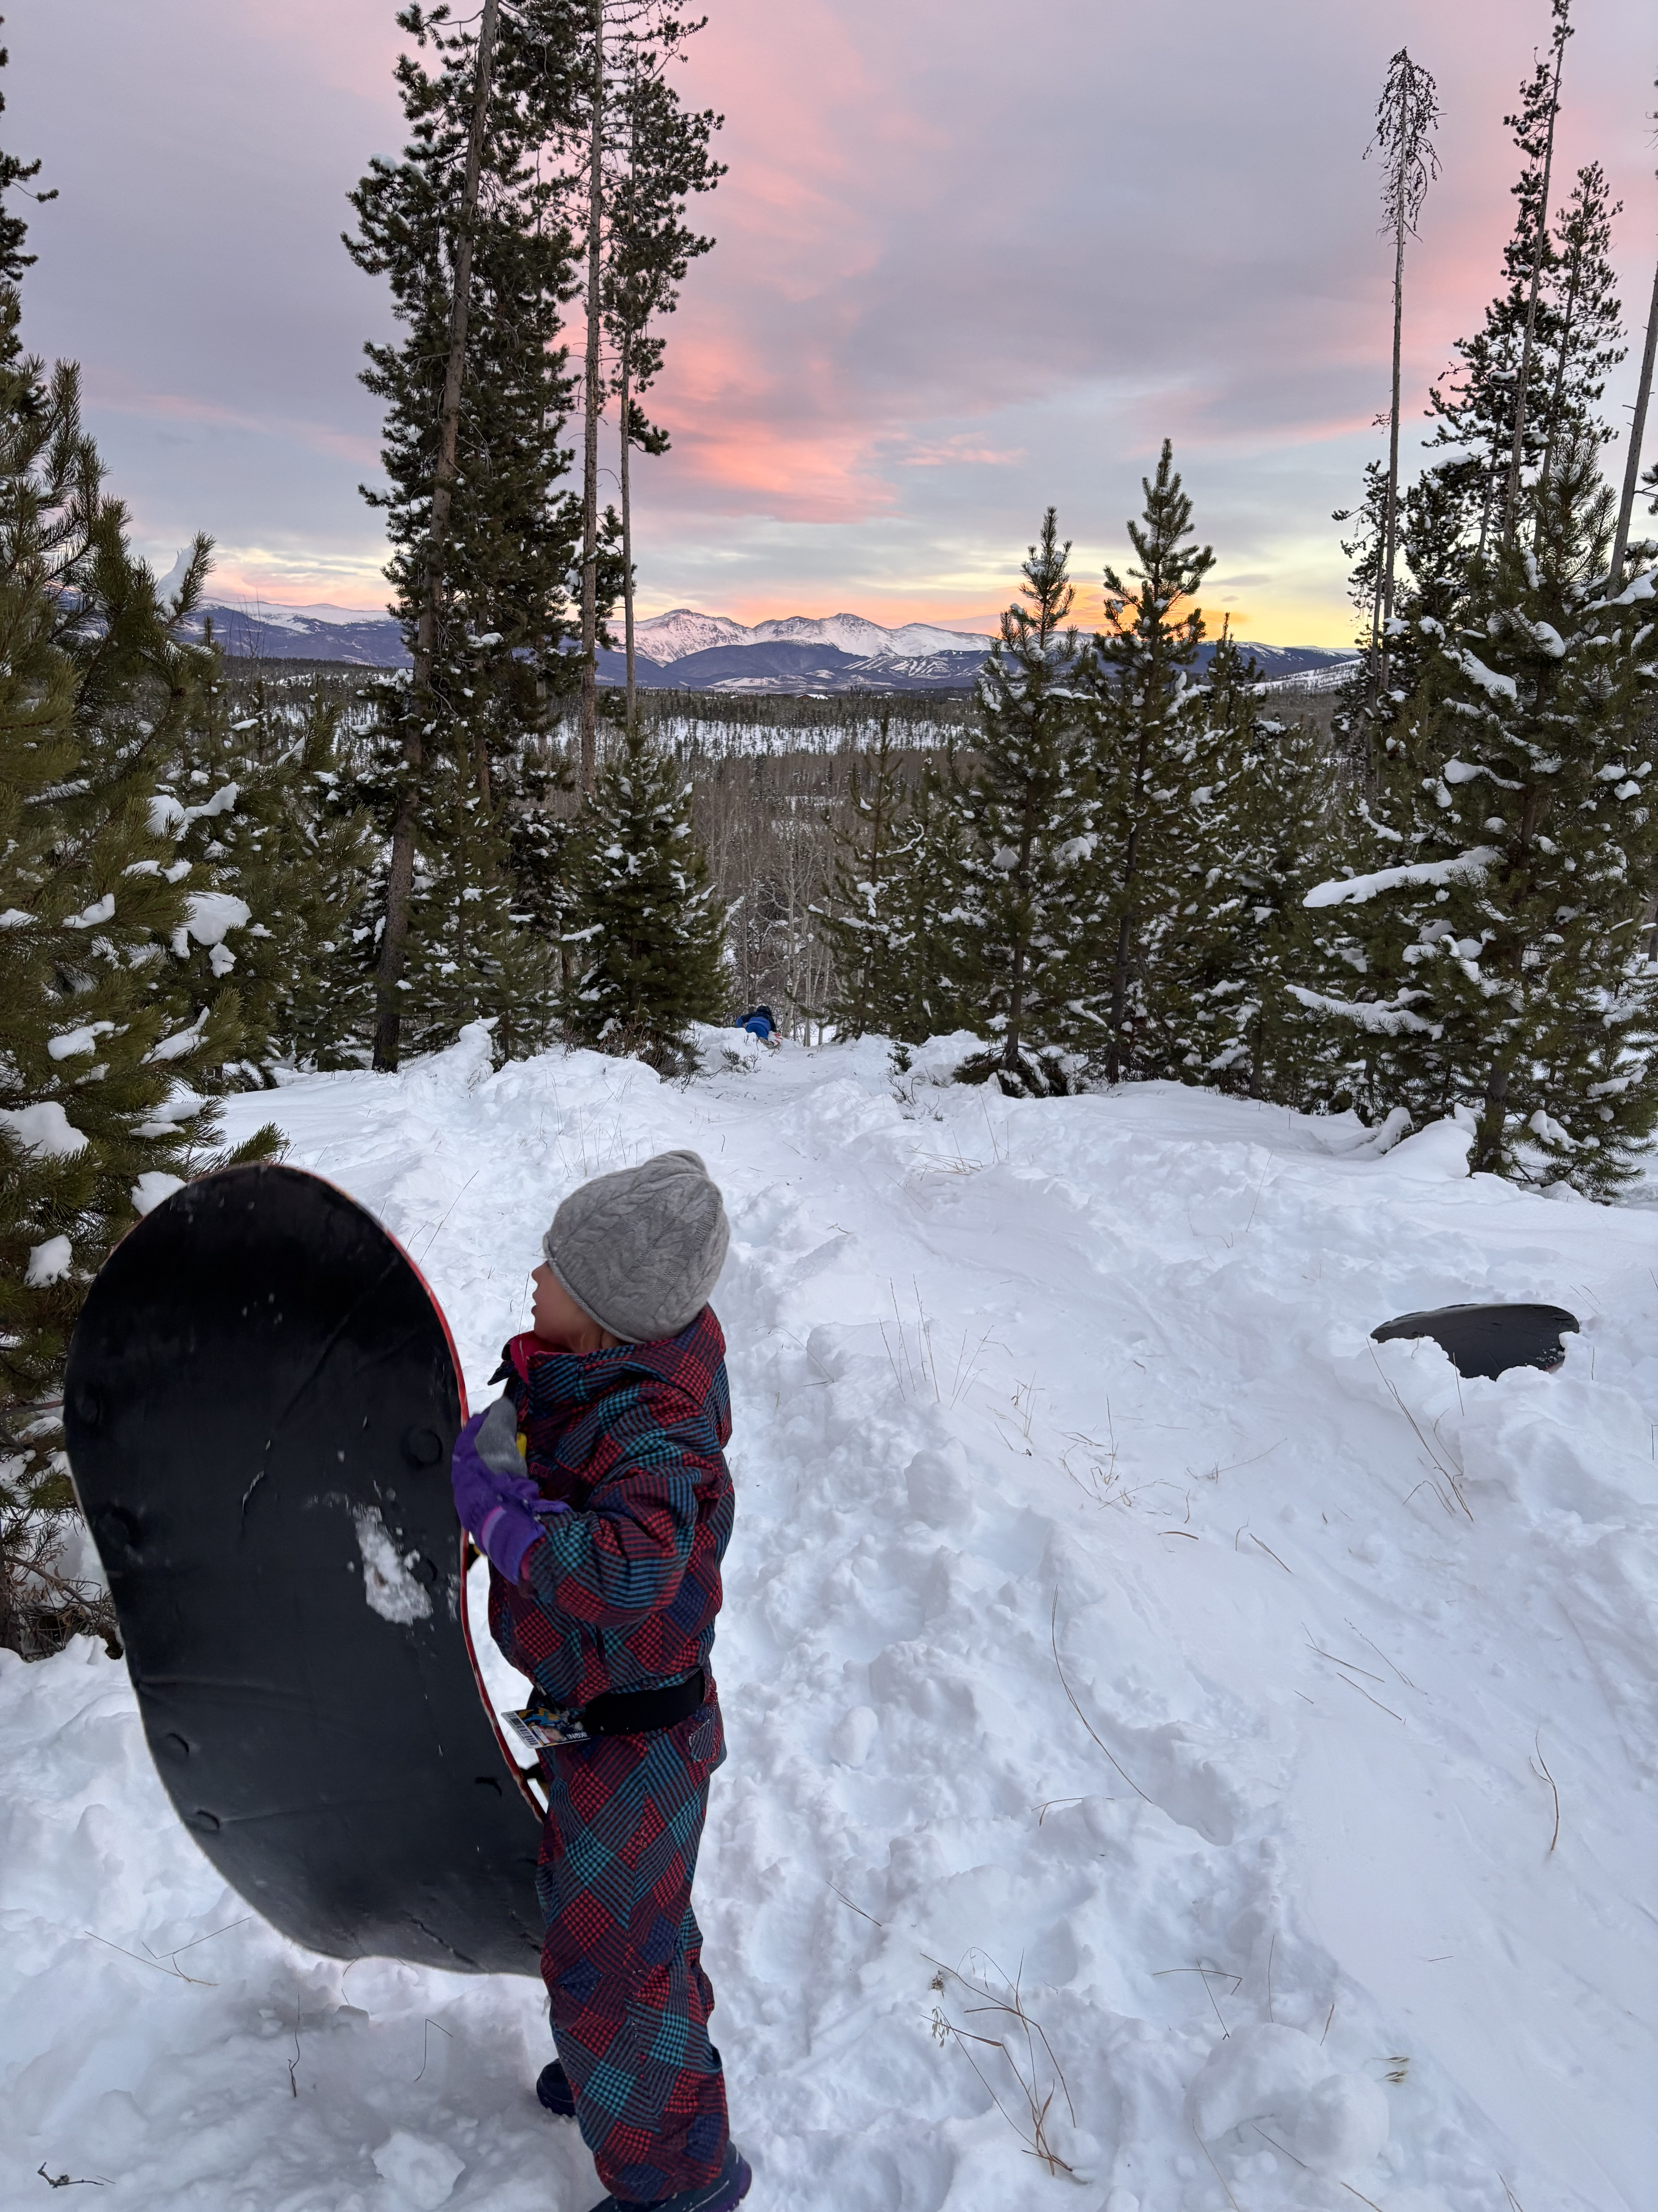
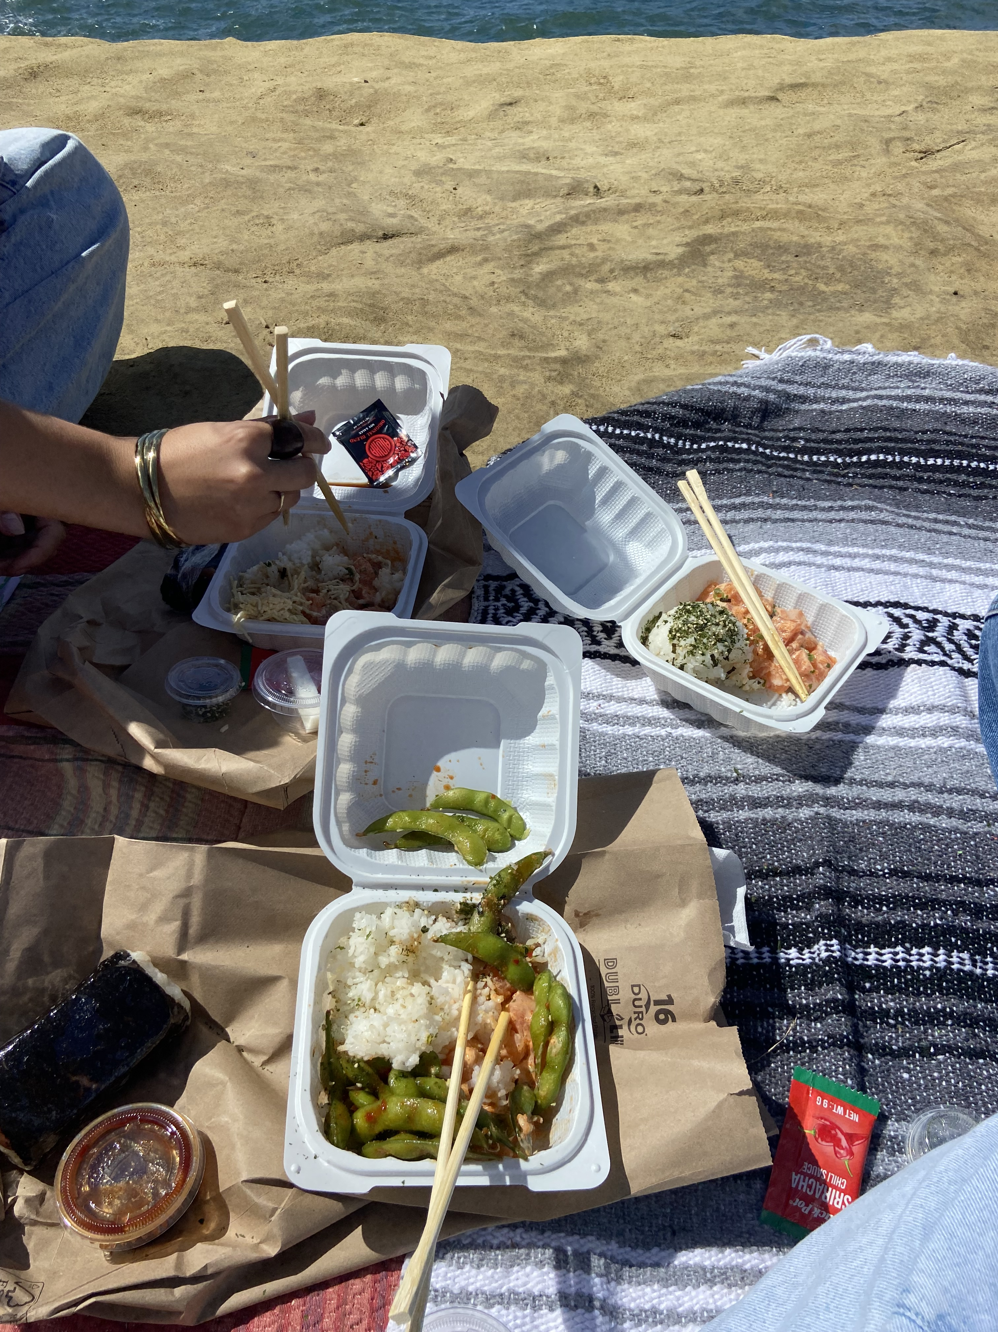
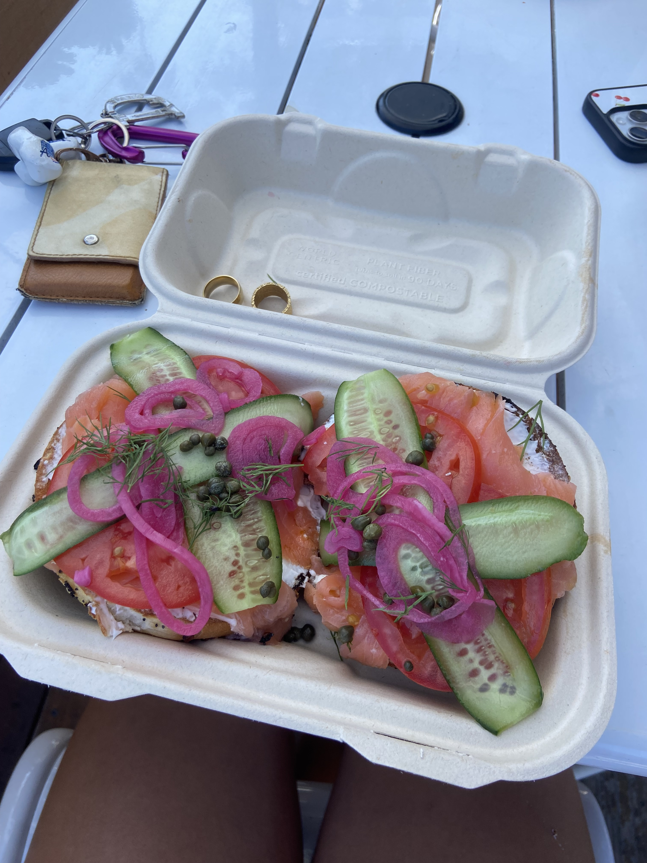
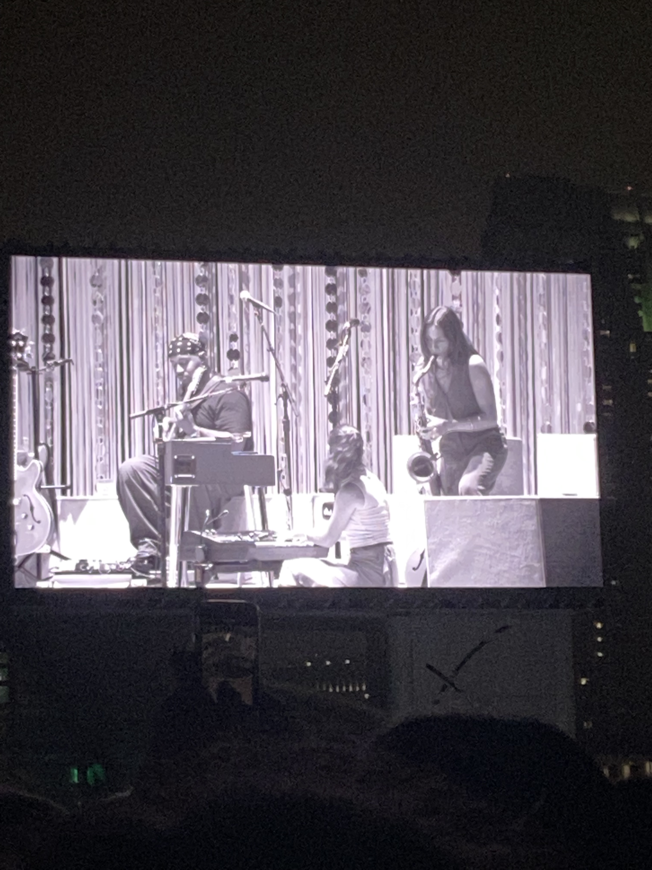
Things I got to do this semester
This semester I was lucky to have gotten the chance to do some pretty amazing stuff: Seeing one of my favorite artists with my best friends, eating really good food, and spending time with my family at home.

Slide 3
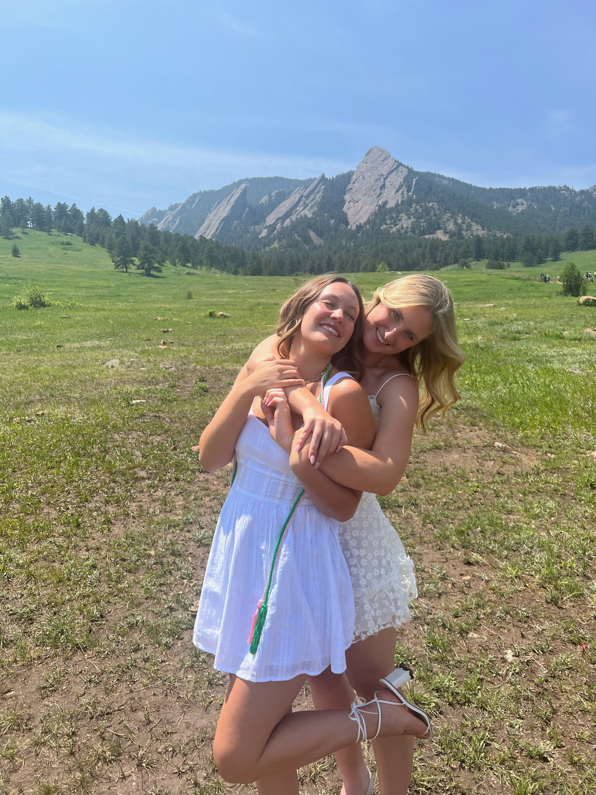
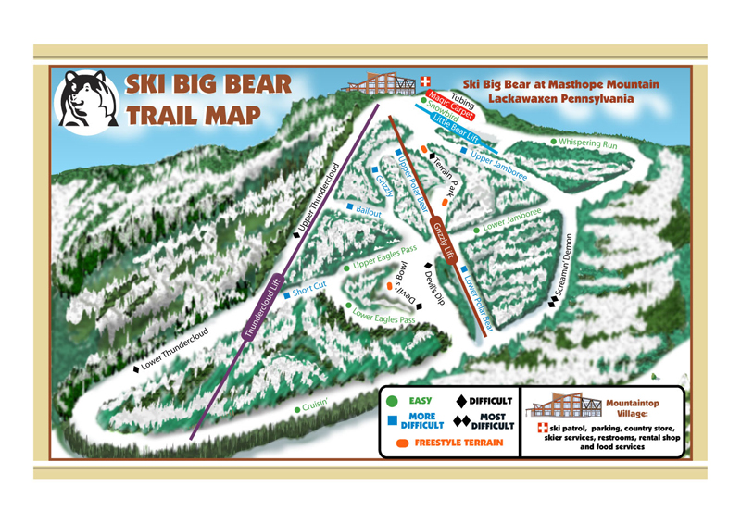
Things that didn’t get a chance to happen
Things that didn’t get a chance to happen were:
My best friend was supposed to visit me from Cal Poly, but her finals scheduled changed and she couldn’t come down.
Me and my roommates were going to go to Big Bear and I was going to teach them to ski.
This Photo by Unknown Author is licensed under CC BY-SA-NC

Slide 4
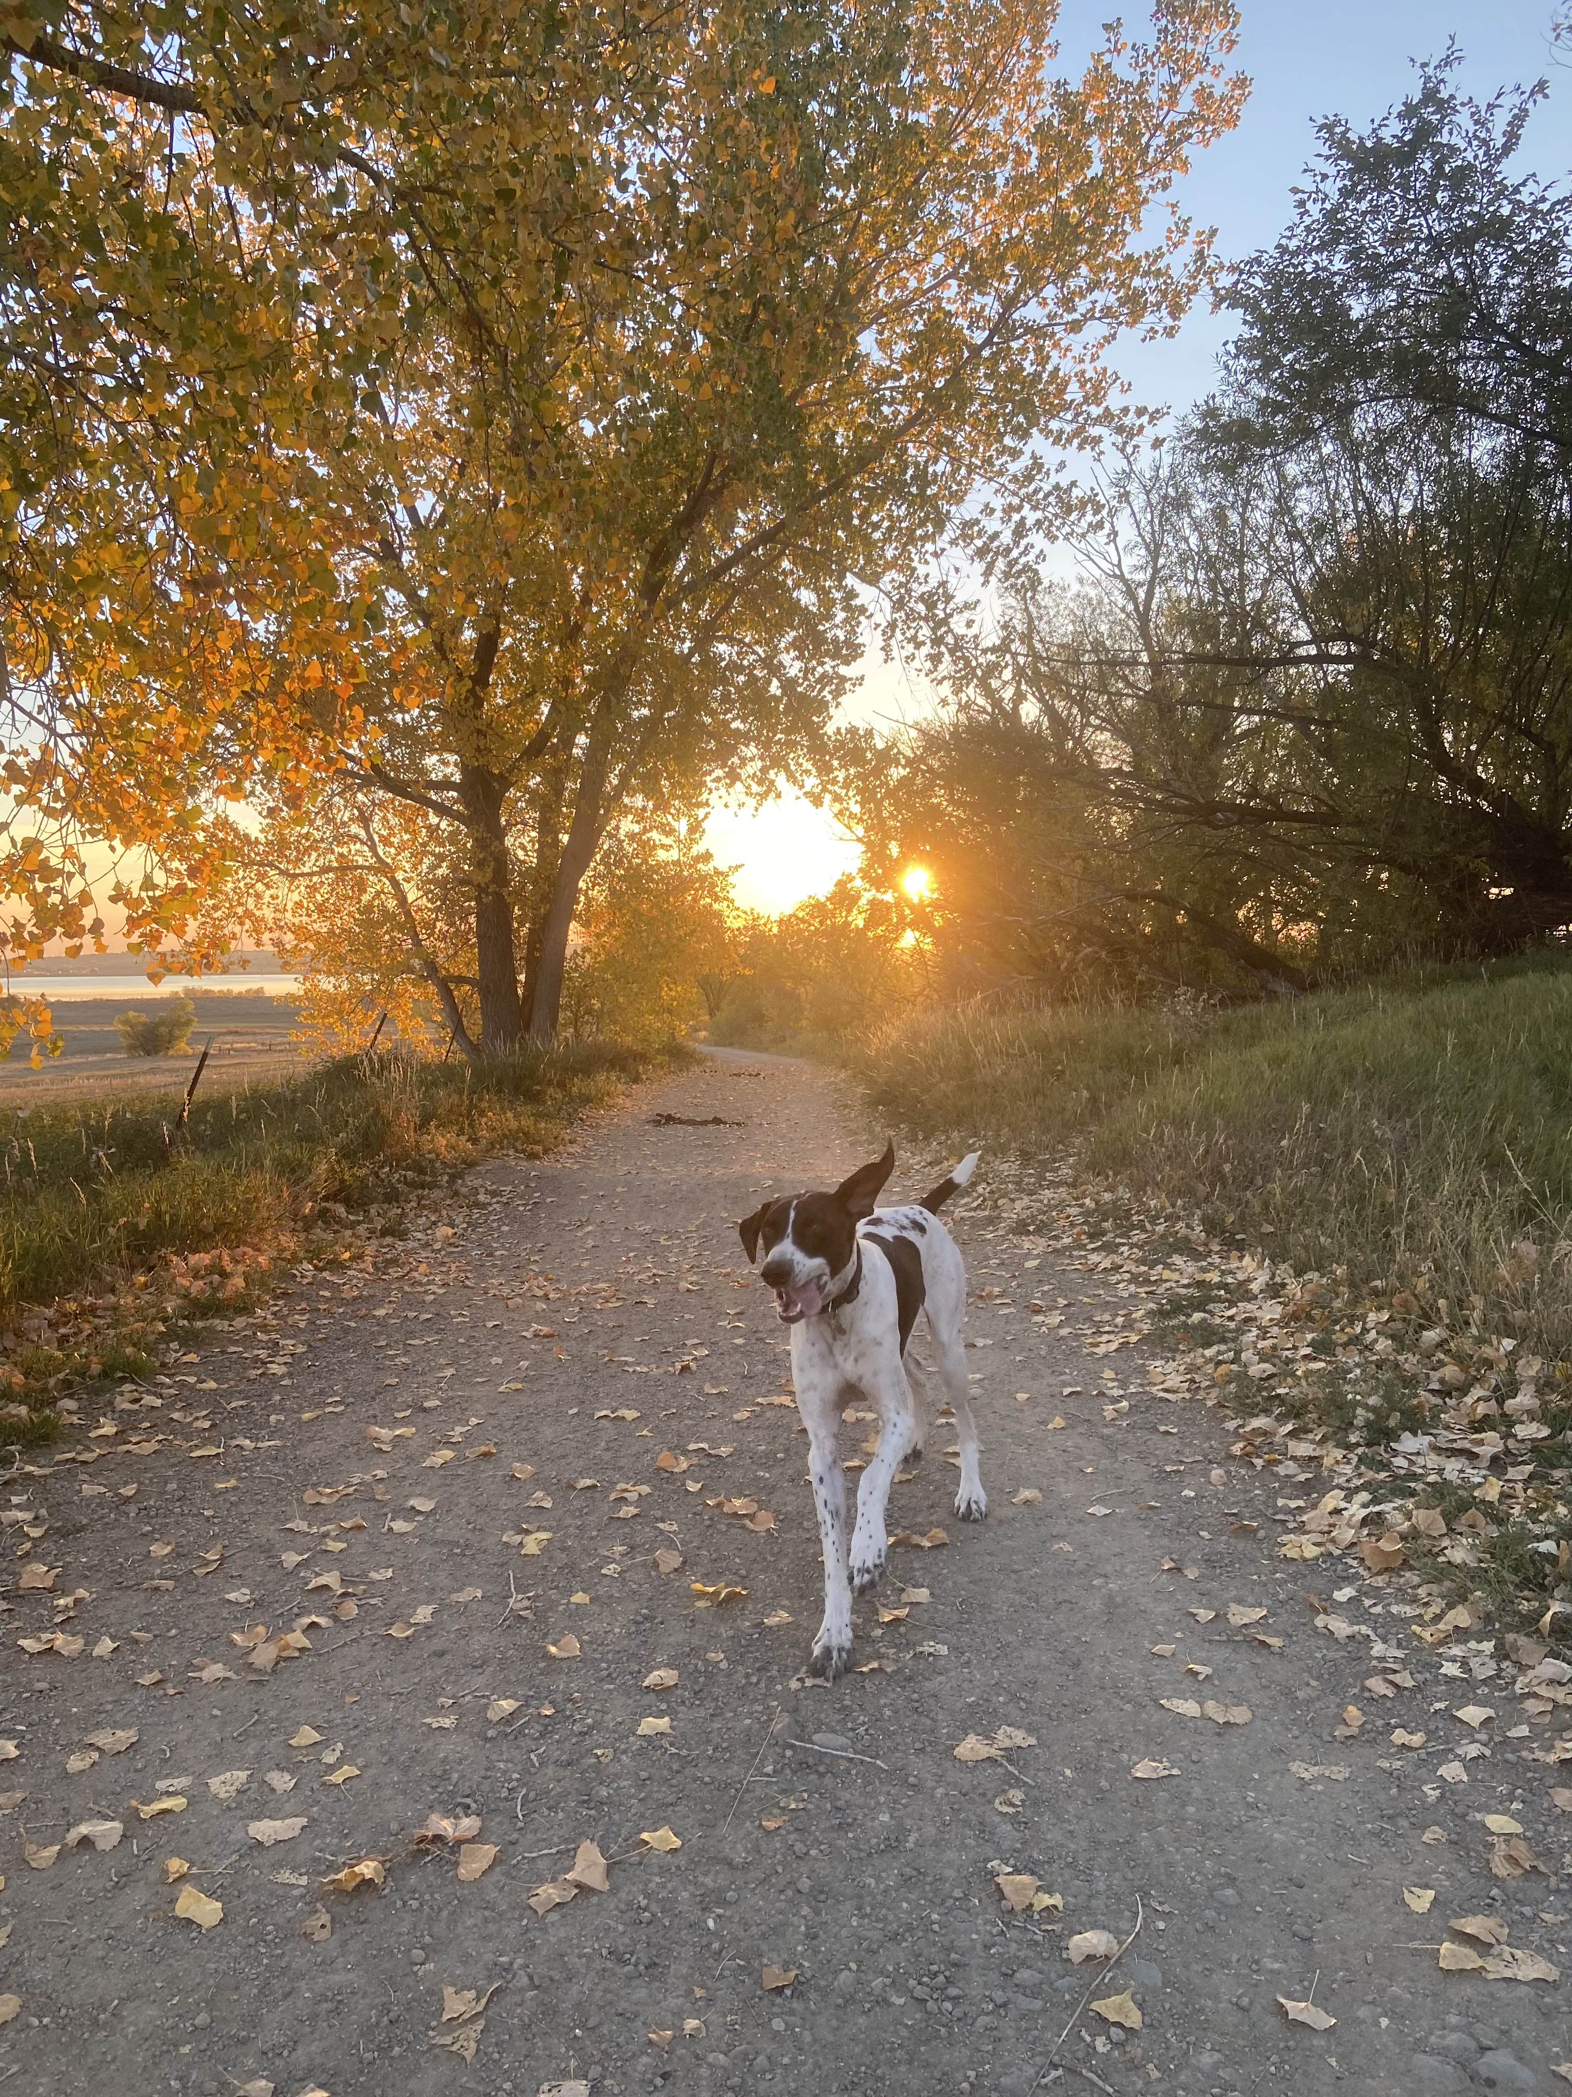
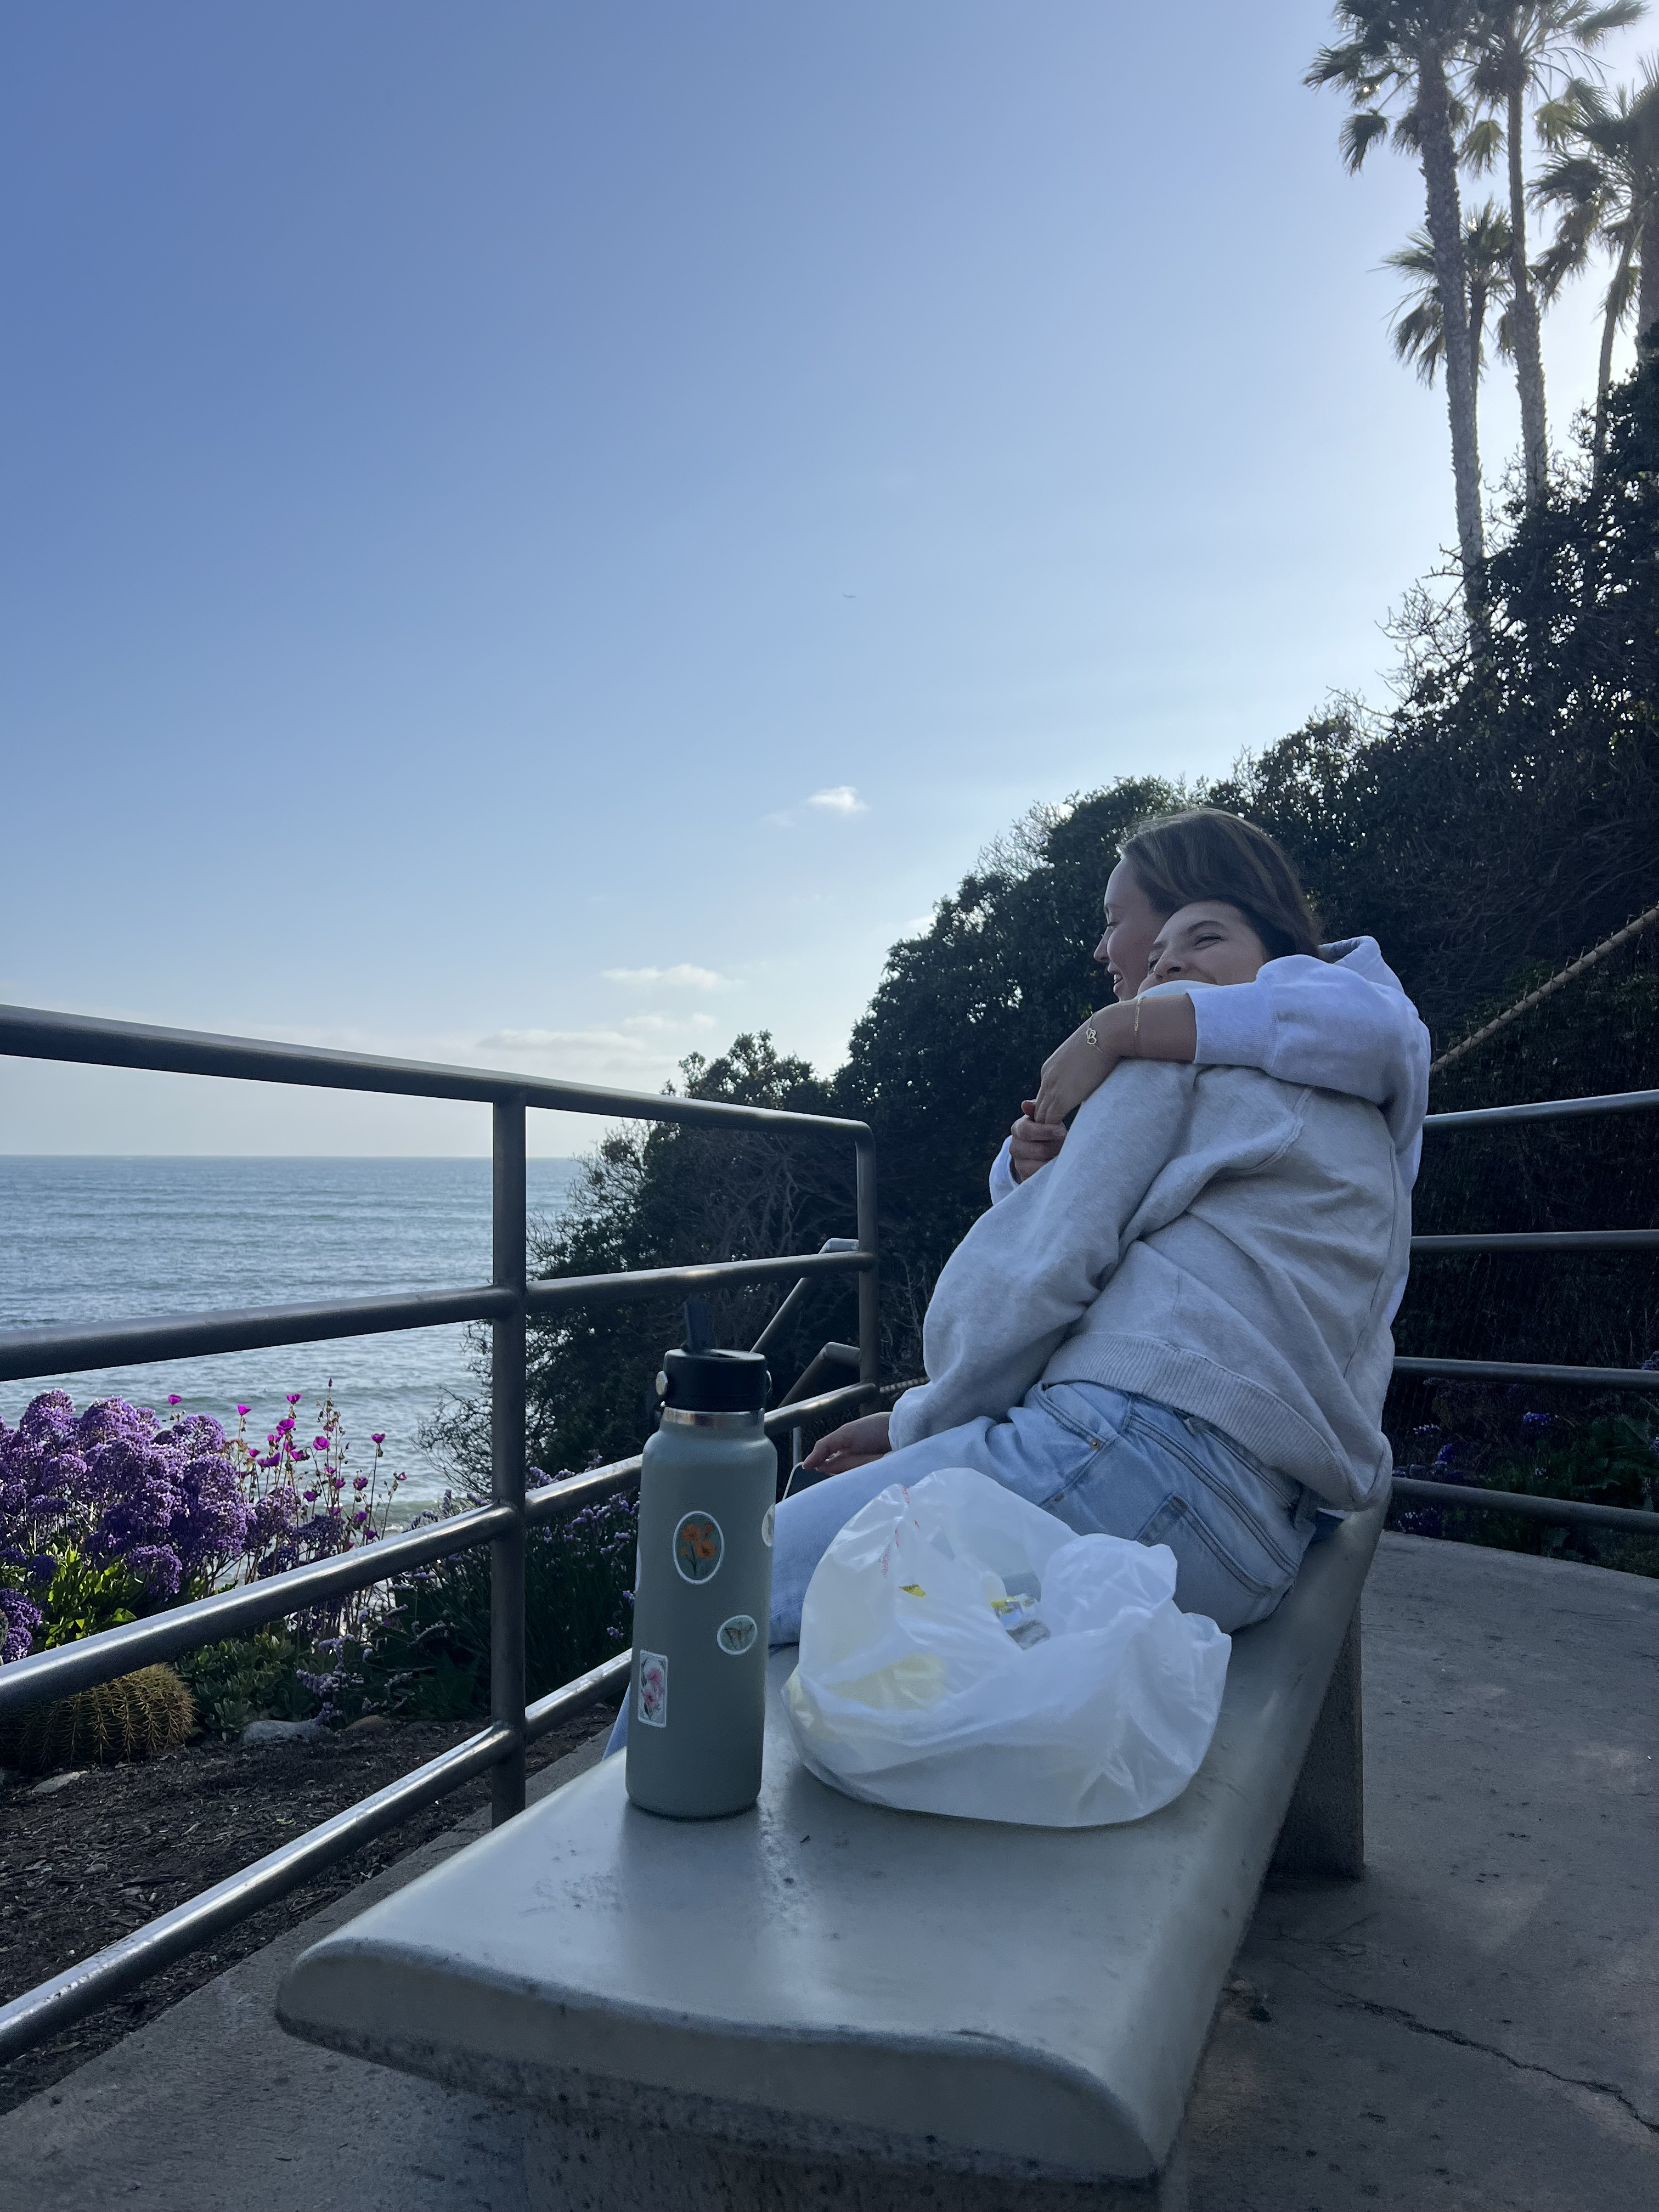
Positive things in my life
A mom who sends me pictures of my dog everyday.
Friends who I love very much.
Getting burritos and eating them by the beach weekly.

Slide 5
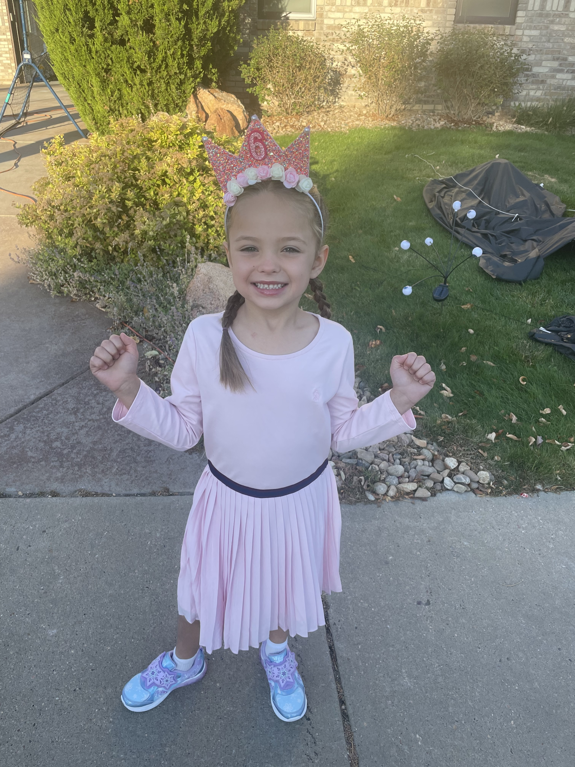
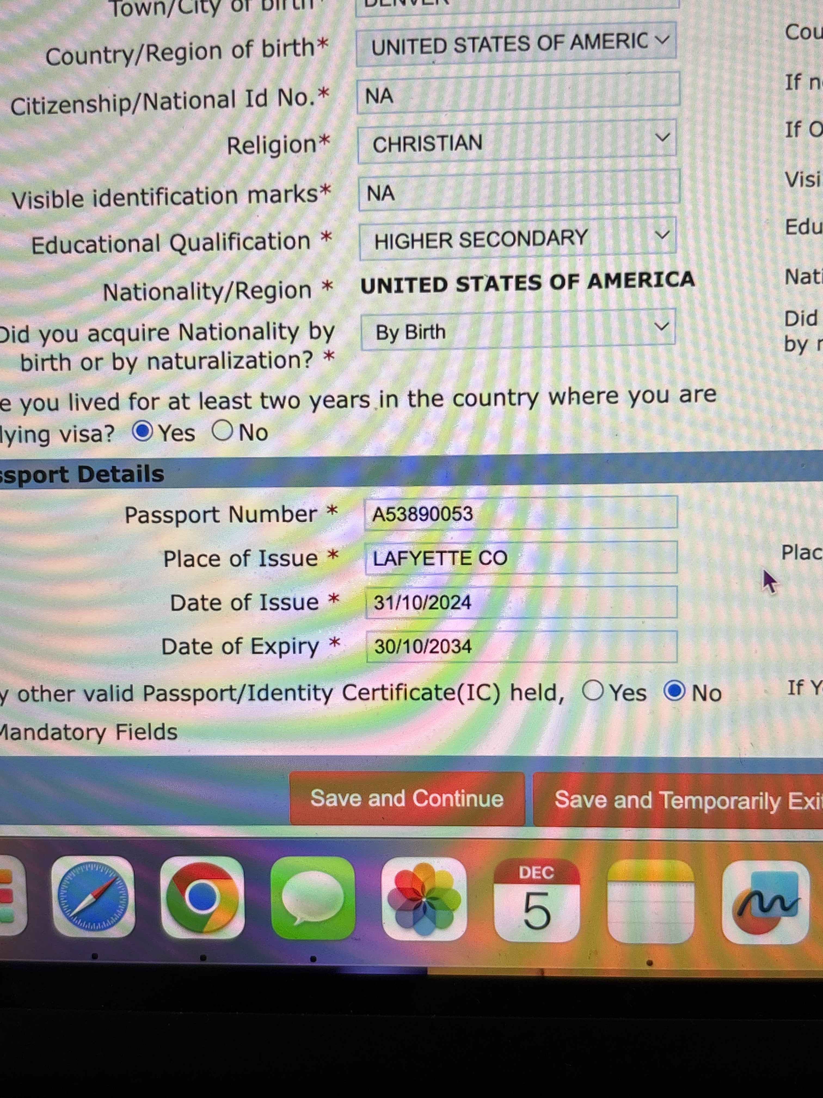
Things I never wish to experience again
I hate the fact that when I am at school, I miss my little cousin’s birthdays.
The task of trying to get an e-visa to India.

Slide 6
Newsworthy events
I got to vote this year for the first time in a presidential election which was very exciting.
This Photo by Unknown Author is licensed under CC BY

Slide 7
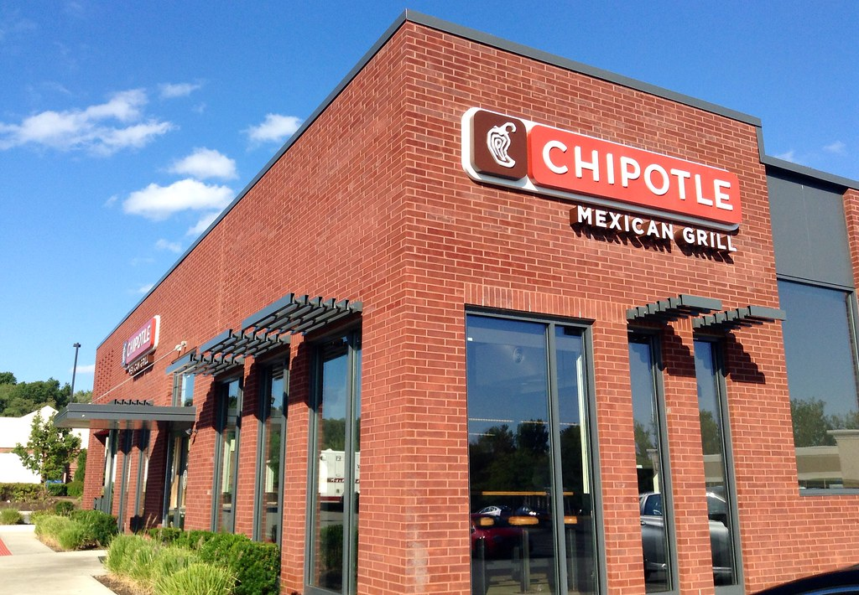
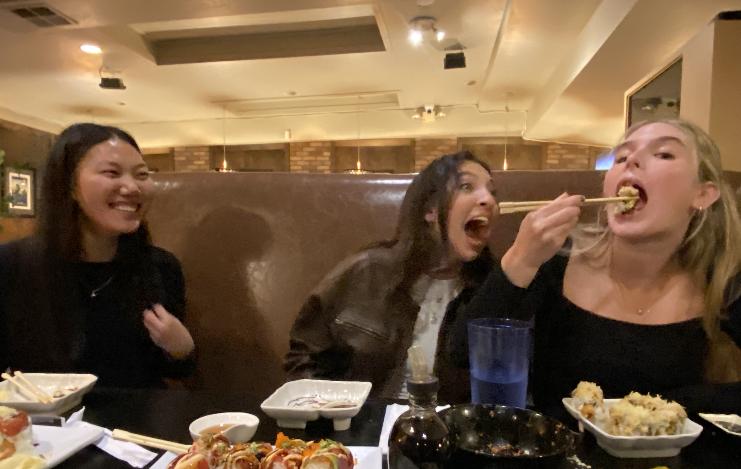
Changes this semester
Chipotle (a place I go probably every week) raised their prices by 2%.
My and my roommates' favorite sushi restaurant also raised their prices by $1.50 each roll.
This Photo by Unknown Author is licensed under CC BY

Slide 8
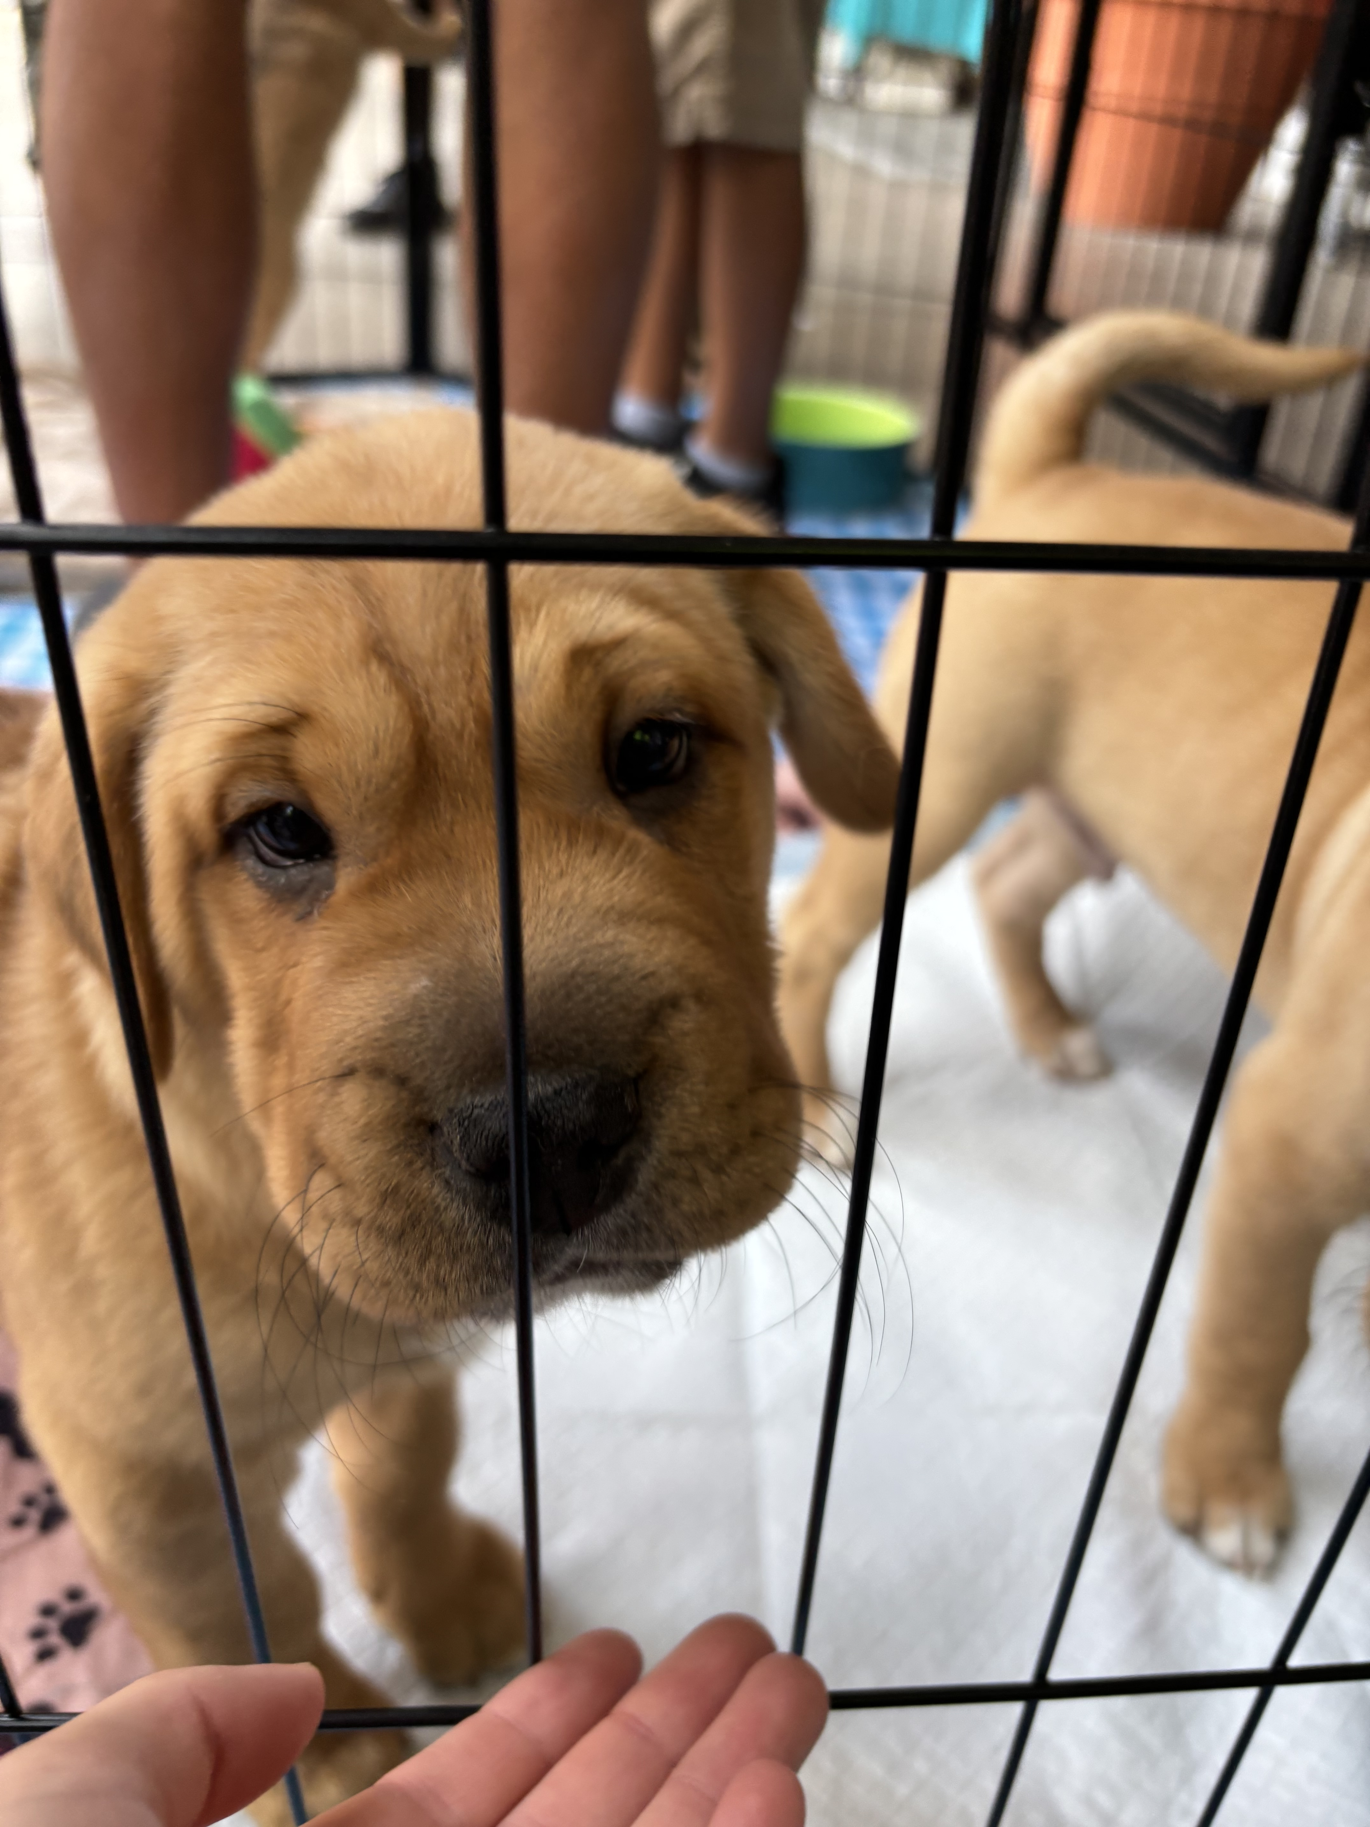
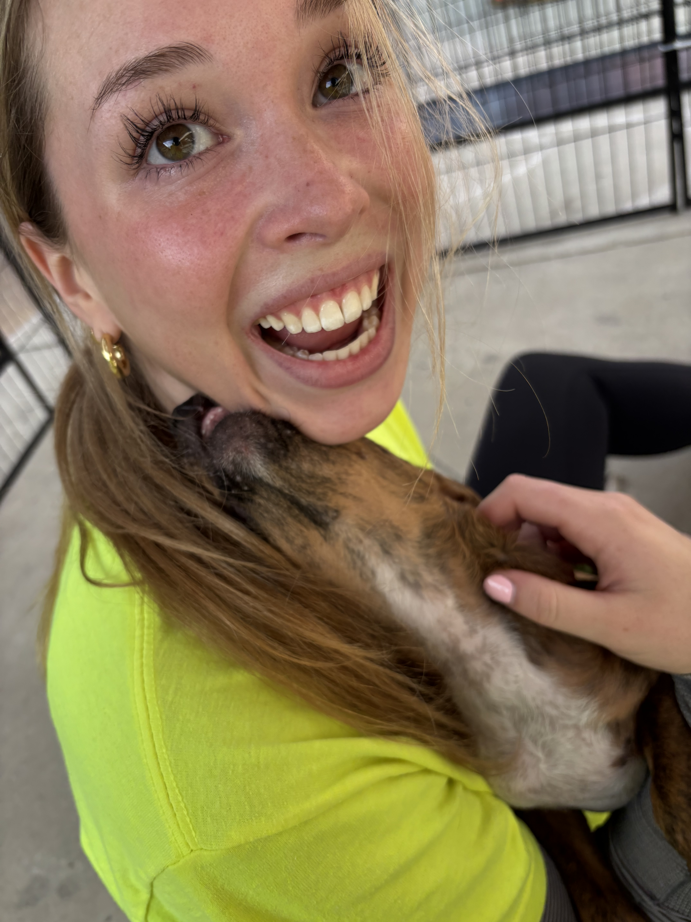
People’s creativity to help
This semester I got to participate in a Christmas pet adoption event. Over 300 rescues all over San Diego came together for one giant adoption event, and it was so cool to be a part of!

Slide 9
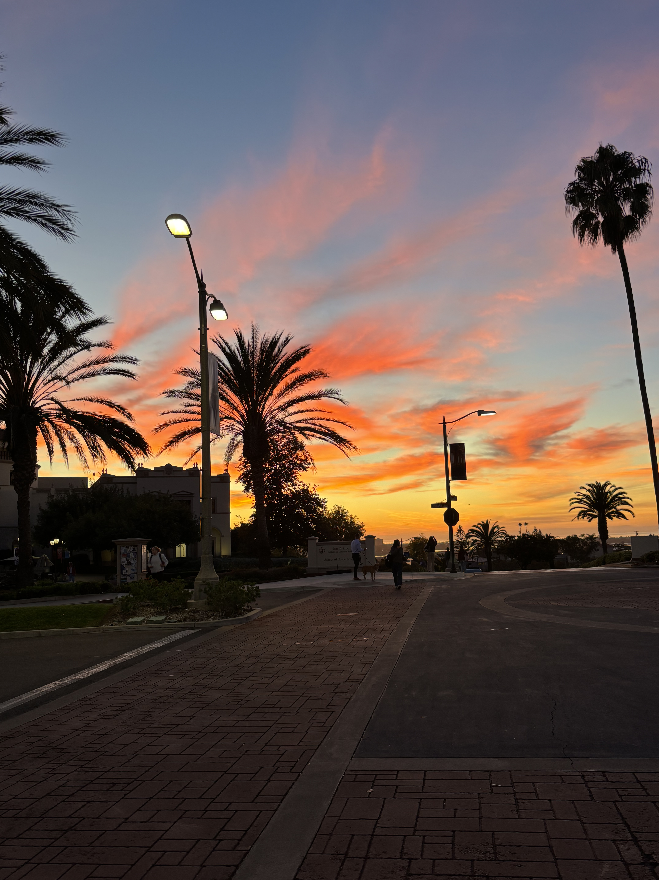
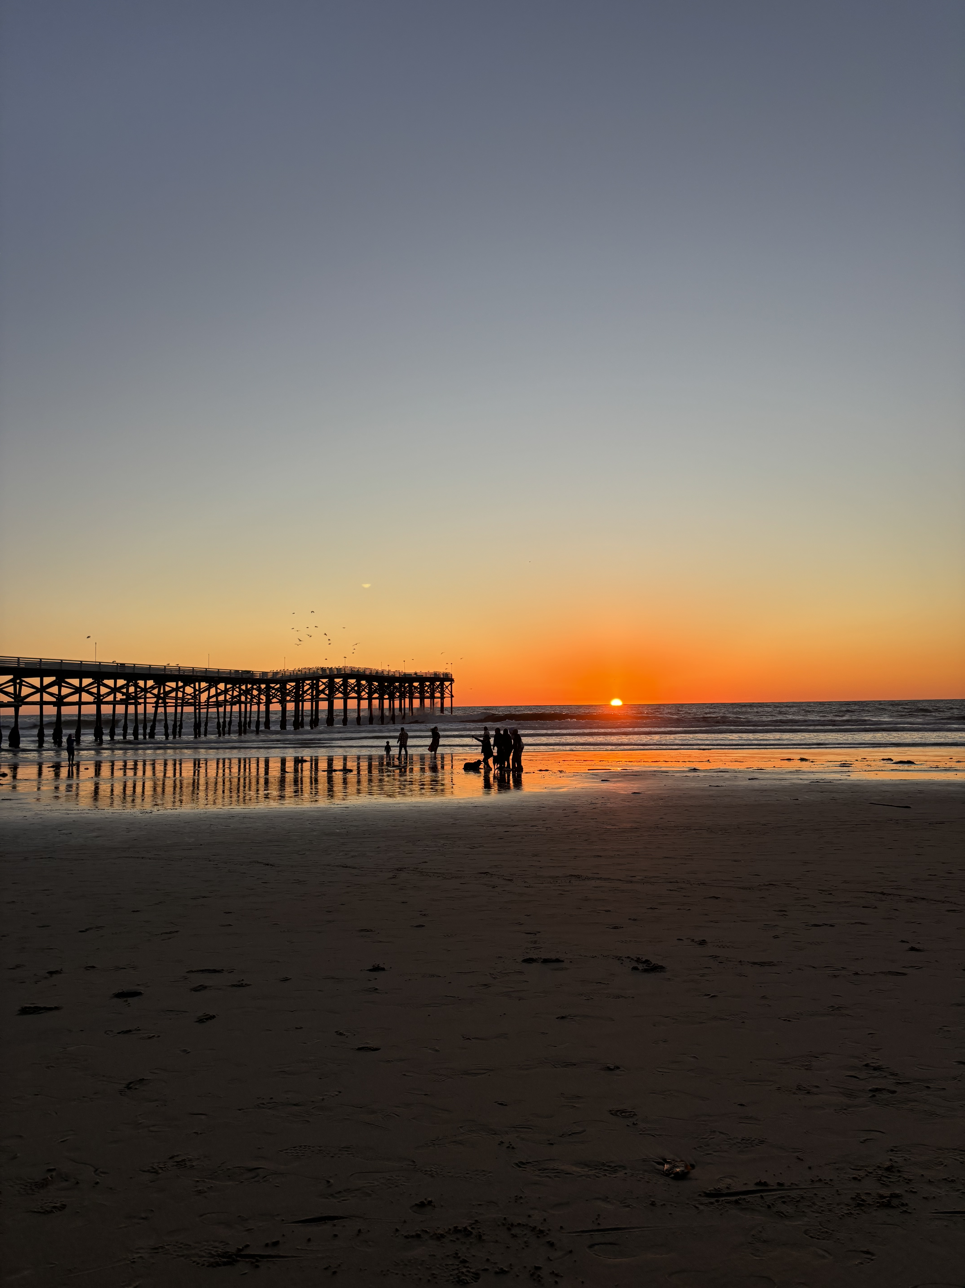
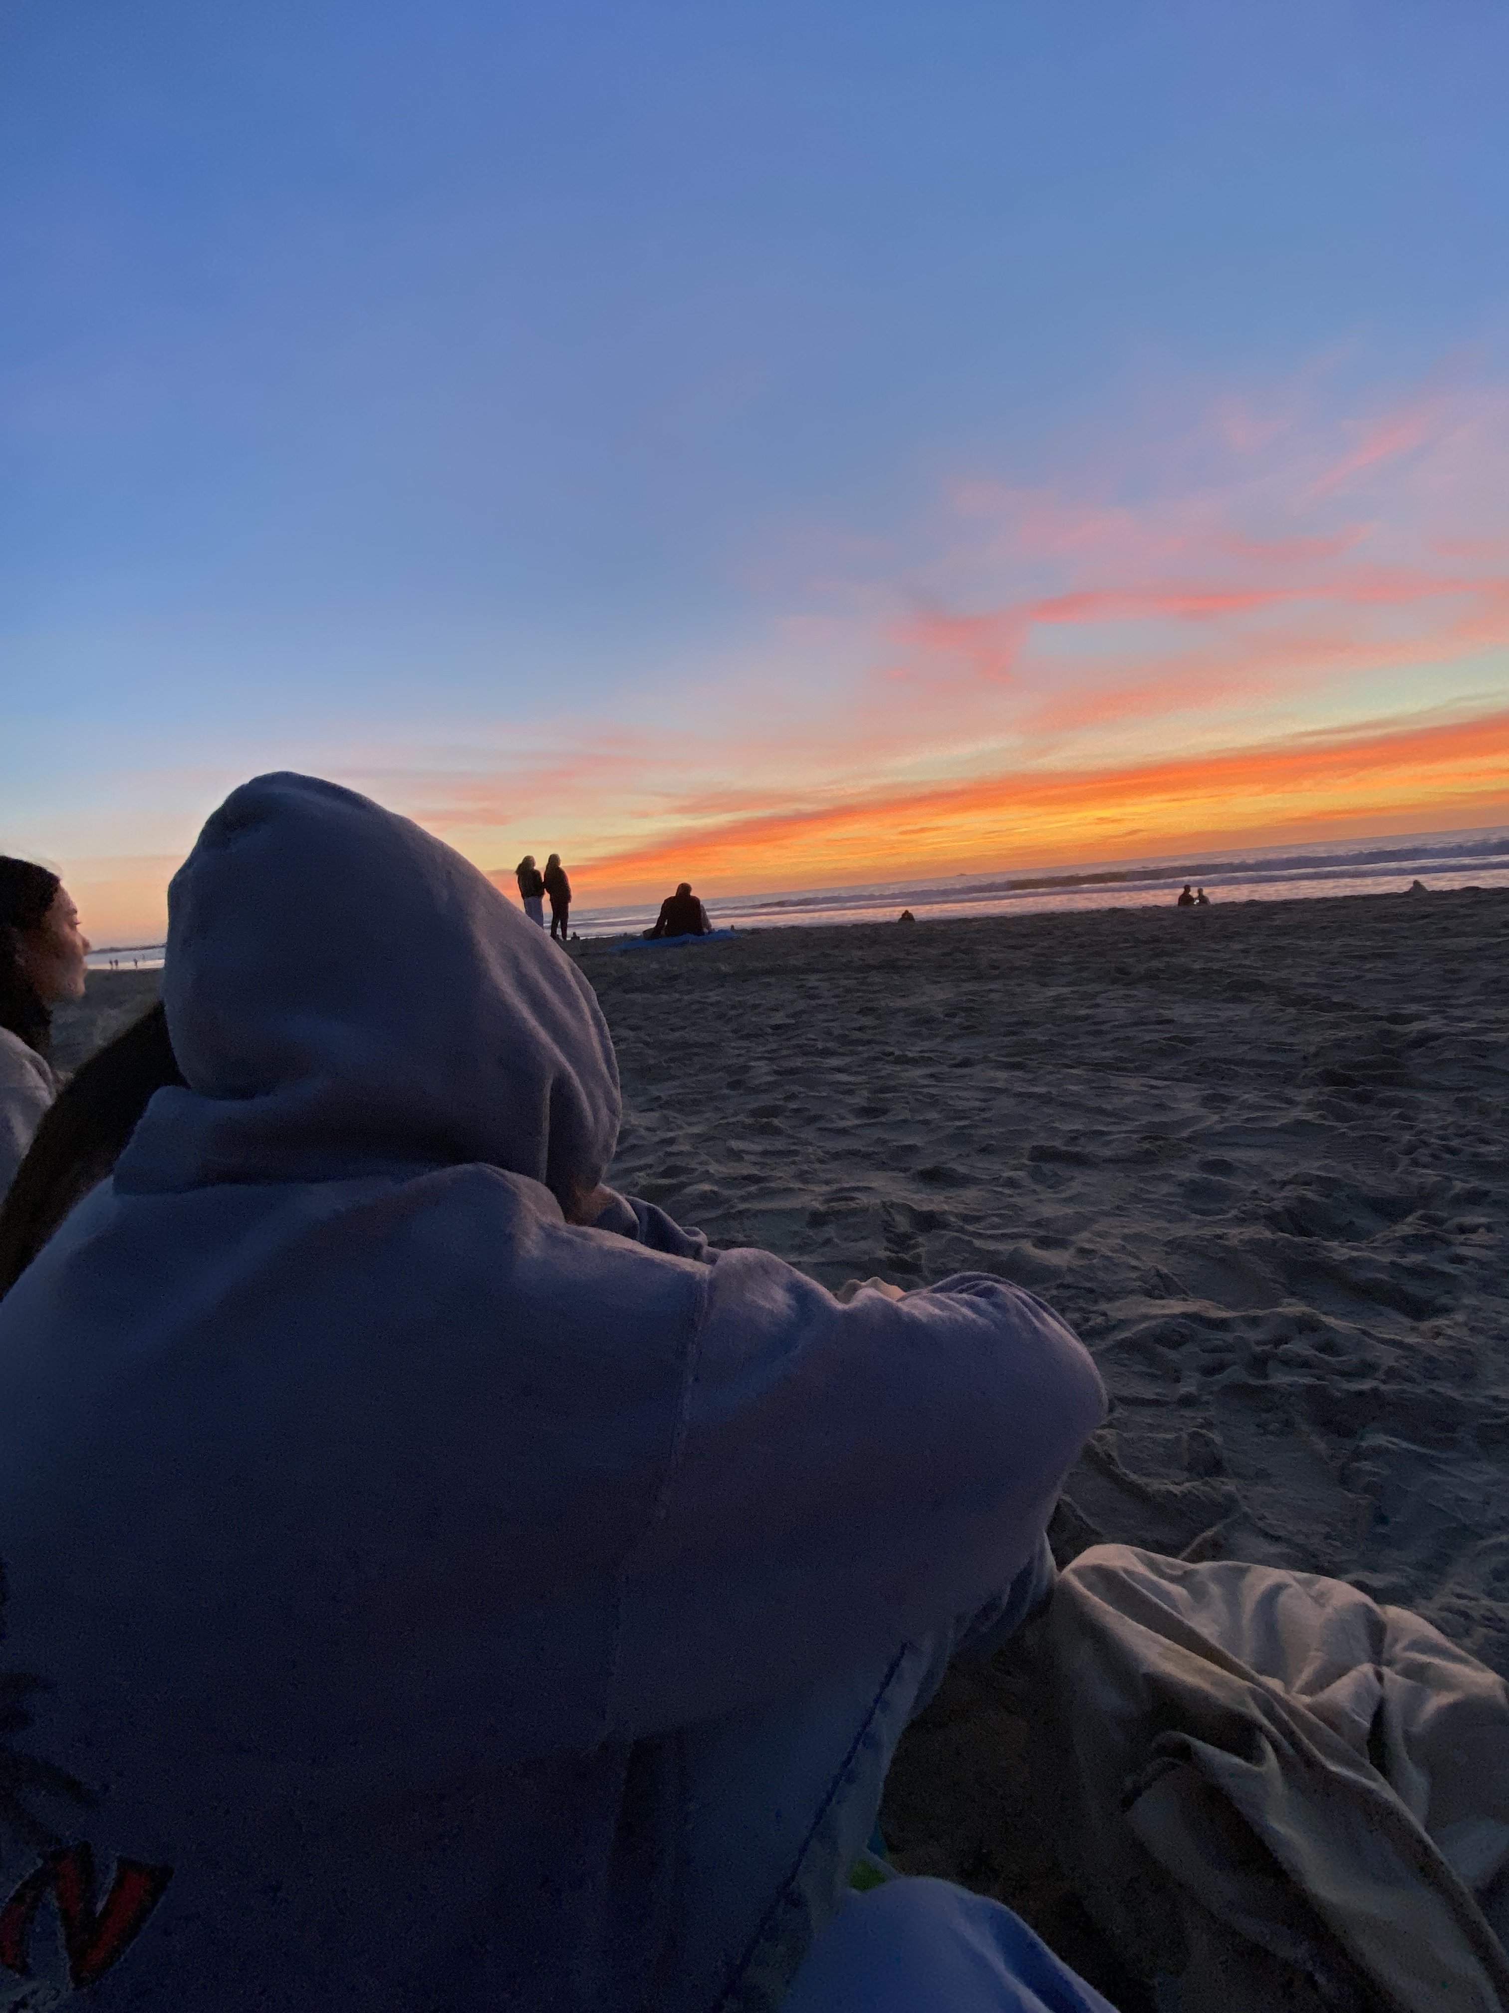
Conclusion
The semester I did have was one that was full of good times with my friends, hard classes, and overall, it went by too fast.
The only difference between the semester I did have and wanted to have is more time to get to check everything off the bucket list
I think that next semester is going to be the best one yet and the hardest to beat.

