Slide 1
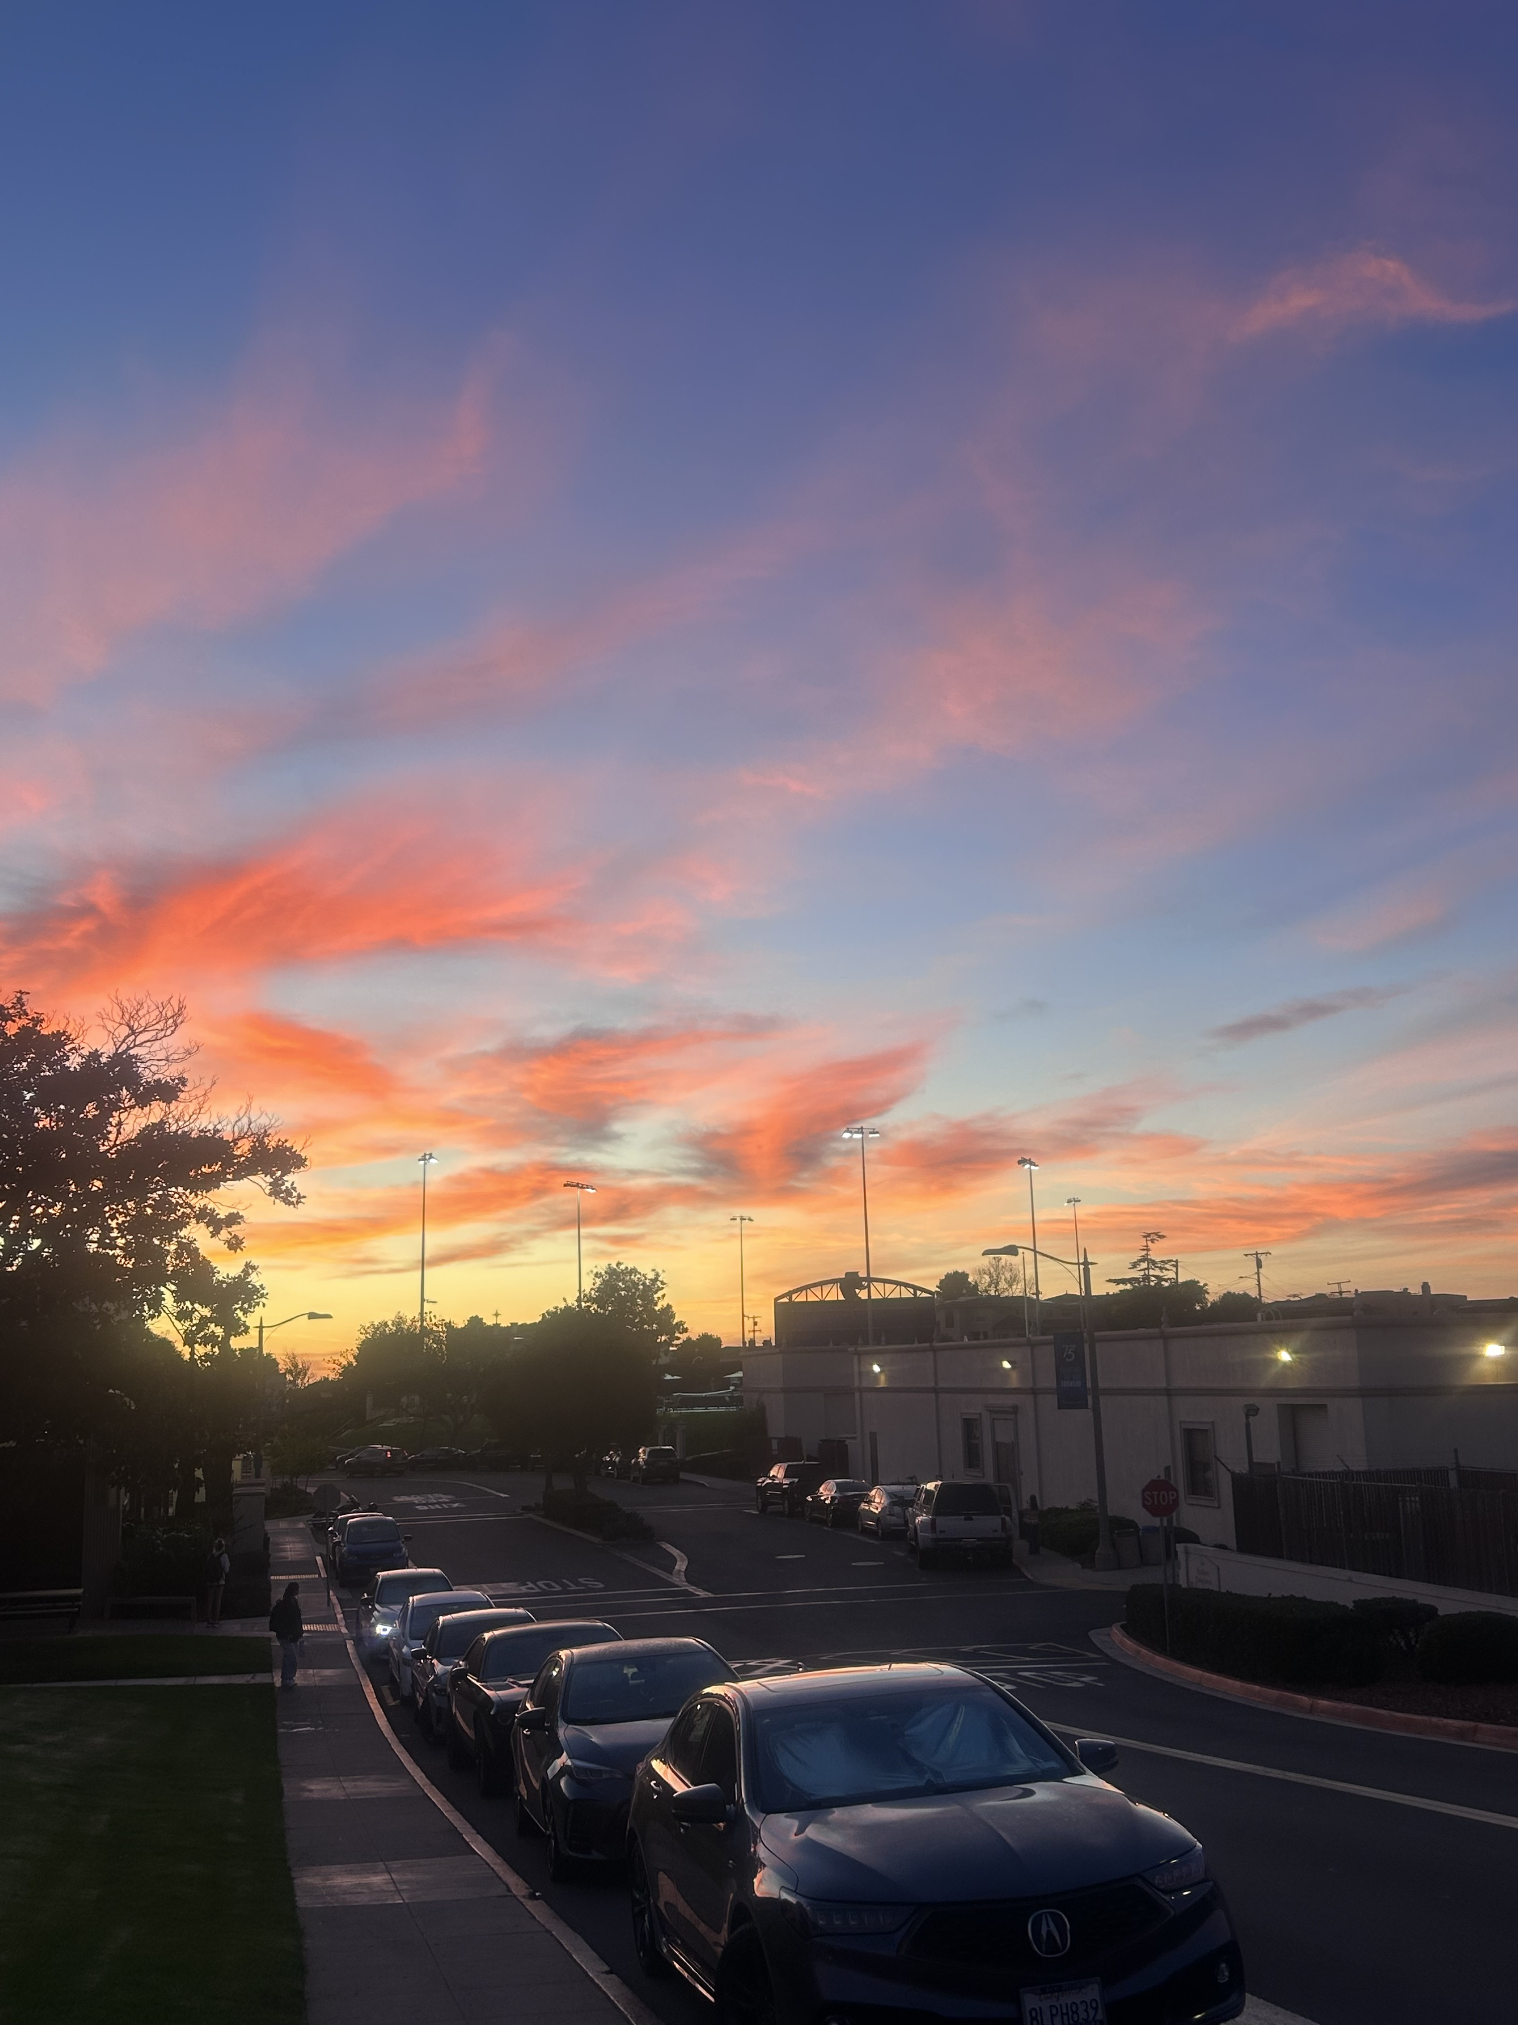
MY 2024
By: Tomas Britton

Slide 2
Items that happened in the semester individually, with friends, groups, locally, nationally
Went to the swap meet with friends I made this semester for the first time

Slide 3
Items that happened in the semester individually, with friends, groups, locally, nationally
Went to the zoo with my friends during the summer and we spent a while watching the orangutans

Slide 4
Items that happened in the semester individually, with friends, groups, locally, nationally
Went to the Del Mar fair with some friends and went into the atrium

Slide 5
Items that happened in the semester individually, with friends, groups, locally, nationally
I went to see one of my favorite movies, The Phantom Menace on May 4th

Slide 6
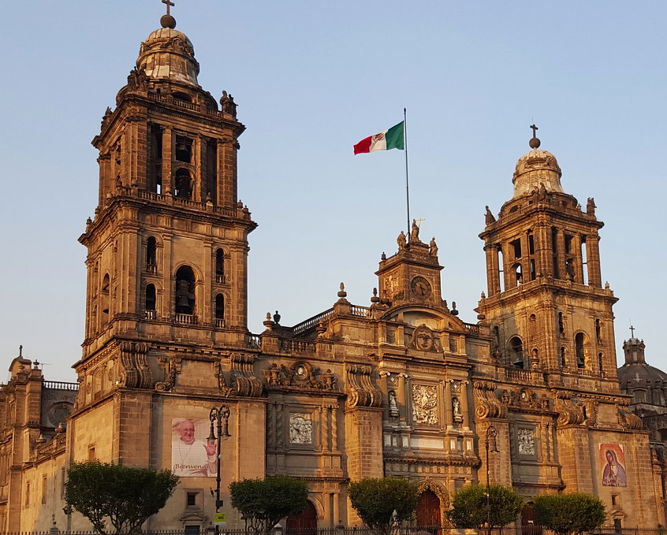
Items that did not happen that you wanted, expected
I was supposed to go to Mexico city

Slide 7
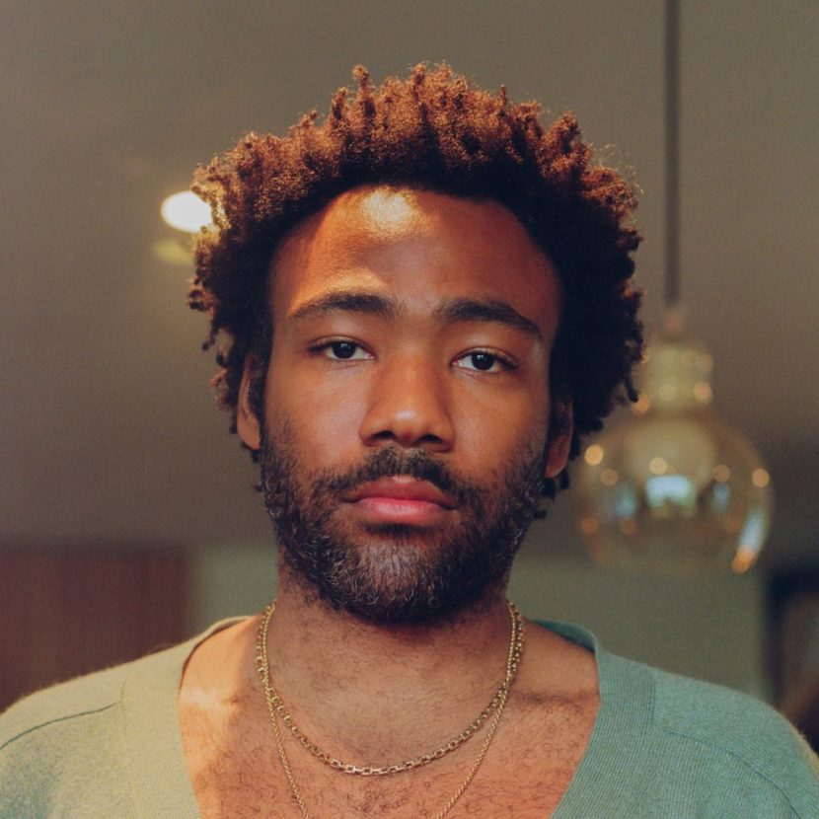
Items that did not happen that you wanted, expected
I did not go the the Childish Gambino concert.

Slide 8
Items that you experienced that have touched your life this semester in an positive way
I helped an injured bird and helped it get back to its nest

Slide 9
Items that you experienced that have touched your life this semester in an positive way
Was approached by a street cat near my house and it let me pet them and pick them up

Slide 10
Items that you experienced that have touched your life this semester in an positive way
I saw this poster talking about mental health and how its something important

Slide 11
Items that you experienced that were sad or negative that you wish not to be experienced again
The Palestine and Israel crisis

Slide 12
Items that were highlighted by news, media advertisements/messages, government, other countries, other sources
The first female Mexican president in Mexico’s history
This Photo by Unknown Author is licensed under CC BY-NC-ND

Slide 13
Items that were highlighted by news, media advertisements/messages, government, other countries, other sources
The 2024 Trump v. Kamala election
This Photo by Unknown Author is licensed under CC BY-SA

Slide 14
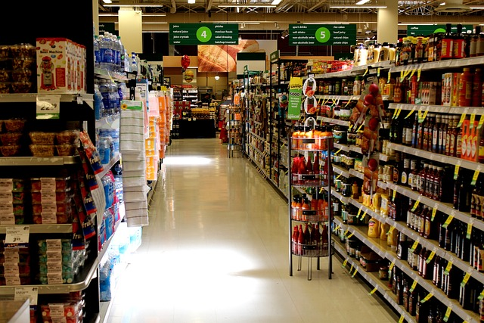
Items that illustrates changes to processes (buying food other items), laws/restrictions
California Governor Gavin Newsom recently signed a bill to standardize food date labels and ban the use of “sell by” dates.

Slide 15
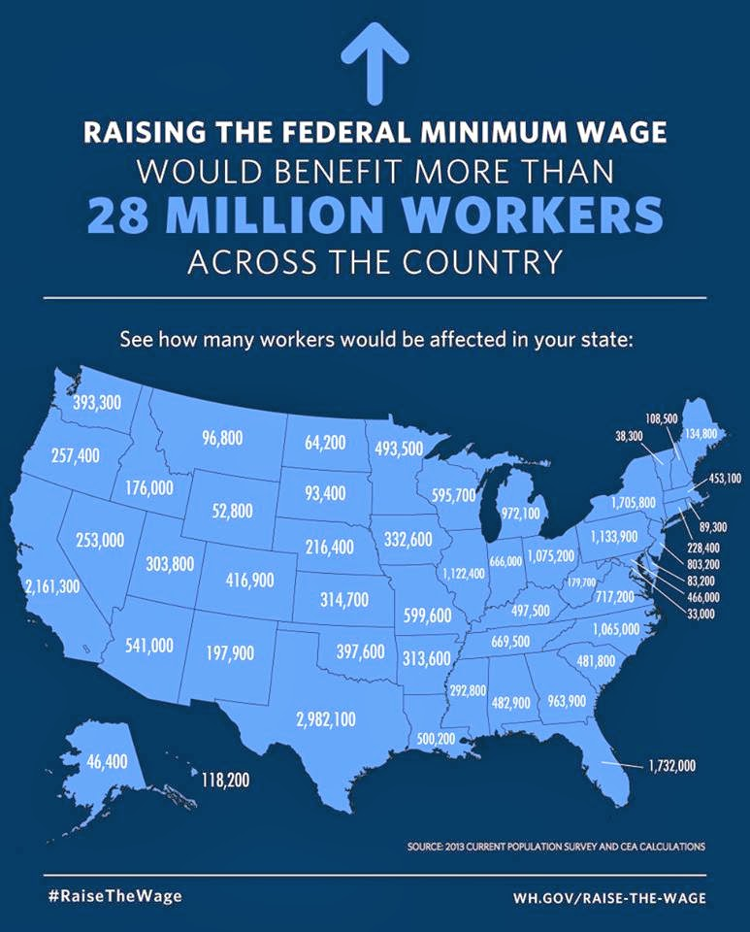
Items that illustrates changes to processes (buying food other items), laws/restrictions
As of January 1, 2024, California's minimum wage is $16 per hour for all employers

Slide 16
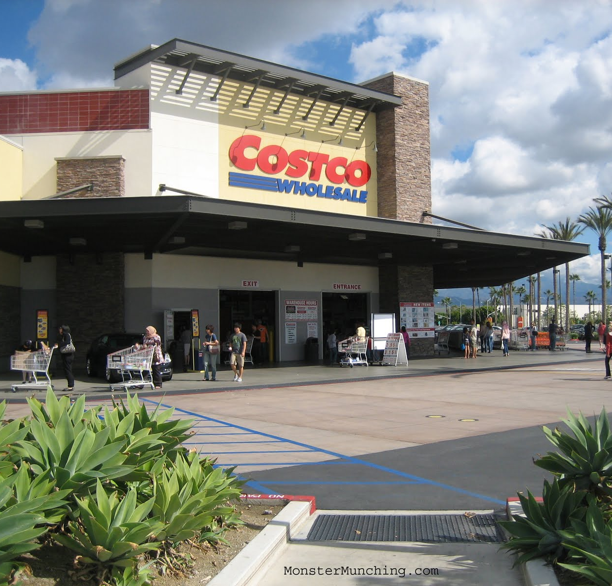
Items that illustrates changes to processes (buying food other items), laws/restrictions
At Costco food court when you buy something the option to add a double chunk chocolate cookie is put onto the screen for a lesser price

Slide 17
Items that illustrates people’s creativity to assist others (i.e. drive by birthday parties)
Made a daft punk helmet for a costume

Slide 18
Items that illustrates people’s creativity to assist others (i.e. drive by birthday parties)
Made a guitar body from scratch from a game character

Slide 19
Items that illustrates people’s creativity to assist others (i.e. drive by birthday parties)
Made cookies for an event and started my baking business

Slide 20
Other relevant items to discuss the semester you had, the semester you wanted, and the semesters that you wish to have in the future.
Started to play the electric guitar

Slide 21
Other relevant items to discuss the semester you had, the semester you wanted, and the semesters that you wish to have in the future.
Managed to tame on of the racoons in the valley.

