Slide 1
Time Capsule
Review of my semester

Slide 2
Items that happened in the semester individually, with friends, groups, locally, nationally Items that you experienced that have touched your life this semester in an positive way

Slide 3
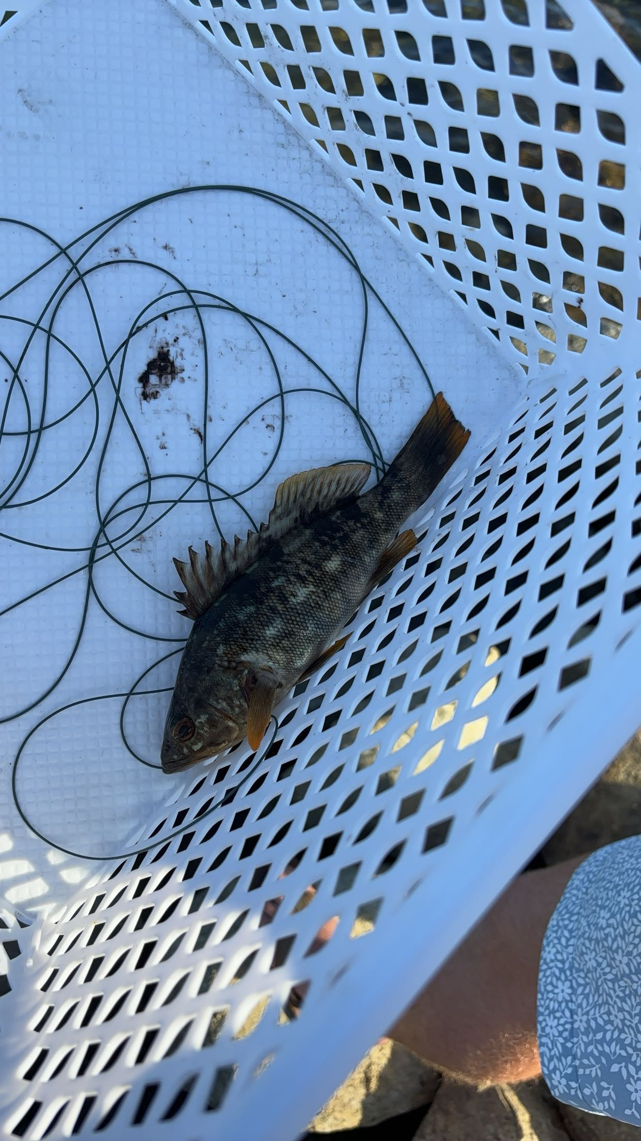
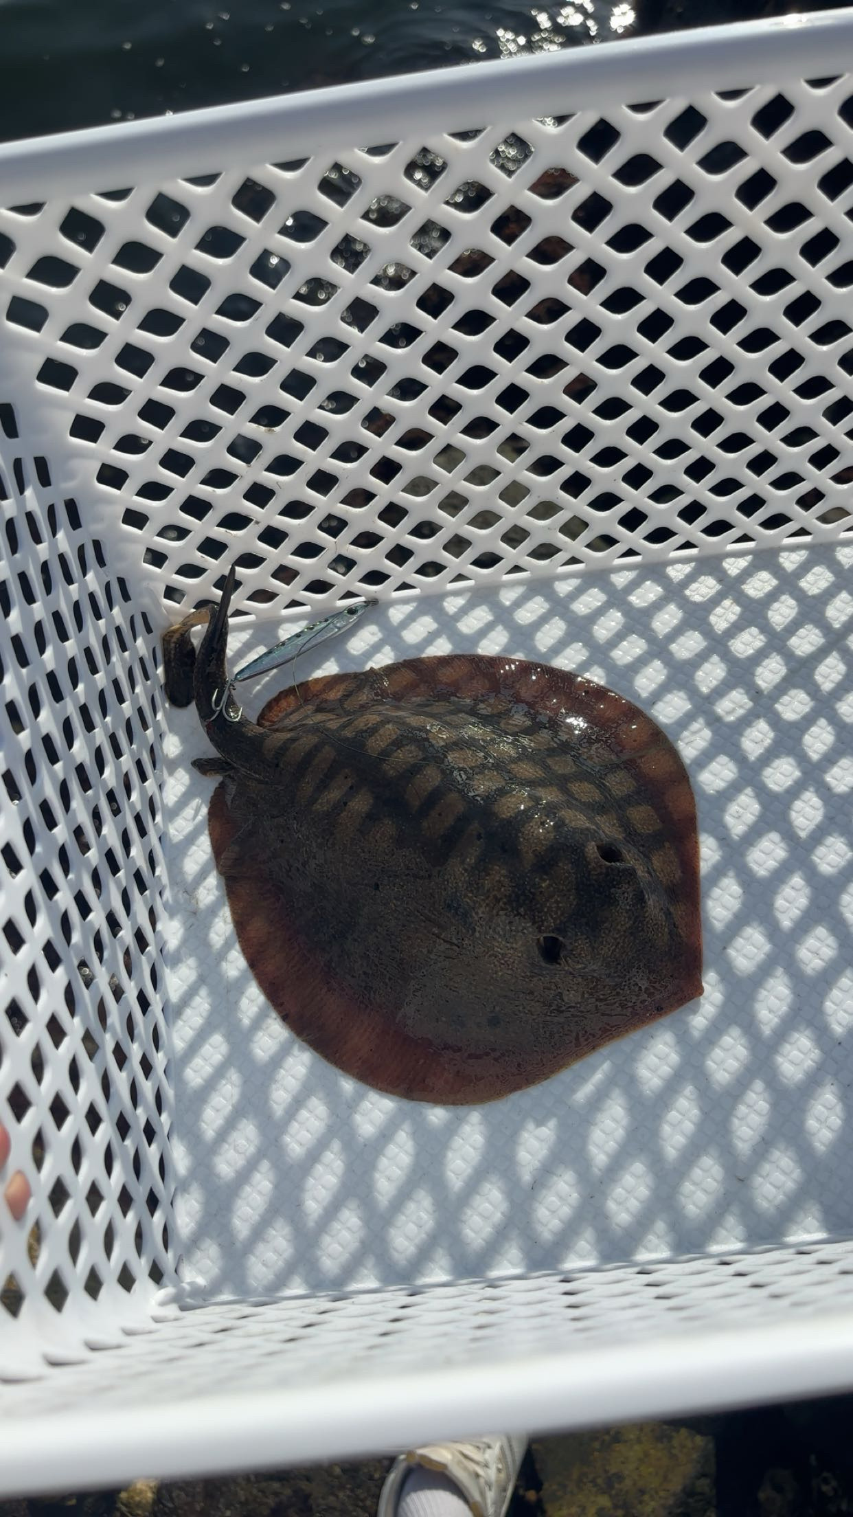
Went Fishing
I went fishing at the beginning of the semester with my roommate. It was a good way to get to know him and it made us much closer. I caught a stingray which was cool along with a spotted sea bass.

Slide 4
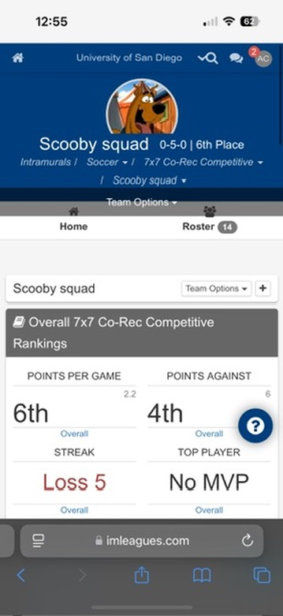
Intramural Soccer and Flag Football
I played both soccer and flag football. It was a good way to get to know people at school and make new connections.

Slide 5
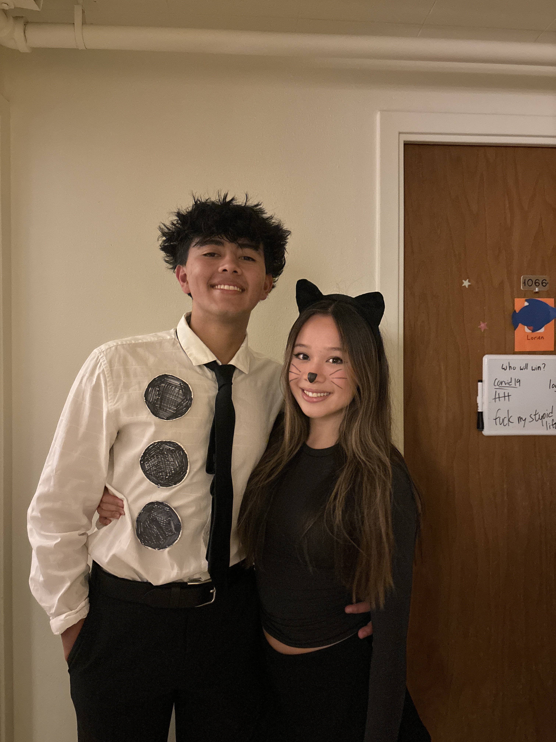
Went To Seattle
Visited my girlfriend in Seattle twice. It was fun exploring a new city and looking forward to going back.

Slide 6
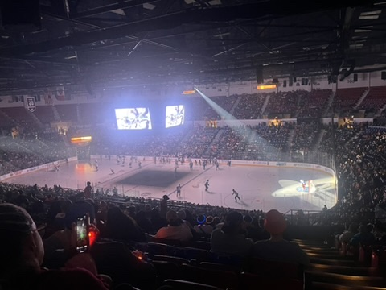
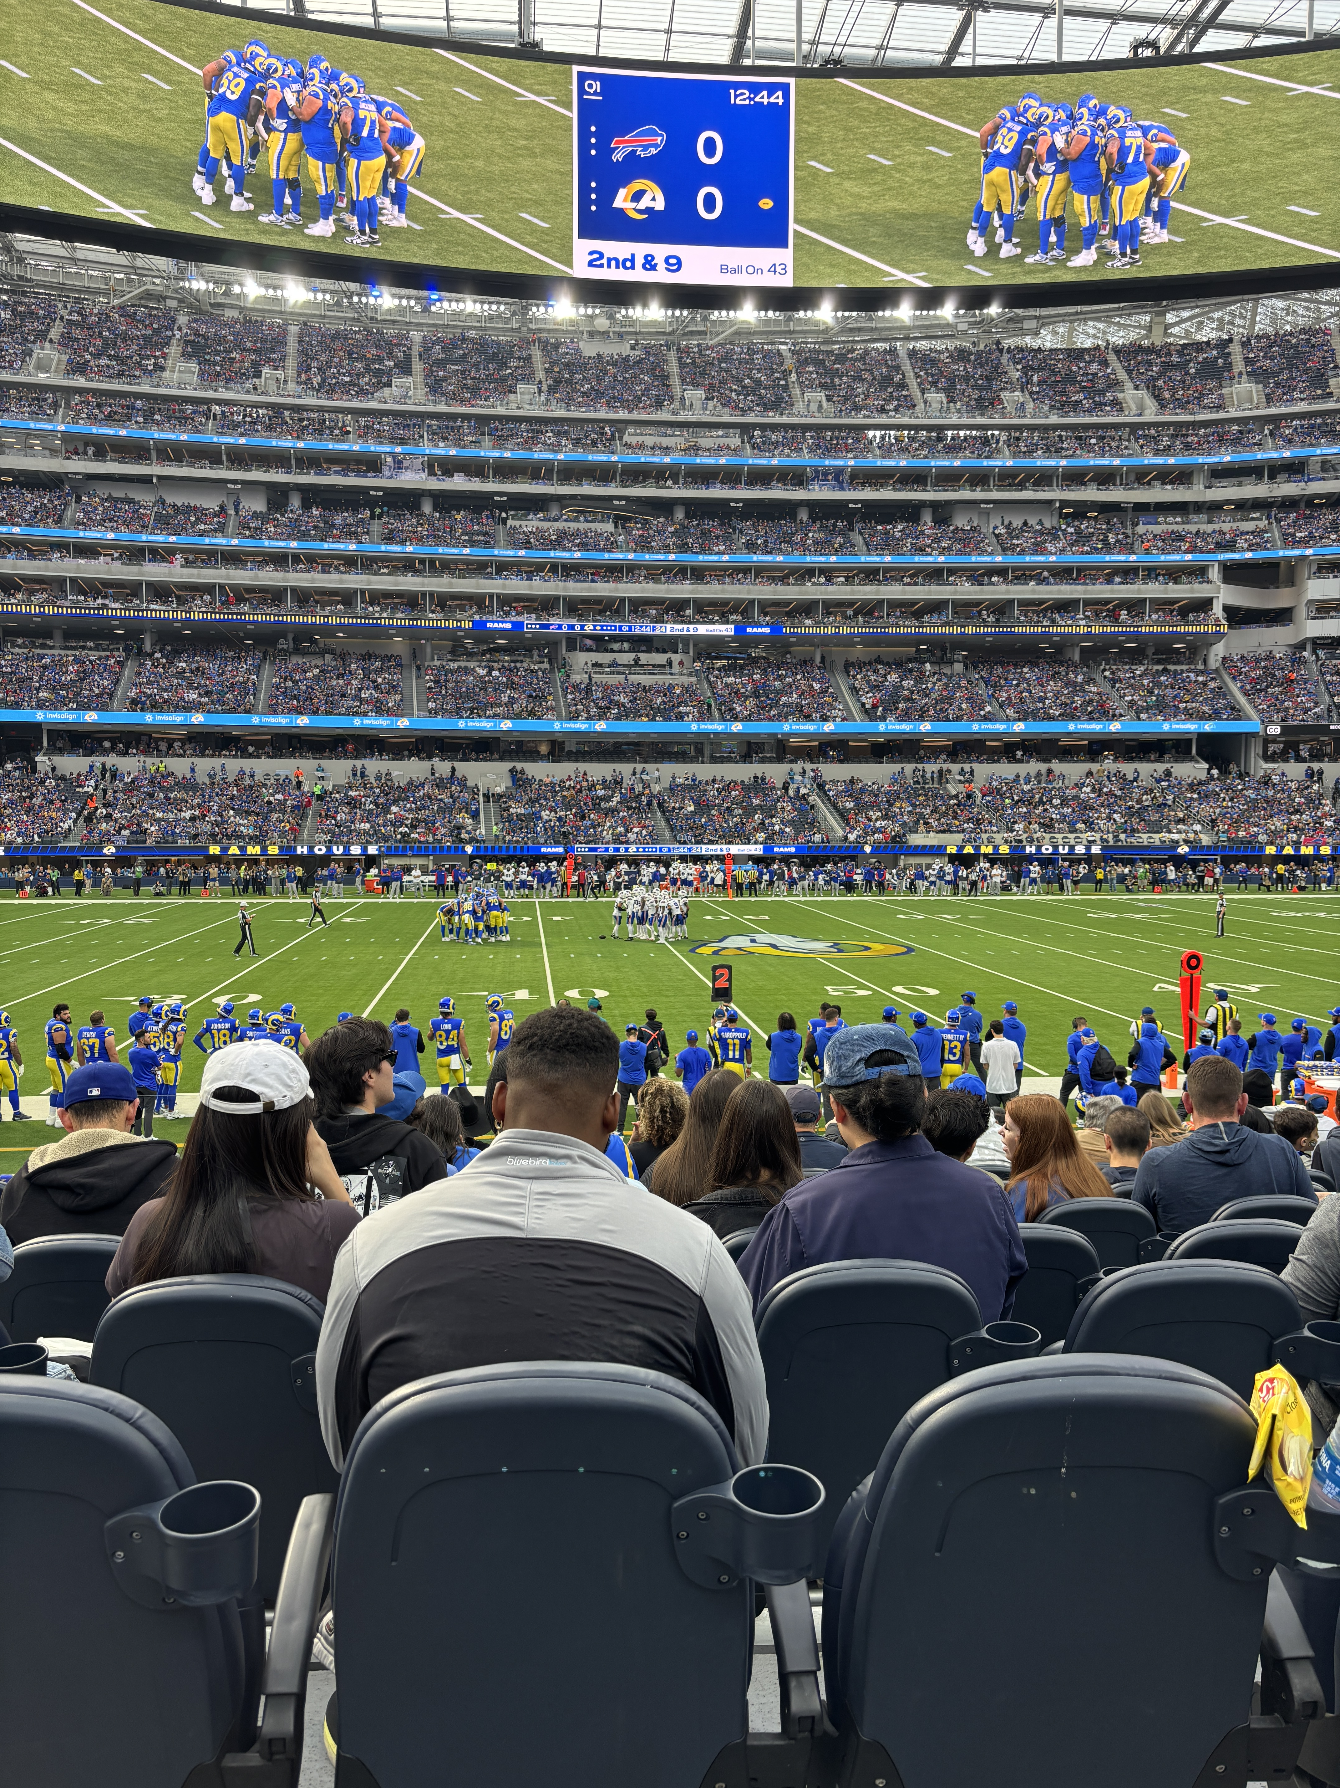
Went to PadreS,Rams, and Gulls Game
Went to multiple sports games. It was very fun experiencing the different sports live and I truly felt the difference between watching a game on the T.V and watching in person.

Slide 7
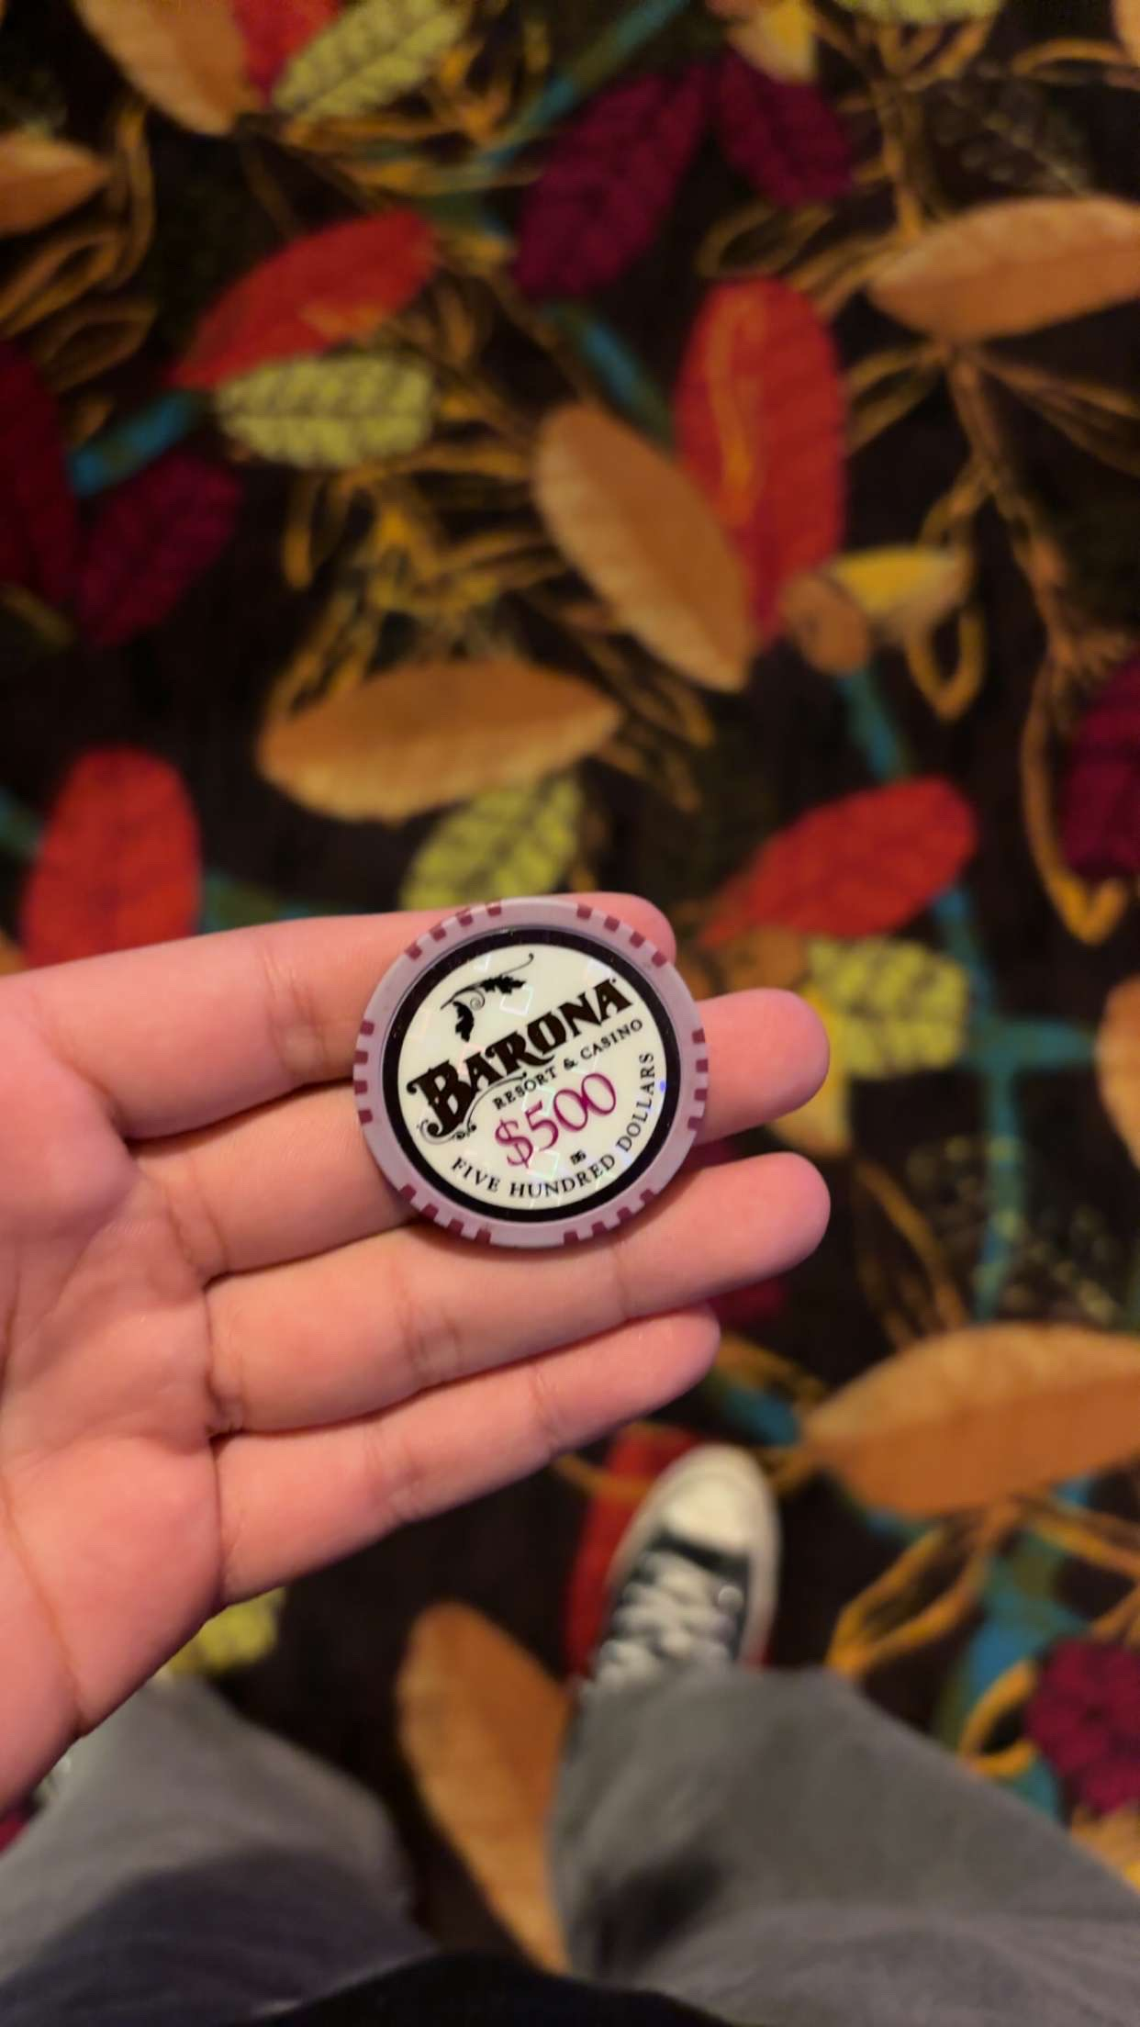
Went to Casino
I went to the casino a couple of times this semester with my friends. It is quite fun but also can be dangerous when you are at the casino.

Slide 8
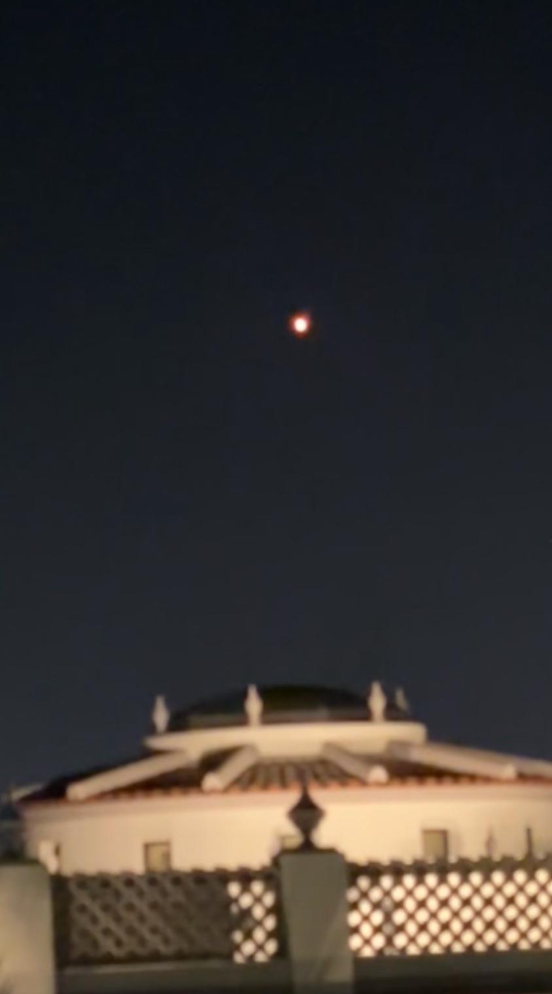
Studying In KNauss
I spent a lot of time studying and doing work in Knauss at night. Got to witness a SpaceX Launch on one of the days.

Slide 9
Things that I Do Not want to experience again

Slide 10
NO A/C at the Start of the year
First month of college was brutal with the weather. We had 5 fans on and left the door open when we were sleeping.

Slide 11
Things that did not happen that I wanted to Happen

Slide 12
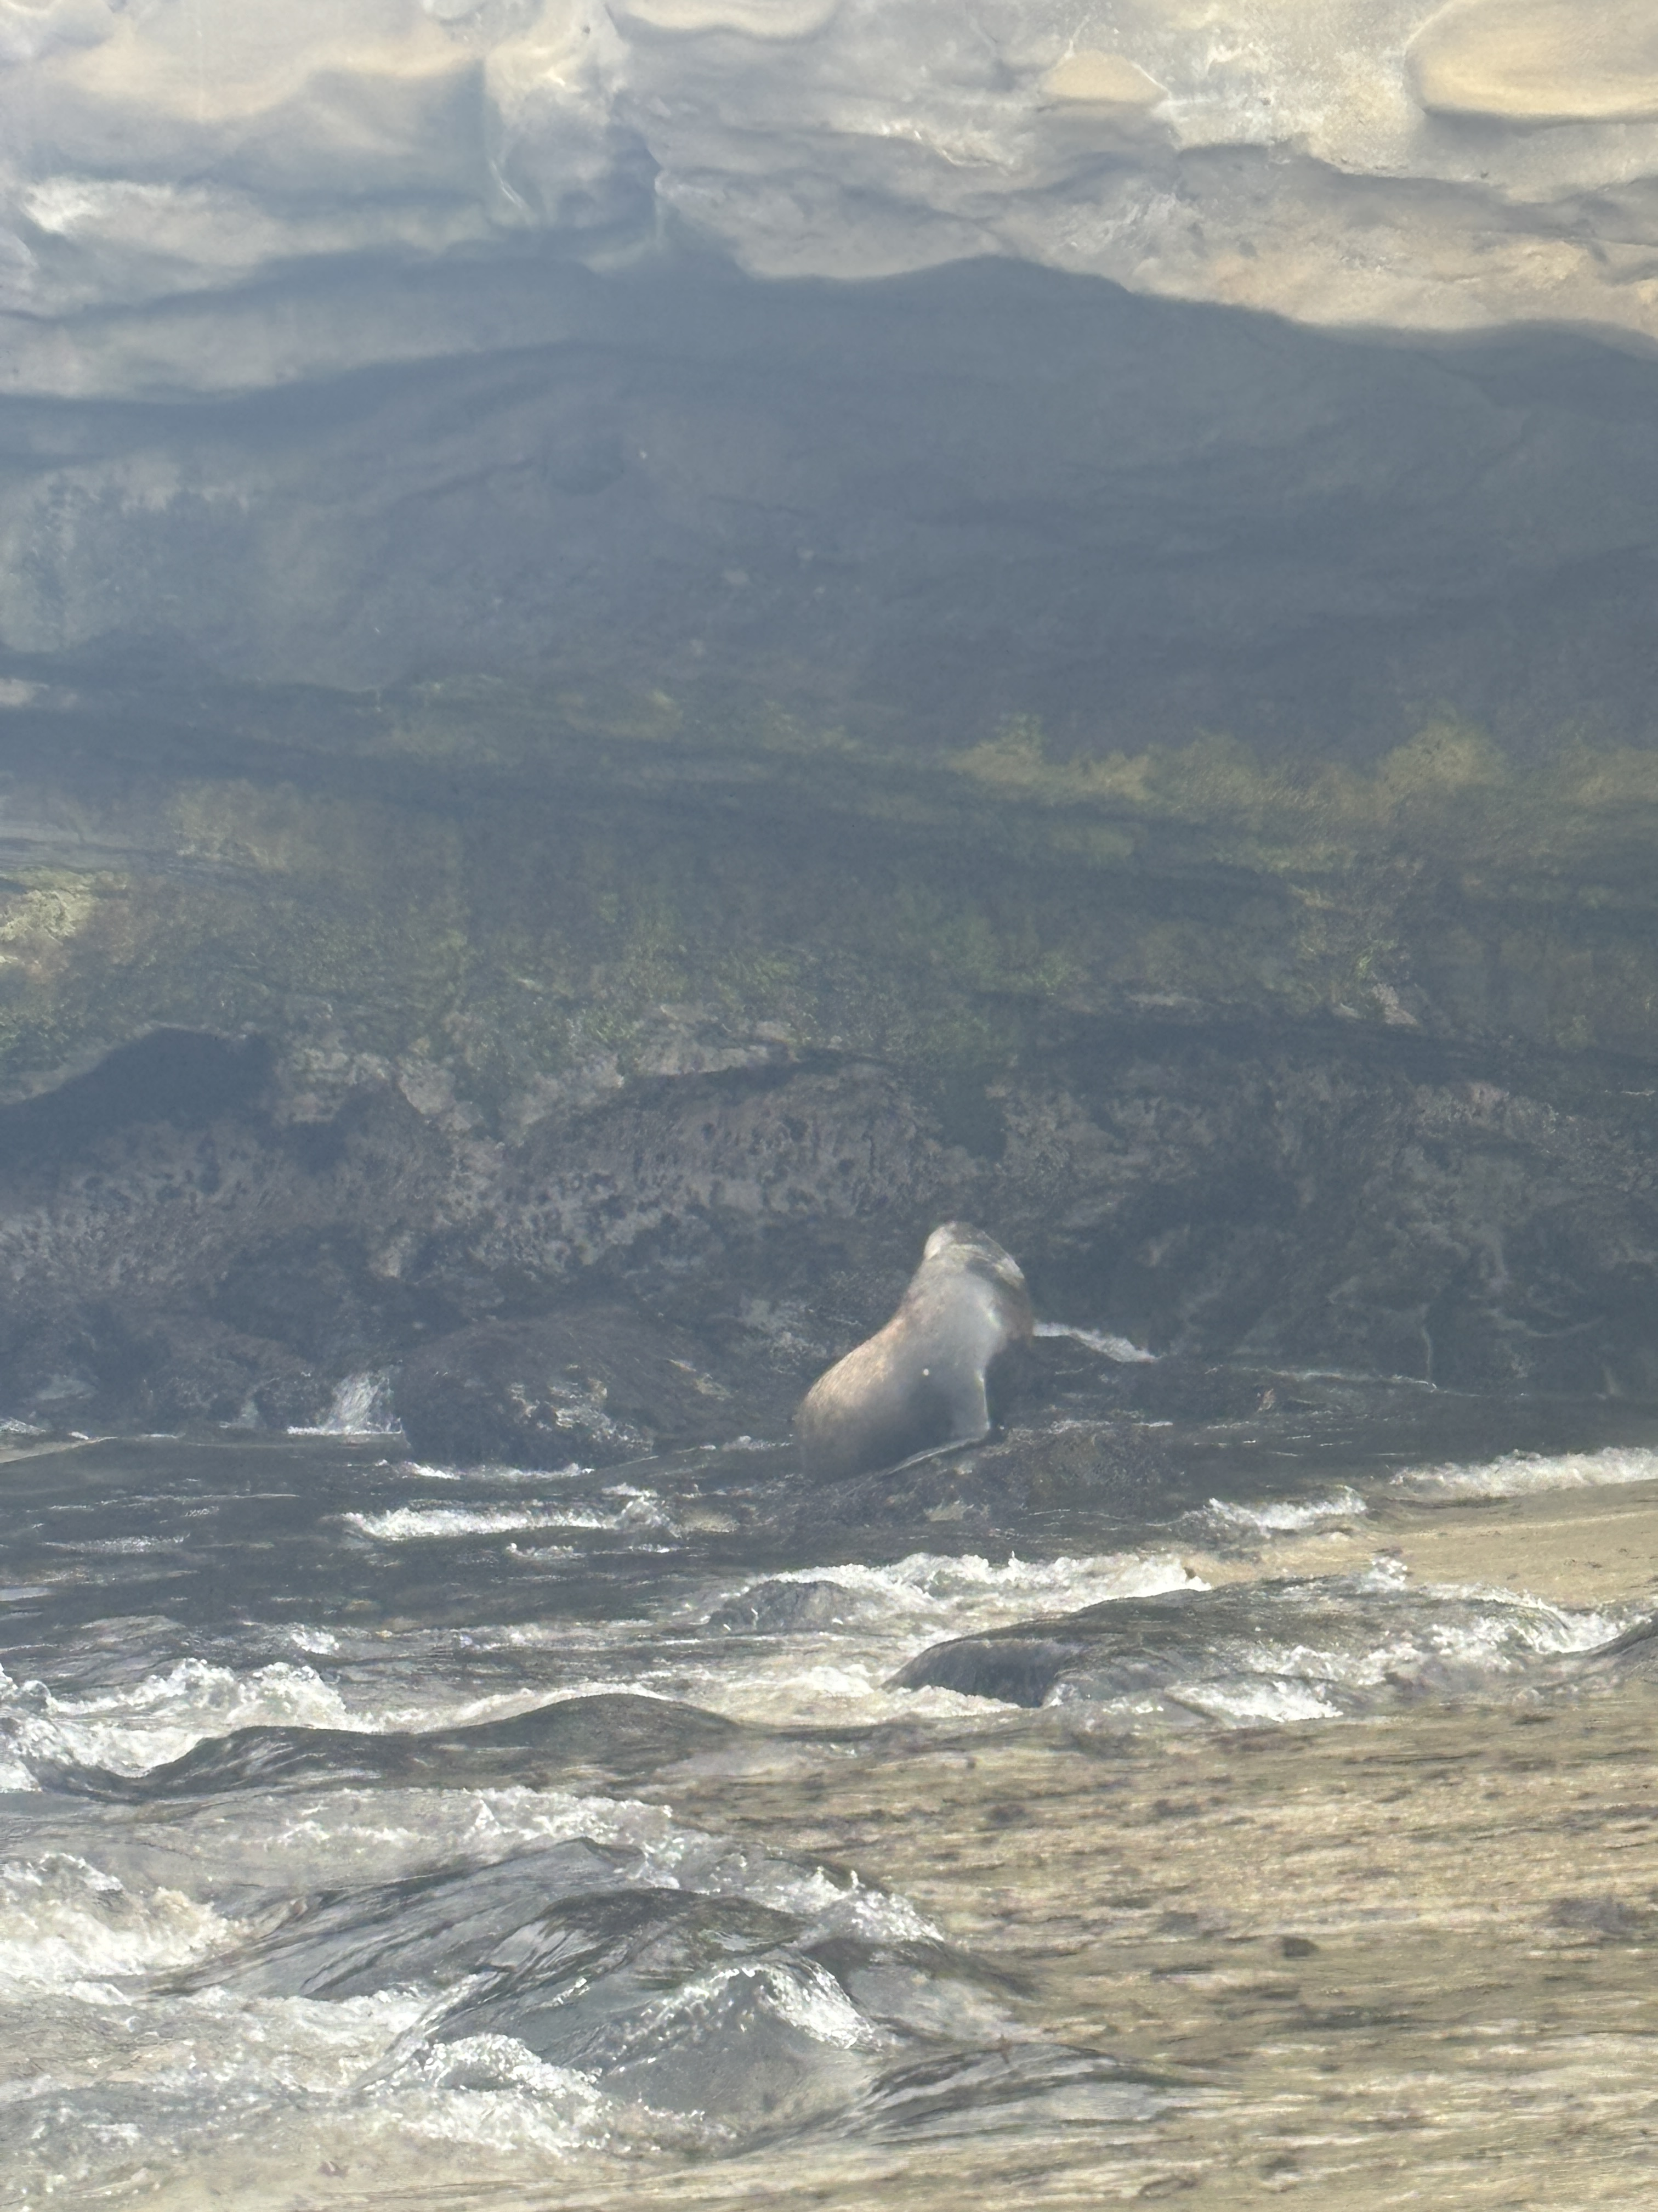
Wanted to go to the beach more
I did not go to the beach a single time during this semester which looking back on I regret since the weather is always so nice in San Diego.

Slide 13
Major News during this past semester

Slide 14
The Election
The most significant world event that happened during the semester was the election. After the election many of my classes were canceled which was pretty significant.

Slide 15
Things I want to happen Next Semester

Slide 16
Join More Intramurals
Next semester I want to experiment with more sports for intramural. I really enjoyed playing intramurals this past semester and want to continue it.

Slide 17
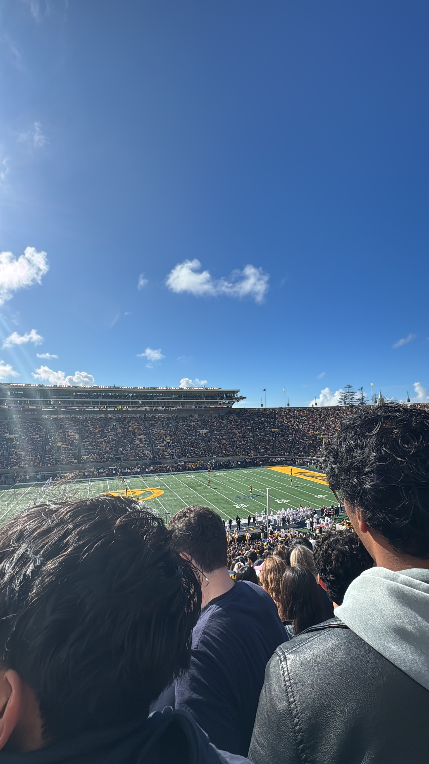
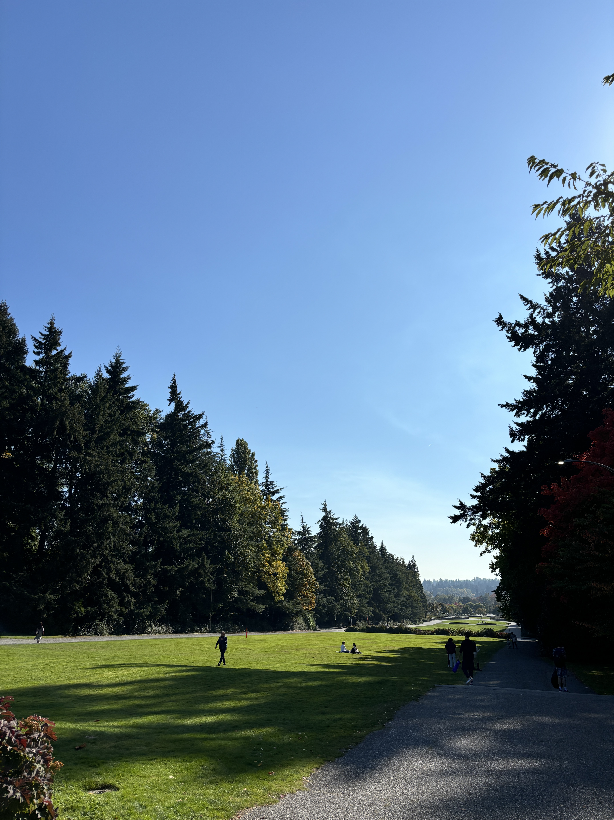
Travel
I want to possibly travel more next semester if I can such as visiting my friends at their colleges since I have Fridays off next semester.

Slide 18
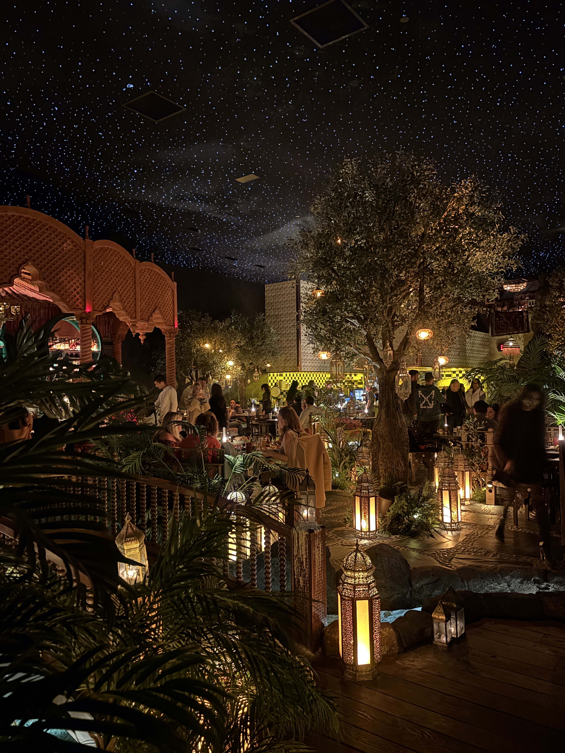
Overview
This semester has been an incredible journey, filled with many highs and, thankfully, only a few challenges. I’ve had the privilege of making a lot of new friends, and I’m excited to continue building connections in the coming semester. I enjoyed all of my classes and am eagerly looking forward to the ones ahead. Participating in intramurals was a highlight, as it allowed me to stay active, have fun, and meet amazing people. I also took the opportunity to explore San Diego, creating unforgettable memories and discovering new experiences. Traveling to places I’d never been before added even more excitement and broadened my perspective. Looking ahead, I hope to continue attending as many sports games as possible and making the most of every opportunity to grow, learn, and connect.

