Slide 1
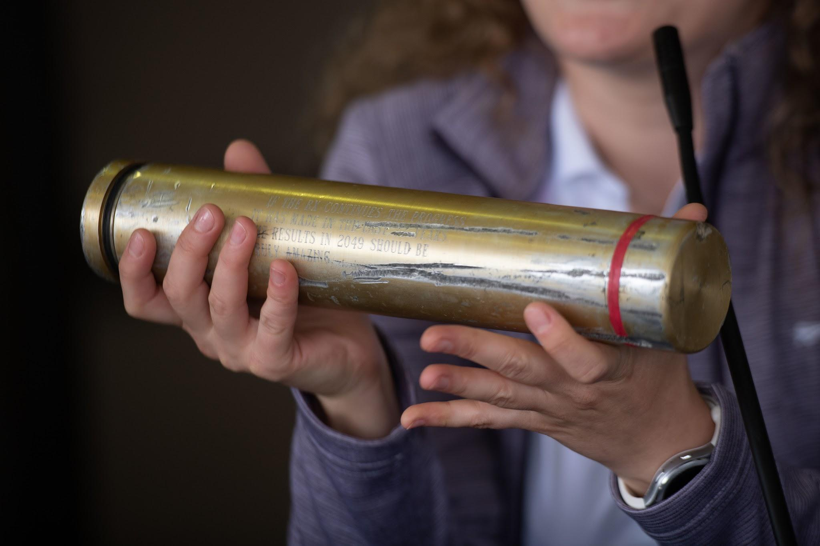
Time Capsule Emilio Costa

Slide 2
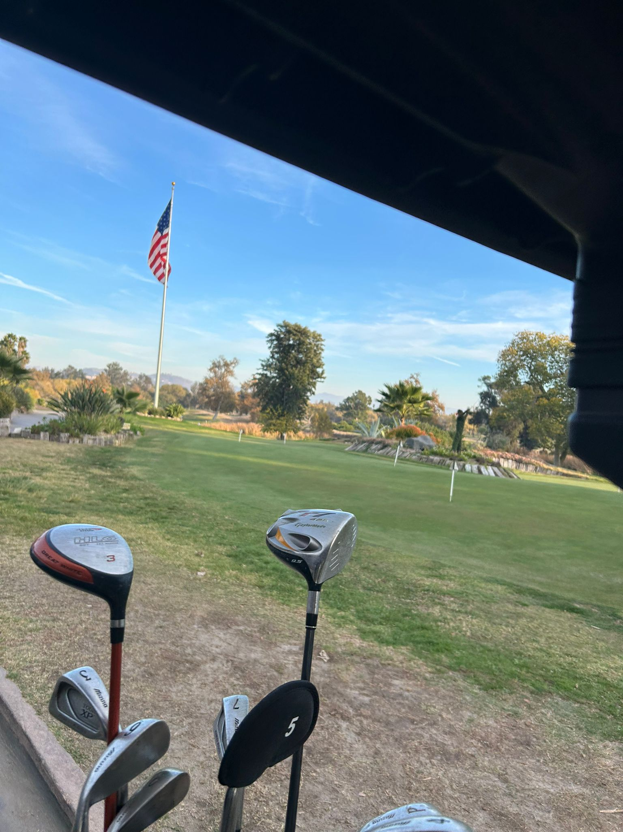
Items that happened in the semester individually, with friends, groups, locally, nationally
Met a lot of new people and played golf with them

Slide 3
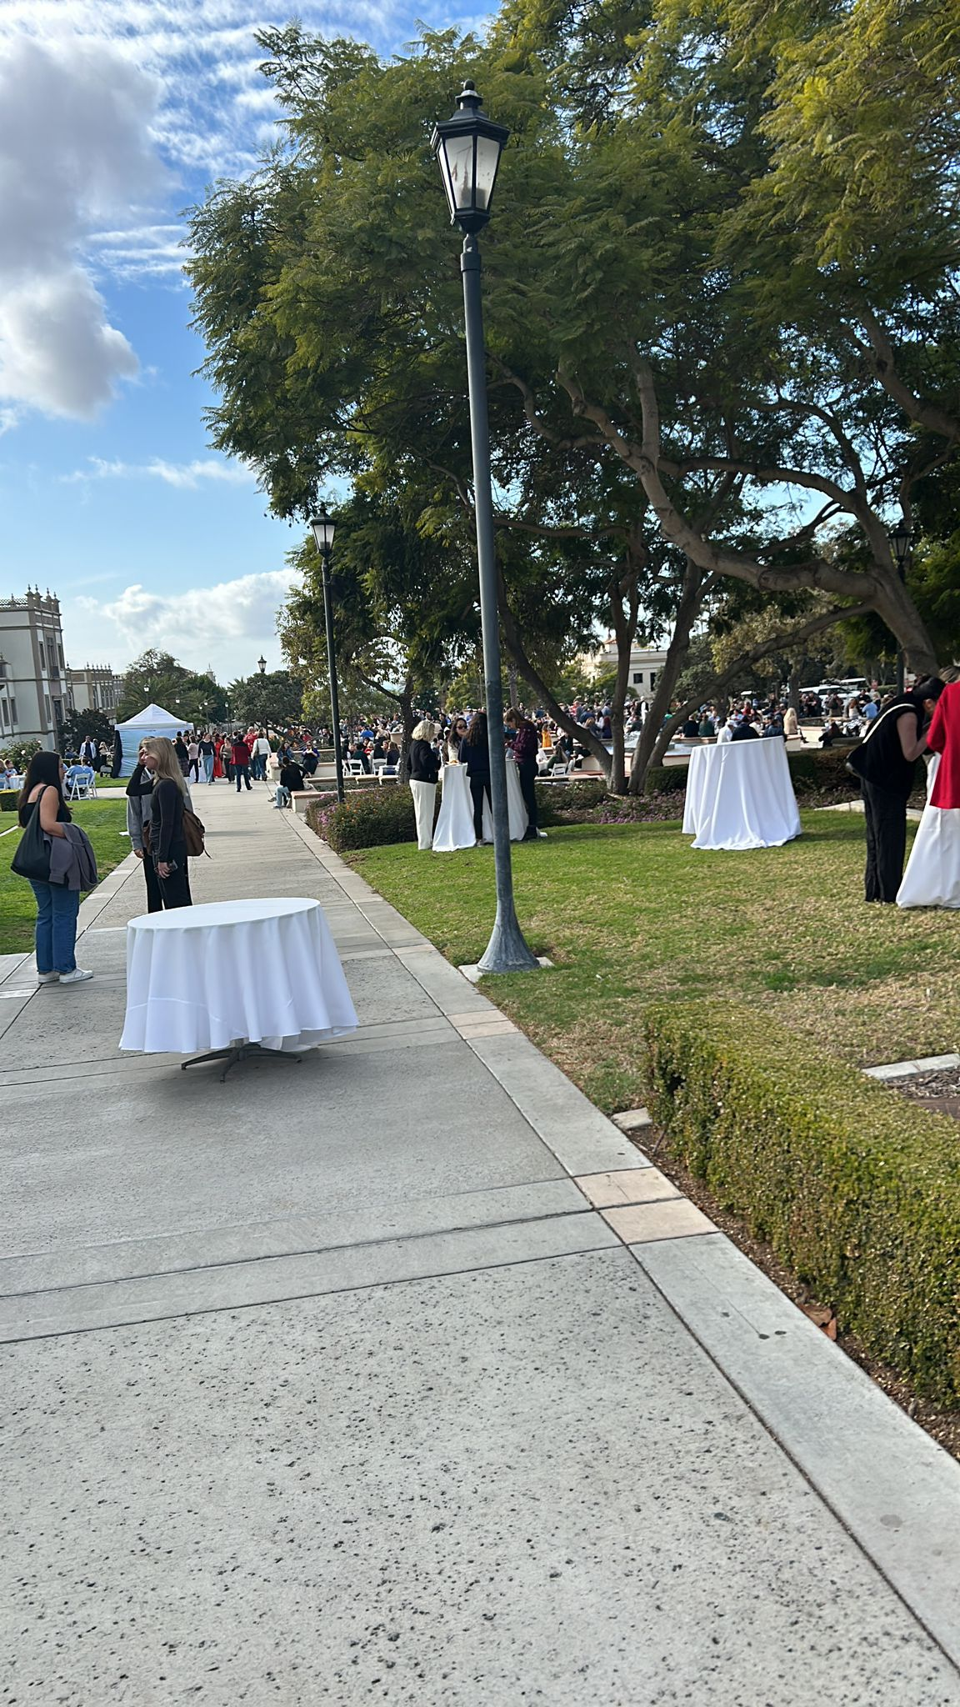
Items that happened in the semester individually, with friends, groups, locally, nationally
Experienced the amazing activities that USD has to offer

Slide 4
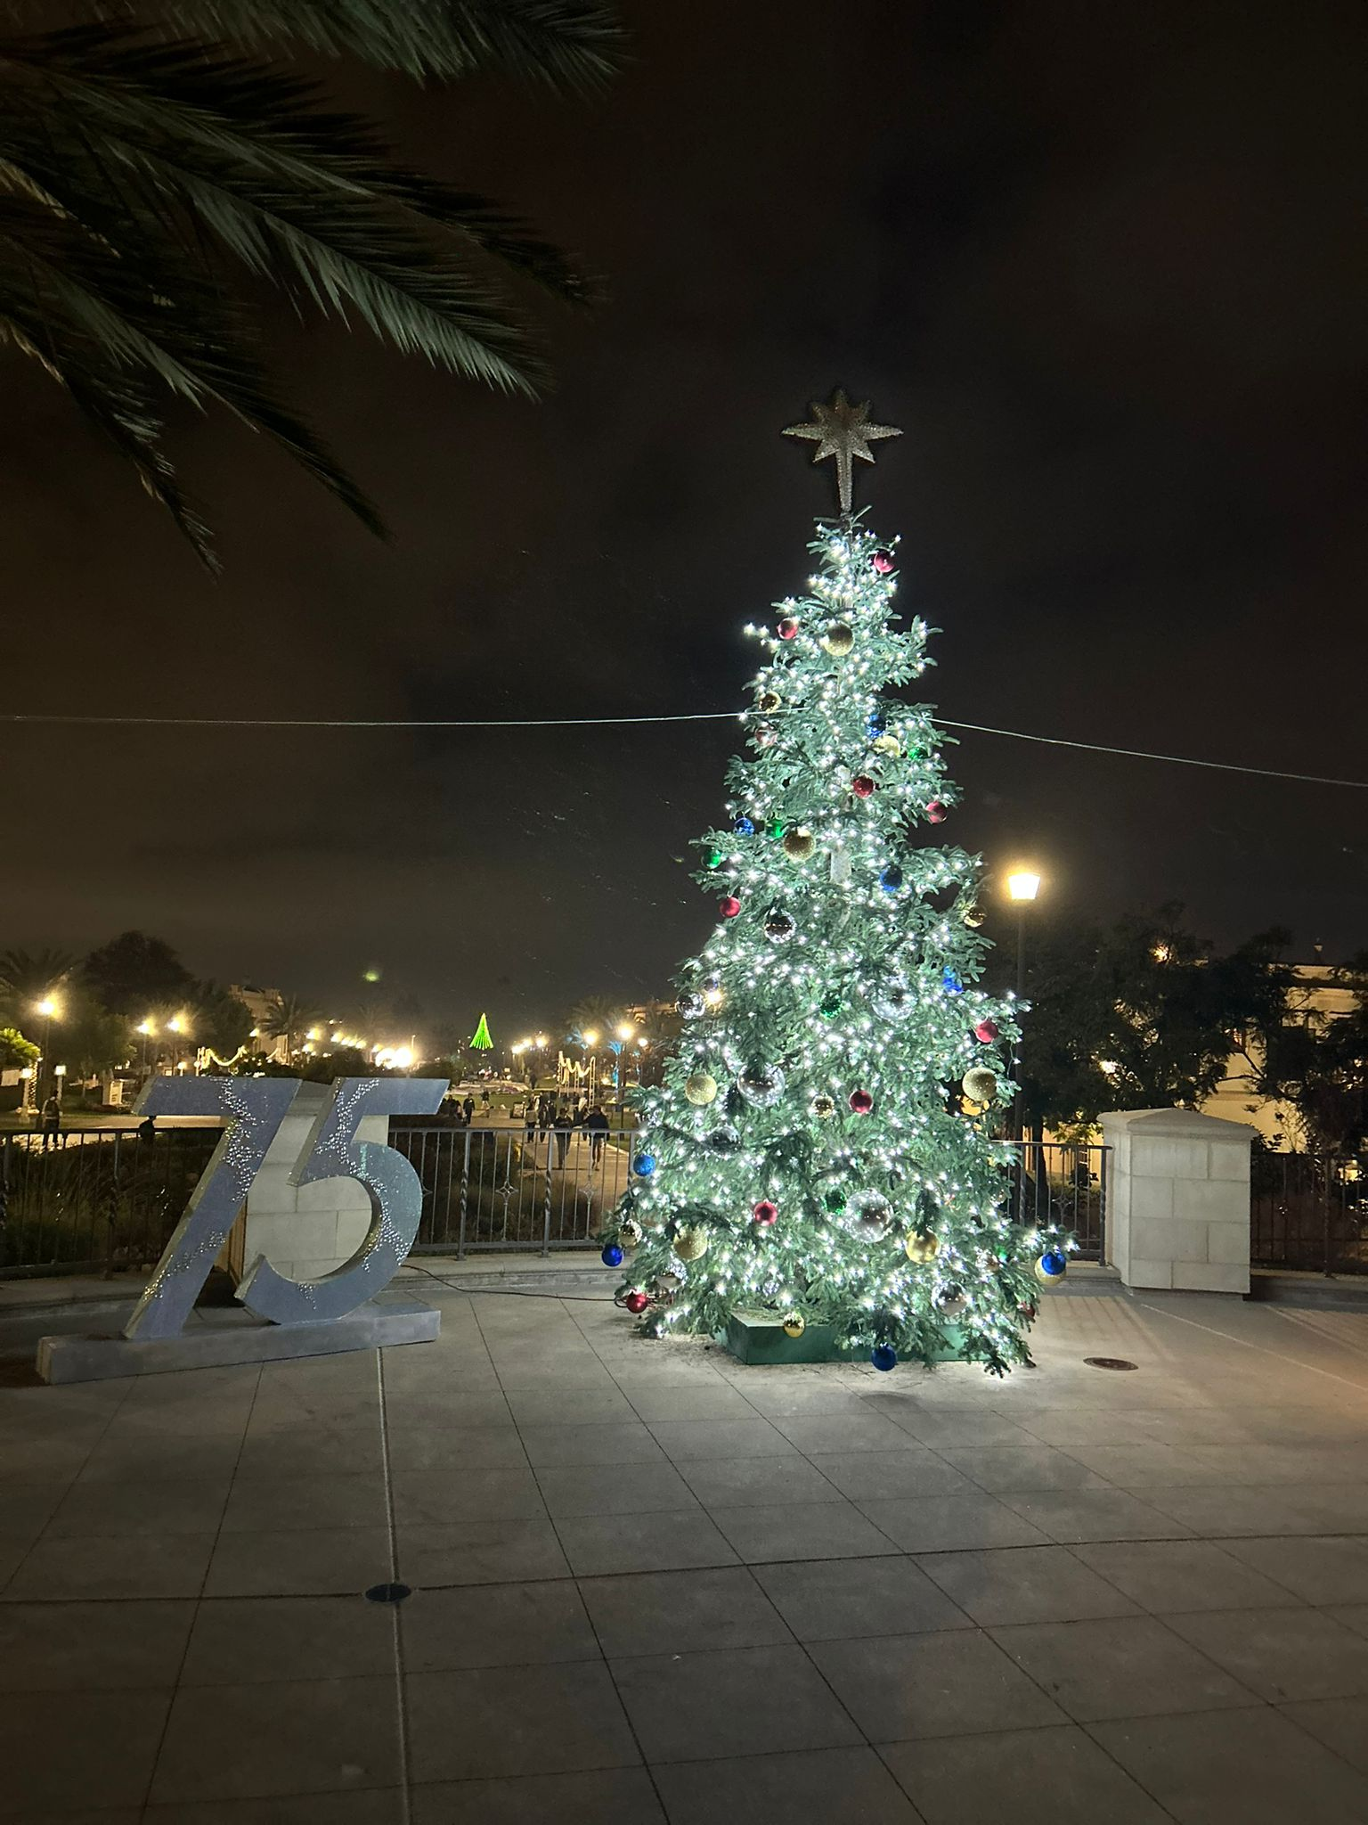
Items that happened in the semester individually, with friends, groups, locally, nationally

Slide 5
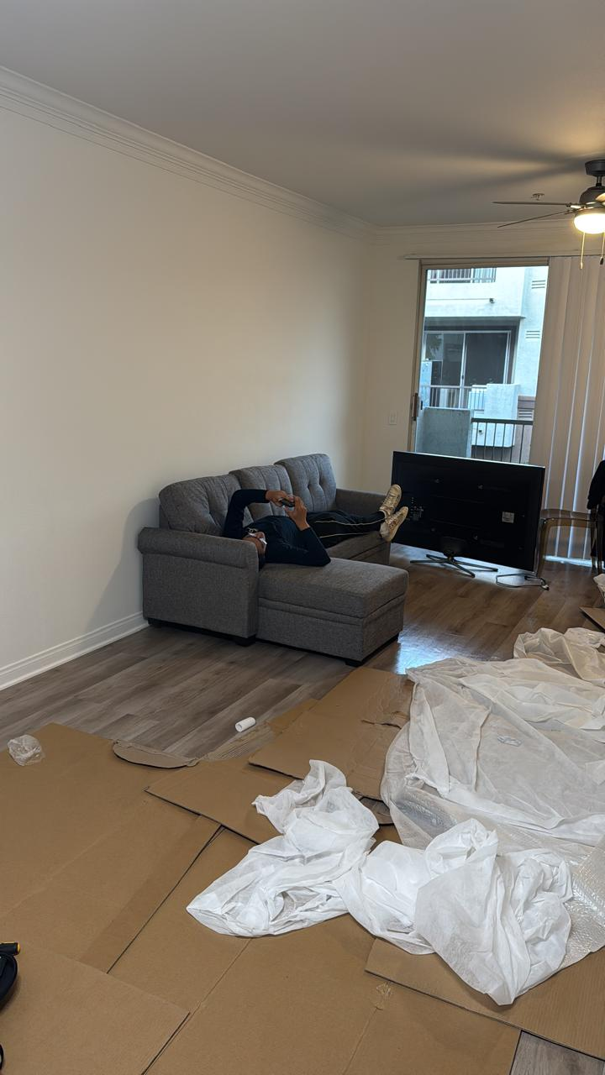
Items that happened in the semester individually, with friends, groups, locally, nationally
Moved into a new apartment (first day just finished building a couch)

Slide 6
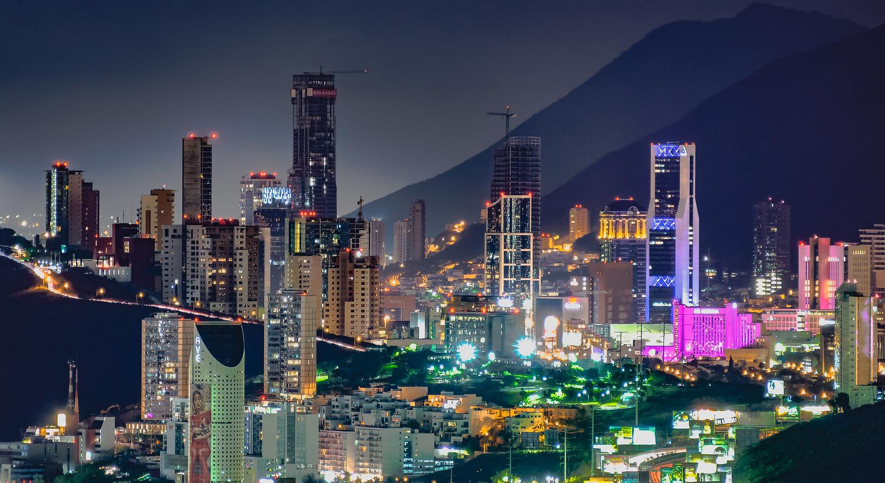
Items that did not happen that you wanted, expected
Was supposed to go to Monterrey Mexico to visit friends but couldn't go last minute

Slide 7
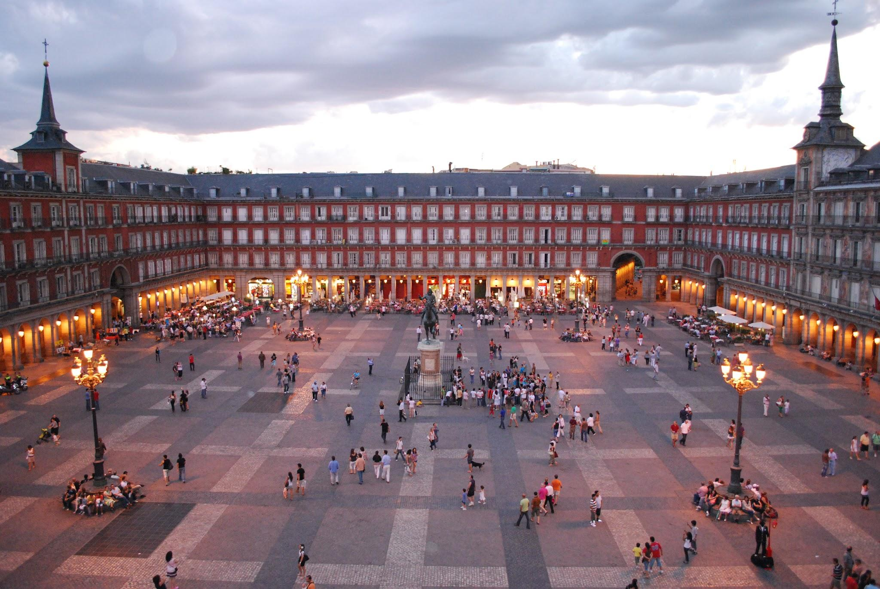
Items that did not happen that you wanted, expected
I was supposed to study abroad in Madrid next semester but I missed the application date

Slide 8
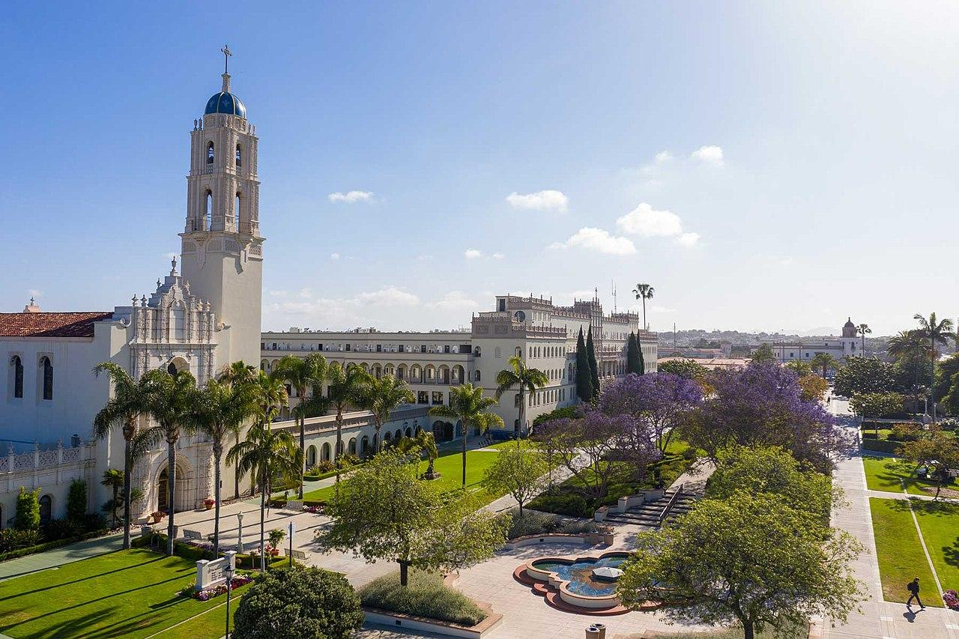
Items that you experienced that have touched your life this semester in an positive way
Getting accepted into USD it is the University I have wanted to attend since I was a kid growing up in SD

Slide 9
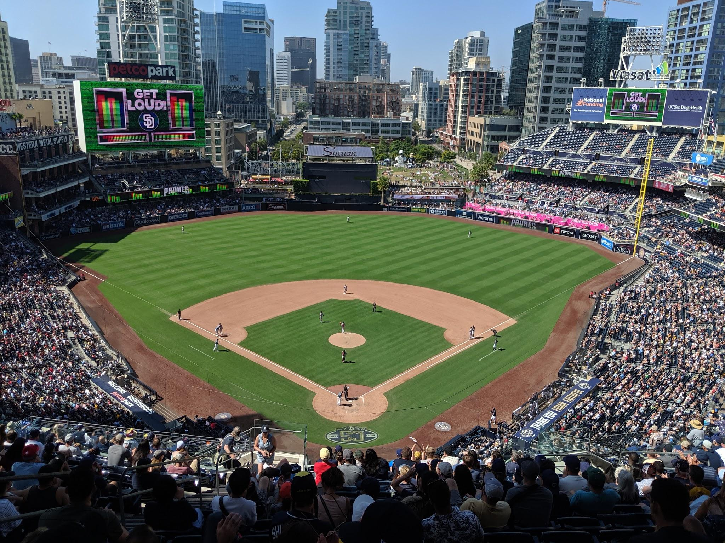
Items that you experienced that have touched your life this semester in an positive way
Meeting a lot of new people and making great new friends which I attended the many Padres games with this semester

Slide 10
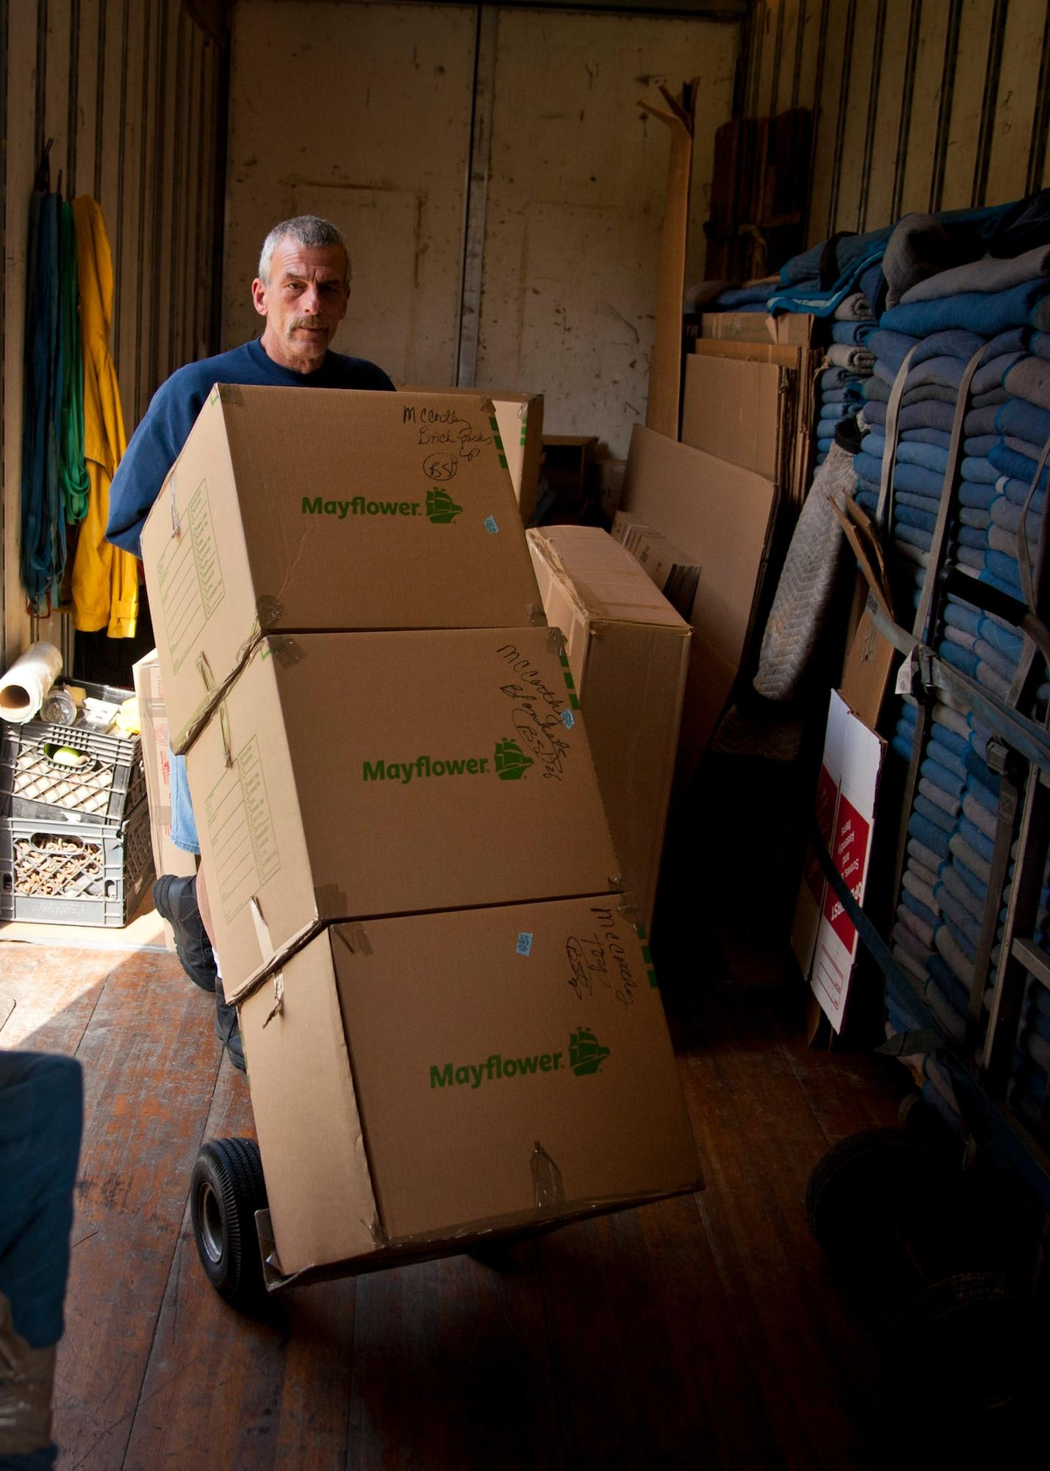
Items that you experienced that were sad or negative that you wish not to be experienced again
Living away from home, I was sad to leave my parents, and my pets.

Slide 11
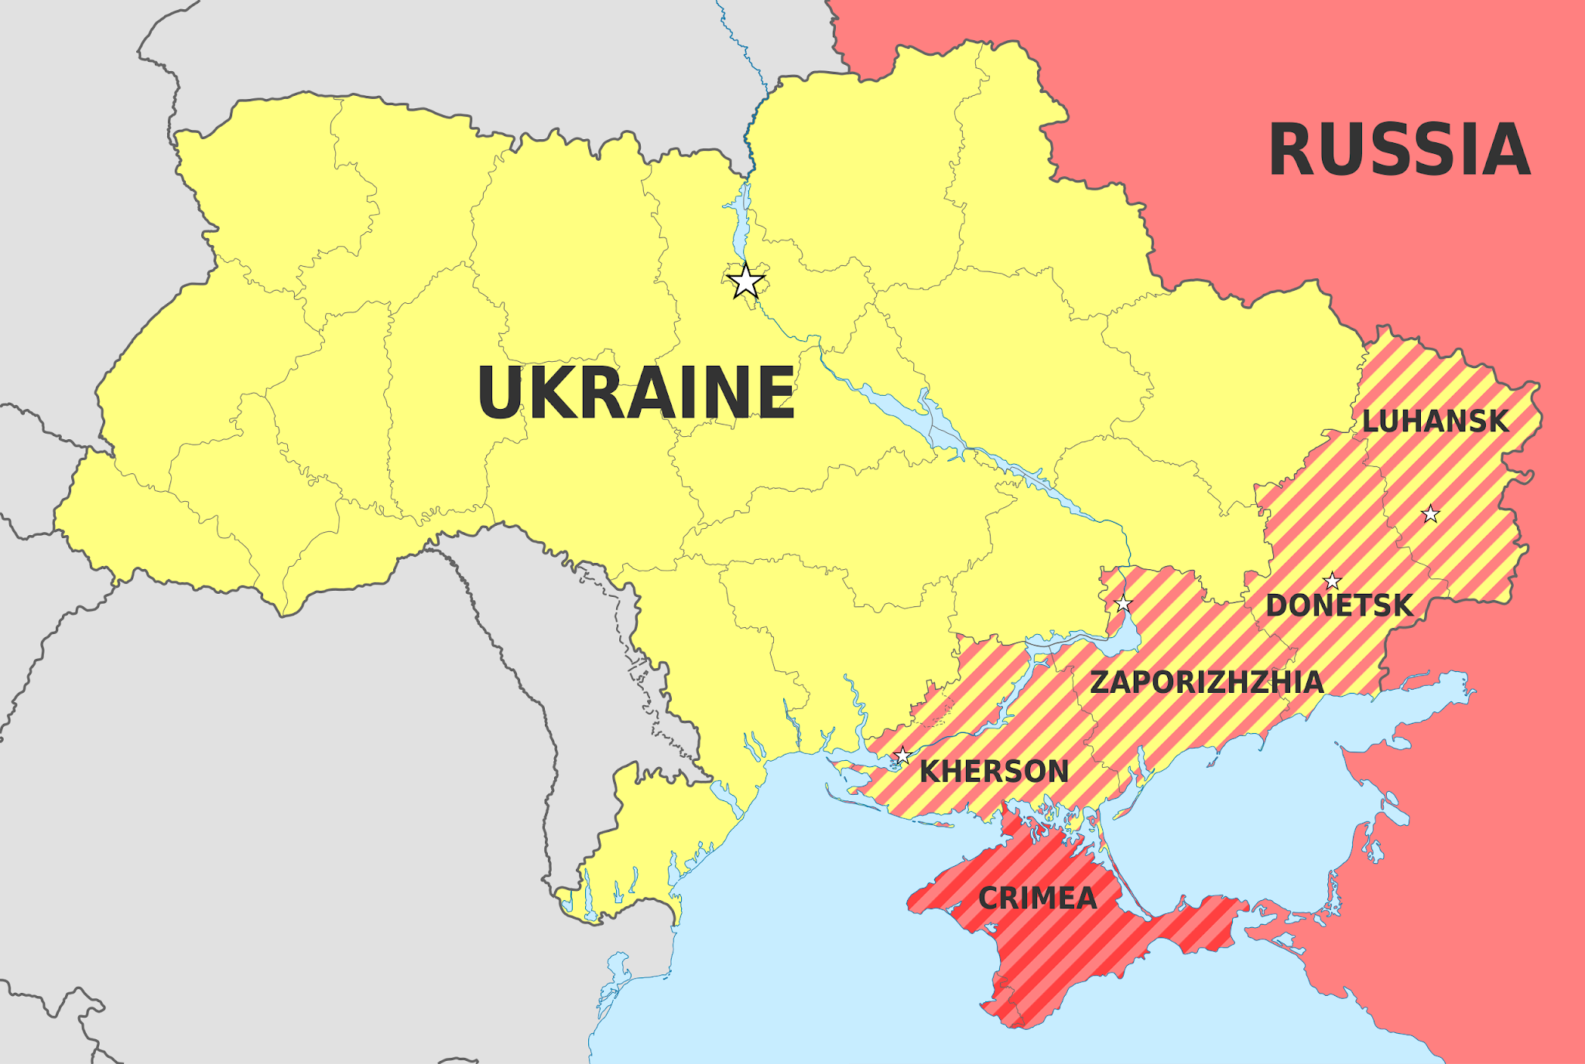
Items that were highlighted by news, media advertisements/messages, government, other countries, other sources
The continuing attacks from Russia to Ukraine and the way there has been no way to stop them

Slide 12
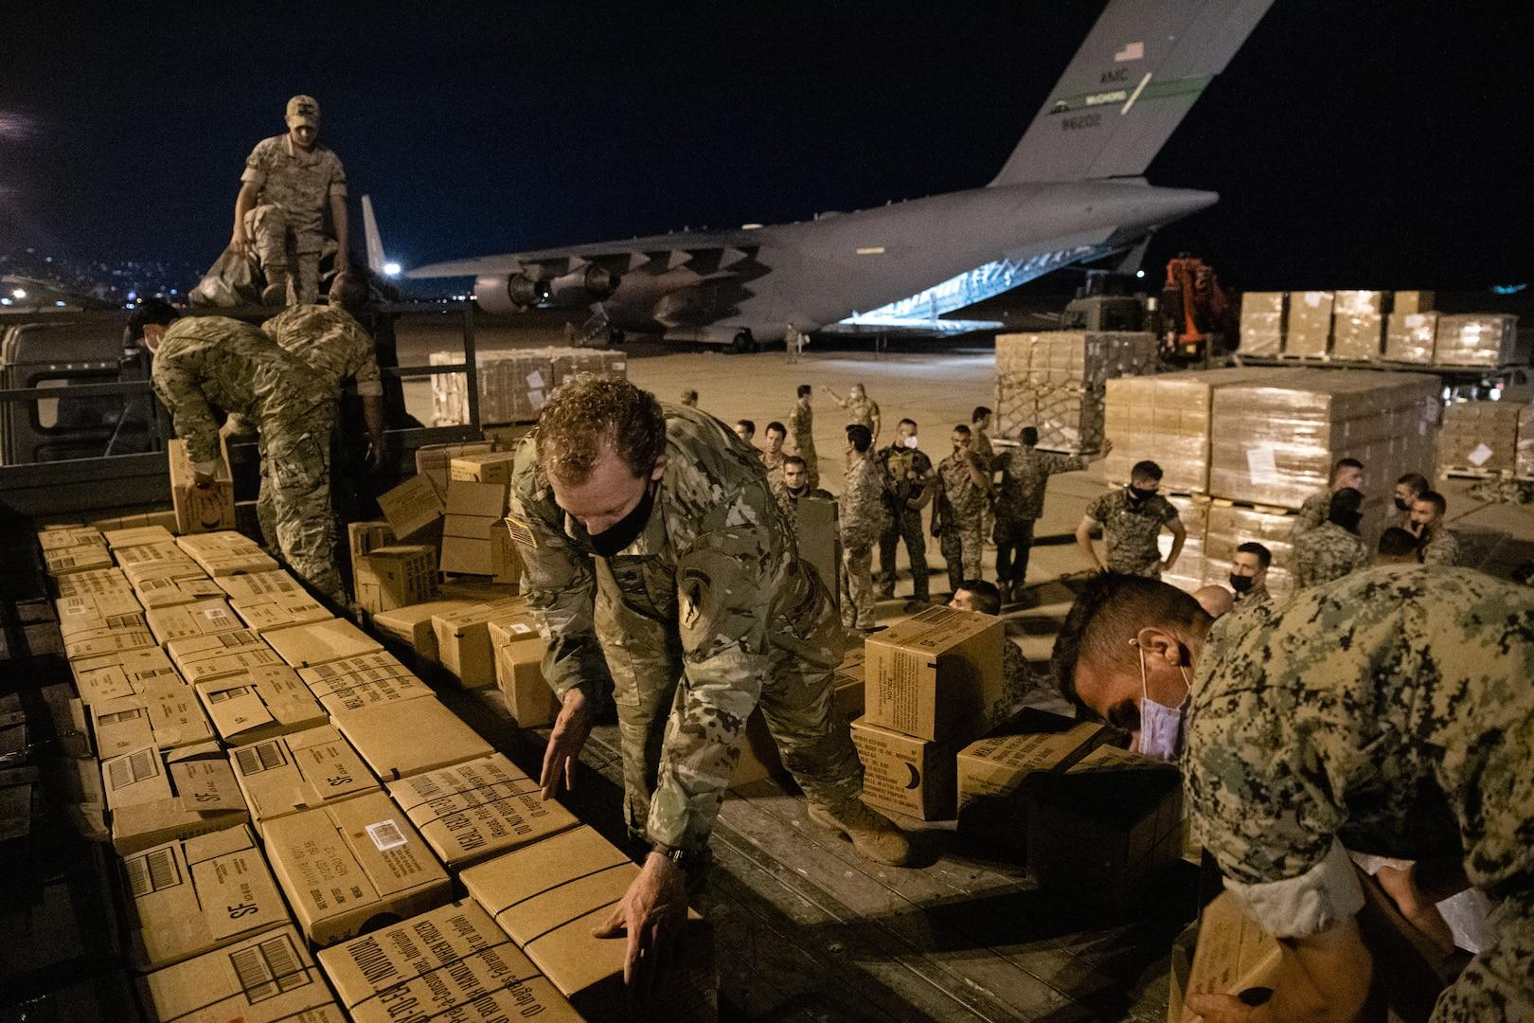
Items that were highlighted by news, media advertisements/messages, government, other countries, other sources
The attack on Lebanon by Israel

Slide 13
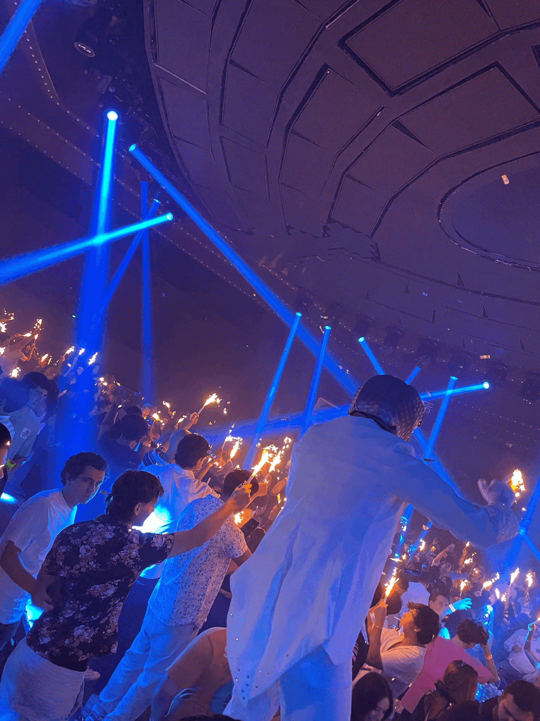
Items that illustrates people’s creativity to assist others (i.e. drive by birthday parties)
We no longer have COVID and are no longer required to be on lock down and don't have to social distance any more

Slide 14
Other relevant items to discuss the semester you had, the semester you wanted, and the semesters that you wish to have in the future.
This Semester (Wanted)
This semester (Actual)
Future Semesters
I want to continue to meet new people and make memories that I will never forget
I wanted to make new friends and make life long memories
I made a lot of new friends and had a lot of fun, made a lot of great memories

Slide 15
During my first semester here at USD I have had a lot of fun met a bunch of new people and have really gotten to experience the college life. During the first few days of the semester I was struggling and really didn't feel comfortable but that all went away after the semester continued. I met a lot of amazing people made a ton of new memories that I will never forget. I am so happy to be here at USD and cannot wait to see what my future holds here at this amazing university. I am so glad I was able to experience all of these amazing things with amazing new people and I can't wait for the next semester to begin, (I am happy about break finals week has not been the most exciting). The images in this presentation while they do take a look at what my semester has been like, words simply cannot explain how truly amazing my semester has been.
-Emilio Costa

