Slide 1
2024 Time Capsule
By: Mason Fils

Slide 2
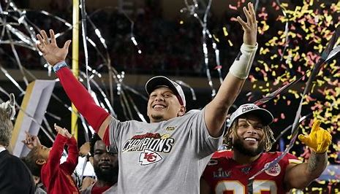
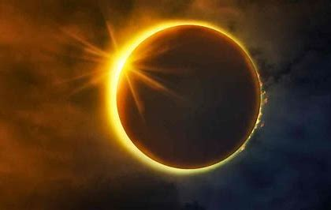
April 8 Solar Eclipse
Kansas City Chiefs win the super bowl
Things that happened this year

Slide 3
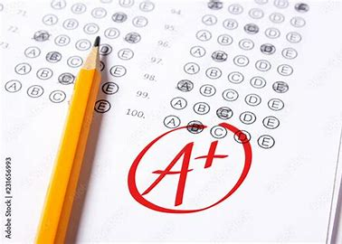
Los Angeles Angels making the playoffs
Finishing my first semester of college with straight As.
Things that I wanted to happen but didn’t

Slide 4
Experiences that touched my life in a meaningful way this year:

Slide 5
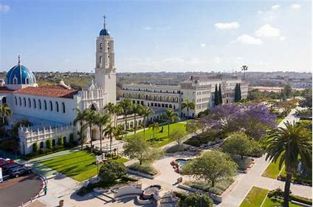
First Semester of College:
Graduating high school and starting a new chapter here at the University of San Diego has been nothing short of amazing. All of the great new people I have met and memories I have made are something I will take with me for the rest of my life. I have really been loving the new lifestyle college has allowed me to live, and I am thankful for this great experience here in San Diego.

Slide 6
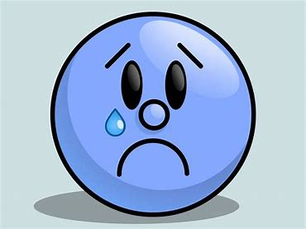
Items I experienced this year that I wish to never experience again:

Slide 7
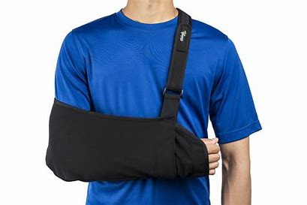
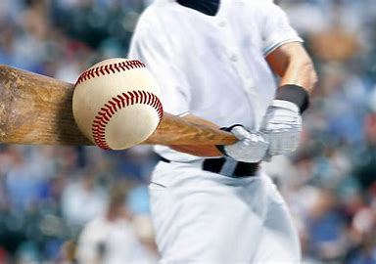
Torn Labrum from playing baseball:
While playing in my senior season of high school baseball, I suffered a torn labrum while swinging the bat, which effectively put an end to my playing days. This was very difficult on me, as I have been playing baseball for as long as I can remember. The road to recovery was very difficult, engaging in demanding physical therapy multiple times per week. However, after six long months of recovery post surgery, I am finally healthy and back in the gym.

Slide 8
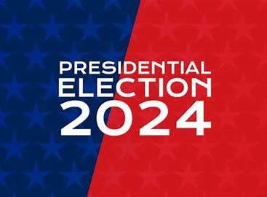
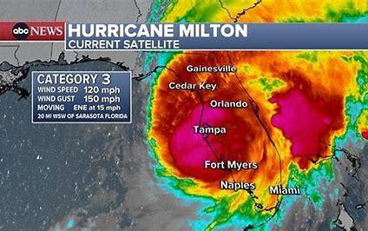
2024 Presidential Election
Hurricane Milton
Items that were highlighted by news, media advertisements/messages, government, other countries, other sources

Slide 9
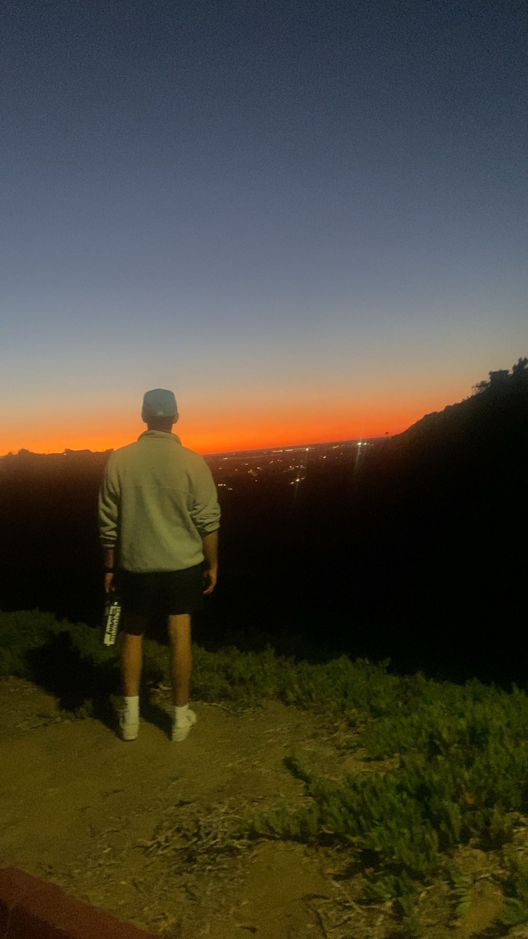
Items that illustrates changes to processes:
This semester, being my first one at the University of San Diego, has changed many processes in my personal life. One major change is being able to enjoy the San Diego sunset every day. It is always a very beautiful site to see, and I am not taking it for granted.

Slide 10
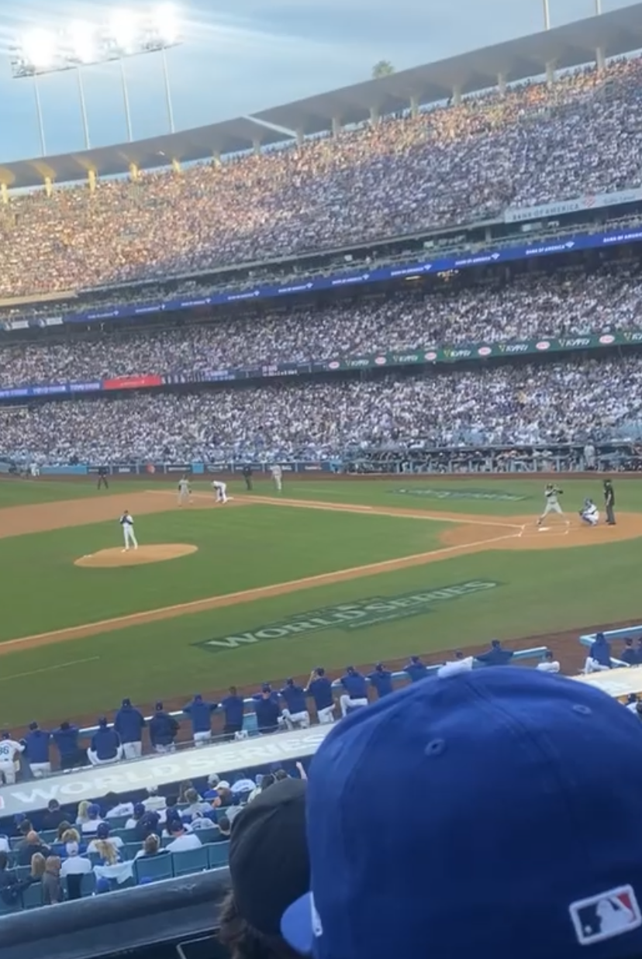
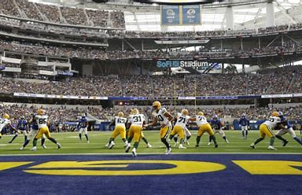
Other relevant Items from the year
I recently attended two sporting events, being game 2 of the MLB World Series, where the Los Angeles Dodgers defeated the New York Yankees, as well as Los Angeles Rams vs the Green Bay Packers week 5, where the Packers defeated the Rams.

