Slide 1
Time Capsule
Samuel Georgies

Slide 2
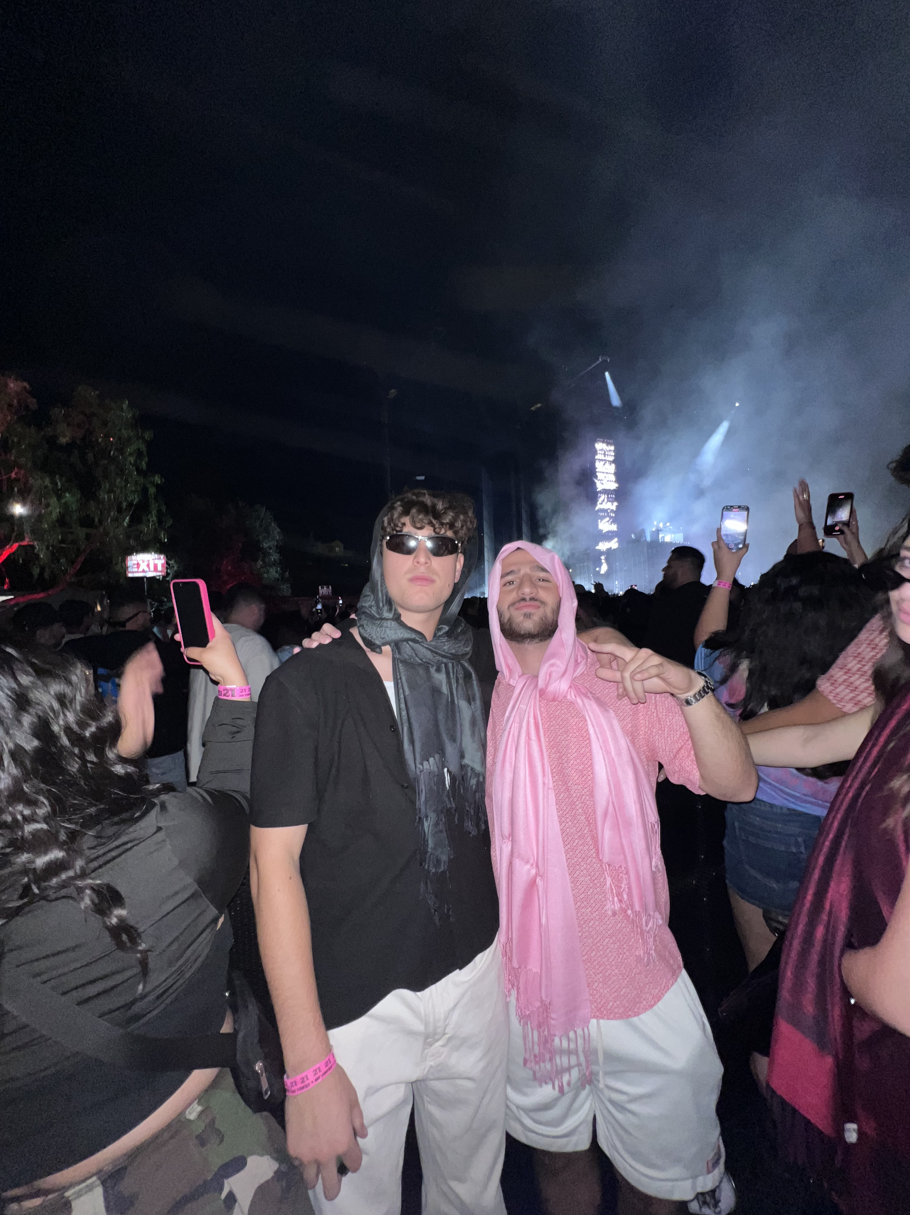
Times with Friends
Fun times with friends at concert

Slide 3
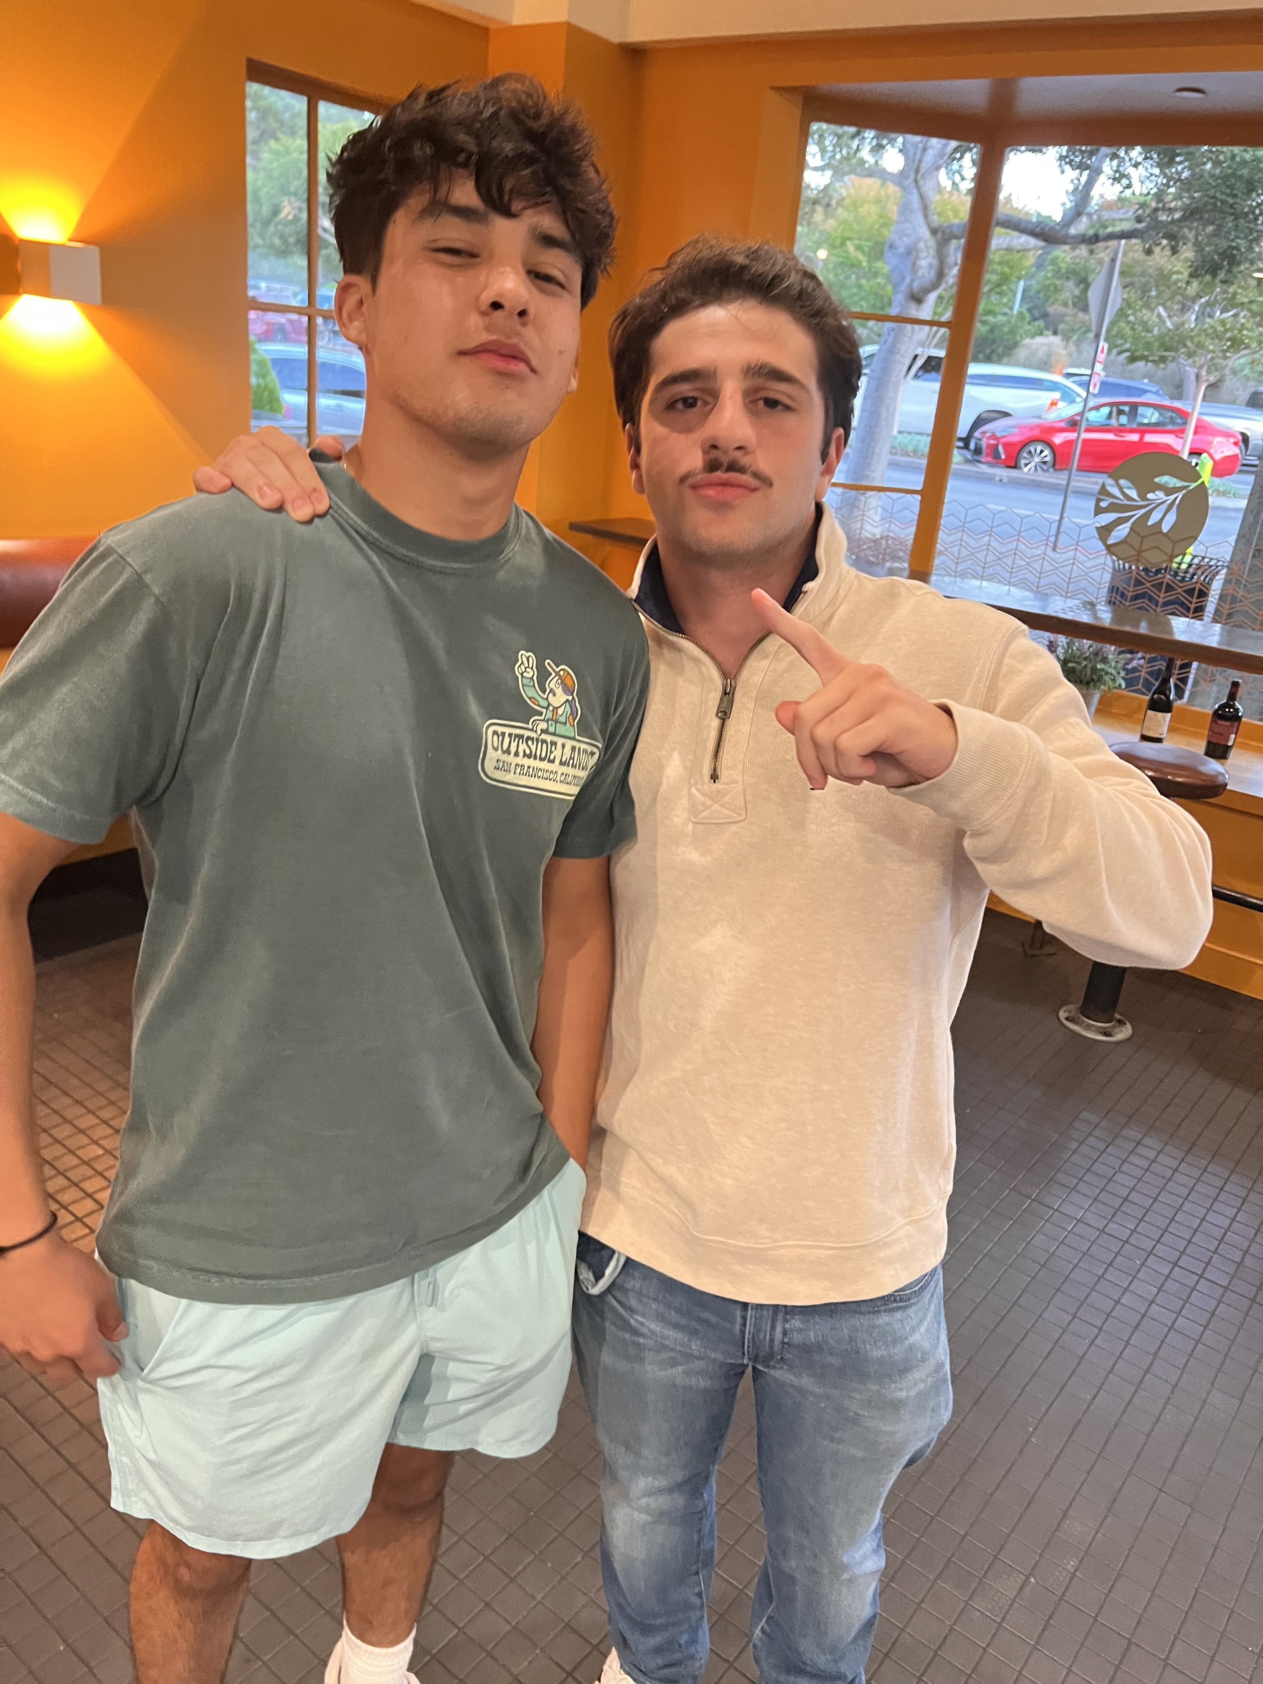
HomEtown Friends came to visit
My friend, Matt, from Stockton came to visit me at San Diego. My friends Dom and Ronnie came to visit from the University of Arizona. Good to see people from my hometown, when I have not seen them in a long time.

Slide 4
Times with Family
From Stockton, California, different not being able to see my family all of the time. Been an adjustment moving to southern California.

Slide 5
Positive Items
The beautiful campus and weather that San Diego has to offer. Being able to enjoy warm weather that not many other places have.

Slide 6
Hometown Friend transferring
One of my best friends from home is transferring here next semester. Really excited for him to come to this school.

Slide 7
Negative experiences
Being sick with the flu during finals.

Slide 8
Seeing family more often
Wish I was able to see my family more often. Hard being away from home and not being able to see family on a normal basis.

Slide 9
Wish I learned to Surf
Wish I learned to surf. Always wanted to my whole life. Next semester, hopefully I can kill some free time by taking lessons.

Slide 10
Wish I learned how to play the guitar
Wish I spent more of my free time learning how to play the guitar. Always wanted to learn how to play the guitar.

Slide 11
Wish my Stocks went higher
Wish my stock options went higher so I made more dinero.

Slide 12
Wish I stayed more Active
I wish I utilized the campus facilities more. Wish I was in better shape and more healthy.

Slide 13
Seeing more of San Diego
I wish I was able to explore more of what San Diego has to offer. I wish I spent more time at the beach and state parks that San Diego has to offer.

Slide 14
Relevant News: 2024 Election
Presidential election took place in November, will impact many polices that will have a lasting effect on the rest of our lives.
First election I could vote in.

Slide 15
Rise of AI Technology
The rise of artificial intelligence (AI) is the rapid growth and popularity of AI technology, which has led to both excitement and debate about its impact on society

Slide 16
Bitcoin hitting 100K!!!
Significant because it the new crypto wave has made a lot of people a lot of money in a short amount of time.

Slide 17
Use of Apple Wallet and contactless pay
Much easier to pay for things, don’t have to bring my wallet around everywhere. Much easier when everything is just kept in my phone.

Slide 18
Conclusion
To conclude, had a good first semester looking forward to meeting more new people next semester.

