Slide 1
USD Fall 2024
My first semester at USD

Slide 2
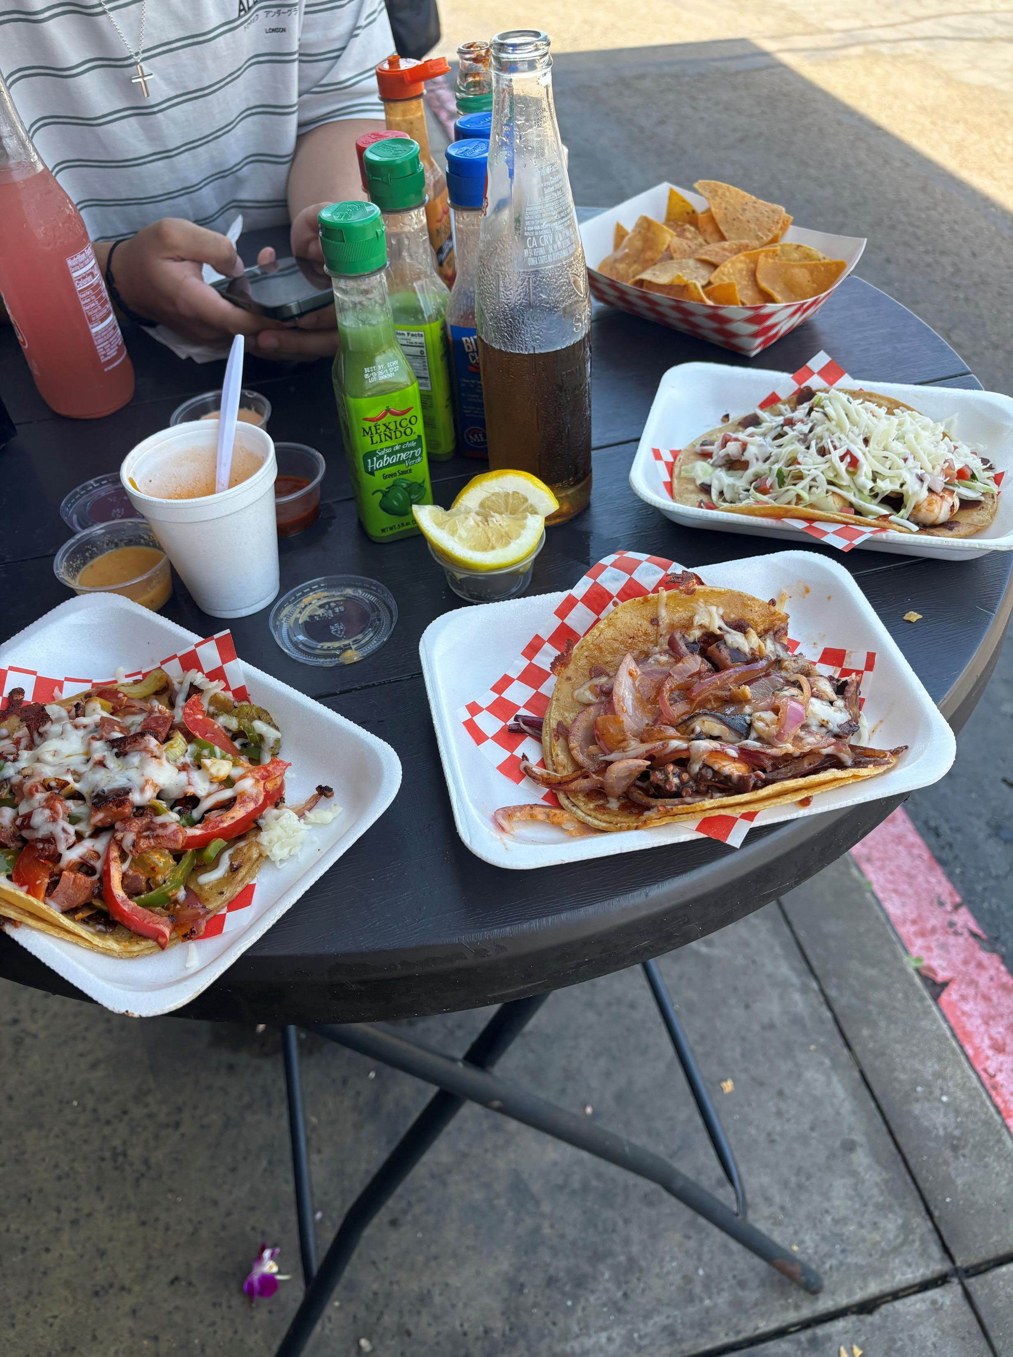
SEAFOOD TACOS

Slide 3
Korean BBQ

Slide 4
Eating Healthy

Slide 5
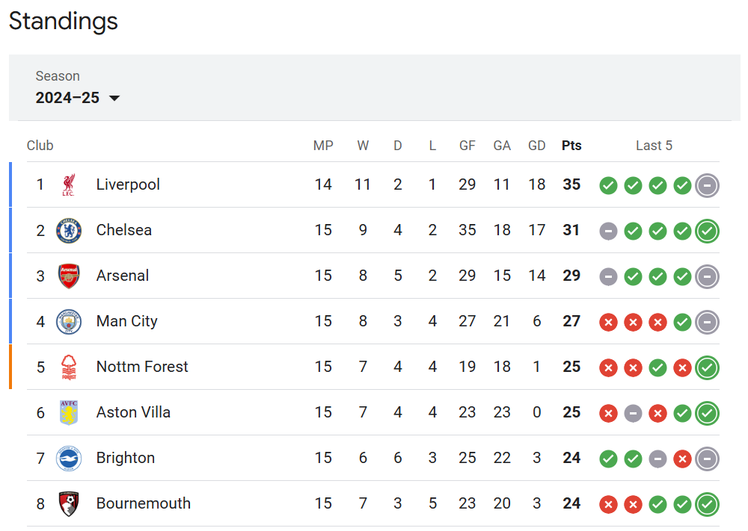
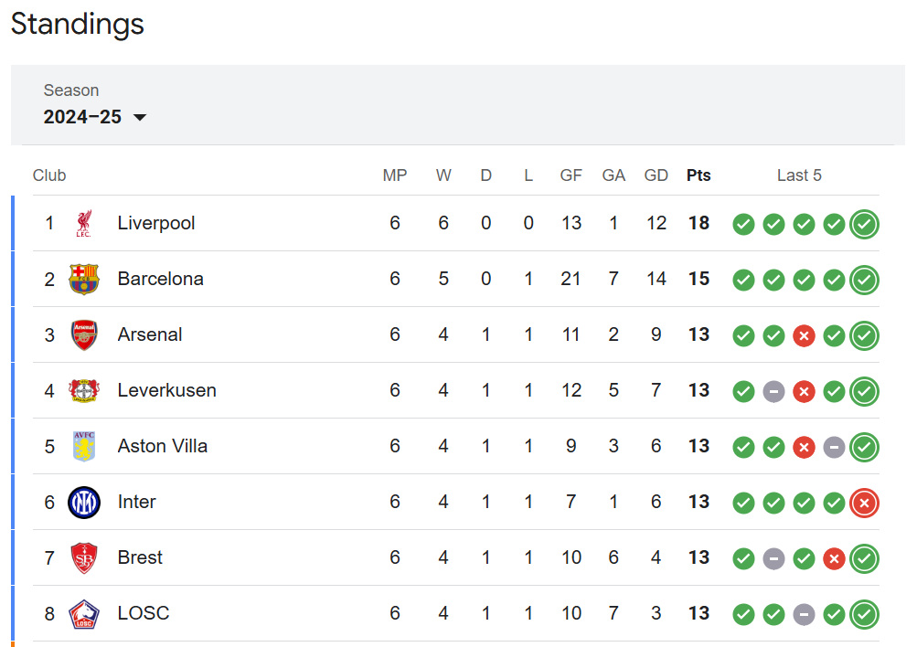
Top of the LEAGUES!!

Slide 6
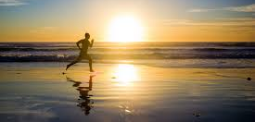
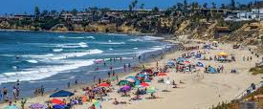
Didn’t go to the beach enough

Slide 7
Jaime Rivera (Mulvaney Center)

Slide 8
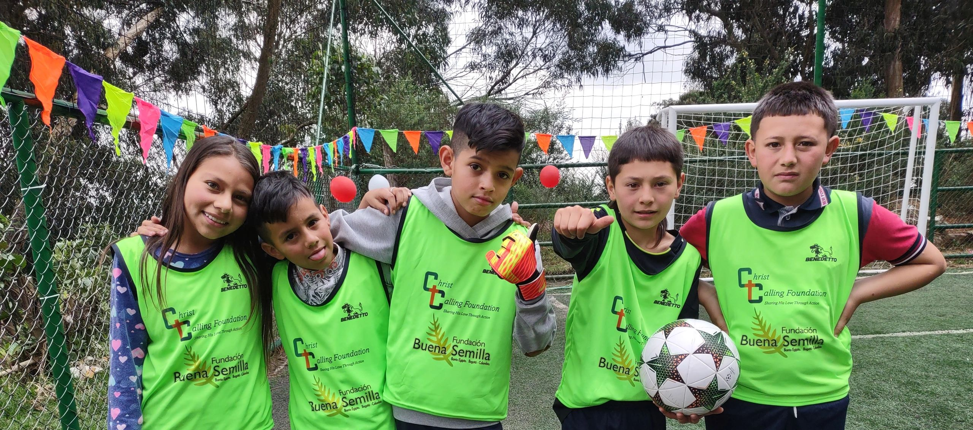
Giving back

Slide 9
Colombia losing Copa Final

Slide 10
Missing Felipe

Slide 11
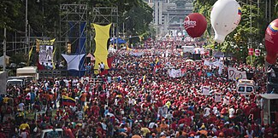
Venezuela Election
This Photo by Unknown Author is licensed under CC BY-SA
This Photo by Unknown Author is licensed under CC BY

Slide 12
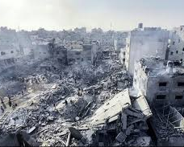
Gaza bombings

Slide 13
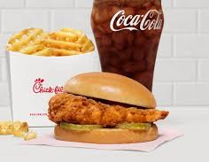
No more Antibiotic-Free

Slide 14
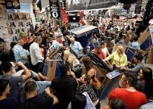
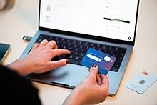
Black Friday Bust?
- 3.2%
VS.
+ 8.8%

Slide 15
Trying to start a Latino Fraternity

Slide 16
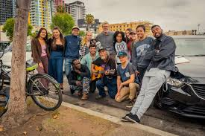
Pancakes: Serving Up Hope
One Saturday a month

Slide 17
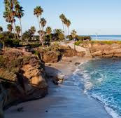
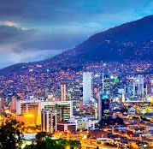
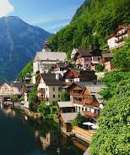
Future Semesters
Travel, learning, and the BEACH!

