Slide 1

SPRING 2020
“One Helluva Semester”
Daniel Diederich

Slide 2

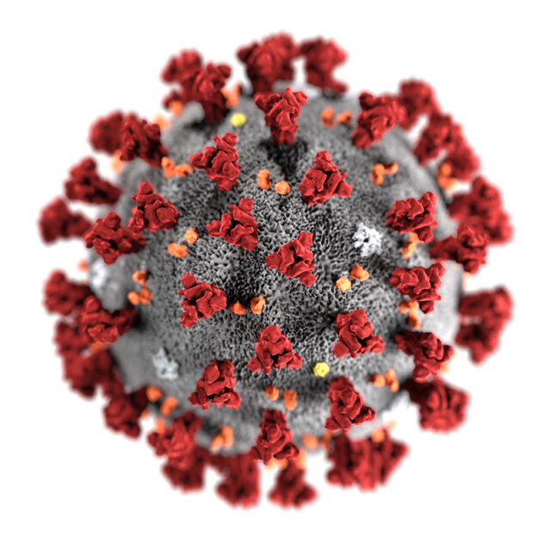
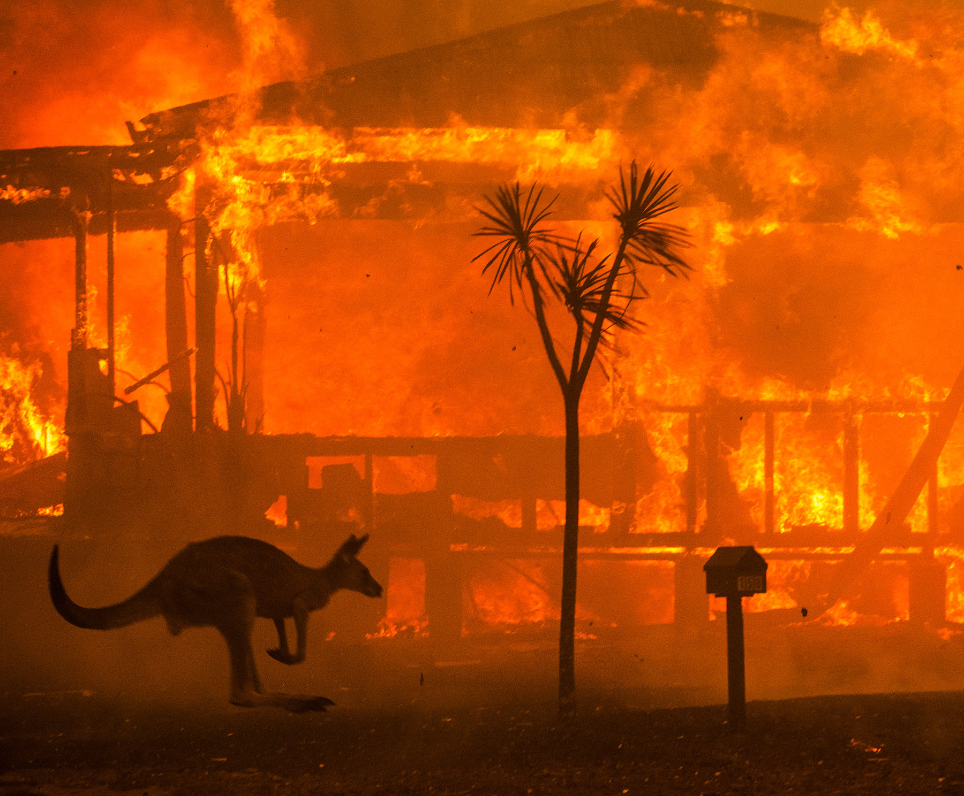
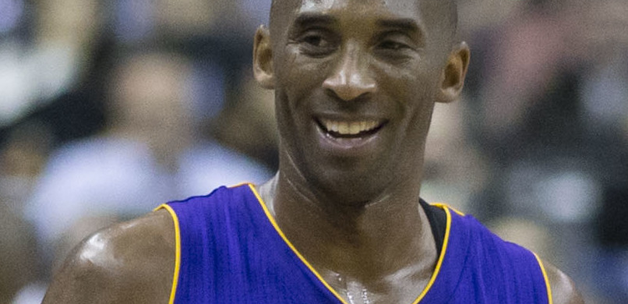
Things that Happened This Semester
January 26th, 2020
Kobe Bryant’s Sudden Death
Corona Virus
Australian Wildfires

Slide 3


Things That I wanted to Happen but Didn’t

Slide 4
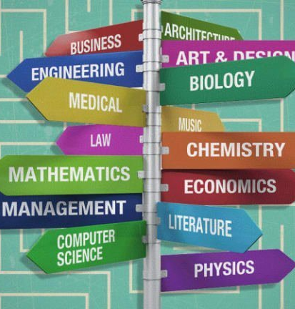
Figure Out My Major
Wanted to be able to determine what I wanted my major to be in 2nd semester, however, after being kicked off campus, it seems harder than ever.
OPINION: Not knowing your major or having any semblance of an idea as what it could be sucks. I don’t know what I want to study and taking classes I don’t even know if I want to do or not takes its toll on me. I feel like none of the classes I’ve done did anything for me and that I wasted 25% of my college time on nothing.

Slide 5
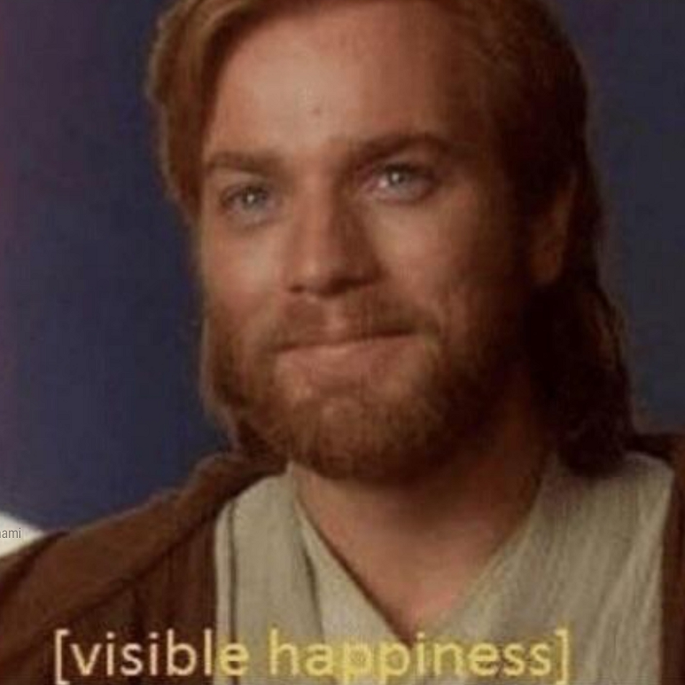
Experiences that have Touched My Life in a Meaningful Way this Semester

Slide 6

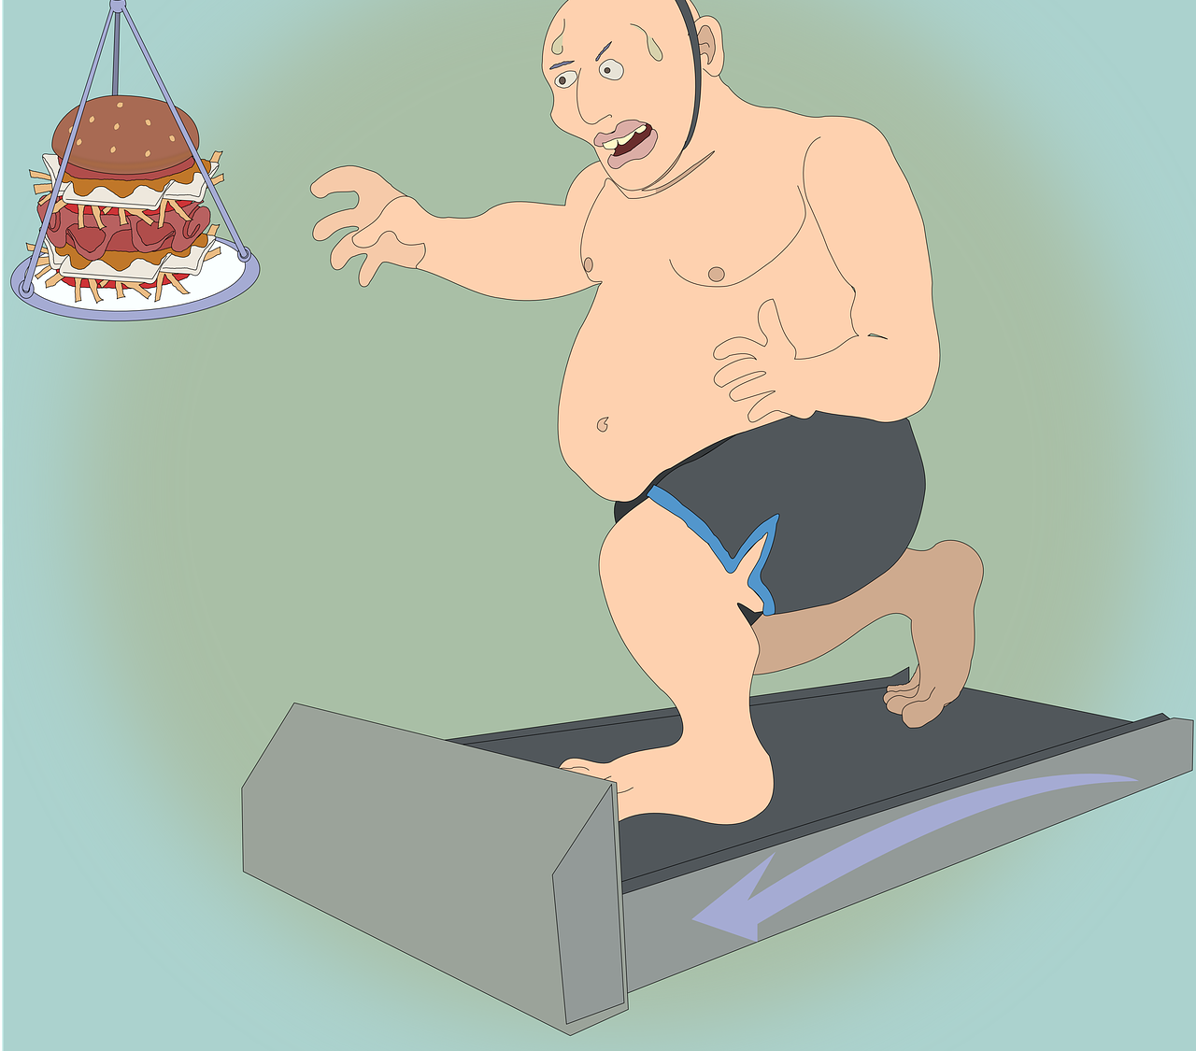
Weight-Loss
Over the course of January 26th – April 26th 2020, I was able to lose roughly 46.4 lbs.
OPINION: Losing weight sucks, especially during college, when you literally have an endless buffet for dinner every night and two endless buffets for breakfast on the weekends. Also, it sucks because it seems that the only thing to do on or off campus at U.S.D. is eat. Also, running sucks. I could never run before this semester. But now, I still can’t run very well. But it has become easier. And I am glad I worked hard for this.

Slide 7
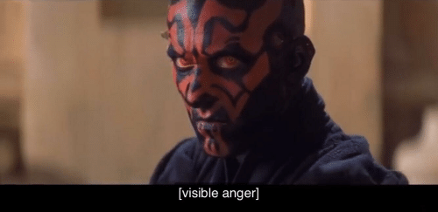
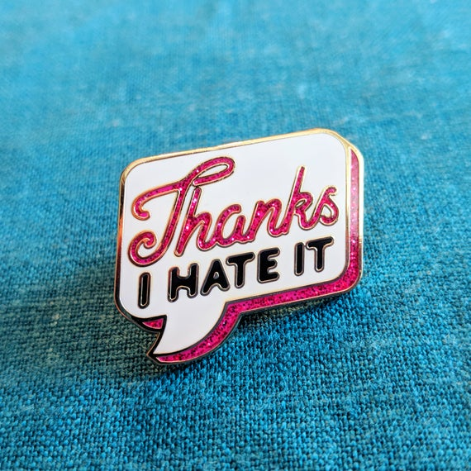
Experiences that were Negative that I Never Want to go through Again

Slide 8
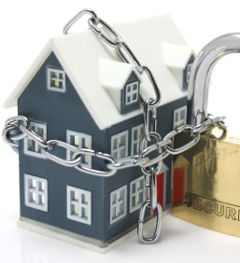
Being Locked Inside during Quarantine
Staying inside our homes in order to slow the COVID-19 spread and flatten the curve as to not overwhelm the healthcare system.
OPINION: It is important to stay inside at the moment, but many people, including myself, don’t like how there seems to be no agreement on what is going on and that local governments are just doing what advances their political interest without any clarity to the public. Like, seriously, we were told to stay inside in order to flatten the curve. It was flattened. Now what? What are we doing this for specifically? I want to listen to them, but the longer this goes on without any actual answers, the less I will.

Slide 9

IMPORTANT NEWS ITEMS FROM THIS SEMESTER
(Aside from covid-19 updates)

Slide 10
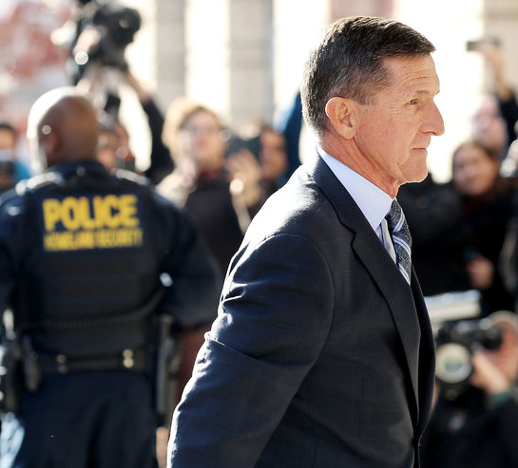

The “Release” of Michael Flynn
Michael Flynn, who pleaded guilty to lying to the FBI in 2017, was just “released” after documents from the FBI and DOJ were released, showing apparent shady business and possible corruption.
OPINION: Although not COVID-19 related, this news story is quite important when you read about it. Very recently, some FBI and DOJ documents were released that showed that the FBI had done shady business in regards to Michael Flynn in early 2017. These documents suggest that they were trying to get him to lie to them in order to try and convict him and/or turn him over. While lying to the FBI is a crime, you can only be charged with “lying to the FBI” is you are currently being under investigation for an underlying crime. Flynn was not under investigation, nor had he committed a crime. His lie was that he had a phone call with a Russian diplomat after becoming the incoming National Security Advisor and told the FBI he didn’t. While this was a lie, this phone call was in no way against the law. Then, the FBI, it seems, wanted him to go to jail and/or try and convict other people with him, so they tried to get him to lie. For me, this just shows how corrupt government branches are when they have too much power, regardless of the political party involved. It furthers my distaste for the government.

Slide 11
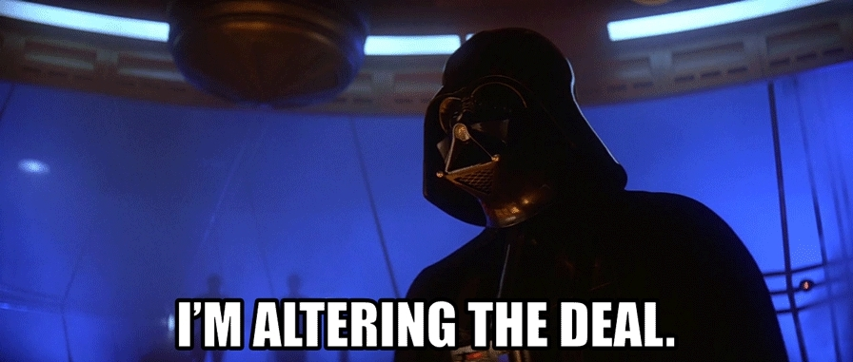
WAYS LIFE HAS BEEN ALTERED

Slide 12
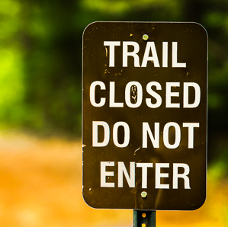
The Closing of Walking/Hiking Trails
In attempts to slow the spread of COVID-19, governments around the country but specifically in Southern California closed all walking and hiking trails.
OPINION: I understand the sentiment that governments had. If the close these trails, then it will disincentivize people from going outside. However, an unintended consequence could be that people are going to go outside no matter what, so closing the trails makes people walk on the streets, closer to each other and to peoples houses. Also, going outside in the sun is better as people are way less likely to catch this outside, in the sun, while socially distancing, etc. So the effects remain to be seen but still. I like to walk and run and so this sucks for me but I see why.

Slide 13


HUMANITY’S CREATIVITY DURING THIS SEMESTER

Slide 14

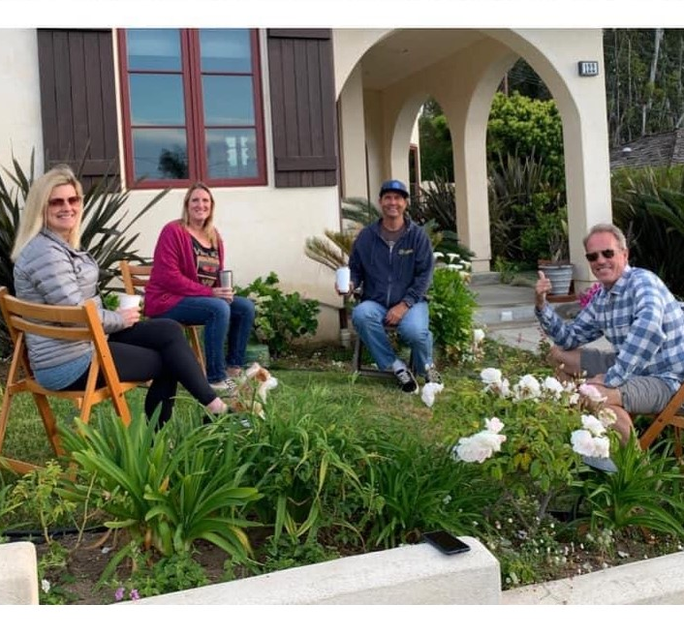
Drinking While Socially Distancing
For my mom’s 49th birthday, she and my dad rode to their friend’s houses on their bikes and drank with them in their front yards while socially distancing.
OPINION: It seems really fun to me and good way to still see your friends even though we aren’t supposed to. Getting out while still being socially distanced but still being able to get buzzed and celebrate your birthday is a very good idea.

Slide 15


WISHES FOR THE FUTURE and a
REFLECTION ON THE PAST

Slide 16


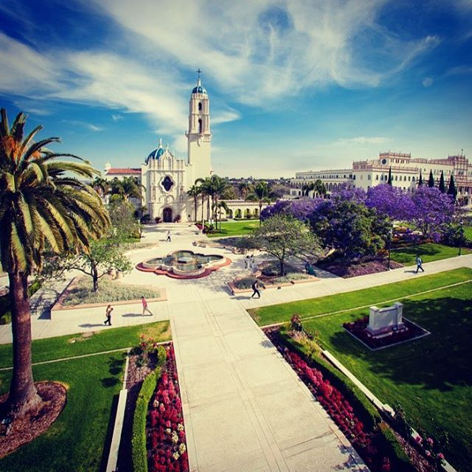
This Semester (Actual)
This Semester (What I Wanted)
Future Semester Expectations?
I had hoped that this semester would be fun, make new friends, be able to make life long memories, and, as stated earlier, figure out my major.
I don’t believe it will, but I really hope that future semesters at U.S.D aren’t as terrible and mind-numbingly painful as this one was. I think that in future semesters, hopefully Fall 2020, I will be able to figure out my major and complete so many of my other goals. I am excited to have a better semester next year but more importantly, just excited to be able to leave my house.
As with everyone, this semester was terrible. Learning at home is extremely difficult and it made the classes and subjects was less “enjoyable” and even less “learnable”.

Slide 17
In Conclusion
Also, congratulations Carl on your new baby and thank you for teaching us all about Excel and ITMG!
In short, this was one weird semester. The first month was okay, a very normal month, but then after coming back from spring break, it felt like a completely different world. These past few months have been extremely depressing in a way and they sucked, from learning online to thinking the world is about to end, but we made it through them. And everyone always says you want to remember your college years. I don’t think I will ever be able to forget this semester.
THANK YOU!

