Slide 1
Getting to Be EPIC
Going to SQL

Slide 2
Learning Objectives
Examine Structured Query Language (SQL)
Select data using criteria in SQL

Slide 3
In class Practice
SMSS OVERIEW
SELECT FROM
SELECT FROM WHERE
material revised from University of Arkansas/Microsoft Enterprise Consortium, originally prepared by Jennifer Kreie

Slide 4
What you will need
For these SQL lessons, you need your EPIC user account and password. You can log in remote at https://waltonlab.uark.edu/ and work through the browser or there is an option to download the Horizon Client and run a direct application.
Remember BE EPIC when using EPIC
Excellence
Professional
Innovative
Collegial

Slide 5
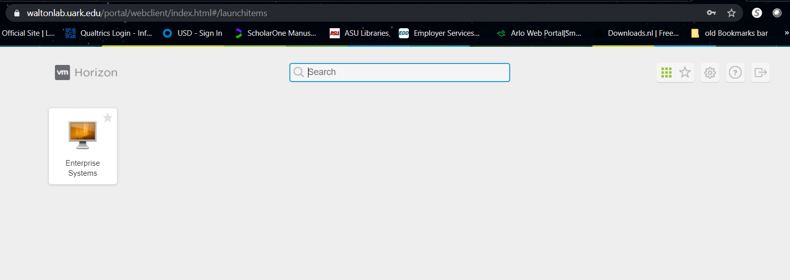
After selecting remote Client – CLICK on Enterprise sys

Slide 6
Starting Screen
There are three ways to access SMSS (MS SQL Management Server Studio
Through icon on the task bar, through icon on startup, and through the listing of installed applications.

Slide 7
After splash screen comes up, you will also be required to login into the SQL Server

Slide 8
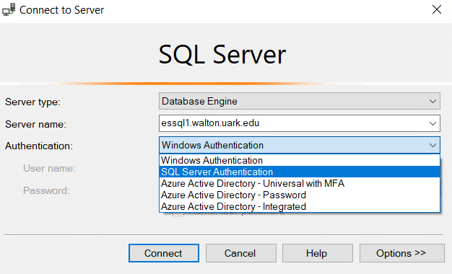
SMSS LOGIN
You will need the exact name of the server.
essql1.walton.uark.edu
There are several types of authentication, and you only need to be concerned with 2 of them.
WINDOWS Authentication will allow you to run queries and does not give you any access to your own db, or creating tables, etc. You also do not need to supply anymore credentials since you have validated yourself in the earlier remote access step
SQL Server Authentication – this will be necessary if you want to use your own db, create tables, import, etc, and YOU WILL need to authenticate yourself again.
You should be able use your same UARK login

Slide 9
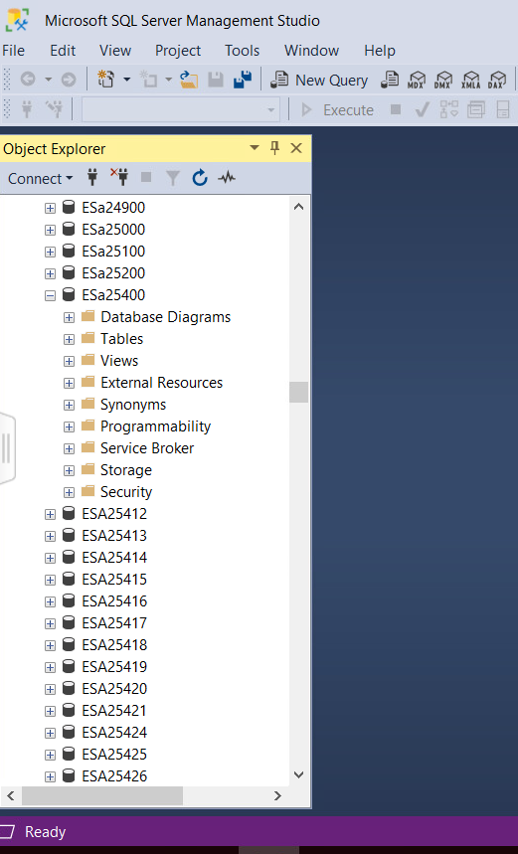
Object EXPLORER pane
The Object EXPLORER provides a hierarchical view of databases maintained by a SQL Server installation.
Username (database name)
Schema name
Object name

Slide 10
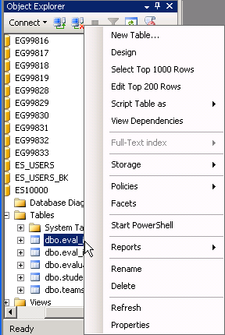
Object EXPLORER Context menu
The context-sensitive menu (right-click) gives you several options when working with objects such as tables.
Top 1000
Top 200
and more …

Slide 11
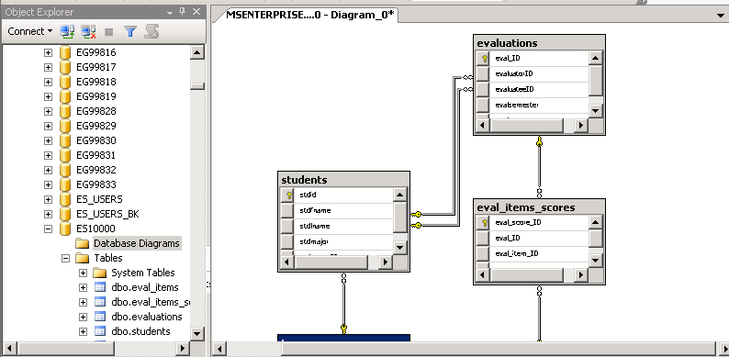
Database Diagram
An easy way to see how a list of tables comprise a database is to create a diagram.
This diagram shows the relationships between table.
For a database with a lot of table, such as AdventureWorks2008, you can select a subset of tables for a diagram.

Slide 12
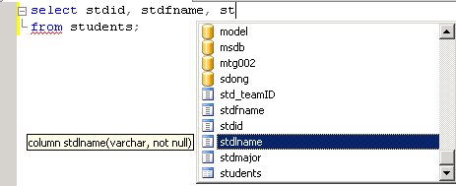
Query Editor Window
IntelliSense features helps you enter SQL code.
Suggestion: When writing SQL commands, enter the table(s) first to help IntelliSense feature help you.

Slide 13
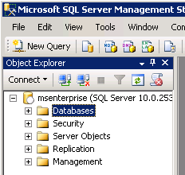
Object Explorer in MSSMS
In the Object Explorer select and expand the Database section.
Locate your account ID in the list NOT the account shown here.

Slide 14
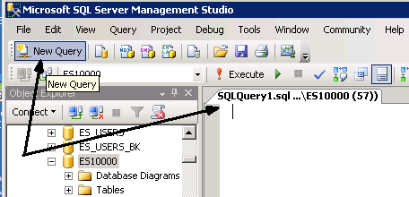
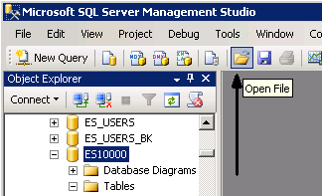
SQL pane
First make certain you download the 3 SQL Scripts from the course website (while in the EPIC remote access)
Either click New Query to open an SQL pane and paste in the contents of the “create” script OR …
Open the CREATE script file, which opens the SQL pane with the file contents.

Slide 15
Select from query

Slide 16
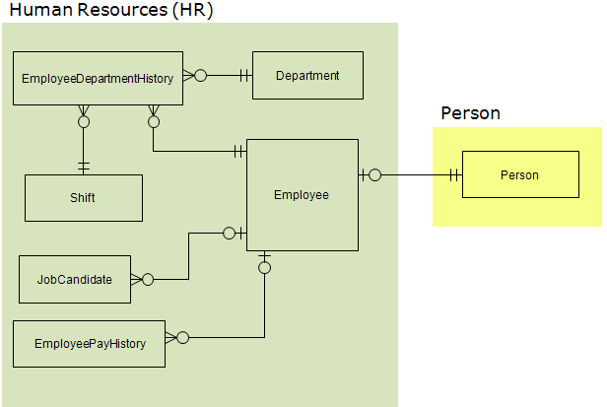
AdventureWorks
Microsoft provides an example database called AdventureWorks (AW). For the time being, only a subset of tables from this database will be used.
Shown here is the data model for the HR portion of the AW database. An additional table is included from the PERSON section of the database.

Slide 17
SELECT … FROM
The SELECT statement has several components but let’s start with only the FROM clause.
A simple SELECT statement has the following format …
SELECT <column1>, <column2>, …
FROM <tablename>;
The angle brackets indicate words that change depending on what data we want to see.
Recommendation: Keep all the SQL commands you write for a lesson in a text file using Notepad. Do the same for SQL you write or assignments.

Slide 18
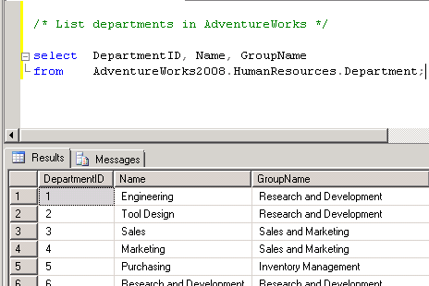
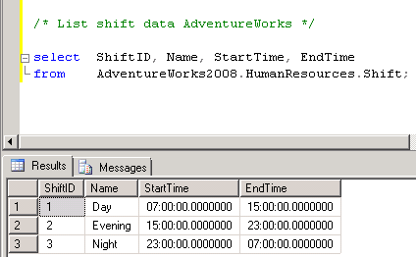
Query tables in AdventureWorks (AW)
The AdventureWorks2008 database is not in your account. To query tables in other accounts, you need to add more information to the table name in the FROM clause.
In SQL below we specify the database or account name and the schema
databasename.schema.tablename
/* List departments in AdventureWorks */
Select DepartmentID, Name, GroupName
From AdventureWorks2008.HumanResources.Department;
Show information about shifts.
/* List shift data AdventureWorks */
Select ShiftID, Name, StartTime, EndTime
From AdventureWorks2008.HumanResources.Shift;

Slide 19
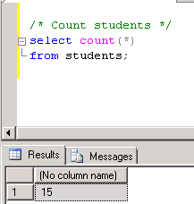
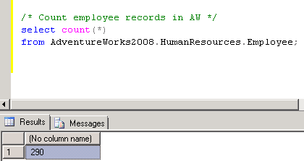
Count rows in a table
How many students are there?
/* Count students */
select count(*)
from students;
How many records are there in AW2008’s EMPLOYEE table?
/* Count employee records in AW */
select count(*)
from AdventureWorks2008.HumanResources.Employee;

Slide 20
SELECT FROM WHERE

Slide 21
SELECT … FROM … WHERE
Adding the WHERE clause to the SELECT statement allows you to filter output based on a criterion.
Syntax:
SELECT <column1>, <column2>, …
FROM <tablename>
WHERE <column> = <criterion>;
The syntax shown here checks whether data in a column equals the criterion. Of course, other evaluations can be used.

Slide 22
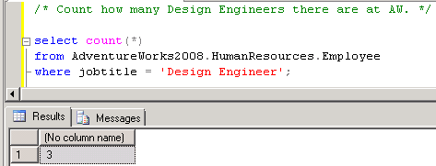
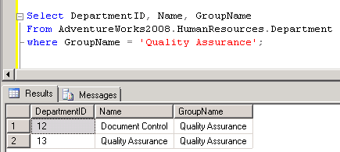
Query the AW database
Count how many AW employees are Design Engineers.
/* Count how many Design Engineers there
are at AW. */
select count(*)
from AdventureWorks2008.HumanResources.Employee
where jobtitle = 'Design Engineer';
Which departments are in the Quality Assurance group?
Select DepartmentID, Name, GroupName
From AdventureWorks2008.HumanResources.Department
where GroupName = 'Quality Assurance';

Slide 23
What WAS COVERED
SSMS AND SQL FUNDAMENTALS
SELECT … FROM …
SELECT … FROM … WHERE

