Slide 1
The Relational Database Model

Slide 2
Your best quote that reflects your approach… “It’s one small step for man, one giant leap for mankind.”
- Neil Armstrong

Slide 3
The history
The relational data model was introduced by C. F. Codd in 1970. Currently, it is the most widely used data model.
The relational model has provided the basis for:
• Research on the theory of data/relationship/constraint
• Numerous database design methodologies
• The standard database access language called structured query language (SQL)
• Almost all modern commercial database management systems
The relational data model describes the world as “a collection of inter-related relations (or tables).”

Slide 4
Relation/Table pt.1
A relation, also known as a table or file, is a subset of the Cartesian product of a list of domains characterized by a name. And within a table, each row represents a group of related data values.
A row, or record, is also known as a tuple.
The columns in a table are a field and is also referred to as an attribute.
You can also think of it this way: an attribute is used to define the record and a record contains a set of attributes.

Slide 5
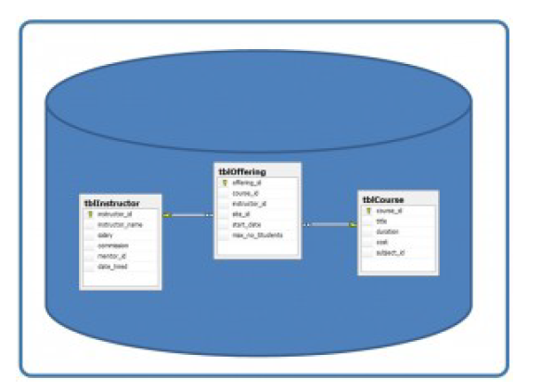
Relation/Table pt. 2
Table
A database is composed of multiple tables and each table holds the data. The following shows a database that contains three tables.

Slide 6
Column
A database stores pieces of information or facts in an organized way. Understanding how to use and get the most out of databases requires us to understand that method of organization.
The principal storage units are called columns or fields or attributes. These house the basic components of data into which your content can be broken down.
When deciding which fields to create, you need to think generically about your information, for example, drawing out the common components of the information that you will store in the database and avoiding the specifics that distinguish one item from another.

Slide 7
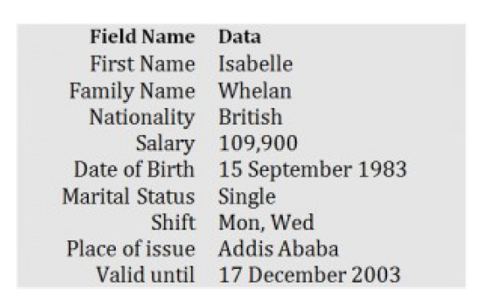
Example of an ID card and the relationship between fields and their data.

Slide 8
Domain
A domain is the original sets of atomic values used to model data. By atomic value, we mean that each value in the domain is indivisible as far as the relational model is concerned.
For example:
• The domain of Marital Status has a set of possibilities: Married, Single, Divorced.
• The domain of Shift has the set of all possible days: {Mon, Tue, Wed…}.
• The domain of Salary is the set of all floating-point numbers greater than 0 and less than 200,000.
• The domain of First Name is the set of character strings that represents names of people.
In summary, a domain is a set of acceptable values that a column can contain. This is based on various properties and the data type for the column.

Slide 9
Record
Just as the content of any one document or item needs to be broken down into its constituent bits of data for storage in the fields, the link between them also needs to be available so that they can be reconstituted into their whole form.
Records contain fields that are related, such as a customer or an employee. As noted earlier, a tuple is another term used for record. Records and fields form the basis of all databases. A simple table gives us the clearest picture of how records and fields work together in a database storage project.

Slide 10
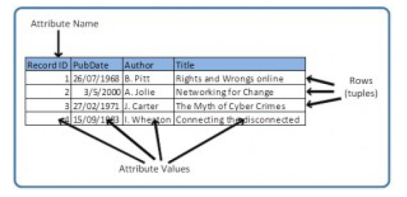
Simple Table
The simple table shows us how fields can hold a range of different sorts of data. This one
has:

Slide 11
Simple Table Continued
• A Record ID field: this is an ordinal number; its data type is an integer.
• A PubDate field: this is displayed as day/month/year; its data type is date.
• An Author field: this is displayed as Initial. Surname; its data type is text.
• A Title field text: free text can be entered here.
You can command the database to sift through its data and organize it in a particular way. For example, you can request that a selection of records be limited by date: 1. all before a given date, 2. all after a given date or 3. all between two given dates. Similarly, you can choose to have records sorted by date. Because the field, or record, containing the data is set up as a Date field, the database reads the information in the Date field not just as numbers separated by slashes, but rather, as dates that must be ordered according to a calendar system.

Slide 12
Degree and Properties of A table
The degree is the number of attributes in a table. In our simple table example the degree is 4.
A table has a name that is distinct from all other tables in the database.
There are no duplicate rows; each row is distinct.
Entries in columns are atomic. The table does not contain repeating groups or multivalued attributes.
Entries from columns are from the same domain based on their data type including:
number (numeric, integer, float, smallint,…)
character (string)
date◦
logical (true or false)
Operations combining different data types are disallowed.
Each attribute has a distinct name.
The sequence of columns is insignificant.
The sequence of rows is insignificant.

Slide 13
The Access Window
Navigation Pane and Access Work Area
Define the following
Access work area
Object tabs
Navigation Pane
Status bar
Datasheet view
Datasheet

Slide 14
Determining Tables and Fields (1 of 2)
Naming Tables and Fields
Names can be up to 64 characters in length
Names can contain letters, digits, and spaces, as well as most of the punctuation symbols
Names cannot contain periods (.), exclamation points (!), accent graves (`), or square brackets ([])
Each field in a table must have a unique name

Slide 15
Determining Tables and Fields (2 of 2)
Determining the Primary Key
Unique identifier
Field called ID
Autonumber field
Determining Data Types for the Fields
Data type
Short Text
Number
Currency
Date & Time

Slide 16
Creating a Table in Datasheet View (1 of 17)
Datasheet view—rows and columns, like a spreadsheet
Design view—only used to create a table or to modify the structure of a table
Caption—an assigned value to a field

Slide 17
Creating a Table in Datasheet View (2 of 17)
To Modify the Primary Key
Click the Field Size text box to select the current field size, use either the DELETE or BACKSPACE key to erase the current field size, and then type the new field size
Click the Name & Caption button to display the Enter Field Properties dialog box
Click the Caption text box, and then type the desired caption
Click the Description text box, and then type the desired description
Click the OK button to change the caption and description

Slide 18
Creating a Table in Datasheet View (3 of 17)
To Define the Renaming Fields in a Table
Click the “Click to Add” column heading to display a menu of available data types
Click the desired data type
Type the desired field name
Click the blank space below the field name to complete the change of the name. Click the blank space a second time to select the field
Change the field size, if necessary

Slide 19
Creating a Table in Datasheet View (4 of 17)
Making Changes to the Structure
Undo
Delete a field
Change the name of a field
Insert a field as the last field
Insert a field between existing fields
Move a field

Slide 20
Creating a Table in Datasheet View (5 of 17)
To Save a Table
Click the Save button on the Quick Access Toolbar to display the Save As dialog box
Type the desired table name
Click the OK button (Save As dialog box) to save the table
Notes:
Figure 1-13: display using the views group and the change in the table name

Slide 21
Creating a Table in Datasheet View (6 of 17)
To View the Table in Design View
Click the View button arrow to display the View menu
Click Design View on the View menu to view the table in Design view
Notes:
Figure 1-15: The design view is displayed

Slide 22
Creating a Table in Datasheet View (7 of 17)
Checking the Structure in Design View
Carefully check the entries made
Use the row selector to display properties
Make necessary changes
Remember to save

Slide 23
Creating a Table in Datasheet View (8 of 17)
To Close the Table
Click the Close button for the open table to close the table
Notes:
Figure 1-16: display of close button

Slide 24
Creating a Table in Datasheet View (9 of 17)
To Add Records to a Table
Run Access
Open desired database
Open the Navigation Pane
Click Open on the shortcut menu to open the table in Datasheet view
Click the “Shutter Bar Open/Close Button” to close the Navigation Pane
Click the first row to enter data, pencil icon indicates record is being edited, but not saved yet
Enter data, use the TAB key to move to the next field
Close the table

Slide 25
Creating a Table in Datasheet View (10 of 17)
Making Changes to the Data
Undo
Add a record
Delete a record
Change the contents of a field

Slide 26
Creating a Table in Datasheet View (11 of 17)
Table 1-4 Navigation Buttons in Datasheet View
Button | Purpose
First record | Moves to the first record in the table
Previous record | Moves to the previous record
Next record | Moves to the next record
Last record | Moves to the last record in the table
New (blank) record | Moves to the end of the table to a position for entering a new record
Notes:
Table 1-4: Navigation buttons in Datasheet view

Slide 27
Creating a Table in Datasheet View (12 of 17)
To Create a Table in Design View
Display the Create tab then click the Table Design button to display the table in Design view
Click the empty field and enter the desired data
Click the row selector, if necessary, then click Primary Key
Click the Save button

Slide 28
Creating a Table in Datasheet View (13 of 17)
Correcting Errors in the Structure
Accidental additions
Desired additions
Correcting primary keys
Moving fields

Slide 29
Creating a Table in Datasheet View (14 of 17)
Populating the Patients Table
Click the View button to change to Datasheet view
Enter patient data
Figure 1–32: Patients
Patient ID | Patient Name | Animal Type | Breed | Owner ID
C-1 | Paws | Feline | Calico | O-2
C-2 | Ranger | Canine | Labrador | O-1
F-1 | Fluffy | Feline | Tabby | O-1
Notes:
Figure 1-32: display of entered patient data

Slide 30
Creating a Table in Datasheet View (15 of 17)
To Close the Table
Click the Close button for the open table to close the table
Notes:
Figure 1-33: display of close button

Slide 31
Creating a Table in Datasheet View (16 of 17)
To Resize Columns in a Datasheet
Double-click the right boundary of the field selector to resize the field so that it best fits the data
Save the changes to the layout by clicking the Save button on the Quick Access Toolbar
Click the table’s Close button to close the table

Slide 32
Creating a Table in Datasheet View (17 of 17)
Importing Additional Access Database Tables into an Existing Database
Open the desired database
Click on External data on the ribbon to display the External Data tab
Click the “New Data Source” button
Point to From Database to display a menu and then click Access to display the Get External Data, Access Database dialog box
Click the Browse button and navigate to the desired source file
Click “Import tables, queries, forms, reports, macros, and modules into the current database” option box
Click OK, then Select All, then OK
Click Close
Open the table and explore the data

