Slide 1

SQL part two

Slide 2
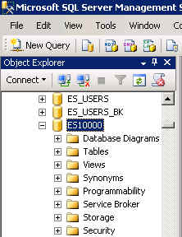
What you’ll need …
Log in to EPIC into MSSMS (Microsoft SQL Server Management Studio).
  Be sure to select your account ID under Database in the Object Explorer pane, similar to the example shown here.

Slide 3
Two Tables or More

Slide 4
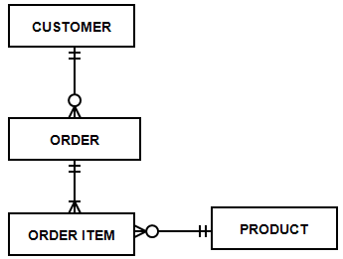
Using more than one table in a query
A relational database has many tables. Usually, you will want to combine information from two or more tables in a query.
For example, if you create a query to list sales orders for today, you may want to include customer information and product information along with the sales order data itself.
Based on this example data model, 4 tables would be used in the query to list sales orders for today if query includes customer names and product names.

Slide 5
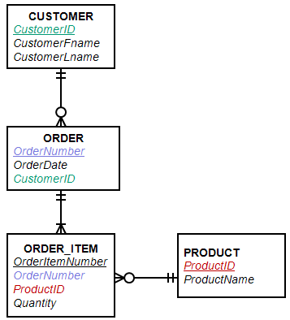
Joining tables in a query
Tables are joined or connected in a query based on a column they have in common.
For example, the CUSTOMER table is joined with the ORDER table through the CustomerID column each table has.
Order is joined to Order_Item through OrderNumber.
Order_Item is joined to Product through ProductID.
Customer.CustomerID = Order.CustomerID
Order.OrderNumber = Order_Item.OrderNumber
Order_Item.ProductID = Product.ProductID

Slide 6
What is a join?
A join is a query that combines records from two or more tables.
A join will be performed whenever multiple tables appear in the FROM clause of the query. The select list of the query can select any columns from any of these tables.
If join condition is omitted or invalid then a Cartesian product is formed (all possible combinations are generated).
If any two of these tables have a column name in common, then must qualify these columns throughout the query with table or table alias names to avoid ambiguity.
Most join queries contain at least one join condition, either in the FROM clause or in the WHERE clause.

Slide 7
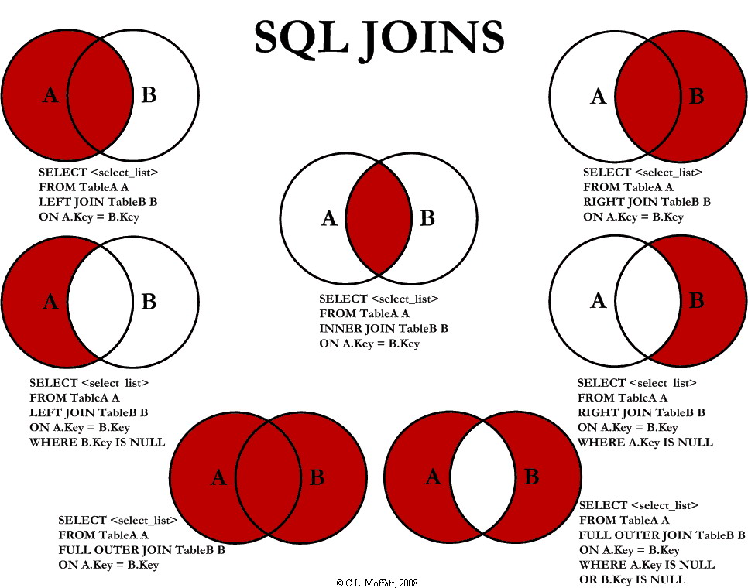

Slide 8
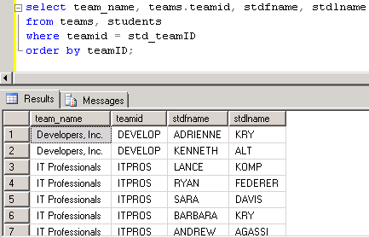
Using 2 tables in a query
The 2 tables must be joined in the query on column they have in common.
Show team names and students on each team.
/* Show the full team name and students on each team. Sort by team. */
select team_name, teams.teamid, stdfname, stdlname
from team, students
where teams.teamid = students.std_teamID
order by teamID;
When you display a column name that appears in more than one table, you may need to add the table name to the column name in the SELECT clause.
You have to do this if the column names are identical in each table. If you don’t put the table name first, you’ll get an error that the column is ambiguously defined.

Slide 9
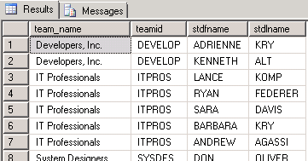
Two way to join tables: WHERE clause and JOIN operator.
There are 2 ways to join tables in a query.
WHERE Clause
select team_name, teams.teamID, stdfname, stdlname
from team, students
WHERE teams.teamid = students.std_teamID
order by teamID;
JOIN Operator in FROM clause
select team_name, teams.teamID,
stdfname, stdlname
from teams INNER JOIN students
ON teamID = std_teamID
order by teamID;

Slide 10
Using more than 2 tables in a query.
Take a look at using 3 tables in a query.
Show students and their evaluations as evaluatee.
Use the JOIN operator in the FROM clause.
INNER JOIN … INNER is optional and often omitted
/* Join with the JOIN operator in the FROM clause. */
select team_name, teams.teamID, stdid, stdfname, stdlname, evalsemester, evalyear, eval_ID
from teams join students
on teams.teamID = students.std_teamid
join evaluations
on students.stdid = evaluations.evaluateeID
order by teamID, stdid;
/* Show team name, teamd ID, student ID and name, semester, year and evaluation ID for each student who was evaluated (evaluate. Sort by team name and student ID. */

Slide 11
Each JOIN has a temporary data set
Each JOIN creates a temporary data set and this data set is what is joined with the next JOIN operator.
/* Show team name, teamd ID, student ID and name, semester,
year and evaluation ID for each student who was evaluated (evaluatee). */
select team_name, teams.teamID, stdid, stdfname, stdlname, evalsemester, evalyear, eval_ID
from teams join students
on teams.teamID = students.std_teamid
join evaluations
on students.stdid = evaluations.evaluateeID
order by teamID, stdid;
Team
Students
Team-Students
Team-students
Evaluations
Team-Students-Evaluations

Slide 12
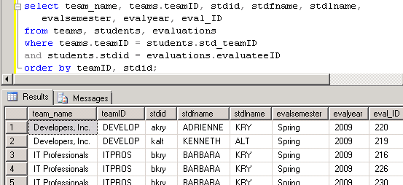
Joining 3 tables in the WHERE clause
Show students and their evaluations as evaluatee.
/* Join in the WHERE clause */
select team_name, teams.teamID, stdid, stdfname, stdlname,
evalsemester, evalyear, eval_ID
from teams, students, evaluations
where teams.teamID = students.std_teamID
and students.stdid = evaluations.evaluateeID
order by teamID, stdid;

Slide 13
What was covered in this section
How to use more than one table in a query.
Joining tables
  WHERE clause
  JOIN operator in the FROM clause

Slide 14
Aggregating Data
SUM(), AVG(), MIN(), MAX(), COUNT ()

Slide 15
Aggregates
We often want to group data, also known as aggregating data.
For example, a school might want a list of how many students are in each course in the fall and spring semesters. The grouping would be based on the current year, then by semester, then by course.
Year | Semester | Course | Student Count
2010 | Fall | ENG301 | 46
 | Fall | MAT301 | 35
 | Spring | ENG301 | 51

Slide 16
Aggregates
Another example of aggregating data would be to list the current semester’s courses, the majors, and the number of students in each major. (You would filter the data for the current year and semester in the WHERE clause.)
Course | Major | Student Count
ENG301 | HIST | 17
 | EDUC | 19
 | BUS | 10
MAT301 | MATH | 15
 | BUS | 8
 | EEG | 12

Slide 17
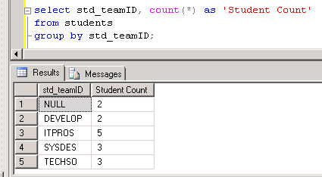
GROUP BY clause
The GROUP BY clause determines how data is grouped or aggregated. This comes after the WHERE clause, if one is used.
Aggregate functions—such as count, average, sum—are in the SELECT clause.
/* Show how many students are on each team. */
select std_teamID, count(*) as 'Student Count’
from students
group by std_teamID;

Slide 18
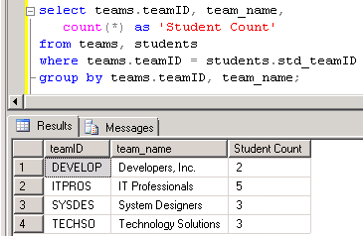
Grouping with more fields in the SELECT clause and GROUP BY clause.
Fields in the GROUP BY clause:
  The GROUP BY clause needs to include any fields in the SELECT clause that are not aggregate functions.
/* Show how many students are on each team. Show the full team name. */
select teams.teamID, team_name, count(*) as 'Student Count’
from teams, students
where teams.teamID = students.std_teamID
group by teams.teamID, team_name;

Slide 19
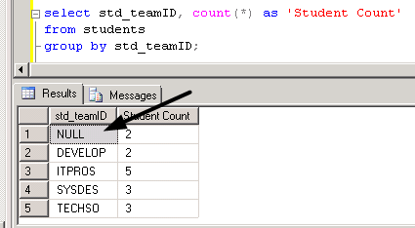
Just a comment for now …
Did you notice in the past two queries that one showed “null” for students without a team but the other query only shows students on teams?
When you join two tables, by default, you only get output for data that is found in both tables. The students without a team “disappear” because there’s no team ID value to link the student to the TEAMS table.

Slide 20
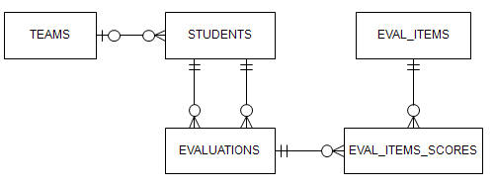
Using other aggregate functions
To see some of the other aggregate functions, let’s look at a student’s evaluation scores—average, maximum and minimum.
First, let’s review the data model to see what tables we will use. We’ll use 3 tables but only display information from 2.
Stdid = evaluateeID
evaluations.Eval_ID = eval_items_scores.Eval_ID

Slide 21
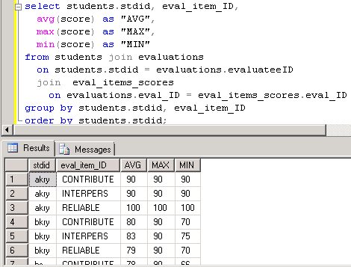
Aggregate functions: average, maximum, minimum
To see some of the other aggregate functions, let’s look at a student’s evaluation scores—average, maximum and minimum.
Used column aliases for clearer output.
Two JOINs joined the 3 tables.
GROUP BY has each column in the SELECT clause that isn’t an aggregate function.

Slide 22
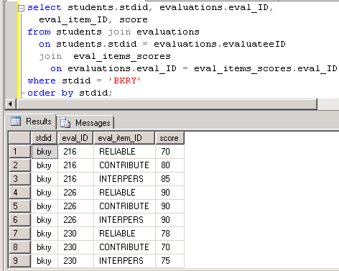
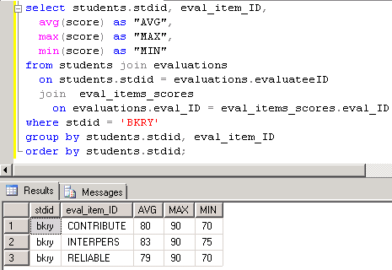
Compare detailed data versus aggregate data for a student.
Contribution:
80 + 90 + 70 = 240
240/3 = 80

Slide 23
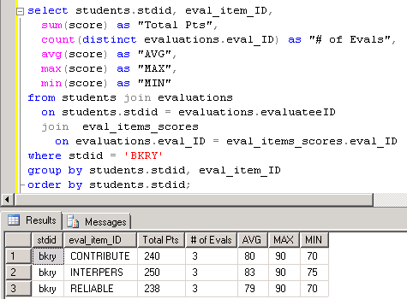
A few more aggregate functions.
sum(<field>)
count(distinct <field>)

Slide 24
What was covered in this section
How to group data using the GROUP BY clause.
Some aggregates functions
  COUNT() and COUNT(distinct)
  SUM()
  AVG()
  MIN()
  MAX()

Slide 25
Aggregating Data Part II
Aggregate data and the HAVING clause

Slide 26
GROUP BY – aggregating data
Sometimes when we aggregate data, we also want to filter the output based on the aggregated values.
Before filtering, a school might want a list of how many students are in each course in the fall and spring semesters. The grouping shown here is based on the year, then by semester, then by course.
Year | Semester | Course | Student Count
2010 | Fall | ENG301 | 46
 | Fall | MAT301 | 35
 | Spring | ENG301 | 51

Slide 27
GROUP BY and HAVING
What if the list should only show classes with more than 40 students? If that’s the case, the aggregated data we saw on the previous slide would filter out one row.
Year | Semester | Course | Student Count
2010 | Fall | ENG301 | 46
 | Fall | MAT301 | 35
 | Spring | ENG301 | 51
Year | Semester | Course | Student Count
2010 | Fall | ENG301 | 46
 | Spring | ENG301 | 51

Slide 28
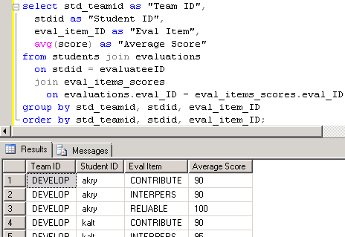
GROUP BY clause
First, let’s look at the aggregate query: Show the evaluation scores for each student in each team.
select std_teamid as "Team ID", stdid as "Student ID", eval_item_ID as "Eval Item", avg(score) as "Average Score”
from students join evaluations
on stdid = evaluateeID join eval_items_scores
on evaluations.eval_ID = eval_items_scores.eval_ID
group by std_teamid,
stdid, eval_item_ID
order by std_teamid,
stdid, eval_item_ID;

Slide 29
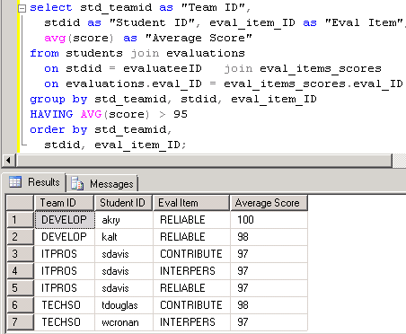
GROUP BY with a HAVING clause
Next, let’s add a filter criterion in the HAVING clause. Show the evaluation scores for each student in each team if their average is above 95.
select std_teamid as "Team ID", stdid as "Student ID", eval_item_ID as "Eval Item", avg(score) as "Average Score”
from students join evaluations
on stdid = evaluateeID
join eval_items_scores
on evaluations.eval_ID =
eval_items_scores.eval_ID
group by std_teamid,
stdid, eval_item_ID
HAVING avg(score) > 95
order by std_teamid,
stdid, eval_item_ID;

Slide 30
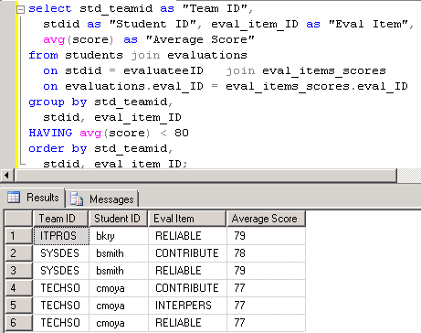
Another HAVING clause example
Next, let’s add a filter criterion in the HAVING clause. Show the evaluation scores for each student in each team if their average is below 80.
select std_teamid as "Team ID", stdid as "Student ID", eval_item_ID as "Eval Item", avg(score) as "Average Score”
from students join evaluations
on stdid = evaluateeID
join eval_items_scores
on evaluations.eval_ID =
eval_items_scores.eval_ID
group by std_teamid,
stdid, eval_item_ID
HAVING avg(score) < 80
order by std_teamid,
stdid, eval_item_ID;

Slide 31
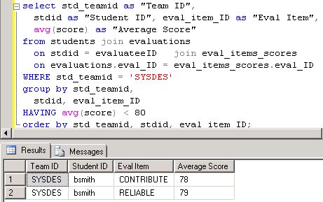
WHERE and HAVING clauses
We can filter individual rows in the WHERE clause and the aggregate values in the HAVING clause.
select std_teamid as "Team ID", stdid as "Student ID", eval_item_ID as "Eval Item", avg(score) as "Average Score”
from students join evaluations
on stdid = evaluateeID
join eval_items_scores
on evaluations.eval_ID =
eval_items_scores.eval_ID
WHERE std_teamid = 'SYSDES’
group by std_teamid,
stdid, eval_item_ID
HAVING avg(score) < 80
order by std_teamid,
stdid, eval_item_ID;

Slide 32
What was covered in this section
HAVING clause for aggregate values
  Filter output based on aggregate value criteria.
HAVING versus WHERE criteria
  Aggregate versus detail (row by row) criteria

Slide 33

Self-joins
A unary relationship occurs when an entity (table) is related to itself. This is not that unusual in a database, by the way.
For this presentation we’ll use the Student-Teams database and we’ll also use a simple one-table example created just for this lesson.
EMPLOYEE: The ERD shown here shows that the employee table has a one-to-many relationship with itself.

Slide 34
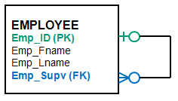
EMPLOYEE – A unary relationship
Why is the employee related to itself?
  An employee may report to another employee (supervisor).
  An employee may supervise zero to many employee (subordinates).
In the EMPLOYEE table example, emp_ID is the primary key.
Emp_Supv is the foreign key (this is the supervisor’s employee ID).
SELF-JOIN: If we want a list of employees and the names of their supervisors, we’ll have to JOIN the EMPLOYEE table to itself to get this list.

Slide 35
EMPLOYEE – Create table & insert data
To prepare for the self-join, create the employee table and insert data. (The SQL script is provided to instructors.)
Insert data
CREATE TABLE dbo.employee(
emp_ID varchar(4) NOT NULL,
emp_Fname varchar(10) NULL,
emp_Lname varchar(10) NULL,
emp_Supv varchar(4) NULL,
CONSTRAINT PK_employee PRIMARY KEY(emp_ID) ,
CONSTRAINT FK_supervisor FOREIGN KEY(emp_Supv) REFERENCES employee(emp_ID));
insert into employee
(emp_id, emp_fname, emp_lname, emp_supv)
values ('1050', 'Carlo', 'Mora', NULL);
insert into employee
(emp_id, emp_fname, emp_lname, emp_supv)
values ('1062', 'Robert', 'Block', 1050);
insert into employee
(emp_id, emp_fname, emp_lname, emp_supv)
values ('1063', 'Teresa', 'Roberts', 1062);
insert into employee
(emp_id, emp_fname, emp_lname, emp_supv)
values ('1077', 'Carla', 'Stevens', 1050);
insert into employee
(emp_id, emp_fname, emp_lname, emp_supv)
values ('1080', 'Wilma', 'Washington', 1050);
insert into employee
(emp_id, emp_fname, emp_lname, emp_supv)
values ('1081', 'Rory', 'Block', 1062);

Slide 36
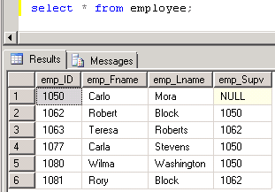
EMPLOYEE data
If you look at the employee data, you can figure out that Robert Block’s supervisor is Carlo Mora.
Carla Stevens and Wilma Washington also report to Carlo Mora.
Select * from employee;
How can we get the list of employees and their supervisors?

Slide 37
Using EMPLOYEE twice in a query.
We will use the EMPLOYEE table twice in the query. In order to do this we have to rename the table—give it an alias.
When we list the table in the FROM clause the table name is immediately followed by the table alias.
We’ll use sub (subordinate) and supv (supervisor).
select ...
from employee sub, employee supv
Where ...
You should decide on the aliases before typing the SELECT clause because you’ll use them in the SELECT clause.
select sub.emp_id as "Sub ID",
sub.emp_fname + ' ' + sub.emp_lname as "Subordinate",
supv.emp_id as "Supv ID",
supv.emp_fname + ' ' + supv.emp_lname as "Supervisor“
from employee sub, employee supv
where sub.emp_supv = supv.emp_id;

Slide 38
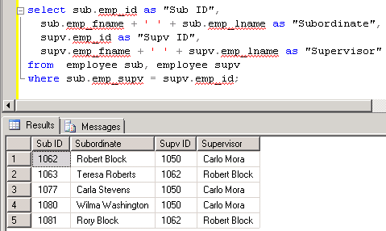
Self-join output: List of employees and their supervisors.
select sub.emp_id as "Sub ID",
sub.emp_fname + ' ' + sub.emp_lname as "Subordinate", supv.emp_id as "Supv ID",
supv.emp_fname + ' ' + supv.emp_lname as "Supervisor“
from employee sub, employee supv
where sub.emp_supv = supv.emp_id;

Slide 39
Another need for table aliases:
Two joins between two tables
The Student-Teams database has two tables with two relationships.
To get the names of evaluatees and evaluators, we’ll need to use the STUDENTS table twice—one for each relationship to EVALUATIONS.
TEAMS
STUDENTS
EVAL_ITEMS
Evaluatee
Evaluator
EVALUATIONS
EVAL_ITEMS_SCORES

Slide 40
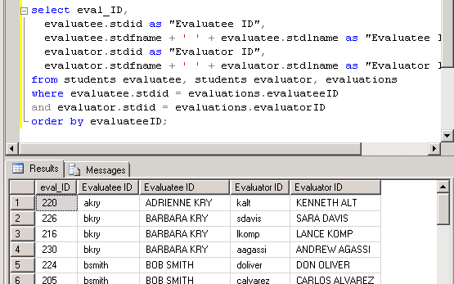
Another need for table aliases:
Two joins between two tables
STUDENTS
/* List evaluatees and evaluators. Show the evaluation ID, student IDs and full names. */
We’ll use EVALUATEE and EVALUATOR as the table aliases for the STUDENTS table.
select eval_ID,
evaluatee.stdid as "Evaluatee ID",
evaluatee.stdfname + ' ‘
+ evaluatee.stdlname as "Evaluatee ID",
evaluator.stdid as "Evaluator ID",
evaluator.stdfname + ' ‘
+ evaluator.stdlname as "Evaluator ID“
from students evaluatee, students evaluator,
evaluations
where evaluatee.stdid = evaluations.evaluateeID
and evaluator.stdid = evaluations.evaluatorID
order by evaluateeID;
Evaluatee
Evaluator
EVALUATIONS

Slide 41
What was covered in this section
Unary relationship
Self-join in a query
Table aliases
Joining the same two tables twice in a query

Slide 42
Set Operators

Slide 43
SET OPERATORS
There are 3 set operator commands:
  UNION
  INTERSECT
  EXCEPT
UNION combines two or more data sets.
A
B
A and B
+
=

Slide 44
Set Operators: UNION
UNION: If the data sets overlap (have common data), the duplicates are removed.
UNION compatible rule: This rule applies to all 3 set operators.
  The # of columns must be the same in both data sets.
  The column data types must be in the same sequence and compatible. Example: Column 2 in both data sets must be have the same data type.
A
+
A and B
=
B

Slide 45
Set Operators: INTERSECT
INTERSECT: If the data sets overlap, only the overlap is in the result.
A
+
=
B

Slide 46
Set Operators: EXCEPT
EXCEPT: If the data sets overlap, only the portion not in common with the second data set is in the result.
A
+
=
B

Slide 47
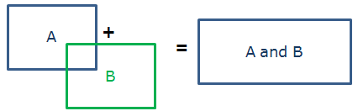
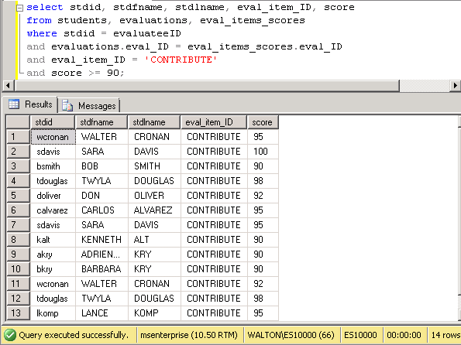
UNION example – p1
List students who got 90 or higher on their CONTRIBUTE evaluation item (they were evaluatees).
select stdid, stdfname, stdlname, eval_item_ID, score
from students, evaluations, eval_items_scores
where stdid = evaluateeID
and evaluations.eval_ID = eval_items_scores.eval_ID
and eval_item_ID = 'CONTRIBUTE’
and score >= 90;
The output has 14 rows.

Slide 48
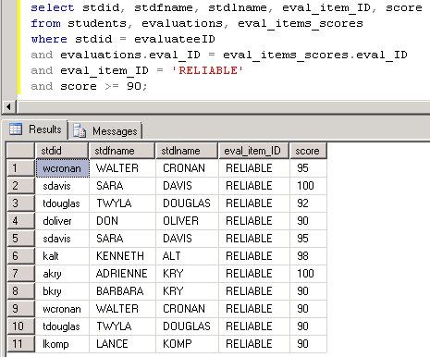
UNION example – p2
List students who got 90 or higher on their RELIABLE evaluation item (they were evaluatees).
select stdid, stdfname, stdlname, eval_item_ID, score
from students, evaluations, eval_items_scores
where stdid = evaluateeID
and evaluations.eval_ID = eval_items_scores.eval_ID
and eval_item_ID = 'RELIABLE’
and score >= 90;
The output has 11 rows.

Slide 49
UNION example – p3
UNION the lists to combine the output.
select stdid, stdfname, stdlname, eval_item_ID, score
from students, evaluations, eval_items_scores
where stdid = evaluateeID
and evaluations.eval_ID = eval_items_scores.eval_ID
and eval_item_ID = 'CONTRIBUTE’
and score >= 90
UNION
select stdid, stdfname, stdlname, eval_item_ID, score
from students, evaluations, eval_items_scores
where stdid = evaluateeID
and evaluations.eval_ID = eval_items_scores.eval_ID
and eval_item_ID = 'RELIABLE’
and score >= 90;

Slide 50
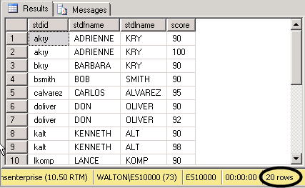
UNION example – p4
Remove the evaluation item ID column. This will reduce the list because some students were listed twice—once for CONTRIBUTE and once for RELIABLE.
The output drops to 20 rows.
select stdid, stdfname, stdlname, eval_item_ID, score
from students, evaluations, eval_items_scores
where stdid = evaluateeID
and evaluations.eval_ID = eval_items_scores.eval_ID
and eval_item_ID = 'CONTRIBUTE’
and score >= 90
UNION
select stdid, stdfname, stdlname, eval_item_ID, score
from students, evaluations, eval_items_scores
where stdid = evaluateeID
and evaluations.eval_ID = eval_items_scores.eval_ID
and eval_item_ID = 'RELIABLE’
and score >= 90;

Slide 51
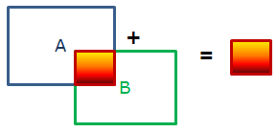
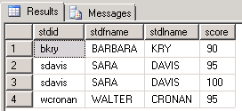
INTERSECT example
Change UNION to INTERSECT. Now, we see which students got 90 or higher in both CONTRIBUTE and RELIABLE>
select stdid, stdfname, stdlname, score
from students, evaluations, eval_items_scores
where stdid = evaluateeID
and evaluations.eval_ID = eval_items_scores.eval_ID
and eval_item_ID = 'CONTRIBUTE’
and score >= 90
INTERSECT
select stdid, stdfname, stdlname, score
from students, evaluations, eval_items_scores
where stdid = evaluateeID
and evaluations.eval_ID = eval_items_scores.eval_ID
and eval_item_ID = 'RELIABLE’
and score >= 90;

Slide 52

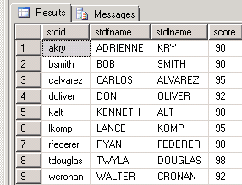
EXCEPT example
Now, use EXCEPT. We see which students got 90 or higher for CONTRIBUTE but didn’t for RELIABLE.
select stdid, stdfname, stdlname, score
from students, evaluations, eval_items_scores
where stdid = evaluateeID
and evaluations.eval_ID = eval_items_scores.eval_ID
and eval_item_ID = 'CONTRIBUTE’
and score >= 90
EXCEPT
select stdid, stdfname, stdlname, score
from students, evaluations, eval_items_scores
where stdid = evaluateeID
and evaluations.eval_ID = eval_items_scores.eval_ID
and eval_item_ID = 'RELIABLE’
and score >= 90;

Slide 53
What was covered in this section
Set Operators
  UNION
  INTERSECT
  EXCEPT
UNION compatible rule

Slide 54
the end

