Slide 1

Triggers
An sql concept of create, insert, update

Slide 2
The triggers
Insert
update
delete

Slide 3
Intro to trigger
SQL Server triggers are special stored procedures that are executed automatically in response to the database object, database, and server events. SQL Server provides three type of triggers:
  Data manipulation language (DML) triggers which are invoked automatically in response to INSERT, UPDATE, and DELETE events against tables.
  Data definition language (DDL) triggers which fire in response to CREATE, ALTER , and DROP statements. DDL triggers also fire in response to some system stored procedures that perform DDL-like operations.
  Logon triggers which fire in response to LOGON events
For example, a trigger could be defined to perform validation of values to be inserted or to perform calculations on values involved in an update.

Slide 4
IUD defined
Insert triggers are fired whenever an insert operation is performed on a table.
  They are often used to enforce referential integrity in situations where another type of constraint is not advisable, or to populate another table during an insert.
An update trigger will fire each time any row (or rows!) is updated.
  Update triggers can also be used to check field constraints and relationships.
Delete triggers are fired whenever a delete operation is performed on a table. Delete triggers are typically used for two reasons:
  The first reason is to prevent deletion of records that will cause data integrity problems if they indeed are deleted. An example of such records is those used as foreign keys to other tables.
  The second reason for using a Delete trigger is to perform a cascading delete operation that deletes children records of a master record.
Insert and update triggers are particularly useful because they can enforce referential integrity constraints and ensure that your data is valid before it enters the table.
All triggers add some overhead, but overhead can accumulate quickly for statements that process large numbers of rows. Avoid placing expensive SQL statements in triggers.

Slide 5
creation
Declaration
Triggers are created using the CREATE TRIGGER syntax:
  CREATE TRIGGER trigger_name [BEFORE | AFTER] [INSERT | UPDATE | DELETE] ON table_name
  FOR EACH ROW trigger_body
Trigger declarations do not allow a parameter list.
Invocation
The set of statements that make up a trigger are run when an event occurs on a table. They cannot be invoked like procedure or function calls.
Body
Triggers are generally formed of regular SQL statements, although there are some differences.
Flow control constructs – specifically, IF, CASE, ITERATE, LEAVE, LOOP, WHILE, and REPEAT – may appear within triggers to control the order of statement execution.
There are restrictions on which SQL statements may appear in triggers.
Triggers may consist of multiple statements by using a BEGIN ... END compound statement block.

Slide 6
RESTRICTIONS
Each trigger is associated with exactly one table
Each trigger is associated with exactly one time period (BEFORE or AFTER).
A BEFORE trigger is activated for each row in the set of affected rows before the trigger event executes.
An AFTER trigger is activated for each row in the set of affected rows or for the statement, depending on the trigger granularity, after the trigger event has been completed.
Each trigger is associated with exactly one event (INSERT, UPDATE, or DELETE).
Insert triggers are fired whenever an insert operation is performed on a table.
An update trigger will fire each time any row (or rows!) is updated.
Delete triggers are fired whenever a delete operation is performed on a table.
The trigger event (INSERT, UPDATE, or DELETE) represents the given type of table operation, not the literal SQL statement of the same name.
A single SQL statement may invoke multiple triggers, and triggers may also invoke other triggers.
For example, INSERT INTO ... ON DUPLICATE KEY UPDATE ... will invoke a BEFORE INSERT trigger for every row, followed by either an AFTER INSERT trigger or both the BEFORE UPDATE and AFTER UPDATE triggers, depending on whether there was a duplicate key for the row.
It is not possible to define multiple triggers for the same time period and event combination for a given table (e.g., only one BEFORE INSERT trigger per table); each table can have, at most, six triggers.

Slide 7
LIMITATIONS
Triggers cannot be created on views or temporary tables.
Triggers cannot start, commit or rollback transactions.
Triggers cannot return anything.
Triggers cannot (or should not) modify a table that is being used by the statement that invoked the trigger. In other words, do not, for example, issue an UPDATE query on the same table for which an UPDATE trigger is fired. In fact, you should not design a trigger that modifies the table it is defined on. This is referred to as a recursive query.
Triggers cannot use prepared statements.
Triggers may invoke stored procedures and stored functions that adhere to the restrictions for triggers.

Slide 8
Examples
Example: Year-To-Date Sales Calculation
As new sales are recorded and existing sales are modified or deleted in the sales table,
these triggers keep the year-to-date sales total current in the titles table.
Note again, that as changes are made in one table, the triggers make updates to another table.
CREATE TRIGGER YtdSalesInsert BEFORE INSERT ON sales
FOR EACH ROW
UPDATE titles
SET ytd_sales = ytd_sales + NEW.qty
WHERE title_id = NEW.title_id;
CREATE TRIGGER YtdSalesDelete BEFORE DELETE ON sales
FOR EACH ROW
UPDATE titles
SET ytd_sales = ytd_sales - OLD.qty
WHERE title_id = OLD.title_id;
CREATE TRIGGER YtdSalesUpdate BEFORE UPDATE ON sales
FOR EACH ROW
UPDATE titles
SET ytd_sales = ytd_sales - OLD.qty + NEW.qty
WHERE title_id = OLD.title_id;
Notice the UPDATE trigger uses both OLD.qty and NEW.qty to account for the change in quantity.

Slide 9
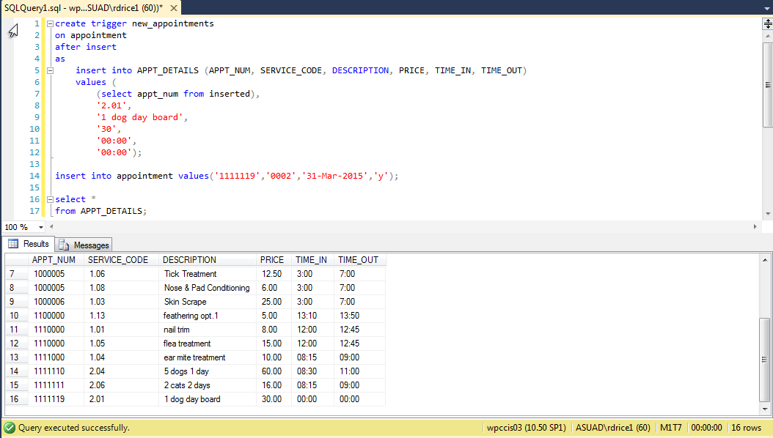
Example 2
Trigger that adds a default an appointment details entry for 1 dog day board into the Appt_Details table when an appointment is added to the Appointment table. The addition to Appt_Details is displayed below.

Slide 10
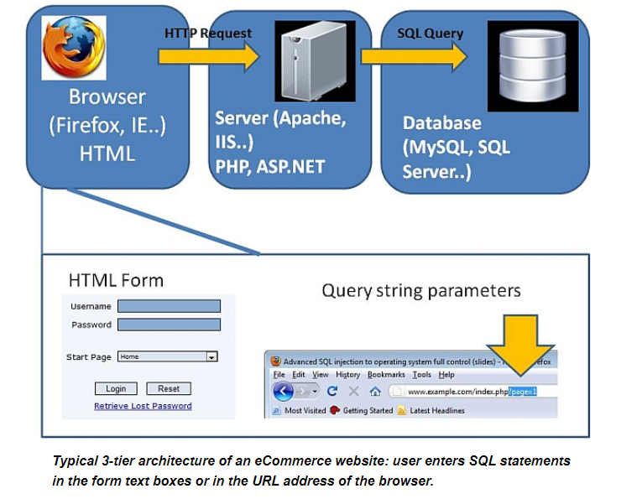
SQL Injection overview
SQL injection is an attack technique used to exploit code by altering back-end SQL statements through manipulating input.
A SQL injection attack "injects" or manipulates SQL code. By adding unexpected SQL to a query, it is possible to manipulate a database in ways initially not thought of by the database administrator/developer.
A SQL injection attack involves entering malformed or unexpected data so that the back-end SQL database running behind the website or application executes SQL commands that the programmer never intended to permit, possibly allowing an intruder to break into or damage the database.

Slide 11
CONsequences
Attacker gains unauthorized access to confidential data in the database
Attacker changes or deletes data in the database
Attacker gains unauthorized access to the server file system
Attacker changes the appearance of the website
Possible identity theft
Loss of customer trust in the website

Slide 12
Examples
One of the most popular ways to validate a user on a web site is by providing them with a HTML form through which they can enter their username and password. Let's assume that we have the following simple HTML form:
<form name="frmLogin" action="login.php" method="post">
<label class="newLine">Username:
<input class="newLine" type="text" name="userName"/>
</label>
<label class="newLine">Password:
<input class="newLine" type="password" name="password"/>
</label>
<input title="Log in." type="submit" value="Log in" />
</form>
When the form is submitted, the contents of the username and password fields are passed to the login.php script and are available to that script through the request methods like GET or POST.

Slide 13
Example continued
So, if the user entered a username of john and password of doe, then he or she would be presented with the text "Logged In". The query would look something like this:
select count(*) from users where userName='john' and userPass='doe’
There’s nothing unsecure or dangerous about the above query.
However, there are ways of manipulating the underlying SQL code using SQL comments. To see how comments are entered in queries, see the aside. Now, if a user entered the following:
Username: john
Password: ' or 1=1 --
...the resulting query would become:
select count(*) from users where userName='john' and userPass='' or 1=1 -- '
1=1 evaluates to TRUE, and anything OR TRUE evaluates to TRUE

Slide 14
Results of attack
So, as a result of the injection attack, the query now only checks for any user with a username field of john.
Instead of checking for a matching password, it now checks for an empty password or the conditional equation of 1=1, meaning that if the password field is empty OR 1 equals 1 (which it does), then a valid entry has been found in the users table.
Notice how the last quote is commented out with a single-line comment delimiter (-- ). This stops servercode from spitting an error about any unclosed quotations.
So, with the login script we created above, one row would be returned, and the text "Logged in" would be displayed.

Slide 15
Going a step further
We could take this a bit further by doing the same thing to the username field, like this:
Username: ' or 1=1 --
Password: [empty]
This would result in the following query being executed against the users table:
select count(*) from users where userName='' or 1=1 -- ' and userPass=''
The query above returns a count of all rows in the user table.
This is an example of a SQL injection attack: adding code that manipulates the contents of a query to perform an undesired result.

Slide 16
SQL INJECTION PREVENTION
The first thing to do is to protect SQL queries by implementing sanitization techniques for all input received from any request object.
Sanitization routines vary based on the DBMS, but the following examples were developed using MySQL and MariaDB.
Some of the following examples use PHP, one of the most widely used server-side languages. Comparable server-side languages typically provide similar features.
If you want to know more about PHP, here is a thorough "Introduction to PHP".
Injection attacks against PHP coded sites can be mitigated by simply running any user input that can come in contact with the database through sanitization routines like PHP's built-in function called mysqli_real_escape_string.
This function will escape any special characters in a string, preventing them from being used as a potential attac

Slide 17
SQL Injection PReVENTION CONTINUED
The original PHP code looked like this:
$userName = $_POST['userName'];
$password = $_POST['password'];
Applying mysqli_real_escape_string results in these changes:
$userName = mysqli_real_escape_string($connection, $_POST['userName']);
$password = mysqli_real_escape_string($connection, $_POST['password']);
The first argument is a connection identifier returned by mysqli_connect().

Slide 18
Other approaches
Limit the Length of User Input
It makes no sense to have a text box on a form that can accept 50 characters if the field it is compared against can only accept 10.
Keeping all text boxes and form fields as short as possible takes away the number of characters that can be used to formulate a SQL injection attack.
To specify the maximum number of characters allowed in the <input> element, use the maxlength attribute.
If you're accepting a querystring value for a product ID or the like, always use a function to check if the value is actually numeric, such as the ctype_digit() function for PHP.
If the function returns FALSE, meaning that not every character in the string text is a decimal digit, then either raise an error or redirect the user to another page where they can choose a product.
Also, always try to post your forms with the method attribute set to POST, so nefarious users don't get any ideas – they might if they saw your form variables tacked onto the end of the URL.

Slide 19
Stored procedures
Stored Procedures
One method of preventing SQL injection is to avoid the use of dynamically generated SQL in your code.
Stored procedures can secure your database by restricting objects within the database to specific accounts, and permitting the accounts to just execute stored procedures.
Your code then performs all database access using this one account that only has access to execute stored procedures.
You do not provide this account any other permissions, such as write, which would allow an attacker to enter SQL statements to execute against your database.
Any interaction to your database would have to be done using a stored procedure that you wrote and that is in the database itself, which is usually inaccessible elsewhere.

Slide 20
MINIMIZE INFORMATION EXPOSURE
To further reduce the risk of SQL injection, be sure to remove any technical information from client-delivered error messages.
Allow minimal information to the user when an error does occur.
Error messages often reveal technical details that can enable an attacker to reveal vulnerable entry points.
This includes any custom messages your application generates as well as server- or environment-generated errors.
Always try to provide the least amount of information possible to the users.
Here is a link that discusses the danger and another that tells you how to modify error reporting in PHP.

Slide 21
URLS
Another variation of the SQL injection attack exists when receiving querystring parameters to generate dynamic pages, such as myapp.php?target=showproducts&categoryid=123
This code opens itself to a SQL injection attack because a malicious user could substitute the valid categoryid for an unauthorized SQL command by passing into the categoryid something like: 0 or 1=1 (i.e., http://www.example.com/myapp.php?target=showproducts&categoryid==0 or 1=1).
In this example, the script expects a variable (categoryid) of type long integer to be passed. Unauthorized SQL commands can be executed by appending SQL to the ID parameter.
A Beginner’s Guide to URL Rewriting discusses similar topics.

Slide 22
PERMISSIONS
Finally, to limit the scope of a SQL injection attack, the network or database administrator should limit the permissions granted to the database user account the web application is using. The less permission granted to your database the better!
Do not assign administrator rights to PHP or ASP.NET application accounts
Limit write access to tables
Do not allow execution of DDL statements (CREATE, ALTER, DROP) by the application account

Slide 23
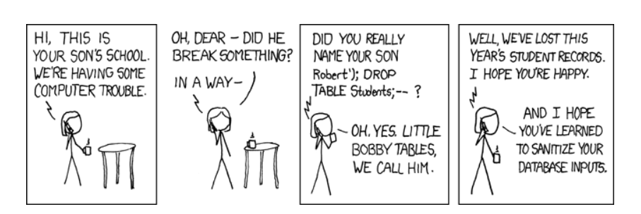
Bobby tables

Slide 24
MORE ON BOBBY TABLES
We can assume a SQL statement like:
INSERT INTO students (name) VALUES ('');
And when we insert "Robert'); DROP TABLE students;-- "
INSERT INTO students (name) VALUES ('Robert'); DROP TABLE students;-- ');
Since Bobby’s name contains the ");" the VALUES argument is closed in the middle of his name and the text that follows – "DROP TABLE students;" – is a new SQL statement that deletes the entire table. Finally the "-- " at the end comments out the remaining SQL, essentially ignoring the rest of the original code and making sure no error occurs.
How Little Bobby Tables Ruined the Internet
How does the SQL injection from the "Bobby Tables" XKCD comic work?
The Sad Story of Mr. Null and Little Bobby Tables
Bobby Tables: A guide to preventing SQL injection

