Slide 1
Introduction to Databases
A collection of different chapter 1 concepts

Slide 2
Learning Objectives
Describe the characteristics of information
Understand the importance of databases in information access
Describe what a database is, various types, and why they are valuable assets for decision making
Outline the major components of a DBMS
Explain the importance of database design
See how modern databases evolved from file systems
Describe the main functions of a database management system (DBMS)
Describe the need for database knowledge in business careers

Slide 3
Why Databases?
Characteristics of data in today’s world
  Ubiquitous (i.e., abundant, global, and everywhere)
  Pervasive (i.e., unescapable, prevalent, and persistent)
Databases make data persistent and shareable in a secure way
  Specialized structures that allow computer-based systems to store, manage, and retrieve data very quickly

Slide 4
How Did We Get Here?
The Internet World I
Personal Computers
  1977: Apple II
  1981: IBM PC
Local Area Networks
  Ethernet networking technology
    Early 1970s: Xerox Palo Alto Research Center
    1983: U.S. National Standard

Slide 5
How Did We Get Here?
The Internet World II
The Internet
  1969: ARPANET
World Wide Web (WWW)
  1993: First Web browser (Netscape) available
  Mid 1990s: Online retail sites
    1995: Amazon
    Followed by Best Buy
Early 2000s: Web 2.0

Slide 6
How Did We Get Here?
The Smartphone World
Mid 1970s: Mobile Phone (Cell Phone)
Smartphone
  2007: Apple iPhone
  2008: Google Android Operating System
Tablets
  2010: Apple iPad
Apps
All of these examples depend on databases

Slide 7
Databases in the Internet and Mobile Device World
Databases are important because they are everywhere and are used daily:
  Facebook
    Posts
    Likes
  Twitter
    Tweets
  Online shopping
    Amazon.com – [Do an actual search]

Slide 8

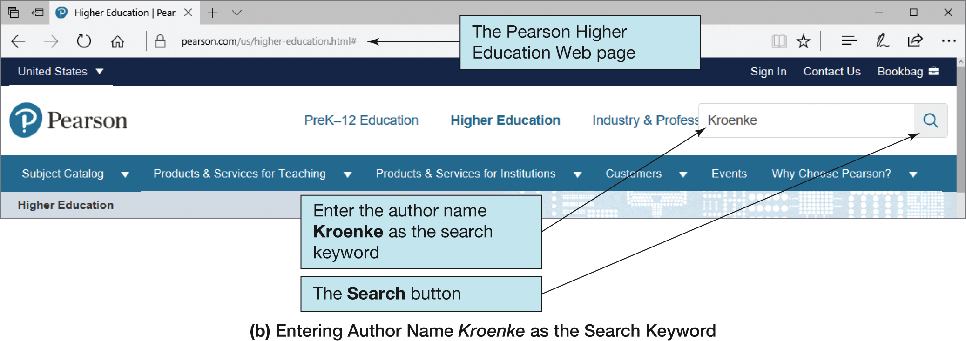
Searching a Database in a Web Browser (1 of 2)

Slide 9
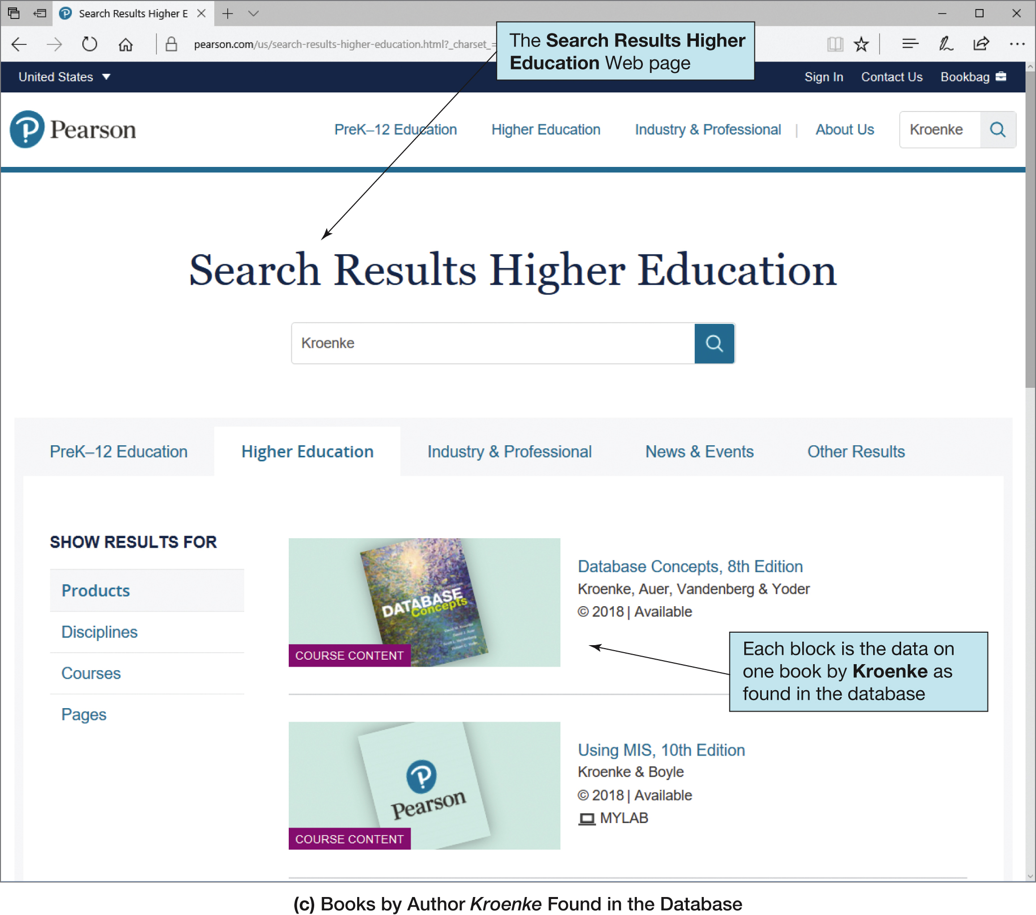
Searching a Database in a Web Browser (2 of 2)

Slide 10
Databases: The Unseen Services
Let us examine some examples.
Login and use Facebook, Twitter or Instagram: Your login and personal information is kept in a database, as is the information for all of your friends, posts, and messages.
Make a phone call or send a text message: The lists of phone numbers and locations are maintained by databases. All the information about your phone calls and messages is maintained at a very detailed level in databases.
Read your email: Not only is your login information kept in a database, but also all the history of incoming and outgoing emails is kept in very large databases.
Go shopping (Groceries, clothes, gasoline): First, the product, inventory levels, and price information is kept in a database so that the checkout register can identify it correctly. Then if you use a credit or debit card, that information must be retrieved from another database.

Slide 11
Databases: The Unseen Services II
Check a book out of the library: The database is checked to make sure you are a valid patron of the library. Then information about the book, its availability, and check out status is all verified and updated for your library loan. The database is used to obtain both patron information and book information.
Withdraw money from an ATM: First, your authorization information must be verified, and then the availability of sufficient funds is verified. Finally, your account balances must be updated. All this information is stored in the bank's databases.
Have a physical exam with your doctor: All of your patient information is maintained in your medical database. Your records will be updated from the results of your exam. The accounting, billing, and insurance records will also all be updated.

Slide 12
Databases: The Unseen Services III
We seldom think about these databases, unless they become unavailable or there has been a security breach where private data has been accessed by unauthorized individuals or been made public.
When they do not work correctly, we get frustrated and upset that the level of service that we expect is not being provided.
The availability and integrity of databases is an important issue in the daily activities of each of our lives.

Slide 13
Databases: The Ubiquitous Information Provider
The primary contributor in our access to abundant information is database technology. Ways databases support our need to obtain in-depth information:
  Searching to buy a specific item (e.g. an appliance, a service, clothing, a book...):
  Researching more in-depth before purchasing a major item such as a car: The information you need for this includes items like repair history, performance data, and safety record.
  Planning a vacation or trip: In this case, we want geographical and resort information – information about places and things to do.

Slide 14
Databases: The Ubiquitous Information Provider II
  Learning about a particular hobby or sport that you enjoy such as skiing, boating, or geocaching:
  Researching a particular company before investing: Many institutions maintain databases of financial records.
  Researching a particular medical condition or medical problem:.
  Solving a technical problem or learning a new technical skill such as writing SQL queries:
  Writing a research paper or researching for a school project:
  Wikipedia

Slide 15
Interesting public databases 1
Annotated Human Genome Data: This is a large database (310 GB) of genome information for humans and about 50 other species. The database has several different methods to access the data, including a simple Web interface, export via FTP, MySQL server queries, Perl API, and even a data-mining tool. (Website at http://ensembl.org/)
Federal Reserve Economic Data: This database contains time lines of economic data for the US and includes 61,000 different time series. Access to the data is by website, or customized API. The entire database can also be downloaded. (Website at http://research.stlouisfed.org/fred2/)
US Labor, Economic, and Census Data: Various departments of the US Government provide large datasets containing information about the US economy, plus labor, commerce, housing, and census data. These databases can be accessed through a browser as well as customized APIs and download. (Various departments such as http://www.bls.gov/data/ and http://www.census.gov/ )

Slide 16
Interesting public databases II
Freebase Dataset: The freebase database is an open database of current facts of the world's information covering millions of topics and hundreds of categories. It focuses on people, places but also contains information on many topics. As you can imagine the complexity of categorizing and structuring such a wide range of information is daunting. Some of the structure that it provides includes time lines, location graphs, information facts, and relationship connections. (Website at http://freebase.com)
Historical Weather Datasets: The National Oceanic and Atmospheric Administration provides time series data and climatological data in several different databases. The various databases provide different series of data. The data can be accessed via a browser interface as well as specific tools that are provided by the administration. (Website at http://www.ncdc.noaa.gov/most-popular-data)
Twitter Archive at the Library of Congress: This massive database contains 133 Terabytes of compressed data. A single search could take up to 24 hours to complete. The Library of Congress also has numerous interesting databases containing information on a variety of subjects. Although there is extensive information, it is available through website interfaces rather than specialized tools or APIs. (Website http://loc.gov) Note: There are also other Twitter databases available on the Web. (Website http://www.infochimps.com/tags/bigdata)

Slide 17
The Database Approach
The central component of the database approach is the DBMS. This software is also referred to as the “database engine” or the “back end.” With regard to the data it manages, it has several responsibilities including the following:
Data Definition: providing a way to define and build the database
Data Manipulation: providing a way to insert and update data in the database
Query Execution: retrieving information from the data in the database
Data Integrity: ensuring that data stored is well formed
Data Security: enforcing restrictions about who is able to access what data
Provenance: logging capabilities to provide an audit trail for data changes
Multiuser Concurrency: supporting the activities of many users at the same time

Slide 18
3 Components of Databases
DBMS – component one: Some of the more popular DBMS's today are MySQL, Microsoft SQL Server, Oracle, PostgreSQL, Microsoft Access, and IBM's DB2.
The second component in the database approach is the data. As long as the DBMS has access and is able to perform its responsibilities with respect to the data, the details of the data storage are not relevant.
The final component of the database approach is the application, also called "front-end" software. Application software interacts with the DBMS to provide information to a user.
All relational databases use a standard language to receive and process requests. The standard language is called Structured Query Language (SQL).

Slide 19
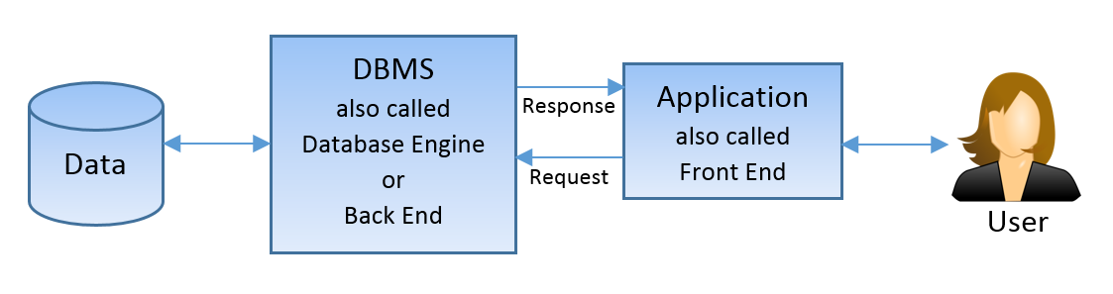
The DATAbase approach

Slide 20
The Characteristics of Databases
The purpose of a database is to help people track things of interest to them.
Data is stored in tables, which have rows and columns like a spreadsheet.
A database may have multiple tables, where each table stores data about a different thing.
Each row in a table stores data about an occurrence or instance of the thing of interest.
A database stores data and relationships.

Slide 21
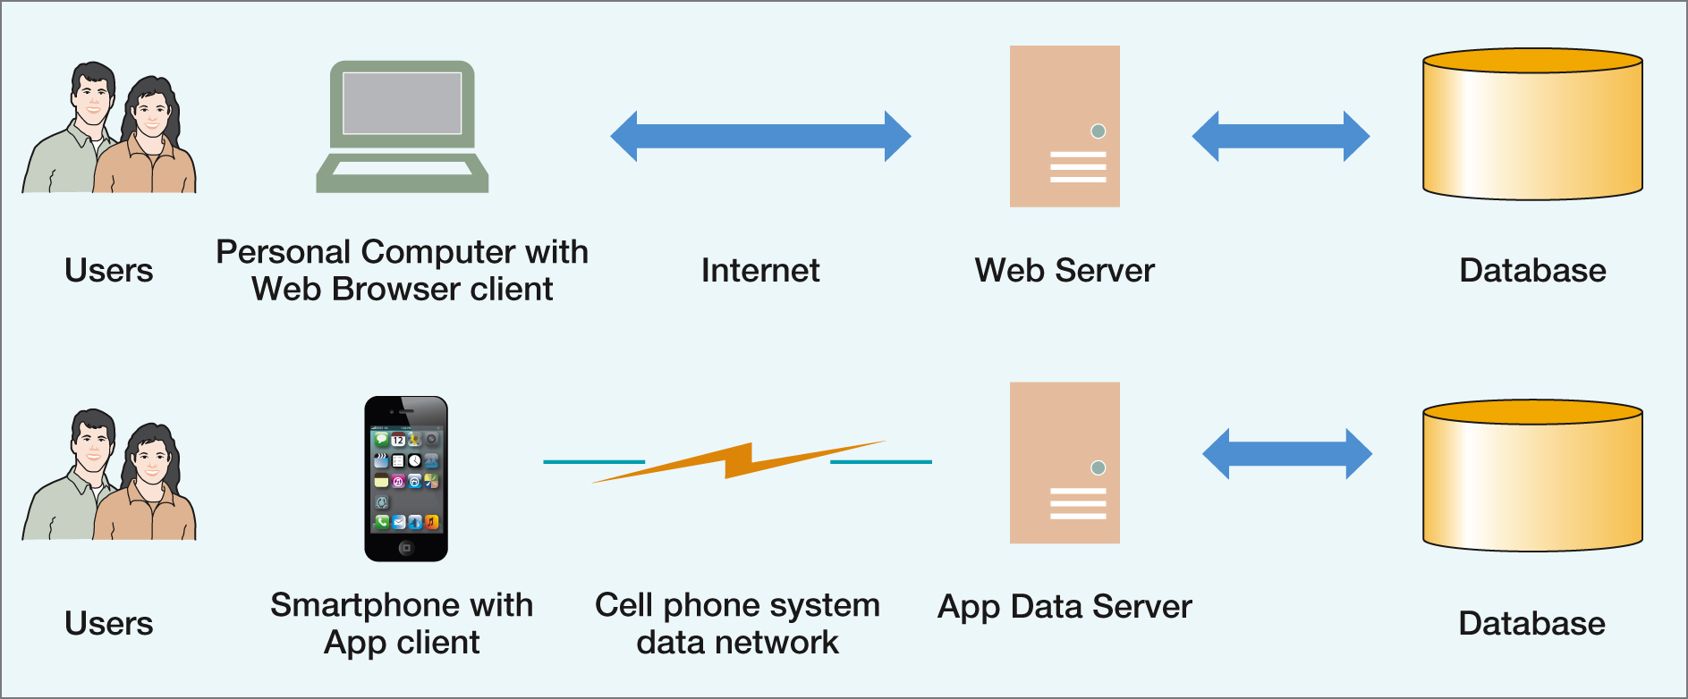
The Internet and Mobile Device World

Slide 22
INITIAL TERMINOLOGY
Data - facts that are recorded and can be accessed
  Data formats – text, numbers, figures, graphics, images, audio/video recordings and more
  Data is recorded and kept because it is considered to be of use to an intended user
Information - refers to the data that is accessed by a user for some particular purpose
  Typically, getting the needed information from a collection of data requires performing an activity, such as searching through, processing, or manipulating the data in some form or fashion
Metadata - data that describes the structure and the properties of the data
  Metadata is essential for the proper understanding and use of the data
Notes:
The terms “data” and “information” are often interchanged and used as synonyms for each other (information is simply the data that we need)

Slide 23
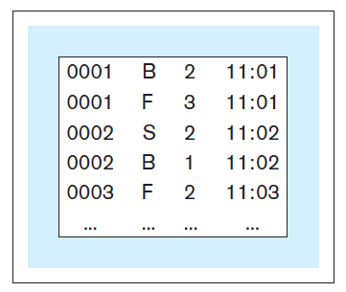
INITIAL TERMINOLOGY
Data without metadata - example

Slide 24
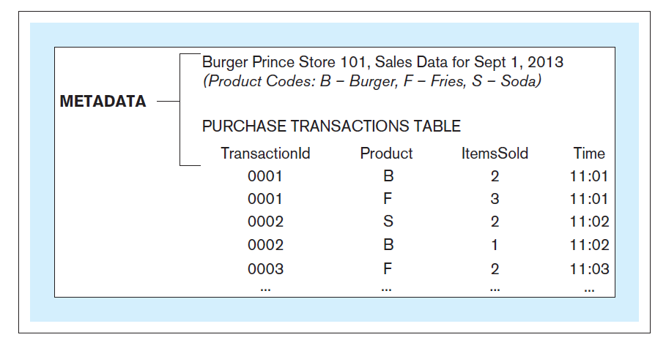
INITIAL TERMINOLOGY
Data with metadata - example

Slide 25
INITIAL TERMINOLOGY
Database - structured collection of related data stored on a computer medium
  Organizes the data in a way that facilitates efficient access to the information captured in the data
Database metadata – represents the structure of the database
  Database content that is not the data itself (data about the data)
  Contains:
    Names of data structures
    Data types
    Data descriptions
    Other information describing the characteristics of the data

Slide 26
INITIAL TERMINOLOGY
Database management system (DBMS) - software used for:
  Creation of databases
  Insertion, storage, retrieval, update, and deletion of the data in the database
  Maintenance of databases
Database system - computer-based system whose purpose is to enable an efficient interaction between the users and the information captured in a database

Slide 27
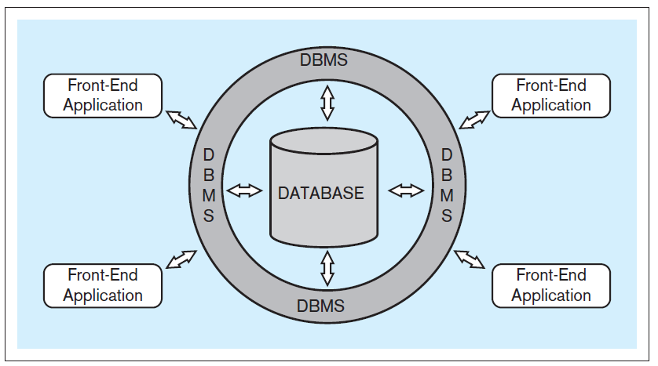
INITIAL TERMINOLOGY
Typical database system architecture

Slide 28
INITIAL TERMINOLOGY
Front-end applications - provide a mechanism for easy interaction between the users and the DBMS
End-users (business-users) - users using a database system to support their tasks and processes
Indirect interaction - end-user communicating with the database through front-end applications
Direct interaction - end-user communicating with the database directly through DBMS

Slide 29
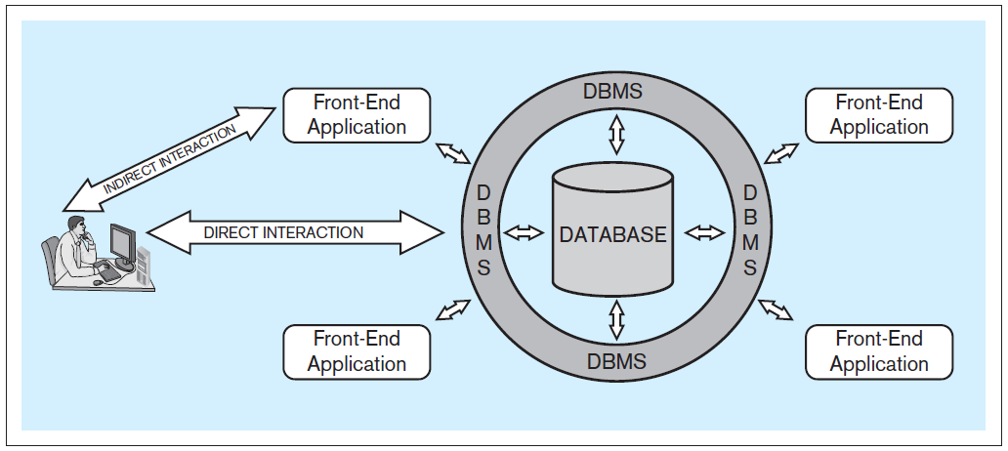
INITIAL TERMINOLOGY
Typical database system architecture
Notes:
Indirect interaction is where the end user has little knowledge of databases, direct is where they know SQL, etc

Slide 30
Types of Databases (1 of 5)
Single-user database: supports one user at a time
  Desktop database: single-user database on a personal computer
Multiuser database: supports multiple users at the same time
  Workgroup databases: supports a small number of users or a specific department
  Enterprise database: supports many users across many departments

Slide 31
Types of Databases (2 of 5)
Classification by location
  Centralized database: data located at a single site
  Distributed database: data distributed across different sites
  Cloud database: created and maintained using cloud data services that provide defined performance measures for the database

Slide 32
Types of Databases (3 of 5)
Classification by data type
  General-purpose database: contains a wide variety of data used in multiple disciplines
  Discipline-specific database: contains data focused on specific subject areas
  Operational database: designed to support a company’s day-to-day operations

Slide 33
Types of Databases (4 of 5)
Analytical database: stores historical data and business metrics used exclusively for tactical or strategic decision making
  Data warehouse: stores data in a format optimized for decision support
  Online analytical processing (OLAP): tools for retrieving, processing, and modeling data from the data warehouse
  Business intelligence: captures and processes business data to generate information that support decision making

Slide 34
Types of Databases (5 of 5)
Databases can be classified to reflect the degree to which the data is structured
  Unstructured data exists in its original (raw) state
  Structured data results from formatting
    Structure is applied based on type of processing to be performed
  Semistructured data: processed to some extent
Extensible Markup Language (XML)
  Represents data elements in textual format

Slide 35
OPERATIONAL VERSUS ANALYTICAL DATABASES
Operational information (transactional information) - the information collected and used in support of day to day operational needs in businesses and other organizations
Operational database - collects and presents operational information in support of daily operational procedures and processes
Analytical information - the information collected and used in support of analytical tasks
  Analytical information is based on operational (transactional) information
Analytical database - collects and presents analytical information in support of analytical tasks

Slide 36
Why Database Design Is Important
Focuses on design of database structure that will be used to store and manage end-user data
  Well-designed database: facilitates data management and generates accurate and valuable information
  Poorly designed database: causes difficult-to-trace errors that may lead to poor decision making

Slide 37
Evolution of File System Data Processing (1 of 3)
Manual file systems
  Accomplished through a system of file folders and filing cabinets
Computerized file systems
  Data processing (DP) specialist created a computer-based system to track data and produce required reports
File system redux: modern end-user productivity tools
  Includes spreadsheet programs such as Microsoft Excel

Slide 38
Evolution of File System Data Processing (2 of 3)
Table 1.2 | Basic File Terminology
TERM | DEFINITION
Data | Raw facts, such as a telephone number, a birth date, a customer name, and a year-to-date (YTD) sales value. Data has little meaning unless it has been organized in some logical manner.
Field | A character or group of characters (alphabetic or numeric) that has a specific meaning. A field is used to define and store data.
Record | A logically connected set of one or more fields that describes a person, place, or thing. For example, the fields that constitute a record for a customer might consist of the customer’s name, address, phone number, date of birth, credit limit, and unpaid balance.
File | A collection of related records. For example, a file might contain data about the students currently enrolled at Gigantic University.

Slide 39
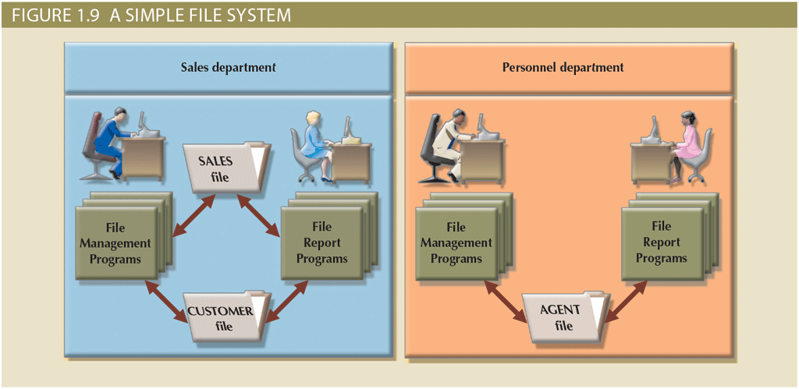
Evolution of File System Data Processing (3 of 3)

Slide 40
Problems with File System Data Processing
Problems with file systems challenge the types of information that can be created from data as well as information accuracy
  Lengthy development times
  Difficulty of getting quick answers
  Complex system administration
  Lack of security and limited data sharing
  Extensive programming

Slide 41
Structural and Data Dependence (1 of 2)
Structural dependence
  Access to a file is dependent on its own structure
  All file system programs are modified to conform to a new file structure
Structural independence
  File structure is changed without affecting the application’s ability to access the data

Slide 42
Structural and Data Dependence (2 of 2)
Data dependence
  Data access changes when data storage characteristics change
Data independence
  Data storage characteristics are changed without affecting the program’s ability to access the data
Practical significance of data dependence is the difference between logical and physical format

Slide 43
Data Redundancy (1 of 2)
Unnecessarily storing the same data at different places
  Islands of information (i.e., scattered data locations)
  Increases the probability of having different versions of the same data

Slide 44
Data Redundancy (2 of 2)
Possible results of uncontrolled data redundancy
  Poor data security
  Data inconsistency
  Data-entry errors
  Data integrity problems

Slide 45
Data Anomalies
Develop when not all of the required changes in the redundant data are made successfully
  Update anomalies
  Insertion anomalies
  Deletion anomalies

Slide 46
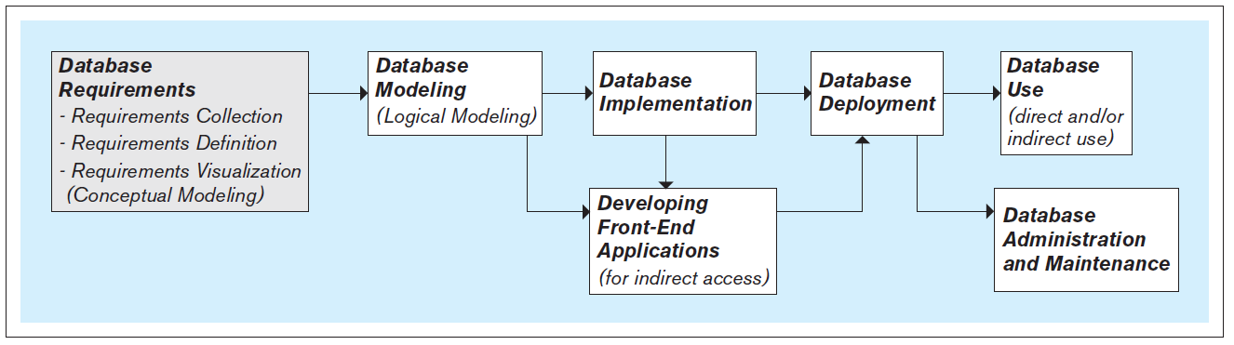
STEPS IN THE DEVELOPMENT OF DATABASE SYSTEMS

Slide 47
STEPS IN THE DEVELOPMENT OF DATABASE SYSTEMS
Requirements collection, definition, and visualization - results in the requirements specifying which data the future database system will hold and in what fashion, and what the capabilities and functionalities of the database system will be
  The collected requirements should be clearly defined and stated in a written document, and then visualized
Notes:
The first and most critical step in the development of the database.

Slide 48
STEPS IN THE DEVELOPMENT OF DATABASE SYSTEMS
Requirements collection, definition, and visualization
  Conceptual database model – a visualization of requirements by using a conceptual data modeling technique (such as entity-relationship [ER] modeling)

Slide 49
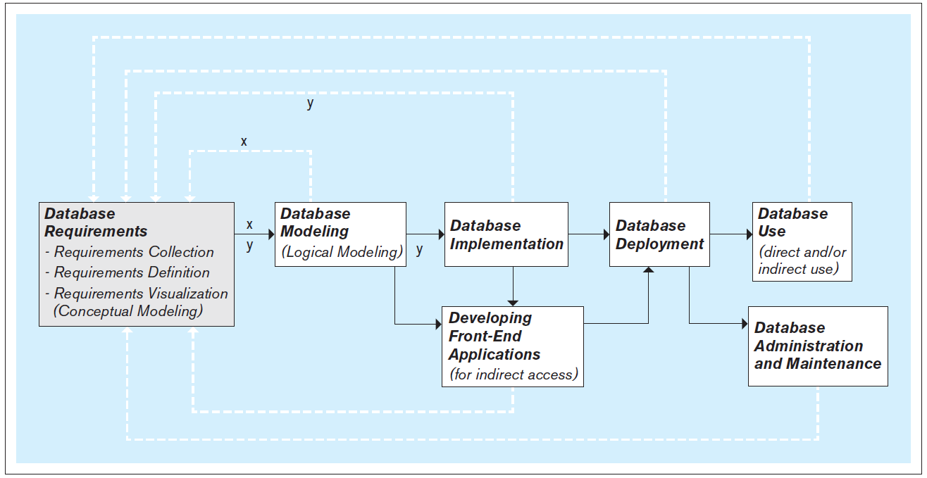
STEPS IN THE DEVELOPMENT OF DATABASE SYSTEMS
Iterative nature of the database requirements collection, definition, and visualization process

Slide 50
STEPS IN THE DEVELOPMENT OF DATABASE SYSTEMS
Database modeling (logical database modeling ) - creation of the database model that is implementable by the DBMS software
  Logical database modeling follows conceptual database modeling
Notes:
A database has two models:
Conceptual model - created as a visualization of requirements during the requirements collection, definition, and visualization step and serves as a as a blueprint for the actual (logical) database model
Logical model - actual database model, created during the database modeling step to be used in the subsequent step of database implementation using the DBMS

Slide 51
STEPS IN THE DEVELOPMENT OF DATABASE SYSTEMS
Database implementation - using a DBMS to implement the database model as an actual database
  Most modern databases are implemented using a relational DBMS (RDBMS) software
Notes:
SQL is a language used by most relational DBMS software packages.
SQL includes commands for creating, modifying and deleting database structures (these commands are used during database implementation).

Slide 52
STEPS IN THE DEVELOPMENT OF DATABASE SYSTEMS
Developing front-end applications - designing and creating applications for indirect use by the end-users
  Front-end applications are based on the database model and the requirements specifying the front-end functionalities
  Front-end applications contain interfaces (such as forms and reports) accessible via a navigation mechanism (such as a menu)
Notes:
The design and creation of front-end applications can commence and proceed in parallel with database implementation .The actual creation of a front-end application involves connecting it to the database. Connecting front-end application to the database can only be done once the database is implemented.

Slide 53
STEPS IN THE DEVELOPMENT OF DATABASE SYSTEMS
Database deployment - releasing the database system for use by the end users
Notes:
Typically, database deployment also involves populating the implemented database with the initial set of data.

Slide 54
STEPS IN THE DEVELOPMENT OF DATABASE SYSTEMS
Database use - the insertion, modification, deletion and retrieval of the data in the database system
Notes:
The database system can be used indirectly, via the front-end applications, or directly via the DBMS.
SQL includes commands for insertion, modification, deletion and retrieval of the data. These commands can be issued by front-end applications (indirect use), or directly by the end-users themselves (direct use)

Slide 55
STEPS IN THE DEVELOPMENT OF DATABASE SYSTEMS
Database administration and maintenance - performing activities that support the database end user, including dealing with technical issues, such as:
  Providing security for the information contained in the database
  Ensuring sufficient hard-drive space for the database content
  Implementing the backup and recovery procedures

Slide 56
THE NEXT VERSION OF THE DATABASE
The new version of the database follows the same development steps as the initial version
Notes:
In most cases, after a certain period of use, the need for modifications and expansion of the existing database system becomes apparent, and the development of a new version of the existing database system is initiated.

Slide 57
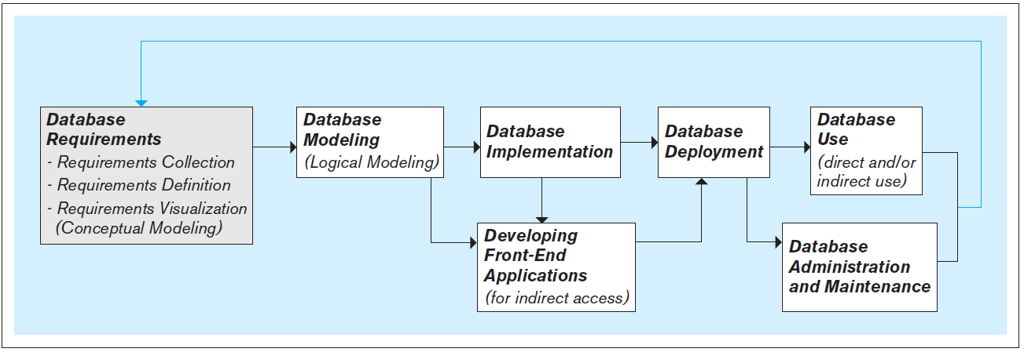
THE NEXT VERSION OF THE DATABASE

Slide 58
DATABASE SCOPE
Databases can vary in their scope from small single-user (personal) databases to large enterprise databases that can be used by thousands of end-users
Regardless of their scope, all databases go through the same fundamental development steps (requirements, modeling, implementation, deployment, use, etc.)
Notes:
The difference in the scope of databases is reflected in the size, complexity and cost in time and resources required for each of the steps.

Slide 59
DBMS Functions (1 of 3)
Data dictionary management
  Data dictionary: stores definitions of data elements and their relationships
Data storage management
  Performance tuning ensures efficient performance
Data transformation and presentation
  Data is formatted to conform to logical expectations
Security management
  Enforces user security and data privacy

Slide 60
DBMS Functions (2 of 3)
Multiuser access control
  Sophisticated algorithms ensure that multiple users can access the database concurrently without compromising its integrity
Backup and recovery management
  Enables recovery of the database after a failure
Data integrity management
  Minimizes redundancy and maximizes consistency

Slide 61
DBMS Functions (3 of 3)
Database access languages and application programming interfaces
  Query language: lets the user specify what must be done without having to specify how
  Structured Query Language (SQL): de facto query language and data access standard supported by the majority of DBMS vendors
Database communication interfaces
  Accept end-user requests via multiple, different network environments

Slide 62
Managing the Database System: A Shift in Focus
Disadvantages of database systems
  Increased costs
  Management complexity
  Maintaining currency
  Vendor dependence
  Frequent upgrade/replacement cycles

Slide 63
PEOPLE INVOLVED WITH DATABASE SYSTEMS
Database analysts, designers, and developers
  Database analysts - involved in the requirements collection, definition, and visualization stage
  Database designers (a.k.a. database modelers or architects) - involved in the database modeling stage
  Database developers – in charge of implementing the database model as a functioning database using the DBMS software
Notes:
It is not uncommon for the same people to perform more than one of these roles. In fact (especially in smaller companies and organizations), the same people may be in charge of all aspects of the database system, including the design, implementation, administration, and maintenance.

Slide 64
PEOPLE INVOLVED WITH DATABASE SYSTEMS
Front-end applications analysts and developers
  Front-end application analysts - in charge of collecting and defining requirements for front-end applications
  Front-end applications developers - in charge of creating the front-end applications

Slide 65
PEOPLE INVOLVED WITH DATABASE SYSTEMS
Database administrators (DBAs) - perform the tasks related to the maintenance and administration of a database system

Slide 66
PEOPLE INVOLVED WITH DATABASE SYSTEMS
Database end users - use a database system to support their work- or life-related tasks and processes
  Users differ in:
    Level of technical sophistication
    Amount of data that they need
    Frequency with which they access the database system
Notes:
Arguably, database end users are the most important category of people involved with database systems. They are the reason for the existence of database systems. The quality of a database system is measured by how quickly and easily it can provide the accurate and complete information needed by its end users.

Slide 67
Preparing for Your Database Professional Career
TABLE 1.3 | DATABASE CAREER OPPORTUNITIES
JOB TITLE | DESCRIPTION | SAMPLE SKILLS REQUIRED
Database Developer | Create and maintain database-based applications | Programming, database fundamentals, SQL
Database Designer | Design and maintain databases | Systems design, database design, SQL
Database Administrator | Manage and maintain DBMS and databases | Database fundamentals, SQL, vendor courses
Database Analyst | Develop databases for decision support reporting | QL, query optimization, data warehouses
Database Architect | Design and implementation of database environments (conceptual, logical, and physical) | DBMS fundamentals, data modeling, SQL, hardware knowledge, etc.
Database Consultant | Help companies leverage database technologies to improve business processes and achieve specific goals | Database fundamentals, data modeling, database design, SQL, DBMS, hardware, vendor-specific technologies, etc.
Database Security Officer | Implement security policies for data administration | DBMS fundamentals, database administration, SQL, data security technologies, etc.
Cloud Computing Data Architect | Design and implement the infrastructure for next-generation cloud database systems | Internet technologies, cloud storage technologies, data security, performance tuning, large databases, etc.
Data Scientist | Analyze large amounts of varied data to generate insights, relationships, and predictable behaviors | Data analysis, statistics, advanced mathematics, SQL, programming, data mining, machine learning, data visualization

Slide 68
Database Skills for Knowledge-based Careers
Job Title | Job Description | DB Knowledge Required | Skill Level Required
Financial planner | Analyze security market and recommend financial portfolios | Understand financial information available in databases. Know how to extract information in various combinations | Moderate
Market research analyst | Analyze sales and economic data to predict future trends | Understand economic databases. Be able to use databases in novel ways to discover and extract information. | Substantial
Advertising manager | Manage advertising campaigns and budgets | Understand sales and performance data. Be able to extract information in various ways. | Moderate
Human resource manager | Manage all the hiring, evaluation, and monitoring of the work force. | Understand information about employees as well as all financial information. | Moderate

Slide 69
Job Title | Job Description | DB Knowledge Required | Skill Level Required
Accountant | Support all the accounting requirements of an organization | Understand all financial databases. Identify problems or potential fraudulent activity through database analysis | Extensive
Economist | Analyze and predict economic trends based on historical data | Understand economic databases, their structure and data. Be able to extract information in various forms using novel approaches. | Extensive
Sales manager | Manage the sales persons and sales activities of an organization | Understand sales data and be able to extract information in various forms. Evaluate performance. | Moderate
Sociologist | Analyze social trends and social problems in communities and nations | Understand demographic and social data from diverse and disparate databases. Be able to extract information using multiple techniques | Extensive

Slide 70
Job Title | Job Description | DB Knowledge Required | Skill Level Required
Management consultant | Analyze organizational issues and recommend solutions | Understand financial and operational data of an organization as found in various databases | Substantial
Public Administrator | Manage a public government unit | Be able to understand data and information provided in various and diverse databases from the governmental database. | Extensive
Political Scientist | Understand and research demographic data and trends | Be able to analyze data and draw conclusions from demographic databases and questionnaire data. | Substantial

