Slide 1
ITMG 494 business/it project management
Chapter One Intro to Project Management

Slide 2
Welcome
Course Overview
About the Professor
Syllabus
iPad Project Connection
Main Class Project Deliverable – USD/SDSU/UCSD Blood Donor Challenge

Slide 3
Learning Objectives
Understand what a project is, provide examples of projects, and understand different types of projects pertaining to various industries.
Classify projects based on technology uncertainty and system scope.
Identify project life span in various industries and explain the basic six phases of a project.
Describe project management and its benefits.
Identify factors for project success and project management success
Identify factors that cause project and project management failure
Understand the growing need for better project management, especially for information technology (IT) projects
Explain what a project is, provide examples of BUSINESS/IT projects, list various attributes of projects, and describe the triple constraint of project management

Slide 4
Learning Objectives continued
Describe project management and discuss key elements of the project management framework, including project stakeholders, the project management knowledge areas, common tools and techniques, and project success
Discuss the relationship between project, program, and portfolio management and the contributions each makes to enterprise success
Understand the role of project managers by describing what they do, what skills they need, and career opportunities for IT project managers
Describe the project management profession, including its history, the role of professional organizations like the Project Management Institute (PMI), the importance of certification and ethics, and the advancement of project management software

Slide 5
Introduction
What is project management?
What is project management (vid 2)?
Many organizations today have a new or renewed interest in project management
Computer hardware, software, networks, and the use of interdisciplinary and global work teams have radically changed the work environment
The world as a whole spends nearly $10 trillion of its $40.7 trillion gross product on projects of all kinds
More than 16 million people regard project management as their profession

Slide 6
Project Management statistics
The overall information and communications technology market grew by 6 percent to almost $3 trillion in 2010
In the U.S. the size of the IT workforce topped 4 million workers in 2008, and the unemployment rate for IT professionals is half the rate for the overall labor market
In 2011 the total compensation for the average senior project manager in U.S. dollars was $105,000 per year in the United States and $160,409 in Switzerland.
The number of people earning their Project Management Professional (PMP) certification continues to increase.
44 percent of employers listed project management as a skill they looked for in new college grads, behind only communication and technical skills

Slide 7
History of Project management
Project Management developed from several fields of application including construction, engineering, and defense activity
Two forefathers of project management are:
Henry Gantt, called the father of planning and control techniques (Gantt chart), and
Henri Fayol for his creation of management functions which form the foundation of the body of knowledge associated with project and program management.
Frederick Winslow Taylor's theories of scientific management. His work is the forerunner to modern project management tools including work breakdown structure (WBS) and resource allocation.
1950s: Beginning of the modern Project Management era
Prior to the 1950s, projects were managed on an ad hoc basis using mostly Gantt Charts, and informal techniques and tools.
The "Critical Path Method" (CPM) was developed as a joint venture between DuPont Corporation and Remington Rand Corporation for managing plant maintenance projects.

Slide 8
History of project management continued
"Program Evaluation and Review Technique" or PERT, was developed by Booz-Allen & Hamilton as part of the United States Navy's (in conjunction with the Lockheed Corporation) Polaris missile submarine program.
In 1956, the American Association of Cost Engineers (now AACE International; the Association for the Advancement of Cost Engineering) was formed by early practitioners of project management and the associated specialties of planning and scheduling, cost estimating, and cost/schedule control (project control).
AACE continued its pioneering work and in 2006 released the first integrated process for portfolio, program and project management (Total Cost Management Framework).
The International Project Management Association (IPMA) was founded in Europe in 1967 as a federation of several national project management associations.
IPMA maintains its federal structure today and now includes member associations on every continent except Antarctica.
IPMA offers a Four Level Certification program based on the IPMA Competence Baseline (ICB).
The ICB covers technical competences, contextual competences, and behavioral competences.
In 1969, the Project Management Institute (PMI) was formed in the USA.

Slide 9
The Project Management Institute
The Project Management Institute (PMI) is an international professional society for project managers founded in 1969
PMI has continued to attract and retain members, reporting more than 380,000 members worldwide by 2012
There are communities of practices in many areas, like information systems, financial services, and health care
Project management research and certification programs continue to grow
Students can join PMI at a reduced fee and earn the Certified Associate in Project Management (CAPM) certification(see www.pmi.org for details)

Slide 10
Project Management Certification
PMI provides certification as a Project Management Professional (PMP)
A PMP has documented sufficient project experience, agreed to follow a code of ethics, and passed the PMP exam
The number of people earning PMP certification is increasing quickly
PMI and other organizations offer additional certification programs (see Appendix B)

Slide 11
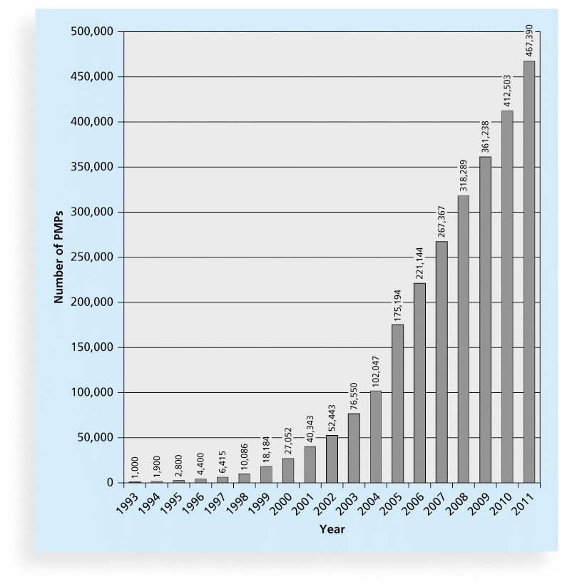
Figure 1-9 Growth in PMP Certification, 1993-2011

Slide 12
Project Management Definition
“Project management is the discipline of planning, organizing, and managing resources to bring about the successful completion of specific project goals and objectives. The primary challenge of project management is to achieve all of the project goals and objectives while honoring the preconceived project constraints. Typical constraints are scope, time, and budget.”
en.wikipedia.org/wiki/Project_management

Slide 13
Project Management Definition Continued
Management is defined as the act of getting people together to accomplish desired goals and objectives.
Management is composed of planning, organizing, and controlling an organization or a group of people and other needed resources to accomplish a goal.
Projects consist of many activities, and those activities are brought together to make up a project including:
Project management; and
Engineering and services of projects.
Project management is the act of collaborating people and other required resources such that the project is planned, organized, and controlled effectively to accomplish project goals and objectives.

Slide 14
Project management benefits
Ensure the scope of a project as required by a customer is completely met
Provides a process that can be followed to successful completion of projects
Success from project management will inspire individuals and organizations to perform efficiently in the future
Helps individuals and organizations to map a clear strategy to complete a project successfully
Forces individuals and organizations to identify and assess all perceived risks and exposures so that they know the problems before they surface

Slide 15
Project management benefits continued
Helps individuals and organizations to know when goals and objectives cannot be achieved
Makes individuals and organizations understand and work towards their customers’ requirements thus increasing quality of the output
Creates a structure and process which enables a project to be kept under control
Motivates individuals and organizations to ensure a quality output
Helps to deliver projects successfully
Helps to measure goals and objectives
Helps individuals and organizations to save time and money

Slide 16
What is a Project Manager?
“Project managers function as bandleaders who pull together their players each a specialist with individual score and internal rhythm. Under the leader's direction, they all respond to the same beat.” L.R. Sayles
Project managers have the responsibility of the planning, implementation, and closing of any project in a variety of industries or fields, i.e., healthcare, insurance, construction, etc.
A project manager is the person accountable for accomplishing the stated project objectives.
Key project manager responsibilities include creating clear and attainable project objectives, building the project requirements, and managing the triple constraint for projects, which is cost, time, and scope.
A project manager ensures that the key issues of cost, time, quality and above all, Executive Sponsor satisfaction, can be realized.
Notes:
Project Managers are ‘Large and in charge’ – PMBOK
If project is successful, Team was awesome
If project failed, project manager is responsible

Slide 17
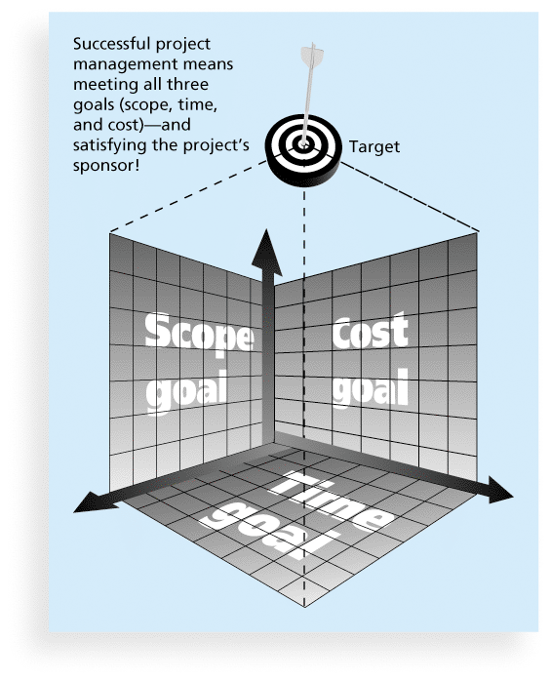
TRIPLE CONSTRAINT

Slide 18
Suggested skills for project managers
The Project Management Body of Knowledge
Application area knowledge, standards, and regulations
Project environment knowledge
General management knowledge and skills
Soft skills or human relations skills

Slide 19
Table 1-3 Ten Most Important Skills and Competencies for Project Managers
1. People skills
2. Leadership
3. Listening
4. Integrity, ethical behavior, consistent
5. Strong at building trust
6. Verbal communication
7. Strong at building teams
8. Conflict resolution, conflict management
9. Critical thinking, problem solving
10. Understands, balances priorities

Slide 20
Different Skills Needed in Different Situations
Large projects: Leadership, relevant prior experience, planning, people skills, verbal communication, and team-building skills were most important
High uncertainty projects: Risk management, expectation management, leadership, people skills, and planning skills were most important
Very novel projects: Leadership, people skills, having vision and goals, self confidence, expectations management, and listening skills were most important

Slide 21
What is a Project?
Definitions:
Project (characteristics-PMBOK*)
A project is finite —having specific start and completion dates—and is undertaken to create a unique product or service which brings about beneficial change or added value. This finite characteristic of projects stands in sharp contrast to processes, which are (semi) permanent functional work to repetitively produce the same product or service. Projects are delivered under certain constraints, traditionally listed as "scope," "time," and "cost.”
Temporary
Unique results
Progressive elaboration
*Project Management Institute (PMI): PMBOK = Project Management Body of Knowledge
Operations is work done to sustain the business
Projects end when their objectives have been reached or the project has been terminated
Projects can be large or small and take a short or long time to complete
Notes:
Progressive elaboration The process of providing or discovering greater levels of detail as the project moves toward completion.

Slide 22
What is a PROJECT Continued…
A project:
Is a unique activity.
Has a beginning.
Has an end – a definite end.
Has constraints and requirements.
Scope, Cost, Schedule, Resources, Performance, Value (Quality)
Has to add value.
Should have a primary customer or sponsor
Involves uncertainty

Slide 23
What is a Process (operations) vs. a Project?
Processes (operations) are: | Projects are:
On-going with no clearly defined beginning and end states Should be customer driven Repeatable | One way of implementing a Process Improvement or innovation Time-bound and have a customer Have clear beginning and end dates Longer projects are often broken down into phases or stages. Each one phase can become a project unto itself. Follow a specific cycle of Initiation, Plan, Implement and Close Often result in process improvement Factors that may necessitate a project include: complexity, risk, time-sensitive, etc.
Process Improvement is the examination of a business process in order to better meet customer & quality requirements. Projects arise from this examination. | Project Management is the application of knowledge and expertise to the development and completion of a project.

Slide 24
What is a Process (operations) vs. a Project Continued?
Features | Projects are: | Processes (operations) are:
Key Similarities | Planned, executed, and controlled Performed by people Resource constrained | Planned, executed, and controlled Performed by people Resource constrained
Purpose | Attain objectives and terminate | Sustain the organization
Time | Temporary Definite beginning and end points | Ongoing
Outcome | Unique product, service, or result | Non-unique product, service, or result
People | Dynamic, temporary teams formed to meet project needs Generally not aligned with organizational structure | Functional teams generally aligned with organizational structure
Authority of Manager | Varies by organizational structure Generally minimal, if any, direct line authority | Generally formal, direct line authority

Slide 25
Types of PROJECTS
Computer/IT
Healthcare
New Product Development
Finance
Construction

Slide 26
Computer/it Projects
Include networking, infrastructure, and software design and development projects
Computer software projects include system software projects, programming software projects, and application software projects.
A team of students creates a smartphone application and sells it online
A company develops a driverless car
A small software development team adds a new feature to an internal software application for the finance department
A college upgrades its technology infrastructure to provide wireless Internet access across the whole campus

Slide 27
Healthcare projects
Projects will typically be varied in their nature, according to the needs of the client and the hospital.
Projects focus on improving patient care and service delivery while increasing innovation and efficiency.
Stakeholders may include:
Doctors, Pharmaceutical and Insurance companies.
Payers: Individuals, businesses, government organizations.
Fiscal intermediaries: MOs, and Pharmacy.
Hospitals, delivery networks, and individual clinics.
Groups who aggregate healthcare products and services.

Slide 28
NEW PRODUCT DEVELOPMENT PROJECTS
Firms use new product development process as the first stage in generating and commercializing new products to maintain or grow their market share.
The project manager’s task is to:
coordinate deployment of a product or new releases
coordinate testing of such new products and releases
coordinate pilots with potential product users.
Priority of development objectives, planned timing, sequence of development activities, major project milestones and prototypes are mechanisms for coordination among team members.

Slide 29
Construction projects
Small (home) to Large (Airports)
Construction projects are often time-consuming.
Require several phases and may involve:
financial organizations
government agencies
engineers and architects
insurance companies
attorneys
contractors, material suppliers, and builders.

Slide 30
Classification of projects
Three underlying dimensions that encompass almost all aspects of technology are complexity, interdependence, and uncertainty.
Complexity refers to the number of products or operations that are performed at the same time and the resulting degree of difficulty.
Interdependence refers to the extent to which the items or elements upon which work is performed or the work processes themselves are interrelated.
Uncertainty refers to the variability in the process of transformation of inputs to outputs or in the inputs themselves.

Slide 31
Four types of uncertainty
Type A projects rely on mature technologies for all industries to have equal access. Hence, there is no competitive advantage.
Type B projects rely on mature technologies with new modifications and new features. The goal is competitive advantage.
Type C projects use new technologies leading to new products thus providing competitive advantage.
Type D projects require development of new technologies, providing great competitive advantage.

Slide 32
Dimension of Projects Based on Technology Uncertainty
Project Type | A | B | C | D
Classification | Mature | Improvement | Integration | New Development
Description | Using existing and well tested technologies | Adapting existing well tested technologies with slight improvements | Integrating existing mature technologies | New technologies
Examples | New website | A new website with database integration and new features | SAP implementation, New hardware, Military systems | Space projects

Slide 33
Dimension of Projects Based on Complexity
Complexity Level | 1 | 2 | 3
Classification | Low | Medium | High
Description | Assembling components and modules in order to perform a single function | Develop subsystems in order to perform a wide range of functions or activities | Build large systems that function as a single entity in order to achieve a common purpose
Examples | DVDs, CDs, Refrigerators | Computers, iPads, Smart phones, radar, aircraft, ships | Cloud services, a city, public transportation system

Slide 34
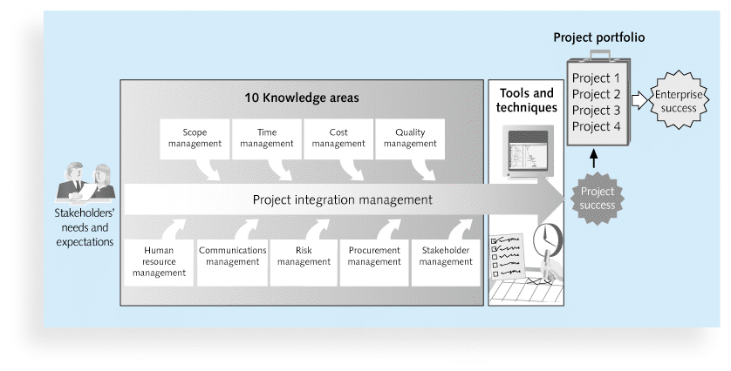
Project management framework/knowledge areas

Slide 35
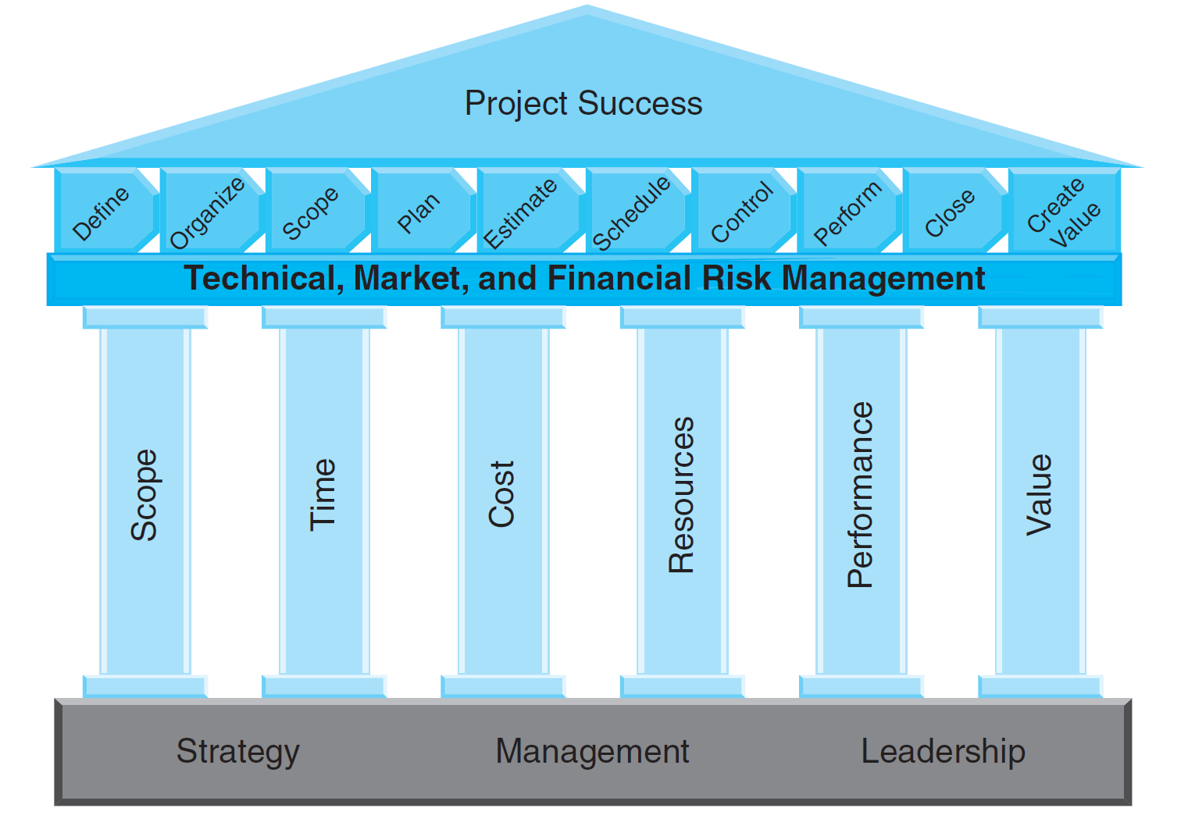
Project management component areas(similar to knowledge areas)

Slide 36
Knowledge areas according to Pmbok 1 of 2
# | Knowledge Areas | PMBOK Guide Description | Common Deliverables
1 | Project Integration Management | Processes required to ensure the elements of the project are properly coordinated | Project Charter Project Plan Change Requests Work Results
2 | Project Scope Management | Processes required to ensure that project includes all the work that is required and only the work that is required to complete the project successfully | Scope Statement Work Breakdown Structure (WBS) Formal Acceptance.
3 | Project Time Management | Processes required to ensure timely completion of the project | Network Diagram Task Estimates Project Schedule
4 | Project Cost Management | Processes required to ensure the project is completed within the approved budget | Resource Requirements Cost Estimates Project Budgets
5 | Project Quality Management | Processes required to ensure the project wil satisfy the needs for which it was undertaken | Quality Management Plan Checklists Quality Reviews

Slide 37
Knowledge areas according to Pmbok 2 of 2
# | Knowledge Areas | PMBOK Guide Description | Common Deliverables
6 | Project Human Resources Management | Processes required to make the most effective use of the people involved with the project. | Role and Responsibility Matrix Organization Chart Performance Evaluations
7 | Project Communications Management | Processes required to ensure the timely and appropriate generation, collection, dissemination, storage, and ultimate disposition of projection information. | Communication Plan Status Plan Presentations Lessons Learned
8 | Project Risk Management | Processes concerned with identifying, analyzing, and responding to project risk. | Risk Management Plan Risk Response Plan Risk Log
9 | Project Procurement Management | Processes required to acquire good and services outside the performing organization. | Procurement Plan Statement of Work Proposals Contracts

