Slide 1
Project life span

Slide 2
Project life span
Project life span is a progression through a series of differing stages of development of a project. It is the total phases through which a project passes from the time it is initially conceived until the time it is either in use as a success or abandoned as a failure.
Phase 1 – Conceptualization or Pre-Feasibility
Phase 2 – Planning or Feasibility or Demonstration
Phase 3 – Design/Development
Phase 4 – Implementation/Execution/Testing
Phase 5 – Launch or Termination or Closure
Phase 6 – Post Implementation Review

Slide 3
Phase 1: Conceptualization or Pre-Feasibility
Conceptualization: A conceptualization is an idea or thought that refers to the reflection of a targeted business function or process and how the various facets of the process or function relate to each other.
A thought process is a series of ideas, thoughts, or decisions.
How and when does this conceptualization process originate?
Pre-feasibility study: A pre-feasibility study is a preliminary study to assess whether to conduct a full feasibility study or not.

Slide 4
Phase 2: Planning or Feasibility or Demonstration
Before the start of any major project, a complete, realistic, and accurate project plan is very important.
Project planning is the process of setting goals, developing strategies to support an organization’s strategic goals, and outlining tasks and schedules to accomplish project goals.
Planning a project assumes that the project under consideration has been approved for implementation.
The approval can result from Phase 1 conceptualization or pre-feasibility findings.
A feasibility study is a detailed study in a controlled process to identify potential problems and opportunities.

Slide 5
Phase 3: Design/Development or Development or Engineering/Manufacturing Development
Once Phase 2 is completed, Phase 3 is initiated, and takes a project from planning through construction or realization of project scope.
Design and development follows customer requirements and assesses for quality against predefined criteria.
While analysis is discovering what the requirements are, design is evaluating a number of choices and choosing the best solution.

Slide 6
Phase 4: Implementation or Execution and Testing or Production and Deployment
This is the phase where products, services, and systems are realized. After the design of a product and its components, the method of manufacturing or production is defined in this phase.
This phase usually consists of both implementation and testing of the implemented product or system.
Drawings, specifications, and contract documents that were prepared in the design phase will be implemented, software will be coded, contracts will be tendered and awarded, and construction work will be undertaken.

Slide 7
Phase 5: Launch or Termination or Closure
Project closure: Business stakeholders agree to release the product and launch the product for the user or consumer.
A project is brought to its proper completion in this phase.
This is where the business stakeholders agree to release the product and launch the product for the user or consumer.
The client’s formal acceptance is essential in this phase.
Often, lessons learned from previous project completions and installations are used in this phase.
Launch of a product or system usually combines contributions from multiple disciplines in an organization.

Slide 8
Phase 6: Post-Implementation Review
Progress and success are measured, project documents are archived, lessons learned are captured, and project activities are formally closed.
The post-implementation phase allows an organization to step back and review processes and results.
The organization will consider processes that need adjustment, highlight the most effective processes, and provide action items to improve future projects.
Post-occupancy evaluations are also used to assess the effectiveness of construction or production or implementation.

Slide 9
Project Lifecycle
Initiator/
Stakeholder
Project Team
New Team/
Owner
Organizational
Framework
Define Work
Project Work
Report
Integrate
Initiate
Plan
Execute
Control
Close
PLAN
DO
ACT
CHECK
Organizational Framework – identify project and align with strategy map, identify and provide resources, project scheduling, prioritizing, direction-setting, issue resolution, milestone reviews
Initiate – develop business case and project plan/charter, including role(s) of sponsor(s), owner(s), define problem/opportunity with supporting data, participants, success measure(s), and scope (boundaries and parameters)
Plan – develop execution steps, timeline, dependencies, milestone dates, plans for risk and risk mitigation, plans for communications and for training
Execute – do the work defined in plans
Control – hold milestone meetings with sponsors, produce reports on performance and success measure(s), identify issues, resolutions, and management (e.g. scope management)
Close – report results, determine ownership and integration into ongoing work of all affected work units, evaluate the project, summarize lessons learned, and document the process and materials developed
Integrate – implement agreements, identify ongoing roles/responsibilities, create ongoing operational measures and dashboard reporting cycles, provide training, standardize processes, and continually improve

Slide 10
PMBOK Project Mgmt Process groups
# | Process Group | PMBOK Guide Description | Common Terms
1 | Initiating | Authorizing the project or phase | “ preliminary planning” “kicking off”
2 | Planning | Defining and refining objectives of the project and selecting the best course of action to attain those principles | “defining” “developing the plan” “setting the stage”
3 | Executing | Coordinating the people and resources to implement the plan | “making it happen” “getting it done” “coordinating”
4 | Controlling | Ensuring project objectives are met by monitoring and measuring progress regularly to identify variances from the plan so that corrective actions can be taken. | “tracking progress” “keeping on course”
5 | Closing | Formalizing acceptance of project or phase and bringing it to an orderly end. | “client acceptance” “transition” “closeout” “party”

Slide 11
Program and Project Portfolio Management
A program is “a group of related projects managed in a coordinated way to obtain benefits and control not available from managing them individually” (PMBOK® Guide, Fifth Edition, 2012)
A program manager provides leadership and direction for the project managers heading the projects within the program
Examples of common programs in the IT field include infrastructure, applications development, and user support

Slide 12
Project Portfolio Management
As part of project portfolio management, organizations group and manage projects and programs as a portfolio of investments that contribute to the entire enterprise’s success
Portfolio managers help their organizations make wise investment decisions by helping to select and analyze projects from a strategic perspective

Slide 13
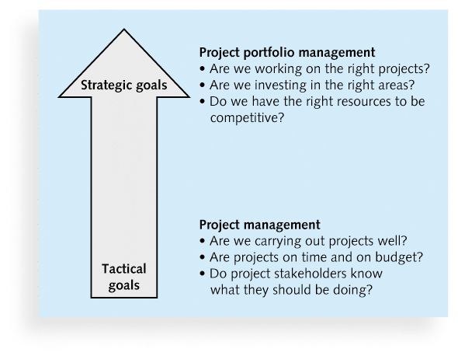
Figure 1-3. Project Management Compared to Project Portfolio Management

Slide 14
Best Practice
A best practice is “an optimal way recognized by industry to achieve a stated goal or objective”*
Robert Butrick suggests that organizations need to follow basic principles of project management, including these two mentioned earlier in this chapter:
Make sure your projects are driven by your strategy. Be able to demonstrate how each project you undertake fits your business strategy, and screen out unwanted projects as soon as possible
Engage your stakeholders. Ignoring stakeholders often leads to project failure. Be sure to engage stakeholders at all stages of a project, and encourage teamwork and commitment at all times
*Project Management Institute, Organizational Project Management Maturity Model (OPM3) Knowledge Foundation (2003), p. 13.

