Slide 1
Project Human Resource Management

Slide 2
Learning Objectives
Explain the importance of good human resource management on projects, including the current state and future implications of human resource management, especially on information technology projects.
Define project human resource management and understand its processes.
Summarize key concepts for managing people by understanding the theories of Abraham Maslow, Frederick Herzberg, David McClelland, and Douglas McGregor on motivation, H. J. Thamhain and D. L. Wilemon on influencing workers, and Stephen Covey on how people and teams can become more effective.

Slide 3
Learning Objectives
Discuss human resource planning and be able to create a project organizational chart, responsibility assignment matrix, and resource histogram.
Understand important issues involved in project staff acquisition and explain the concepts of resource assignments, resource loading, and resource leveling.
Assist in team development with training, team-building activities, and reward systems.
Explain and apply several tools and techniques to help manage a project team and summarize general advice on managing teams.
Describe how project management software can assist in project human resource management.

Slide 4
The Importance of Human
Resource Management
Many corporate executives have said, “People are our most important asset”
People determine the success and failure of organizations and projects

Slide 5
What is Project Human Resource Management?
Making the most effective use of the people involved with a project.
Processes include:
  Human resource planning: Identifying and documenting project roles, responsibilities, and reporting relationships.
  Acquiring the project team: Getting the needed personnel assigned to and working on the project.
  Developing the project team: Building individual and group skills to enhance project performance.
  Managing the project team: Tracking team member performance, motivating team members, providing timely feedback, resolving issues and conflicts, and coordinating changes to help enhance project performance.

Slide 6
Keys to Managing People
Psychologists and management theorists have devoted much research and thought to the field of managing people at work.
Important areas related to project management include:
  Motivation theories
  Influence and power
  Effectiveness

Slide 7
Intrinsic and Extrinsic Motivation
Intrinsic motivation causes people to participate in an activity for their own enjoyment.
Extrinsic motivation causes people to do something for a reward or to avoid a penalty.
For example, some children take piano lessons for intrinsic motivation (they enjoy it) while others take them for extrinsic motivation (to get a reward or avoid punishment).

Slide 8
Maslow’s Hierarchy of Needs
Abraham Maslow argued that human beings possess unique qualities that enable them to make independent choices, thus giving them control of their destiny.
Maslow developed a hierarchy of needs, which states that people’s behaviors are guided or motivated by a sequence of needs.

Slide 9
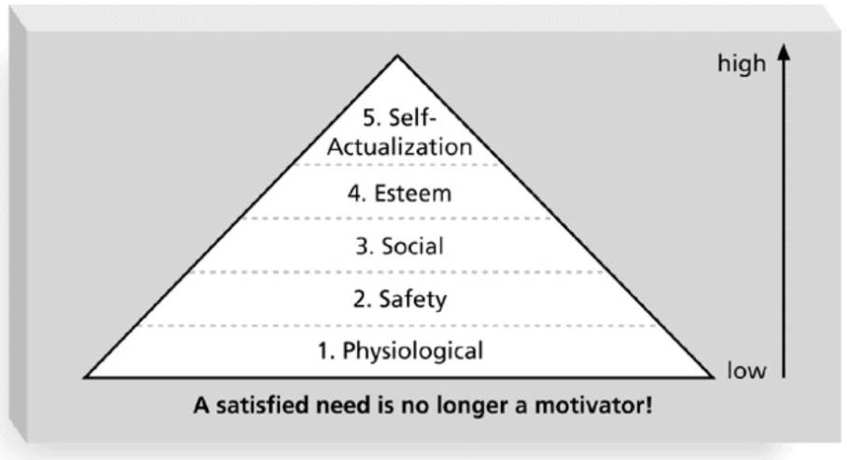
Maslow’s Hierarchy of Needs

Slide 10
Herzberg’s Motivational and Hygiene Factors
Frederick Herzberg wrote several famous books and articles about worker motivation. He distinguished between:
  Motivational factors: Achievement, recognition, the work itself, responsibility, advancement, and growth. These factors produce job satisfaction.
  Hygiene factors: Larger salaries, more supervision, and a more attractive work environment. These factors cause dissatisfaction if not present, but do not motivate workers to do more.

Slide 11
McClelland’s Acquired-Needs Theory
Specific needs are acquired or learned over time and are shaped by life experiences. The following are the main categories of acquired needs:
  Achievement (nAch): People with a high need for achievement like challenging projects with attainable goals and lots of feedback.
  Affiliation (nAff): People with high need for affiliation desire harmonious relationships and need to feel accepted by others, so managers should try to create a cooperative work environment for them.
  Power (nPow): People with a need for power desire either personal power (not good) or institutional power (good for the organization). Provide institutional power seekers with management opportunities.

Slide 12
McGregor’s Theory X and Y
Douglas McGregor popularized the human relations approach to management in the 1960s.
Theory X: Assumes workers dislike and avoid work, so managers must use coercion, threats, and various control schemes to get workers to meet objectives.
Theory Y: Assumes individuals consider work as natural as play or rest and enjoy the satisfaction of esteem and self-actualization needs.
Theory Z: Introduced in 1981 by William Ouchi and is based on the Japanese approach to motivating workers, which emphasizes trust, quality, collective decision making, and cultural values.

Slide 13
Thamhain and Wilemon’s Ways to Have Influence on Projects
Authority: The legitimate hierarchical right to issue orders.
Assignment: The project manager's perceived ability to influence a worker's later work assignments.
Budget: The project manager's perceived ability to authorize others' use of discretionary funds.
Promotion: The ability to improve a worker's position.
Money: The ability to increase a worker's pay and benefits.

Slide 14
Thamhain and Wilemon’s Ways to Have Influence on Projects (cont’d)
Penalty: The project manager's ability to cause punishment.
Work challenge: The ability to assign work that capitalizes on a worker's enjoyment of doing a particular task.
Expertise: The project manager's perceived special knowledge that others deem important.
Friendship: The ability to establish friendly personal relationships between the project manager and others.

Slide 15
Ways to Influence that Help and Hurt Projects
Projects are more likely to succeed when project managers influence people using:
  Expertise
  Work challenge
Projects are more likely to fail when project managers rely too heavily on:
  Authority
  Money
  Penalty

Slide 16
Power
Power is the potential ability to influence behavior to get people to do things they would not otherwise do.
Types of power include:
  Coercive power
  Legitimate power
  Expert power
  Reward power
  Referent power

Slide 17
Improving Effectiveness:
Covey’s Seven Habits
Project managers can apply Covey’s seven habits to improve effectiveness on projects.
  Be proactive.
  Begin with the end in mind.
  Put first things first.
  Think win/win.
  Seek first to understand, then to be understood.
  Synergize.
  Sharpen the saw.

Slide 18
Empathic Listening and Rapport
Good project managers are empathic listeners, meaning they listen with the intent to understand.
Before you can communicate with others, you have to have rapport, which is a relation of harmony, conformity, accord, or affinity.
Mirroring is the matching of certain behaviors of the other person, and is a technique used to help establish rapport.
IT professionals need to develop empathic listening and other people skills to improve relationships with users and other stakeholders.

Slide 19
Acquiring the Project Team
Acquiring qualified people for teams is crucial.
The project manager who is the smartest person on the team has done a poor job of recruiting!
Staffing plans and good hiring procedures are important, as are incentives for recruiting and retention.
  Some companies give their employees one dollar for every hour that a new person who they helped hire works.
  Some organizations allow people to work from home as an incentive.

Slide 20
Myers-Briggs Type Indicator (MBTI)
MBTI is a popular tool for determining personality preferences and helping teammates understand each other.
Four dimensions include:
  Extrovert/Introvert (E/I)
  Sensation/Intuition (S/N)
  Thinking/Feeling (T/F)
  Judgment/Perception (J/P)
NTs, or rationals, are attracted to technology fields.
IT people vary most from the general population in their tendency to not be extroverted or sensing.

Slide 21
Wideman and Shenhar’s Views on MBTI and Project Management*
Most suited for project leadership:
  100 percent: INTJ, ENTJ, ISTJ, ESTJ
  50 percent: INTP, ENTP, ENFP, ENFJ
Best suited as followers:
  100 percent: INFJ, ISFJ
  50 percent: INTP, ENTP, ENFP, ENFJ, ESFJ
Not suited for project work:
  100 percent: INFP, ISFP, ESFP, ISTP
  50 percent: ENFP, ESTP
*Wideman, R. Max and Aaron J. Shenhar, “Professional and Personal Development: A Practical Approach to Education and Training,” Project Management for Business Professionals, edited by Joan Knutson, 2001, p. 375.

Slide 22
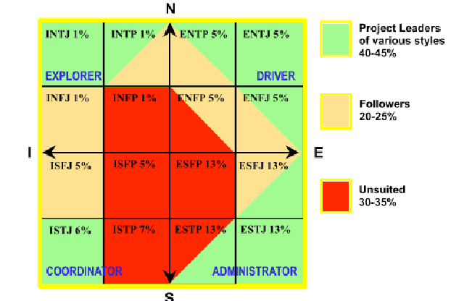
MBTI and Suitability to Project Work*
What do you think about these views?
*Wideman, R. Max. “Project Teamwork, Personality Profiles and the Population at Large: Do we
have enough of the right kind of people?” (http://www.maxwideman.com/papers/profiles/profiles.pdf ).

Slide 23
Social Styles Profile
People are perceived as behaving primarily in one of four zones, based on their assertiveness and responsiveness:
  Drivers
  Expressives
  Analyticals
  Amiables
People on opposite corners (drivers and amiables, analyticals and expressives) may have difficulty getting along.

Slide 24
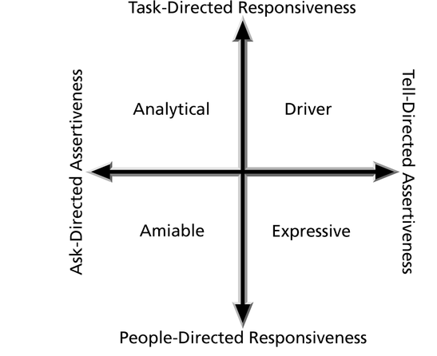
Social Styles

Slide 25
Developing the Project Team
The main goal of team development is to help people work together more effectively to improve project performance.
It takes teamwork to successfully complete most projects.

Slide 26
Tuckman Model of Team Development
Forming
Storming
Norming
Performing
Adjourning

Slide 27
Training
Training can help people understand themselves and each other, and understand how to work better in teams.
Team building activities include:
  Physical challenges
  Psychological preference indicator tools

Slide 28
Managing the Project Team
Project managers must lead their teams in performing various project activities.
After assessing team performance and related information, the project manager must decide:
  If changes should be requested to the project.
  If corrective or preventive actions should be recommended.
  If updates are needed to the project management plan or organizational process assets.

Slide 29
Tools and Techniques for Managing Project Teams
Observation and conversation
Project performance appraisals
Conflict management
Issue logs

Slide 30
Reward and Recognition Systems
Team-based reward and recognition systems can promote teamwork.
Focus on rewarding teams for achieving specific goals.
Allow time for team members to mentor and help each other to meet project goals and develop human resources.

Slide 31
Why People Leave Their Jobs
They feel they do not make a difference.
They do not get proper recognition.
They are not learning anything new or growing as a person.
They do not like their coworkers.
They want to earn more money.

Slide 32
General Advice on Teams
Be patient and kind with your team.
Fix the problem instead of blaming people.
Establish regular, effective meetings.
Allow time for teams to go through the basic team-building stages.
Limit the size of work teams to three to seven members.

Slide 33
General Advice on Teams (cont’d)
Plan some social activities to help project team members and other stakeholders get to know each other better.
Stress team identity.
Nurture team members and encourage them to help each other.
Take additional actions to work with virtual team members.

Slide 34
Resource Loading
Resource loading refers to the amount of individual resources an existing schedule requires during specific time periods.
Helps project managers develop a general understanding of the demands a project will make on the organization’s resources and individual people’s schedules.
Overallocation means more resources than are available are assigned to perform work at a given time.

Slide 35
Staffing Management Plans and Resource Histograms
A staffing management plan describes when and how people will be added to and taken off the project team.
A resource histogram is a column chart that shows the number of resources assigned to a project over time.

Slide 36
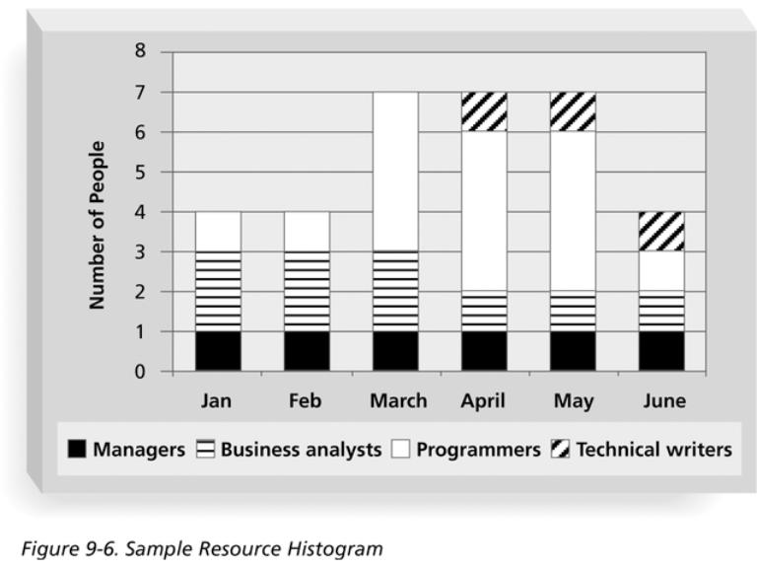
Sample Resource Histogram

Slide 37
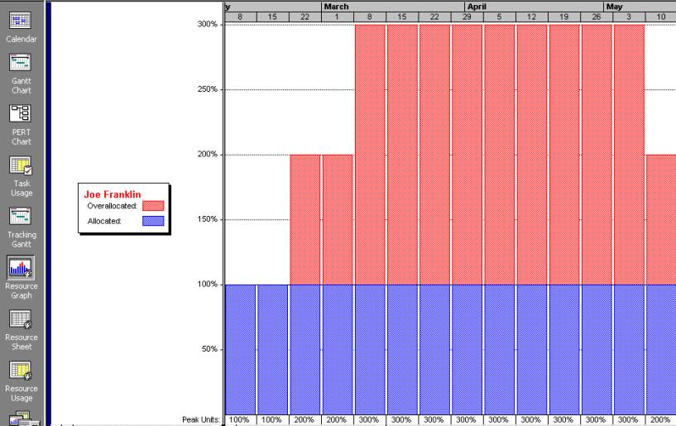
Sample Histogram Showing an Overallocated Individual
What’s wrong with this picture? Assume 100 percent means Joe is working eight hours per day.

Slide 38
Resource Leveling
Resource leveling is a technique for resolving resource conflicts by delaying tasks.
The main purpose of resource leveling is to create a smoother distribution of resource use and reduce overallocation.

Slide 39
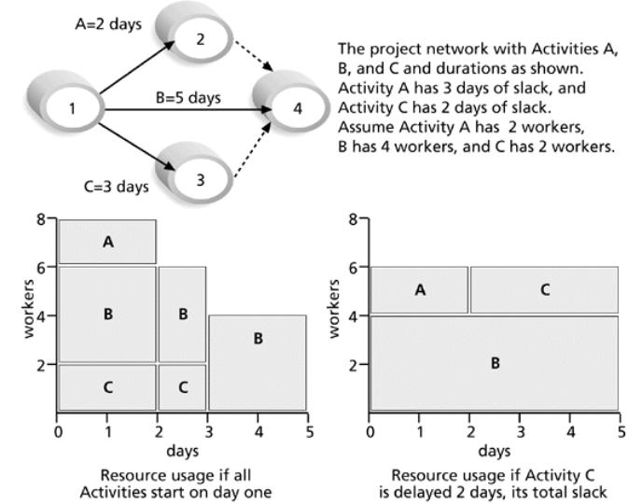
Resource Leveling Example

Slide 40
Benefits of Resource Leveling
When resources are used on a more constant basis, they require less management.
It may enable project managers to use a just-in-time inventory type of policy for using subcontractors or other expensive resources.
It results in fewer problems for project personnel and the accounting department.
It often improves morale.

Slide 41
Using Software to Assist in Human Resource Management
Software can help produce RAMS and resource histograms.
By using project management software for human resource management, you can:
  Assign resources.
  Identify potential resource shortages or underutilization.
  Level resources.

Slide 42
Project Resource Management Involves Much More Than Using Software
Project managers must:
  Treat people with consideration and respect.
  Understand what motivates people.
  Communicate carefully with people.
Focus on your goal of enabling project team members to deliver their best work.

