Slide 1
Project Risk Management
Chapter Six RBS AND QUANT/QUALT ANALYSIS

Slide 2
Risk Breakdown Structure
A risk breakdown structure is a hierarchy of potential risk categories for a project.
Similar to a work breakdown structure but used to identify and categorize risks.

Slide 3
Risk Breakdown Structure
Level 0 | Level 1 | Level 2 | Level 3
Project Risk | Management | Corporate | Organizational stability
 |  |  | Financial stability
 |  | Stakeholders | History and culture
 |  |  | Financial stability
 |  |  | Requirements definitions and scope
 | External | Cultural | Cultural issues
 |  |  | Political, legal, regulatory issues
 |  |  | Interest groups, lobbyist issues
 |  | Economic | Labor market
 |  |  | Labor conditions
 |  |  | Financial markets

Slide 4
Sample Risk Breakdown Structure
IT Project
Business
Technical
Organizational
Project
Management
Competitors
Hardware
Executive
support
Estimates
Suppliers
Software
User support
Communication
Cash flow
Network
Team support
Resources

Slide 5
Internal Risks
Internal risks can be controlled by project managers and stakeholders.
They originate from all phases of a project.
Examples of internal risks are not meeting time, cost, scope, performance and value of a project due to technological difficulties.
Internal risks occur due to failure in customer relationships. These may be due to failure in key success factors of a project.

Slide 6
External Risk
These risks are from sources outside the project.
Project managers or stakeholders have little or no control over these risks.
Physical risks encompass damage by fire, flood, or other catastrophe, computer virus that infects the development environment or operational system, and a team member who steals confidential project material and makes it available to competitors.

Slide 7
Risk Identification
Risk identification is the process of understanding what potential events might hurt or enhance a particular project.
Risk identification tools and techniques include:
Brainstorming
The Delphi Technique
Interviewing
SWOT Analysis
MindMapping
Nominal Group Technique
Lessons learned from other projects
Risk Source | Risk Level
No of system modules
Less than 10 | None
10-20 | Low
21-30 | Medium
More than 30 | High
No of System Components
0-3 | None
3-6 | Low
7-10 | Medium
More than 11 | High

Slide 8
Brainstorming
Brainstorming is a technique by which a group attempts to generate ideas or find a solution for a specific problem by amassing ideas spontaneously and without judgment.
An experienced facilitator should run the brainstorming session.
Be careful not to overuse or misuse brainstorming.
Psychology literature shows that individuals produce a greater number of ideas working alone than they do through brainstorming in small, face-to-face groups.
Group effects often inhibit idea generation.

Slide 9
Delphi Technique
The Delphi Technique is used to derive a consensus among a panel of experts who make predictions about future developments.
Provides independent and anonymous input regarding future events.
Uses repeated rounds of questioning and written responses and avoids the biasing effects possible in oral methods, such as brainstorming.

Slide 10
Interviewing
Interviewing is a fact-finding technique for collecting information in face-to-face, phone, e-mail, or instant-messaging discussions.
Interviewing people with similar project experience is an important tool for identifying potential risks.

Slide 11
SWOT Analysis
SWOT analysis (strengths, weaknesses, opportunities, and threats) can also be used during risk identification.
Helps identify the broad negative and positive risks that apply to a project.

Slide 12
Potential Negative Risk Conditions Associated With Each Knowledge Area

Slide 13
Risk assessment
Risk assessment is the determination of the quantitative or qualitative value of the risks in a project.
Qualitative risk analysis
Each risk is defined by a set of standard parameters including likelihood or probability, severity or impact, detection process, and mitigation plans.
Quantitative risk analysis
Help a project manager determine the probability that a project will be completed on time and within a budget
Identify critical project parameters that affect project schedule the most, determine project success rate, and make decisions about viable project alternatives

Slide 14
Project Failure Mode and Effects Analysis

Slide 15
Project Failure Mode and Effects Analysis
RPN is a measure used when assessing risk in a project. Larger RPN values normally indicate more critical failure modes or risks.
Any risk that has an effect resulting in an impact of 9 or 10 would have a top priority to control and mitigate. Impact is given the most weight when assessing risk.

Slide 16
Failure Modes and Effects Analysis
Risk ID | Risks | Occurrence | Outcome | Detection | RS | RPN
1 | Will the products be delivered? | 7 | 8 (schedule) | 4 | 56 | 224
2 | How will the quality of products be? | 8 | 10 (quality) | 6 | 80 | 480
3 | How good is the technical capability? | 4 | 10 (schedule) | 10 | 40 | 400
4 | How is financial stability? | 4 | 3 (schedule) | 3 | 12 | 36
5 | Will our IP be protected? | 2 | 1 (schedule) | 4 | 2 | 8

Slide 17
Probability/Impact Matrix
A probability/impact matrix or chart lists the relative probability of a risk occurring on one side of a matrix or axis on a chart and the relative impact of the risk occurring on the other
List the risks and then label each one as high, medium, or low in terms of its probability of occurrence and its impact if it did occur
Can also calculate risk factors:
Numbers that represent the overall risk of specific events based on their probability of occurring and the consequences to the project if they do occur

Slide 18
PROBABILITY Rating FOR A HAZARD
Rating | Description | Detail
A | Highly Likely | Almost 100% probability in 12 months
B | Likely | Between 10% and 100% probability in next 10 years
C | Possible | Between 1% and 10% probability in next 100 years
D | Unlikely | Less than 1% probability in next 100 years

Slide 19
Impact Rating FOR A hazard
Rating | Description | Detail
1 | Marginal | Facility can provide a normal level of service
2 - 4 | Serious | Facility can provide a normal level of service with assistance from local community
5 - 7 | Critical | Facility can provide a normal level of service with assistance from local as well as outside communities
8 - 10 | Catastrophic | Facility cannot provide services

Slide 20
Risk Rating AS A PROBABILITY AND IMPACT MATRIX
 | Marginal | Serious | Critical | Catastrophic
High likely | A1 | A2-A4 | A5-A7 | A8-A10
Likely | B1 | B2-B4 | B5-B7 | B8-B10
Possible | C1 | C2-C4 | C5-C7 | C8-C10
Unlikely | D1 | D2-D4 | D5-D7 | D8-D10

Slide 21
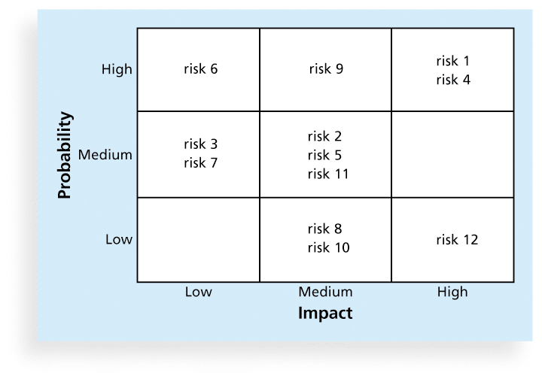
Another Sample Probability/Impact Matrix

Slide 22
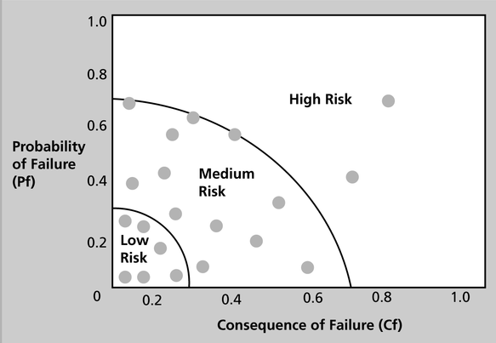
Chart Showing High-, Medium-, and Low-Risk Technologies

Slide 23
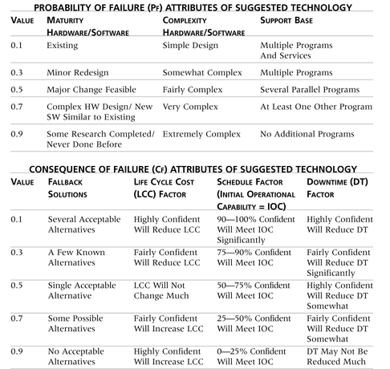
Table 11-6. Sample Probability/Impact Matrix for Qualitative Risk Assessment

Slide 24
Top Ten Risk Item Tracking
Top Ten Risk Item Tracking is a qualitative risk analysis tool that helps to identify risks and maintain an awareness of risks throughout the life of a project.
Establish a periodic review of the top ten project risk items.
List the current ranking, previous ranking, number of times the risk appears on the list over a period of time, and a summary of progress made in resolving the risk item.

Slide 25
Top Ten Risk Items
Boehm’s Ten risks to consider include:
1. Personnel Shortfalls
2. Unrealistic schedules and budgets
3. Developing the wrong software functions
4. Developing the wrong user interface
5. Gold plating
6. Continuing stream of requirements changes
7. Shortfalls in externally performed tasks
8. Shortfalls in externally furnished components
9. Real-time performance shortfalls
10. Straining computer science capabilities

Slide 26
Table 11-7. Example of Top Ten Risk Item Tracking

Slide 27
Expert Judgment
Many organizations rely on the intuitive feelings and past experience of experts to help identify potential project risks.
Experts can categorize risks as high, medium, or low with or without more sophisticated techniques.
Can also help create and monitor a watch list, a list of risks that are low priority, but are still identified as potential risks.

Slide 28
Quantitative Risk Analysis
Often follows qualitative risk analysis, but both can be done together.
Large, complex projects involving leading edge technologies often require extensive quantitative risk analysis.
Main techniques include:
Decision tree analysis
Simulation
Sensitivity analysis

Slide 29
Decision Trees and Expected Monetary Value (EMV)
A decision tree is a diagramming analysis technique used to help select the best course of action in situations in which future outcomes are uncertain.
Estimated monetary value (EMV) is the product of a risk event probability and the risk event’s monetary value.
You can draw a decision tree to help find the EMV.

Slide 30
BUT BEFORE DECISION TREE ANALYSIS …
Statistics terms to know:
Probability
Median
Mode
Mean
Skew
Variance
Sigma or Standard Deviation
Notes:
Before getting into Quantitative Risk Management
Quick review of statistics and some terms that are often used will help
Then will resume with Decision Tree Analysis

Slide 31
PROBABILITY
How likely that an event will occur
Greater than 0 and less than 1.0 (i.e., normally .1 to .9)
The probability (Pr) of two independent events:
Pr (Event #1) x Pr (Event #2) = Pr (Both Events)
P(t) = P(A) * P(B)
OR
0.70 X 0.80 = 0.56 OR 56%
Note: This applies to independent events only
Notes:
Everyone knows basic probability definition.
Ranges from 0 (will not happen) to 1.0 (will happen)
Can convert to Percentage
Can combine two independent probabilities by multiplying

Slide 32
PROBABILITY (continued)
Likelihood of an event can be considered as multiple probabilities:
Low (a)
Most Likely (m)
High (b)
This concept is applied in more complex projects, using the “PERT” approximations
Notes:
This is traditional variables used in PM for the range of possibilities
Keep in mind that High is “b” and Low is “a”
Use the range variables to get a PERT approximation for mean value and variance … will discuss these terms in a minute

Slide 33
MEDIAN
17
30
48
75
92
If the set of values is an odd number, then the median is the value in the middle:
Median is 48
Notes:
Our first Statistics Term … Median
The answer is always the middle value in an odd number
Does not matter how strange the numbers are distributed
Example:
1
2
3 << Median
45
46

Slide 34
MEDIAN (continued)
17
30
30
48
75
92
If the set of values is an even number, then the median is half-way between the two middle values:
The median is half-way between 30 and 48, so the median here is 39.
Notes:
This is the median when you have an even number of values

Slide 35
MODE
The value that exists most frequently in a set of values:
17
30
30
48
75
92
17
30
48
75
92
This set of values does not have a mode
Mode is 30
Notes:
Mode is the most frequently occurring value
Q: What if have two sets of numbers where multiple same values occur?
A: Called a Bimodal Distribution
David T. Hulett:
Good. Later I hope you show this distinction with median on continuous distributions, which are more common in quantitative analysis

Slide 36
MEAN
Mean, or x (aka: Expected Value)
The simple definition:
The average
Add up all the values and divide by the number of values
The definition for more complex projects: The weighted average
Weighted by the likelihood of the occurrence
Notes:
Most everyone familiar with definition of “Mean”
Mean = Average
Sum and divide is formal definition
Weighted average considers effects of more than one value

Slide 37
MEAN (continued)
Mean, or x (continued)
Mean ( x ) = (Low + 4 times the Most Likely + High) divided by 6: x = (a + 4m + b) / 6 We know this formula as the PERT approximation for the mean for a Beta Distribution!
Triangular is:
(Low + Most Likely + High) divided by
(a + ml + b) / 3
Notes:
PERT approximation is a form of weighted average
This one applies only to Beta Distribution
Different one for Triangular Distribution
Will discuss these shortly
David T. Hulett:
Craig, I would start with the triangle which is (L + ML + H)/3 and is EXACT. This one is an approximation to Beta (you say that) and is more “aggressive” than the triangle. We can then use the charts. We can then also compute the standard deviations for each.

Slide 38
SKEW
Rightward Skew
MEDIAN MEAN
Median < Mean
Notes:
Some more Statistics information to know
When Mean is to right of Median -- Called Rightward Skew

Slide 39
SKEW (continued)
Symmetric
MEDIAN MEAN
Median = Mean
Notes:
Some more Statistics information to know
When Mean equals Median -- Called Symmetrical

Slide 40
SKEW (continued)
Leftward Skew
Median > Mean
MEAN MEDIAN
Notes:
Some more Statistics information to know
When Mean is to left of Median -- Called Leftward Skew

Slide 41
VARIANCE
Variance, or σ²
A statistical formula
For an individual activity, the variance is the distances from the mean
For a project variance, it is the sum of the individual activity variances
Used to calculate the “standard deviation” for a project
Notes:
Variance talks to distance from the mean
Official equation is much more complex
PM uses an approximation
Have seen these before
Triangular on Left and Beta on Right
Can sum the different variances to get a project total variance
David T. Hulett:
The one on the left is triangular, so we should have the mean of the triangular identified earlier, then compare them for the same 3-point rightward skewed estimate (say 80-100-160). A comparison table shows that triangular is more conservative and beta approximations are more aggressive

Slide 42
SIGMA
Sigma, or σ (aka: Standard Deviation )
The square root of the sum of the variances
The measure of the distance from the mean in a set of probabilities
In other words, the probability distribution for a project
Can be used to display the level of risk for the project
Standard deviation = sum of the variances
Notes:
This gives you the value for how far away a standard deviation is from the mean
Square root of the variance
Hardest math on PM exam
What do we do with variance … tells us level of risk for a project
Again, can get project variance by summing the variances
Can get project standard deviation by getting square root of the project variance
So how is this used on a project ….. NEXT SLIDE

Slide 43
PROBABILITY EXAMPLE
DATA:
Probability of Scope = 0.70
Probability of No Scope = 0.30
Probability of Approval = 0.80
Probability of No Approval = 0.20
EXAMPLE:
Pr(Scope) x Pr(Approval) = 0.70 x 0.80 = 0.56
Pr(Scope) x Pr(No Approval) = 0.70 x 0.20 = 0.14
Pr(No Scope) x Pr(Approval) = 0.30 x 0.80 = 0.24
Pr(No Scope) x Pr(No Approval) = 0.30 x 0.20 = 0.06
Total= 1.00
Practical Application - Decision Tree Analysis
NOTE: The probability of both scope and approval is 56% (smaller than one would have thought with .7 and .8)
Notes:
KEY POINTS TO NOTE:
PROBABILITIES MUST ADD TO 1.00 OR 100%
THIS IS A CHECK FOR YOUR WORK
THREE PLACES HERE:
1) SCOPE PROBABILITY
2) APPROVAL PROBABILITY
3) RESULTANT EVENT PROBABILITY
ADD

Slide 44
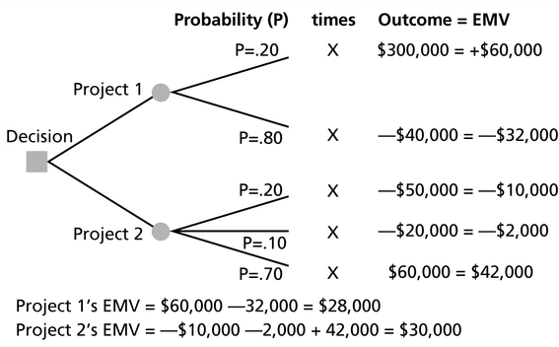
Expected Monetary Value (EMV) Example

Slide 45
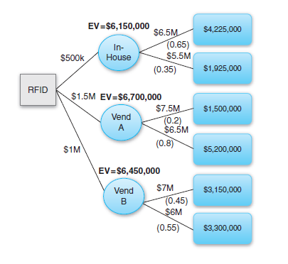
Decision Trees Example Two
Inventory control project in a manufacturing environment budgeted at $5M with a total risk impact of $1M.
Vendor-A is ready to implement the RFID system for $1.5M with a failure probability of 20%.
Vendor-B is willing to implement a similar system for $1M with a failure rate of 45%.
The project manager estimates that if the in-house project team implements the system, the failure probability will be 65% for $500K.

Slide 46
Sensitivity Analysis
Sensitivity analysis is a technique used to show the effects of changing one or more variables on an outcome.
For example, many people use it to determine what the monthly payments for a loan will be given different interest rates or periods of the loan, or for determining break-even points based on different assumptions.
Spreadsheet software, such as Excel, is a common tool for performing sensitivity analysis.

Slide 47
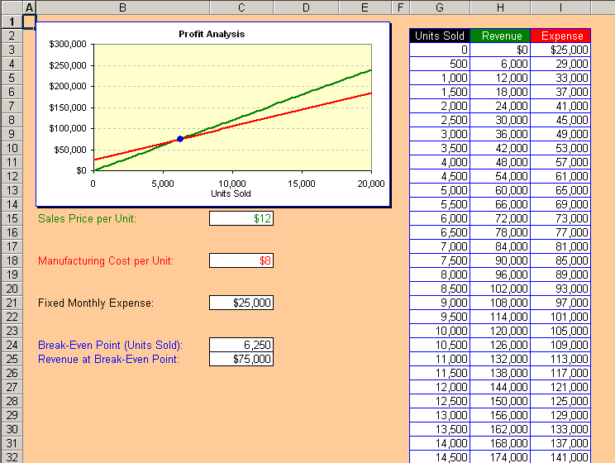
Sample Sensitivity Analysis for Determining Break-Even Point

Slide 48
In Class Activity
Refer to the Expected Monetary Value Handout.

