Slide 1
Chapter Four
Project Initiation and Integration

Slide 2
Learning Objectives
Discuss the strategic planning process and apply different project selection methods/Select projects and set priorities
Select a project manager and project team
Explain the importance of creating a project charter to formally initiate projects/write a project charter
Describe project management plan development, understand the content of these plans, and review approaches for creating them
Gather requirements for a project
Prepare and write a project scope
Explain project execution, its relationship to project planning, the factors related to successful results, and tools and techniques to assist in directing and managing project work
Describe the process of monitoring and controlling a project

Slide 3
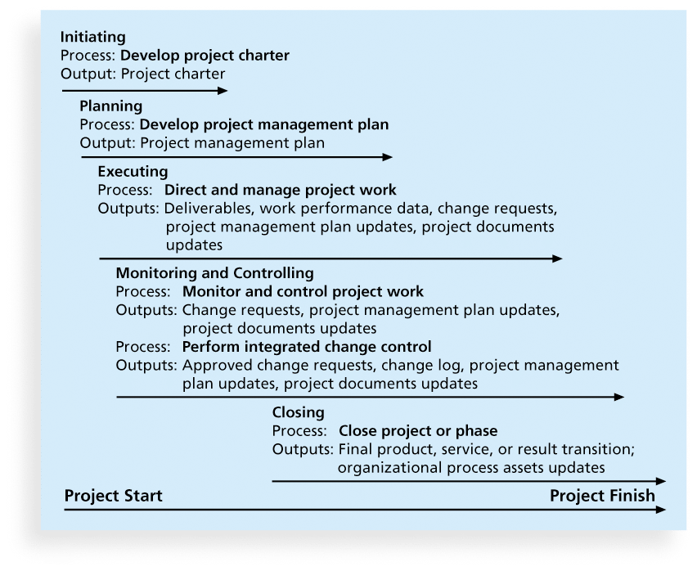
Project Integration/Initation

Slide 4
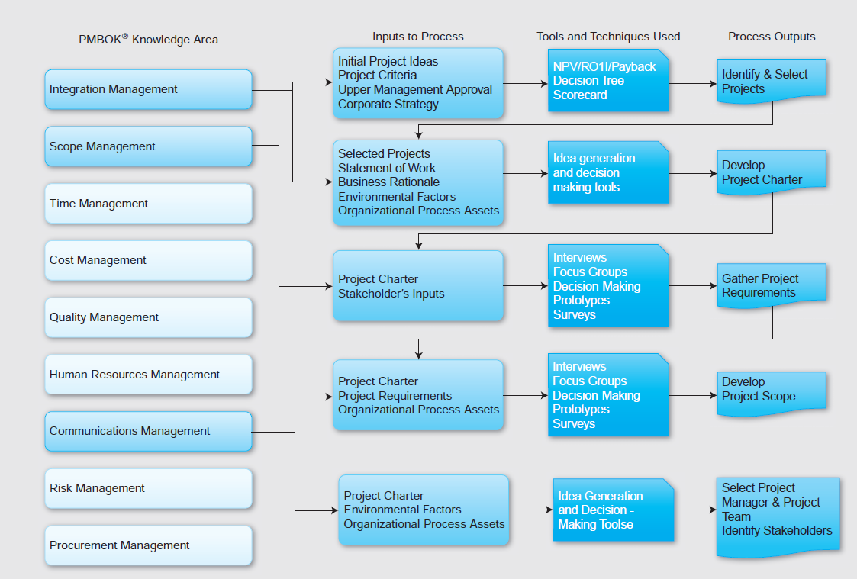
Projection Integration/Initiation

Slide 5
Project Selection
Form upper management team
Identify, organize, and set criteria for all projects including financial and qualitative factors
Gather data on all projects
Estimate time and resources required
Analyze and decide on projects
Implement initial project plans

Slide 6
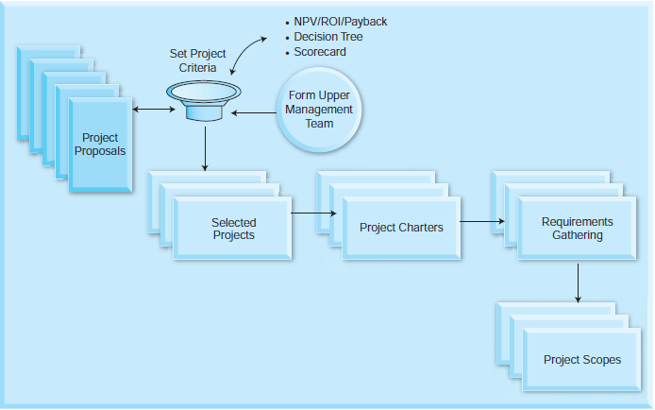
Project Selection Process

Slide 7
Methods for Selecting Projects
There are usually more projects than available time and resources to implement them
Methods for selecting projects include:
  focusing on broad organizational needs
  categorizing information technology projects
  performing net present value or other financial analyses
  using a weighted scoring model
  implementing a balanced scorecard

Slide 8
Focusing on Broad
Organizational Needs
It is often difficult to provide strong justification for many IT projects, but everyone agrees they have a high value
“It is better to measure gold roughly than to count pennies precisely”
Three important criteria for projects:
  There is a need for the project
  There are funds available
  There’s a strong will to make the project succeed

Slide 9
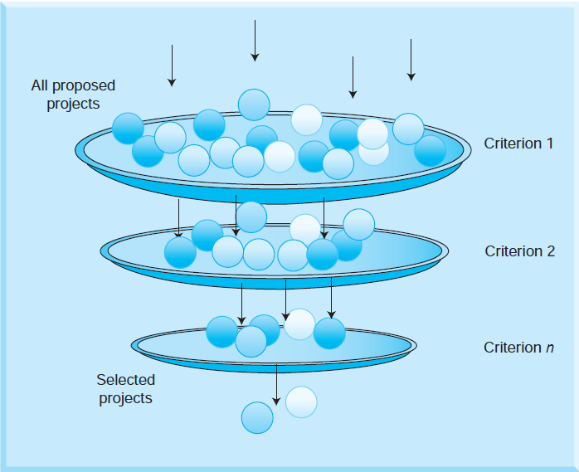
Project Screening Process

Slide 10
Categorizing IT Projects
One categorization is whether the project addresses
  a problem
  an opportunity, or
  a directive
Another categorization is how long it will take to do and when it is needed
Another is the overall priority of the project

Slide 11
Categorizing IT Projects Continued
Projects can be categorized as one of the following:
  Compliance: Projects that are essential to meet new requirements imposed by internal and external entities
    Internal entities may be executive management
    External entities may be government regulations and requirements
    “Must do” projects; if not implemented, may face penalties
  Emergency: Projects that are needed to meet emergency conditions; may be “must-do” projects; if not implemented, organizations may not be fully operational to fulfill their core competencies

Slide 12
Categorizing IT Projects Continued
  Mission Critical: Critical to the mission of a company
    If not completed, would cause immediate, unacceptably negative impact to business
  Operational: Projects that are needed to support current operations
    Increase process efficiency
    Reduce product cost
    Improve performance and other metrics
  Strategic: Projects that are essential to support long-range mission (increase revenue, increase market-share)

Slide 13
Financial Analysis of Projects
Financial considerations are often an important consideration in selecting projects
Three primary methods for determining the projected financial value of projects:
  Net present value (NPV) analysis
  Return on investment (ROI)
  Payback analysis

Slide 14
Net Present Value Analysis
Net present value (NPV) analysis is a method of calculating the expected net monetary gain or loss from a project by discounting all expected future cash inflows and outflows to the present point in time
Projects with a positive NPV should be considered if financial value is a key criterion
The higher the NPV, the better

Slide 15
NPV Calculations
Determine estimated costs and benefits for the life of the project and the products it produces
Determine the discount rate (check with your organization on what to use)
Calculate the NPV
  Notes: Some organizations consider the investment year as year 0, while others start in year 1. Some people entered costs as negative numbers, while others do not. Check with your organization for their preferences

Slide 16
Net Present Value (NPV/Qualitative)
If you are investing $600,000 and expecting $750,000 a year from now, Present Value = Discount factor * Future Value
Where discount factor = where r is the discount rate
If the discount rate was 10%, the present value is:
750,000/1.10 = $681,818.
The building is worth $681,818, your investment is $600,000 and your NPV is $81,818.
Therefore, NPV = PV – investment.

Slide 17
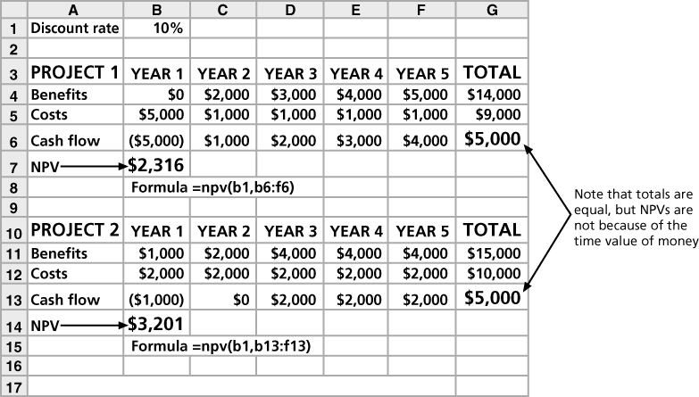
Net Present Value (NPV/Qualitative)

Slide 18
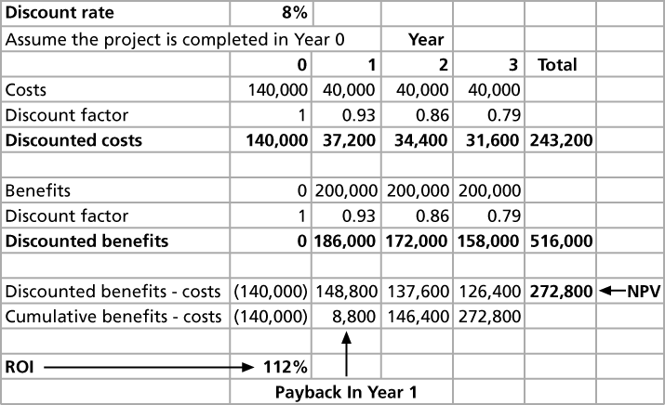
Figure 4-5. JWD Consulting NPV Example

Slide 19
Return on Investment (ROI)
Return on investment (ROI) is calculated by subtracting the project costs from the benefits and then dividing by the costs
  ROI = (total discounted benefits - total discounted costs) / discounted costs
The higher the ROI, the better
Many organizations have a required rate of return or minimum acceptable rate of return on investment for projects
Internal rate of return (IRR) can by calculated by finding the discount rate that makes the NPV equal to zero

Slide 20

ROI Example
For example, if you invest $100 today and if the $100 is worth $105 next year, the ROI is: $105/$100 = 0.05 or 5%.
ROI =
5% is the ROI of that investment. For the two projects Project 1 and Project 2 in Example 4-1, ROI can be calculated as 58% and 59% respectively. Here, the higher the ROI, the better for the organization.

Slide 21
Payback Analysis
Another important financial consideration is payback analysis
The payback period is the amount of time it will take to recoup, in the form of net cash inflows, the total dollars invested in a project
Payback occurs when the net cumulative discounted benefits equals the costs
Many organizations want IT projects to have a fairly short payback period

Slide 22
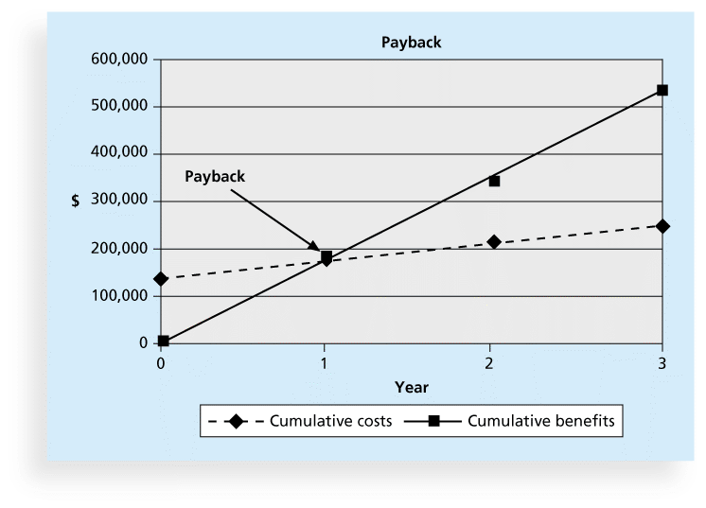
Figure 4-6. Charting the Payback Period

Slide 23
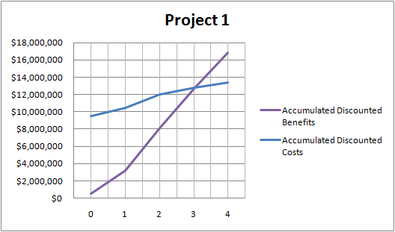
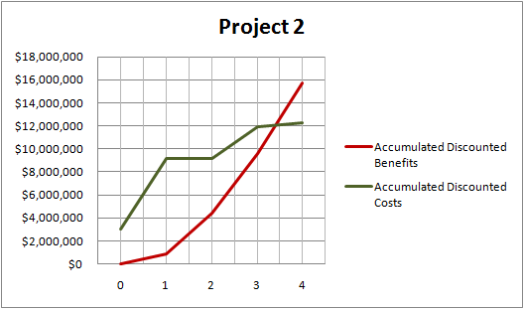
Payback Analysis

Slide 24
Project Strategy and Value
Project strategic value is defined as the impact a project will have on external entities like customers and suppliers.
Competitive differentiation may depend upon:
  Economies of scale
  Product differentiation
  Capital Requirements
  Access to distribution channels
  Cost disadvantages independent of scale
  Government policies
  Perceived competitive reactions in the market, and
  Price of organization’s products and services.

Slide 25
Project Strategy and Value
Value of a project can be determined by cash benefits (both magnitude and its timing).
  Magnitude and timing of cash benefits when compared to investments made on the projects have to be evaluated in project selection as well.
  If a project is not expected to bring some benefit to the organization, then there is no point in implementing this project.

Slide 26
Weighted Scoring Model
A weighted scoring model is a tool that provides a systematic process for selecting projects based on many criteria
    Identify criteria important to the project selection process
    Assign weights (percentages) to each criterion so they add up to 100%
    Assign scores to each criterion for each project
    Multiply the scores by the weights and get the total weighted scores
The higher the weighted score, the better

Slide 27
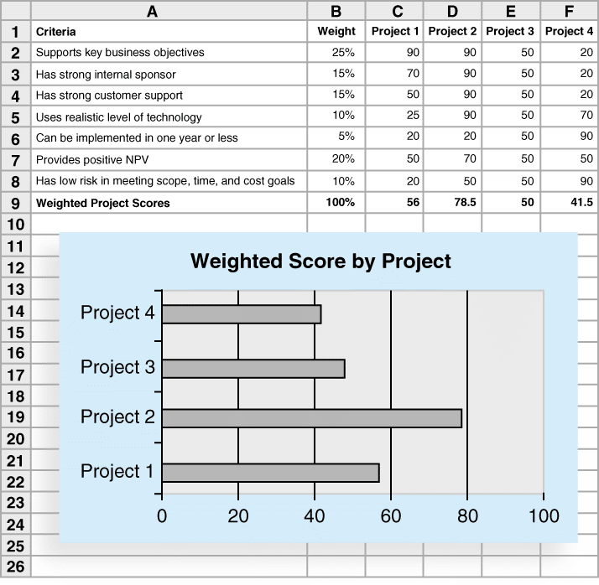
Sample Weighted Scoring Model for Project Selection

Slide 28
Implementing a Balanced Scorecard
Drs. Robert Kaplan and David Norton developed this approach to help select and manage projects that align with business strategy
A balanced scorecard
  is a methodology that converts an organization’s value drivers, such as customer service, innovation, operational efficiency, and financial performance, to a series of defined metrics
See www.balancedscorecard.org for more information

Slide 29
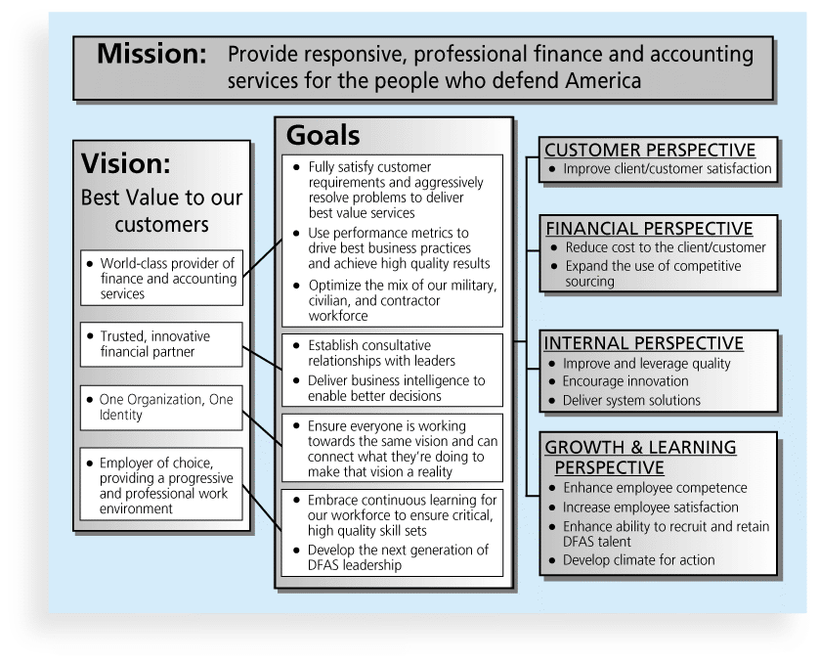
Balanced Scorecard Example

Slide 30
Project Charter
A project charter is a document that formally recognizes a project, includes a problem statement, project objectives, benefits, process owners, and a project sponsor or a champion.
  Project purpose or justification
  Project objectives
  Project success criteria
  Project description
  Project risks at a high level
  Key milestones
  Budget information

Slide 31
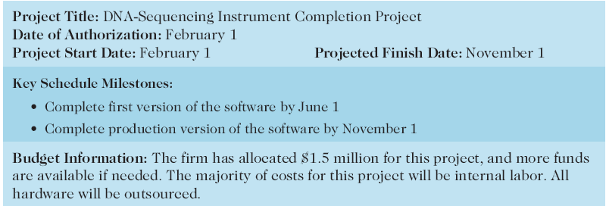
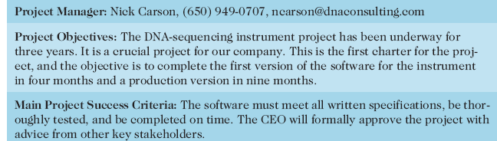
Sample Project Charter

Slide 32
Project Charter Continued
  High level requirements of the project
  Project approval requirements
  Roles and responsibilities of the project manager and the project team
  Level of authority of the project manager
  Sponsor and authorizing persons of the project charter

Slide 33
Developing a Project Management Plan
A project management plan is a document used to coordinate all project planning documents and help guide a project’s execution and control
Plans created in the other knowledge areas are subsidiary parts of the overall project management plan

Slide 34
Common Elements of a Project Management Plan
Introduction or overview of the project
Description of how the project is organized
Management and technical processes used on the project
Work to be done, schedule, and budget information

Slide 35
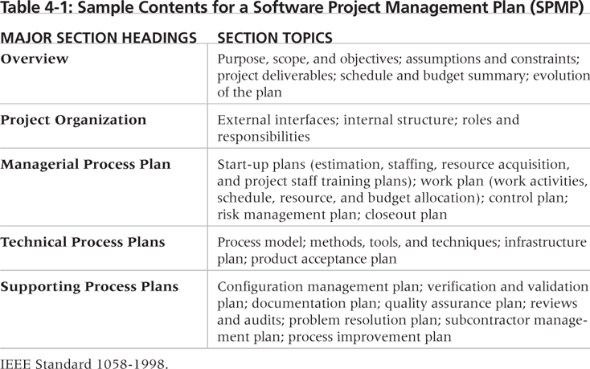
Table 4-2. Sample Contents for a Software Project Management Plan (SPMP)

Slide 36
Directing and Managing Project Work
Involves managing and performing the work described in the project management plan
The majority of time and money is usually spent on execution
The application area of the project directly affects project execution because the products of the project are produced during execution

Slide 37
Coordinating Planning and Execution
Project planning and execution are intertwined and inseparable activities
Those who will do the work should help to plan the work
Project managers must solicit input from the team to develop realistic plans

Slide 38
Providing Leadership and a Supportive Culture
Project managers must lead by example to demonstrate the importance of creating and then following good project plans
Organizational culture can help project execution by
  providing guidelines and templates
  tracking performance based on plans
Project managers may still need to break the rules to meet project goals, and senior managers must support those actions

Slide 39
Capitalizing on Product, Business, and Application Area Knowledge
It is often helpful for IT project managers to have prior technical experience
On small projects, the project manager may be required to perform some of the technical work or mentor team members to complete the projects
On large projects, the project manager must understand the business and application area of the project

Slide 40
Project Execution Tools and Techniques
Expert judgment: Experts can help project managers and their teams make many decisions related to project execution
Meetings: Meetings allow people to develop relationships, pick up on important body language or tone of voice, and have a dialogue to help resolve problems.
Project management information systems: There are hundreds of project management software products available on the market today, and many organizations are moving toward powerful enterprise project management systems that are accessible via the Internet
See the What Went Right? example of Kuala Lumpur’s Integrated Transport Information System on p. 169

Slide 41
Monitoring and Controlling Project Work
Changes are inevitable on most projects, so it’s important to develop and follow a process to monitor and control changes
Monitoring project work includes collecting, measuring, and disseminating performance information
A baseline is the approved project management plan plus approved changes

Slide 42
Performing Integrated Change Control
Three main objectives are:
  Influencing the factors that create changes to ensure that changes are beneficial
  Determining that a change has occurred
  Managing actual changes as they occur

Slide 43
Change Control on Information Technology Projects
Former view: The project team should strive to do exactly what was planned on time and within budget
Problem: Stakeholders rarely agreed up-front on the project scope, and time and cost estimates were inaccurate
Modern view: Project management is a process of constant communication and negotiation
Solution: Changes are often beneficial, and the project team should plan for them

Slide 44
Change Control System
A change control system is a formal, documented process that describes when and how official project documents and work may be changed
Describes who is authorized to make changes and how to make them

Slide 45
Change Control Board (CCB)
A change control board is a formal group of people responsible for approving or rejecting changes on a project
CCBs provide guidelines for preparing change requests, evaluate change requests, and manage the implementation of approved changes
Includes stakeholders from the entire organization

Slide 46
Making Timely Changes
Some CCBs only meet occasionally, so it may take too long for changes to occur
Some organizations have policies in place for time-sensitive changes
  “48-hour policy” allows project team members to make decisions, then they have 48 hours to reverse the decision pending senior management approval
  Delegate changes to the lowest level possible, but keep everyone informed of changes

Slide 47
Configuration Management
Configuration management ensures that the descriptions of the project’s products are correct and complete
Involves identifying and controlling the functional and physical design characteristics of products and their support documentation
Configuration management specialists identify and document configuration requirements, control changes, record and report changes, and audit the products to verify conformance to requirements
See www.icmhq.com for more information

Slide 48
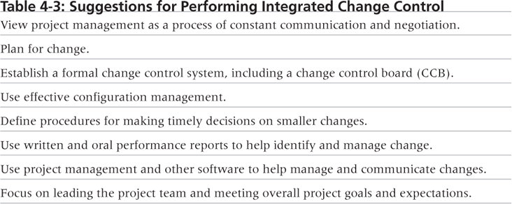
Table 4-3. Suggestions for Performing Integrated Change Control

Slide 49
Closing Projects or Phases
To close a project or phase, you must finalize all activities and transfer the completed or cancelled work to the appropriate people
Main outputs include
  Final product, service, or result transition
  Organizational process asset updates

Slide 50
Using Software to Assist in Project Integration Management
Several types of software can be used to assist in project integration management
  Documents can be created with word processing software
  Presentations are created with presentation software
  Tracking can be done with spreadsheets or databases
  Communication software like e-mail and Web authoring tools facilitate communications
  Project management software can pull everything together and show detailed and summarized information
  Business Service Management (BSM) tools track the execution of business process flows

Slide 51
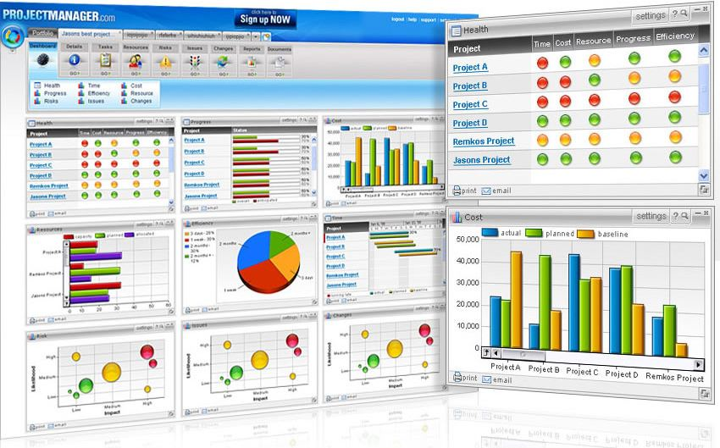
Figure 4-9. Sample Portfolio Management Software Screen
Source: www.projectmanager.com

Slide 52
Chapter Summary
Project integration management involves coordinating all of the other knowledge areas throughout a project’s life cycle
Main processes include
  Develop the project charter
  Develop the project management plan
  Direct and manage project execution
  Monitor and control project work
  Perform integrated change control
  Close the project or phase

