Slide 1
Project Risk Management

Slide 2
Learning Objectives
Understand what risk is and the importance of good project risk management.
Identify project risks, describe the risk identification process, tools and techniques to help identify project risks
Determine quantitative or qualitative value of project risks and prioritize them in a risk management plan
Propose plans to mitigate such risks, risk register
Monitor and control the risks
Manage projects by lowering internal and external risks

Slide 3
Learning Objectives (cont’d)
Explain the quantitative risk analysis process and how to apply decision trees, simulation, and sensitivity analysis to quantify risks.
Provide examples of using different risk response planning strategies to address both negative and positive risks.
Discuss what is involved in risk monitoring and control.
Describe how software can assist in project risk management.

Slide 4
The Importance of Project Risk Management
Project risk management is the art and science of identifying, analyzing, and responding to risk throughout the life of a project and in the best interests of meeting project objectives.
Risk management is often overlooked in projects, but it can help improve project success by helping select good projects, determining project scope, and developing realistic estimates.

Slide 5
Benefits from Software Risk Management Practices*
*Kulik, Peter and Catherine Weber, “Software Risk Management Practices – 2001,” KLCI Research Group (August 2001).

Slide 6
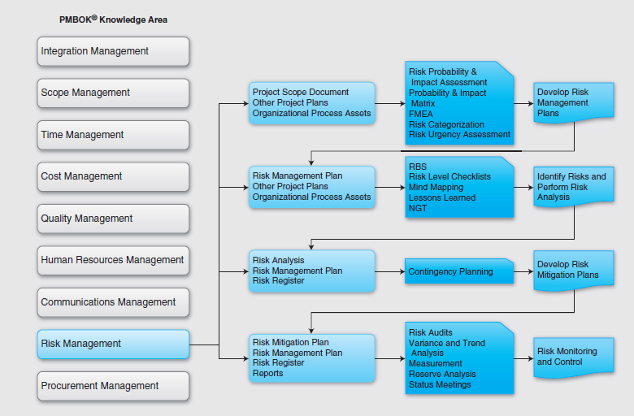
PMBOK MAPPING TO RISK MGMT

Slide 7
INTEGRATING RISK
PROJECT
MANAGEMENT
INTEGRATION
SCOPE
Life Cycle and
INFORMATION /
Environment Variables
COMMUNICATIONS
Expectations
Ideas, Directives,
Feasibility
Data Exchange Accuracy
Requirements
Standards
PROJECT
RISK
Availability
Productivity
HUMAN
QUALITY
RESOURCES
Time Objectives,
Services, Plant, Materials:
Restraints
Performance
TIME
Cost Objectives,
CONTRACT /
Restraints
PROCUREMENT
COST
Ref: Project and Program Risk Management, Wideman
Notes:
THIS FIGURE SHOWS HOW RISK MGT IS INEXTRICABLY TIED TO
THE REMAINING 7 PMBOK MANAGEMENT FUNCTIONS. NOTE
HOW SPECIFIC AREAS OF RISK ARE ASSOCIATED WITH EACH
OF THE INDIVIDUAL FUNCTIONS AS SHOWN ON THE DIAGRAM.
TALK TO THE VARIOUS FUNCTIONS AND GIVE EXAMPLES. <-NEXT PAGE
EXPERIENCE ON MANY PROJECTS REVEALS POOR PERFORMANCE
IN TERMS OF REACHING SCOPE, QUALITY, TIME, AND COST
OBJECTIVES. MANY OF THESE SHORTCOMINGS ARE
ATTRIBUTED EITHER TO UNFORESEEN EVENTS, WHICH MIGHT
OR MIGHT NOT HAVE BEEN ANTICIPATED BY MORE EXPERIENCED
PROJECT MANAGEMENT, OR TO FORESEEN EVENTS FOR
WHICH THE RISKS WERE NOT FULLY ACCOMMODATED.
** BETTER DECISIONS VIA RISK MGMT APPROACH VS. SEAT OF PANTS
ONE OF THE BIGGEST HURDLES IS THAT OF MANAGEMENT'S
ATTITUDE TO RISK ITSELF. SOME HAVE LITTLE UNDERSTANDING
OF THE CONCEPTS, WHILE OTHERS LACK CONFIDENCE IN
THE MATHEMATICAL TECHNIQUES AND RESULTS OBTAINED,
PREFERRING TO RELY ALTERNATIVELY ON AGGRESSIVE
RISK TAKING OR UNDUE CAUTION. OR AGAIN, INHERENT RISKS
MAY SIMPLY BE OPTIMISTICALLY IGNORED. IN REALITY, FAR
BETTER DECISIONS WITH HIGHER CHANCES OF PROJECT
SUCCESS ARE REACHED BY FACING THESE ISSUES.
1
2
3

Slide 8
PMBOK FIGURE
Project Risk Management (Page 1 of 3)
Risk Management Planning
Inputs
Project Charter
Organization’s risk management policies
Defined Roles and responsibilities
Stakeholder risk tolerances
Template for the organization’s plan
Work breakdown structure (WBS)
Tools & Techniques
Planning Meetings
Outputs
Risk management plan
Risk Identification
Inputs
Risk management plan
Project planning outputs
Risk categories
Historical information
Tools & Techniques
Documentation reviews
Information-gathering techniques
Checklists
Assumptions analysis
Diagramming techniques
Outputs
Risks
Triggers
Inputs to other processes
Notes:
THIS IS THE OUTLINE FOR RISK MANAGEMENT FROM THE CURRENT PMBOK (Page 128)
DO NOT NEED TO MEMORIZE THIS -- THIS IS HOW THE PMBOK STRUCTURES THE INFORMATION
NOTE: THERE IS A DIFFERENCE BETWEEN THE PMBOK METHOD FOR ORGANIZING IT AND THE RISK MANAGEMENT BOOK THAT PMI MAKES AVAILABLE.
I HAVE TRIED TO MARRY THE TWO TOGETHER AS BEST AS POSSIBLE, BECAUSE THE RISK MANAGEMENT BOOK IS A GOOD SINGLE SOURCE ON THIS TOPIC. FOR THE MOST PART, PHASES 1 & 2 ARE VERY SIMILAR BETWEEN THE TWO. PHASE 3 HAS A FEW MORE DIFFERENCES AND PHASE 4 ARE VERY DIFFERENT.
KEY POINT -- INFORMATION IS STILL VALID NO MATTER HOW IT IS ORGANIZED.

Slide 9
PMBOK FIGURE
Project Risk Management (Page 2 of 3)
Qualitative Risk Analysis
Inputs
Risk management plan
Identified risks
Project status
Project type
Data precision
Scales of probability and impact
Assumptions
Tools & Techniques
Risk probability and impact
Probability/impact risk rating matrix
Project assumptions testing
Outputs
Overall risk ranking for the project
List of prioritized risks
List of risks for additional analysis and management
Trends in qualitative risk analysis results
Quantitative Risk Analysis
Inputs
Risk management plan
Identified risks
List of prioritized risks
List of risks for additional analysis and management
Historical information
Expert judgement
Other planning outputs
Tools & Techniques
Interviewing
Sensitivity analysis
Decision tree analysis
Simulation
Outputs
Prioritized list of quantified risks
Probabilistic analysis of the project
Probability of achieving the cost and time objectives
Trends in quantitative risk analysis results
Notes:
THIS IS THE OUTLINE FOR RISK MANAGEMENT FROM THE CURRENT PMBOK (Page 128)
DO NOT NEED TO MEMORIZE THIS -- THIS IS HOW THE PMBOK STRUCTURES THE INFORMATION
NOTE: THERE IS A DIFFERENCE BETWEEN THE PMBOK METHOD FOR ORGANIZING IT AND THE RISK MANAGEMENT BOOK THAT PMI MAKES AVAILABLE.
I HAVE TRIED TO MARRY THE TWO TOGETHER AS BEST AS POSSIBLE, BECAUSE THE RISK MANAGEMENT BOOK IS A GOOD SINGLE SOURCE ON THIS TOPIC. FOR THE MOST PART, PHASES 1 & 2 ARE VERY SIMILAR BETWEEN THE TWO. PHASE 3 HAS A FEW MORE DIFFERENCES AND PHASE 4 ARE VERY DIFFERENT.
KEY POINT -- INFORMATION IS STILL VALID NO MATTER HOW IT IS ORGANIZED.

Slide 10
PMBOK FIGURE
Project Risk Management (Page 3 of 3)
Risk Response Planning
Inputs
Risk management plan
List of prioritized risks
Risk rankings of the project
Prioritized list of quantified risks
Probabilistic analysis of the project
Probability of achieving the cost and time objectives
List of potential responses
Risk thresholds
Risk owners
Common risk causes
Trends in qualitative and quantitative risk analysis results
Risk Response Planning (continued)
Tools & Techniques
Avoidance
Transference
Mitigation
Acceptance
Outputs
Risk response plan
Residual risks
Secondary risks
Contractual agreements
Contingency reserve amounts needed
Inputs to other processes
Inputs to a revised project plan
Risk Monitoring and Control
Inputs
Risk management plan
Risk response plan
Project communication
Additional risk identification and analysis
Tools & Techniques
Procurement
Contingency Planning
Alternative Strategies
Insurance
Outputs
Risk Management Plan
Inputs to other Processes
Contingency Plans
Reserves
Contractual Agreements
Notes:
THIS IS THE OUTLINE FOR RISK MANAGEMENT FROM THE CURRENT PMBOK (Page 128)
DO NOT NEED TO MEMORIZE THIS -- THIS IS HOW THE PMBOK STRUCTURES THE INFORMATION
NOTE: THERE IS A DIFFERENCE BETWEEN THE PMBOK METHOD FOR ORGANIZING IT AND THE RISK MANAGEMENT BOOK THAT PMI MAKES AVAILABLE.
I HAVE TRIED TO MARRY THE TWO TOGETHER AS BEST AS POSSIBLE, BECAUSE THE RISK MANAGEMENT BOOK IS A GOOD SINGLE SOURCE ON THIS TOPIC. FOR THE MOST PART, PHASES 1 & 2 ARE VERY SIMILAR BETWEEN THE TWO. PHASE 3 HAS A FEW MORE DIFFERENCES AND PHASE 4 ARE VERY DIFFERENT.
KEY POINT -- INFORMATION IS STILL VALID NO MATTER HOW IT IS ORGANIZED.

Slide 11
TYPICAL RISK ITEMS

Slide 12
TYPICAL RISK ITEMS (continued)

Slide 13
TYPICAL RISK ITEMS (continued)

Slide 14
Negative Risk
A dictionary definition of risk is “the possibility of loss or injury.”
Negative risk involves understanding potential problems that might occur in the project and how they might impede project success.
Negative risk management is like a form of insurance; it is an investment.

Slide 15
Risk Can Be Positive
Positive risks are risks that result in good things happening; sometimes called opportunities.
A general definition of project risk is an uncertainty that can have a negative or positive effect on meeting project objectives.
The goal of project risk management is to minimize potential negative risks while maximizing potential positive risks.

Slide 16
Risk Utility
Risk utility or risk tolerance is the amount of satisfaction or pleasure received from a potential payoff.
Utility rises at a decreasing rate for people who are risk-averse.
Those who are risk-seeking have a higher tolerance for risk and their satisfaction increases when more payoff is at stake.
The risk-neutral approach achieves a balance between risk and payoff.

Slide 17
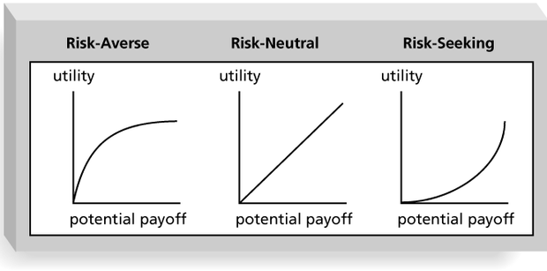
Risk Utility Function and Risk Preference

Slide 18
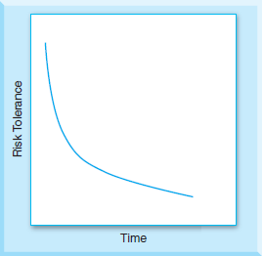
Specific to firms
Upper management must ensure that project managers understand their project’s role within the context of organizational risk.
Because organizations have limited resources and many projects competing for these scarce resources, they ask project managers not to be overly optimistic in their estimates and forecasts.
Bad decisions can lead to risks that result in project delays, late finish dates, budget overruns, and unmet project goals.

Slide 19
Specific to project managers
A lack of understanding of risk on the part of management or a project manager’s wrong perceptions of management’s understanding of risks can lead to serious problems in projects.
Project managers may feel that by exposing risks they themselves may be at risk and that management may suggest more control of the risks than necessary.
A project manager’s risk tolerance depends heavily on the visibility of a project.
A project manager may accept more risk if a project is highly visible as success will bring rewards.
If the project is small and not that visible, taking risks may not be lucrative, and PMs may take fewer risks.

Slide 20
Specific to project managers
Identifying and assessing risks will compel project managers to make better decisions.
While it is great to have a timeline and an agreed-upon date, risk management means that the project manager and upper management need to have realistic expectations of the people who will be doing the work.

Slide 21
Specific to stakeholders
When a client and contractor lay out project goals, risk tolerances of both the client and the customer have to be defined.
Identified risks enable stakeholders of a firm to manage issues accordingly and be ready to exploit opportunities.
If a stakeholder possesses some information and does not share it with a project manager, the performance of the project will suffer as there may be risks associated with their actions.

Slide 22
Project Risk Management Processes
Risk management planning: Deciding how to approach and plan the risk management activities for the project.
Risk identification: Determining which risks are likely to affect a project and documenting the characteristics of each.
Qualitative risk analysis: Prioritizing risks based on their probability and impact of occurrence.

Slide 23
Project Risk Management Processes (cont’d)
Quantitative risk analysis: Numerically estimating the effects of risks on project objectives.
Risk response planning: Taking steps to enhance opportunities and reduce threats to meeting project objectives.
Risk monitoring and control: Monitoring identified and residual risks, identifying new risks, carrying out risk response plans, and evaluating the effectiveness of risk strategies throughout the life of the project.

Slide 24
Risk Management Planning
The main output of risk management planning is a risk management plan—a plan that documents the procedures for managing risk throughout a project.
The project team should review project documents and understand the organization’s and the sponsor’s approaches to risk.
The level of detail will vary with the needs of the project.

Slide 25
Topics Addressed in a Risk Management Plan
Methodology
Roles and responsibilities
Budget and schedule
Risk categories
Risk probability and impact
Risk documentation

Slide 26
Contingency and Fallback Plans, Contingency Reserves
Contingency plans are predefined actions that the project team will take if an identified risk event occurs.
Fallback plans are developed for risks that have a high impact on meeting project objectives, and are put into effect if attempts to reduce the risk are not effective.
Contingency reserves or allowances are provisions held by the project sponsor or organization to reduce the risk of cost or schedule overruns to an acceptable level.

Slide 27
Broad Categories of Risk
Market risk
Financial risk
Technology risk
People risk
Structure/process risk

