Slide 1
Project Cost Management
Chapter nine resource, Cost, control

Slide 2
Learning Objectives
Manage cost in projects
Plan and allocate resources in a project
Estimate costs and how to budget
Measure resources, schedule, and cost
Identify and measure cost variances and earned value management
Monitor and control projects
Learn how to control project performance factors

Slide 3
Learning Objectives
Understand the importance of project cost management
Explain basic project cost management principles, concepts, and terms
Describe the process of planning cost management
Discuss different types of cost estimates and methods for preparing them
Understand the benefits of earned value management and project portfolio management to assist in cost control
Describe how project management software can assist in project cost management

Slide 4
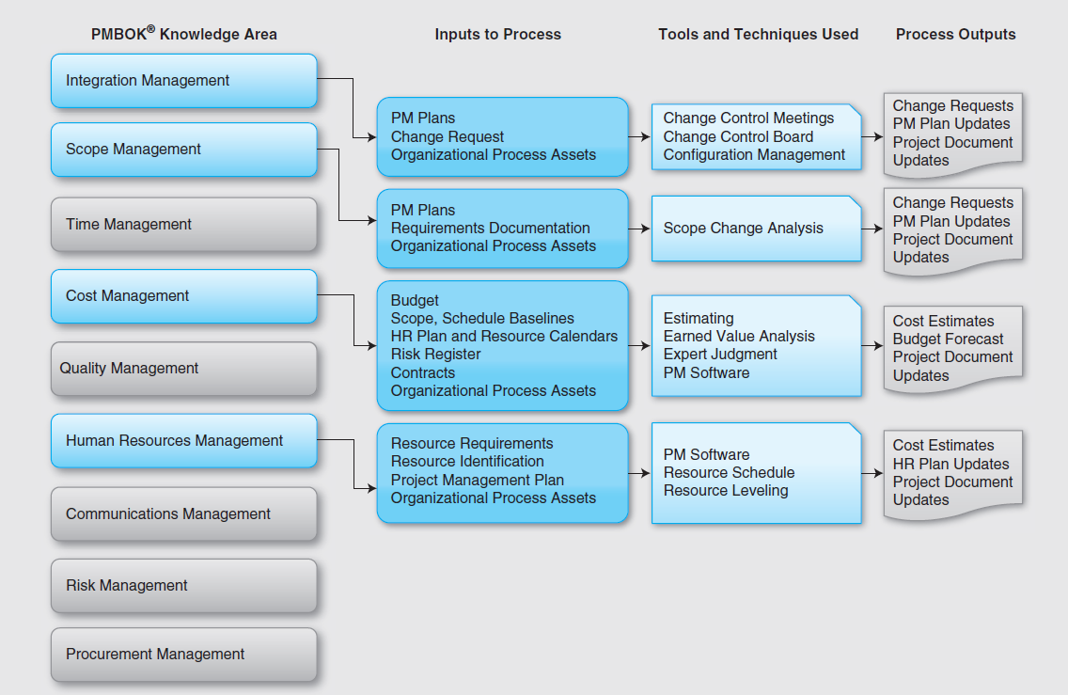
PMBOK Mapping to Cost Management

Slide 5
Importance of Cost Management
IT projects have a poor track record for meeting budget goals
The CHAOS studies found the average cost overrun (the additional percentage or dollar amount by which actual costs exceed estimates) ranged from 180 percent in 1994 to 43 percent in 2010
A 2011 Harvard Business Review study reported an average cost overrun of 27 percent. The most important finding was the discovery of a large number of gigantic overages or “black swans”

Slide 6
What Went Wrong?
The U.S. government, especially the IRS, continues to provide examples of how not to manage costs
A series of project failures by the IRS in the 1990s cost taxpayers more than $50 billion a year
In 2006, the IRS was in the news for a botched upgrade to its fraud-detection software, costing $318 million in fraudulent refunds that didn’t get caught
A 2008 Government Accountability Office (GAO) report stated that more than 400 U.S. government agency IT projects, worth an estimated $25 billion, suffer from poor planning and underperformance
The United Kingdom’s National Health Service IT modernization program was called the greatest IT disaster in history with an estimated $26 billion overrun. It was finally scrapped in 2011.

Slide 7
What is Cost and Project Cost Management?
Cost is a resource sacrificed or foregone to achieve a specific objective or something given up in exchange
Costs are usually measured in monetary units like dollars
Project cost management includes the processes required to ensure that the project is completed within an approve budget

Slide 8
Project Cost Management Processes
Planning cost management :determining the policies, procedures, and documentation that will be used for planning, executing, and controlling project cost.
Estimating costs: developing an approximation or estimate of the costs of the resources needed to complete a project
Determining the budget: allocating the overall cost estimate to individual work items to establish a baseline for measuring performance
Controlling costs: controlling changes to the project budget

Slide 9
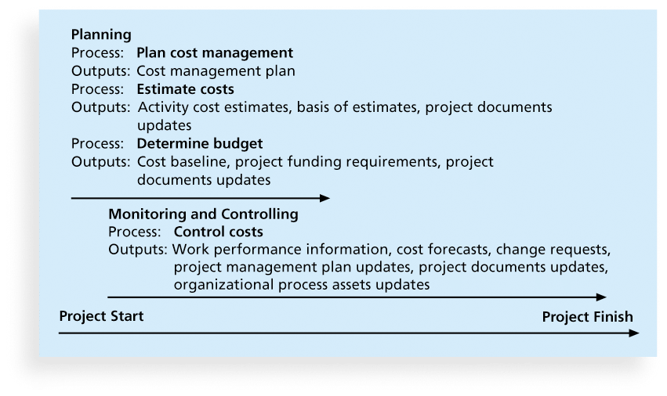
Project Cost Management Summary

Slide 10
Basic Principles of Cost Management
Most members of an executive board better understand and are more interested in financial terms than IT/project terms , so IT project managers must speak their language
Profits are revenues minus expenditures
Profit margin is the ratio of revenues to profits
Life cycle costing considers the total cost of ownership, or development plus support costs, for a project
Cash flow analysis determines the estimated annual costs and benefits for a project and the resulting annual cash flow

Slide 11
Monitoring and Controlling Projects
Monitoring and controlling of project work encompasses a process of tracking, reviewing, and regulating the progress of a project to meet the performance objectives defined in the project management plan.
Projects benefit only from a properly conceived and implemented project controls strategy.
Controls are essential in managing projects to success. and if proper controls are in place and if the dynamics of the project escalation process are understood, project managers and executives can learn to avoid failure.
Monitoring a project includes collecting, measuring, and distributing important information that is accomplished throughout the length of a project.

Slide 12
Monitoring and Controlling Projects Continued
The monitoring and controlling of a project are associated with the following:
Comparing actual project factors such as scope, cost, schedule, resources, performance, and values against the project management plan
Identifying new risks
Analyzing, tracking, monitoring, and managing already identified risks as well as newly identified risks
Making sure that appropriate risk mitigation plans are being executed

Slide 13
Monitoring and Controlling Projects Continued
Assessing project performance and implementing corrective and preventive actions as necessary
Providing information to project plans using the inputs from project teams and other stakeholders
Forecasting to update current costs, resource allocations, and schedules
Monitoring implementation of approved changes as they occur

Slide 14
Integrated change control
Integrated change control focuses on identifying the factors that influence the proposed changes, evaluating such influences, and managing the changes in real time during project implementation.
To accomplish integrated change control, the inputs are project management plan, work performance information, change requests, environmental factors, and organizational process assets.
Work performance information is essential to the project management plan and includes the following:
Progress of projects or status of projects
Progress of project deliverables or status of project deliverables
Start status and completed status of project activities
Budgeted costs versus actual incurred costs
Resource utilization details

Slide 15
Integrated change control continued
The integrated change control process includes reviewing all change requests, approving or denying changes, and controlling the approved changes throughout the project lifespan.
The change management activities in a project are part of the integrated change control process.
When a change request is received, the following steps have to be accomplished:
The requested change needs to be identified within the project.
The factors that are affected by the change have to be identified.

Slide 16
Benefits of Integrated change control
The benefits of such a change have to be evaluated.
The criticality of the change has to be determined.
The impact of the change with respect to the six success factors has to be evaluated.
All alternative solutions including crashing, fast tracking, and critical chain project management have to be analyzed and evaluated.
The change must be communicated to key management, customers, and other stakeholders for their approval.

Slide 17
Configuration Management
Configuration management is the process of managing change in hardware, software, documentation, and measurements.
Focuses on identifying and controlling the functional and physical design of systems and products along with their supporting documentation.
It also helps to capture the revision history of the configuration item, which is the goal of baseline identification.
A baseline depicts an approved configuration item
For example, an approved scope document in its initial state that is used as a basis for comparison against future revisions of the scope document

Slide 18
Cost Managment
Cost is a resource expended to achieve a specific objective, in our case, a project.
Cost management in projects is the process by which companies control and plan the costs of implementing projects.
Before a project is started, the anticipated costs should be identified.
These costs should then be evaluated and approved before any procurement.
During the implementation of a project, all costs should be recorded, tracked and monitored to control the costs and kept in line with initial expectations.

Slide 19
Cost of Downtime for IT Applications
Source: The Standish Group International, “Trends in IT Value,” www.standishgroup.com (2008).

Slide 20
What Went Right?
Many organizations use IT to reduce operational costs
Technology has decreased the costs associated with processing an ATM transaction:
In 1968, the average cost was $5.
In 1978, the cost went down to $1.50
In 1988, the cost was just a nickel.
In 1998, it only cost a penny.
In 2008, the cost was just half a penny!
Investing in green IT and other initiatives has helped both the environment and companies’ bottom lines. Michael Dell, CEO of Dell, reached his goal to make his company “carbon neutral” in 2008. As of March 2012, Dell had helped its customers save almost $7 billion in energy costs

Slide 21
Types of Costs and Benefits
Tangible costs or benefits are those costs or benefits that an organization can easily measure in dollars
Intangible costs or benefits are costs or benefits that are difficult to measure in monetary terms
Direct costs are costs that can be directly related to producing the products and services of the project
Indirect costs are costs that are not directly related to the products or services of the project, but are indirectly related to performing the project
Sunk cost is money that has been spent in the past; when deciding what projects to invest in or continue, you should not include sunk costs

Slide 22
More Basic Principles of Cost Management
Learning curve theory states that when many items are produced repetitively, the unit cost of those items decreases in a regular pattern as more units are produced
Reserves are dollars included in a cost estimate to mitigate cost risk by allowing for future situations that are difficult to predict
Contingency reserves allow for future situations that may be partially planned for (sometimes called known unknowns) and are included in the project cost baseline
Management reserves allow for future situations that are unpredictable (sometimes called unknown unknowns ).

Slide 23
Estimating Costs
Project managers must take cost estimates seriously if they want to complete projects within budget constraints
It’s important to know the types of cost estimates, how to prepare cost estimates, and typical problems associated with IT cost estimates

Slide 24
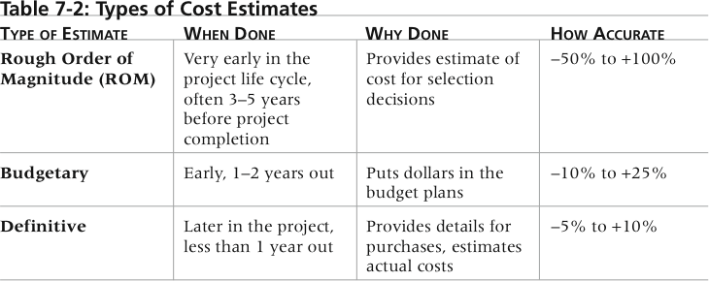
Types of Cost Estimates

Slide 25
More on Cost Estimates
The number and type of cost estimates vary by application area. The Association for the Advancement of Cost Engineering International identifies five types of cost estimates for construction projects: order of magnitude, conceptual, preliminary, definitive, and control
Estimates are usually done at various stages of a project and should become more accurate as time progresses
A large percentage of total project costs are often labor costs

Slide 26
Cost Estimation Tools and Techniques
Basic tools and techniques for cost estimates:
Analogous or top-down estimates: use the actual cost of a previous, similar project as the basis for estimating the cost of the current project
Bottom-up estimates: involve estimating individual work items or activities and summing them to get a project total
Parametric modeling uses project characteristics (parameters) in a mathematical model to estimate project costs

Slide 27
Typical Problems with IT Cost Estimates
Estimates are done too quickly
People lack estimating experience
Human beings are biased toward underestimation
Management desires accuracy

Slide 28
Cost Estimation
Budgetary rough order of magnitude estimate (BROME)
Approximate historical estimate (AHE);
Definitive estimate (DE)

Slide 29
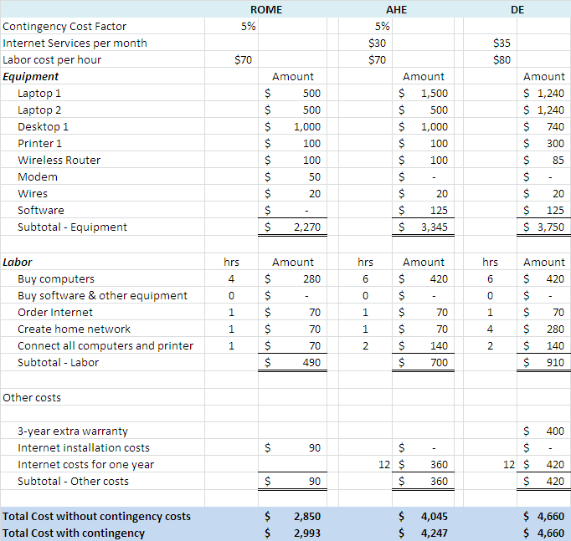
Cost Estimation

Slide 30
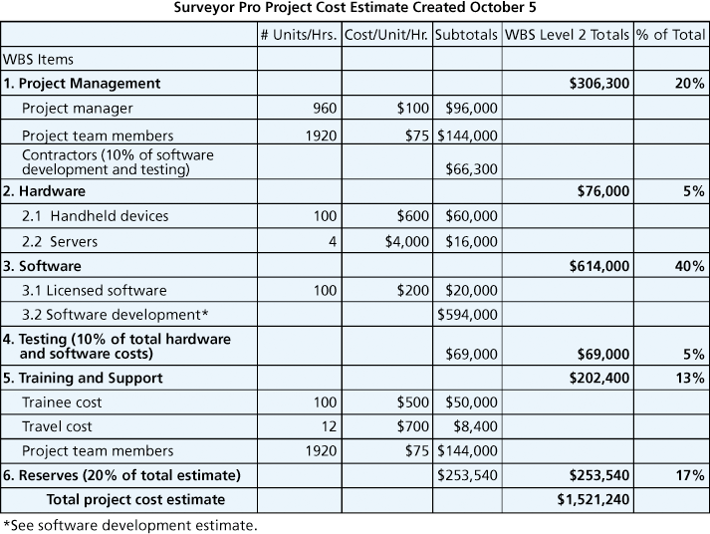
Surveyor Pro Project Cost Estimate

Slide 31
Cost Management Process
Costs are estimated using resource planning.
The estimated costs are budgeted by an organization, and the project manager controls the budget.
A project that stays within budget is usually an exception, not the rule.
A project manager has to control schedule, performance, scope, value, and resources in order to control the costs.

Slide 32
Typical Problems with Cost Estimating
Estimates are done too quickly
People lack estimating experience
Human beings are biased toward underestimation
Management desires accuracy

Slide 33
Determining the Cost Budget
Cost budgeting involves allocating the project cost estimate to individual work items over time
The WBS is a required input to the cost budgeting process since it defines the work items
Important goal is to produce a cost baseline
a time-phased budget that project managers use to measure and monitor cost performance

Slide 34
Controlling Costs
Project cost control includes
Monitoring cost performance
Ensuring that only appropriate project changes are included in a revised cost baseline
Informing project stakeholders of authorized changes to the project that will affect costs
Many organizations around the globe have problems with cost control

Slide 35
Earned Value Management (EVM)
EVM is a project performance measurement technique that integrates scope, time, and cost data
Given a baseline (original plan plus approved changes), you can determine how well the project is meeting its goals
You must enter actual information periodically to use EVM
More and more organizations around the world are using EVM to help control project costs

Slide 36
Earned Value Management Terms
The planned value (PV), formerly called the budgeted cost of work scheduled (BCWS), also called the budget, is that portion of the approved total cost estimate planned to be spent on an activity during a given period
Actual cost (AC), formerly called actual cost of work performed (ACWP), is the total of direct and indirect costs incurred in accomplishing work on an activity during a given period
The earned value (EV), formerly called the budgeted cost of work performed (BCWP), is an estimate of the value of the physical work actually completed
EV is based on the original planned costs for the project or activity and the rate at which the team is completing work on the project or activity to date

Slide 37
Earned Value Management Terms
Actual Cost (AC): Actual amount spent in completing the work accomplished within a given time period
Cost Variance (CV): The cost variance compares deviations only from the budget and does not include schedule into account
Schedule Variance (SV): The schedule variance compares deviations only from the schedule and does not include cost into account
Cost Performance Index (CPI): Ratio of earned value to actual cost; if CPI>1 , project under budget
Schedule Performance Index (SPI): Ratio of earned value to planned value; if SPI >1, then project behind schedule

Slide 38
EV Equations
Earned Value | Earned Value Equation
PV: Planned Value | Planned completion % * Budget at completion
EV: Earned Value | Actual completion % * Budget at Completion
AC: Actual Value | Actual costs
CV: Cost Variance | EV – AC
SV: Schedule Variance | EV – PV
CPI: Cost Performance Index | EV / AC
SPI: Schedule Performance Index | EV / PV
EAC: Estimate at Completion | (AC/EV) * Budget at completion
ETC: Estimate to Complete | EAC – AC
VAC: Variance at Completion | Budget at Completion – EAC

Slide 39
Rate of Performance
Rate of performance (RP) is the ratio of actual work completed to the percentage of work planned to have been completed at any given time during the life of the project or activity
Brenda Taylor, Senior Project Manager in South Africa, suggests this term and approach for estimating earned value
For example, suppose the server installation was halfway completed by the end of week 1. The rate of performance would be 50% because by the end of week 1, the planned schedule reflects that the task should be 100 percent complete and only 50 percent of that work has been completed

Slide 40
Variances
Question on project | What should be used?
How much work is planned? | PV
How much work is done already? | EV
How much have we spent so far? | AC
What is the total cost of the project? | BAC
What do we expect project cost to be now? | EAC
What is the estimate to complete the project? | ETC
What is the future of this project? | VAC

Slide 41
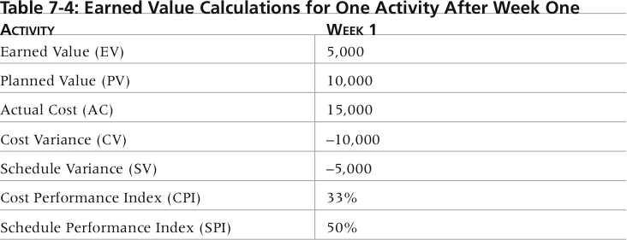
Earned Value Calculations for One Activity After Week One

Slide 42
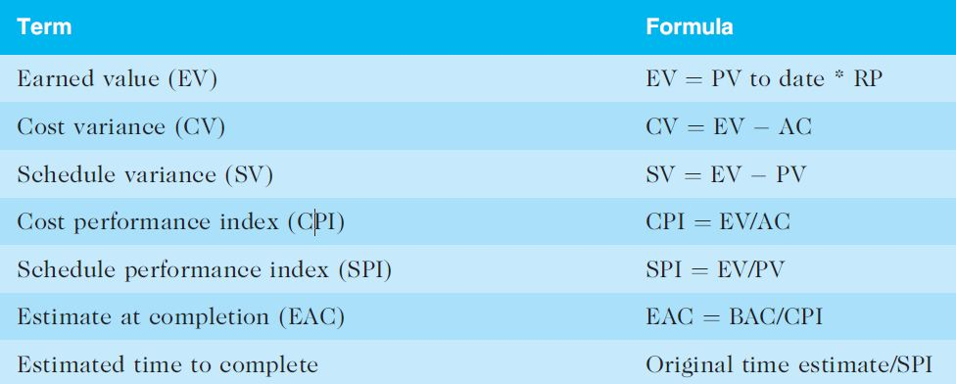
Earned Value Formulas

Slide 43
Rules of Thumb for Earned Value Numbers
Negative numbers for cost and schedule variance indicate problems in those areas
CPI and SPI less than 100% indicate problems
Problems mean the project is costing more than planned (over budget) or taking longer than planned (behind schedule)
The CPI can be used to calculate the estimate at completion (EAC)—an estimate of what it will cost to complete the project based on performance to date. The budget at completion (BAC) is the original total budget for the project

Slide 44
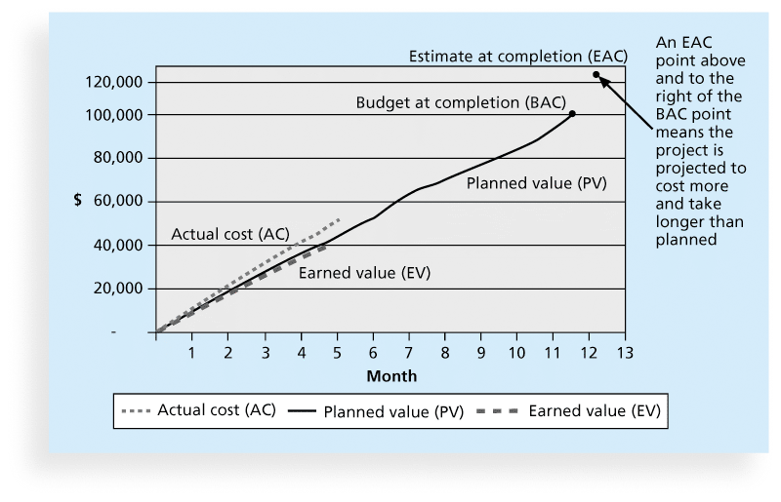
Earned Value Chart for Project after Five Months

Slide 45
Global Issues
EVM is used worldwide, and it is particularly popular in the Middle East, South Asia, Canada, and Europe
Most countries require EVM for large defense or government projects, as shown in Figure 7-6
EVM is also used in such private-industry sectors as IT, construction, energy, and manufacturing.
However, most private companies have not yet applied EVM to their projects because management does not require it, feeling it is too complex and not cost effective

Slide 46
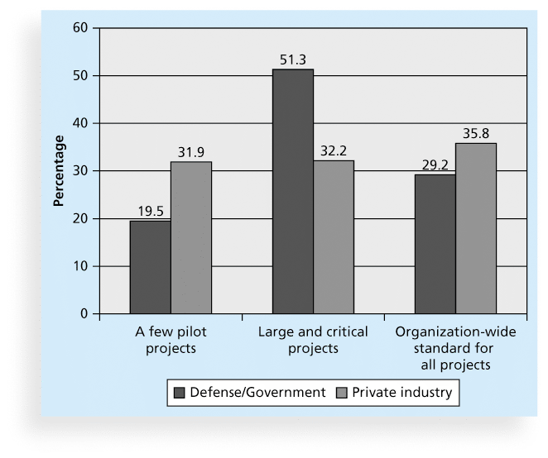
Earned Value Usage

