Slide 1
Portfolio Management and Resource Leveling
Chapter nine

Slide 2
Project Portfolio Management
Many organizations collect and control an entire suite of projects or investments as one set of interrelated activities in a portfolio
Five levels for project portfolio management
Put all your projects in one database
Prioritize the projects in your database
Divide your projects into two or three budgets based on type of investment
Automate the repository
Apply modern portfolio theory, including risk-return tools that map project risk on a curve

Slide 3
Benefits of Portfolio Management
Schlumberger saved $3 million in one year by organizing 120 information technology projects into a portfolio
ROI of implementing portfolio management software by IT departments:
Savings of 6.5 percent of the average annual IT budget by the end of year one
Improved annual average project timeliness by 45.2 percent
Reduced IT management time spent on project status reporting by 43 percent and IT labor capitalization reporting by 55 percent
Decreased the time to achieve financial sign-off for new IT projects by 20.4 percent, or 8.4 days

Slide 4
Best Practice
A global survey released by Borland Software in 2006 suggests that many organizations are still at a low-level of maturity in terms of how they define project goals, allocate resources, and measure overall success of their information technology portfolios. Some of the findings include the following:
Only 22 percent of survey respondents reported that their organization either effectively or very effectively uses a project plan for managing projects
Only 17 percent have either rigorous or very rigorous processes for project plans, which include developing a baseline and estimating schedule, cost, and business impact of projects
Only 20 percent agreed their organizations monitor portfolio progress and coordinate across inter-dependent projects

Slide 5
Using Software to Assist in Cost Management
Spreadsheets are a common tool for resource planning, cost estimating, cost budgeting, and cost control
Many companies use more sophisticated and centralized financial applications software for cost information
Project management software has many cost-related features, especially enterprise PM software
Portfolio management software can help reduce costs

Slide 6
Resource Planning
The planning of the resources used to execute the project
To accomplish resource planning:
List the required resource
Quantify the required resource
Construct a resource schedule, and
Level the resources

Slide 7
List Resources
List all required resources based on WBS. Each task listed in WBS demands particular skills or knowledge. Based on this information, resources can be identified and listed.
Labor: Identify all the roles involved in undertaking the project, including all full-time, part-time and contracting roles.
Equipment: Identify all of the equipment involved in undertaking the project. For example, equipment may include personal computers, photocopiers, mobile phones, telecommunications equipment such as switches, routers and machinery, for example, heavy and light machinery.
Materials: Identify all non-consumable materials to complete project activities such as office materials and materials required for construction including lumber, steel and concrete.

Slide 8
Quantify Resources
All identified resources are subject to some specification. This next step is to describe such specifications of each resource.
Labor: List skills and experiences required by all roles and quantify how many of such resources are needed.
Equipment: List the specification of all equipment, the total quantity needed, and dates of requirement.
Materials: List the specification of all required materials and the total quantity.

Slide 9
Construct schedule
Resources required to complete the project
Timeframes for the consumption of each resource
Quantity of each resource required per week
Total quantity of resource consumed per week

Slide 10
Resource Schedule
Table 12-2. Equipment and Materials Resource Schedule
Activity | Description | Required resources | Required resources | Timeframe | Requirements per week | Quantity consumed per week
A | Scope documentation | Bob | PC, MS Office, Printer | 11/10/10 to 11/15/10 | 40 hrs
 |  | Dan | PC, MS Office, Printer | 11/12/10 to 11/23/10 | 40 hrs
B | Project planning | Ed | PC, MS Office, MS Project, Printer | 11/24/10 to 12/14/10 | 40 hrs
 |  | Frank | PC, MS Office, MS Project, Printer | 11/24/10 to 12/14/10 | 40 hrs
C | Buy materials | Gary | Wood, Nails & Screws | 12/15/10 to 2/8/11 | 40 hrs
D | Prototype design | Ian | PC, AutoCad | 12/15/10 to ¼/11 | 40 hrs
 |  | Jake | PC, AutoCad | 12/15/10 to ¼/11 | 40 hrs
 |  | Katie | PC, AutoCad | 12/15/10 to ¼/11 | 40 hrs
E | Prototype analysis | Linda | PC, FEA software | 1/5/11 to 2/15/11 | 40 hrs
 |  | Mary | PC, FEA software | 1/5/11 to 2/15/11 | 40 hrs
F | Prototype implementation | Linda | Wood, Nails & Screws | 2/16/11 to 3/22/11 | 40 hrs | Wood: 300 ft Fasteners: 100 Glue: 5 lbs.
 |  | Mary | Wood, Nails & Screws | 2/16/11 to 3/22/11 | 40 hrs | Wood: 300 ft Fasteners: 100
G | Testing of prototype | Nancy | Tester | 3/23/11 to 4/19/11 | 40 hrs
 |  | Oliver | Tester | 3/23/11 to 4/19/11 | 40 hrs
H | Presenting prototype to customer | Pam | PC, MS PowerPoint | 4/20/11 to 5/3/11 | 40 hrs

Slide 11
Resource Leveling
When the project is large and contains many resource over-allocations, resource leveling must be accomplished.
Purpose is to create a smoother distribution of resource usage.
Leveling is done by delaying or splitting tasks until the resources assigned to them are no longer over-allocated.
Before the leveling is attempted, schedule must be refined
by adding more resources
by deciding and allocating over-time policies for certain individuals
by splitting the tasks with others who are under-allocated
Leveling extends the project time.

Slide 12
Resource Leveling
Resource leveling aims to minimize the period-by-period variations in resource loading by shifting tasks within their slack allowances.
Resource leveling is accomplished by heuristics or “rule of thumb”.
A resource-leveling heuristic is a method to flatten the schedule when resources are over-allocated. The general idea is to prevent team members not overextended on activities.

Slide 13
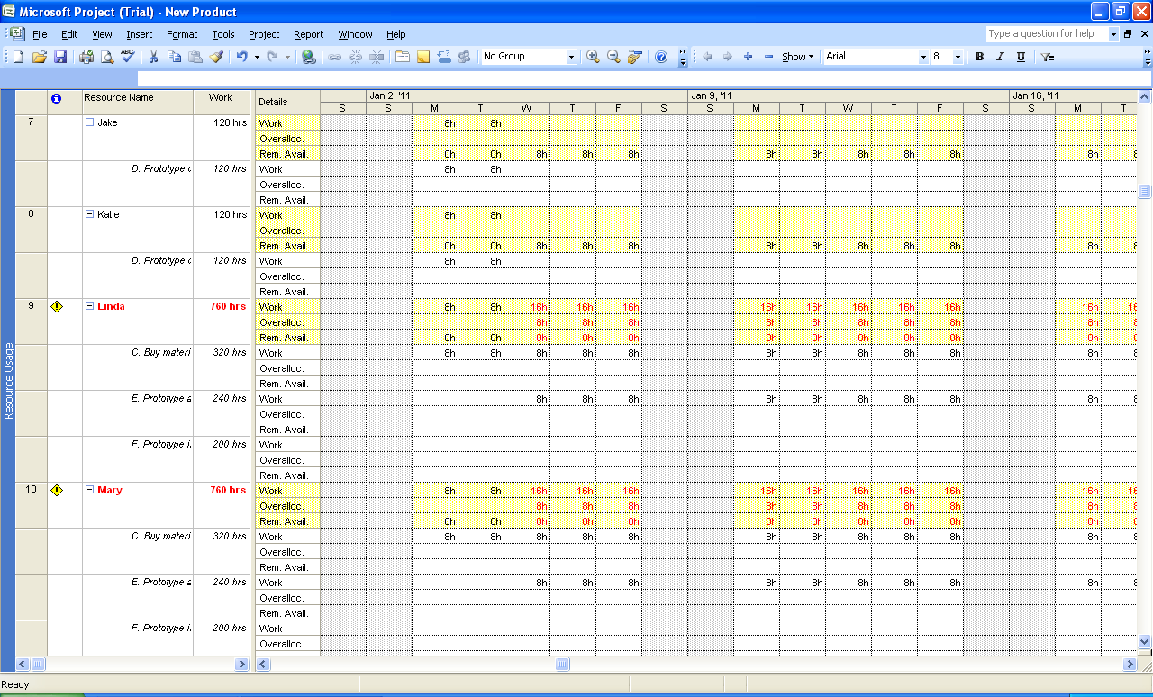
Resource Leveling
Resource Leveling

Slide 14
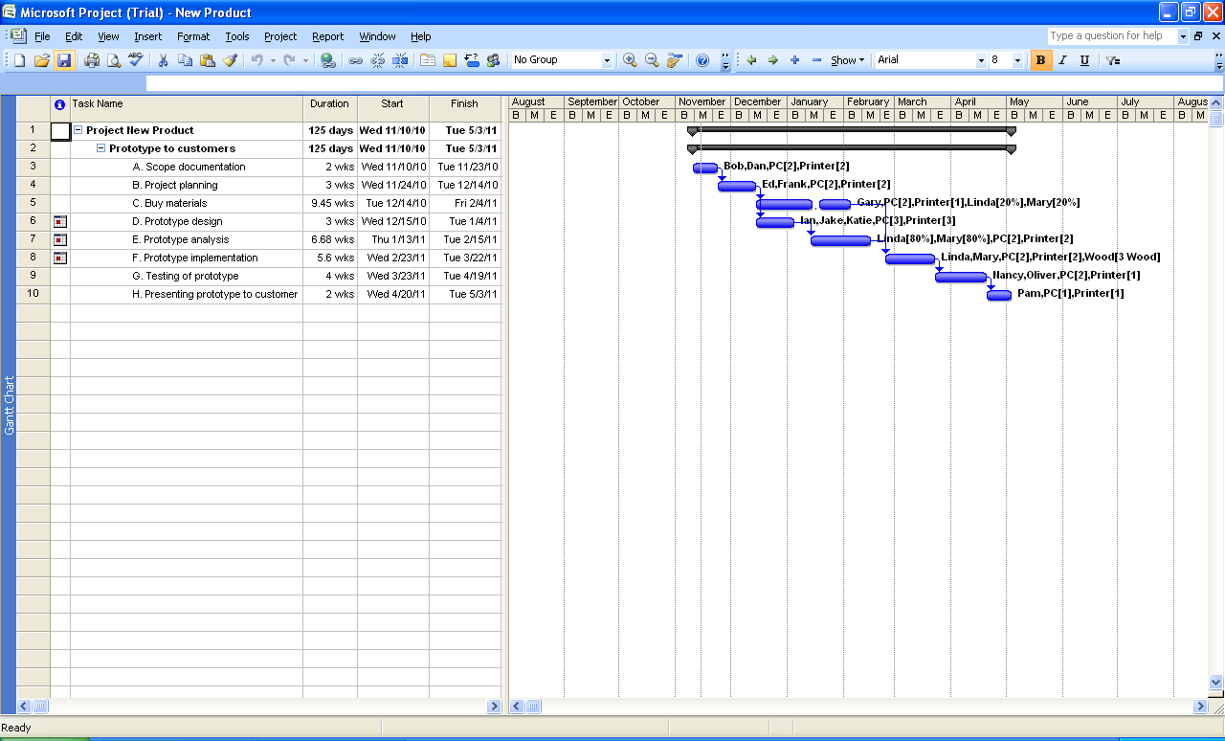
Resource Leveling
Resource Leveling

Slide 15
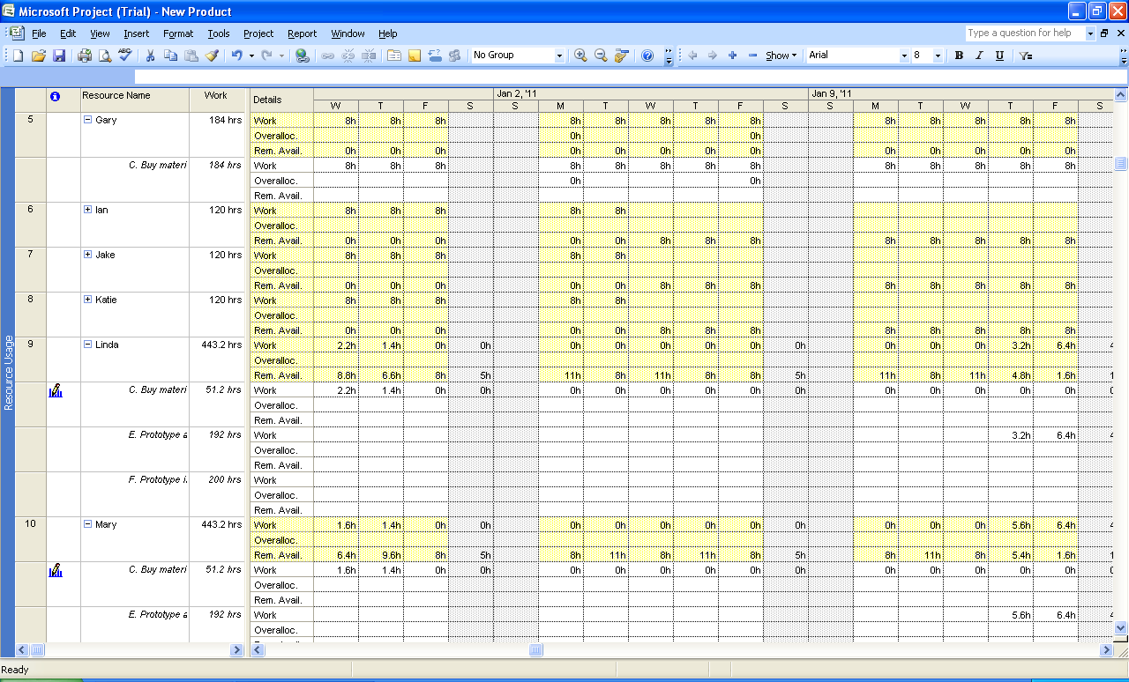
Resource Leveling
Resource Leveling

