Slide 1
Project Schedule (TIME) Managment
Chapter Eight

Slide 2
Learning Objectives
Understand the importance of project schedules and good project time management
Discuss the process of planning schedule management
Define activities as the basis for developing project schedules
Describe how project managers use network diagrams and dependencies to assist in activity sequencing
Understand the relationship between estimating resources and project schedules
Explain how various tools and techniques help project managers perform activity duration estimates

Slide 3
Learning Objectives continued
Schedule projects
Construct project networks
Identify slack in projects
Crash projects
Fast-track projects

Slide 4
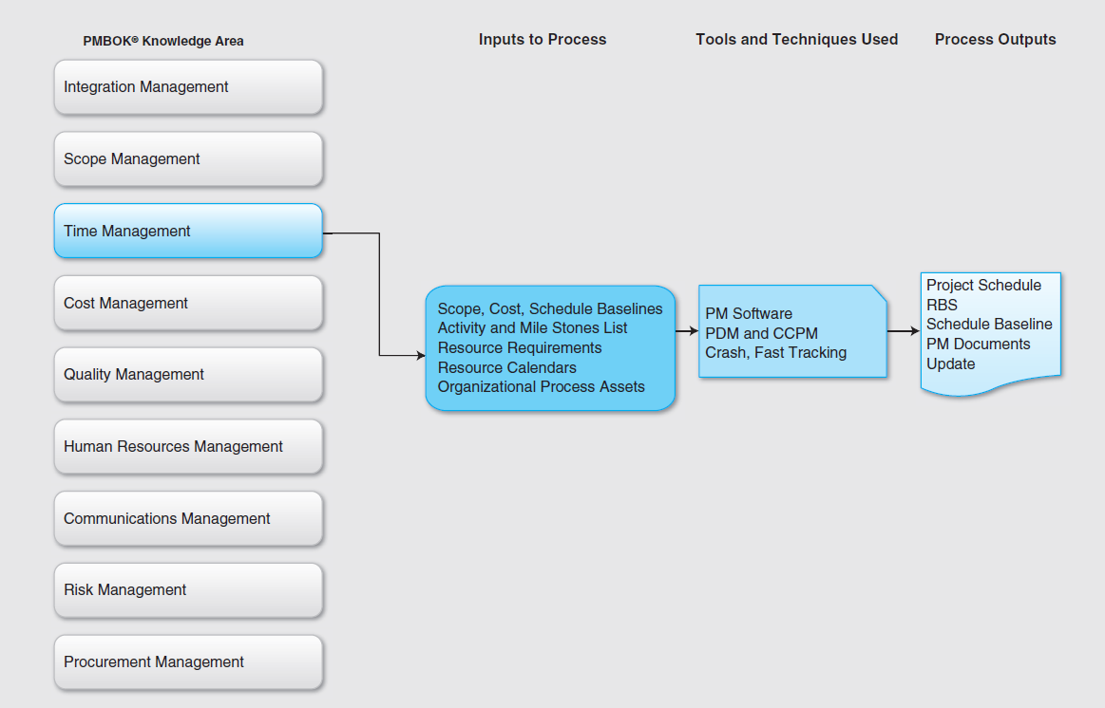
PMBOK Knowledge Mapping

Slide 5
Importance of Project Schedules
Managers often cite delivering projects on time as one of their biggest challenges
Time has the least amount of flexibility; it passes no matter what happens on a project
Schedule issues are the main reason for conflicts on projects, especially during the second half of projects

Slide 6
Individual Work Styles and Cultural Differences Cause Schedule Conflicts
One dimension of the Meyers-Briggs Type Indicator focuses on peoples’ attitudes toward structure and deadline
Some people prefer to follow schedules and meet deadlines while others do not (J vs. P)
Difference cultures and even entire countries have different attitudes about schedules

Slide 7
Scheduling
Scheduling is a plan to implement a project using an ordered sequence of activities with time allotted for each activity.
A project schedule is the delivery of a project scope.
Scheduling is a plan to implement a project using an ordered sequence of activities with time allotted for each activity.
In order to complete the schedule, a project manager should have access to:
  WBS, the project plans, the project charter, the project scope, a list of all available resources, the process assets of the organization, and the requirements for the project

Slide 8
Scheduling Continued
Scheduling is a very important facet of project management as it helps a project manager complete the project within scope, time, and budget as well as use the available resources effectively in order to perform and provide value to the organization.
Scheduling helps a project manager break down a complex project into simple activities.
Project manager has to input these simple activities in the right order along with the likely amount of time and resources needed to complete each activity. All such inputs have to be error-free for a project to be completed in time, under budget, and within the scope.

Slide 9
Order Activity
The order in which these activities have to be completed, i.e., the predecessors and successors of each activity, has to be determined.
Some of these activities may be completed in parallel and others in series. For example, two activities such as coding and testing can be accomplished only in series, i.e., testing can be started only after coding.
Scheduling helps a project manager overlap several activities by different members of the project team to complete the overall project in the shortest period of time possible.

Slide 10
Scheduling Questions
A project manager can use the schedule to manage the project effectively. The goal of an effective project schedule is to answer the following questions:
  What activities will be accomplished?
  What is the sequence of those activities?
  When will those activities be accomplished?
  Who will accomplish those activities?

Slide 11
Scheduling Benefits
The network provides many benefits to a project including:
  An estimate of project completion time
  An overview of how resources will be utilized in the project
  All activities that must be critical to meet the schedule
  A graphical representation of work to be performed
  The progress that can be used to track the project
  An estimation of time and cost at any point of a project
  The start and end times of all activities in a project
  All resource conflicts and which activities are to be coordinated in order to avoid such conflicts
  The interdependence of the activities of a project
  Project milestones

Slide 12
Project Time Management Processes
Planning schedule management: determining the policies, procedures, and documentation that will be used for planning, executing, and controlling the project schedule
Defining activities: identifying the specific activities that the project team members and stakeholders must perform to produce the project deliverables
Sequencing activities: identifying and documenting the relationships between project activities
Estimating activity resources: estimating how many resources a project team should use to perform project activities
Estimating activity durations: estimating the number of work periods that are needed to complete individual activities
Developing the schedule: analyzing activity sequences, activity resource estimates, and activity duration estimates to create the project schedule
Controlling the schedule: controlling and managing changes to the project schedule

Slide 13
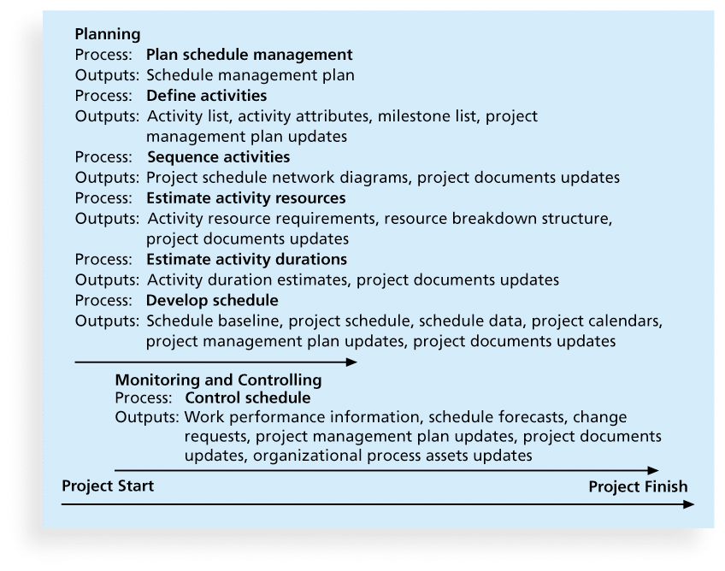
Project Time Management Summary

Slide 14
Planning Schedule Management
The project team uses expert judgment, analytical techniques, and meetings to develop the schedule management plan
A schedule management plan includes:
  Project schedule model development
  The scheduling methodology
  Level of accuracy and units of measure
  Control thresholds
  Rules of performance measurement
  Reporting formats
  Process descriptions

Slide 15
Defining Activities
An activity or task is an element of work normally found on the work breakdown structure (WBS) that has an expected duration, a cost, and resource requirements
Activity definition involves developing a more detailed WBS and supporting explanations to understand all the work to be done so you can develop realistic cost and duration estimates

Slide 16
Activity Lists and Attributes
An activity list is a tabulation of activities to be included on a project schedule that includes
  the activity name
  an activity identifier or number
  a brief description of the activity
Activity attributes provide more information such as predecessors, successors, logical relationships, leads and lags, resource requirements, constraints, imposed dates, and assumptions related to the activity

Slide 17
Milestones
A milestone is a significant event that normally has no duration
It often takes several activities and a lot of work to complete a milestone
They’re useful tools for setting schedule goals and monitoring progress
Examples include obtaining customer sign-off on key documents or completion of specific products

Slide 18
Sequencing Activities
Involves reviewing activities and determining dependencies
A dependency or relationship is the sequencing of project activities or tasks
You must determine dependencies in order to use critical path analysis

Slide 19
Three types of Dependencies
Mandatory dependencies: inherent in the nature of the work being performed on a project, sometimes referred to as hard logic
Discretionary dependencies: defined by the project team., sometimes referred to as soft logic and should be used with care since they may limit later scheduling options
External dependencies: involve relationships between project and non-project activities
.

Slide 20
Network Diagrams
Network diagrams are the preferred technique for showing activity sequencing
A network diagram is a schematic display of the logical relationships among, or sequencing of, project activities
Two main formats are the arrow and precedence diagramming methods

Slide 21
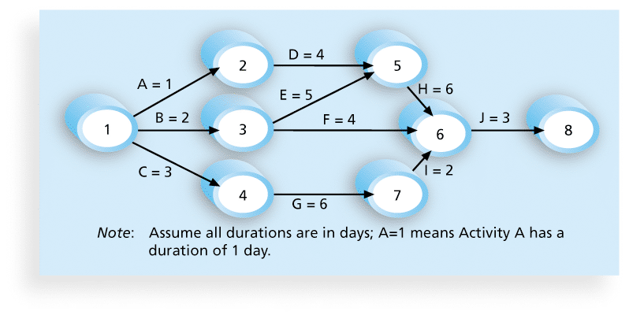
Network Diagram for Project X

Slide 22
Arrow Diagramming Method (ADM)
Also called activity-on-arrow (AOA) network diagrams
Activities are represented by arrows
Nodes or circles are the starting and ending points of activities
Can only show finish-to-start dependencies

Slide 23
Process for Creating AOA Diagrams
Find all of the activities that start at node 1. Draw their finish nodes and draw arrows between node 1 and those finish nodes. Put the activity letter or name and duration estimate on the associated arrow
2. Continuing drawing the network diagram, working from left to right. Look for bursts and merges. Bursts occur when a single node is followed by two or more activities. A merge occurs when two or more nodes precede a single node
3. Continue drawing the project network diagram until all activities are included on the diagram that have dependencies
4. As a rule of thumb, all arrowheads should face toward the right, and no arrows should cross on an AOA network diagram

Slide 24
Project Evaluation and Review Technique (PERT)
Project Evaluation and Review Technique (PERT) is a project management tool used to schedule, organize, and coordinate tasks within a project
From PERT we can get answers to questions like:
  How long will it take to complete a project?
  What are the risks involved in a project in terms of schedule?
  Which are the critical activities or tasks in a project that can cause delay of the entire project?
  If the project has to be finished earlier than planned, what is the most efficient and effective way at the least cost?
  Is the project on schedule, behind schedule, or ahead of schedule?

Slide 25
Adv/Disadvantages of PERT
PERT is used in project planning because it helps a project manager identify interdependencies and problems between various activities.
PERT can help project managers evaluate and shift resources from less critical activities to more critical activities.
PERT has disadvantages. It is complex, and this complexity may add to already existing implementation problems. It is also expensive to maintain and is employed mostly in large, complex projects.

Slide 26
Precedence Diagramming Method (PDM)
Activities are represented by boxes
Arrows show relationships between activities
More popular than ADM method and used by project management software
Better at showing different types of dependencies

Slide 27
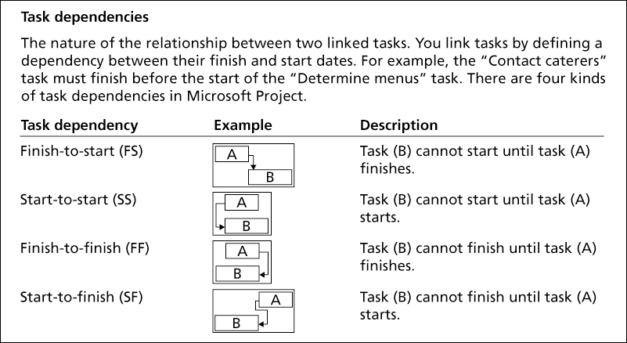
Task Dependency Types

Slide 28
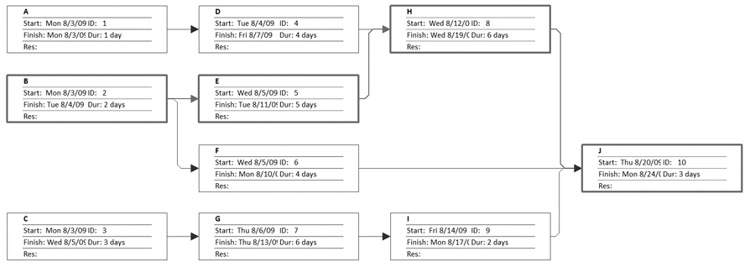
Sample PDM Network Diagram

Slide 29
Estimating Activity Resources
Before estimating activity durations, you must have a good idea of the quantity and type of resources that will be assigned to each activity; resources are people, equipment, and materials
Consider important issues in estimating resources
  How difficult will it be to do specific activities on this project?
  What is the organization’s history in doing similar activities?
  Are the required resources available?
A resource breakdown structure is a hierarchical structure that identifies the project’s resources by category and type

Slide 30
Activity Duration Estimating
Duration includes the actual amount of time worked on an activity plus elapsed time
Effort is the number of workdays or work hours required to complete a task
Effort does not normally equal duration
People doing the work should help create estimates, and an expert should review them

Slide 31
Three-Point Estimates
Instead of providing activity estimates as a discrete number, such as four weeks, it’s often helpful to create a three-point estimate
  an estimate that includes an optimistic, most likely, and pessimistic estimate, such as three weeks for the optimistic, four weeks for the most likely, and five weeks for the pessimistic estimate
Three-point estimates are needed for PERT and Monte Carlo simulations

Slide 32
Developing the Schedule
Uses results of the other time management processes to determine the start and end date of the project
Ultimate goal is to create a realistic project schedule that provides a basis for monitoring project progress for the time dimension of the project
Important tools and techniques include Gantt charts, critical path analysis, and critical chain scheduling, and PERT analysis

Slide 33
PERT and PDM
Activity: a specific task or set of tasks that is part of the scope of a project, uses up some of the resources of a project, and requires some finite time to be completed
  Path: sequence of activities
  Event: Beginning and End of activity
  LS: Late Start time ES: Early Start time -----FORWARD PASS
  LF: Late Finish time EF: Early Finish time ---BACKWARD PASS
Slack: Amount of play in the system; Difference between critical path time and time required for a given path.
=LS-ES or LF-EF
Crashing: reducing overall time required to complete project
  Involves trading off costs of additional resources against the value of time saved to complete the project.

Slide 34
PERT Formula and Example
PERT weighted average =
optimistic time + 4X most likely time + pessimistic time
6
Example:
PERT weighted average =
8 workdays + 4 X 10 workdays + 24 workdays = 12 days 6
where optimistic time= 8 days
most likely time = 10 days, and
pessimistic time = 24 days
Therefore, you’d use 12 days on the network diagram instead of 10 when using PERT for the above example

Slide 35
PERT and CPM
Activity | Description | Activity Predecessor | Duration (Weeks)
A | Scope documentation |  | 2
B | Project planning | A | 3
C | Buy materials | B | 8
D | Prototype design | C | 3
E | Prototype analysis | C | 6
F | Prototype implementation | D, E | 5
G | Testing of prototype | F | 4
H | Presenting prototype to customer | G | 2

Slide 36
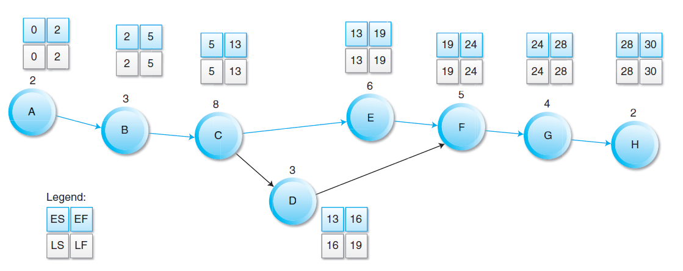
Forward and Backward Pass
Legend:
ES
EF
Slack: 3 weeks (16-13) or (19-16)
Critical Path: A-B-C-E-F-G-H

Slide 37



Variance in Scheduling Activities
This expected time may be used in the network diagram instead of the normal duration period for each activity.
To calculate the variance for each activity duration:
Variance (σ²) for a single activity can be calculated as:
The total path standard deviation

Slide 38

Variance in Scheduling Activities
To calculate the probability of completing the project in a specified period of time:
where,
E is the sum of the expected time of the critical path
D is the desired due time
is the total path deviation

Slide 39
To Accelerate Project Completion
Adding Resources: Brookes Law: Adding manpower to a late software project may make it later
Outsourcing Project Work: Frees up resources that can be assigned to a critical activity
Scheduling Overtime: Has problems with direct and intangible costs yet the preferred choice
Establish a core team: Undivided attention to the project
Fast tracking: Critical activities done parallel
Critical Chain: Longest string of dependencies that exist on the project (Goldratt) – difficult to apply in the middle of a project
Reduce Project Scope: Customer satisfaction may suffer and quality may be compromised
Crash: Shortening an activity

Slide 40
Project Crash
Attempt to reduce the completion time of a project to a lesser amount of time
Daily crash cost: How much does it cost in resources to reduce the time by a day?
Crash limit: What is the lower limit of daily crash cost?
Cease crashing when
  the target completion time is reached.
  the crash cost exceeds the penalty cost.

Slide 41
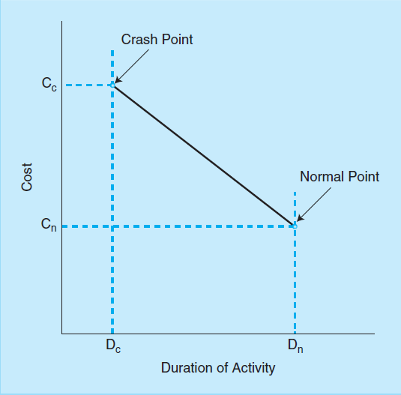
Project Crash

Slide 42
Project Crash
Activity | Cost | Maximum Crash Time | Normal |  | Crash
 |  |  | Time | Cost | Time | Cost
A | $20 | 1 | 3 | 50 | 2 | 70
B | $40 | 2 | 6 | 80 | 4 | 160
C | $30 | 1 | 10 | 60 | 9 | 90
D | $25 | 4 | 11 | 50 | 7 | 150
E | $30 | 2 | 8 | 100 | 6 | 160
F | $30 | 1 | 5 | 40 | 4 | 70
G | $0 | 0 | 6 | 70 | 6 | 70

Slide 43
Project Crash
A critical path can be computed using the network diagram. Let us assume the critical path is A-D-F-G. The project duration is 25 days.
Total normal cost: $450
Reducing activity A one-time costs $20 and increases the total cost to $470.
Cuts the project duration to 24 time units from 25 days.
It is not possible to reduce the last activity G
Reducing activity B one time = 80/2 = $40; the resulting project cost is $470+$40 = $510

Slide 44
Schedule Control Suggestions
Perform reality checks on schedules
Allow for contingencies
Don’t plan for everyone to work at 100% capacity all the time
Hold progress meetings with stakeholders and be clear and honest in communicating schedule issues

Slide 45
Controlling the Schedule
Goals are to know the status of the schedule, influence factors that cause schedule changes, determine that the schedule has changed, and manage changes when they occur
Tools and techniques include
  Progress reports
  A schedule change control system
  Project management software, including schedule comparison charts like the tracking Gantt chart
  Variance analysis, such as analyzing float or slack
  Performance management, such as earned value

Slide 46
Reality Checks on Scheduling
First review the draft schedule or estimated completion date in the project charter
Prepare a more detailed schedule with the project team
Make sure the schedule is realistic and followed
Alert top management well in advance if there are schedule problems

Slide 47
Working with People Issues
Strong leadership helps projects succeed more than good PERT charts
Project managers should use
  empowerment
  incentives
  discipline
  negotiation

Slide 48
Using Software to Assist in Time Management
Software for facilitating communications helps people exchange schedule-related information
Decision support models help analyze trade-offs that can be made
Project management software can help in various time management areas

Slide 49
What Went Right?
Microsoft lists dozens of examples of how customers benefit from using Project 2010. One such customer, Amdocs, a global provider of customer experience systems (CES) software, wanted to help its IT project teams work more efficiently
Employees now have Web-based access from any location, managers have better project visibility, and the company can extend the centralized solution to include more users and applications. Amdocs can now deploy Project Server 2010 in less than a day, or 50 percent faster. Only one person is needed to manage the shared infrastructure.

Slide 50
Words of Caution on Using Project Management Software
Many people misuse project management software because they don’t understand important concepts and have not had training
You must enter dependencies to have dates adjust automatically and to determine the critical path
You must enter actual schedule information to compare planned and actual progress

