Slide 1
Critical Path and Gantt
Project Schedule/Time Management Chapter 8

Slide 2
Gantt Charts
Gantt charts provide a standard format for displaying project schedule information by listing project activities and their corresponding start and finish dates in a calendar format
Symbols include:
A black diamond: a milestones
Thick black bars: summary tasks
Lighter horizontal bars: durations of tasks
Arrows: dependencies between tasks

Slide 3
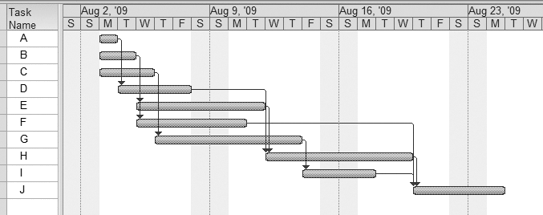
Gantt Chart for Project X

Slide 4
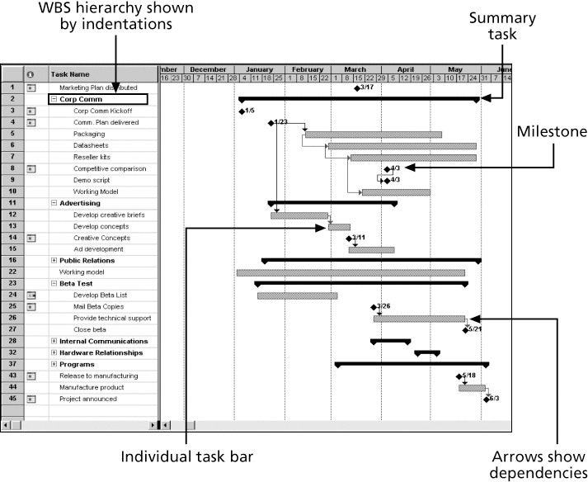
Gantt Chart for Software Launch Project

Slide 5
Adding Milestones to Gantt Charts
Many people like to focus on meeting milestones, especially for large projects
Milestones emphasize important events or accomplishments on projects
Normally create milestone by entering tasks with a zero duration, or you can mark any task as a milestone

Slide 6
SMART Criteria
Milestones should be
Specific
Measurable
Assignable
Realistic
Time-framed

Slide 7
Best Practice
Schedule risk is inherent in the development of complex systems. Luc Richard, the founder of www.projectmangler.com, suggests that project managers can reduce schedule risk through project milestones, a best practice that involves identifying and tracking significant points or achievements in the project.
The five key points of using project milestones include the following:
1. Define milestones early in the project and include them in the Gantt chart to provide a visual guide
2. Keep milestones small and frequent
3. The set of milestones must be all-encompassing
4. Each milestone must be binary, meaning it is either complete or incomplete.
5. Carefully monitor the critical path

Slide 8
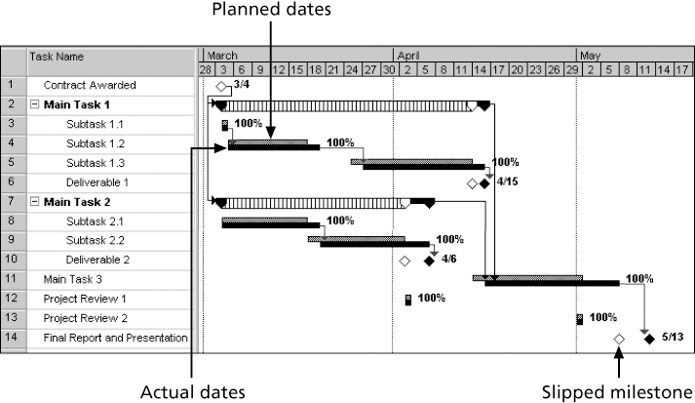
Sample Tracking Gantt Chart

Slide 9
Critical Path Method (CPM)
CPM is a network diagramming technique used to predict total project duration
A critical path for a project is the series of activities that determines the earliest time by which the project can be completed
The critical path is the longest path through the network diagram and has the least amount of slack or float
Slack or float is the amount of time an activity may be delayed without delaying a succeeding activity or the project finish date

Slide 10
Calculating the Critical Path
First develop a good network diagram
Add the duration estimates for all activities on each path through the network diagram
The longest path is the critical path
If one or more of the activities on the critical path takes longer than planned, the whole project schedule will slip unless the project manager takes corrective action

Slide 11
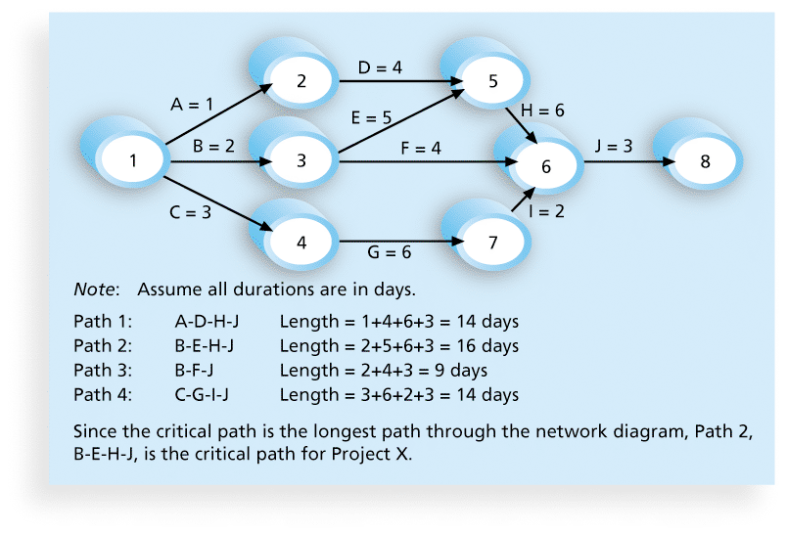
Determining the Critical Path for Project X

Slide 12
More on the Critical Path
A project team at Apple computer put a stuffed gorilla on the top of the cubicle of the person currently managing critical task
The critical path is not the one with all the critical activities; it only accounts for time
Remember the example of growing grass being on the critical path for Disney’s Animal Kingdom
There can be more than one critical path if the lengths of two or more paths are the same
The critical path can change as the project progresses

Slide 13
Using Critical Path Analysis to Make Schedule Trade-offs
Free slack or free float is the amount of time an activity can be delayed without delaying the early start of any immediately following activities
Total slack or total float is the amount of time an activity may be delayed from its early start without delaying the planned project finish date
A forward pass through the network diagram determines the early start and finish dates
A backward pass determines the late start and finish dates

Slide 14
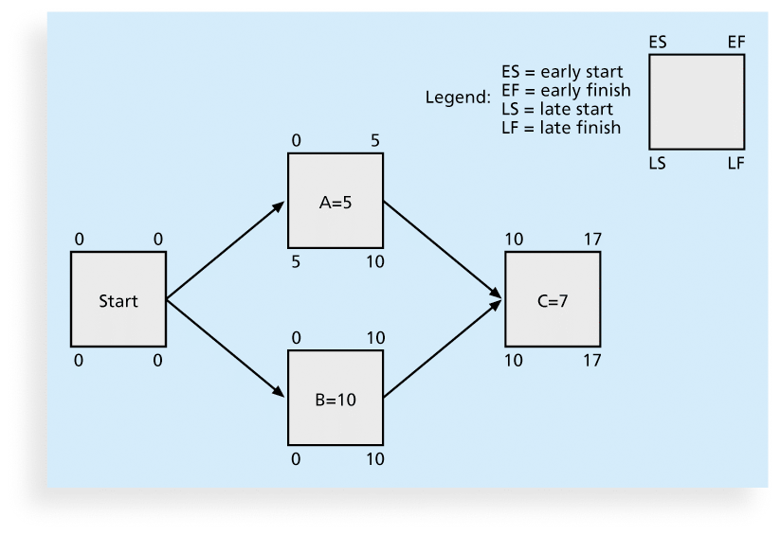
Calculating Early and Late Start and Finish Dates

Slide 15
Free and Total Float or Slack for Project X

Slide 16
Using the Critical Path to Shorten a Project Schedule
Three main techniques for shortening schedules
Shortening durations of critical activities/tasks by adding more resources or changing their scope
Crashing activities by obtaining the greatest amount of schedule compression for the least incremental cost
Fast tracking activities by doing them in parallel or overlapping them

Slide 17
Importance of Updating Critical Path Data
It is important to update project schedule information to meet time goals for a project
The critical path may change as you enter actual start and finish dates
If you know the project completion date will slip, negotiate with the project sponsor

Slide 18
Critical Chain Scheduling
Critical chain scheduling
a method of scheduling that considers limited resources when creating a project schedule and includes buffers to protect the project completion date
Uses the Theory of Constraints (TOC)
a management philosophy developed by Eliyahu M. Goldratt and introduced in his book The Goal.
Attempts to minimize multitasking
when a resource works on more than one task at a time

Slide 19
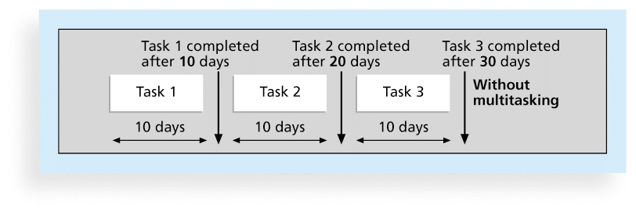
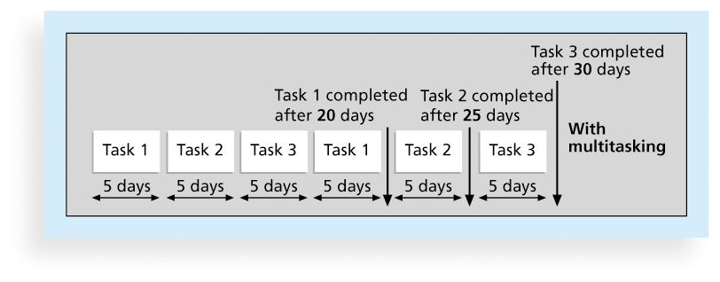
Multitasking Example

Slide 20
Buffers and Critical Chain
A buffer is additional time to complete a task
Murphy’s Law states that if something can go wrong, it will
Parkinson’s Law states that work expands to fill the time allowed
In traditional estimates, people often add a buffer to each task and use it if it’s needed or not
Critical chain scheduling removes buffers from individual tasks and instead creates
a project buffer or additional time added before the project’s due date
feeding buffers or additional time added before tasks on the critical path

Slide 21
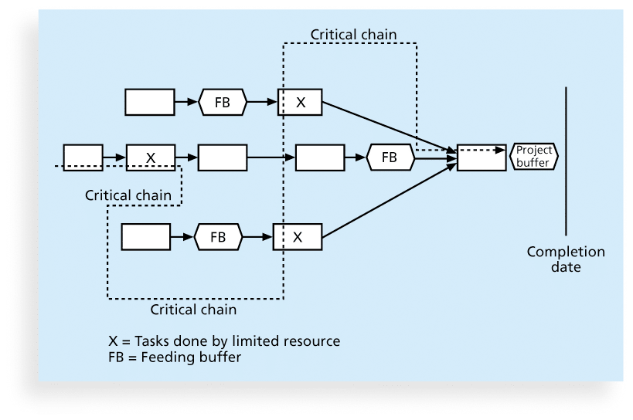
Example of Critical Chain Scheduling

