Slide 1
Your Office: Getting Started
with Project Management
Module 1 Workshop 1
Plan a Project
Series Editor Amy Kinser
by Kristyn Jacobson
Notes:
This workshop introduces you to Microsoft Project 2013 and focuses on basic project management features.

Slide 2
Objectives
Understand project management and Microsoft Project terminology
Explore the Project 2013 window
Prepare a project schedule
Modify a project calendar
Understand manually scheduled versus auto scheduled projects
Notes:
The objectives of this chapter are:
Understand project management and Microsoft Project terminology
Explore the Project 2013 window
Prepare a project schedule
Modify a project calendar
Understand manually scheduled versus auto scheduled projects
The objectives continue on the next slide.

Slide 3
Objectives (Continued)
Identify project tasks
Modify project tasks in Project 2013
Prepare Project for printing project views
Create task dependencies
Modify task dependencies and task constraints
Notes:
Additional objectives include to:
Identify project tasks
Modify project tasks in Project 2013
Prepare Project for printing project views
Create task dependencies
Modify task dependencies and task constraints

Slide 4
Understand Project Management and Microsoft Project Terminology
Project management consists of initiating, planning, executing, monitoring, and closing project tasks and resources so that the project goal is achieved
Notes:
The project management process consists of initiating, planning, executing, monitoring, and closing project tasks and resources so that the project goal is achieved.
A project goal is the anticipated result of a project when completed and is met when project tasks are accomplished on time, on budget, and within the scope of a given project.
Information on understanding project management and Microsoft Project terminology continues on the next slide.

Slide 5
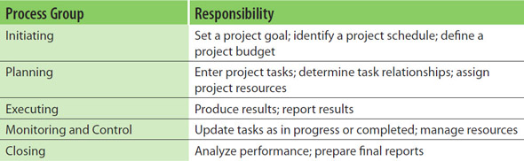
Understand Project Management and Microsoft Project Terminology (Continued)
Notes:
Take the time to study the management process groups show in the slide table.
Information on understanding project management and Microsoft Project terminology continues on the next slide.

Slide 6
Understand Project Management and Microsoft Project Terminology (Continued)
Project manager:
  Responsible for overseeing project plan details
  Works to create a plan that leads to project success
  Motivates project team members to achieve the project goal
Notes:
The project manager is responsible for overseeing all the details of the project plan, works to create a plan that will lead to project success, and motivates project team members to achieve the project goal.
Information on understanding project management and Microsoft Project terminology continues on the next slide.

Slide 7
Understand Project Management and Microsoft Project Terminology (Continued)
Task—activity that is concluded in order to reach a project goal
Task duration—prediction of how long it takes to complete a task
Predecessor task—task that must be completed before the next task can begin
Successor task—task that has a predecessor task
Notes:
A task is an activity that is concluded in order to reach a project goal. For example, when planning for a wedding, a task could be to set the wedding date and time.
Task duration is a prediction of how long it takes to complete a task and can be measured in minutes, hours, days, weeks, months, and years.
A predecessor task is a task that must be completed before the next task can begin.
A successor task is a task that has a predecessor task.
Information on understanding project management and Microsoft Project terminology continues on the next slide.

Slide 8
Understand Project Management and Microsoft Project Terminology (Continued)
Task dependency—relationship between two tasks
Constraint—limitation set on a task that affects how a task is scheduled
Resource—work, material, or cost associated with a project task
Notes:
Task dependency is the relationship between two tasks that defines which task(s) have to finish before the next task(s) can begin.
A constraint is a limitation set on a task and affects how a task is scheduled.
A resource is a work, material, or cost associated with a project task:
Work resources—people and equipment
Material resources—resources expended during a project
Cost resources—independent costs that are associated with a task.
Information on understanding project management and Microsoft Project terminology continues on the next slide.

Slide 9
Understand Project Management and Microsoft Project Terminology (Continued)
Scope of a project—what must be completed to deliver a specific product or service
Milestone—task that is used to communicate project progress or mark a significant point in a project
Gantt chart—graphical representation of the tasks
Notes:
The scope of a project is what must be completed to deliver a specific product or service and includes meeting the project goals, tasks, and deadlines.
A milestone is a task that is used to communicate project progress or mark a significant point in a project. For example, a milestone for the wedding planning could be that a banquet hall has been reserved.
A Gantt chart is a graphical representation of the tasks.

Slide 10
Explore the Project 2013
Window
Gantt chart view:
  Gantt chart—displays the project’s tasks against a timeline
  Entry table—used to enter task information
  Timeline—visual representation of a project from start to finish
  View Bar—contains buttons for quick access to different Project 2013 views
Notes:
The Gantt Chart view is the default Project 2013 view, and includes components, such as:
Gantt Chart displays the project’s tasks against a timeline, where the activities are displayed as horizontal bars in which the length of the bar is determined by the duration of the activities and start/finish dates.
Entry table is used to enter task information, and is used to record project tasks, durations, predecessors, and resources.
A timeline is a visual representation of a project from start to finish.
View Bar contains buttons for quick access to different Project 2013 views and is used to navigate within the different Project 2013 views.
Information on exploring the Project 2013 window continues on the next slide.

Slide 11
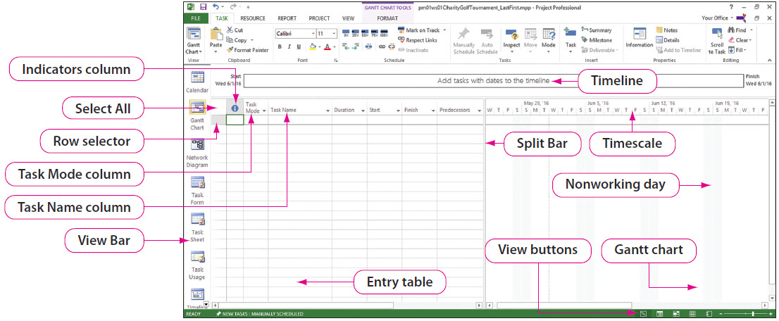
Explore the Project 2013
Window (Continued)
Notes:
As shown on the slide, there are several other components in the Project 2013 window, which you will be using in this workshop.

Slide 12
Prepare a Project
Schedule
Project Information dialog box—used to update project aspects, such as:
  Project start date or finish date
  Current date or status date
  Project base calendar
Notes:
The Project Information dialog box is used to update various aspects of a project, such as:
Project start date or finish date—either or both can be used to schedule a project
Current date or status date—status date is the date set to run reports on a project’s progress
Project base calendar—specifies hours in which work can occur
Information on preparing a project schedule continues on the next slide.

Slide 13
Prepare a Project
Schedule(Continued)
Notes:
As shown in the Project Information dialog box in the slide:
The Start date is Wednesday June 1st of the next year
The Current date is December 1st of this year
The Finish date is Wednesday June 18th of the next year
There is no Status date
The Standard Calendar (40-hour work week) is used as the project base calendar

Slide 14
Modify a Project
Calendar
Notes:
When a base calendar is assigned to a project, the base calendar must correctly indicate the working time hours a project team is actually able to work on the project. For example, a team may only be able to work Monday, Wednesday, and Friday afternoons from 1:00 to 5:00.
To indicate this, the Calendar Detail dialog box is used to modify the Standard calendar and specify the actual days of the week and the hours.
To select the three days, press and hold Ctrl while clicking Monday, Wednesday, and Friday.
To select the hours, enter 1:00 PM as the From time and 5:00 PM as the To time.
Information on modifying a project calendar continues on the next slide.

Slide 15
Modify a Project
Calendar (Continued)
Notes:
There can be exceptions, such as a holiday, that must be included in the project calendar. Such calendar changes are made using the Exceptions tab on the Change Working Time dialog box.
As shown on the slide, the January calendar indicates New Year’s is an exception. Note: Below the calendar, on the Exceptions tab, another exception for Christmas has also been created.

Slide 16
Understand Manually Scheduled Versus Auto Scheduled Projects
Manually Scheduled tasks:
  Start date and duration are entered
  Project 2013 calculates the Finish date
Auto Scheduled tasks—based on:
  The project’s calendar
  Project tasks, durations, and dependencies
  Resource assignments
  Constraint dates assigned to tasks
Notes:
Project tasks can be manually or automatically created.
The default for creating tasks is Manually Scheduled, where the Start date and duration are entered, and Project 2013 calculates the Finish date. Note: When changes are made to tasks, task dates are not calculated or adjusted by Project’s 2013 scheduling engine.
When Auto Scheduled is selected, the project schedule is calculated based on:
The project’s calendar
Project tasks, durations, and dependencies
Resource assignments
Constraint dates assigned to tasks.
Information on understanding manually scheduled versus auto scheduled projects continues on the next slide.

Slide 17
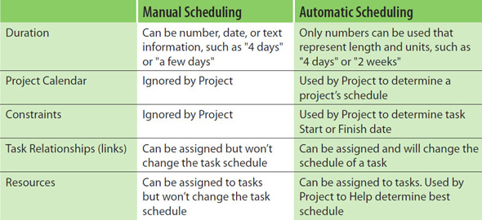
Understand Manually Scheduled Versus Auto Scheduled Projects (Continued)
Notes:
The table shown in the slide displays the differences between scheduling a project manually versus scheduling it automatically.

Slide 18
Identify Project Tasks
Notes:
Tasks are activities that must be completed to reach the project goal. When designing a project, in addition to identifying the project tasks, you must also enter the task durations, task dependencies, and task constraints. The Task Information dialog box contains the details for each task and can be used to make changes to a task.
As shown in the slide, there are six task categories (tabs), one of which is a Notes tab, where additional information about a task can be added.
Information on identifying project tasks continues on the next slide.

Slide 19
Identify Project Tasks (Continued)
Notes:
This slide shows several tasks that have been added to the Entry table on the left, and the resulting changes to the Gantt chart on the right.

Slide 20
Modify Project Tasks in
Project 2013
Project tasks may have to be:
  Added
  Deleted
  Modified
  Copied
  Moved
Notes:
Once a project plan has been created, tasks may have to be added, deleted, modified, copied, or moved.
Tasks can be added or deleted using the Ribbon, the shortcut menu, or the keyboard. Similar to adding a row in Excel, when a task is added or deleted, the other tasks are moved accordingly.
Information on modifying project tasks in Project 2013 continues on the next slide.

Slide 21
Modify Project Tasks in
Project 2013 (Continued)
Notes:
Tasks can be modified, copied, or moved in the Gantt Chart view. When moving a task, it can be dragged and dropped in a new location, or it can be copied and pasted from the Clipboard.
This slide uses the Gantt Chart view and show that task 5 has been selected and will be moved to become task 3.
Information on modifying project tasks in Project 2013 continues on the next slide.

Slide 22
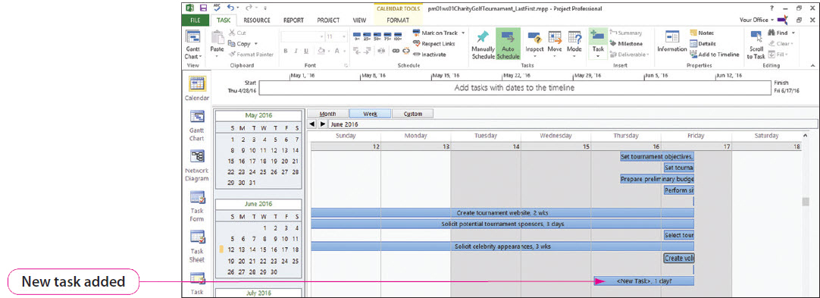
Modify Project Tasks in
Project 2013 (Continued)
Notes:
Besides the Gantt Chart view, tasks can be added and modified using the Calendar and Network Diagram views.
The Calendar view displays tasks as bars on a weekly or monthly calendar. This slide shows a weekly calendar after the Task button has been clicked. Double-clicking the newly added task opens the Task Information dialog box (previously shown on Slide 18), where task information is entered.
Information on modifying project tasks in Project 2013 continues on the next slide.

Slide 23
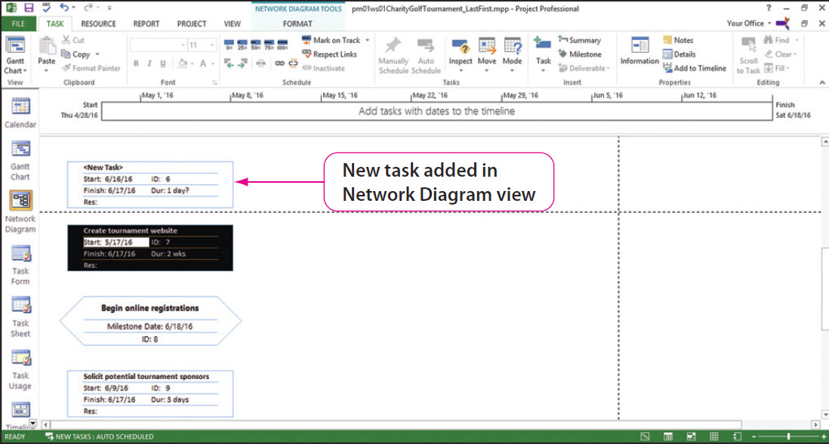
Modify Project Tasks in
Project 2013 (Continued)
Notes:
The Network Diagram view displays each task in a detailed box and represents task dependencies with link lines. This slide shows the Network Diagram after task 6 has been selected and the Task button has been clicked. Double-clicking the newly added task rectangle once again opens the Task Information dialog box, where task information is entered.

Slide 24
Prepare Project for
Printing Project Views
Use Backstage view to print projects in:
  Gantt Chart view
  Network Diagram view
  Calendar view
Printout can be viewed in the Preview pane
Headers and footer can be added to printouts
Notes:
To print a project, click FILE and use Backstage view. We have looked at three views—Gantt Chart, Network Diagram, and Calendar—and Backstage view is used to print any of these. Backstage view has a Preview pane that allows you to see what your printouts will look like prior to actually printing them. If you have used Office 2013’s Backstage view, you will recognize some similar features.
Headers or footers can be added to all views in Project 2013.

Slide 25
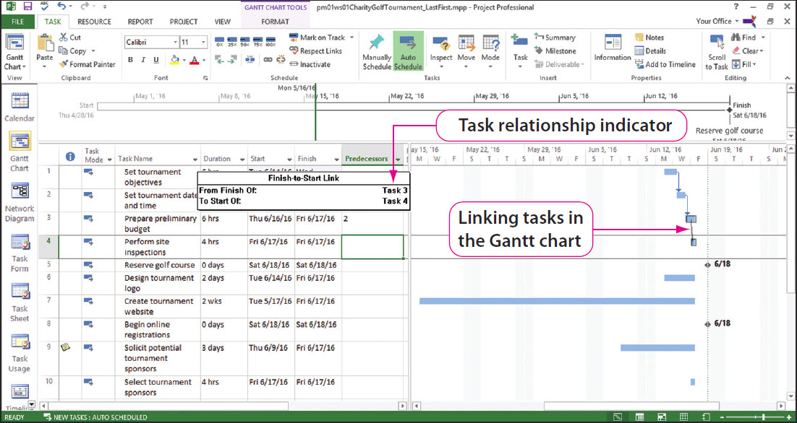
Create Task Dependencies
Notes:
Task dependencies create predecessor tasks and successor tasks. If you do not define task dependencies, all tasks will start on the project Start date or finish on the project Finish date. Task dependencies can be created in any of the three views—Gantt Chart, Network Diagram, and Calendar.
Note: The terms relationship, dependency, and link may be used interchangeably.
When using the Gantt Chart view, one way to link tasks is to select them in the Entry table and then click the Link the Selected Tasks button. The slide shows how linked tasks are indicated in the Gantt Chart view.
Information on creating task dependencies continues on the next slide.

Slide 26
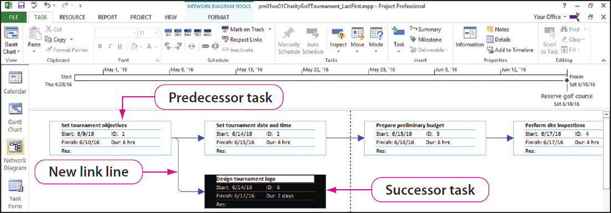
Create Task Dependencies (Continued)
Notes:
When using the Network Diagram view, one way to link tasks is to select the predecessor task and drag it to the successor task. The slide shows how linked tasks are indicated in the Network Diagram view.
Information on creating task dependencies continues on the next slide.

Slide 27
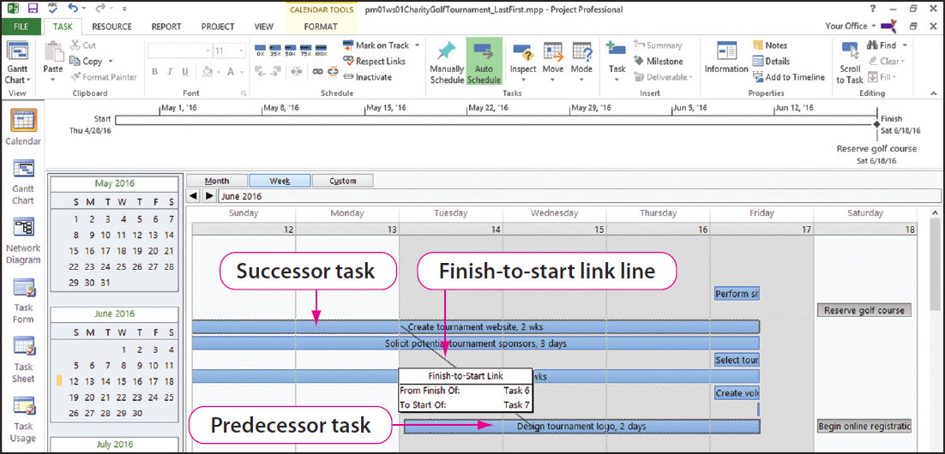
Create Task Dependencies (Continued)
Notes:
When using the Calendar view, one way to link tasks is to select the predecessor task and drag it to the successor task. The slide shows how linked tasks are indicated in the Calendar view.

Slide 28
Modify Task Dependencies and Task Constraints
Task relationships can be:
  Modified
  Added
  Deleted
Task dependencies can be modified by creating:
  Lag time
  Lead time
Notes:
Project 2013 allows the modification, addition, or deletion of task relationships and task constraints during the planning process. Task relationships can be modified, added, or deleted in the following ways:
• Using the Predecessors column of Gantt Chart view
• Using the Task Information dialog box Predecessors tab
• Double-clicking the link line in Gantt Chart and Network Diagram views and using the Task Dependency dialog box
When a project is scheduled by Start date, task dependencies can be modified by creating lag time or lead time.
Lag time moves a successor task forward in time so the Start date between the tasks become further apart.
Lead time moves a successor task back in time so the two tasks overlap and the Start dates between the tasks gets closer.
Note: Adding lag time is likely to extend the length of a project.

Slide 29
Summary
Project management is a process of initiating, planning, executing, monitoring, and closing a project’s tasks and resources so that the project goal is achieved.
Microsoft Project 2013 is software that can be used to manage projects.
Notes:
Project management is a process of initiating, planning, executing, monitoring, and closing a project’s tasks and resources so that the project goal is achieved.
Microsoft Project 2013 is software that can be used to manage projects.

Slide 30
Questions
Notes:
As you complete this introduction to Microsoft Project 2013, be sure you ask questions. You want to understand the concepts so that you can continue to build on them in the next workshop.

Slide 31
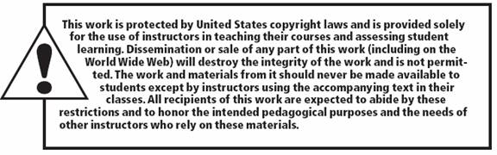
Copyright
All rights reserved. No part of this publication may be reproduced, stored in a retrieval system, or transmitted, in any form or by any means, electronic, mechanical, photocopying, recording, or otherwise, without the prior written permission of the publisher. Printed in the United States of America.

