Slide 1
Your Office: Getting Started
with Project Management
Module 1 Workshop 2
Creating a Detailed Project Plan
Series Editor Amy Kinser
by Kristyn Jacobson
Notes:
This workshop uses Microsoft Project 2013 to create a detailed project plan.

Slide 2
Objectives
Identify the critical path
Create a Work Breakdown Structure
Create and assign project resources
Change task durations by adding resources
Notes:
The objectives of this chapter are:
Identify the critical path
Create a Work Breakdown Structure
Create and assign project resources
Change task durations by adding resources
The objectives continue on the next slide.

Slide 3
Objectives (Continued)
View Resource Assignments in the Team Planner view
Enhance a project schedule with elapsed duration and recurring tasks
Create Project reports
Notes:
Additional objectives include:
View Resource Assignments in the Team Planner view
Enhance a project schedule with elapsed duration and recurring tasks
Create Project reports
The objectives continue on the next slide.

Slide 4
Objectives (Continued)
Copy and paste information to other applications
Share project information with Microsoft Excel
Use Project templates and create Project templates
Notes:
Additional objectives include to:
Copy and paste information to other applications
Share project information with Microsoft Excel
Use Project templates and create Project templates

Slide 5
Identify the Critical Path
Critical path—task(s) that:
  Determine project finish or start time
  Must be completed on time to meet project timeline
Slack—time a task can be delayed from its scheduled start date without delaying the project
Critical tasks:
  Are on the critical path
  Do not have slack
Notes:
A critical path consists of task(s) that determine the project’s finish or start date and must be completed on time to meet the project timeline.
Slack is the time a task can be delayed from its scheduled start date without delaying the project.
Tasks on the critical path are critical tasks and do not have slack.

Slide 6
Identify the Critical Path (Continued)
Notes:
In Network Diagram view, the critical path is represented by red task boxes and red link lines.
Information on identifying the critical path continues on the next slide.

Slide 7
Identify the Critical Path (Continued)
Notes:
When using the Gantt Chart view, you may have to click the Critical Tasks check box to display the critical path. Once again the critical path is indicated in red.

Slide 8
Create a Work Breakdown Structure
WBS—creates a project plan structure in which:
  Project tasks are identified
  Task relationships are defined
  Task resources are assigned
When creating a WBS:
  Main goals of the scope of a project are defined
  Tasks needed to complete the goals are identified
Notes:
A Work Breakdown Structure (WBS) creates a project plan structure in which:
Project tasks are identified
Task relationships are defined
Task resources are assigned
When creating a WBS:
The main goals of the scope of a project are defined
The tasks needed to complete the goals are identified
Information on creating a Work Breakdown Structure continues on the next slide.

Slide 9
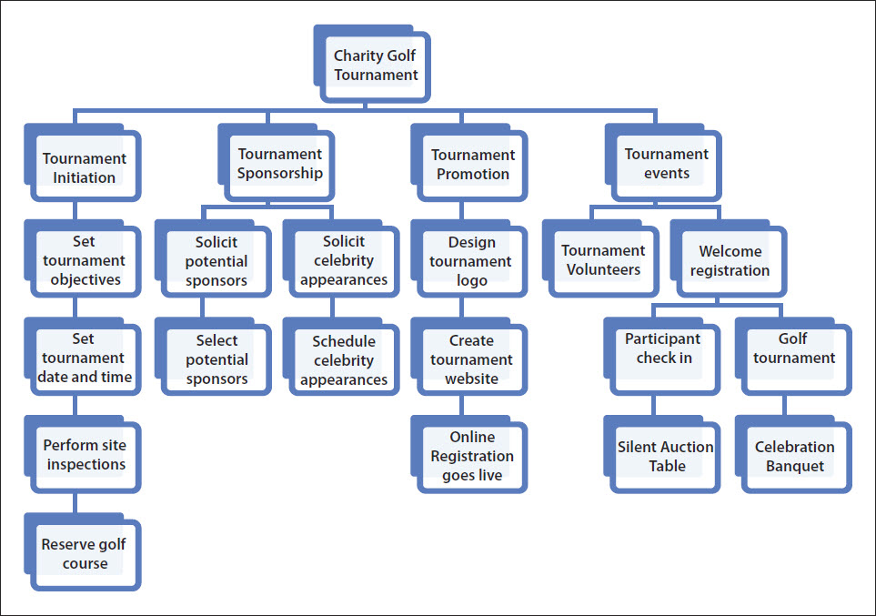
Create a Work Breakdown Structure (Continued)
Notes:
A WBS may have a top-down structure, similar to a detailed outline, where the main goals are defined and supporting tasks to complete these goals are identified.
This slide shows a project that is broken down into four main goals or summary tasks—tournament initiation, sponsorship, promotion, and events—and under the main goals are the subtasks that need to be completed to meet the project goal.
Information on creating a Work Breakdown Structure continues on the next slide.

Slide 10
Create a Work Breakdown Structure (Continued)
Notes:
To create summary tasks, you can indent and outdent tasks. Indenting a task moves a task to the right in the Entry table and makes it a lower-level task in a WBS, such as a task that needs to be completed to achieve the main goal. Outdenting a task moves a task to the left in the Entry table and makes it a higher-level in a WBS, such as a main goal.
If you are familiar with Microsoft Word, you can see the similarity of indenting and outdenting tasks to that of increasing and decreasing paragraph indentation.
This slide shows the Tournament Initiation summary task and the four subtasks depicted on the previous slide.
Information on creating a Work Breakdown Structure continues on the next slide.

Slide 11
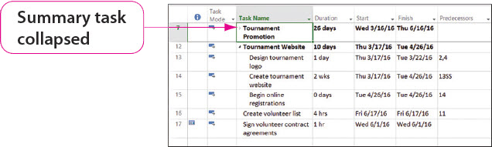
Create a Work Breakdown Structure (Continued)
Notes:
Once a Work Breakdown Structure is created, project tasks can be temporarily hidden, and they can be filtered to only show certain tasks.
A task can be collapsed by clicking the Collapse arrow. This slide shows that the Tournament Promotion summary task.
Information on creating a Work Breakdown Structure continues on the next slide.

Slide 12
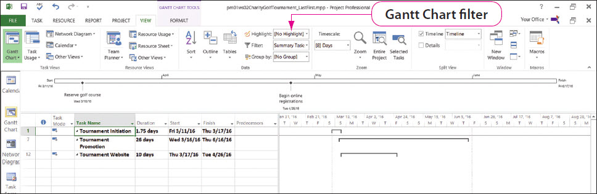
Create a Work Breakdown Structure (Continued)
Notes:
A task can be filtered by clicking the Filter arrow. This slide shows that the Gantt Chart view has been filtered to only show the summary tasks.

Slide 13
Create and Assign Project Resources
Resources—people, materials, or costs needed to complete project tasks
Resource Sheet view—resource information entered in columns and rows:
  Resource name
  Resource type
  Resource cost
  Assign a calendar to a resource
Notes:
Resources are the people, materials, or costs needed to complete project tasks.
When using Project 2013, resources can be added in many views, but the most common way of adding resources is by using Resource Sheet view.
When using Resource Sheet view, you can enter resource information in columns and rows to include information such as:
Resource name
Resource type
Resource cost
Assign a calendar to a resource
Information on creating and assigning project resources continues on the next slide.

Slide 14
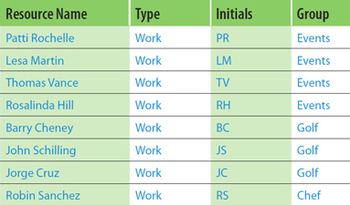
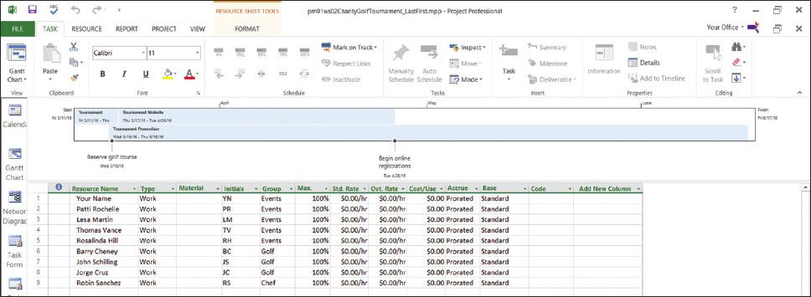
Create and Assign Project Resources (Continued)
Notes:
This slide shows a table of resources and how they look after being added in Resource Sheet view.
Information on creating and assigning project resources continues on the next slide.

Slide 15
Create and Assign Project Resources (Continued)
Project resources can be assigned to tasks:
  Assign Resources dialog box
  Cell in the Resource column arrow of the Entry table in Gantt Chart view
  Resources tab in the Task Information dialog box
  Task Work Form in Details view
Notes:
Once you have created resources, you must assign the resources to tasks. There are various ways of assigning project resources to tasks:
The Assign Resources dialog box
A cell in the Resource column arrow of the Entry table in Gantt Chart view
The Resources tab in the Task Information dialog box
The Task Work Form in Details view
Information on creating and assigning project resources continues on the next slide.

Slide 16
Create and Assign Project Resources (Continued)
Notes:
This slide shows the Assign Resources dialog box on the right and the resources that have been assigned to tasks.

Slide 17
Change Task Durations by Adding Resources
The duration of a task is:
  Shortened as resources are added
  Lengthened as resources are removed
The amount of effort necessary to complete a task remains unchanged
Notes:
When resources are added to a project, task durations may change. The duration of a task is shortened as resources are added or lengthened as resources are removed from a task; however, the amount of effort necessary to complete a task remains unchanged.
This means the more effort assigned to a task, the shorter the duration will be and when resources are removed from an effort-driven task, the longer the duration of the task (even though the total work does not change).
Information on changing task durations by adding resources continues on the next slide.

Slide 18
Change Task Durations by Adding Resources (Continued)
Overallocated—when a resource is assigned to more work than available working hours
Leveling—correcting overallocated resources to make sure no resource is assigned more hours than available work hours
Crashing—adding resources to a project to be sure the project is completed on time
Notes:
Overallocated—when a resource is assigned to more work than available working hours
Leveling—process of correcting overallocated resources to make sure no resource is assigned more hours than available work hours
Crashing—adding additional resources to a project to be sure the project is completed on time. Note: Crashing a project may help to level a project but may also cause the project to go over budget.
Information on changing task durations by adding resources continues on the next slide.

Slide 19
Change Task Durations by Adding Resources (Continued)
Notes:
Task 14 originally had one person, Thomas Vance, assigned to the task of creating the tournament over two weeks, or 80 hours. This slide shows that an additional resource, Rosalinda Hill, has been added to the task and the duration is now one week. Note: Two people working for a week still requires 80 hours of work.

Slide 20
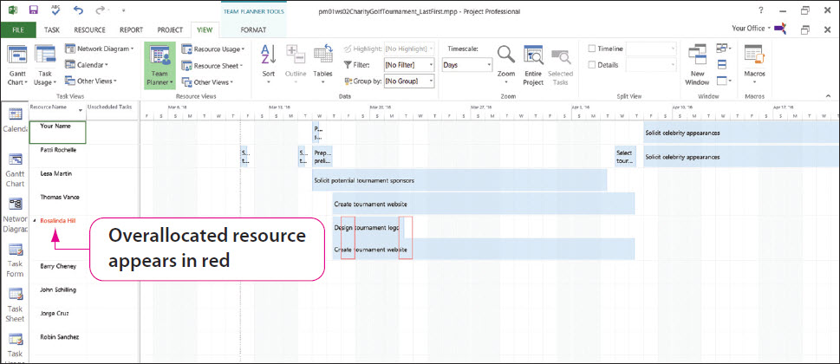
View Resource Assignments in the Team Planner View
Notes:
Team Planner is a Project view that shows a project’s resources and tasks assigned to each resource. The name of each resource appears on a separate row.
Tasks associated with the individual resources appear on the same row as the resource name. Note: Rosalinda Hill is identified in red indicating that she is an overallocated resource.

Slide 21
Enhance a Project Schedule with Elapsed Duration and Recurring Tasks
Notes:
If a task is assigned a duration of 56 hours, Project will schedule that task for 7 days of work (56 hours divided by an 8-hour work day). However, assume a task in the project needs 56 hours total without regard to the Project calendar. If this is the case, Project permits you to assign elapsed duration times. Elapsed durations ignore any project or resource’s working and nonworking times and schedules the task(s) to 24 hours a day.
A recurring task is a task that repeats at regular intervals. A weekly Wednesday staff meeting is an example of a recurring task. This slide shows the creation of such a meeting using the Recurring Task Information dialog box.

Slide 22
Create Project Reports
Project 2013 reporting features:
  Include charts and images
  Provide dozens of pre-loaded reports
  Allow customizable reports
  Based on project status
Project 2013 reports:
  Dashboard
  Resources
  Costs
  In Progress
Notes:
The reporting features of Project 2013 include charts and images to represent a project at a glance. Project provides dozens of pre-loaded reports, as well as the ability to customize them to meet the project reporting needs.
Most Project reports are based on project status. To display the status of a project, a baseline must be set and the project is tracked. A baseline is a record of each task at a point in time from which you will track project progress.
Tracking is recording the actual progress of the project’s tasks. Baselines are set on the Project tab, and task tracking is done in the Schedule group of the Task tab.
Project 2013 contains a variety of reports:
Dashboard
Resources
Costs
In Progress
Information on creating project reports continues on the next slide.

Slide 23
Create Project Reports (Continued)
Notes:
This slide shows a Resource Overview report.

Slide 24
Copy and Paste Information to
Other Applications
Sharing Project 2013 information with other applications:
  Copying and pasting
  Importing and exporting
  Linking
Notes:
Project 2013 information can be shared with other applications by:
Copying and pasting
Importing and exporting
Linking
Pasting information into Excel creates a worksheet with columns and rows of data. Pasting information into Word converts the information into a table.
Information on copying and pasting information to other applications continues on the next slide.

Slide 25
Copy and Paste Information to
Other Applications (Continued)
Notes:
This slide shows the selected information in Project. Compare this slide with the next two slides, where the information has been copied and then pasted into an Excel workbook and a Word document.
Information on copying and pasting information to other applications continues on the next slide.

Slide 26
Copy and Paste Information to
Other Applications (Continued)
Notes:
This slide shows the Project information after it has been pasted into an Excel workbook. If necessary, go back to the previous slide to compare the information and how it is displayed.
Information on copying and pasting information to other applications continues on the next slide.

Slide 27
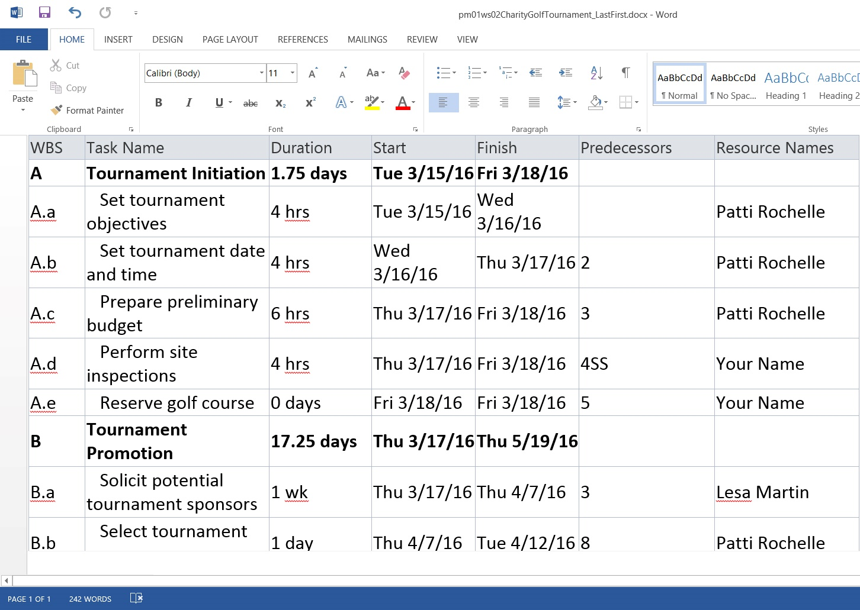
Copy and Paste Information to
Other Applications (Continued)
Notes:
This slide shows the Project information after it has been pasted into a Word document. If necessary, go back to the two previous slides to compare the information and how it is displayed.
Information on copying and pasting information to other applications continues on the next slide.

Slide 28
Copy and Paste Information to
Other Applications (Continued)
Notes:
Since the Entry table is similar to Excel’s column and row format, copying and pasting data from the table works well. However, copying and pasting project data does not work well in Calendar or Network Diagram views.
This slide shows the Calendar view and the Copy Picture dialog box.
Instead of copying and pasting the data, you use Copy Picture to copy and paste a picture of the view into another application.
Information on copying and pasting information to other applications continues on the next slide.

Slide 29
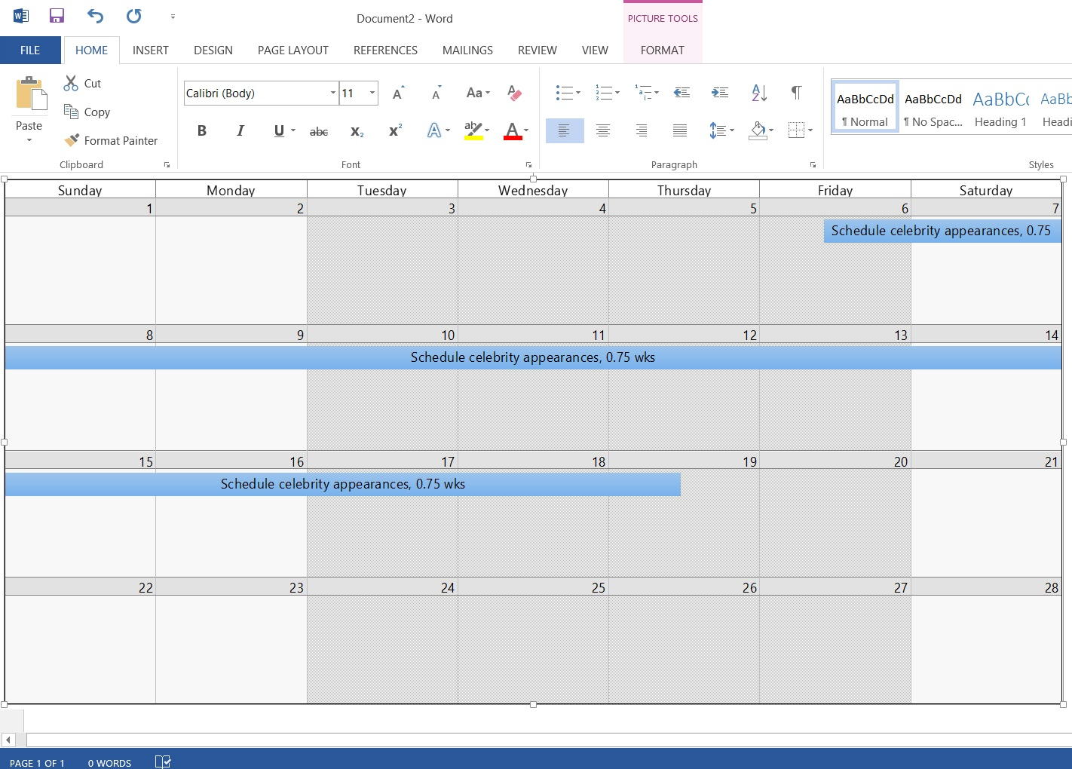
Copy and Paste Information to
Other Applications (Continued)
Notes:
This slide shows the image of the calendar from the previous slide that has been pasted into a Word document. Remember, this is an image, and you cannot edit the text.

Slide 30
Share Project Information with Microsoft Excel
Notes:
How do you share Project 2013 information with someone who does not have Project 2013? We have already seen that some Project information can be copied and pasted, but there is another alternative. You can export and import Project information with other applications using the Export and Import Wizards, which guide you through the process.
Because Microsoft Excel 2013 contains data analysis tools, it is useful to export project data into Excel and then use these tools.
This slide shows the result of exporting Project information into an Excel workbook. Notice that the columns are not wide enough to display their contents. Widening columns is a simple Excel process.
Information on sharing Project information with Microsoft Excel continues on the next slide.

Slide 31
Share Project Information with Microsoft Excel (Continued)
Notes:
Although information can be copied into Project from another application, importing information into Project is more flexible because it allows data to be imported that doesn’t exactly match. External data can be imported into a new project or the current project.
This slide shows the result of importing information from an Excel workbook into a Project entry table. Note: Imported tasks may not have the proper formatting, task relationships, or resource assignments, and you may have to modify the imported tasks to meet your project’s needs.
Information on sharing Project information with Microsoft Excel continues on the next slide.

Slide 32
Share Project Information with Microsoft Excel (Continued)
Linking data:
  Advantage—when the data is updated in the source document, it is automatically updated in the destination file or vice versa
  Disadvantage—the source file and the destination file must accompany each other when emailed, moved, or shared
Notes:
The final way to share data is to link it.
An advantage of linking data is that when the data is updated in the source document, it is automatically updated in the destination file or vice versa. Note: If data is updated in the source document but the destination document is closed, the destination document will be updated the next time it is opened.
A disadvantage of linking files is that the source file and the destination file must accompany each other when emailed, moved, or shared. Otherwise, the link will be broken, and you will get an error in the destination file.

Slide 33
Use Project Templates and Create Project Templates
Notes:
A Project template is a Project file that contains sample project information such as tasks, durations, resources, and other project data and can provide a consistent look to a project. When a new project is opened, the Blank Project template is used. If you are familiar with Office 2013 applications, you have used a Blank Word document or a Blank Excel workbook when beginning the application.
To begin a project from a Project template, click FILE and click New. You can use Project’s Search box to find templates. This slide shows the Simple project plan displayed in the template preview window.
Information on using project templates and creating project templates continues on the next slide.

Slide 34
Use Project Templates and Create Project Templates (Continued)
Notes:
Although there are many Project templates, they may not fit your project needs. You can create a project plan and then save your plan as a template for future work.
Once again, if you have saved a Word or PowerPoint template, you are familiar with the process. Once you have made changes to an existing template, click FILE and click Save As to open the Save As dialog box. Select Project Template (*.mpt) and click Save.
Once you have created a customized template; you can use it in future projects. Templates are stored in a location specified by you or in the Templates folder that is usually located in the Users\default\AppData\Roaming\Microsoft\Templates folder on your computer.

Slide 35
Summary
Project managers can use Microsoft Project 2013 to assist them in planning and achieving project success.
Project 2013 provides managers with systematic tools for creating, modifying, and sharing a project.
Notes:
Project managers can use Microsoft Project 2013 to assist them in planning and achieving project success.
Project 2013 provides managers with systematic tools for creating, modifying, and sharing a project.

Slide 36
Questions
Notes:
As you complete your study of Microsoft Project 2013, be sure you ask questions. You want to understand the concepts so that you can apply them in the future.

Slide 37
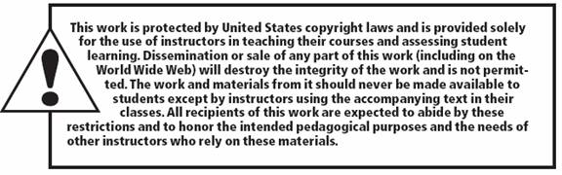
Copyright
All rights reserved. No part of this publication may be reproduced, stored in a retrieval system, or transmitted, in any form or by any means, electronic, mechanical, photocopying, recording, or otherwise, without the prior written permission of the publisher. Printed in the United States of America.

