Slide 1

CH 2
The relational model
Queries in access db (QBE), relational algrebra

Slide 2
Objectives
Describe the relational database model
Create queries using Design view
Include fields in the design grid
Use text and numeric data in criteria
SELECT query
Use compound criteria in queries (AND/OR)
Use parameter query
Use calculated field query

Slide 3
Relational database model - terminology
Some terms and concepts in the database environment are important to know
Entity
  A person, place, event, item, or other transaction for which you want to store and process data
Attribute
  A characteristic or property of an entity, and is also called a field or column in many database systems
Relationship
  An association between entities, for example a one-to-many relationship

Slide 4
Examining relational databases
A relational database is a collection of tables
  Formally, these tables are called relations
Each entity is stored in its own table
The JCC database has a table for employees, for clients, and so on
  The attributes of an entity become the fields or columns in the table
  The table for employees, for example, has a column for the employee ID, a column for the employee’s first name, the employee’s last name, and so on

Slide 5
Examining relational database (2/4)
At JC Consulting, there is a one-to-many relationship between clients and projects
  Each client may be related to many project estimates created for that client
How is the relationship implemented in a relational database?
  The answer is through common columns in the tables
  For any client, you can use these columns to determine all the projects that were created for that client
  Each column in a table should have a short but descriptive unique name
  Entries in each column should be consistent with the column name
  Each row should contain information for a new item in that entity and should not be repeated

Slide 6
EXAMINING RELATIONAL DATABASE 3/4
A relation is a two-dimensional table (rows and columns) in which the following are true:
  The entries in the table are single-valued; that is, each intersection of the row and column in the table contains only one value
  Each column has a distinct name (technically called the attribute name)
  All values in a column are values of the same attribute (that is, all entries must match the column name)
  The order of the columns is not important
  Each row is distinct
  The order of rows is immaterial

Slide 7
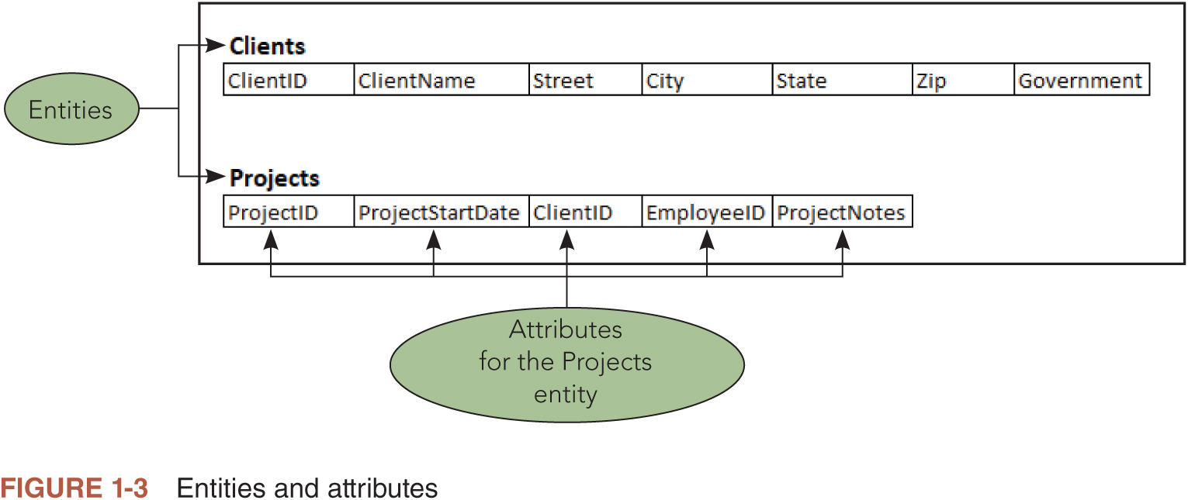
Entities and attributes

Slide 8
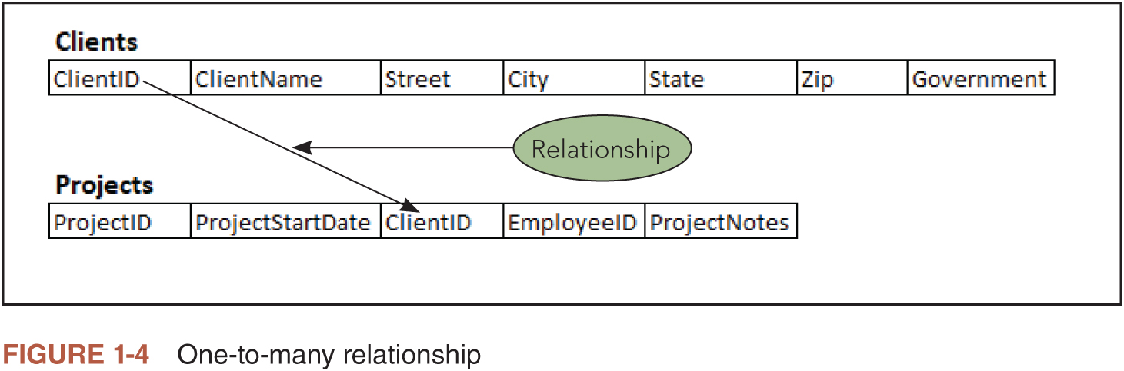
relationships

Slide 9
Examining relational database (4/4)
Relational database shorthand
  You write the name of the table and then, within parentheses, list all the columns in the table
  Each table should appear on its own line
    Employees (EmployeeID, LastName, Firstname, HireDate, Title, Salary)
When a database has duplicate column names, you need a way to indicate the column to which you are referring
  Write both the table name and the column name, separated by a period
    Employees.Salary
Technically, when you combine a column name with a table name, you say that you qualify the column names
  It always is acceptable to qualify column names, even when there is no possibility of confusion

Slide 10
Simple queries and QBE
A query is a question structured in a way that the DBMS can recognize and process
Query-By-Example (QBE) is a visual GUI (graphical user interface) approach to writing queries
  Users ask their questions by dragging column names to a grid as opposed to writing commands from a keyboard
  The upper portion of the window contains a field list for each table used in the query
  The lower pane contains the design grid, the area in which you specify the fields to include in the query results, a sort order for the query results, any criteria, and other instructions

Slide 11
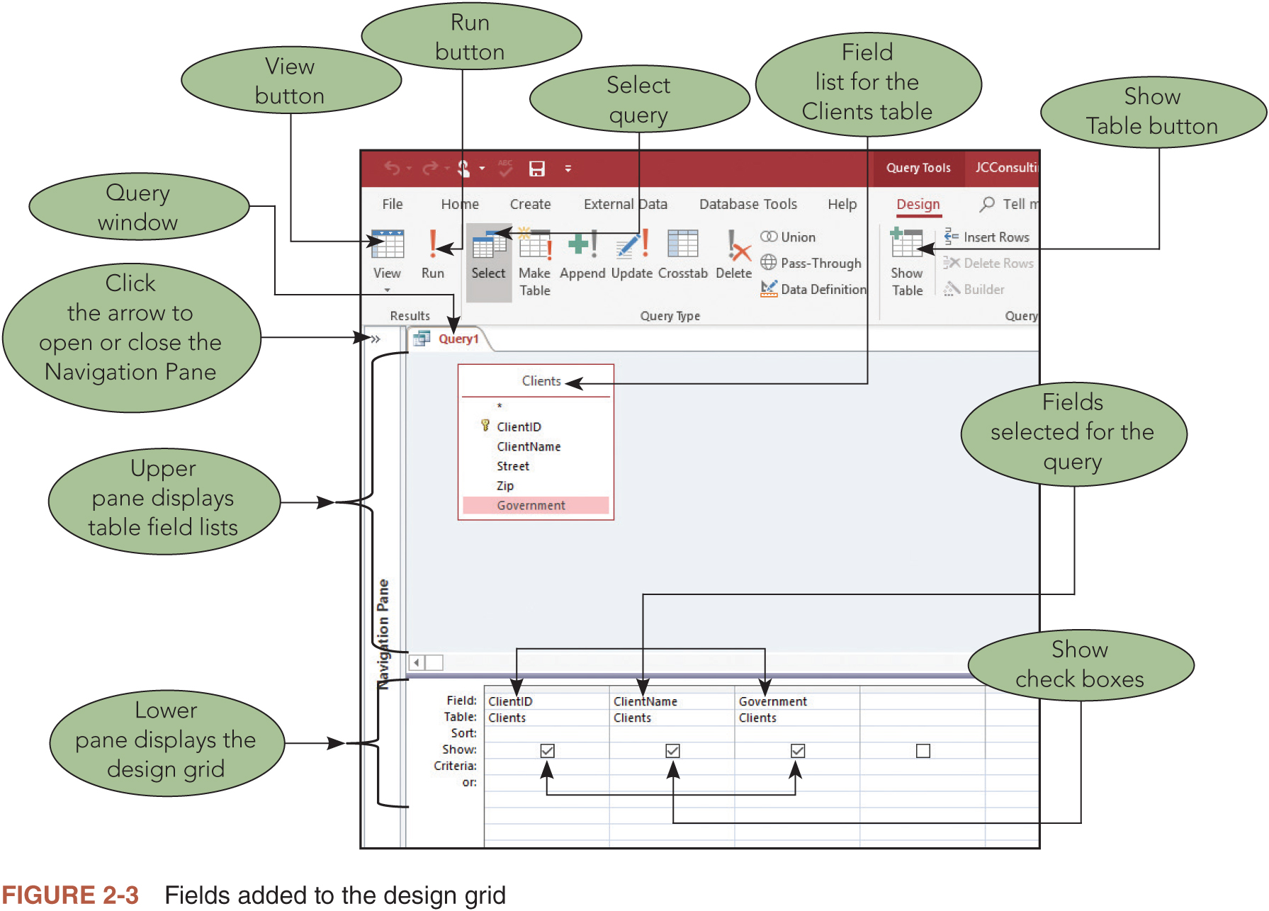
The access qBE (query by design) interface

Slide 12
Simple queries
The two query views you will use in this module are Datasheet View and Design View
It’s common to build a select query in incremental steps
Running a query in Access does not create a copy of the data
You can add and delete records as well as modify data in Datasheet View of a select query
The ability to store data in only one location, the tables, yet allow you to select, view, and analyze it in multiple queries is a powerful feature of all modern relational database systems

Slide 13
Creating Queries – SELECT
To Create a Query in Design View
  Click CREATE on the ribbon to display the CREATE tab
  Click the Query Design button to create a new query
  Click the add table to add table or tables to the query
  Select the table and click the add button to add the selected table to the query
  Click the Close button to remove the dialog box from the screen
  Drag the lower edge of the field list down far enough so all fields in the table appear

Slide 14
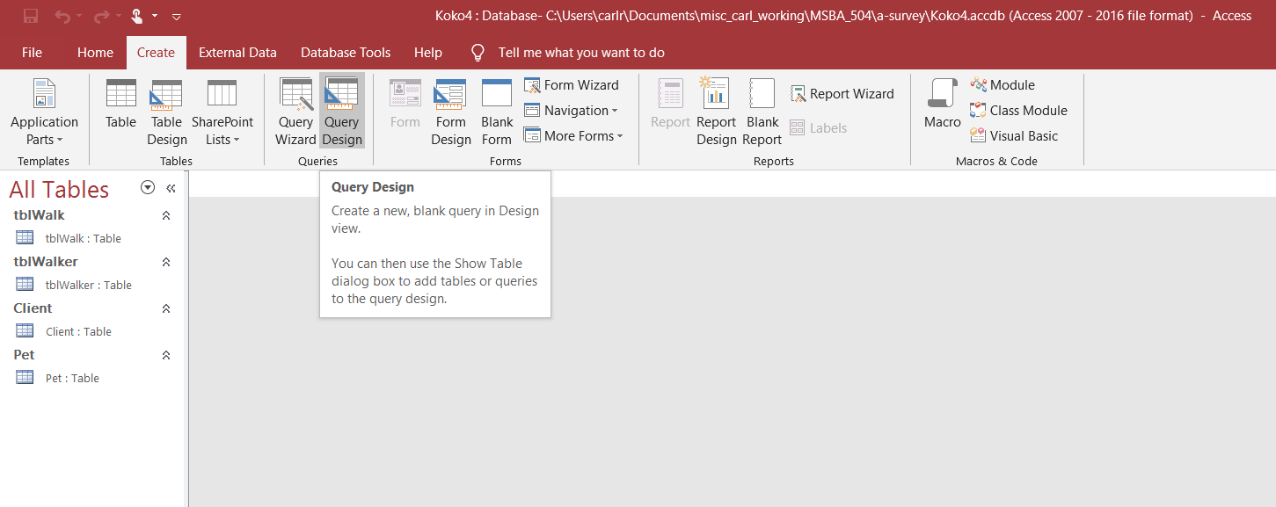
Select Create tab and then Query Design Button

Slide 15
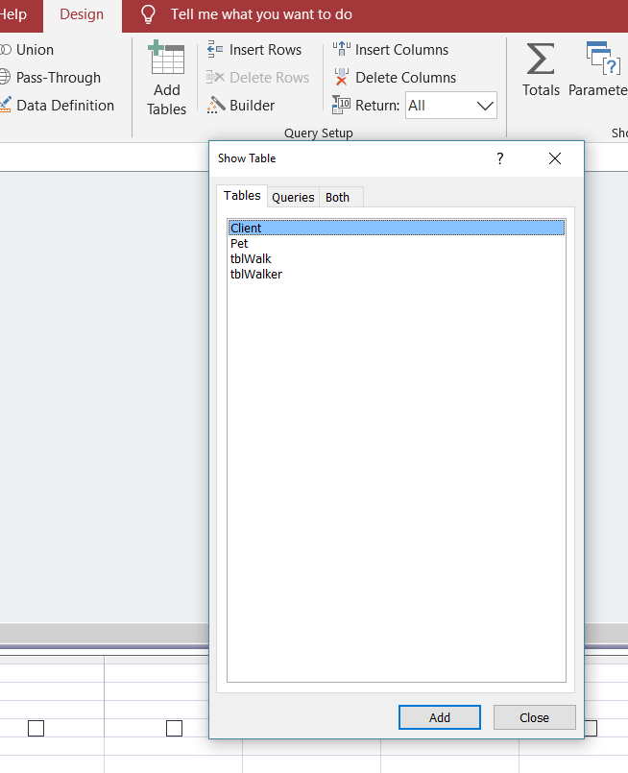
Select Add TaBLE Button, then select table, and click on add Button

Slide 16
Creating queries (the select with numeric criterion ISQ1)
  After you have selected your table, Click the Close button to remove the dialog box from the screen
  You table will appear in the query design field
  Drag the lower edge of the field list down far enough so all fields in the table appear (in necessary)
  Repeat this process as necessary until all necessary tables are included.
    NOTE do not include all tables in the database ONLY those that are needed to answer the query

Slide 17
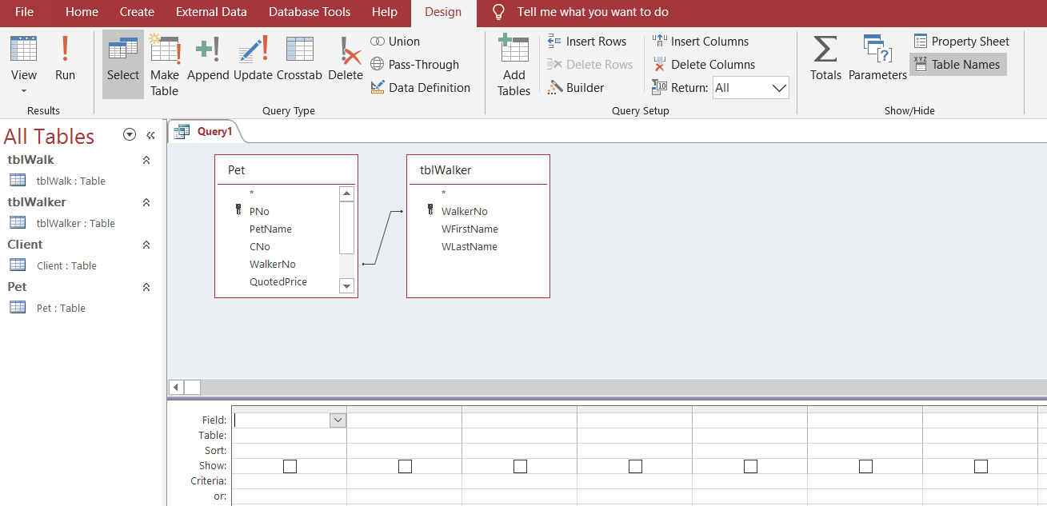
Creating Queries
Notes:
Figure 2-2: display of a query in Design view

Slide 18
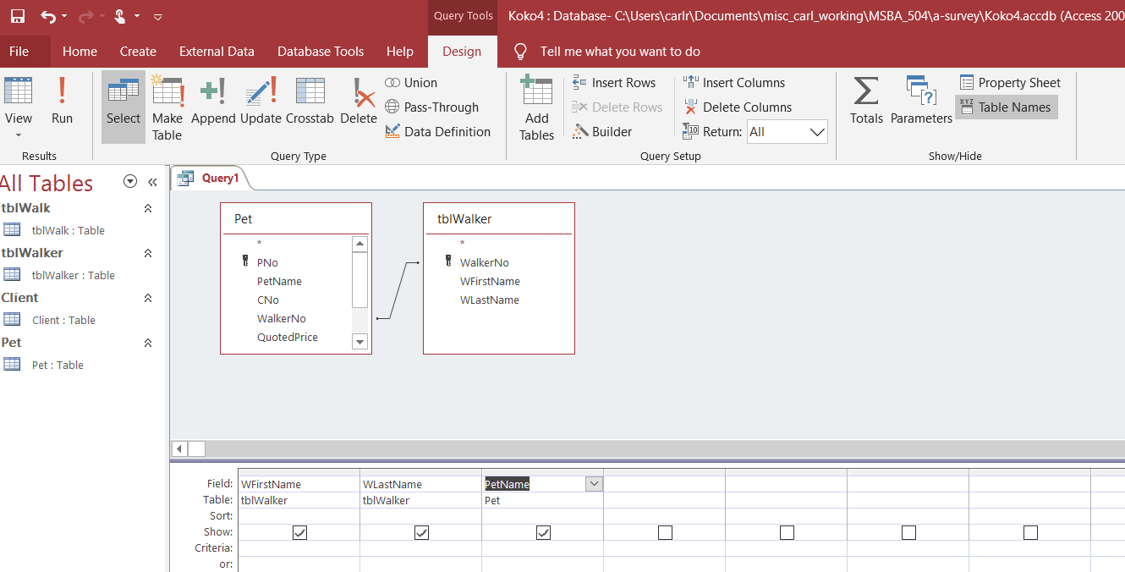
Add Fields by either selecting and drag, or double-click
For purposes of this illustration, the fields shown correspond to ISQ1 in the Kokos case.

Slide 19
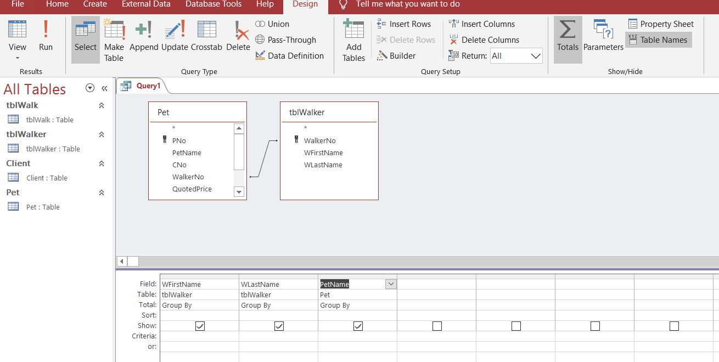
Selecting the sigma button adds TOTALS row

Slide 20
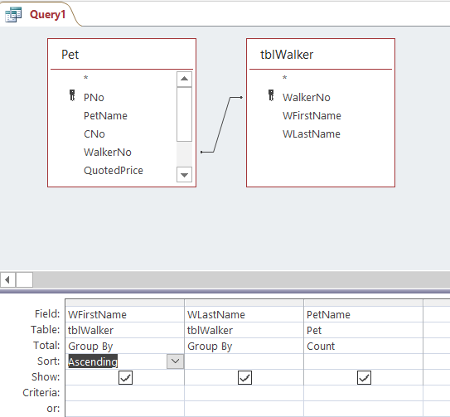
The detail below tables allows for criterion and sorting
In this example, ISQ1 asks for a query that shows each pet walker first and last name and the pet count of each pet walker. There is also a request that the information is sorted in ascending order based on the pet walker’s last name.
The sigma button provided the totals row which allows
Us to ust the COUNT function
Below the totals row is the ability to select SORT

Slide 21
Simple criteria
When the records you want must satisfy a condition, you enter that condition in the appropriate column in the query design grid
  Conditions also are called criteria
If you plan to use a query repeatedly, but with different criteria, you might want to save it as a parameter query
  A parameter query allows you to enter criteria when you run the query, as opposed to placing it in the design grid
A comparison operator, also called a relational operator, can be used in criteria to compare two values in a test that returns true or false
  The comparison operators are = (equal to), > (greater than), < (less than), >= (greater than or equal to), <= (less than or equal to), and <> (not equal to)

Slide 22
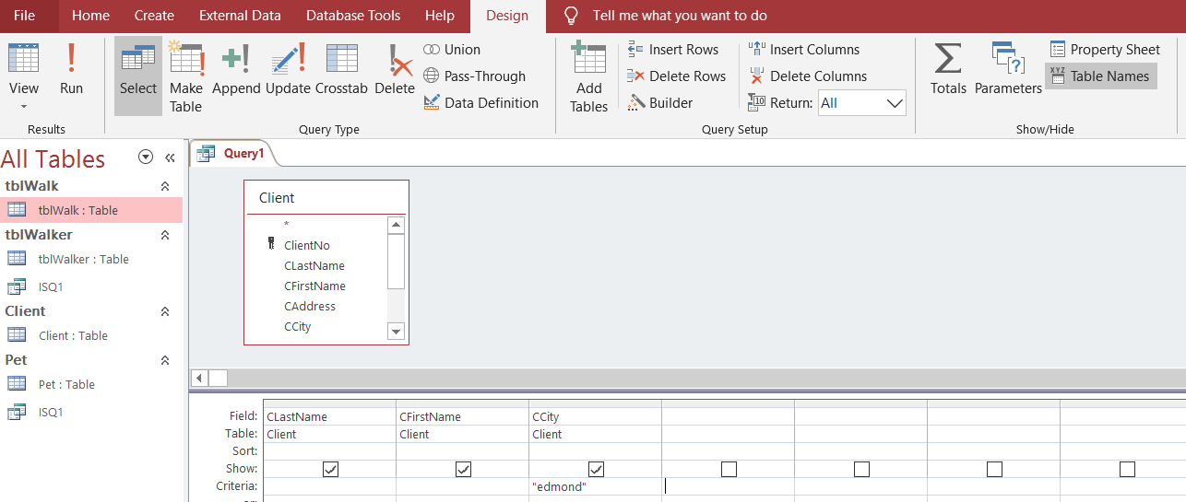
ISQ2 Select CRITERION on value HARD CODED
Question asks which clients are located in Edmond,
and to accomplish this the specific value is placed in t
The criteria row in the bottom design grid

Slide 23
Parameter query
If you plan to use a query repeatedly, but with different criteria, you might want to save it as a parameter query
  A parameter query allows you to enter criteria when you run the query, as opposed to placing it in the design grid
  The syntax is started and ended with brackets [ ]
    In the ISQ2 example, the question explicitly asks for Edmond. To change it to a parameter query remove Edmond to [which city?]
      The actual text inside the brackets does not matter it is only the text shown to the end user, access only cares about the value placed in the enter parameter value box

Slide 24
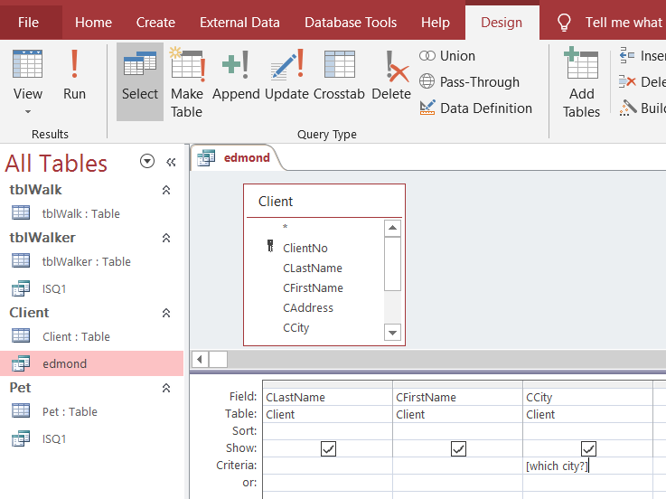
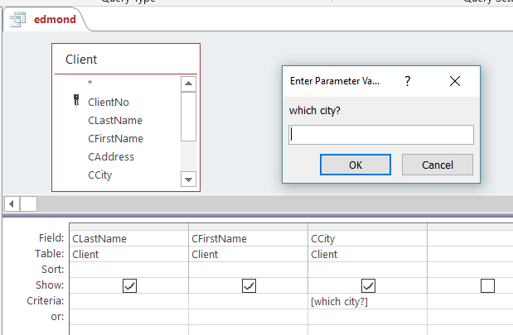
Parameter value
Syntax
When run produces parameter value box

Slide 25
Compound criteria
You can combine more than one criterion to create compound criteria, or compound conditions
If you use AND criteria, each criterion must be true for a record to be selected
If you use OR criteria, only one of the criterion must be true for a record to be selected
You may add as many AND or OR criteria as desired to create the combination needed for the query
The key is to remember that all AND criteria must be true and only one OR criterion must be true for the record to be selected

Slide 26
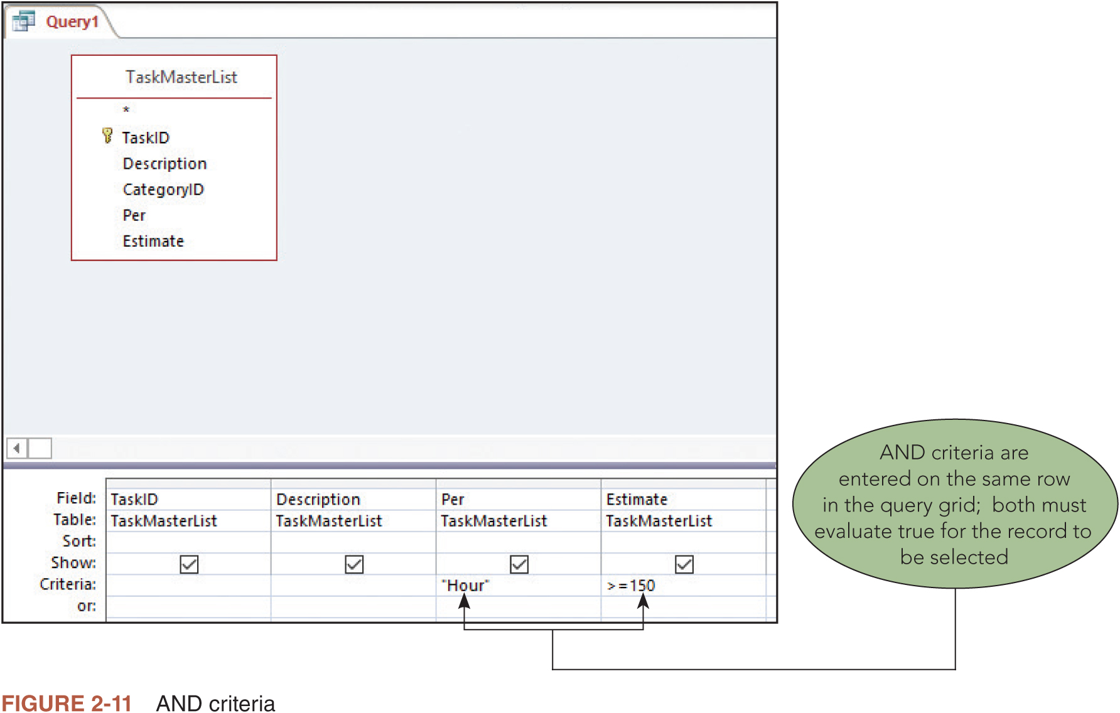
AND cRITERIA

Slide 27
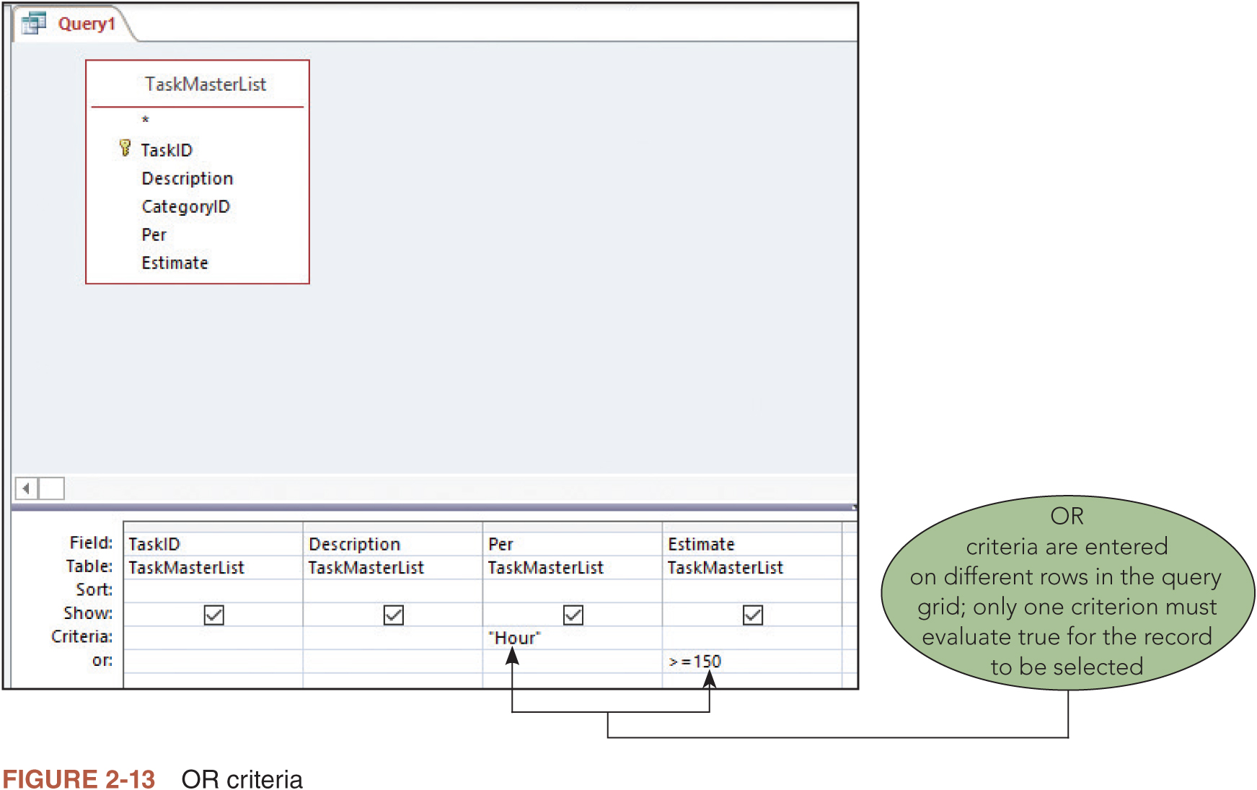
OR CRITERIA

Slide 28
Calculated fields (1/4)
A computed field or calculated field is a field in a record that is the result of a calculation using data from the rest of the record
Any time you can determine the value of a field using information from existing fields in a record, you should create a computed field
For example, a record in a line item table may include a value for a discount or a tax
  By calculating the discount or tax from other data in the record, you can be confident that the discount or tax values are calculated correctly
  Asking a user to enter the discount or tax values, is both error prone and unproductive
You can also create computed fields from existing fields that contain text

Slide 29
Calculated fields (2/4)
In Access, when you use a field name in an expression, it is enclosed in [square brackets]
When you are entering the expression, you do not need to include the [square brackets] for field names that do not contain spaces
However, field names that have spaces require this syntax, so it’s a good habit to include the square brackets around field names any time you are using them in an expression
If you open the Zoom dialog box to create a computed field, close the dialog box by clicking OK, and then click the Run button (Query Tools Design tab | Results group) to display the query results

Slide 30
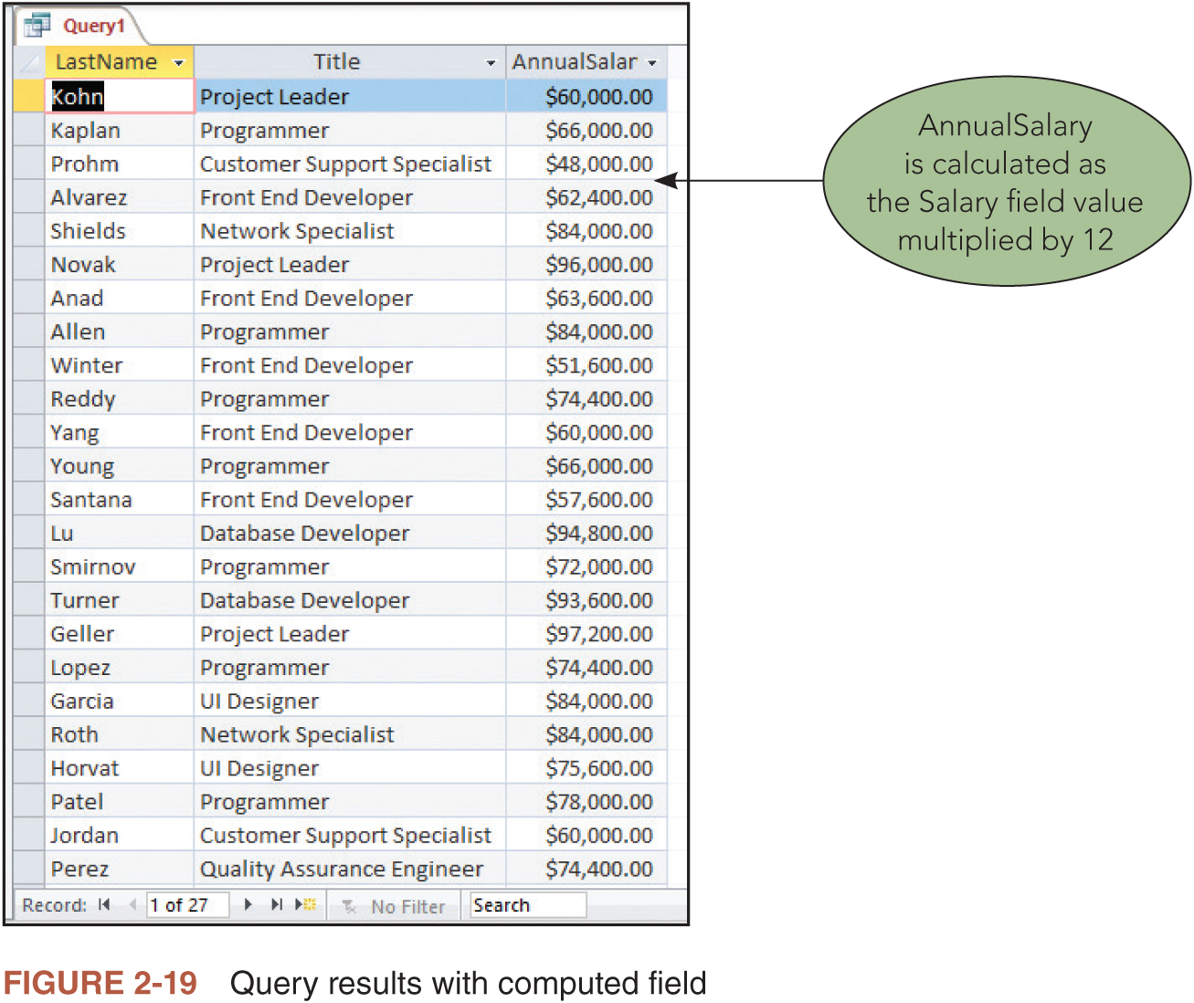
Calculated fields (3/4)

Slide 31
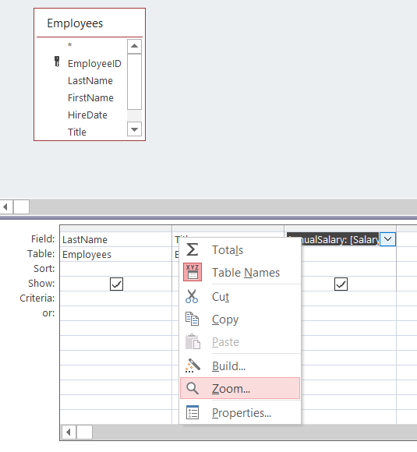
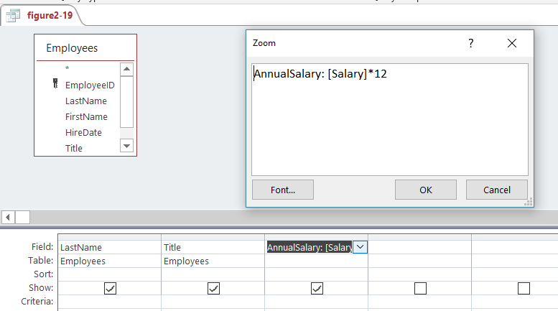
Calculated fields (4/4)
Right click on field row to see zoom selection
When zoo box opens up, manually type in code, in this case words before the colon (:) tells Access what the field name should be, everything after the colon is the calculated field formula

Slide 32
Summarizing with aggregate functions (1/3)
Aggregate functions use a single field name as their only argument such as Sum([Salary]) or Count([LastName])
The following are common aggregate functions:
  Avg: Returns the average value of a numeric field in a group of records
  Count: Returns the number of records in a group
  Max: Returns the maximum field value in a group of records
  Min: Returns the minimum field value in a group of records
  Sum: Returns the summed total of a numeric field in a group of records
Before creating a query with an aggregate function, you should decide how you want to group the records together

Slide 33
Summarize with aggregate function (2/3)
Without a grouping field, all records are summarized for the calculation
You can add criteria to the query grid to further refine which records are selected for the query
You can also add criteria to the query grid for queries that group and summarize data using the WHERE keyword
Date criteria is surrounded by # symbols (sometimes called the pound sign, hash mark, or octothorpe symbol)
  Access automatically adds the # symbols around date criteria if you do not enter those symbols yourself
Text criteria is surrounded by “quotation marks”

Slide 34
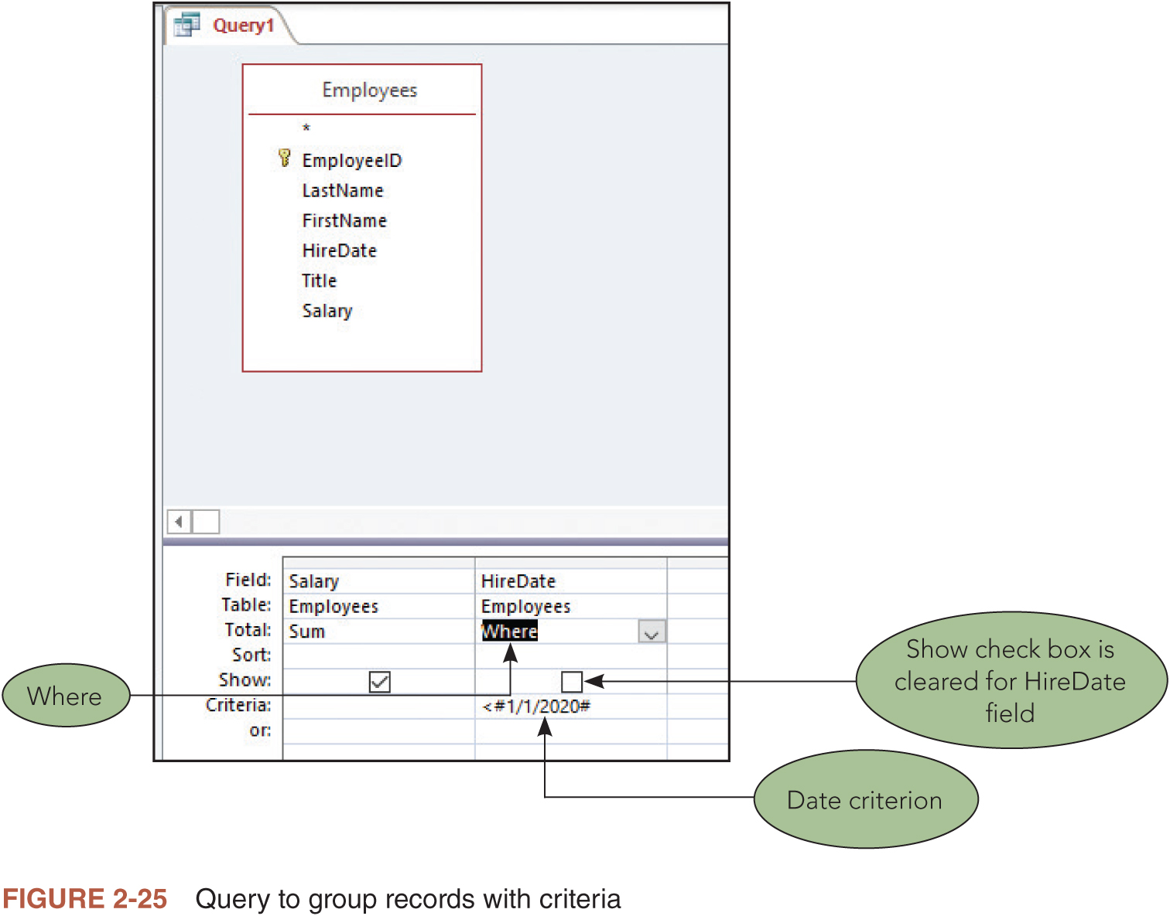
Summarize with aggregate function (3/3)

Slide 35
sorting
Specifying a sort order to determine the order of the records that are selected for a query can make the information easier to read
The field on which records are sorted is called the sort key
  You can sort records using as many fields as desired
  To sort in Access, you specify the sort order
You can specify more than one sort key in a query
  The leftmost sort order in the design grid is the major (primary) sort key
Moving a column changes the output order
  If the original order is important, you can include the secondary sort field twice

Slide 36
JOINING TABLES pt1
In many cases you will need to create queries to select data from more than one table at the same time
  To do so, it is necessary to join the tables based on a common field
  You can join two tables in the upper pane of Query Design View
  It is more productive to join the tables ahead of time, in the Relationships window, so that they are automatically joined for every query
The Relationships window is where you add, delete, or modify relationships between tables
  The one symbol on the join line between the two tables identifies the field in the “one” table (parent table)
  The infinity symbol identifies the field in the “many” table (child table)

Slide 37
Joining tables pt2
Notice that the field on the “one” side of a one-to-many relationship is always a primary key field as indicated by the key symbol to the left of the field in the field list
The field on the “many” side of a one-to-many relationship is called the foreign key field
Recall from Module 1 that referential integrity is a set of rules applied to the relationship that prevents the creation of orphan records
  An orphan record is a record in the “many” (child) table that has no match in the “one” (parent) table
A relationship created in Query Design View will not allow you to enforce referential integrity

Slide 38
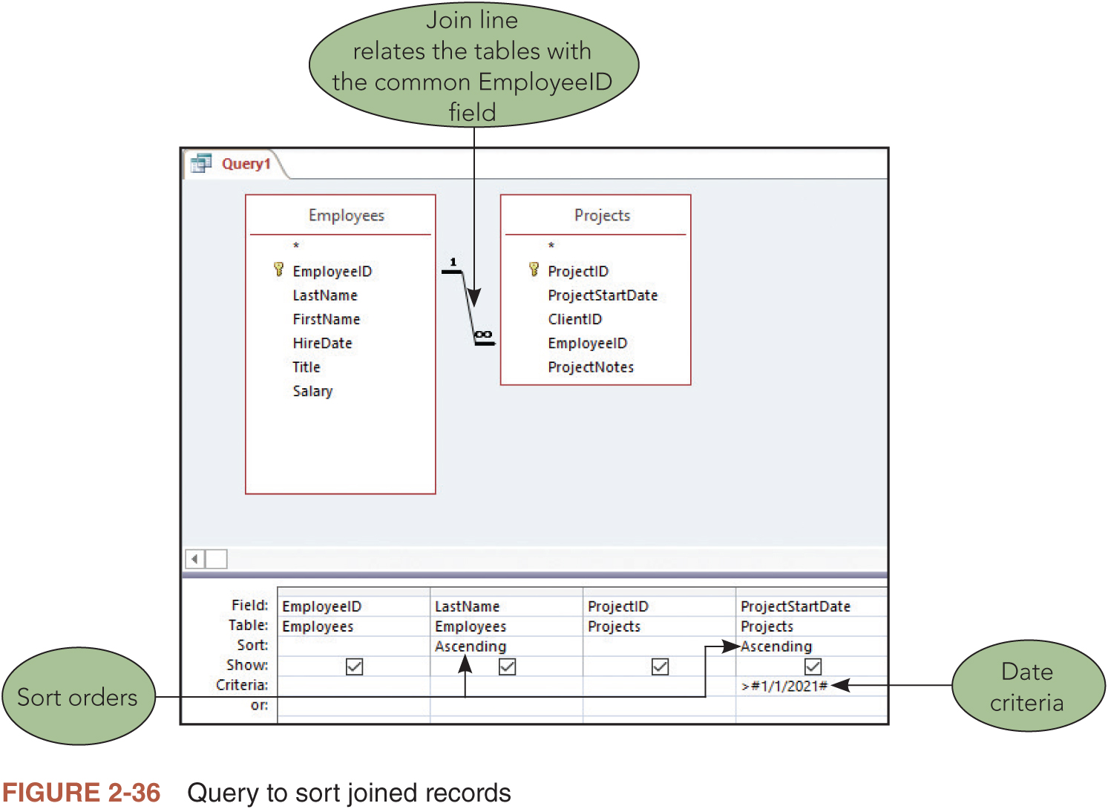
Joining tables pt3

Slide 39
Update query
Modifying several records in a single process is sometimes called a batch update
A query that changes data in a batch process is called an action query
An update query makes a specified change to all records satisfying the criteria in the query
  There is no undo feature to reverse the changes made by an update query
  First use a select query to make sure you have the correct records
  Once sure, change to an update query and run the update process

Slide 40
Delete query
A delete query permanently deletes all the records satisfying the criteria entered in the query
  Cannot be undone
  If you run a delete query with no criteria, all records are selected
  Running a delete query in that situation would delete all records from the table with fields in the query grid

Slide 41
Make table query
A make-table query creates a new table in the current or another database with the records selected by the query
  The new table is a copy of the selected data
  Make-table queries are only needed for specific reasons such as preparing data to be used by programs outside of the database or creating archived copies of data to capture information as of a particular point in time
You can also specify sort orders within the make-table query if you want to order the records in a specific way in the new table

Slide 42
Optimizing queries
A query optimizer is a DBMS component that analyzes a query and attempts to determine the most efficient way to execute it
  The query optimizer is a process that occurs behind the scenes without direct access to those who use the database
In addition to using a query optimizer, you can use other techniques to increase the speed of your queries
  Establish as many relationships in the Relationships window as possible
  Enforce referential integrity on as many relationships as possible
  Include only the minimum number of fields necessary
  Delete any field lists that are not needed for the query
  Include meaningful criteria

Slide 43
Relational algrebra pt 1
Relational algebra is a query language that takes instances of relations as input and yields instances of relations as output
Relational algebra is rarely directly used with modern database management systems today
Relational algebra provides the foundation for SQL, Structured Query Language
  Vitally important to programmers seeking to select, enter, update, and delete data stored in relational databases

Slide 44
Relational algebra pt 2
Common commands and operators used with relational algebra
  Select
  Project
  Join
  Union
  Intersection
  Subtract
  Product
  Rename

Slide 45
Summary pt1
A relational database is a collection of relations.
An unnormalized relation is a structure in which a field may have multiple values.
A field name is qualified by preceding it with the table name and a period.
A table’s primary key is the field or fields that uniquely identify a given row within the table.
QBE is a visual tool for selecting and changing data in relational databases.
Criteria are conditions added to a query that limit the number of records that are selected.

Slide 46
Summary pt.2
To create a calculated field in Access, enter an appropriate expression in the desired column of the design grid.
Aggregate functions are used to summarize data for a group of records.
To sort query results in Access, select Ascending or Descending in the Sort row for the field or fields that are sort keys.
To join, delete, or modify table relationships in Access, use the Relationships window.
Queries that update data in a batch process are called action queries.
Relational algebra is a theoretical method of manipulating relational databases and is the foundation for SQL, Structured Query Language.

