Slide 1

Chapter 3
Going to SQL

Slide 2
Learning Objectives
Examine Structured Query Language (SQL)
Create tables and fields with SQL
Select data using criteria in SQL
Select data using AND, OR, BETWEEN, and NOT operators
Create computed fields in SQL
Use wildcards and the LIKE and IN operators
Apply built-in SQL aggregate functions
Group records in SQL
Use subqueries in SQL

Slide 3
In class Practice for SQL Assignment FIVE packET
SMSS OVERIEW
a CREATE TABLE
  a1INSERT INTO TABLE
b SELECT FROM
c SELECT FROM WHERE
d LOGICAL OPERATORS
e INEXACT MATCH
f IN AND NULL
material revised from University of Arkansas/Microsoft Enterprise Consortium, originally prepared by Jennifer Kreie

Slide 4
What you will need
For these SQL lessons, you need your EPIC user account and password. You can log in remote at https://waltonlab.uark.edu/ and work through the browser or there is an option to download the Horizon Client and run a direct application.
Remember BE EPIC when using EPIC
  Excellence
  Professional
  Innovative
  Collegial

Slide 5
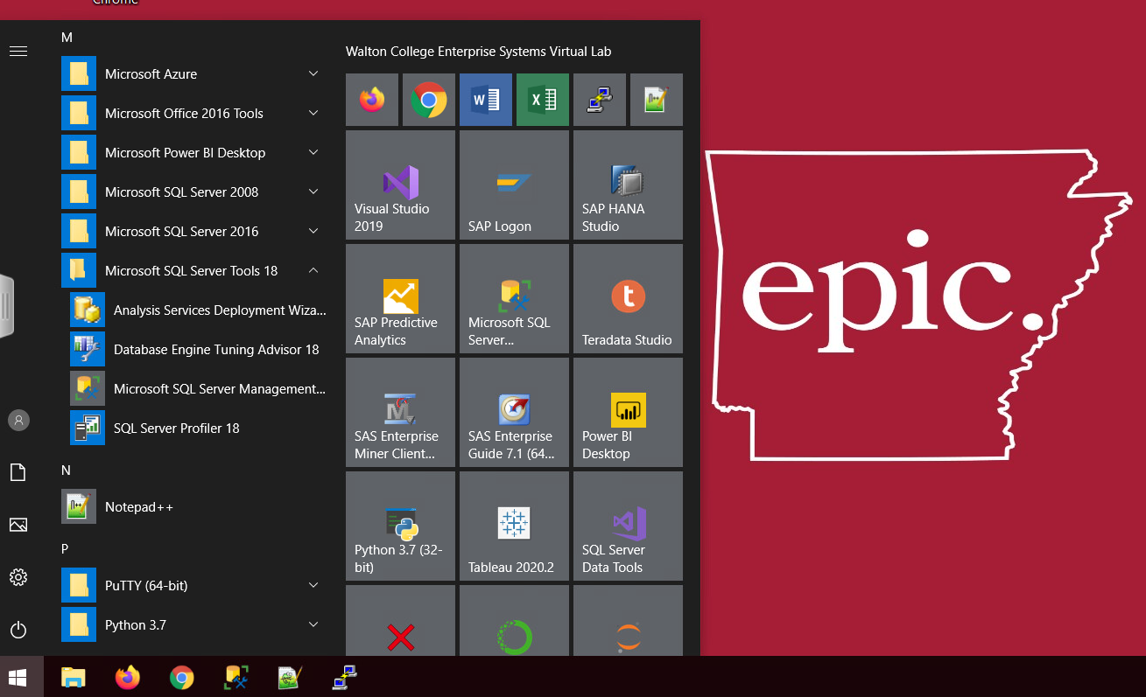
Starting Screen
There are three ways to access SMSS (MS SQL Management Server Studio
Through icon on the task bar, through icon on startup, and through the listing of
installed applications.

Slide 6
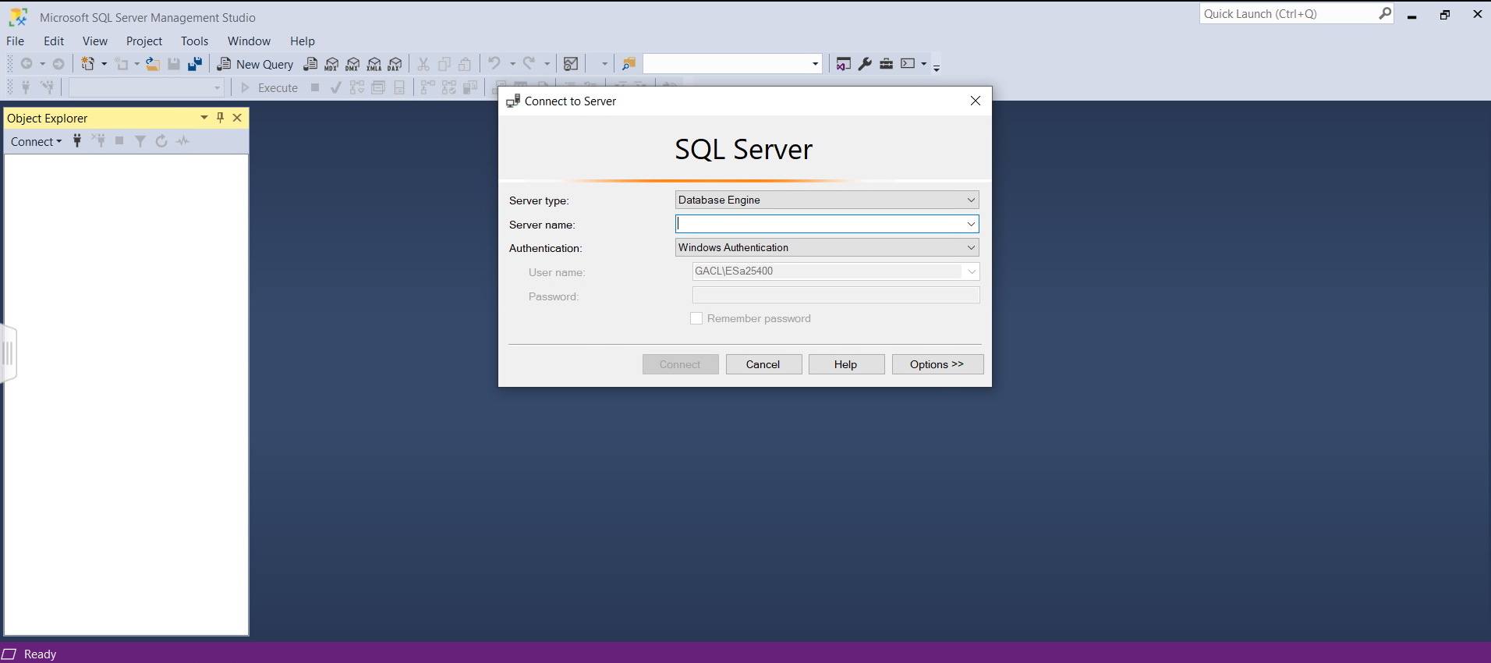
After splash screen comes up, you will also be required to login into the SQL Server

Slide 7
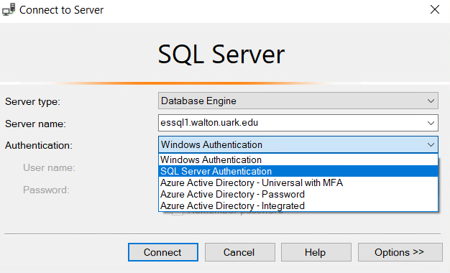
SMSS LOGIN
You will need the exact name of the server.
  essql1.walton.uark.edu
  There are several types of authentication, and you only need to be concerned with 2 of them.
    WINDOWS Authenication will allow you to run queries and does not give you any access to your own db, or creating tables, etc. You also do not need to supply anymore credentials since you have validated yourself in the earlier remote access step
    SQL Server Authentication – this will be necessary if you want to use your own db, create tables, import, etc, and YOU WILL need to authenticate yourself again.
      You should be able use your same UARK login

Slide 8
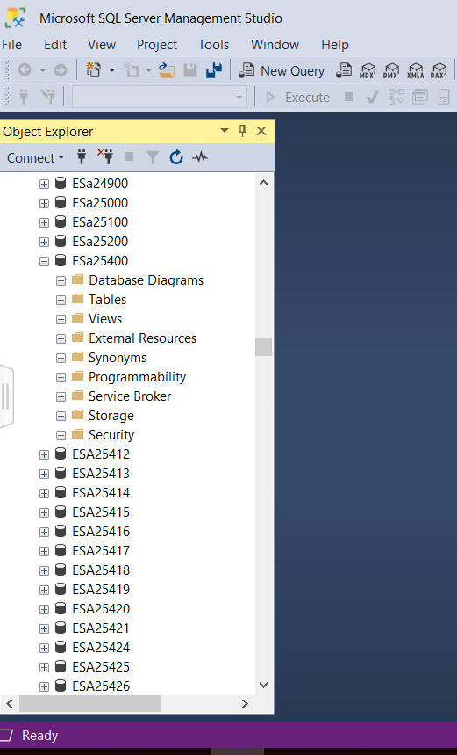
Object EXPLORER pane
The Object EXPLORER provides a hierarchical view of databases maintained by a SQL Server installation.
Username (database name)
  Schema name
    Object name

Slide 9
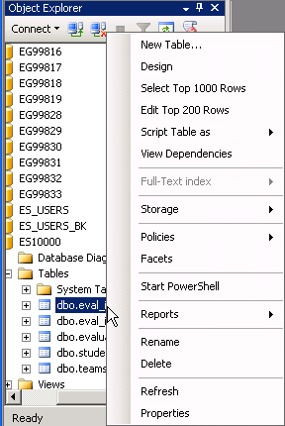
Object EXPLORER Context menu
The context-sensitive menu (right-click) gives you several options when working with objects such as tables.
Top 1000
Top 200
and more …

Slide 10
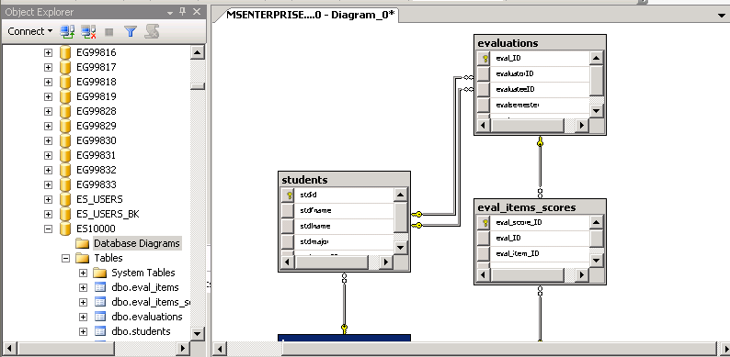
Database Diagram
An easy way to see how a list of tables comprise a database is to create a diagram.
This diagram shows the relationships between table.
For a database with a lot of table, such as AdventureWorks2008, you can select a subset of tables for a diagram.

Slide 11
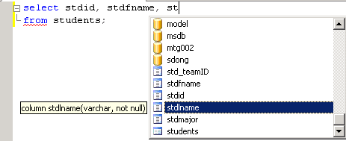
Query Editor Window
IntelliSense features helps you enter SQL code.
Suggestion: When writing SQL commands, enter the table(s) first to help IntelliSense feature help you.

Slide 12
Creating a Table (1 of 2)
You may need to learn how to create a new table to enhance the database at a later time
The SQL CREATE TABLE command creates a new table
The rules for naming tables and columns vary slightly from one relational database management system to another
  It is a good practice to avoid spaces or any special characters in table or field names
  If a name already has spaces, enclose that field name or table in brackets
  If permitted to use upper and lower case letters, capitalize the first letter to create a recognizable name
  Underscore can also be used to separate words in field names

Slide 13
Creating a Table (2 of 2)
Some of the common data types used to create tables with SQL Create Table command
  AutoNumber (COUNTER or AUTOINCREMENT)
  Currency (CURRENCY)
  Date/Time (DATETIME)
  Long Text (LONGTEXT)
  Number (SINGLE, DOUBLE, BYTE, SHORT, and LONG)
  Short Text (TEXT or VARCHAR)
  Yes/No (YESNO)

Slide 14
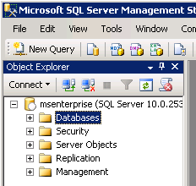
Object Explorer in MSSMS
In the Object Explorer select and expand the Database section.
Locate your account ID in the list NOT the account shown here.

Slide 15
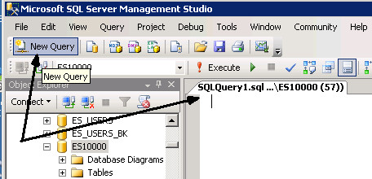
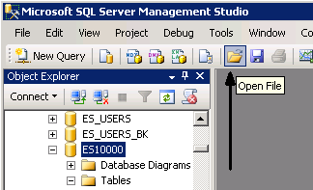
SQL pane
First make certain you download the 3 SQL Scripts from the MSBA 504 course website (while in the EPIC remote access)
Either click New Query to open an SQL pane and paste in the contents of the “create” script OR …
Open the CREATE script file, which opens the SQL pane with the file contents.

Slide 16
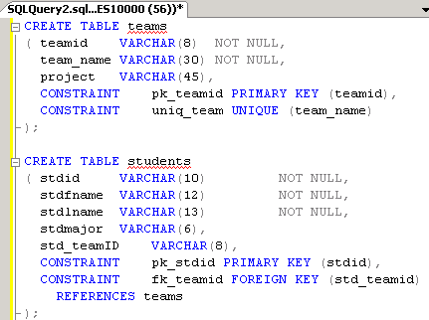
CREATE – Build tables & relationships.
The CREATE script contains several comments. You should read these to learn more about the Student-Teams database and the SQL commands this script.
The commands in this file show:
  How to create a table by defining the columns it will contain.
  How to define a primary key field.
  How to define a foreign key field (a relationship).

Slide 17
Relationships and the CREATE TABLE sequence.
A data model shows the sequence in which tables are created in the database.
In a one-to-many relationship, the table on the “one” side is created first so that it already exists when the foreign key constraint is created in the “many” table.
The CREATE TABLE statements in the script are listed in the correct order. Execute these SQL commands.
Click
TEAMS
STUDENTS
EVAL_ITEMS
TEAMS is created before STUDENTS.
STUDENTS is created before EVALUATIONS.
EVAL_ITEMS and EVALUATIONS are created before EVAL_ITEMS_SCORES.
EVALUATIONS
EVAL_ITEMS_SCORES

Slide 18
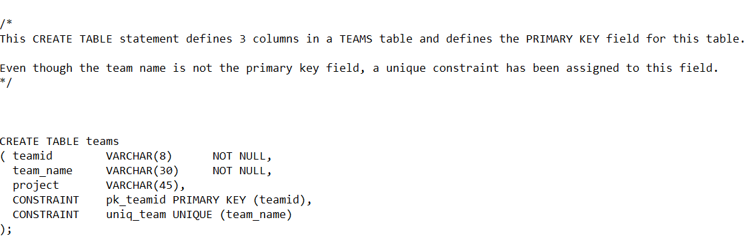
CREATE TABLE CODE

Slide 19
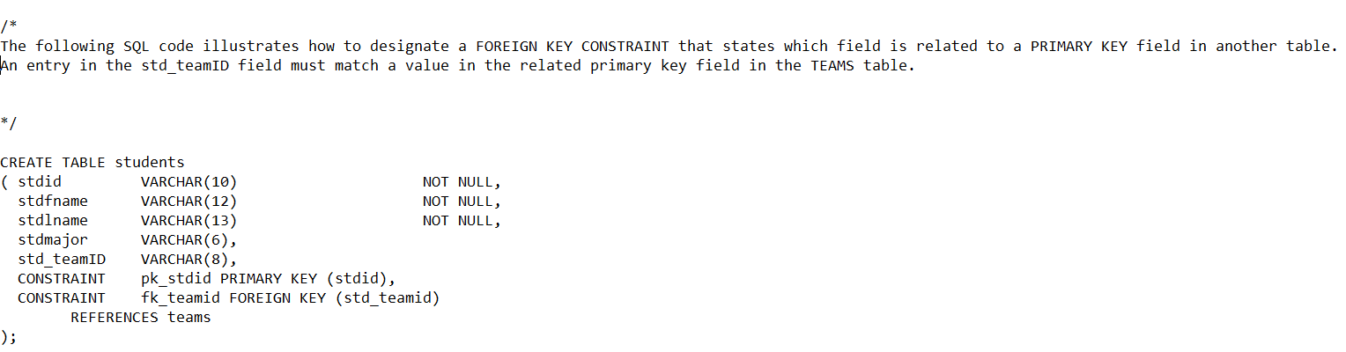
ADDING PRIMARY AND FOREIGN KEY CONSTRAINT [CODE]

Slide 20
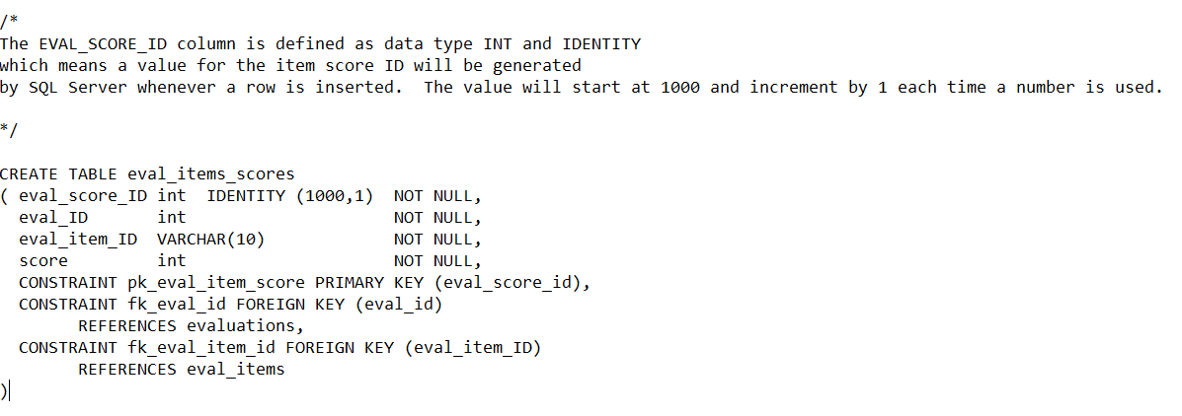
Creating and AUTOID FIELD

Slide 21
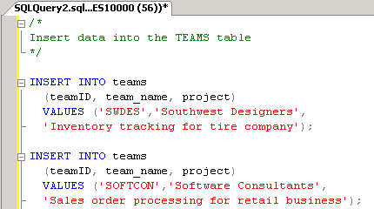
INSERT INTO – Populate the tables.
The INSERT INTO script has SQL commands to insert data into the tables in the Student-Team database.
First, you specify the table name after INSERT INTO.
Next, you list in parentheses the column names in the order in which the data is listed.
  Each column name is separated by a comma.
Last, after VALUES the data values are listed in parentheses.
  Each value separated by a comma.

Slide 22
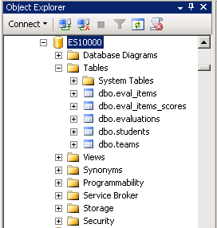
Student-Teams Database
Now you have the Student-Teams database in your MEC account. You can see the list of tables in the Object Explorer pane.
NOTE 1: Need to drop these tables? A script for deleting these tables is available. Also, MSSMS can generate these commands for you if you right-click a table then select SCRIPT TABLE AS ... DROP TO ....
NOTE 2: There are graphical tools that allow you to create tables and populate them without writing the SQL yourself. However, the purpose of these lessons is to learn SQL so we won’t use these tools right now.

Slide 23
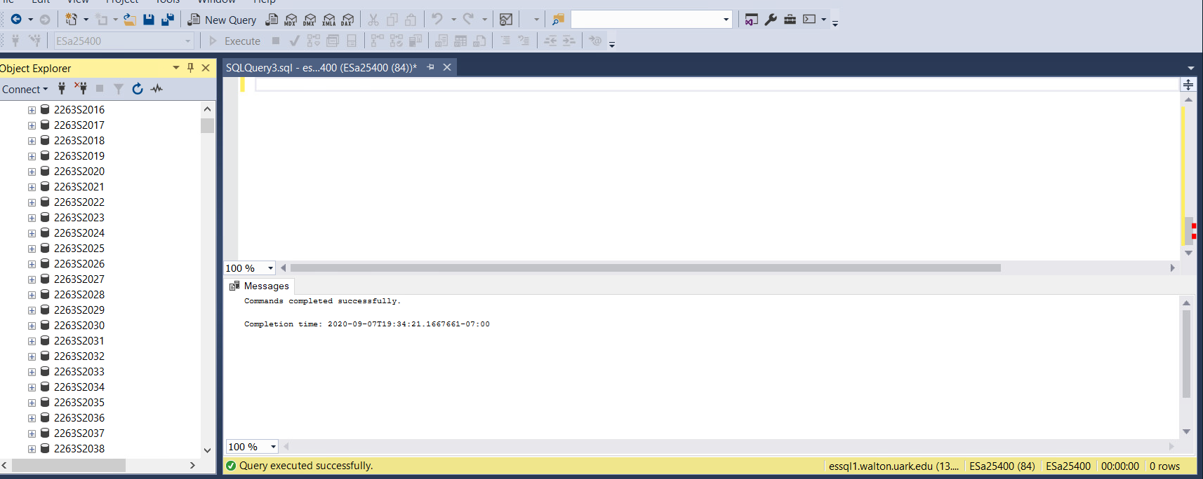
After you have entered in your CODE you need to hit EXECUTE to run the query. If successful a message will appear at the bottom

Slide 24
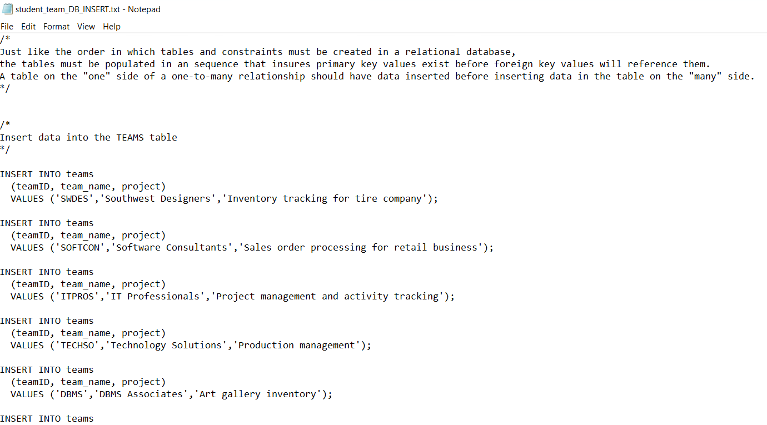
Open up and copy the STUDENT_TEAMdb_INSERT code

Slide 25
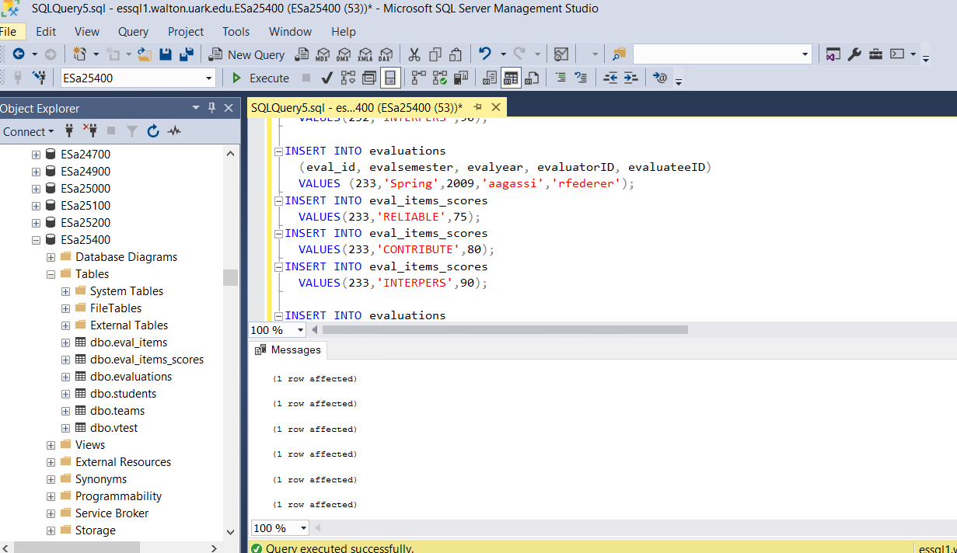

Slide 26
Select from query

Slide 27
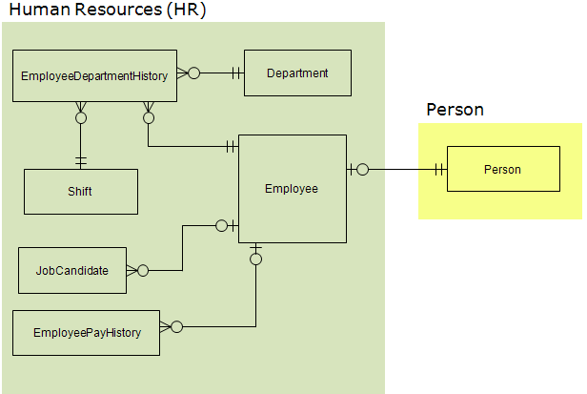
AdventureWorks
Microsoft provides an example database called AdventureWorks (AW). For the time being, only a subset of tables from this database will be used.
Shown here is the data model for the HR portion of the AW database. An additional table is included from the PERSON section of the database.

Slide 28
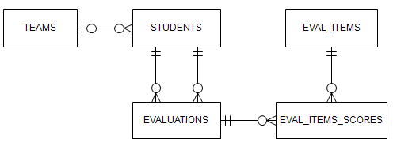
Student-Teams
This database keeps information about students, the teams they are assigned to and the peer evaluations students complete for their teammates at the end of a project.

Slide 29
SELECT … FROM
The SELECT statement has several components but let’s start with only the FROM clause.
A simple SELECT statement has the following format …
    SELECT <column1>, <column2>, …
    FROM <tablename>;
The angle brackets indicate words that change depending on what data we want to see.
Recommendation: Keep all the SQL commands you write for a lesson in a text file using Notepad. Do the same for SQL you write or assignments.

Slide 30
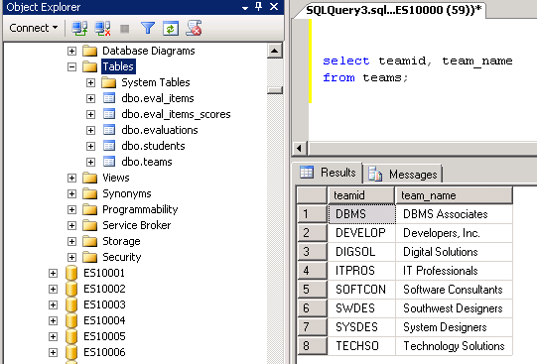
Query the Student-Team database
Open a Query pane (New Query).
Type the SQL in Notepad then copy/paste into the query pane. Add a comment.
Let’s start off by seeing what teams there are.
Enter two columns (teamID and team_name) in the SELECT clause.
List the table name in the FROM clause.
Execute the query.
/* Show teams */
select teamid, team_name
from teams;

Slide 31
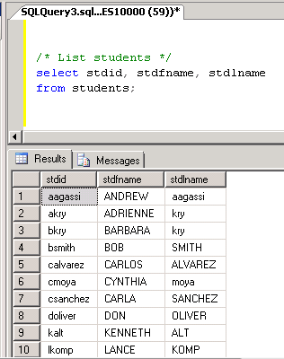
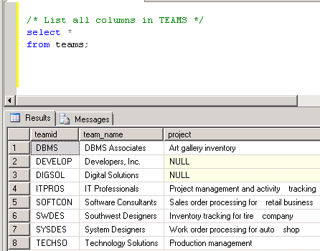
Query students & teams
Query the STUDENTS table and show the ID and full name of each student.
/* List students */
select stdid, stdfname, stdlname
from students;
Query the TEAMS table and show all columns.
The asterisk is a “wild card” that means to show all columns without listing them by name.
/* List all columns in TEAMS */
select *
from teams;

Slide 32
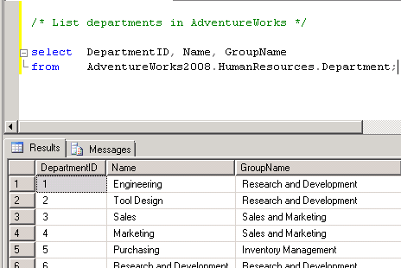
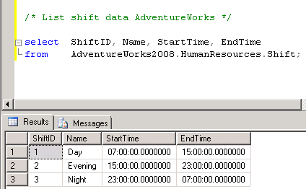
Query tables in AdventureWorks (AW)
The AdventureWorks2008 database is not in your account. To query tables in other accounts, you need to add more information to the table name in the FROM clause.
In SQL below we specify the database or account name and the schema
    databasename.schema.tablename
/* List departments in AdventureWorks */
Select DepartmentID, Name, GroupName
From AdventureWorks2008.HumanResources.Department;
Show information about shifts.
/* List shift data AdventureWorks */
Select ShiftID, Name, StartTime, EndTime
From AdventureWorks2008.HumanResources.Shift;

Slide 33
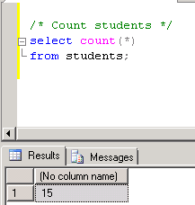
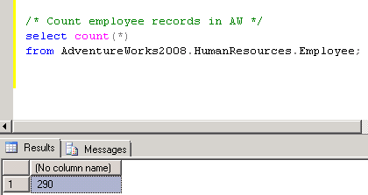
Count rows in a table
How many students are there?
/* Count students */
select count(*)
from students;
How many records are there in AW2008’s EMPLOYEE table?
/* Count employee records in AW */
select count(*)
from AdventureWorks2008.HumanResources.Employee;

Slide 34
SELECT FROM WHERE

Slide 35
SELECT … FROM … WHERE
Adding the WHERE clause to the SELECT statement allows you to filter output based on a criterion.
Syntax:
    SELECT <column1>, <column2>, …
    FROM <tablename>
    WHERE <column> = <criterion>;
The syntax shown here checks whether data in a column equals the criterion. Of course, other evaluations can be used.

Slide 36
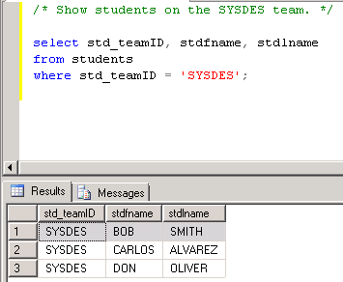
Query the Student-Team database
Open a Query pane (New Query).
Find out which students are on the Systems Designers (SYSDES) team.
/* Show students on the SYSDES team. */
select std_teamID, stdfname, stdlname
from students
where std_teamID = 'SYSDES';

Slide 37
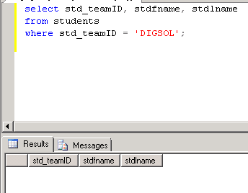
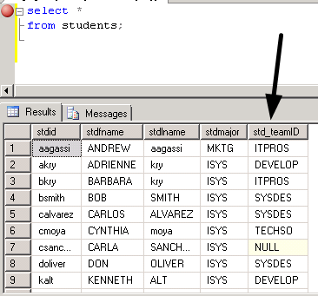
Find students on another team.
Which students are on the Digital Solutions team?
/* Show students on the DIGSOL team. */
select std_teamID, stdfname, stdlname
from students
where std_teamID = 'DIGSOL';
/* Show all student data.
Show that no one is on the DIGSOL team.*/
select *
from students;

Slide 38
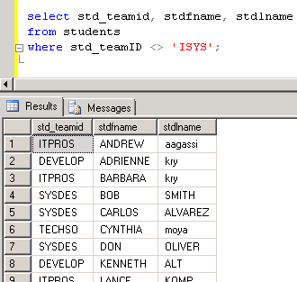
Filter students by major
Which students are majoring NOT in IS?
  Use “not equal” for the evaluation.
/* Show students not majoring in information systems. */
select std_teamid, stdfname, stdlname
from students
where std_teamID <> 'ISYS';

Slide 39
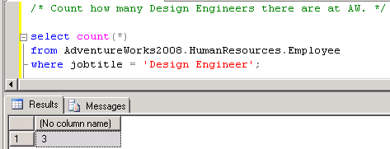
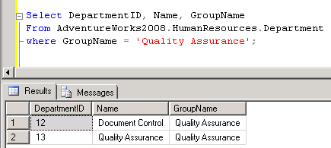
Query the AW database
Count how many AW employees are Design Engineers.
/* Count how many Design Engineers there
are at AW. */
select count(*)
from AdventureWorks2008.HumanResources.Employee
where jobtitle = 'Design Engineer';
Which departments are in the Quality Assurance group?
Select DepartmentID, Name, GroupName
From AdventureWorks2008.HumanResources.Department
where GroupName = 'Quality Assurance';

Slide 40
LOGICAL OPERATORS

Slide 41
Logical Operators: AND
The WHERE clause in the SELECT statement allows you to filter output based on a single criterion or several criteria.
  To use more than one criterion in the WHERE clause you need to learn about logical operators.
AND
  The AND operator specifies that two conditions be met.
  For example: List employees in marketing who were hired before 2005.
    Department = ‘marketing’
    AND Hire date < 01/01/2005

Slide 42
Logical Operators: OR
OR
  The OR operator specifies that at least one condition be met, though both may be.
  For example: List employees who work in the Southwest or Northwest regional office.
    Office location = Southwest
    OR office location = Northwest

Slide 43
Logical Operators: Output for AND
Assume you have a SELECT statement with the AND operator in the WHERE clause. When is data displayed?
The table below shows the possible combinations when evaluating two conditions using the AND operator.
Condition 1 AND | Condition 2 | Display Data?
NO | NO | Don’t display.
YES | NO | Don’t display.
NO | YES | Don’t display.
YES | YES | Display.
YES means the condition is met.

Slide 44
Logical Operators: Output for OR
Assume you have a SELECT statement with the OR operator in the WHERE clause. When is data displayed?
The table below shows the possible combinations when evaluating two conditions using the OR operator.
Condition 1 OR | Condition 2 | Display Data?
NO | NO | Don’t display.
YES | NO | Display.
NO | YES | Display.
YES | YES | Display.
YES means the condition is met.

Slide 45
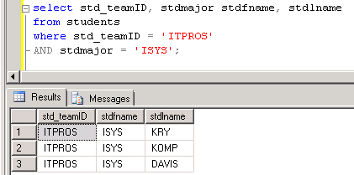
Query S-T database using AND operator
Show students in the ITPROS team with an ISYS major.
/* Show students in the ITPROS team AND with an ISYS major. */
select std_teamID, stdmajor, stdfname, stdlname
from students
where std_teamID = 'ITPROS' AND stdmajor = 'ISYS';

Slide 46
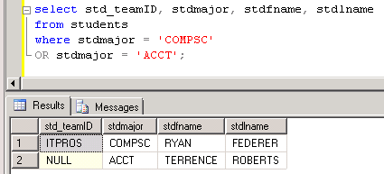
Query S-T database using OR operator
Show students majoring in computer science or accounting.
/* Show students who are majoring computer science (COMPSC) OR accounting (ACCT). */
select std_teamID, stdmajor, stdfname, stdlname
from students
where stdmajor = 'COMPSC' OR stdmajor = 'ACCT';

Slide 47
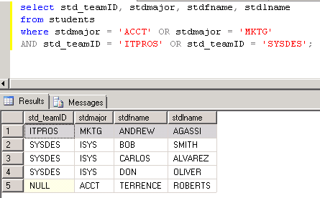
Using operator OR with AND
Show students majoring in accounting or marketing that are in team ITPROS or SYSDES.
/* Show students majoring in accounting OR marketing AND that are in the ITPROS team OR the SYSDES team.*/
select std_teamID, stdmajor, stdfname, stdlname
from students
where stdmajor = 'ACCT' OR stdmajor = 'MKTG'
AND std_teamID = 'ITPROS' OR std_teamID = 'SYSDES';
Is there a problem with this output?

Slide 48
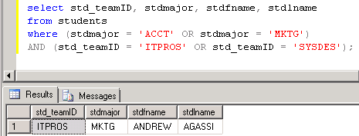
Using operator OR with AND
Show students majoring in accounting or marketing that are in team ITPROS or SYSDES.
/* Show students majoring in accounting OR marketing AND that are in the ITPROS team OR the SYSDES team.*/
select std_teamID, stdmajor, stdfname, stdlname
from students
where (stdmajor = 'ACCT' OR stdmajor = 'MKTG')
AND (std_teamID = 'ITPROS' OR std_teamID = 'SYSDES');

Slide 49
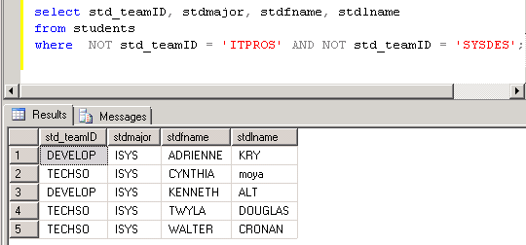
Logical Operators: NOT
You can use NOT to negate an evaluation.
Show students who are NOT in the ITPROS and SYSDES teams.
/* Show students who are NOT in ITPROS and NOT in SYSDES. */
select std_teamID, stdmajor, stdfname, stdlname
from students
where NOT std_teamID = 'ITPROS' AND NOT std_teamID = 'SYSDES';

Slide 50
IN EXACT MATCH

Slide 51
Evaluating an inexact match
Sometimes the criterion in the WHERE clause of the SELECT statement is not precise.
For example: List students whose last starts with particular letter.
  To evaluate for this we use LIKE instead of =
  and we use a “wildcard” symbol to indicate anything else is acceptable. The symbol is the percent sign (%).

Slide 52
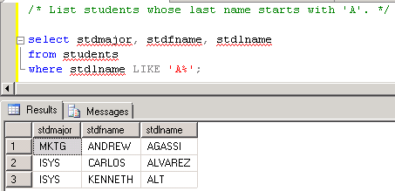
Query the Student-Team database
List students whose last name starts with the letter ‘A’.
/* List students whose last name starts with 'A'. */
select stdmajor, stdfname, stdlname
from students
where stdlname LIKE 'A%';

Slide 53
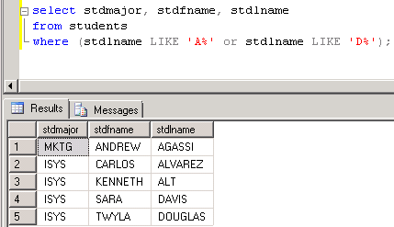
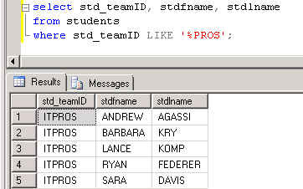
More examples using LIKE
List students whose last name starts with A or D.
/* List students whose last name starts with 'A' or "D'. */
select stdmajor, stdfname, stdlname
from students
where (stdlname LIKE 'A%' or
stdlname LIKE 'D%');
List students whose team name ends with PROS.
/* List students whose team ends with 'PROS'. */
select std_teamID, stdfname, stdlname
from students
where std_teamID LIKE '%PROS';

Slide 54
Evaluating a range of values
Sometimes the criterion in the WHERE clause of the SELECT statement is for a range of values.
For example: List employees with a salary between $25,000 and $45,000.
  BETWEEN <starting value> AND <ending value>
  The starting and ending values are included.

Slide 55
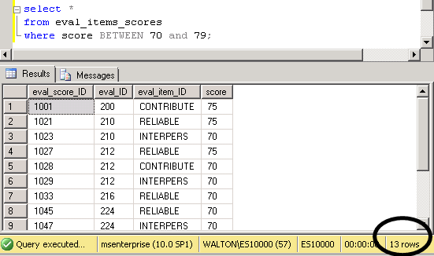
Example using a range of values
List evaluation item scores between 70 and 79.
select *
from eval_items_scores
where score BETWEEN 70 AND 79;

Slide 56
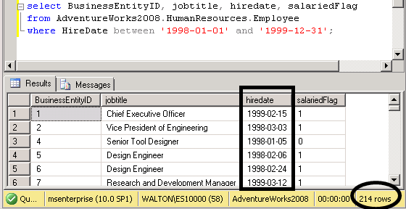
Evaluate a range of dates - BETWEEN
In AW, list employees hired between 1998 and 1999.
/* List employees hired between 1998 and 1999. */
select BusinessEntityID, jobtitle, hiredate, salariedFlag
from AdventureWorks2008.HumanResources.Employee
where HireDate between '1998-01-01' and '1999-12-31';

Slide 57
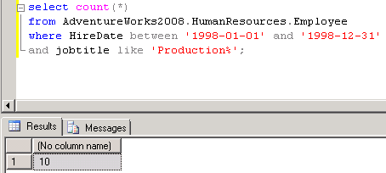
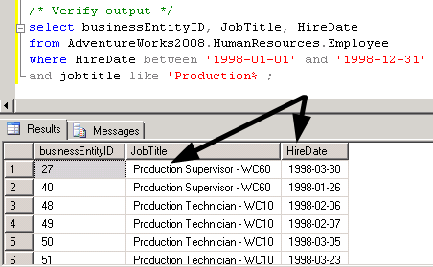
Evaluate a range of dates and other criteria
In AW, count how many people were hired in 1998 and work in production (job title starts with ‘Production’).
/* Count how many people were hired in 1998 who work in production
(job title starts with 'Production'). */
select count(*)
from AdventureWorks2008.HumanResources.Employee
where HireDate between '1998-01-01' and '1998-12-31'
and jobtitle like 'Production%';

Slide 58
IN AND NULL

Slide 59
An alternative to using the OR operator
In a previous lesson, we covered the use of the logical operators AND, OR and NOT. This lesson presents other operators you can use in the WHERE clause of a SELECT statement.
IN (…, …, … ) – An alternative to the OR operator.
IS NULL – Check for null values.

Slide 60
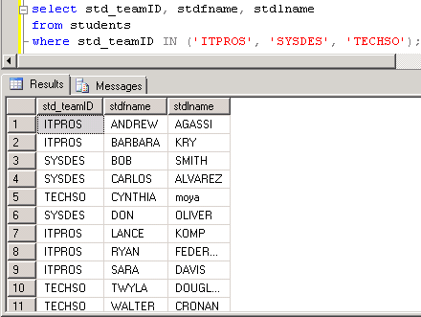
Using IN instead of OR
List students in these teams: ITPROS, SYSDES or TECHSO.
/* List students who are in these
teams: ITPROS, SYSDES or TECHSO. */
/* using OR */
select std_teamID, stdfname, stdlname
from students
where std_teamID = 'ITPROS'
OR std_teamID = 'SYSDES'
OR std_teamID = 'TECHSO';
/* using IN */
select std_teamID, stdfname, stdlname
from students
where std_teamID IN ('ITPROS', 'SYSDES', 'TECHSO');

Slide 61
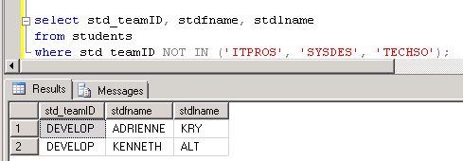
NOT IN
List students who are NOT in these teams: ITPROS, SYSDES or TECHSO.
/* List students who are NOT in these teams: ITPROS, SYSDES or TECHSO. */
select std_teamID, stdfname, stdlname
from students
where std_teamID NOT IN ('ITPROS', 'SYSDES', 'TECHSO');

Slide 62
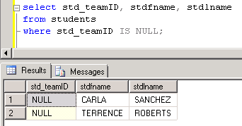
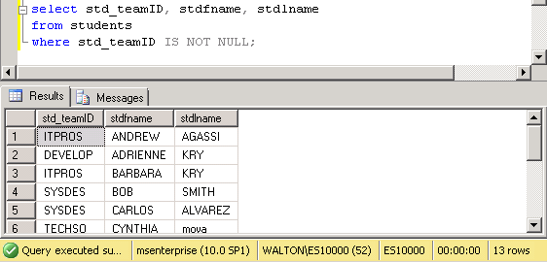
Working with NULL (no data)
List students who have not been assigned to a team. This is the case if the teamID field is null (no data).
/* List students who have not been assigned to a team. */
select std_teamID, stdfname, stdlname
from students
where std_teamID IS NULL;
/* List students who are assigned to a team. */
select std_teamID, stdfname, stdlname
from students
where std_teamID IS NOT NULL;

Slide 63



Working with NULL - continued
Count how many students there are, how many are not assigned to a team and how many are assigned to a team.
/* How many students are there? */
select count(*) from students;
/* How many students have not been assigned to a team. */
select count(*)
from students
where std_teamID IS NULL;
/* How many students have been
assigned to a team. */
select count(*)
from students
where std_teamID IS NOT NULL;

Slide 64
Sort calculate

Slide 65
Sorting output
The more data your query displays the more likely you’ll want to sort the output.
ORDER BY – You add the ORDER BY clause to the SELECT statement to sort output.
    SELECT <column1>, <column2>, <column3>
    FROM <tablename>
    WHERE <column1> = <criterion>
    ORDER BY <column1>, <column2>;
The trick is to remember to not use the word SORT but ORDER.

Slide 66

Sort output from the Student-Team database
List students and their team ID. Sort by team ID.
/* List students and their team ID. Sort by team ID. */
select std_teamID, stdmajor, stdfname, stdlname
from students
order by std_teamID;

Slide 67


Sort by more than one column.
List students by team and major.
/* List students and their team ID. Sort by team ID and major. */
select std_teamID, stdmajor, stdfname, stdlname
from students
order by std_teamID, stdmajor;
/* Another way to identify which columns to sort by using numbers. */
select stdfname, stdlname, stdmajor, std_teamID
from students
order by 4, 3;

Slide 68

Column aliases improve readability
Columns in the output display can show standard text rather than field names.
/* Use column aliases column headings in output. */
select std_teamID "Team", stdmajor "Major",
stdfname "First Name", stdlname "Last Name"
from students
order by std_teamID, stdmajor;

Slide 69


Combine columns into a single output column
Sometimes you can improve output readability by combining columns, also known as concatenated columns.
/* Combine 2 columns into one (concatenate columns). */
select std_teamID "Team", stdmajor "Major",
stdfname + ' ' + stdlname "Student"
from students
order by 1, 2;
select std_teamID "Team", stdmajor "Major",
stdlname + ', ' + stdfname "Student"
from students
order by 1, 2, 3;

Slide 70

Creating a calculated column
The concatenated column we just created in one example of a calculated column. You can also actually do calculations.
/* Add a calculated column. */
select eval_id, eval_score_id, eval_item_id,
score, score * .1 "Points Earned"
from eval_items_scores
order by eval_id, eval_score_id, eval_item_id;

Slide 71
What we COVERED
SSMS AND SQL FUNDAMENTALS
CREATE AND INSERT TABLES
SELECT … FROM …
SELECT … FROM … WHERE
LOGICAL OPERATORS
IN EXACT MATCH AND BETWEEN
IN AND NULL
SORT/CACULATE

