Slide 1
Chapter four
Relational database
Advanced SQL

Slide 2
More advanced topics
Views, Triggers
Outer joins/Nested Queries
FUN

Slide 3
Views
In some cases, it is not desirable for all users to see the entire logical model (that is, all the actual relations stored in the database.)
Consider a person who needs to know an instructors name and department, but not the salary. This person should see a relation described, in SQL, by select ID, name, dept_name from instructor
A view provides a mechanism to hide certain data from the view of certain users.
Any relation that is not of the conceptual model but is made visible to a user as a “virtual relation” is called a view.

Slide 4
View Definition
A view is defined using the create view statement which has the form
create view v as < query expression >
where <query expression> is any legal SQL expression. The view name is represented by v.
Once a view is defined, the view name can be used to refer to the virtual relation that the view generates.
View definition is not the same as creating a new relation by evaluating the query expression
Rather, a view definition causes the saving of an expression; the expression is substituted into queries using the view.

Slide 5
Example Views
A view of instructors without their salary create view faculty as select ID, name, dept_name from instructor
Find all instructors in the Innovation and Entrepreneurship (IENT) department select name from faculty where dept_name = ‘IRNT’
Create a view of department salary totals create view departments_total_salary(dept_name, total_salary) as select dept_name, sum (salary) from instructor group by dept_name;

Slide 6
Views Defined Using Other Views
create view innov_ent_fall_2020 as select course.course_id, sec_id, building, room_number from course, section where course.course_id = section.course_id and course.dept_name = ’IENT’ and section.semester = ’Fall’ and section.year = ’2020’;
create view innov_ent_fall_2009_knauss as select course_id, room_number from innov_ent_fall_2020 where building= ’Knauss’;

Slide 7
View Expansion
Expand use of a view in a query/another view
create view innov_ent_fall_2020_knauss as
(select course_id, room_number
from (select course.course_id, building, room_number
from course, section
where course.course_id = section.course_id
and course.dept_name = ’IENT’
and section.semester = ’Fall’
and section.year = ’2020’)
where building= ’Knauss’;

Slide 8
What is a join?
A join is a query that combines records from two or more tables.
A join will be performed whenever multiple tables appear in the FROM clause of the query. The select list of the query can select any columns from any of these tables.
If join condition is omitted or invalid then a Cartesian product is formed.
If any two of these tables have a column name in common, then must qualify these columns throughout the query with table or table alias names to avoid ambiguity.
Most join queries contain at least one join condition, either in the FROM clause or in the WHERE clause.

Slide 9
Processing Multiple Tables
Join–a relational operation that causes two or more tables with a common domain to be combined into a single table or view
Equi-join–a join in which the joining condition is based on equality between values in the common columns; common columns appear redundantly in the result table
Natural join–an equi-join in which one of the duplicate columns is eliminated in the result table
The common columns in joined tables are usually the primary key of the dominant table and the foreign key of the dependent table in 1:M relationships

Slide 10
Processing Multiple Tables
Outer join–a join in which rows that do not have matching values in common columns are nonetheless included in the result table (as opposed to inner join, in which rows must have matching values in order to appear in the result table)
Union join–includes all columns from each table in the join, and an instance for each row of each table
Self join–Matching rows of a table with other rows from the same table

Slide 11
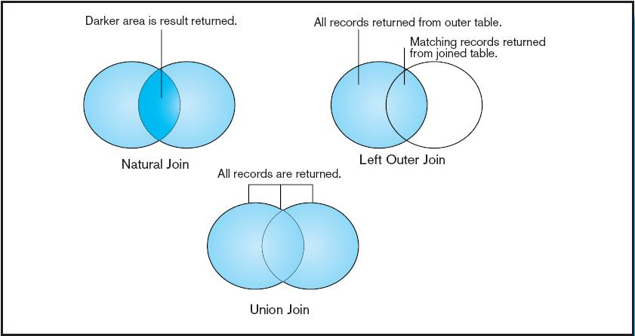
Visualization of different join types with results returned in shaded area

Slide 13
What is a subquery?
A Subquery or Inner query or Nested query is a query within SQL query and embedded within the WHERE clause.
A Subquery is a SELECT statement that is embedded in a clause of another SQL statement.
They can be very useful to select rows from a table with a condition that depends on the data in the same or another table.
A Subquery is used to return data that will be used in the main query as a condition to further restrict the data to be retrieved.
The subquery can be placed in the following SQL clauses they are WHERE clause, HAVING clause, FROM clause.

Slide 14
Processing Multiple Tables Using Subqueries
Subquery–placing an inner query (SELECT statement) inside an outer query
Options:
In a condition of the WHERE clause
As a “table” of the FROM clause
Within the HAVING clause
Subqueries can be:
Noncorrelated–executed once for the entire outer query
Correlated–executed once for each row returned by the outer query

Slide 15
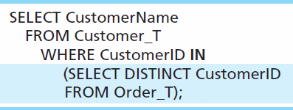
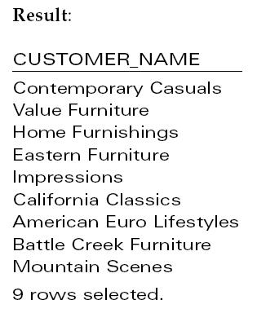
Subquery Example
Show all customers who have placed an order
The IN operator will test to see if the CUSTOMER_ID value of a row is included in the list returned from the subquery
Subquery is embedded in parentheses. In this case it returns a list that will be used in the WHERE clause of the outer query

Slide 16
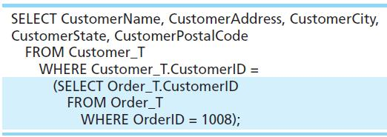
Join vs. Subquery
Some queries could be accomplished by either a join or a subquery
Join version
Subquery version

Slide 17
Advantages/Disadvantages Joins
Advantages Of Joins:
The advantage of a join includes that it executes faster.
The retrieval time of the query using joins almost always will be faster than that of a subquery.
By using joins, you can maximize the calculation burden on the database i.e., instead of multiple queries using one join query. This means you can make better use of the database’s abilities to search through, filter, sort, etc.
Disadvantages Of Joins:
Disadvantage of using joins includes that they are not as easy to read as subqueries.
More joins in a query means the database server has to do more work, which means that it is more time consuming process to retrieve data
As there are different types of joins, it can be confusing as to which join is the appropriate type of join to use to yield the correct desired result set.
Joins cannot be avoided when retrieving data from a normalized database, but it is important that joins are performed correctly, as incorrect joins can result in serious performance degradation and inaccurate query results.

Slide 18
Advantages/Disadvantages Subqueries
Advantages Of Subquery:
Subqueries divide the complex query into isolated parts so that a complex query can be broken down into a series of logical steps.
It is easy to understand and code maintenance is also at ease.
Subqueries allow you to use the results of another query in the outer query.
In some cases, subqueries can replace complex joins and unions.
Disadvantages of Subquery:
The optimizer is more mature for MYSQL for joins than for subqueries, so in many cases a statement that uses a subquery can be executed more efficiently if you rewrite it as join.
We cannot modify a table and select from the same table within a subquery in the same SQL statement.

Slide 19
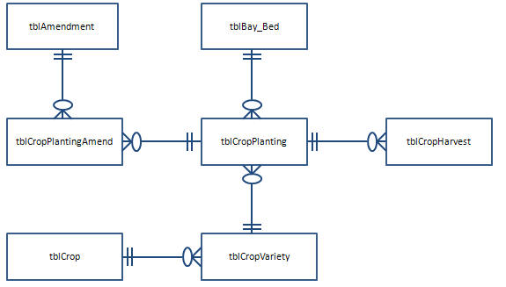
Greenhouse Database
Below is the greenhouse data model.
Amend_Code = AmendCode
bay_bed
CropPlantingID
CropPlantingID
CropVarID
Crop

Slide 20
Greenhouse Database – Crops are planted and harvested.
Area, Zone, Sector, Bay-Bed
Area = “Greenhouse”
Zone = “North Seed”
Zone = “South Seed”
Sector = “A”
Bay=“01”
Bay=“02”
A1
A1
A2
A2
A3
A3
Sector = “B”
Bay=“01”
B1
B2
B3

Slide 21
Greenhouse Database - How many rows in a table?
/* Get a count of the records in each table. */
select count(*) as "tblCrop Rows"
from tblCrop;
select count(*) as "tblCropVariety Rows"
from tblCropVariety;
select count(*) as "tblBay_Bed Rows"
from tblBay_Bed;
select count(*) as "tblCropHarvest Rows"
from tblCropHarvest;
select count(*) as "tblCropPlanting Rows“ from tblCropPlanting;
select count(*) as "tblAmendment Rows“ from tblAmendment;
select count(*) as "tblCropPlantingAmend Rows"
from tblCropPlantingAmend;

Slide 22
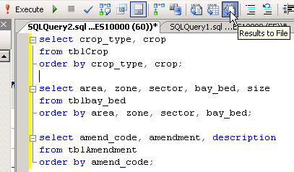
Greenhouse Database - List contents of small tables.
/* List contents of smaller tables. Save output to a file. */

Slide 23
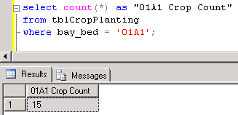
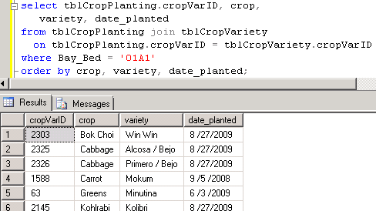
Greenhouse Database - View some crop planting data.
/* Example SQL: Show how many crops have been planted in bay-bed 01A1. */
select count(*) as "01A1 Crop Count"
from tblCropPlanting
where bay_bed = '01A1';
* Show which crops have been planted in bay-bed 01A1. */
select tblCropPlanting.cropVarID, crop, variety, date_planted
from tblCropPlanting join tblCropVariety
on tblCropPlanting.cropVarID = tblCropVariety.cropVarID
where bay_bed = '01A1'
order by crop, variety, date_planted;

Slide 24
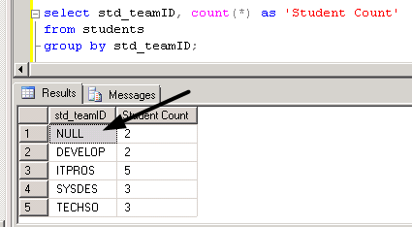
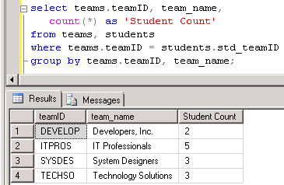
Equi-Join
Equi-join: When you join two tables in a query, by default, you only get output for data that has related data in both tables. This is called an “equi-join.”
We’ve seen an example of this in the Student-Team database. The output on the left is based on 1 table. The one on the right uses 2 tables.

Slide 25
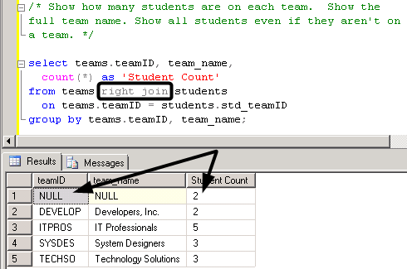
Equi-Join and One-Sided Join
One-sided join: A one-sided join includes all the data on the “one side” and any related data from the other table.
The output on the left uses an equi-join. Add either “right” or “left” to specify from which table you want all data.

Slide 26
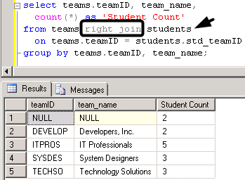
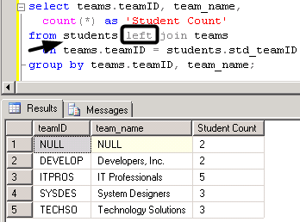
One-Sided Join: Left or Right?
The choice of “left” or “right” is based on which table you want all the data from and the order it is listed in the FROM clause.
Left and right have been used below and the output is the same because the order the tables are listed was switched.

Slide 27
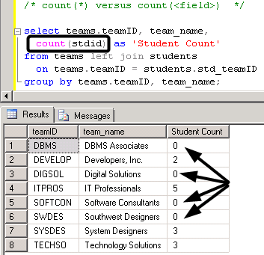
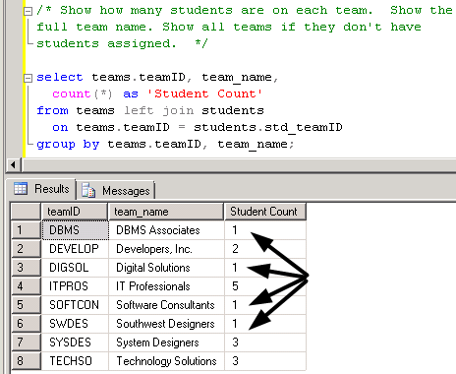
One-Sided Join: Show all teams
Let’s do a one-sided outer join that shows ALL teams and the # of students on each team.
The output on the left demonstrates that sometimes it is important to count a field, not count(*).

Slide 28
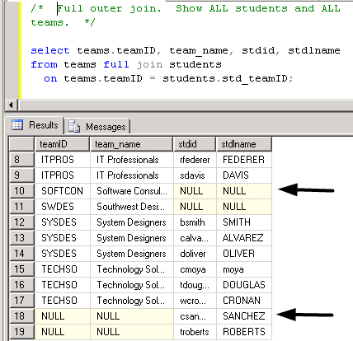
Full outer join
A FULL outer join shows all data from both tables.
/* Full outer join. Show ALL students and ALL teams. */
select teams.teamID, team_name, stdid, stdlname
from teams full join students
on teams.teamID = students.std_teamID;

Slide 29
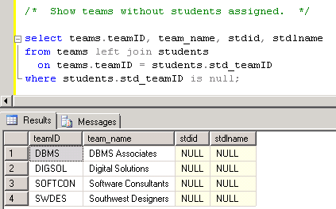
One-Sided JOIN and NULL
If we ask the question “Which teams don’t have students assigned?”, we use a one-sided join and the IS NULL criterion.
/* Show teams without students assigned. */
select teams.teamID, team_name, stdid, stdlname
from teams left join students
on teams.teamID = students.std_teamID
where students.std_teamID is null;

Slide 30
Type I Subquery
A subquery typically appears in the WHERE clause or the HAVING clause but may also be in the FROM clause.
The Type I subquery is executed one time—before the outer query—and the output is a termporary data set used by the outer query.
Let’s take a look at a simple example …

Slide 31
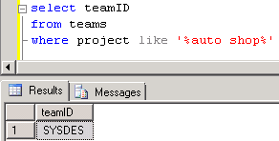
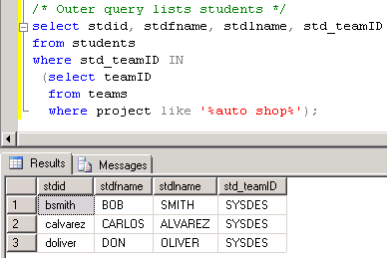
Type I Subquery - Example
List the students working on the auto shop database project.
/* S-T: List students working on the auto shop database project.
Subquery: Find the team ID for the team working on the auto shop project.
Outer query: List students assigned to that team ID. */
/* Subquery */
select teamID from teams
where project like '%auto shop%‘
/* Outer query lists students */
select stdid, stdfname, stdlname, std_teamID
from students where std_teamID IN
(select teamID from teams
where project like '%auto shop%';

Slide 32
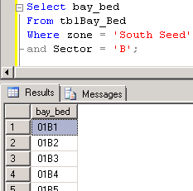
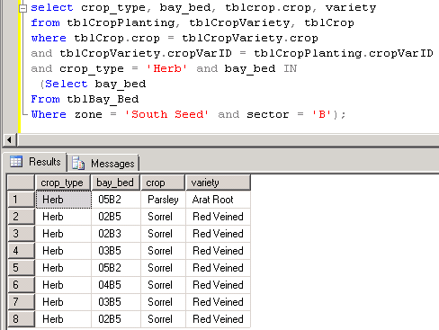
Type I Subquery – Another Example
List the herb crop/varieties planted in sector B of the South Seed zone.
/* Greenhouse: Show crops of type herb planted in sector B of the South Seed zone.
Subquery: List bay-beds for zone South Seed, sector B. Outer query: List the crop_type, bay_bed, crop, and variety for the herb crop type.*/
/* Subquery */
Select bay_bed From tblBay_Bed Where zone = 'South Seed‘ and sector = 'B';
/* Outer query */
select crop_type, bay_bed, tblcrop.crop, variety
from tblCropPlanting, tblCropVariety, tblCrop
where tblCrop.crop = tblCropVariety.crop
and tblCropVariety.cropVarID = tblCropPlanting.cropVarID
and crop_type = 'Herb’ and bay_bed IN
(Select bay_bed From tblBay_Bed Where zone = 'South Seed‘ and sector = 'B');

Slide 33
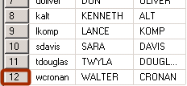
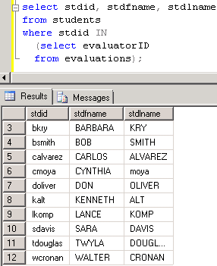
Type I Subquery – versus Distinct
/* Subquery versus DISTINCT
Show students who did evaluations about their teammates. Show the student's ID and name. */
select stdid, stdfname, stdlname
from students, evaluations
where students.stdid = evaluations.evaluatorID;
/* Remove duplicates */
select distinct stdid, stdfname, stdlname
from students, evaluations
where students.stdid = evaluations.evaluatorID;
/* Try this with a Type I subquery. Subquery: List the evaluator IDs.Outquery: List the students that have an ID in the subquery list. */
select stdid, stdfname, stdlname from students
where stdid IN (select evaluatorID from evaluations);

Slide 34
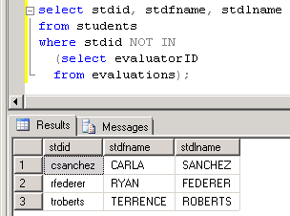
Type I Subquery for deleting records
If you want to delete records from a table based on criteria in another table, you must use a Type I subquery.
/* For instance, see which students didn’t do any evaluations. Note the use of NOT IN. */
select stdid, stdfname, stdlname
from students
where stdid NOT IN
(select evaluatorID
from evaluations);
/* If we wanted to delete these students, we could use the following statement. */
delete
from students
where stdid NOT IN
(select evaluatorID
from evaluations);

Slide 35
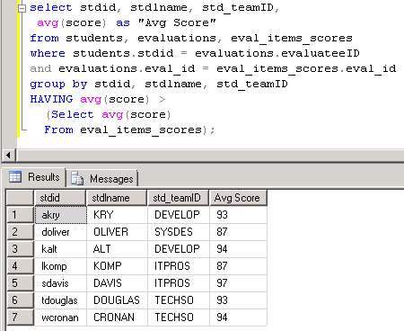
Type I Subquery in the HAVING clause
Find out who got an average evaluation score higher than the class average .
/* Subquery */
Select avg(score)
From eval_items_scores;
/* List students with an above average score. *;
select stdid, stdlname, std_teamID, avg(score)
from students, evaluations, eval_items_scores
where students.stdid = evaluations.evaluateeID
and evaluations.eval_id = eval_items_scores.eval_id
group by stdid, stdlname, std_teamID
HAVING avg(score) >
(Select avg(score)
From eval_items_scores);

Slide 36
Type II Subquery (Correlated)
You saw that the Type I subquery executes independently from the outer query. The subquery executes then the outer query uses that temporary data set. This is the key difference between Type I and Type II.
A Type II subquery references one or more columns in the outer query. The Type II subquery executes once for EACH row in the outer query.
Type II subqueries are used for “difference” problems: What data in the outer query does NOT exist in the subquery?
As with Type I, the Type II query output should NOT show any columns in the subquery.

Slide 37
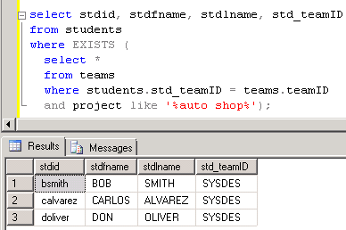
Type II Subquery - Example
/* S-T: List students working on the auto shop database project. Subquery: Find the team ID for the team working on the auto shop project. Outer query: List students assigned to that team ID. */
/* Type I subquery */
select stdid, stdfname, stdlname, std_teamID
from students where std_teamID IN
(select teamID from teams
where project like '%auto shop%‘);
/* Type II Subquery */
select stdid, stdfname, stdlname, std_teamID
from students where EXISTS (select *
from teams
where students.std_teamID = teams.teamID
and project like '%auto shop%');

Slide 38
Type II Subquery – A closer look
/* S-T: List students working on the auto shop database project.
Subquery: Find the team ID for the team working on the auto shop project.
Outer query: List students assigned to that team ID. */
select stdid, stdfname, stdlname, std_teamID from students where EXISTS (select * from teams where students.std_teamID = teams.teamID and project like '%auto shop%');
Join the outer query with the subquery in the subquery’s WHERE clause.
Unlike the Type I subquery, don’t list a common field before the EXISTS keyword.
You don’t list the STUDENTS table in the subquery, although you reference that table in the WHERE clause.
Also, it doesn’t matter what field(s) you list in the SELECT clause of the subquery because it is not used by the outer query.

Slide 39
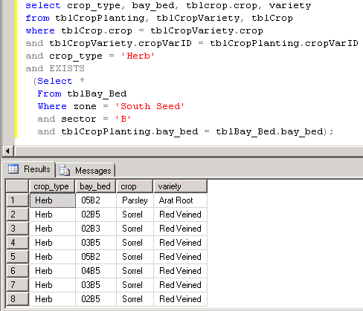
Type II Subquery – Another Example
/* Greenhouse: Show crops of type herb planted in sector B of the South Seed zone. Subquery: List bay-beds for zone South Seed, sector B. Outer query: List the crop_type, bay_bed, crop, and variety for the herb crop type. */
select crop_type, bay_bed, tblcrop.crop, variety from tblCropPlanting, tblCropVariety, tblCrop where tblCrop.crop = tblCropVariety.crop and tblCropVariety.cropVarID = tblCropPlanting.cropVarID and crop_type = 'Herb’ and EXISTS (Select * From tblBay_Bed Where zone = 'South Seed’ and sector = 'B’ and tblCropPlanting.bay_bed = tblBay_Bed.bay_bed);

Slide 40
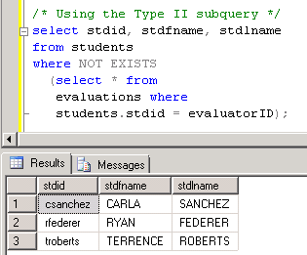
Type II Subquery – Another Example
/* Example of a DIFFERENCE problem. S-T: Show students who have not completed an evaluation. */
/* Incorrect attempt */
select stdid, stdfname, stdlname from students, evaluations where students.stdid <> evaluations.evaluatorID;
/* Using the Type II subquery */
select stdid, stdfname, stdlname from students where NOT EXISTS (select * from evaluations where students.stdid = evaluatorID);

Slide 41
In-line subquery
An in-line subquery is in the FROM clause of the outer query. Think of it has a regular but temporary table that is assigned a name through a table alias and must be joined with at least one other table, if more than one table is used.
The use of subqueries is sometimes necessary but, even if the answer can be found without a subquery, it is often beneficial to use subqueries to decompose a problem statement.

Slide 42
In-line subquery example
For this example, we’ll use the greenhouse database and create 3 temporary tables by using 3 subqueries.
List the crop planting ID and amendment, if the soil was amended with sulphur, potting mix, or mulch.
Count the # of harvests for each crop planting ID.
Be sure to include the field(s) needed to join with other tables.
List crop planting ID, crop, variety, and bay-bed.

Slide 43
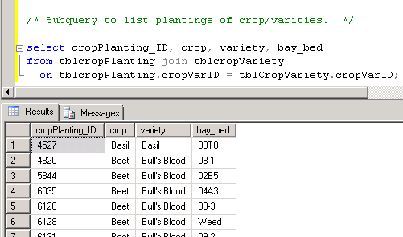
In-line example – 1st subquery
/* Subquery to list plantings of crop/varities. */
select cropPlanting_ID, crop, variety, bay_bed
from tblcropPlanting join tblcropVariety
on tblcropPlanting.cropVarID = tblCropVariety.cropVarID;

Slide 44
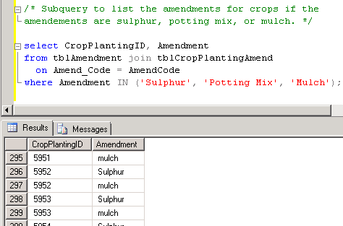
In-line example – 2nd subquery
/* Subquery to list the amendments for crops if the amendements are sulphur, potting mix, or mulch. */
select CropPlantingID, Amendment
from tblAmendment join tblCropPlantingAmend
on Amend_Code = AmendCode
where Amendment IN ('Sulphur', 'Potting Mix', 'Mulch');

Slide 45
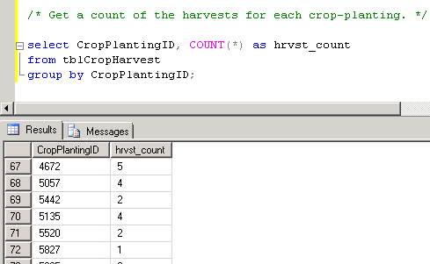
In-line example – 3rd subquery
/* Get a count of the harvests for each crop-planting. */
select CropPlantingID, COUNT(*) as hrvst_count
from tblCropHarvest
group by CropPlantingID;

Slide 46
In-line example – Complete query
/* In-line query using 3 subqueries in the FROM clause. This query uses table aliases. Note that the column aliases in the subquery are used just like "regular" columns in the outer query SELECT clause. */
select Crp.cropPlanting_ID, crop, variety, hrvst_count, BB
from
(select cropPlanting_ID, crop, variety, bay_bed as "BB“ from tblcropPlanting join tblcropVariety on tblcropPlanting.cropVarID = tblCropVariety.cropVarID) Crp, (select CropPlantingID, Amendment from tblAmendment join tblCropPlantingAmend on Amend_Code = AmendCode where Amendment IN ('Sulphur', 'Potting Mix', 'Mulch')) Amd, (select CropPlantingID, COUNT(*) as hrvst_count from tblCropHarvest group by CropPlantingID) Hrv where amd.CropPlantingID = Crp.CropPlanting_ID and Crp.CropPlanting_ID = hrv.CropPlantingID order by hrvst_count desc;

Slide 47
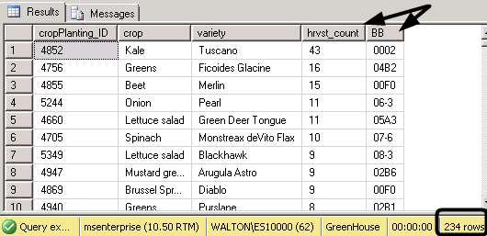
In-line example – Query output
/* In-line query using 3 subqueries in the FROM clause. This query uses table aliases. Note that the column aliases in the subquery are used just like "regular" columns in the outer query SELECT clause. */
OUTPUT:

Slide 48
Nested Aggregate queries
Sometimes it is necessary to embed one aggregate query inside another aggregate query, a.k.a. nested aggregate queries.
As with other types of subqueries, the aggregate subquery decomposes the problem statement and creates a solution for part of the problem statement.

Slide 49
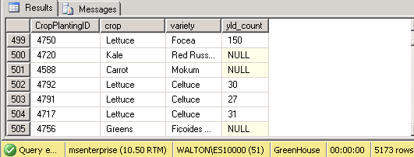
Nested Aggregate – 1st: detailed data
Using the greenhouse database, we will list crop-planting ID, crop, variety, and the yield count.
NOTE: The way harvest data is recorded varies. Some harvests are weighed, others are counted.
/* 1st: List detailed data about crop plantings and the harvest yield count. */
select CropPlantingID, crop, variety,
cast(Yield_Count as decimal) as yld_count
from tblcropVariety CV, tblcropPlanting CP, tblCropHarvest CH
where CV.CropVarID = CP.CropVarID
and CP.CropPlanting_ID = CH.CropPlantingID;
Though not required, table aliases have been used here —defined in the FROM clause and used in the WHERE clause.

Slide 50
Comment about the CAST() function
In the query we just created the CAST() function is used to convert data stored as text to numeric data.
The data types for columns in the greenhouse database may be revised in the future and you may not need to use the CAST() function to convert numbers stored as text to numeric values that can be calculated.
select CropPlantingID, crop, variety,
cast(Yield_Count as decimal) as yld_count
from tblcropVariety CV, tblcropPlanting CP, tblCropHarvest CH
where CV.CropVarID = CP.CropVarID
and CP.CropPlanting_ID = CH.CropPlantingID;

Slide 51
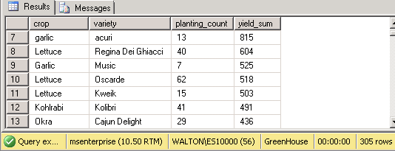
2nd: Aggregate data
Using the previous query in the FROM clause, we now use the count and sum aggregate functions to count the number of crop plantings and sum the yield count.
Note the table alias for the subquery.
select crop, variety,
count(cropPlantingID) as planting_count, sum(yld_count) as yield_sum
from
(select CropPlantingID,crop, Variety, cast(Yield_Count as decimal) as yld_count from tblcropVariety CV, tblcropPlanting CP, tblCropHarvest CH where CV.CropVarID = CP.CropVarID and CP.CropPlanting_ID = ch.CropPlantingID) CVPH group by crop, variety order by yield_sum desc;

Slide 52
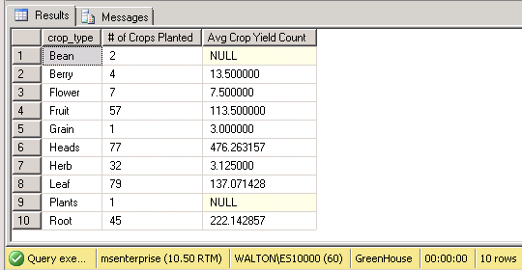
3rd: Aggregate data
Using the previous query in the FROM clause, we now the count the number of crops (not plantings of each crop) and average the yield count.
select crop_type, count(*) as "# of Crops Planted", avg(yield_sum) as "Avg Crop Yield Count“ from tblCrop, (select crop, variety, count(cropPlantingID) as planting_count, sum(yld_count) as yield_sum from
(select CropPlantingID,crop, Variety, cast(Yield_Count as decimal) as yld_count from tblcropVariety CV, tblcropPlanting CP, tblCropHarvest CH where CV.CropVarID = CP.CropVarID and CP.CropPlanting_ID = ch.CropPlantingID) cvph group by crop, variety) SubQ where tblCrop.Crop = SubQ.Crop group by crop_type order by crop_type;

Slide 53
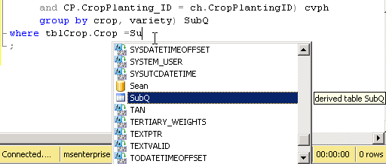
3rd: Aggregate data: Output
Output:
The IntelliSense feature immediately recognizes the use of a temporary (derived) table, i.e. the subquery table alias.

Slide 54
DIVISION problem
The “division” problem asks the question: “Which records in data set A correspond to every record in data set B?”
Example: Which students have attended all the workshops offered for skills needed in teams?
WkSp ID | Course Name
EL | Effective Leadership
CE | Communicating Effectively
AL | Active Listening
GO | Get Organized
ID | First Name | Last Name
1003 | Alice | Anderson
1004 | Bill | Bailey
1005 | Carl | Carson
1006 | Denise | Davis

Slide 55
Set Operators – No DIVISION
Remember the set operators such as UNION, INTERSECT, SUBTRACT? There isn’t a DIVISION operator but you can still answer the question: “Which records in data set A correspond to every record in data set B?”
Count the # of records in data set B then see if any record in data set A has that many links to B.
There are 4 workshops.
Let’s say that Alice has attended 2 workshops, Bill has attended 3, Carl has attended 1, Denise has attended 4.
Therefore, Denise has attended all the workshops.
ID | First Name | Last Name
1003 | Alice | Anderson
1004 | Bill | Bailey
1005 | Carl | Carson
1006 | Denise | Davis
WkSp ID | Course Name
EL | Effective Leadership
CE | Communicating Effectively
AL | Active Listening
GO | Get Organized

Slide 56
DIVISION: Modify the S-T database
We’ll modify the Students-Teams database for this lesson. Students can attend workshops that help them learn skills for working in teams.
We will add a WORKSHOPS table and an ATTENDANCES table. The ATTENDANCES table stores information for each student that attends a workshop.
ATTENDANCES
WORKSHOPS
An SQL script is provided to create these tables and insert data.
TEAMS
STUDENTS
EVAL_ITEMS
EVALUATIONS
EVAL_ITEMS_SCORES

Slide 57
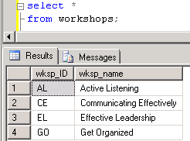
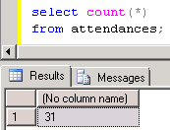
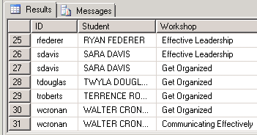
Revised S-T database: Look at the data
Before tackling a DIVISION problem, take a look at the data in the new tables.
/* Show the workshops */ select * from workshops;
/* Show how many records are in the attendance table. */ select count(*) from attendances;
/* Show which workshops each student has attended. List a student even if he/she hasn't attended a workshop. */ select stdid as "ID", stdfname + ' ' + stdlname as "Student", wksp_name as "Workshop“ from students left join attendances on stdid = attnd_stdid join workshops on attnd_wksp_ID = wksp order by stdid;

Slide 58
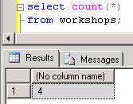
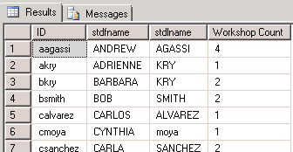
DIVISION problem – Part 1 & 2
Which students have attended all the team skills building workshops?
1st: Count how many workshops there are.
select count(*)
from workshops;
2nd: List students and the # of attendance records each one has.
select stdid as "ID", stdfname, stdlname, count(*) as "Workshop Count“ from students left join attendances on stdid = attnd_stdid group by stdid, stdfname, stdlname;

Slide 59
DIVISION problem – Part 3
Which students have attended all the team skills building workshops?
3rd: Use the workshop counting query (part 1) as a subquery in the HAVING clause of the students’ attendence counting query (part 2).
/* To solve the DIVISION problem, list only students who have attended as many workshops as the # of workshops there are. */ select stdid as "ID", stdfname, stdlname, count(*) as "Workshop Count“ from students left join attendances on stdid = attnd_stdid group by stdid, stdfname, stdlname having count(*) = (select count(*) from workshops );

